Slide 1
INFO 202 “Information Organization & Retrieval” Fall 2014
Robert J. Glushko glushko@berkeley.edu
@rjglushko
10 September 2014 Lecture 3.1 The Organizing Systems Roadmap

Slide 2
The Organizing System Lifecycle
There is always a lifecycle, but there are times when its phases need to be more explicit and formal:
In institutional contexts
In information-intensive contexts
When traceability and impact analysis are necessary
2

Slide 3
The Organizing System Lifecycle: 4 Phases
Defining and scoping the domain
Identifying requirements
Design and implementation
Operations and maintenance
These phases are brief and mostly inseparable for some simple organizing systems, more sequential for others, and more systematic and iterative for complex organizing systems
3

Slide 4
Design Methodologies: Discipline for Design
When we design something we follow – implicitly or explicitly – some steps or techniques for scoping, analysis, idea generation, and implementation
This DESIGN METHODOLOGY makes assumptions about which design questions can be separately answered, the priorities and dependencies, and who can best answer them
4

Slide 5
Design Methodologies: Discipline for Design (2)
The methodology determines
what design activities are done
the order in which they are performed
the tools and techniques used to perform them,
the notations or artifacts that result
5

Slide 6
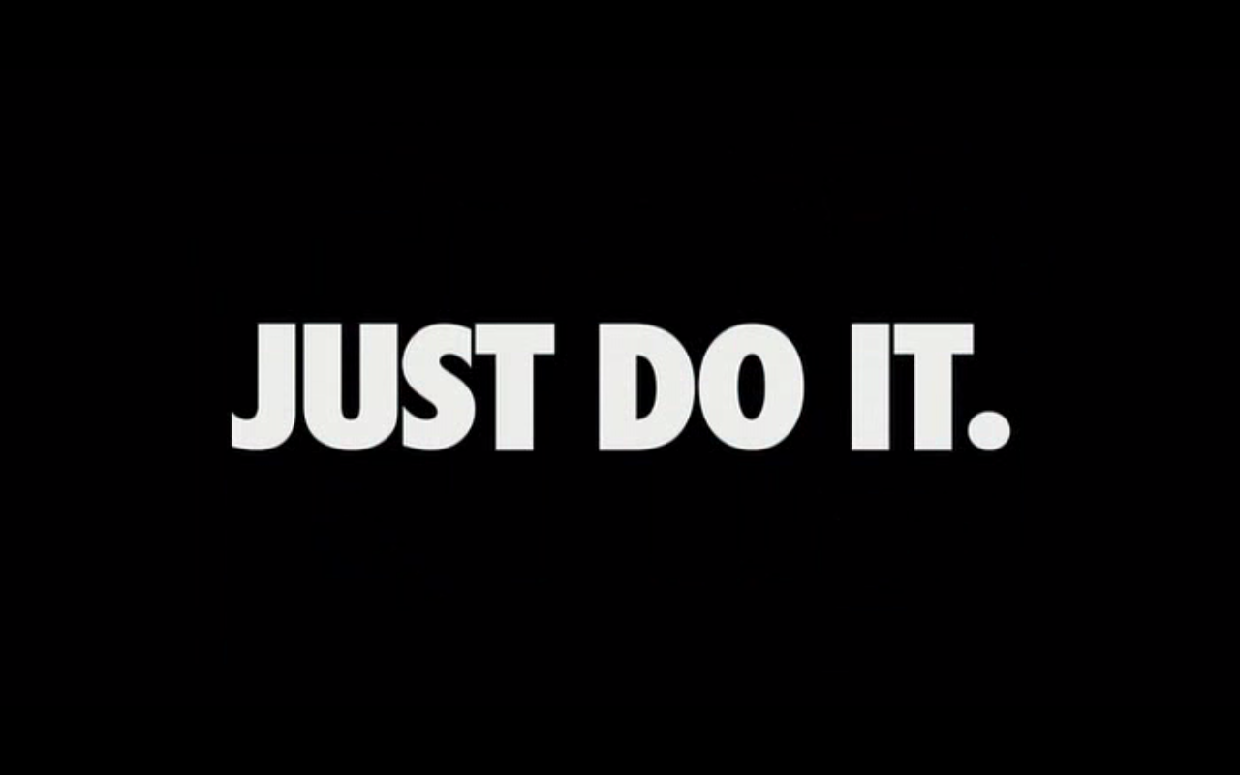
A Lifecycle with Inseparable Phases

Slide 7
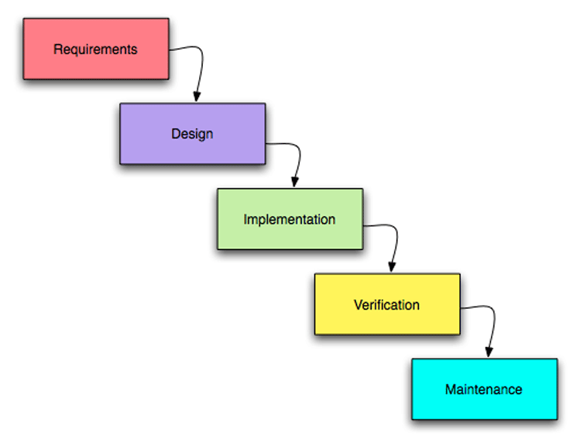
A “Waterfall” or Sequential Lifecycle

Slide 8
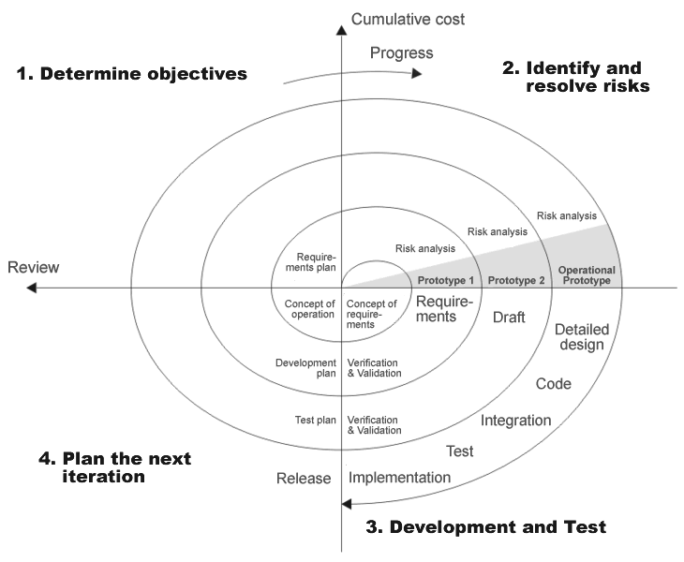
A “Spiral” or Iterative Lifecycle

Slide 9
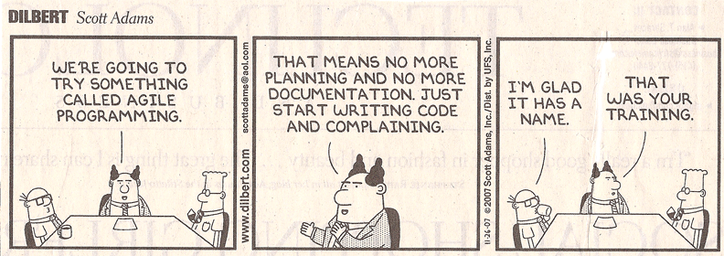
Agile Methods
"Agile“ methods for software development have become very popular and are a specialized form of iterative methods used by small design teams

Slide 10
Design Methodologies: Discipline for Design (3)
The choice of methodology sometimes reflects a management and business philosophy, and sometimes reflects a personal or ideological one -- in either case, it can be highly contentious in a project
My recommendation: Better to be more explicit and formal than absolutely necessary than vice versa
10

Slide 11
Traceability
A TRACE is an assumption or assertion about an interim or final requirement or design artifact that is important enough to record and follow
TRACEABILITY is the ability to describe and follow the life of a TRACE
Backwards traceability: Where did this decision or requirement come from?
Forwards traceability: What were the implications of this requirement or early design decision in the design?
11

Slide 12
Traces that VB Might Have Recorded
We need a way to create and name some set of information resources
Maybe we can package these somehow so they can be shared by their creator with someone else
It would be desirable to arrange resources in an order that tells a story or explains something
Can these packages be edited to add or rearrange the resources after they are shared?
Cameras will surely evolve to be lightweight, fast, and small enough to be worn by the user to take pictures of what he reads

Slide 13
Benefits of Traceability
Prioritizing requirements
Understanding the impact of changes
Demonstrating that the design satisfies requirements
Monitoring progress of the design activity
13

Slide 14
Practical Traceability
The design methodology determines what and when to trace
You can't trace everything you do or you'd have no time to do anything
But if you don't trace the important things in enough detail your design will miss opportunities and be magical and brittle
But if your design is only for yourself with a limited lifetime this might not matter
14

Slide 15
Defining and Scoping the Domain
Determining scope and scale
Nature and number of users
Expected lifetime
Physical and technological environment
Relationship to other organizing systems
15

Slide 16
Scope and Scale
SCOPE: the breadth and variety of resource types
SCALE: the number of resource instances
Heterogeneity of resources is more important than absolute number (Scope >> Scale)
WHY?
16

Slide 17
Scope and Scale (2)
Handling resource heterogeneity:
Fewer, broader categories if possible
Less description
Standards for automated description and classification
But sometimes broad scope and scale are essential
17

Slide 18
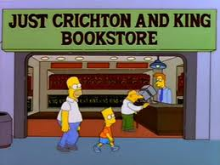
An Organizing System with Narrow Scope and Scale

Slide 19
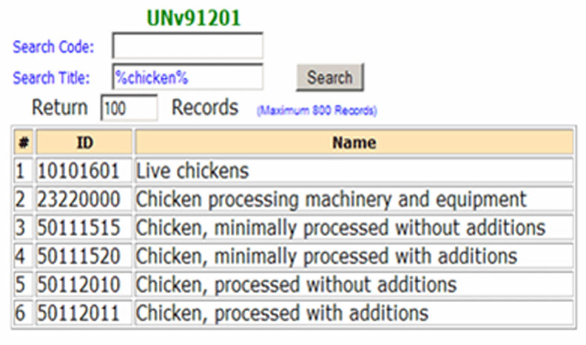
An Organizing System with Global Scope and Scale (unspsc.org)

Slide 20
Nature and Number of Users
How precisely a collection of resources can be described and organized depends on well user types and requirements are known
In some contexts, user types and individual users can be controlled and identified
In others, types and users aren’t known until the organizing system is in operation
20

Slide 21
Who Are We Designing For?
User
Operator
Customer
Patient
Client
Buyer
…
If user types have conflicting requirements, how do we decide what to do?

Slide 22
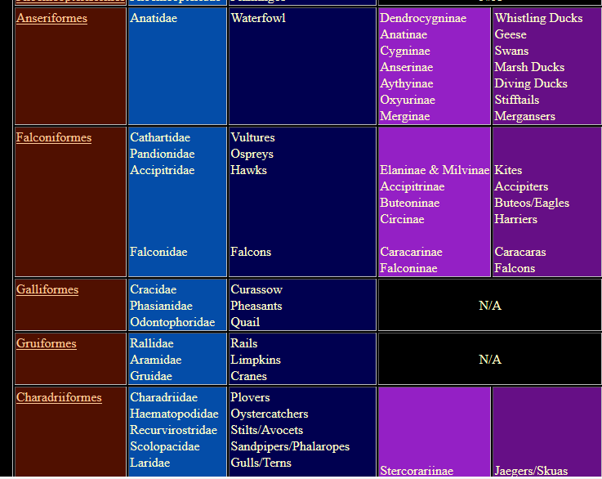
Organizing Birds for Scientists
22

Slide 23
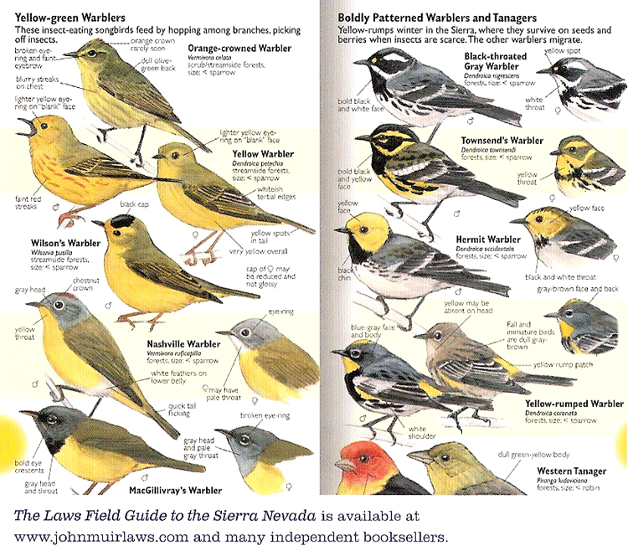
Organizing Birds for Birdwatchers
23

Slide 24
Requirements about Resource Description
The most generic interactions use descriptions that can be associated with almost any type of resource, such as the name, creator, and date
Different types of resources must have differentiating properties, otherwise there would be no reason or way to distinguish them as different types
24

Slide 25
Requirements about Resource Description
Business strategy and economics strongly influence the extent of resource description and the use of technology for automatic description
The tradeoffs imposed by the extent and timing of resource description arise throughout the lifecycle, with the tradeoff between recall and precision being the most salient
25

Slide 26
Descriptive Precision
Poets, painters, composers, sculptors, technical writers, programmers, and devices or machines all create resources
The Dublin Core vocabulary has a single property for “creator”
Easier to use, but loses a great deal of precision

Slide 27
Requirements about Intentional Arrangement
Specifying requirements for the intentional arrangement of resources is analogous to specifying why and how resource categories can be created
There is a continuum of category formation that ranges from minimal use of resource properties to more rigorous use of multiple properties, and finally to statistical or composite use of multiple properties
27

Slide 28
The Choice of Properties Matters!
Organization using behavior or preferences can make interactions highly efficient for some users and the opposite for those who act differently
When multiple properties are used to organize resources, their order determines the arrangement and the ease of interactions
This implies the need to prioritize user and interaction types
28

Slide 29
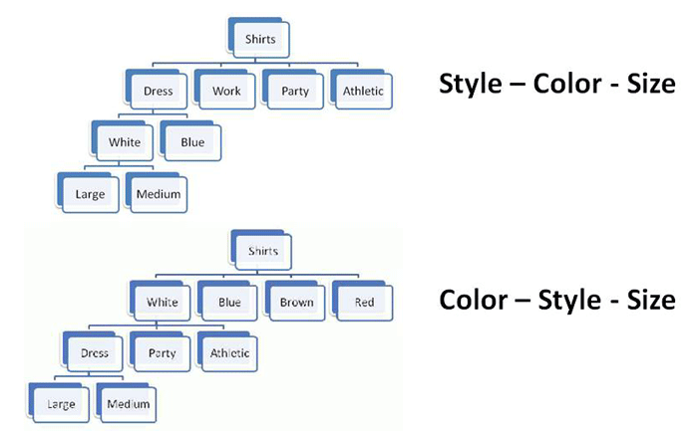
Multiple Properties in Different Order
29

Slide 30
Expected Lifetime
Usually correlated with number of users and resources; small collections with single users are often ad hoc and don’t outlive the specific tasks for which they were created
Think architecturally to enable more robustness and flexibility with respect to changes in technology or business contexts
30

Slide 31
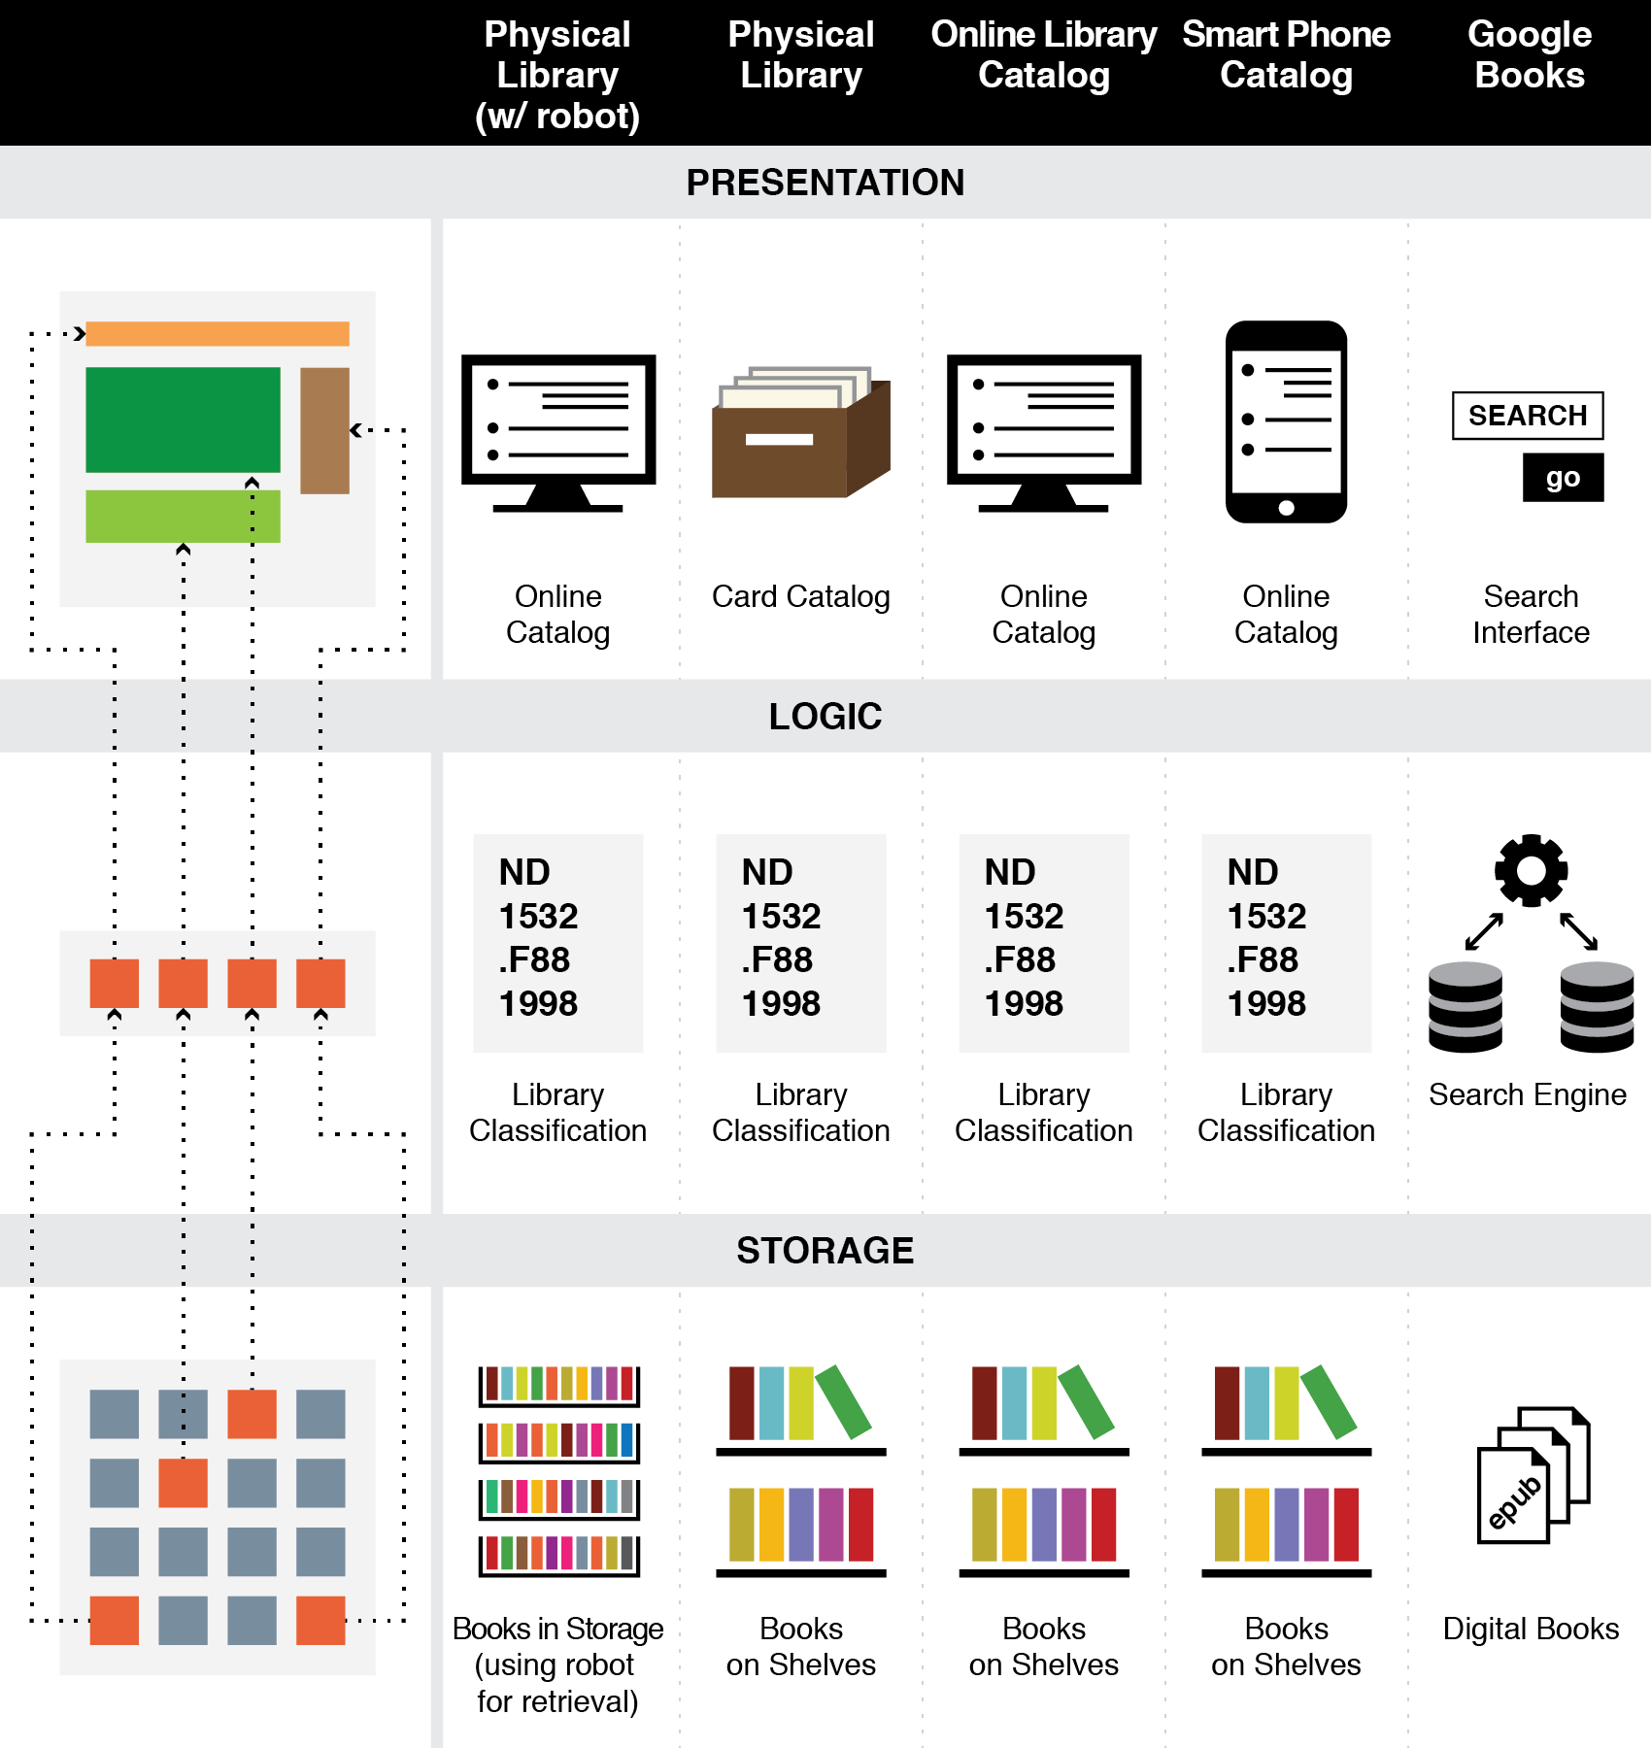
Think Architecturally
31

Slide 32
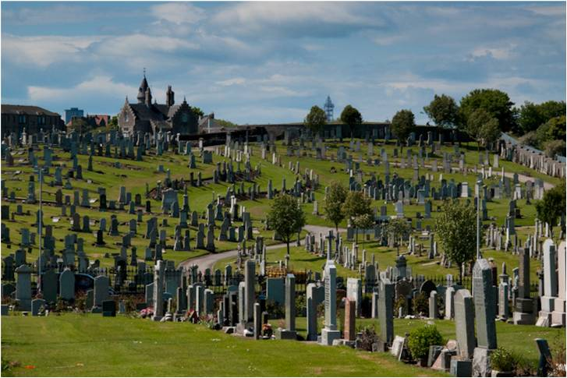
Don’t Confuse Lifetime of Resources with that of the Organizing System
32

Slide 33
Physical or Technological Environment
Physical environments create possibilities for organizing and interaction
But there might be constraints that limit them
“Installed base” or “legacy” concerns
Be careful if you are designing or selecting technology for an organizing system
Avoid resource-specific investments unless absolutely justified
33

Slide 34
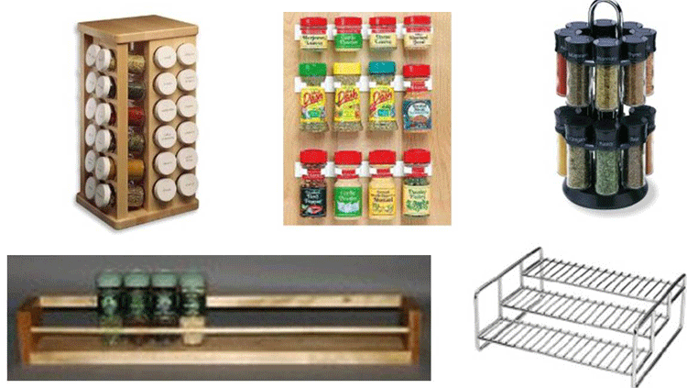
Affordances or Constraints?
34

Slide 35
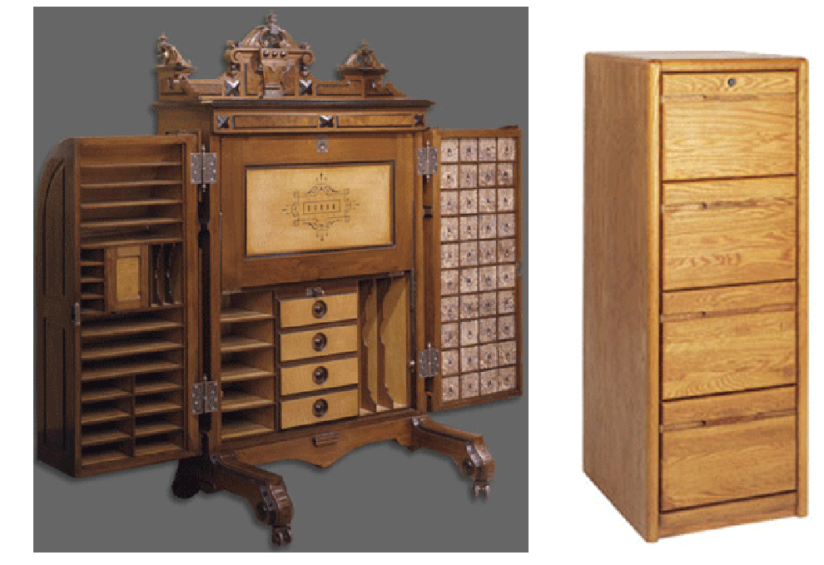
Affordances or Constraints?
35

Slide 36
Physical or Technological Environment (2)
Estimating the ultimate size of a collection at the beginning of an organizing system’s lifecycle can reduce scaling issues related to storage or interaction space
Invest in flexibility and extensibility
36

Slide 37
Physical or Technological Environment (3)
The environment influences that expectations, behavior, and experience of the people who interact with it
37

Slide 38
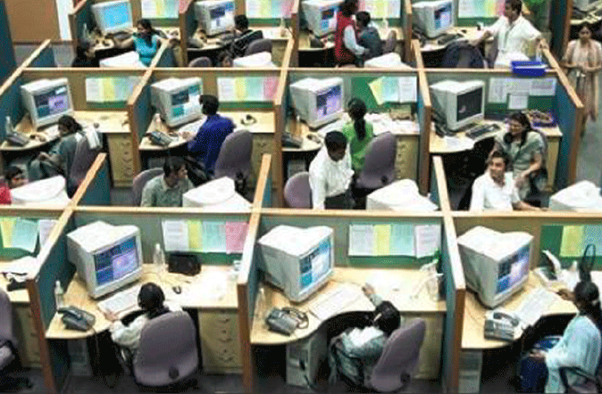
Want to Work Here?
38

Slide 39
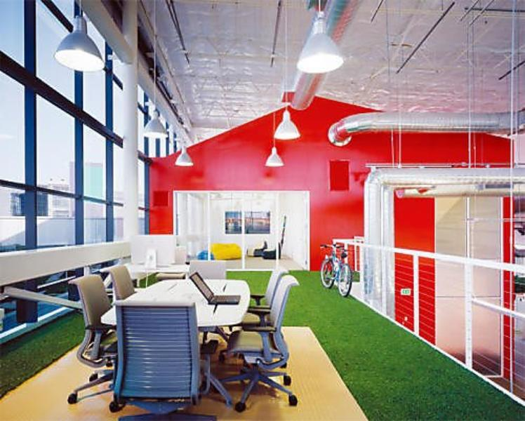
Want to Work Here?
39

Slide 40
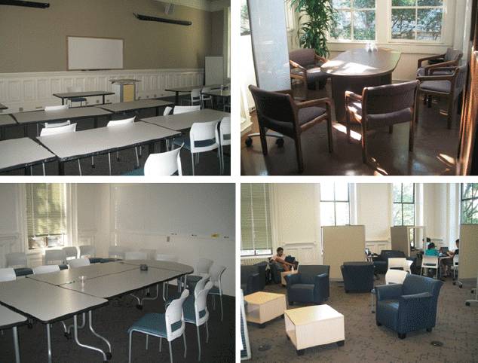
Do these Spaces Facilitate Organization and Interaction?
40

Slide 41
Relationships with Other Organizing Systems
No organizing system exists in isolation
There are always overlapping and adjacent systems from the user’s perspective
Sometimes it is possible to design these to work together to achieve integration and interoperability, or standards / ecosystem can emerge
At very least, try not to make this difficult
41

Slide 42
Requirements for Interactions
All organizing systems have some common interactions, but most of the time we want to pay attention to the more resource-specific interactions that create the most value
The priorities of different interactions are often determined by decisions about intended users
An essential requirement is ensuring that the supported interactions can be discovered and invoked by their intended users (i.e, we need good user interfaces)
42

Slide 43
“Touch Points” and Interaction Intensity / Quality
Services differ intrinsically in the number of touch points they require to create value; this is often called the service intensity
This view lets us treat intensity as a design parameter to differentiate service offerings of the same type or industry domain
The “generic” service offering is a design pattern that can be increased or reduced in intensity by changing the number of touch points
Notes:
43

Slide 44
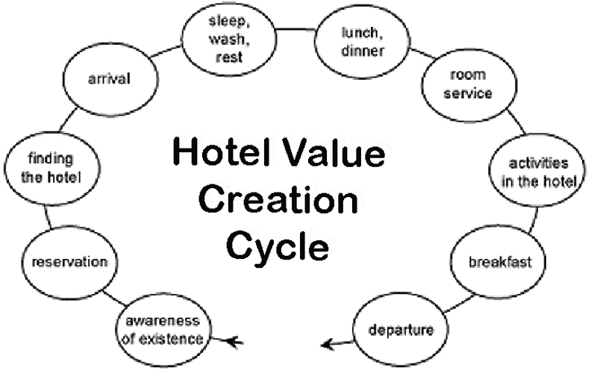
Interaction Design Pattern: “Generic” Hotel
44

Slide 45
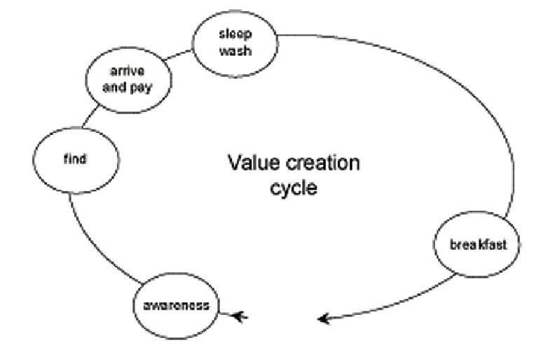
A “Budget” Hotel with Fewer Interactions
45

Slide 46
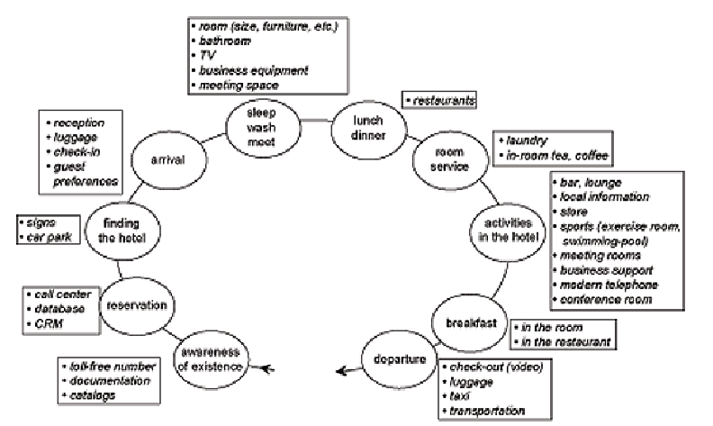
A “Luxury” Hotel with More Interactions
46

Slide 47
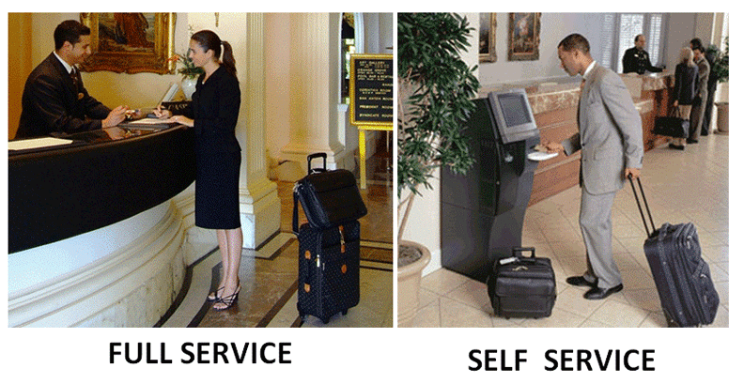
Interaction Alternatives Accommodate User Preferences
47

Slide 48
Tradeoffs in Interaction Design: Substituting Information for Interaction
Capturing, managing, integrating and retrieving information allows service providers to substitute information for interaction
You don’t need high intensity or many touch points if stored information makes interaction unnecessary
A hotel clerk with a database doesn’t need to ask for your room preferences; Amazon doesn’t need to ask you about what type of books you like
Design implication: hidden computational services are interchangeable with customer-facing “touch points”
Notes:
48

Slide 49
The Fundamental Tradeoff in an Organizing System
There is a tradeoff between the amount of work that goes into describing and organizing a collection of resources and the amount of work required to find and use them
The more effort we put into describing and organizing resources, the more effectively they can support interactions
The more effort we put into retrieving resources, the less they need to be organized first
49

Slide 50
The Fundamental Tradeoff in an Organizing System
We need to think in terms of investment, allocation of costs and benefits between the describer/organizer and user
The allocation differs according to the relationship between them; who does the work and who gets the benefit?
50

Slide 51
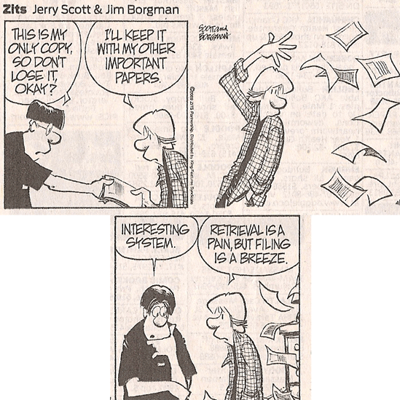
Even Comic Strips Know The Tradeoff

Slide 52
Operating and Maintaining an Organizing System
It is critical to determine an appropriate mix of methods for creating and maintaining resource descriptions, because their cost, quality, consistency, completeness, and semantic richness depends on which human or computational agents do the work
52

Slide 53
Small Changes to Organizing Systems
Incremental changes in description vocabularies and classification schemes needed when new instances or contexts require additional properties
Subdivision and extension to create new subcategories
Technology upgrades to improve capacity or performance that don’t change any interactions
53

Slide 54
Larger Changes to Organizing Systems
Changes in resource description and classifications mandated by new laws or regulations
“All at once” changes to the principles for arranging resources along with changes in the implementing technology because incremental change is infeasible
54

Slide 55
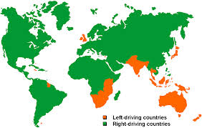
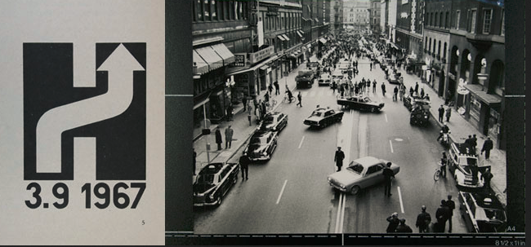
Which Side to Drive On?

Slide 56
Readings for Next Lecture
TDO Chapter 2, Activities in Organizing Systems

Slide 57
Flashback to Case Studies
Which case studies involved organizing systems with a small number of users, or just one user?
…many known users of known type?
… unknown number of users or known type?
… unknown number of users of unknown type?
57

Slide 58
Flashback to Case Studies
Which case studies involved organizing systems with few technology constraints?
…many constraints?
… unknown number of constraints?
58

