Slide 1
Plan for Today’s Lecture(s)
Introduction to Relationships and Structures
Semantic Perspective
Lexical Perspective
1

Slide 2
INFO 202 “Information Organization & Retrieval” Fall 2014
UNIVERSITY OF CALIFORNIA, BERKELEY
SCHOOL OF INFORMATION
Robert J. Glushko glushko@berkeley.edu
@rjglushko
8 October 2014 Lecture 11.1 – Introduction to Relationships and Structures

Slide 3
Defining "Relationship"
“An association among several things, with that association having a particular significance”
“Relationships are the stuff out of which information is made”
The reason is an important part of the relationship
Multiple relationships can exist among the same objects, so the order of the objects matters
3

Slide 4
Relationship != Relation
In mathematics and computer science a “relation” is a set of ordered elements (“tuples”) of equal degree
A binary relation is a set of element pairs, a ternary relation is a set of 3-tuples, and so on.
The elements in each tuple are “related” but they do not need to have any “significant association” or “relationship” among them
4

Slide 5
Five Perspectives on Relationships (1)
SEMANTIC: the meaning of the association
LEXICAL: how the conceptual description of a relationship is expressed using words in a specific language
STRUCTURAL: analyzes the patterns of association, arrangement, proximity, or connection between resources
5

Slide 6
Five Perspectives on Relationships (1)
ARCHITECTURAL: emphasizes the number and abstraction level of the components of a relationship, which together characterize its complexity
IMPLEMENTATION: how the relationship is implemented in a particular notation and syntax and the manner in which relationships are arranged and stored in some technology environment.
6

Slide 7
INFO 202 “Information Organization & Retrieval” Fall 2014
UNIVERSITY OF CALIFORNIA, BERKELEY
SCHOOL OF INFORMATION
Robert J. Glushko glushko@berkeley.edu
@rjglushko
8 October 2014 Lecture 11.2 – The Semantic Perspective on Relationships

Slide 8
The Semantic Perspective on Relationships
The essence of relationships; why the resources are related
Relies on or expresses information that is not directly available from perception
“Homer is married to Marge" is a semantic assertion; "Homer is standing next to Marge" is not
It is difficult to define what a relationship means in a non-circular way that doesn't rely on lots of undefined relationships...
8

Slide 9
Making Sense (1)

Slide 10
Making Sense (2)
Draw a diagram that represents these assertions:
"Mary and Sue are sisters“
"Sally and Martha are mothers”
10

Slide 11
Mother
Mary
Sue
Mary and Sue are sisters…
…of each other

Slide 12
Mary’s Mother
Mary
Mary’s Sister
Mary and Sue are sisters…
…of other people
Sue’s Mother
Sue
Sue’s Sister

Slide 13
Sally
Sally’s Child
Sally and Martha are mothers
…of different children
Martha
Martha’s Child

Slide 14
Sally and Martha are mothers
…Sally is Martha’s mother
Sally
Martha (Sally’s Child)
Martha’s Child

Slide 15
Making Sense (3)
“Bob saw the plane flying over Denver”
“Bob saw the mountains flying over Denver”
15

Slide 16
Language and Meaning
Words and sentence structure only hint at meaning
Meaning is constructed not just from the literal language used, but from all the clues or cues in the context of use -- common knowledge, assumptions, previous discourse, the present situation, and inferences from all of these
16

Slide 17
Specifying Semantic Relationships
"A sequence of categories, that includes one thing from each category“ (Kent)
Predicate/Argument Syntax:
is-married-to (Homer Simpson, Marge Simpson)
Subject / Predicate / Argument Syntax:
Homer Simpson => is-married-to => Marge Simpson
17

Slide 18
The Semantics of "Inclusion"
One class or type of resources logically contains another; predicate is usually is-a or "is-a-type-of"
A set of interconnected class inclusion relationships defines a HIERARCHY or TAXONOMY
An inclusion relationship between an instance and a class -- assigning an instance to a class - is CLASSIFICATION
18

Slide 19
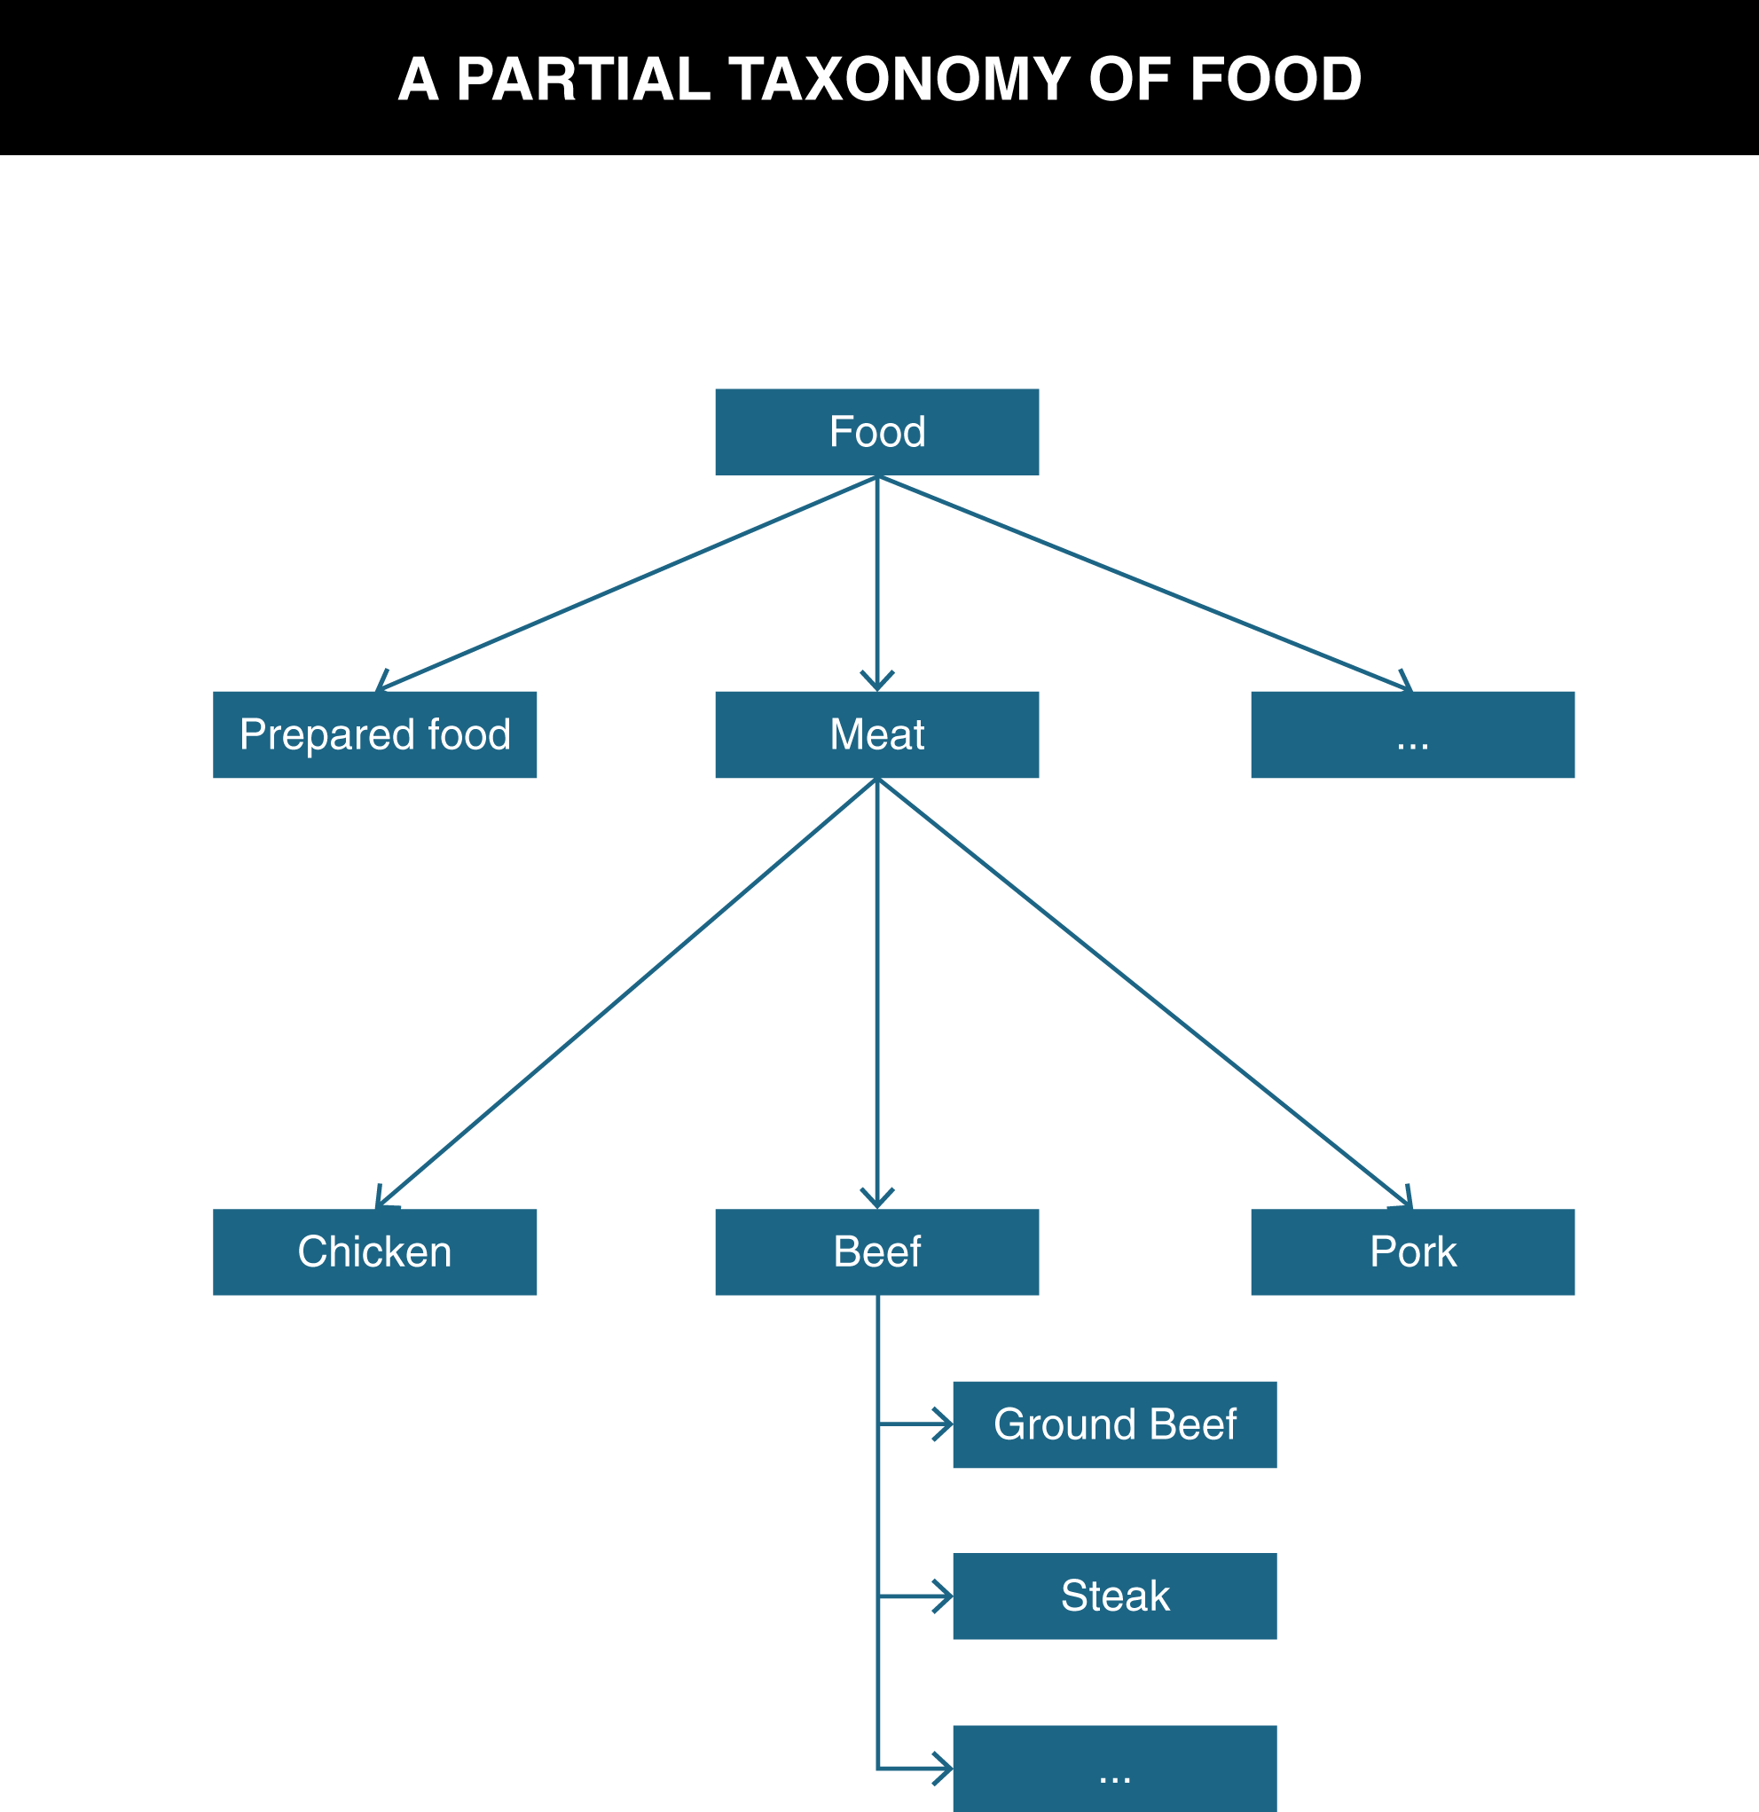
TDO Figure 5.1

Slide 20
Part-Whole or Meronymic Inclusion
A resource class or instance physically, topologically, or temporally contains another
The engine is part of the car
The Napa Valley is part of Northern California
Extra time is part of a football match
expressed using “is-part-of,” “is-partly,” or with other similar predicate expressions
20

Slide 21
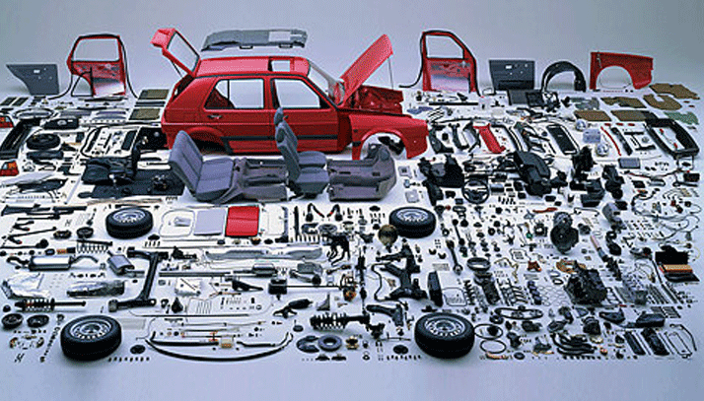
Part-Whole Relationship (Component-Object)

Slide 22
The Semantics of “Attribution”
In contrast to inclusion expressions that state relationships between resources, attribution relationships assert or assign values to properties for a particular resource
Attribution can be thought of as a binary relationship whose predicate has a single argument:
Martin the Gecko => is-small
"Title" : "Moby Dick“
Or with two arguments:
Martin => has-size => small
22

Slide 23
Properties of Semantic Relationships: Symmetry (1)
SYMMETRY: the order in which the arguments of a binary relationship doesn't matter
Homer Simpson => is-married-to => Marge Simpson
Marge Simpson => is-married-to => Homer Simpson
23

Slide 24
Properties of Semantic Relationships: Symmetry (2)
Relationships that are symmetric are also called BI-DIRECTIONAL
ASYMMETRIC relationships are those where the order of the arguments matters
Homer Simpson => is-parent-of => Bart Simpson
24

Slide 25
Properties of Semantic Relationships: Inverse
For asymmetric relationships, it is often useful to be explicit about the meaning of the relationship when the order of the arguments in the relationship is reversed
The resulting relationship is called the INVERSE or the converse of the first relationship
25

Slide 26
Properties of Semantic Relationships: Transitivity (1)
TRANSITIVITY: if X and Y have a relationship, and Y and Z have the same relationship, then X also has the relationship with Z
Homer Simpson => is-taller-than => Bart Simpson
Bart Simpson => is-taller-than => Maggie Simpson
IMPLIES THAT
Homer Simpson => is-taller-than => Maggie Simpson
26

Slide 27
Properties of Semantic Relationships: Transitivity (2)
Any relationship based on inclusion or ordering is transitive
Ordering includes numerical, alphabetic, and chronological relationships as well as those that imply qualitative or quantitative measurement
27

Slide 28
Properties of Semantic Relationships: Equivalence
Any relationship that is both symmetric and transitive is an EQUIVALENCE relationship
We often need to assert that a particular class or property has the same meaning as another class or property or that it is generally substitutable for it
28

Slide 29
Ontology
An ontology defines the concepts and terms used to describe and represent some domain or area of knowledge
To fully understand a domain you need to know class and part-whole inclusion, attribution, equivalence, and many other relationships about and between the resources it contains
Class inclusion relationships can form a kind of backbone or framework to which other kinds of relationships attach, creating a network of relationships
29

Slide 30
Analyzing the Definition of Ontology
The word ontology has been used to describe artifacts with different degrees of structure that differ:
... according to how precisely the terms are defined
... according to how precisely the relationships among them are expressed
So the simplest ontology is a dictionary
A thesaurus is a somewhat more complex ontology
More complete ontologies are expressed using formal logic-based language
30

Slide 31
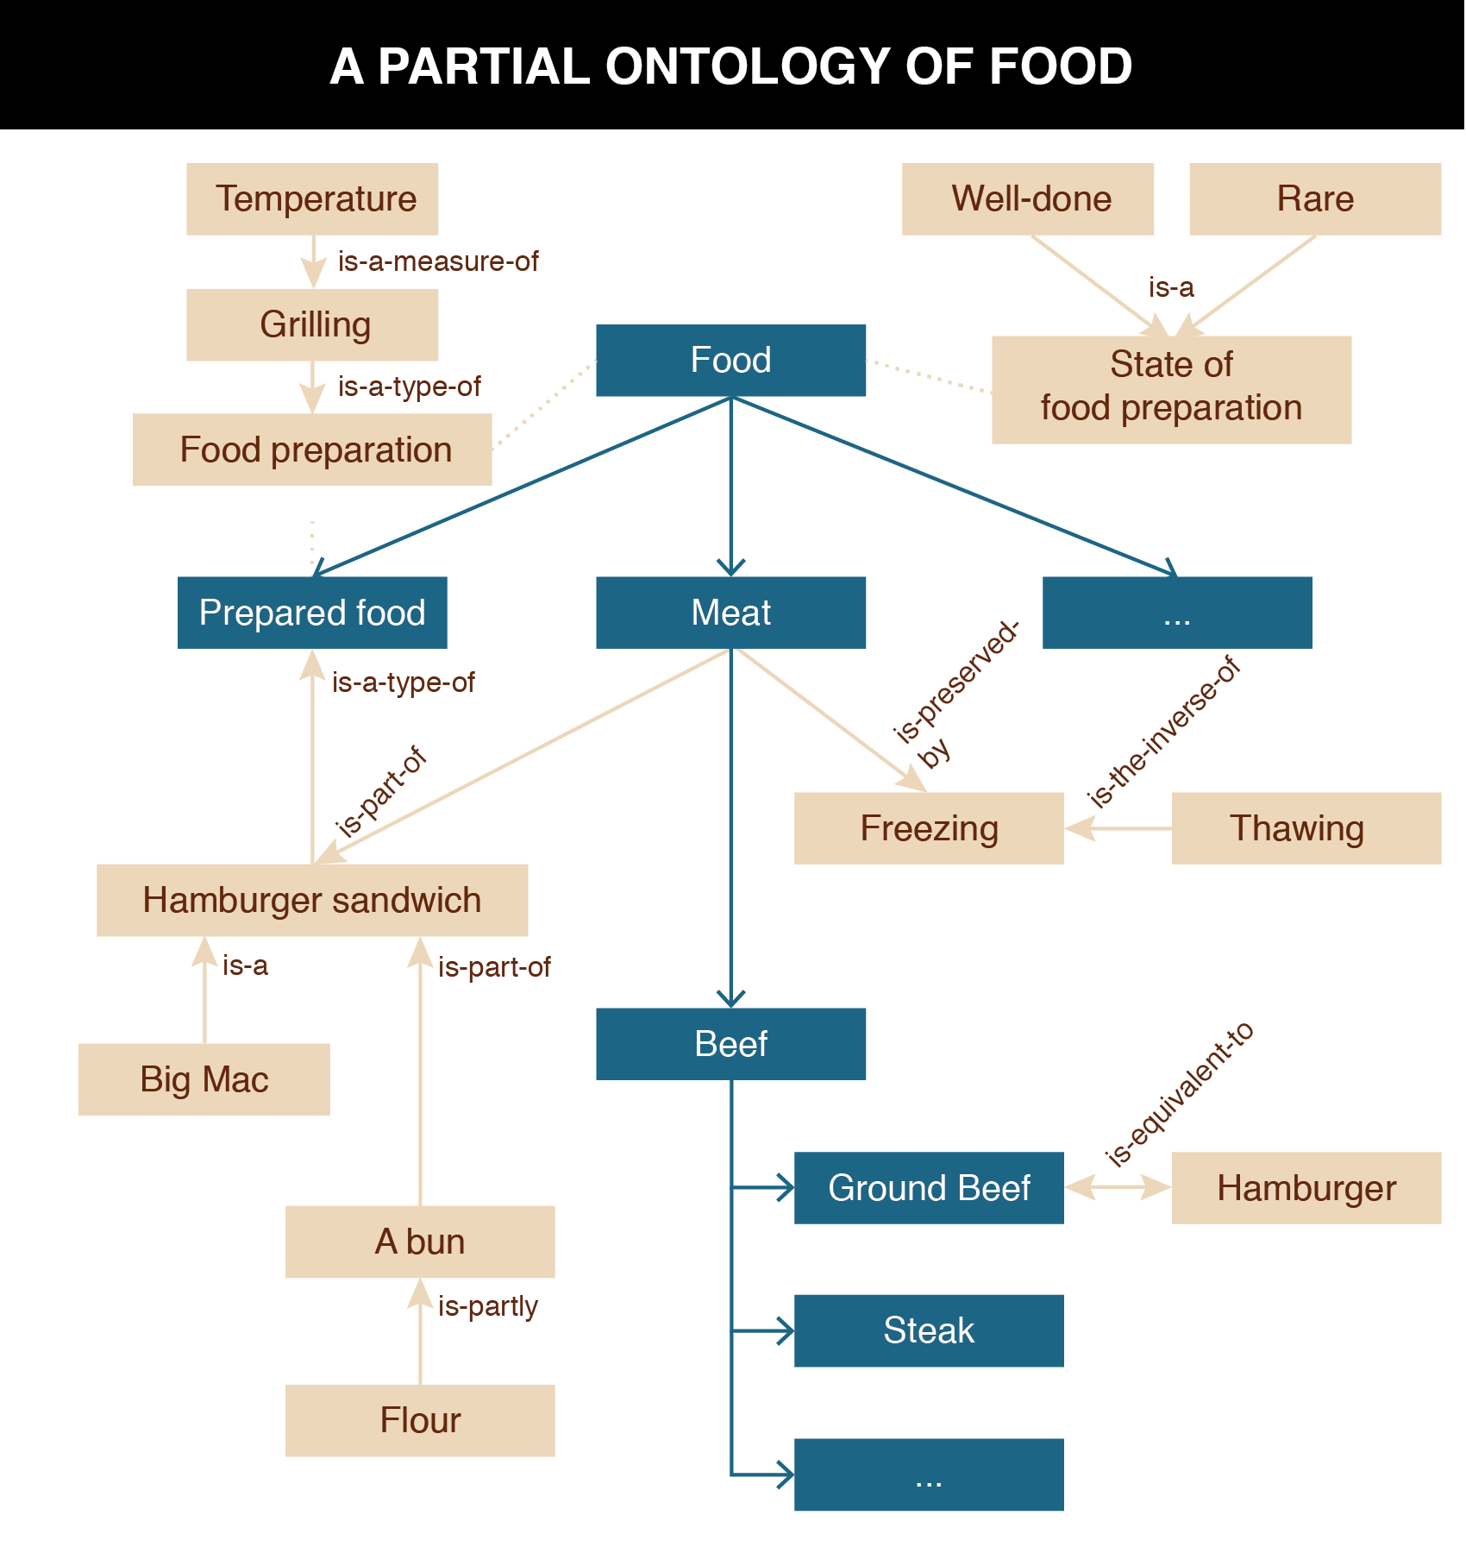
TDO Figure 5.2

Slide 32
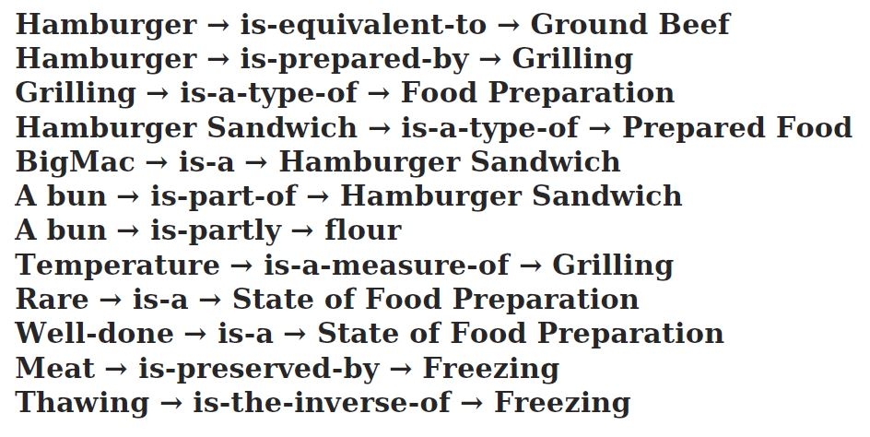
Ontological Assertions That Annotate the Food Taxonomy

Slide 33
Ontologies and the “Vocabulary Problem”
The Artificial Intelligence solution (for computers) to the vocabulary problem is to give an information system all the knowledge -- including "commonsense" -- that is needed to interpret every user's expressions in every context
A great deal of work in AI has been dedicated to building knowledge bases to support language understanding, reasoning, problem solving applications
33

Slide 34
INFO 202 “Information Organization & Retrieval” Fall 2014
UNIVERSITY OF CALIFORNIA, BERKELEY
SCHOOL OF INFORMATION
Robert J. Glushko glushko@berkeley.edu
@rjglushko
8 October 2014 Lecture 11.3 – Lexical Perspective on Relationships

Slide 35
The Lexical Perspective on Relationships
A prototypical word is the minimal "meaning bearing" element of language
Words express concepts and relationships, but not all concepts and relationships have words for them (are "lexicalized")
These "lexical gaps" differ from language to language
Whereas "conceptual gaps" -- the things we can't think of -- may be innate and universal
35

Slide 36
Linguistic Relativity in Iceland

Slide 37
Relationships Among Words / Relationships Among Concepts
Representing the relationships among words is a task for linguistics and cognitive science
In contrast, representing the relationships among concepts is a task for computer science (e.g., ontologies like Cyc)
Understanding both kinds of relationships is essential for designers of organizing systems
37

Slide 38
Relationships Among Words
Hyponymy/Hyperonymy
Metonymy
Synonymy
Polysemy
Antonymy
38

Slide 39
Hyponymy/Hyperonymy
When words encode IS-A or inclusion relationships, the word for the more specific class is the HYPONYM and the other is the HYPERNYM
So there can be a "lexical hierarchy" that represents the "semantic hierarchy"
Often used to situate "basic categories" with respect to superordinate and subordinate categories
39

Slide 40
Hyponymy/Hyperonymy
A is a hyponym of B if A is a type of B
A robin is a hyponym of bird
A is a hypernym of B if B is a type of A
An animal is a hypernym of bird
40

Slide 41
A Formula for Definitions
hyponym = {adjective+} hypernym {distinguishing clause+}
Robin = Migratory BIRD with clear melodious song, a reddish breast, gray or black upper plumage
Doesn't mention every characteristic of hyponym, only those needed to distinguish from other hyponyms
41

Slide 42
Metonymy
The lexical representation of or analogy to part-whole or meronymic relationships
Using one aspect of something to stand for the whole
"Bank" as building stands for the institution of the "bank"
"The White House released new budget figures today"
42

Slide 43
Synonymy
Synonyms are different word forms that can express the same concept
cat, feline, Siamese cat
Absolute synonyms that can always substitute for each other probably don't exist
Propositional synonyms are those where substituting one for another isn’t likely to change the truth value of the statement
43

Slide 44
Polysemy
Many "word forms" (particular spelling patterns) are polysemous with multiple senses established in the language -- they are semantically ambiguous
- That dog has floppy ears - She has a good ear for jazz.
"bank" (financial) has related senses:
- a building (the bank on Shattuck) - specific financial firm (Wells Fargo) - where money is kept (abstract notion) - where anything of value is kept (more abstract)
44

Slide 45
Polysemy vs Homonymy
A HOMOGRAPH is a word with multiple senses that are not conceptually related
- bank (financial sense) - bank (river sense)
But what looks like homography may be polysemy from a historical perspective
- mole (an animal that digs holes; an infiltrating spy)
HOMOPHONES are words with the same pronunciation but different spellings and meanings
- to, two, too; might, mite; clawed, claude
45

Slide 46
Antonymy
Antonyms are lexical opposites
Some are inherently binary “true antonyms”
dead / alive, true / false, on / off
Others are "graded"
long / short, hot / cold
Markedness: if one member of a pair is more restricted in its contexts it can stand out psychologically
long is unmarked, short is marked
46

Slide 47
Thesauri
A THESAURUS is a tool for finding the "right" or "good" terms of a controlled vocabulary
It is a collection of vocabulary terms annotated with lexical relationships to indicate terms that are:
Preferred (UF "used for")
Broader (BT "broader term")
Narrower (NT "narrower term")
Related (RT "related term" or "see also")
USE in a thesaurus refers the reader from a variant term to a preferred term; the inverse of UF
47

Slide 48
Examples from Food Domain (TDO 5.4.2)
Food BT Meat
Beef NT Meat
Food UF Sustenance, Nourishment
Food RT Cooking, Dining, Cuisine
Victuals USE Food
48

Slide 49
WordNet
Another "ontological resource" -- a "semantic dictionary" - started in 1985 by George Miller and others at Princeton's Cognitive Science program
over 100,000 nouns in 80,000 “synonym sets”
11000 verbs in 13000 synsets
Instead of using spelling as the primary organizing principle for words, it uses their semantic properties and relationships
Designed as a network to capture the idea that words and concepts are an interrelated system
49

Slide 50
Using WordNet
The WordNet database is freely downloadable from http://wordnet.princeton.edu/
http://www.synonym.com/ is easier to work with
The Visual Thesaurus is a commercial product that uses WordNet (http://www.visualthesaurus.com)
WordNet is very commonly used in natural language processing research and applications
Most important automated use of WordNet is in sense disambiguation, identifying a sense based on contexts in which it occurs
50

Slide 51
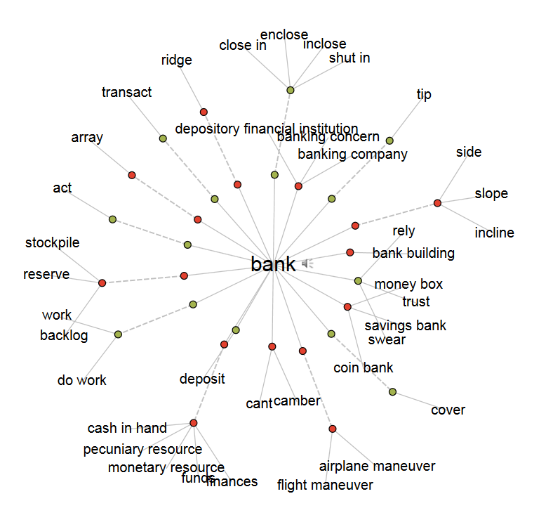
“Bank” in Visual Thesaurus

Slide 52
Sense Disambiguation with WordNet “Put the money in the bank”
Two of the three WordNet senses for “money” are:
1) the most common medium of exchange
2) the official currency issued by a government or national bank
and the first two of the ten WordNet senses for “bank” are:
1) a financial institution that accepts deposits
2) sloping land, especially the slope beside a body of water
The synset hierarchies for the two senses of “money” intersect after a very short path with the hierarchy for the first sense of “bank”, but do not intersect with the second sense of “bank” until they reach very abstract concepts

Slide 53
Implications for Vocabulary Design
Choosing vocabulary terms, and precisely defining their semantics, is essential but impossible to do perfectly
Your vocabulary must express what YOU intend, so you "look inward" -- analyze how you think about a domain
You want others to understand what you mean, so you need to "look outward" -- analyze the terms used by your users, competitors, or subject matter experts
You should reuse other vocabularies or thesauri if they exist, especially for any "horizontal" components, to improve transformability and interoperability
But these three approaches may suggest different terms
53

Slide 54
Midterm Next Time
Multi-part short answer questions
1 required, then select 3 of other 5
Open book, open notes, not open Internet
54

