Slide 1
Plan for Today’s Lecture(s)
The Architectural Perspective on Relationships
Structure between Resources
Link Architecture
A Little Graph Theory
Bibliometrics and Altmetrics
1

Slide 2
INFO 202 “Information Organization & Retrieval” Fall 2014
UNIVERSITY OF CALIFORNIA, BERKELEY
SCHOOL OF INFORMATION
Robert J. Glushko glushko@berkeley.edu
@rjglushko
20 October 2014 Lecture 13.1 – The Architectural Perspective on Relationships

Slide 3
The Architectural Perspective {and, or, vs.} the Structural Perspective
The architectural perspective is abstract and prescriptive
It defines what kinds of relationships can be created given the design of an organizing system
The structural perspective is concrete and descriptive
It says "this is what exists" and describes the actual patterns of association, arrangements, proximity, or connection between resources in a particular context
3

Slide 4
The Architectural Perspective: Degree or Arity
The architectural perspective embodies Kent’s definition of “relation” as “A sequence of categories, that includes one thing from each category”
The DEGREE or ARITY of a relationship is the number of different "entity types" or "resource categories" in the relationship
Husband is-married-to Wife is BINARY
Person is-married-to Person is UNARY
4

Slide 5
The Architectural Perspective: Cardinality
The CARDINALITY is the number of instances that can be associated with each entity type
Husband is-married-to Wife is ONE-TO-ONE, because husbands have only one wife and vice versa (in monogamous societies)
Father is-parent-of Child is ONE-TO-MANY
Homer is-parent-of Bart AND Lisa AND Maggie is one-to-three
5

Slide 6
Modeling Relationships as Binary Ones
Relationships can always be modeled as binary ones, but this makes some relationships implicit that were explicit
Binary relationships are relationship "triples" with a "subject", "predicate," and "object"
With binary relationships the reason for the relationship can often be interpreted in both directions (one is the inverse of the other)
With triples we can combine relationships into a graph and "reason" over the set of relationships when they have common components
6

Slide 7
The Architectural Perspective: Directionality
The DIRECTIONALITY of a relationship defines the order in which the arguments of the relationship are connected
A ONE-WAY or UNI-DIRECTIONAL relationship can be followed in only one direction
A BI-DIRECTIONAL one can be followed in both directions
All symmetric relationships are bi-directional, but not all bi-directional relationships are symmetric
7

Slide 8
INFO 202 “Information Organization & Retrieval” Fall 2014
UNIVERSITY OF CALIFORNIA, BERKELEY
SCHOOL OF INFORMATION
Robert J. Glushko glushko@berkeley.edu
@rjglushko
20 October 2014 Lecture 13.2 – Introduction to Describing Structure Between Resources

Slide 9
“Between-Resource” Structures
Links between printed or digital documents – citations, cross refs, annotations
Links between web pages
Links – communication and information flows - between people, organizations, any other kind of interacting “actors” or resources – social networks
We can analyze all of these with some common concepts and abstractions, which we will introduce in as gentle a way as possible
9

Slide 10
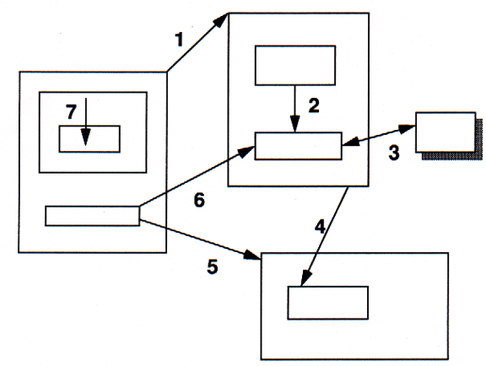
The Variety of Links

Slide 11
Link Properties
The starting point of the link (the ANCHOR)
The end point of the link (the DESTINATION)
The reason for the link (the LINK TYPE)
The number of resources linked to (the CARDINALITY; 1-1 or 1-many)
The DIRECTIONALITY
11

Slide 12
Annotation
An annotation is a link from some anchor to a newly-created destination, the contents of which are the BODY of the annotation
Highlighting can be conceived of as a link from an anchor back to itself where there is no new BODY created
12

Slide 13
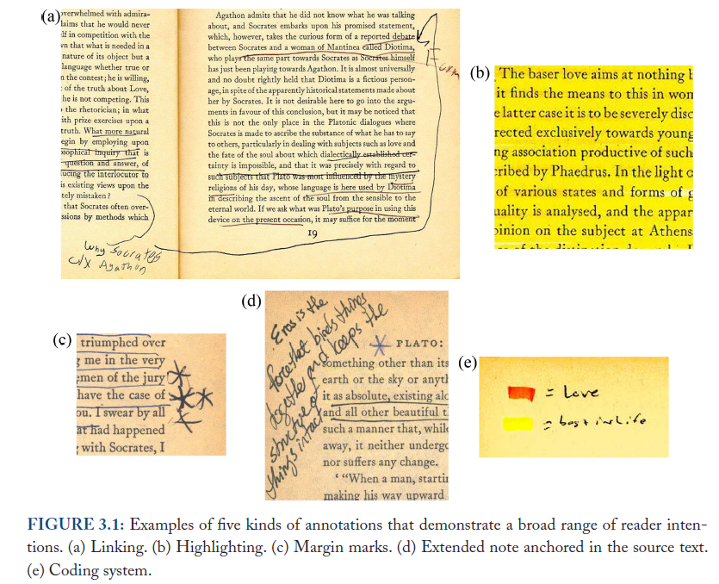
Annotation
Marshall, Reading and Writing the Electronic Book, 2010

Slide 14
Separation of Link Concerns
These structural and semantic issues are distinct from presentation ones
Is the presence of the link indicated (the LINK MARKER)?
Does the link marker change to indicate that the link has been followed?
Is the LINK TYPE indicated by some presentation convention?
Is the DESTINATION TYPE indicated by some presentation convention?
Are the links embedded in the resources, or are they architecturally distinct in a “link base”?

Slide 15
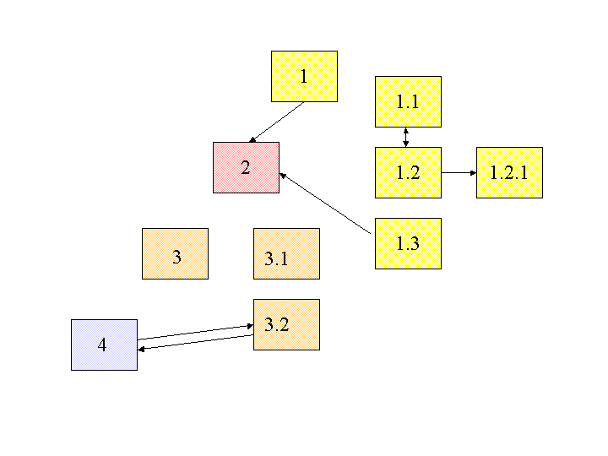
Embedded Links

Slide 16
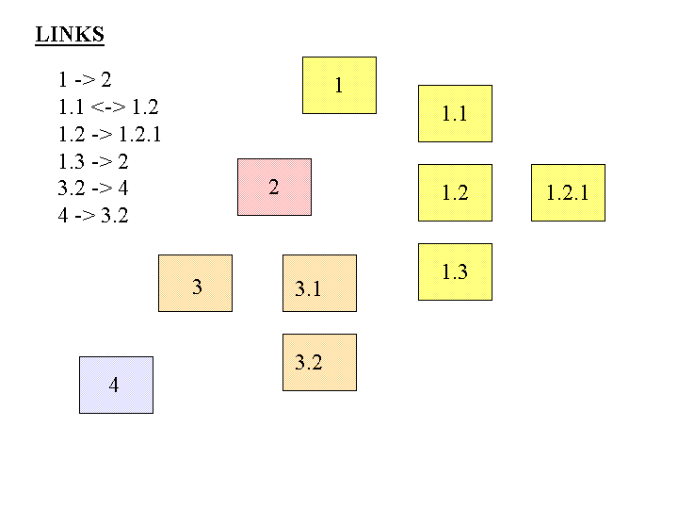
Separate Links

Slide 17
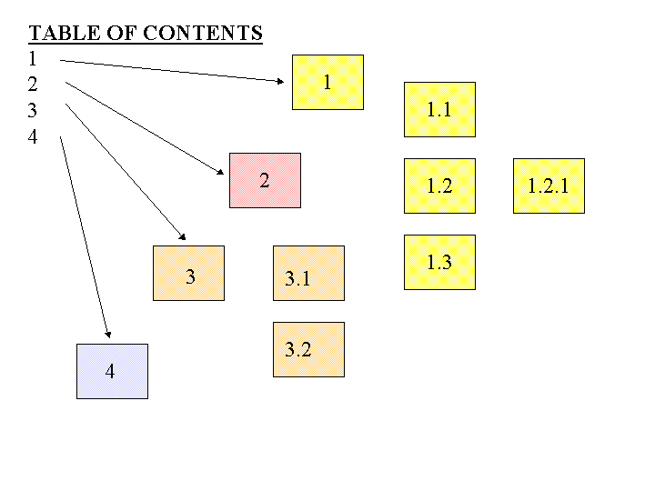

Slide 18
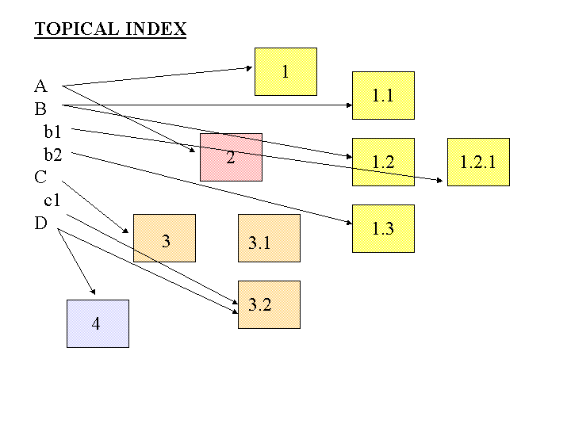

Slide 19
INFO 202 “Information Organization & Retrieval” Fall 2014
UNIVERSITY OF CALIFORNIA, BERKELEY
SCHOOL OF INFORMATION
Robert J. Glushko glushko@berkeley.edu
@rjglushko
20 October 2014 Lecture 13.3 – A Little Graph Theory

Slide 20
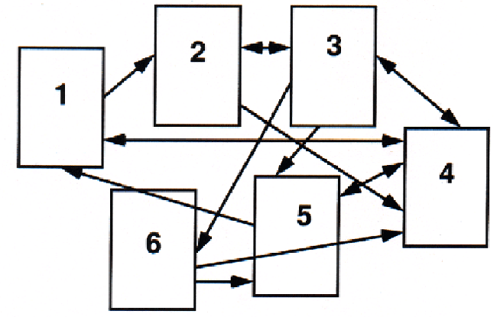
Link Network – Graphical View

Slide 21
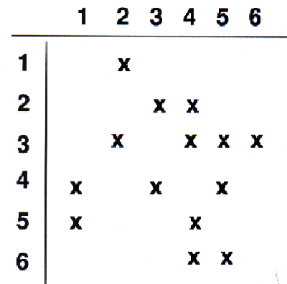
Link Network – Matrix View

Slide 22
Graph Theory
We can apply graph theory to understanding relationships from a structural perspective
A GRAPH treats resources as VERTICES or NODES
The pairwise relationships between resources are represented by the EDGES that connect them
If the edges have an associated direction, this is a DIRECTED graph
A WEIGHT can be assigned to each edge if the relationship has a numerical aspect (distance, cost, time, etc.)
22

Slide 23
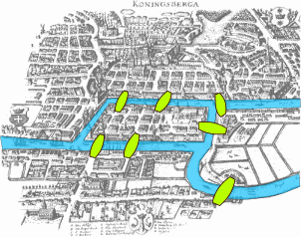
The Origins of Graph Theory (Euler 1735)
2 islands, 7 bridges – can you visit all 4 land masses without crossing any bridge more than once? Euler (1735) proved you couldn’t and invented much of graph theory to explain it
Euler’s Seven Bridges of Königsberg Problem
23

Slide 24
Computing the Properties of Graphs
Reachability – is there a path between any two nodes in the graph?
Shortest path – if there are multiple paths between two nodes, which is the shortest?
Centrality – which nodes are the most connected or have the average shortest paths to the other nodes?
Subgraph discovery – are there sub-graphs that are completely contained in a larger graph?
24

Slide 25
Reachability and Transitive Closure
The REACHABILITY property of a graph is "can you get there from here”
We can determine whether a path exists between any two nodes in a graph by calculating the transitive closure of the graph; the most commonly used approach is Warshall's algorithm
visualizations http://www.cs.sunysb.edu/~skiena/combinatorica/animations/graphpower.html
25

Slide 26
Shortest Path
The shortest path between two nodes in a graph can be calculated using Dijkstra’s algorithm
The shortest path problem is ubiquitous and its solution has obvious value – travel, transportation, financial arbitrage, grocery shopping…
If the graph edges aren’t weighted and we only care about connectivity, we have the familiar “degrees of separation” situation
For mathematicians; for actors
26

Slide 27
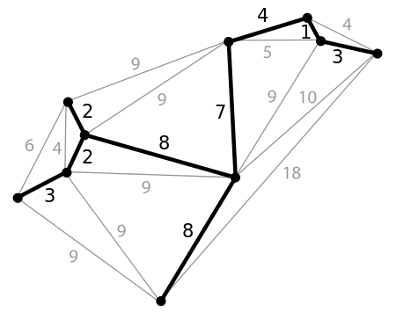
Minimum Spanning Tree
A spanning tree of a graph is a subgraph that is a tree that connects all the vertices – what’s the shortest one, and why would we care?
27

Slide 28
Moving Beyond “Reachability”
We've been treating relationships in purely structural terms - is one thing connected to another - but we can refine that into two perspectives:
RELATIONAL analysis treats links as indicators of the amount of connectedness or the direction of flow between documents, people, groups, journals, disciplines, domains, organizations, or nations
EVALUATIVE analysis treats links as indicators of the level of quality, importance, influence or performance of documents, people, groups
28

Slide 29
Analysis of Large-Scale Social & Information Networks (Kleinberg)
“The Web lets us observe, measure and analyse social interaction at a level of scale and resolution that was previously unimaginable, observing social phenomena that had previously remained essentially unrecorded and invisible”
Social network firms exploit “triadic closure” – the increased tendency for two people to form a relationship when they people in common
People who are the boundaries of one’s social networks – “weak ties” – can be crucial sources of information
29

Slide 30
Analysis of Large-Scale Social & Information Networks (Kleinberg)
Many social networks are directed graphs because of asymmetries in status, power, or values
Identifying “influencers” and predicting their influence is the billion dollar question for web-based social networks
See Coursera course on Social Network Analysis
30

Slide 31
Measures of Centrality
Degree Centrality – number of direct connections
Betweenness – a location in the network that interconnects different clusters
Closeness – low average path length
31

Slide 32
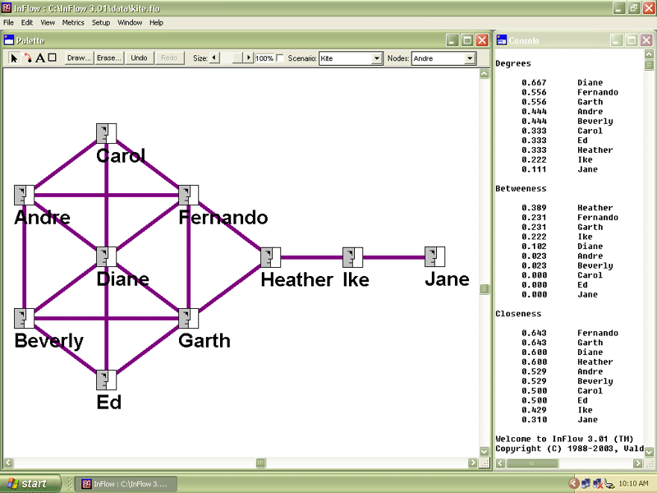
“Kite Network” Example from http://www.orgnet.com/sna.html
32

Slide 33
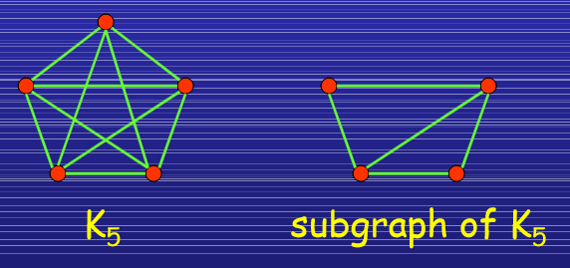
Subgraphs
In a social network setting, connection subgraphs can identify the few most likely paths of transmission for a disease (or rumor, or information-leak, or joke) or spot whether an individual has unexpected ties to any members of a list of individuals.
Faloutsos, Christos, Kevin S. McCurley, and Andrew Tomkins. "Connection subgraphs in social networks” 2004.
33

Slide 34
NSA’s Social Network Analysis
The agency was authorized to conduct “large-scale graph analysis on very large sets of communications metadata without having to check foreignness” of every e-mail address, phone number or other identifier, the document said.
The agency can augment the communications data with material from public, commercial and other sources, including bank codes, insurance information, Facebook profiles, passenger manifests, voter registration rolls and GPS location information, as well as property records and unspecified tax data, according to the documents.
NSA Gathers Data on Social Connections of US Citizens.
NY Times 28 Sept 2013
34

Slide 35
“The Web lets us observe, measure and analyse social interaction at a level of scale and resolution that was previously unimaginable, observing social phenomena that had previously remained essentially unrecorded and invisible”
35

Slide 36
INFO 202 “Information Organization & Retrieval” Fall 2014
UNIVERSITY OF CALIFORNIA, BERKELEY
SCHOOL OF INFORMATION
Robert J. Glushko glushko@berkeley.edu
@rjglushko
20 October 2013 Lecture 13.4 – Bibliometrics and Altmetrics

Slide 37
Bibilometrics (or "Scientometrics"): Structure of Scientific Citation
Analysis of scientific citation began in the 1920s as a way to quantify the influence of specific documents or authors in terms of their "impact factor"
It can also identify "invisible colleges" of scientists whose citations are largely self-referential
It can recognize the emergence of new scientific disciplines
(Eugene Garfield and Derek J. de Solla Price are two of the "founding fathers" of bibliometrics)
37

Slide 38
The Temporal Structure of Citation
Patterns of citation identify the “hot” topics in a discipline and the size of the research community where there is a lot of cross-citation between researchers

Slide 39
Citation Analysis and Impact Ranking
Most articles and most journals are rarely cited
a very large fraction … must be reckoned as merely a distant background noise, and as very far from central or strategic in any of the knitted strips from which the cloth of science is woven (de Solla Price)

Slide 40
Some Problems for Citation Analysis
People lie, are lazy, stupid, biased...
Most papers cite only a small proportion of the sources that influenced them
Secondary sources are cited more than primary ones, because people don't know the literature, and informal ones aren't cited
People cite their friends and themselves more than is justified
40

Slide 41
Citation Signals and Polarity (1)
When one resource cites another there is often a lexical signal that indicates how a writer views the relationship of a citation to the text from which the citation is made
This concept comes from rhetoric and critical theory but is relevant to document engineering and TDO
Pedantic folks call this "genre of invocation" -- distinguishing things like "cite, mention, acknowledged”
41

Slide 42
Citation Signals and Polarity (2)
A citation or link without a signal suggests by default that the citation supports the current text
Explicit signals that indicate positive polarity include "See," "See also," "See generally," and "Cf."
Signals that indicate negative polarity include "But see" and "Contra"
42

Slide 43
Shepardizing
Because of the use of legal cases as precedents, an entire industry in legal publishing exists to interpret any citations to cases; Shepard's is the oldest and checking a prior legal ruling to make sure it is still "good" is called "Shepardizing" a case

Slide 44
Adapting Citation Analysis to the Web
The concepts and techniques of citation analysis seem applicable to the web since we can view it as a network of interlinked articles
But not everything applies because the web is different in numerous ways
We'll return to this issue with web search and structure-based retrieval
44

Slide 45
Altmetrics
Influence measures based on total output are biased against young scholars; one of them proposed the H-Index as a better predictor of scientific impact (check both kinds of measures at Google Scholar)
The “Altmetrics” movement is trying to make non-traditional contributions count for academic evaluations
Publishing in “open publications” – measuring downloading
Sharing “raw science” like datasets, code, and experimental designs
Blogging, microblogging, and comments or annotations on existing work
45

Slide 46
Readings for Next Lecture
TDO 5.8, 8.4
Berners-Lee, Tim, James Hendler, and Ora Lassila. “The semantic web.” Scientific American 284, no. 5 (2001): 28-37.
Heath, Tom, and Christian Bizer. “Linked data: Evolving the web into a global data space.” Synthesis lectures on the semantic web: theory and technology 1, no. 1 (2011). Chapters 1 and 2, pages 1-29.
Byrne, Gillian, and Lisa Goddard. “The Strongest Link: Libraries and Linked Data.” D-Lib Magazine 16, no. 11/12 (2010).
46

