Slide 1
Borges' Classification of Animals
In a certain Chinese encyclopedia "it is written that 'animals are divided into:
(a) belonging to the Emperor, (b) embalmed, (c) tame, (d) suckling pigs, (e) sirens, (f) fabulous, (g) stray dogs, (h) included in the present classification, (i) frenzied, (j) innumerable, (k) drawn with a very fine camelhair brush, (l) et cetera, (m) having just broken the water pitcher, (n) that from a long way off look like flies.'“
1

Slide 2
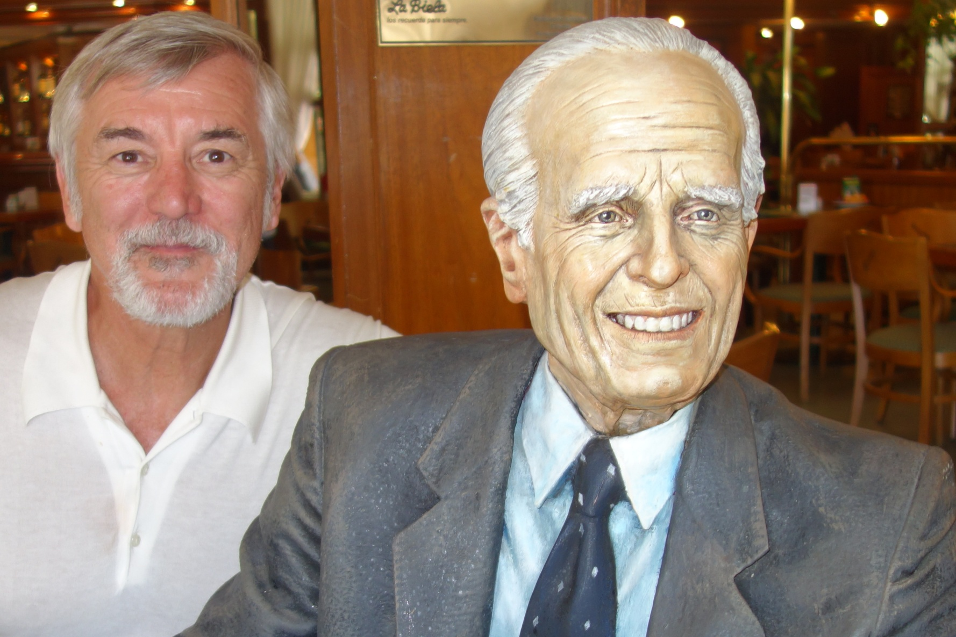
Meeting Borges at Café Tortoni in Buenos Aires (14 Feb 2014)
2

Slide 3
Plan for Today’s Lecture(s)
The What and Why of Categories
Cultural, Individual, and Institutional categories
Principles for creating categories
Classical categories... NOT
3

Slide 4
INFO 202 “Information Organization & Retrieval” Fall 2014
UNIVERSITY OF CALIFORNIA, BERKELEY
SCHOOL OF INFORMATION
Robert J. Glushko glushko@berkeley.edu
@rjglushko
27 October 2014 Lecture 15.1 – The What and Why of Categories

Slide 5
Categories are “Equivalence Classes”
Categories are sets or groups of resources or abstract entities that are treated the same
This almost never means that every instance of the category is identical
It only means that for some purpose we treat them in the same way
5

Slide 6
Categories are Essential
Categories are involved whenever we perceive, communicate, analyze, predict, classify – or otherwise attempt to make sense of our experiences
All human languages and cultures divide the physical and experiential “worlds” into categories
Some of this “sense-making” is discovering categories and some is creating them, but these aspects are often interconnected
6

Slide 7
Categories are Created
Categories can be created in many different ways according to many different types of principles
The equivalence classes that are created depend on which aspects or roles or meanings of the category members are treated as relevant
7

Slide 8
INFO 202 “Information Organization & Retrieval” Fall 2014
UNIVERSITY OF CALIFORNIA, BERKELEY
SCHOOL OF INFORMATION
Robert J. Glushko glushko@berkeley.edu
@rjglushko
27 October 2014 Lecture 15.2 – Category Categories, or Contexts for Categorization

Slide 9
Category Categories
Cultural Categorization
Individual Categorization
Institutional Categorization
9

Slide 10
Cultural Categories
Embodied in culture and language, developing slowly and typically changing slowly
Many have a perceptual or sensorimotor origin based on natural boundaries or discontinuities in perception and experience
Learned implicitly through development via parent-child interactions, language, and experience
Informal and contextual acquisition makes cultural categories flexible, creative, generative, and biased
10

Slide 11
Cultural Categories
When properties or behaviors co-occur in predictable ways, it is useful to have category words that name them => emergence of language
Formal education can teach cultural categories but the non-formal mechanisms often dominate or interfere
Thinking and research about categorization is primarily about cultural categories
11

Slide 12
Linguistic Relativity
Languages differ a great deal in the words they contain (which concepts are lexicalized)
They also differ in more fundamental ways by requiring speakers or writers to attend to details about the world or aspects of experience that another language allows them to ignore
But this doesn't mean that people can't understand concepts that are not lexicalized
12

Slide 13
The Whorfian Hypothesis
Benjamin Whorf (mid 20th century) is widely credited and miscredited with the hypothesis that "language shapes thought" - that the categories embodied in languages shape or even constrain how people perceive and understand the world
Cognitive science professor Lera Boraditsky has done some ingenious experimental tests of the Whorfian hypothesis - see http://www-psych.stanford.edu/~lera/papers/wsj.pdf for a very readable summary... (the WSJ article)
13

Slide 14
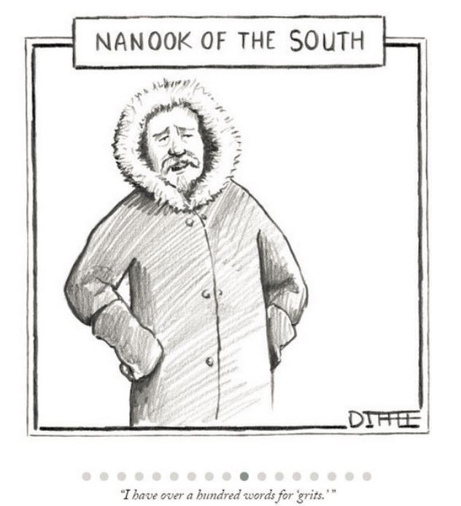
Mocking Linguistic Relativity (from 10/4/1 New Yorker)
14

Slide 15
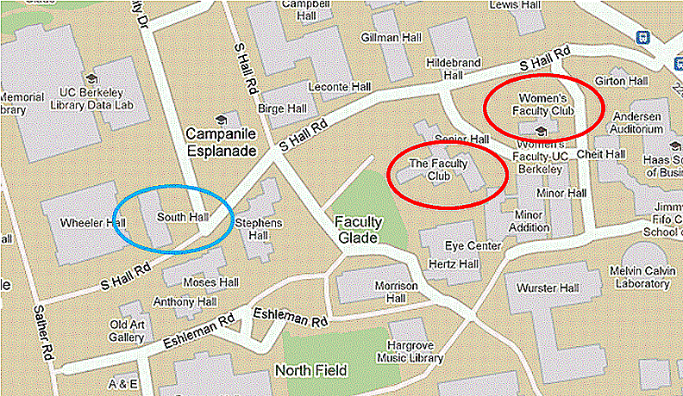
A “Cultural Categories” Example Too Close for Comfort
15

Slide 16
Individual Categories
Created to satisfy ad hoc requirements that emerge from an individual’s unique experiences, preferences, and resource collections
Created intentionally in response to specific organizing requirements
Can have an imaginative or metaphorical basis that distorts or misinterpret cultural categories
Collection hobbies often embody peculiar individual categories.
16

Slide 17
Individual Categories
Often have short lifetimes because they are designed to support specific tasks
When physical resources are involved, individual categories are rarely visible to or shared with others
With digital resources, increasingly common for individual categories to be intentionally or accidentally revealed
“Personal information management” is a subfield that focuses on individual organizing systems
17

Slide 18
Institutional Categorization
Explicit construction of a semantic model of a domain to enable more control, robustness, and interoperability than is possible with just the cultural system
Essential in abstract, information-intensive domains where semantic precision is essential for processes and transactions (especially automated ones)
Often the collaborative artifact of many individuals who represent different organizational or business perspectives
18

Slide 19
Institutional Categorization
Usually developed via rigorous and formal processes (e.g., in standards organizations or legislative bodies)
Laws, regulations, and standards often define institutional categories and the rules for creating and maintaining them
Require ongoing governance and maintenance because of continuous changes taking place in related cultural and individual systems
…FLASHBACK to “Effectivity” (TDO 3.5.2)
19

Slide 20
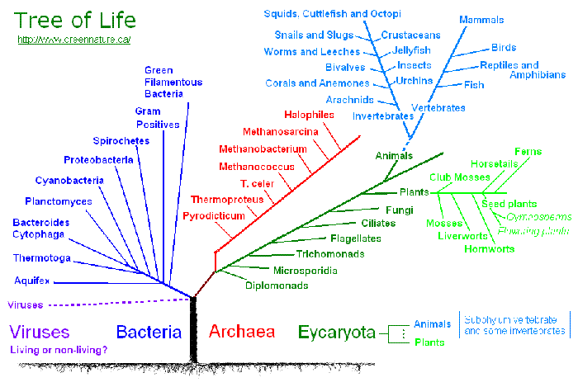
Institutional Categorization of Animals (Sorry Borges)
20

Slide 21
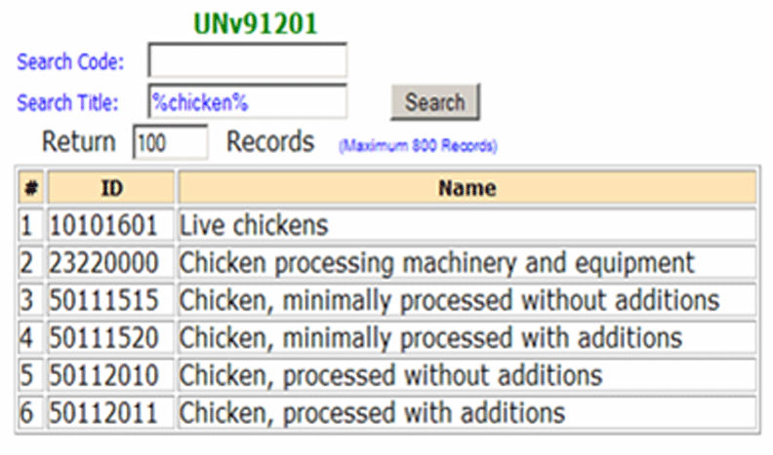
UN Standard Products and Services Codes for "Chicken"
21

Slide 22
Institutional != Unbiased
Creating institutional categories by more systematic processes than cultural or individual categories does not prevent them from being biased
Indeed, the goal of institutional categories is often to impose or incentivize biases in interpretation or behavior
22

Slide 23
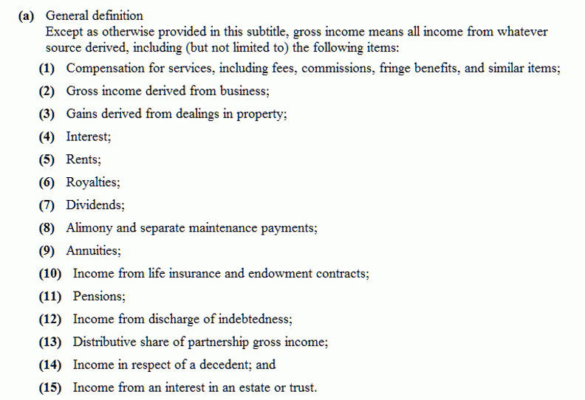
"Gross Income" Tax Code Categories
Should dividends be taxable income?
23

Slide 24
INFO 202 “Information Organization & Retrieval” Fall 2014
UNIVERSITY OF CALIFORNIA, BERKELEY
SCHOOL OF INFORMATION
Robert J. Glushko glushko@berkeley.edu
@rjglushko
27 October 2014 Lecture 15.3 – Principles for Creating Categories

Slide 25
Principles for Creating Categories
Enumeration
Single Properties
Multiple Properties
Family Resemblance
Similarity
Theory-Based
Goal-Derived
25

Slide 26
Defining Categories by Enumeration
Simplest way to define a category is by enumerating (listing) its members
This principle is also called EXTENSIONAL definition; the members of the set are called the EXTENSION
This principle is easy to understand and implement; the meaning of a category or concept is the specific set of resources associated with it
26

Slide 27
Defining Categories by Enumeration
We understand something like "states of the US" as a category by listing all 50 of them, not by testing for one or more properties
Enumerative categories enable membership to be unambiguously determined, but at some scale they become impractical or inefficient, and the category either must be sub-divided or be given a definition based on principles other than enumeration
27

Slide 28
Frege's "Correspondence" Philosophy of Language
Gottlob Frege (1848-1925), father of modern logic, investigated the idea of equivalence – how can you tell that two things are the same – in "Uber Sinn und Bedeuting"
"Sinn" or "sense" (or "intension") – the inner concept that people understand; words have intensions
"Bedeuting" or "reference" (or "extension") – the thing being referred to; the set of all objects in the world that can be described by the concept; intensions belong to extensions
But if "meaning" was just based on reference would we need all that complicated ontology and common sense?
28

Slide 29
If Meaning was just Reference...
Prune == Dried Plum
Chinese Gooseberry == Kiwi Fruit
Patagonian Toothfish == Antarctic Cod == Chilean Sea Bass
Sectarian Conflict == Civil War
Terrorists == Insurgents == Resistance == Freedom Fighters
29

Slide 30
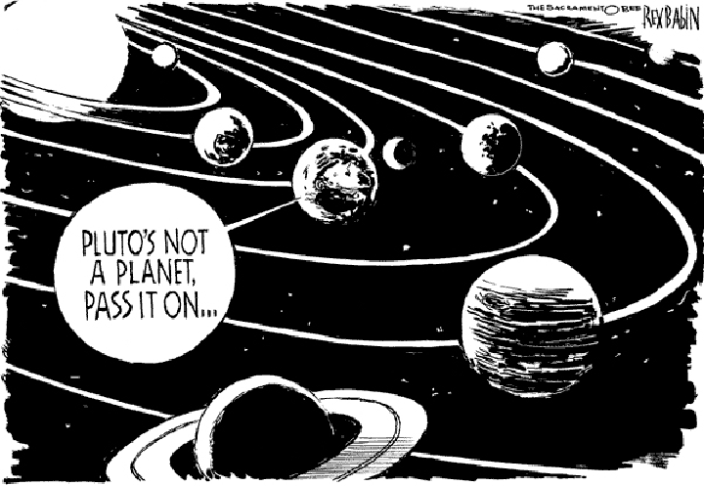
Sorry, Pluto
Not so fast…
30

Slide 31
Categories Defined by Single Properties
Simple category systems can be created using the values of any intrinsic static property, especially when the possible values are discrete and not very numerous
But you can always define ranges for continuous value properties: low, moderate, high cost
It is important to use properties that are psychologically or pragmatically relevant for the resource domain
31

Slide 32
Categories Defined by Single Properties
Whenever a single property is used to define categories, the choice of property is critical
A single-property category with a large numbers of items in it will lack coherence because differences on other properties will be too apparent
32

Slide 33
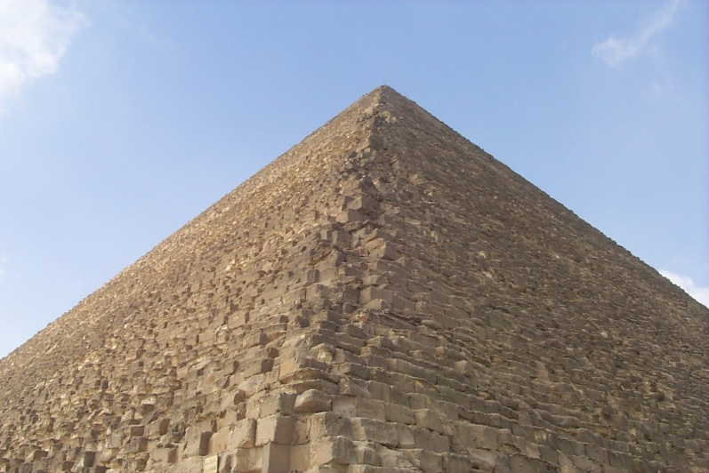
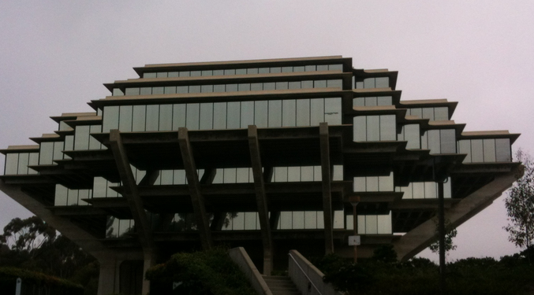
Single Property Category
33

Slide 34
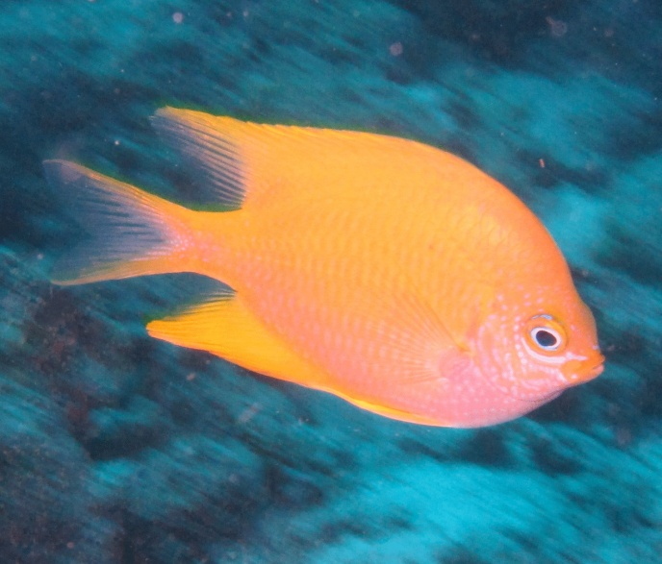
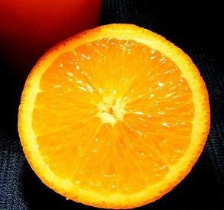
Single Property Category
34

Slide 35
Categories Defined by Multiple Properties
Categories based on multiple properties form a hierarchy
Each successive property differentiates the items in a category to create sub-categories
No more properties are needed if every item is in its own category or if the remaining differences are not important to us
For information resources, easily perceived properties are much less useful than ABOUTNESS
35

Slide 36
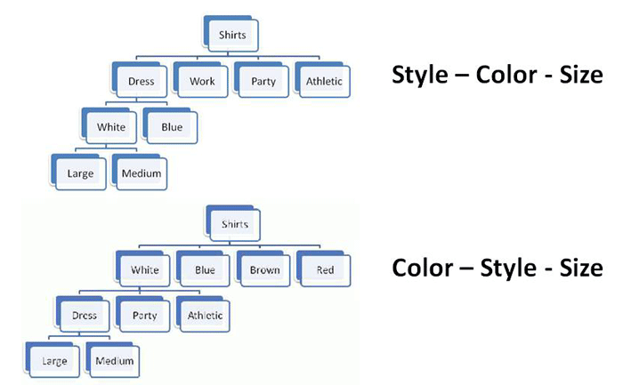
Property Order Determines the Category Hierarchy
36

Slide 37
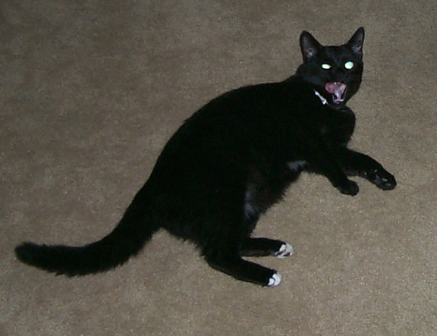
Category Hierarchies
Categories can be organized into a hierarchy from the most general to the most specific
My cat can be described as
An animal
A mammal
A cat
An American Shorthair
Boris
(No intent to line up completely with biological classification)
37

Slide 38
Basic-Level Categories
In the middle of category hierarchies are those that more "basic" because the within-category differences are smallest and the between-category differences are the largest
This means that perceptual, cognitive, and motor functions are "sharpest" at this level at identifying and thinking about category membership
These are the categories when Plato “carves nature at the joints”
38

Slide 39
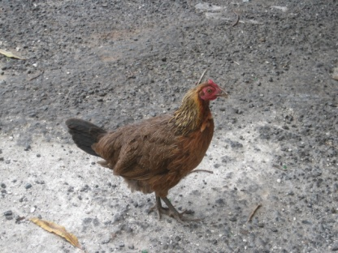
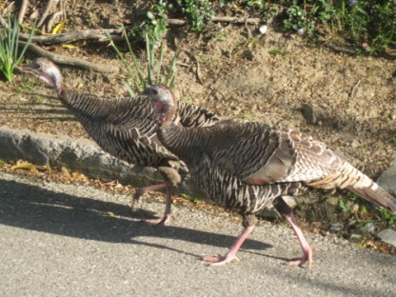
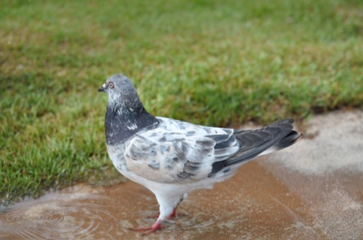
Basic-Level Categories
Members tend to have the same shape
They tend to "share parts"
The same motor movements are involved in interacting with them
39

Slide 40
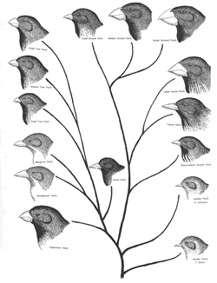
Darwin’s Galapagos Finches Not a basic level category; all finches have a lot in common with each other, but they also share a lot of properties with other birds

Slide 41
The Classical View of Categories
Some categories have clear boundaries defined by a small number of ESSENTIAL or necessary and sufficient properties
Necessary means that every instance must have the property to be in the category
Sufficient means that any instance that has the necessary properties is in the category
41

Slide 42
The Classical View of Categories
All members of the category have equal status in the equivalence class
Example: A prime number is an integer divisible only by itself and 1
42

Slide 43
Wittgenstein
Ludwig Wittgenstein (1889-1951) – "philosophy of ordinary language" - first to discuss problems with classical theory
Dismantles Frege in "Philosophische Untersuchungen"
Agrees with Frege that where the extensions have fixed characteristics or can be enumerated you can understand words by following the association to their extensions
But rebuts Frege with argument that there are no fixed extensions for most words
43

Slide 44
Wittgenstein's Rebuttal to Frege: Meaning is Use
There may be defining features for typical instances
But there are no features that are necessary and sufficient for all examples of the category
Even when features can be identified, they change in different contexts and over time
Different instances vary substantially in how typical or representative they are of the category even though they share all the required features
44

Slide 45
Necessary and Sufficient Properties - Not!
Wittgenstein's Counterexample is "Game"
No common properties are shared by all games
Some involve competition, others are cooperative
Some involve physical skill, others more mental skills, others luck
Some require equipment, others don't
Some involve teams, others are solitary
No fixed category boundary - we can extend game category to include video games, networked games, word games, mind games, …
45

Slide 46
Family Resemblances
Instances of a category often share many features, but some instances might have properties that are not widely shared
These widely shared though not universal properties produce FAMILY RESEMBLANCES among the members
Categories based on family resemblance in $20,000 Pyramid game
46

Slide 47
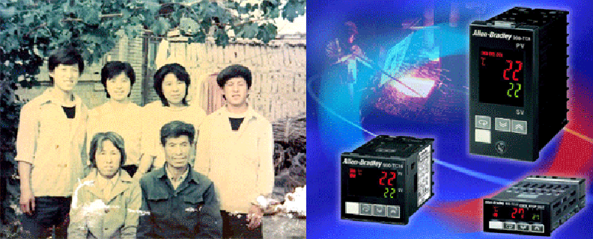
Family Resemblance
Chen Family
Allan Bradley Power Supply Product Family
47

Slide 48
Characteristic Features
Perceived degree of category membership has to do with which features help define the category
Members usually do not have ALL the necessary features, but have some subset
Those members that have more of the central features are seen as more central members
48

Slide 49
Gradience in Category Membership
Not all members of a category are equally good examples
The perceived centrality or typicality of category membership depends on the extent to which the most characteristic properties are shared
"Someone says to me 'Show the children a game.' I teach them gaming with dice, and the other says 'I didn't mean that kind of game.' " (Wittgenstein)
49

Slide 50
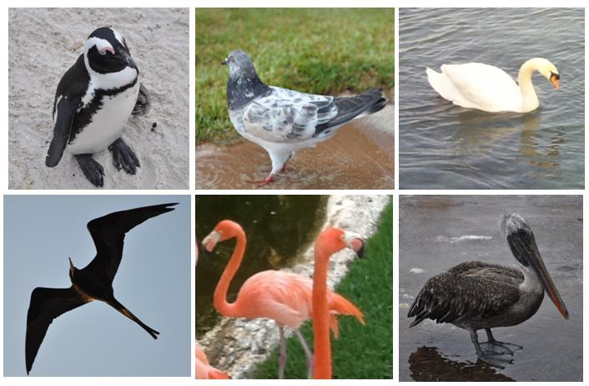
Gradience in Category Membership
Which bird is most typical of the category?
50

Slide 51
Similarity
It is easy to say that we can create categories on the basis of resource similarity
But some people say that similarity is a meaningless and "mostly vacuous" concept because there must always be some unstated set of properties, and if we identify the properties and how they are used, a "similarity" mechanism has nothing to do
51

Slide 52
Theory-Based Categories
Sometimes a category is defined because of a theory of causation or capability that explains why some collection of things go together
A good theory can "trump" similarity or family resemblance based on surface properties
52

Slide 53
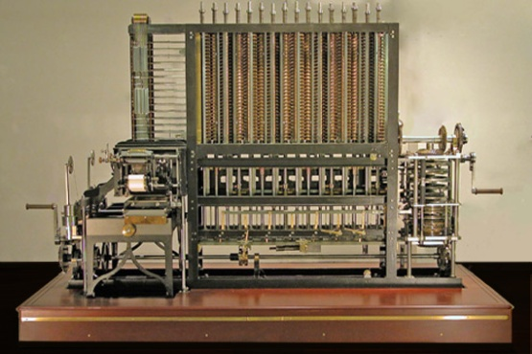
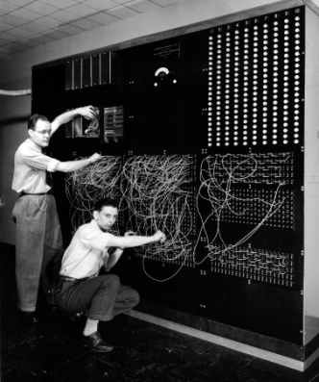
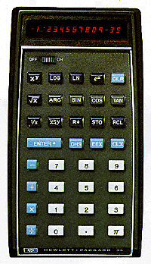
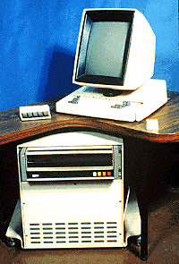
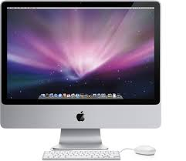
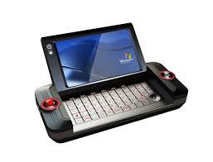
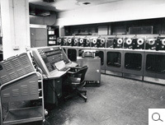
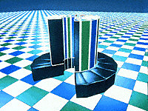
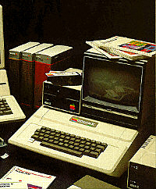
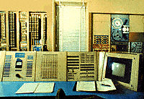
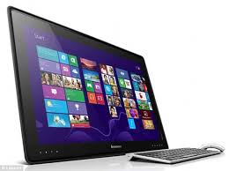
Theory-Based Category: Computer
Category of "computer" is based on being able to compute
53

Slide 54
Goal-Derived Categories
Imagine you are in a city about to be hit by a hurricane and you have 10 minutes to take any of your possessions and evacuate. How do you define the category of what to take?
You might have a set of properties, but they are not likely to be ones that are easy to define: irreplaceable, priceless, sentimentally valuable, etc.
They have no discernable properties in common
Barsalou, Lawrence W. "Ad hoe categories." Memory & cognition 11, no. 3 (1983): 211-227.
54

Slide 55
Goal-Derived Personal Category?
55

Slide 56
Summary: Why Study Categorization?
Categorization is central to how we organize information and the world, and categories are involved whenever we communicate, analyze, predict, or classify
Whenever we design data structures, programming language class hierarchies, user or application interfaces, ...
Categorization is much messier than our computer systems and applications would like
But understanding how people (and each of us) categorize can help us design better systems and interfaces
56

Slide 57
Readings for Next Lecture
TDO 7 through 7.2
Tavris, Carol. How Psychiatry Went Crazy. Wall Street Journal, 17 May 2013
Hoyt, Clark. Semantic minefields. New York Times, 15 May 2010.
Prewitt, Kenneth. Fix the Census’ Archaic Racial Categories. New York Times, 21 August 2013.
Rosenthal, Arnon, Len Seligman, and Scott Renner. “From semantic integration to semantics management: case studies and a way forward.” ACM SIGMOD Record 33, no. 4 (2004): 44-50.
57

