Slide 1
Plan for Today’s Lecture(s)
Introduction to Classification
Classification is Purposeful, Principled, and Biased
Classification and Standardization
MITRE Standards Reference Model
1

Slide 2
INFO 202 “Information Organization & Retrieval” Fall 2014
UNIVERSITY OF CALIFORNIA, BERKELEY
SCHOOL OF INFORMATION
Robert J. Glushko glushko@berkeley.edu
@rjglushko
29 October 2014 Lecture 16.1 – Introduction to Classification

Slide 3
What is Classification?
"Classification is a higher order thinking skill requiring the fusion of the naturalist's eye for relationships...
...with the logician's desire for structured order...
...the mathematician's compulsion to achieve consistent, predictable results...
...and the linguist's interest in explicit and tacit expressions of meaning“
-- Louise Gruenberg, "Faceted Classification, Facet Analysis and the Web“
3

Slide 4
Distinguishing Categorization and Classification
Categories are EQUIVALENCE CLASSES - sets of resources, processes, and events that we treat the same
A Classification (noun) is a SYSTEM OF CATEGORIES, ordered according to a PRE-DETERMINED SET OF PRINCIPLES and used to organize a collection of resources
Classification (verb) is the process of systematically assigning resources to intentional (often institutional) categories in a classification system
4

Slide 5
Classification Schemes (1)
A CLASSIFICATION SCHEME follows one or more organizing principles
An ENUMERATIVE scheme itemizes all possible categories to which resources can be assigned (into one and only one of the categories)
5

Slide 6
Classification Schemes (2)
A HIERARCHICAL or TAXONOMIC scheme emerges when multiple resource properties are used by organizing principles; each property creates another level
A scheme can be both HIERARCHICAL and ENUMERATIVE at the lowest level where resources are categorized
A FACETED classification scheme uses multiple resource properties, but does not require every resource to have a value for every property and allows the properties to be considered in any order
6

Slide 7
INFO 202 “Information Organization & Retrieval” Fall 2014
UNIVERSITY OF CALIFORNIA, BERKELEY
SCHOOL OF INFORMATION
Robert J. Glushko glushko@berkeley.edu
@rjglushko
29 October 2014 Lecture 16.2 – Classification is Purposeful, Principled, and Biased

Slide 8
Classification Is Purposeful
Classifications arrange resources to provide structure for and increase the precision of interactions in organizing systems
Classifications are essential in useful work
They serve as a reference model (a semantic road map) to individual domains and the relationships among them to help people understand the concepts and relationships
8

Slide 9
Classification and Interactions
Effective user interfaces to physical or digital systems present and reinforce the logical classifications embodied in the system
… while poor user interfaces don’t
Standard classifications for products and business services make it easier to discover suitable resources and integrate them into your own processes
With physical resources, activity-based classification makes co-location more useful
9

Slide 10
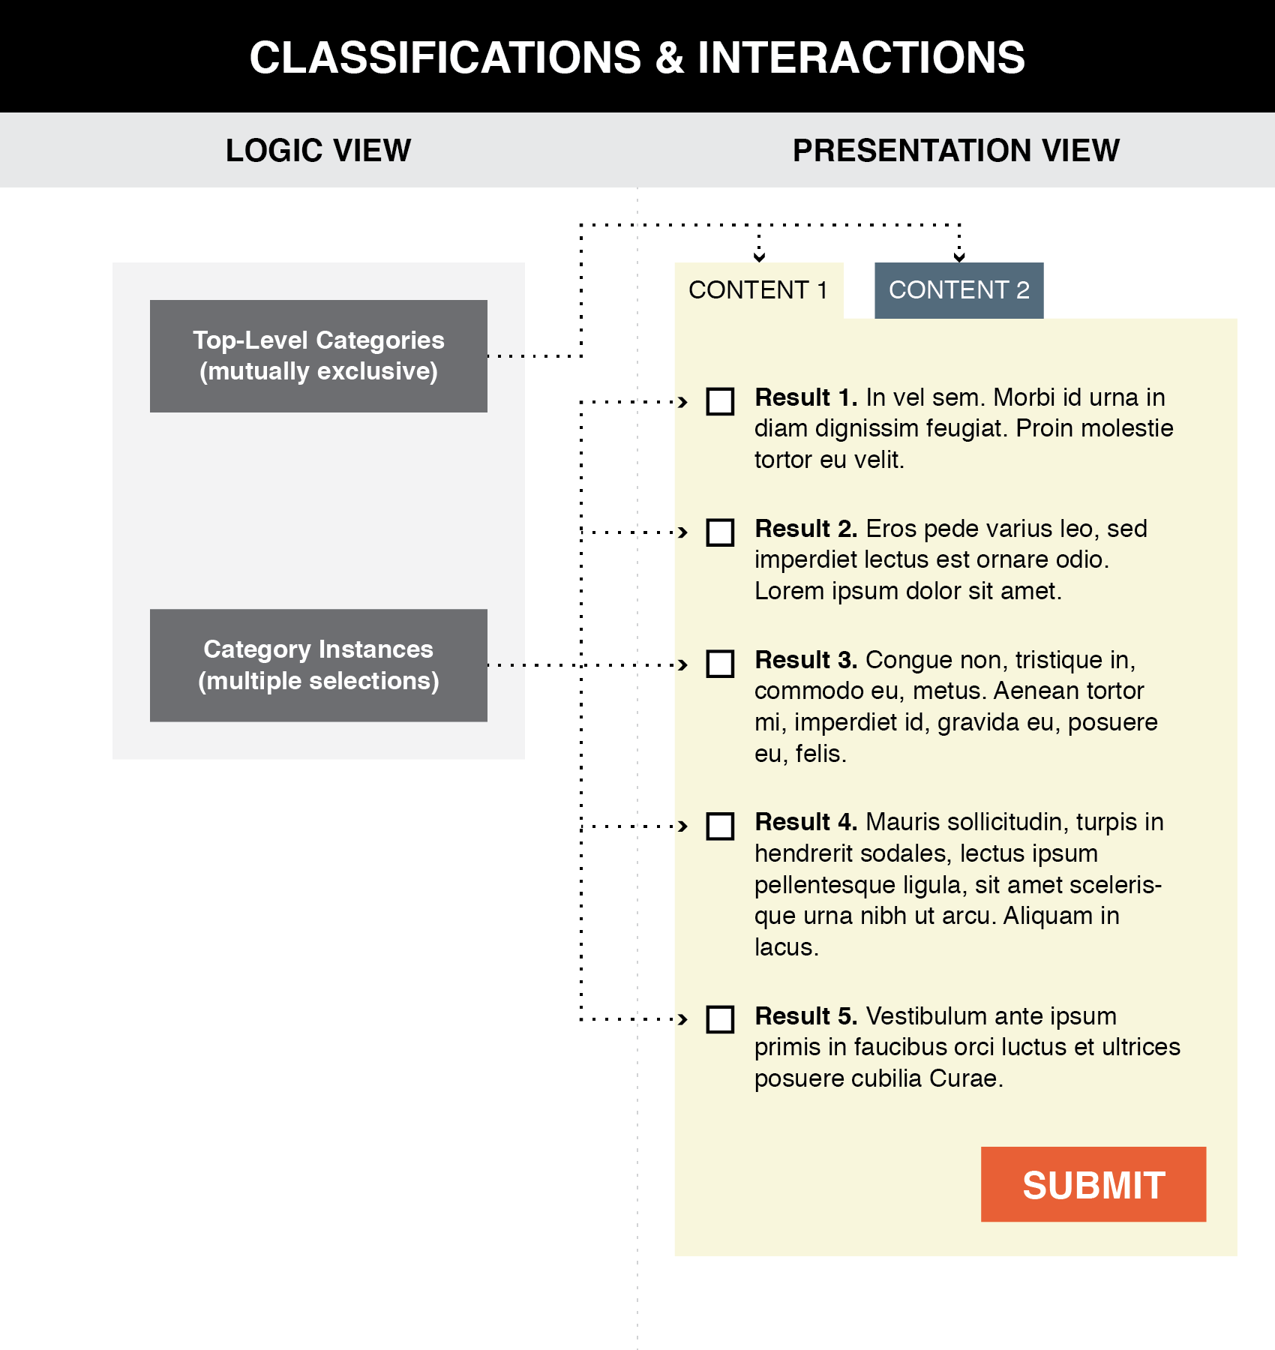
Good user interface design creates a clear mapping between a classification scheme and the arrangements and interactions that users see (TDO, Figure 7.1)
10

Slide 11
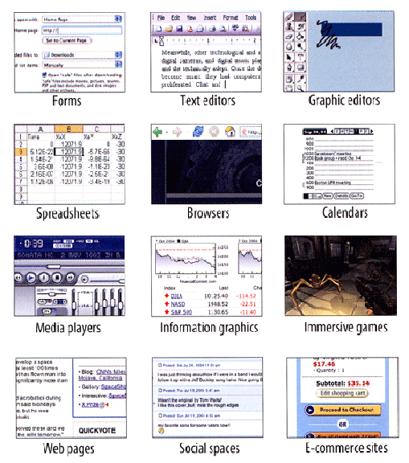
User Interface Design Idioms
Flashback to 17 September
Tidwell, Jenifer.
Designing Interfaces: Patterns for Effective Interaction Design
www.amazon.com/dp/1449379702
11

Slide 12
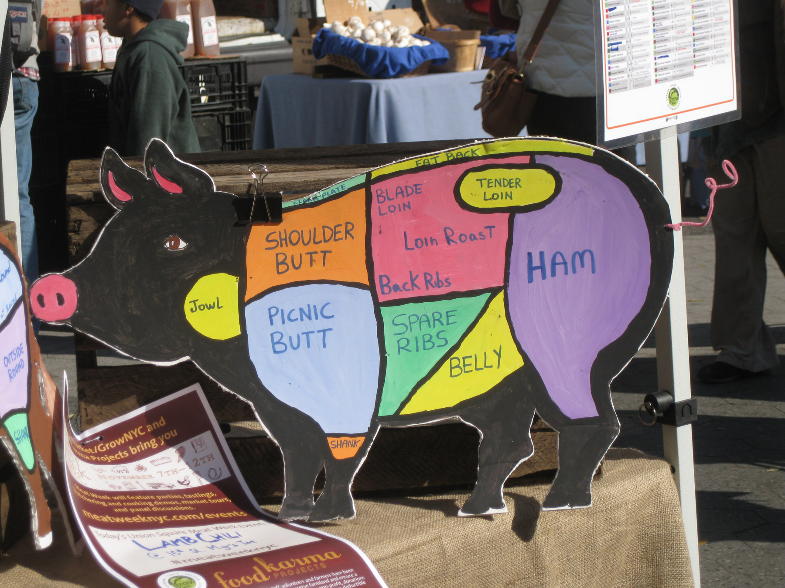
Clear Communication of a Classification Scheme
Photo taken by Bob Glushko at Union Square Greenmarket, NYC

Slide 13
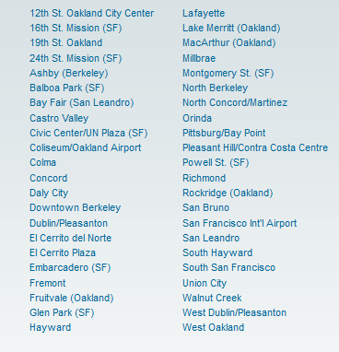
Poor Communication of a Classification Scheme
BART Station List
Better Might Be Something Like…
San Francisco
Embarcadero
Montgomery
Powell
Civic Center
…
Oakland
West Oakland
12 Street
19 Street
MacArthur
Rockridge
…
Berkeley
Ashby
Berkeley Downtown
Berkeley North

Slide 14
Classification is “Principled”
The principles for defining categories (enumeration, properties, similarity, family resemblance, etc.) are embodied in the classifications that use these principles
But the emergent classification system follows other principles about its purposes, scope, scale, intended lifetime, extensibility, and other considerations
Being "principled" means that these design choices are made they should be consistently followed
14

Slide 15
Principles Embodied in the Classification Scheme
Warrant: What is the justification for the choice of categories and their names?
Literary Warrant: Classify only the resources we have?
Scientific Warrant: Use expert categories and names
Use Warrant: Use categories and names from “ordinary” people
Breadth and depth of classification hierarchy
Degree of enumerativeness
15

Slide 16
Hierarchy and Uniqueness Principles
Deeply engrained in our intellectual and physical worlds
Hierarchy: Each category is successively divided into smaller subdivisions according to a feature or property
Uniqueness: Every resource is classified in only one subdivision
16

Slide 17
The "One and Only One Place" Rule
If each resource goes in one and only one category it won't always be easy to decide what description or property determines the categorization
For example, a book's title is often a clue to the subject, but should never be the only thing analyzed
Who Moved My Cheese? is a work on coping with change, not a work related to the culinary arts
Should Leaves of Grass be assigned to the "Gardening" category?
17

Slide 18
Principles for Maintaining the Classification
Lifetime management
Category integrity: Classify once and for all, or change categories and assignments as we learn?
How can a classification have Flexibility / extensibility / hospitality?
18

Slide 19
"Principled" Maybe ... But Every Classification is "Biased"
Every classification is arbitrary to some extent because the criteria used to establish the categories reflect a point of view or perspective on the domain that intentionally excludes all other perspectives
There is no "one true way" about how things go together
Every classification system implicitly or explicitly distinguishes between "good" or "standard" and "bad" or "nonstandard" ways of understanding things
Borges: “there is no classification of the Universe that is not arbitrary and full of conjectures”
19

Slide 20
Classification Biases
Natural vs. man-made disaster?
Welfare vs. entitlement?
Taxes vs. government investments?
Illegal vs. undocumented immigrants?
Coup or regime change?
Dietary supplement vs. beverage?
Employee vs. contractor, full vs. part time?
Unemployed
20

Slide 21
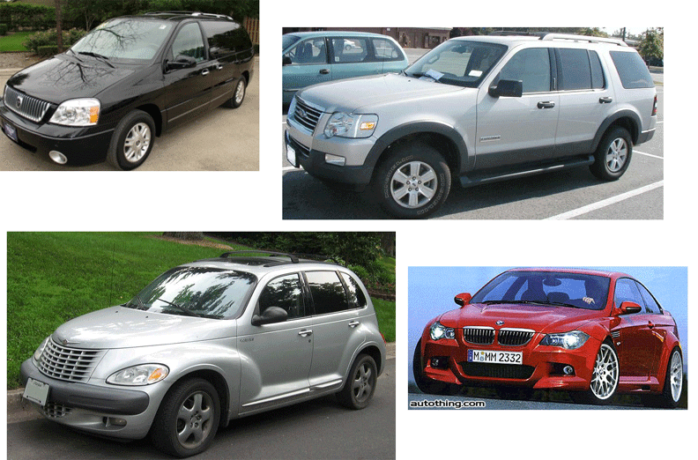
CAFE Categories: Find the Truck(s)
21

Slide 22
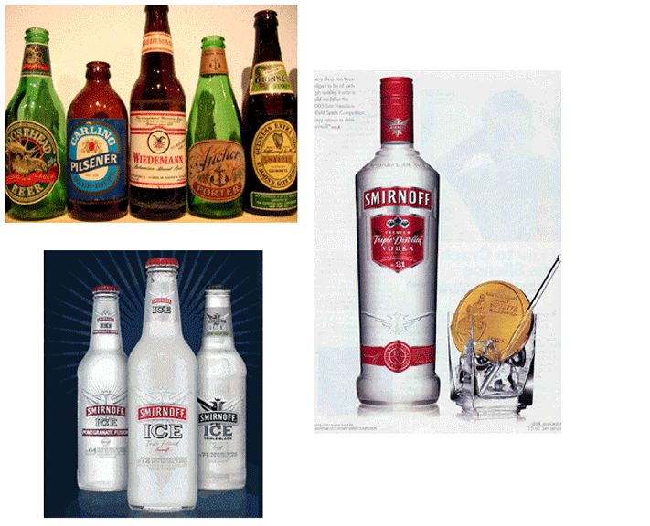
Beverage Categories: Find the Beer
22

Slide 23
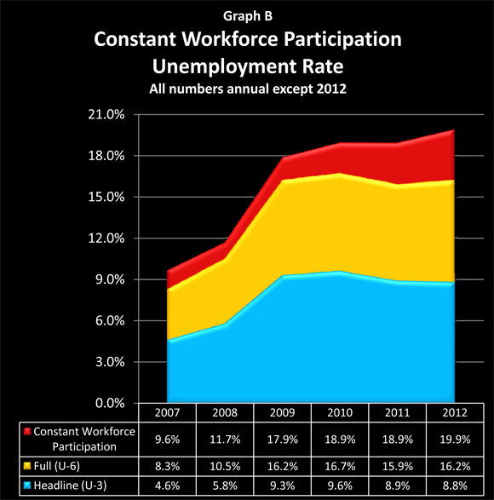
Making 9 Million Jobless People Vanish
When you give up looking for a job, you’re not unemployed
23

Slide 24
INFO 202 “Information Organization & Retrieval” Fall 2014
UNIVERSITY OF CALIFORNIA, BERKELEY
SCHOOL OF INFORMATION
Robert J. Glushko glushko@berkeley.edu
@rjglushko
29 October 2014 Lecture 16.3 – Classification and Standardization

Slide 25
Classification and Standardization (1)
Classifications and standards both impose order on resources
They both distinguish, explicitly or implicitly, between standard / appropriate / effective and nonstandard / inappropriate / ineffective ways of creating organizing, and using resources
But this does not imply that a standard is a good one or that the best one will win a "standards war"
25

Slide 26
Classification and Standardization (2)
Some classifications become standards
Every successful standard imposes a classification system
Standards and classification systems can have significant inertia, becoming part of the "installed base" or "infrastructure" and difficult to change
26

Slide 27
"Specifications"
A specification is an explicit and detailed description about how something (a product, system, service, or practice) works that might include:
the definitions of the key concepts or terms used in the description
the materials from which it is made
the components (tangible or intangible) that are arranged or assembled to make it work
the methods or processes by which it operates
the inputs and outputs for each method or process
27

Slide 28
"Standards"
A standard is a published specification that is developed and maintained by consensus of all the relevant stakeholders in some domain
following a defined and transparent process
usually under the auspices of a dedicated organization with the authority to create standards
The rigor and transparency of the process by which a standard is created is essential to its legitimacy
Some governments or other large procurers or products of systems require that they be based on these "de jure" standards
28

Slide 29
Why Standards Exist (1)
Standards serve as a coordinating mechanism whenever there are alternative ways of doing or making something that might be incompatible or that otherwise wouldn't be possible
Standards can also serve as a regulating mechanism to restrict behavior or operation that might be unsafe, unfair, or otherwise "harmful“
29

Slide 30
Why Standards Exist (2)
Many standards define technical specifications and procedures to ensure a "common design" or "interoperability"-- TDO calls these "institutional semantics"
Standards define institutional categories about models, behaviors, or processes - TDO calls these "institutional taxonomies" (like the UNSPSC)
30

Slide 31
Who Sets Standards? (1)
Some technical standards are set by governments in order to protect the public interest
Other standards are set by organizations created precisely for the purpose of setting standards
Other standards are set by groups of companies who may or may not establish an ongoing organization and governance procedures to maintain and extend a standards "family" around the initial standard
31

Slide 32
Who Sets Standards? (2)
Other "standards" begin as proprietary vendor specifications that will become "de facto" standards if they are widely adopted and achieve market dominance
Often "de facto" standards are submitted to a standards organization with the goal of "rubber stamping" them as "de jure" ones
32

Slide 33
Standards and Metcalfe's Law
Standards are especially important in industries or domains that have significant "network effects" where the value of a product or service depends on the number of interoperable or compatible ones
These contexts are sometimes called "winner take all" markets, which is why standards wars take place - because of the economic implications
How do you encourage and enable others to conform to a standard?
33

Slide 34
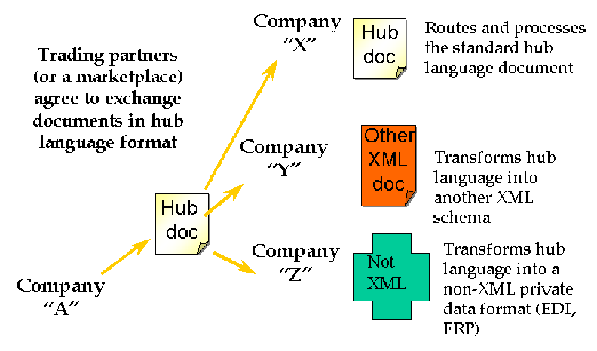
Interchange / Hub Languages
34

Slide 35
Mapping in and out of Hub Language
If all parties/applications/services rely on a hub language for their external interfaces, an exponential interoperability challenge becomes a linear one
Mapping tools for transforming instances from an internal information model to another one are ubiquitous as standalone tools and as parts of application servers
EXAMPLE: Altova MapForce
35

Slide 36
Using Standards in Organizing Systems
You may be required by the government, by your customers, or by "business partners" to conform to some organizing standards
But to the extent that standards embody best practices, it is a good idea to follow them anyway
36

Slide 37
Standards for Document Description in Organizing Systems (1)
For specific vocabularies or "domain-specific languages" (e.g., HTML, UBL, SPL, DocBook, DITA, EPUB, SVG)
For schema languages that formally define the domain-specific languages (e.g., XSD)
For "profiles" that suggest modeling practices like degree of abstraction and granularity, or constrain the possible values for some descriptor
For the metalanguages used to encode the DSLs and schema languages (e.g., XML, SGML)
37

Slide 38
Standards for Document Description in Organizing Systems (2)
For the construction of file and document names
For identifying resources and namespaces
For specifying versions, stages or revisions of documents or other resources
38

Slide 39
Other Standards for Organizing Systems
Metadata standards (MARC, Dublin Core, EAD, METS, RDF, OWL)
Standards for classification (LoC, DD, BISAC)
Standards for thesaurus construction
Standards for processes (WS-*)
Standards for communication protocols
39

Slide 40
INFO 202 “Information Organization & Retrieval” Fall 2014
UNIVERSITY OF CALIFORNIA, BERKELEY
SCHOOL OF INFORMATION
Robert J. Glushko glushko@berkeley.edu
@rjglushko
29 October 2014 Lecture 16.4 – MITRE Reference Model for Understanding and Comparing Standards

Slide 41
MITRE Reference Model for Understanding and Comparing Standards
"We need to proactively produce new areas of useful semantic agreement, and not simply document correspondences among existing systems"
"An approach to semantics management must tolerate organizational realities that are often ignored“
Rosenthal, A., Seligman, L., and Renner, S. 2004. From semantic integration to semantics management: case studies and a way forward. SIGMOD Rec. 33, 4 (Dec. 2004), 44-50
41

Slide 42
Lessons From Standards Making: The "Person-Concept" Tradeoff
Semantic agreement comes at a cost driven by the number of people who require a shared understanding, and by the number of concepts they must all understand
So a small set of people can agree on a complex standard, or a large set of people can agree on a simple one
…especially when participants are just trying to agree on how to describe pre-existing shared concepts rather than having to define them first
42

Slide 43
Lessons from Standards Making: Incentives and Disincentives
Approaches that require perfect coordination and altruism are of no practical interest
Disincentives to agree on semantics arise if agreement means that someone has to change an implementation and pay the cost of doing so
Model-driven development tools that generate needed software artifacts (e.g., system and user interfaces) from specifications can encourage standards adoption by reducing the transition costs
43

Slide 44
MITRE Reference Model for Comparing Standards: Data Objects
What is the semantic granularity of the concepts being standardized?
Is there also a standard for how the concepts are encoding in some syntactic or physical representation?
Does the standard also specify "instance sets" or possible values for each data element concept?
44

Slide 45
MITRE Reference Model for Comparing Standards: Structures
In addition to standards for data objects, are there standards for schemas or "document architectures" that structurally organize them?
Are there standards for the instances or interchange formats used by publishers/producers or expected by subscribers/consumers?
45

Slide 46
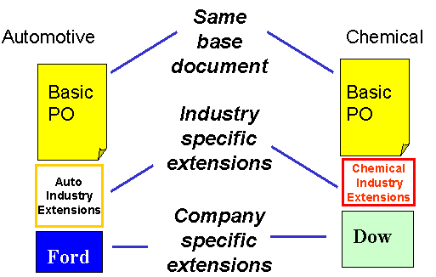
Horizontal and Vertical Document Components
46

Slide 47
The Universal Business Language (UBL)
Over 100 document types built using core components and a common architecture/metamodel needed for supply chains (European) and International Trade (Asia and US), collaborative planning, forecasting, and replenishment; vendor managed inventory; intermodal freight management; and utility billing
These document types use a library of XML schemas for reusable aggregate data components such as "Address," "Item," and "Payment“
47

Slide 48
MITRE Reference Model for Comparing Standards: Community Characteristics
Is there a primary stakeholder with decision making authority, or is authority distributed?
What are participants' obligations to support the standard?
Do the participants already share an understand of the domain to be standardized?
48

Slide 49
Lessons from Standards Making: Enterprise Data Standards
Standards-making can be successful when a "single authority exercises effective control over the system requirements, funding, the developers, and the users"
But a very large enterprise cannot hope to construct a single data model (or even a single-set of universally understood concept definitions) for all the data it requires
49

Slide 50
Lessons from Standards Making: "Communities of Interest"
Standards making is best organized around naturally formed communities of interest rather than "org chart" organizations
Different types of communities might be needed to develop, deploy, and maintain a standard
50

Slide 51
Readings for Next Lecture
TDO rest of chapter 7
Recommended: Don Norman on activity-centered design
51

