Slide 1
INFO 202 “Information Organization & Retrieval” Fall 2015
UNIVERSITY OF CALIFORNIA, BERKELEY
SCHOOL OF INFORMATION
Robert J. Glushko glushko@berkeley.edu
@rjglushko
26 August 2015 Lecture 1.1 – Course Introduction

Slide 2
Outline
Course Introduction
Motivating the “Organizing System”
Definitions for Organizing Systems
Organizing Organizing Systems
The Design Dimensions
Course Administrivia

Slide 3
Introductions
Bob Glushko
The 5 Teaching Assistants (Class of 2016):
Laura Desmond-Black
Daniel Griffin
Emily Paul
Jordan Shedlock
Vijay Velagapudi
The Students
3

Slide 4
The Course In One Two Slides (1)
“Organizing” is a fundamental activity in many disciplines, but the disciplines don't agree much in how they describe problems of organizing and in what they see as solutions.
We organize things, we organize information, we organize information about things, and we organize information about information.
We can see commonalities here that outweigh the differences:
An Organizing System is an intentionally arranged collection of resources and the interactions they support.
4

Slide 5
The Course In One Two Slides (2)
We organize resources as individuals, in informal association with other individuals, or as part of a more formal institutional or business context
The methods and mechanisms we use to organize, and the tradeoffs we make, vary systematically in these different domains and contexts
We must recognize the profound impact of new technologies and their co-evolution with the nature of the organizing we do and the kinds of interactions that this organizing enables, but can't ignore the "classical" concepts and knowledge
We also need to be skeptical of new information technology because it doesn't automatically solve all of our organizing problems; we need to think architecturally, and not focus on implementations
5

Slide 6
Why This Course Exists
INFO 202 has been the "gateway course" in this program since the day it began
The course builds the foundation for much of your I School experience
It introduces the intellectual foundations and vocabulary for students with heterogeneous backgrounds
6

Slide 7
Why This Course Is Challenging and Essential
We deal with deep intellectual issues that have challenged deep thinkers for millennia
You must make the transition from studying information and its organization IN a discipline to studying them AS a discipline
You must learn to look past the presentation / technology reification / thingness of information and organizing to see it more abstractly as meaning and structure
The diversity of perspectives and backgrounds in your class will be one of the challenges in this course and one of its best characteristics
7

Slide 8
INFO 202 “Information Organization & Retrieval” Fall 2015
UNIVERSITY OF CALIFORNIA, BERKELEY
SCHOOL OF INFORMATION
Robert J. Glushko glushko@berkeley.edu
@rjglushko
26 August 2015 Lecture 1.2 – Motivating the “Organizing System”

Slide 9
Everything is Organized
In our daily lives organizing is a fundamental cognitive activity that we often do without thinking much about it
It is also an important part of most business and professional activities
Organizing in any context can be more effective and satisfying if we are more self-aware and systematic about how we organize
9

Slide 10
Bob’s Garage
10

Slide 11
We Organize…
Libraries, museums, business information systems, scientific data… and other institutional resource collections
Different types of documents – from narrative to transactional – which have characteristic content, structures, and presentations
Personal information and artifacts of all kinds in our kitchens, closets, personal computers, smartphones…
11

Slide 12
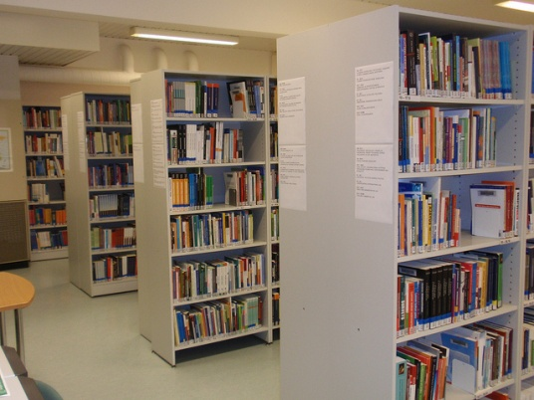
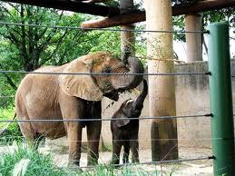
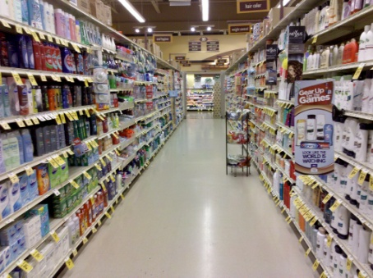
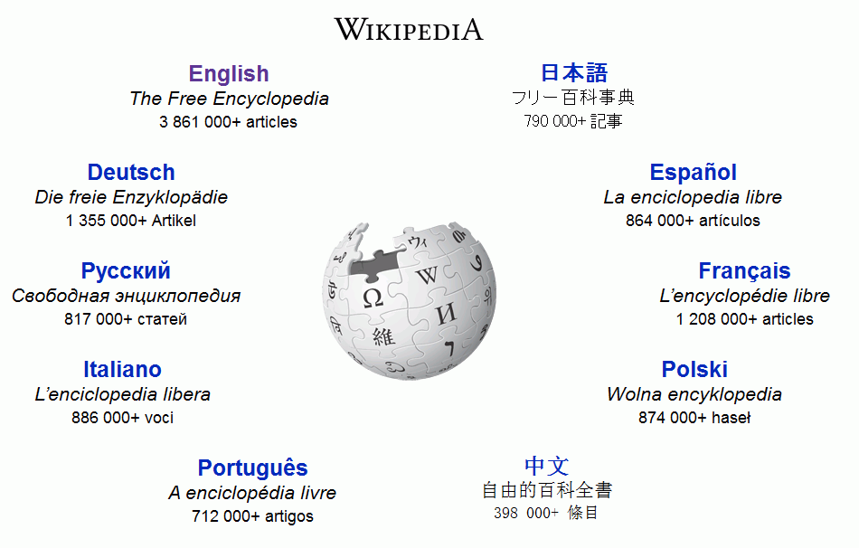
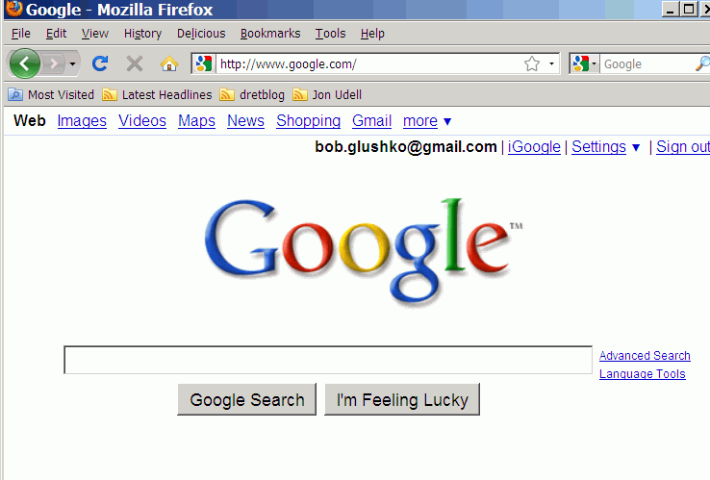
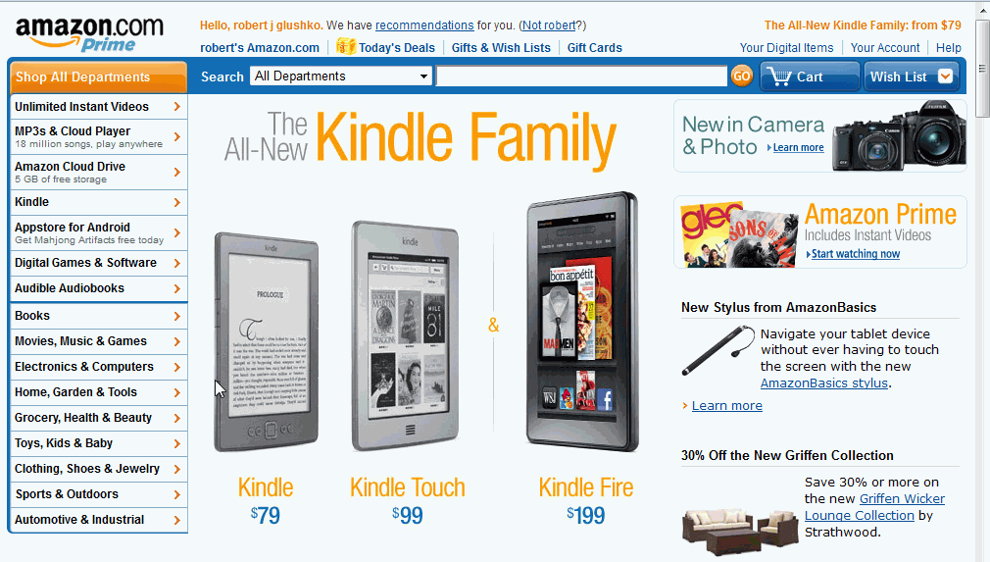
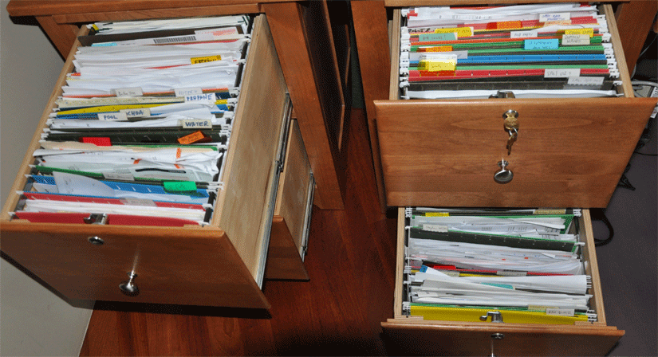
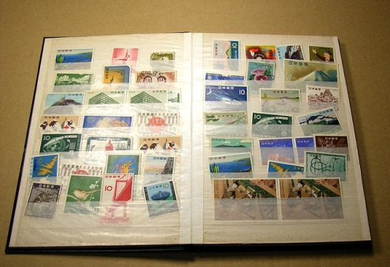
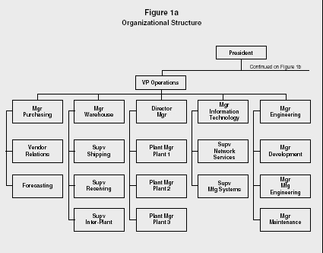
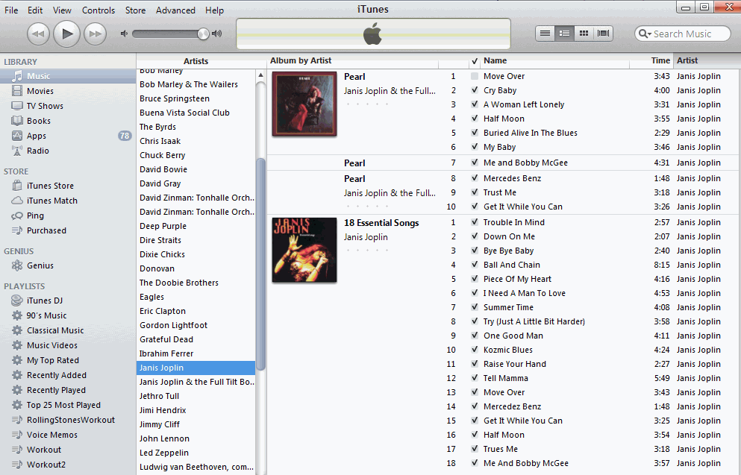
12

Slide 13
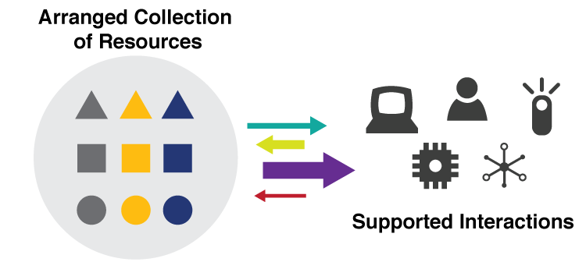
They are all “Organizing Systems”
A collection of resources intentionally arranged to enable some set of interactions
13

Slide 14
INFO 202 “Information Organization & Retrieval” Fall 2015
UNIVERSITY OF CALIFORNIA, BERKELEY
SCHOOL OF INFORMATION
Robert J. Glushko glushko@berkeley.edu
@rjglushko
26 August 2015 Lecture 1.3 – Definitions for Organizing Systems

Slide 15
Key Concepts [1]
RESOURCES are “anything of value that can support goal-oriented activity”
Case Studies for Today
Multigenerational photo collection
Single-source textbook publishing
Earth orbiting satellites
15

Slide 16
Resources On the Web: Universal Resource Identifiers (URIs)
http://people.ischool.berkeley.edu/~glushko/
https://bcourses.berkeley.edu/courses/1360852
https://en.wikipedia.org/wiki/Uniform_resource_identifier#Examples_of_URI_references
16

Slide 17
Resources in the Library
17

Slide 18
Resources in the Zoo
18

Slide 19
Resources in the Vineyard
19

Slide 20
Key Concepts [2]
INTENTIONAL ARRANGEMENT captures the idea that the system requires explicit or implicit acts of organization by AGENTS – human or computational ones
If the organization isn’t intentional, we can’t reuse or recreate it with our own efforts
The agents might also organize themselves in a bottom-up or “collective intelligence” fashion, especially human agents
20

Slide 21
Bottom-Up Organizing
21

Slide 22
Bottom-Up Organizing
22

Slide 23
Organizing Principles [1]
The resource arrangements follow one or more ORGANIZING PRINCIPLES, ideally expressed in an implementation-neutral way
ORGANIZING PRINCIPLES use properties or DESCRIPTIONS that are associated with the resources; organizing and describing resources are inherently interconnected activities
Almost any property of a resource might be used as a basis for an organizing principle, and multiple properties are often used simultaneously
23

Slide 24
Organizing Principles [2]
For physical resources the properties are often perceptual, material ones, or task-oriented ones
For information resources the properties are often semantic ones
Some principles are domain-specific, but others can apply generally
Properties can be computed or inferred (data science techniques)
24

Slide 25
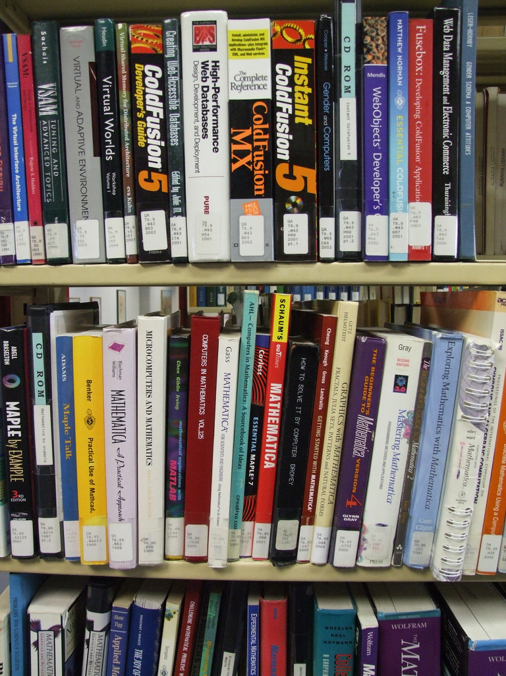
Organizing Books
By Content
(LOC Classification)
Photo by Jeffrey Beall (http://www.flickr.com/photos/denverjeffrey/304220561) Creative Commons CC BY-ND 2.0

Slide 26
Organizing Spices by Cuisine
26

Slide 27
Organizing Principles [3]
Other typical arrangements are based on ownership, origin, taxonomic, or “taskonomic” or behavioral properties (usage frequency, correlated usage)
Any resource with a orderable name or identifier can have alphabetic or numeric ordering
Any resource with an associated date (creation, acquisition) can have chronological ordering
Principles should be expressed logically in a way that doesn’t assume an implementation
27

Slide 28
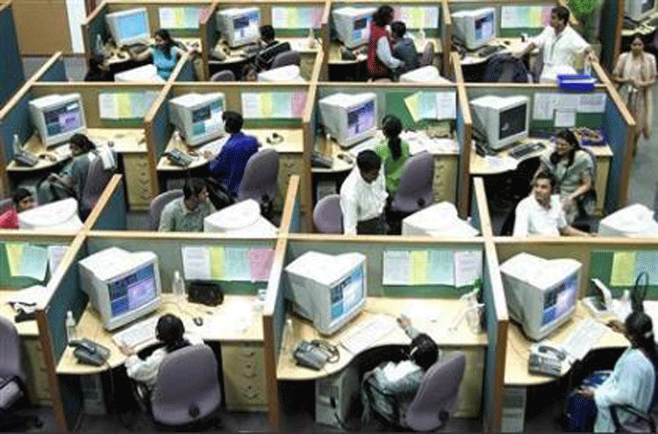
Organizing People by Work Role
28

Slide 29
Organizing People by Family, Religion, Class, Race, Year of Death…

Slide 30
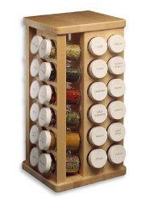
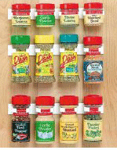
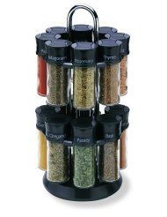
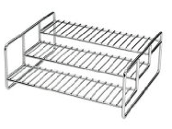
Principles don’t Specify Implementation: “Organize Spices Alphabetically”
THINK ARCHITECTURALLY!
30

Slide 31
INFO 202 “Information Organization & Retrieval” Fall 2015
Robert J. Glushko glushko@berkeley.edu
@rjglushko
26 August 2015 Lecture 1.4 – Organizing Organizing Systems

Slide 32
Organizing Organizing Systems
We can classify organizing systems by:
resource type
dominant purpose
creator
size of intended user community
or many other ways
32

Slide 33
Categorizing by Resource Type
Organizing Systems
Collections of Books
(Libraries)
Collections of Art
(Museum)
Collections of Documents
(Archive)
Collections of Data
(Repository)
Collections of Spices (Pantry) …
33

Slide 34
Categorizing by Purpose: Resource Preservation as Means vs. End
Organizing Systems
Memory Institutions
Libraries
Museums
Business Info Systems
Content Management
Archives
CRM
ERP
34

Slide 35
What Is A Library?
A collection of resources
Organized to enable “access” and “reuse”
Curated for “public good” and “community creation”
Conventional interaction is “circulation” – borrowing and return of resources…
35

Slide 36
A Library
36

Slide 37
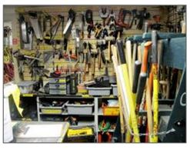
A Library?
37

Slide 38
A Library?
38

Slide 39
A Library?
39

Slide 40
Consequences of Category Thinking
Many types of resource collections have conventional characteristics that are deeply embedded in cultural and linguistic categories
Using an established category to describe an organizing system reinforces these characteristics, even if we add qualifiers
… and marginalizes any atypical characteristics of the organizing system being categorized
40

Slide 41
A “Design Space” or “Dimensional” Perspective
In addition to using categories like Library or Museum or Business Information System, consider a specific organizing system as a point in a multidimensional design space and these categories as regions in that space...
This treats the familiar categories as “design patterns” that embody typical configurations of design choices
41

Slide 42
Consequences of Dimensional Thinking
Overcomes the bias and conservatism inherent in familiar categories
Design patterns support multi-disciplinary work that cuts across familiar categories and applies knowledge about them to new domains
Creates a design vocabulary for translating concepts and concerns from category and discipline-specific vocabularies
42

Slide 43
The 6 Dimensions of an Organizing System
What Is Being Organized?
Why Is It Being Organized?
How Much Is It Being Organized?
When Is It Being Organized?
Who (or What) is Organizing It?
Where is it Organized?
43

Slide 44
INFO 202 “Information Organization & Retrieval” Fall 2015
UNIVERSITY OF CALIFORNIA, BERKELEY
SCHOOL OF INFORMATION
Robert J. Glushko glushko@berkeley.edu
@rjglushko
26 August 2015 Lecture 1.5 – The Design Dimensions

Slide 45
1. What Is Being Organized?
Identifying the unit of analysis is a central problem in every intellectual or scientific discipline - and in every organizing system
Resources that are aggregates or composites of other resources, or that have internal structure, or that can have many attributes, pose questions about the granularity of their "thingness”
45

Slide 46
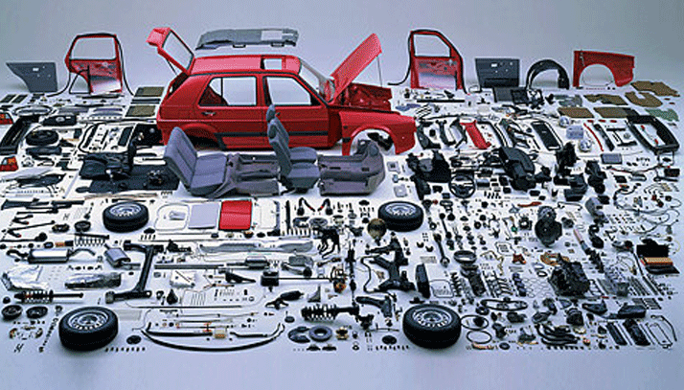
How Many Things is a Car?
When you build it? When you sell it?
When you repair it?

Slide 47
“Thing” vs. “Type of Thing”
We often blur the distinction between individual things (or instances of things) and classes of things
We say that that two objects are the "same thing" when we mean they are the same "type of thing“
Identifying a resource as an instance is not the same as identifying the category or "equivalence class" to which it belongs
47

Slide 48
“Shamu” -- Instance or Type?
48

Slide 49
Describing and Organizing Classes of Things
Categories are sets or groups of resources, “classes of things” or abstract entities, that are treated the same
Many categories are embodied in culture and language and have imprecise / flexible boundaries
Some categories are explicitly constructed to create a precise semantic model of a domain cultural system
49

Slide 50
Specifying Meaning Explicitly
By Reference or Enumeration
Definition
Definition in a controlled vocabulary
Data types
Metadata
Metamodels
Formal assertions
Ontologies and thesauri
50

Slide 51
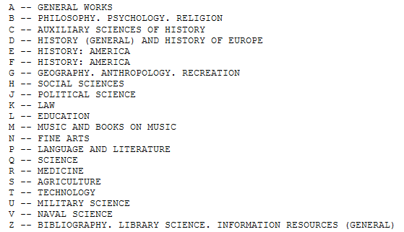
Library of Congress Classification
51

Slide 52
Institutional != Unbiased
Creating institutional categories by more systematic processes than cultural or individual categories does not prevent them from being biased
Indeed, the goal of institutional categories is often to impose or incentivize biases in interpretation or behavior
52

Slide 53
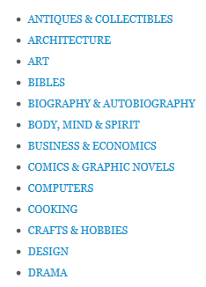
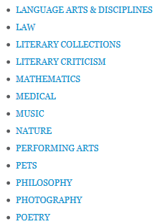
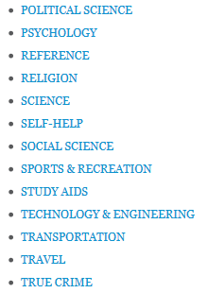
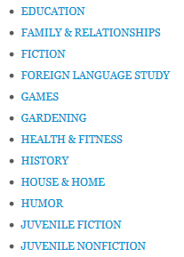
Top Level BISAC Categories … the “Dewey Dilemma”
53

Slide 54
Design Choices & Patterns for Resources
54

Slide 55
Resource Focus
We often designate some resource as primary because it is the focus of our attention
We often create other resources that are descriptions of or otherwise associated with the primary resource
We call these “Description resources” (a more general term than “metadata”)
55

Slide 56
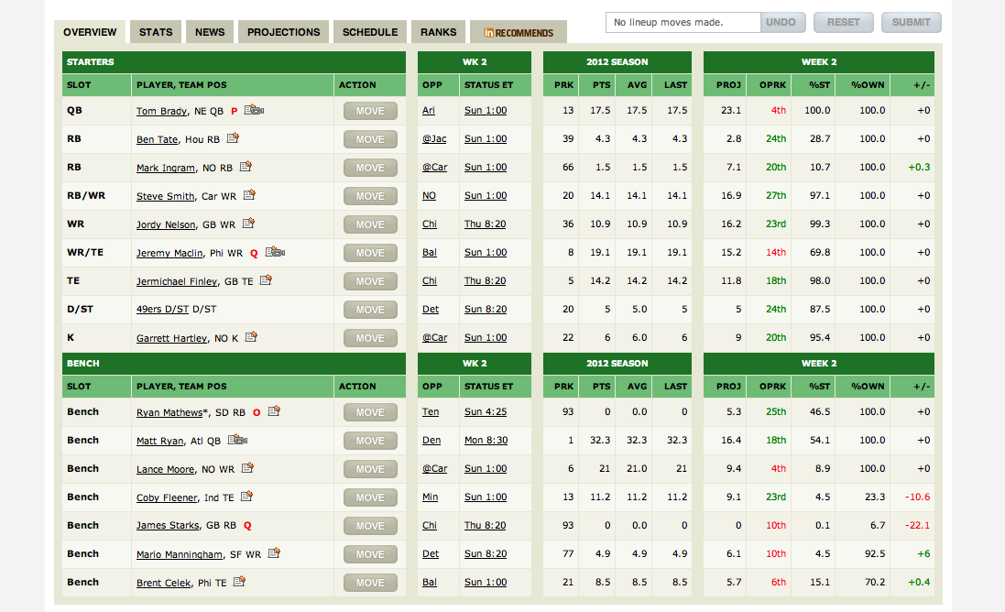
Fantasy Football: One Person’s Description is another Person’s Resource
56

Slide 57
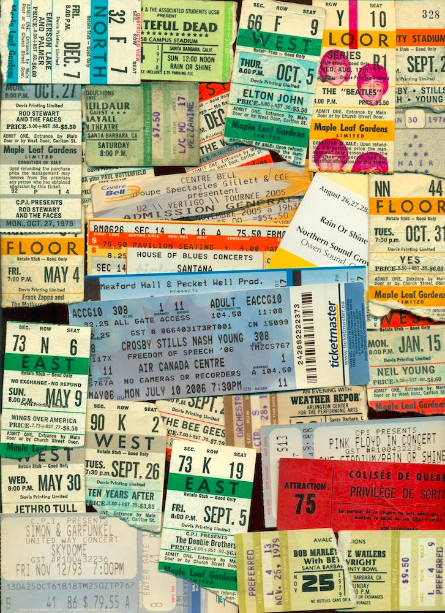
A Ticket is a Resource and a Description Resource at the Same Time
57

Slide 58
2. Why Is It Being Organized?
The essential purpose of every Organizing System is to "bring like things together and differentiating among them” – enabling generic requirements of resource discovery, identification, access…
But there are always more precise requirements and constraints to satisfy and more specific kinds of interactions to support
Different stakeholders might not agree on these requirements, making it necessary to use multiple and possibly incompatible resource descriptions and organizing principles
58

Slide 59
Interactions –The Why of Organizing Systems
INTERACTIONS include any activity, function, or service supported by or enabled with respect to the resources in a collection or with respect the collection as a whole
Interactions can include access, reuse, copying, transforming, translating, comparing, combining, visualizing, recommending… anything that a person or process can do with the resources…
59

Slide 60
Interactions
Some interactions can be enabled with any type of resource, while others are tied to resource types
The supported interactions depend on the nature and extent of the resource descriptions and arrangement
Finding the optimal descriptions is an important goal but not always possible
60

Slide 61
Description is Challenging
People use different words for the same things, and the same words for different things - what would a "good" description be like, and how can it be created?
Describing and organizing always (explicitly or implicitly) takes place in some context
The context shapes which resource properties are important and the organizing principles that use those properties, introducing bias
61

Slide 62
The Vocabulary Problem
62

Slide 63
A DJ Organizes His Records – Beats per Minute
Photo by Matt Earp aka Kid kameleon
63

Slide 64
3. How Much Is It Being Organized?
Not everything is equally organizable, because not everything is equally describable
A controlled vocabulary can yield more consistent organization
Are you organizing the resources you have, or do you need to create an organizing system that can apply to resources that you have not yet collected?
The scope and size of a collection shapes how much it needs to be organized
Making resources “smart” increases how much they can be organized
64

Slide 65
4. When Is It Being Organized?
When the resource is created
When it is added to some collection
Just in time
Never
All the time - continuous or incremental
65

Slide 66
“Just in Case” Organization
66

Slide 67
Postponing Organization
67

Slide 68
5. Who or What Is Organizing?
Authors or creators
Professional organizers
Users “in the wild”
Users "in institutional contexts“
Automated or computerized processes
68

Slide 69
6. Where is it Organized?
Physical location is often a constraint or convenience; use of fixed locations for personal organization
Digital resources often have location-independent or irrelevance except…
Built environments / city plans are places, but are usually organizing people and their interactions rather than “the land”
69

Slide 70
INFO 202 “Information Organization & Retrieval” Fall 2015
UNIVERSITY OF CALIFORNIA, BERKELEY
SCHOOL OF INFORMATION
Robert J. Glushko glushko@berkeley.edu
@rjglushko
26 August 2015 Lecture 1.6 – Course Policies and Administrivia

Slide 71
Outline
Tour of the syllabus and bCourses
The Discipline of Organizing as book and ebook
Class participation
Sections
Assignments
Exams
Grading, Admonitions, Administrivia
Upcoming Readings
71

Slide 72
TDO
“The Discipline of Organizing” was published by MIT Press in May 2013 simultaneously in print and in ebook formats
Section 11.4 Case study
See also Glushko (2015)
Enhanced ebook editions were published by O’Reilly in August 2014, updated in August 2015

Slide 73
Tagged Content in TDO
Over 30% of the content in TDO has been factored out of the core and tagged by discipline, mostly as endnotes
In the “Professional Edition” TDO ebook, there are 11 discipline categories
In pdf version, you follow links to notes
In ebook version, they are “transcluded” in context
(In the “Core Concepts” edition, all of the notes are omitted)
73

Slide 74
The Disciplinary Mix of TDO
This illustration appears in the Preface to the 3rd edition
74

Slide 75
A Tour of the Syllabus
TDO was written to implement my model of how best to teach this course, so it is the foundation of the syllabus
But because TDO is targeted broadly at the ISchools, we need additional texts and readings to optimize the syllabus for Berkeley
REQUIRED BOOK: William Kent. Data and Reality (2012)
REQUIRED BOOK: Grant Ingersoll, Thomas Morton, & Andrew Farris. Taming Text (2013)
RECOMMENDED BOOK: Marti Hearst. Search User Interfaces (2009)
RECOMMENDED BOOK: R. Glushko & T. McGrath, Document Engineering (2005)
Readings come from library science, computer science, cognitive science, linguistics, philosophy, systems analysis, information architecture, business case studies
75

Slide 76
Class Participation
You are expected to have read the assigned readings before the class meets
You are expected to participate in class, in section, and in online contexts to demonstrate your reading and reflection
Everyone will need to demonstrate some participation in all three contexts, but we will enable you to distribute your participation somewhat according to your personal preferences
And to engage in less formal participation, tweet using #i202f15 like I often do
76

Slide 77
Sections
Are critically important because this class is just too big to allow the needed discussion
Sections will present and review the assignments, help you prepare for exams, and otherwise keep you on track in a very challenging course
Your section will become your tribe of fellow ISchoolers
Your TA is your pragmatic and spiritual guide to understanding the ISchool and 202
77

Slide 78
Assignments, Exams, Grading
Case Study Project (20%)
Other 6 Assignments (30%)
4 Exams (10% each, 40% total)
Choice of short answer questions
3 will be take home, 1-hour time limit
Last one will in be in class on 24 November
Class and section participation (10%)
Includes written “reflections” on weeks w/o assignments or exams
78

Slide 79
Academic and Personal Integrity
Unless otherwise instructed, homework assignments are to be completed independently and materials submitted as homework should be the result of your own work.
Exams are "open book," meaning that you can refer to the instructor's lecture notes, your notes, and anything in the course syllabus. But this is because you will be never be tested on simple facts, definitions, or anything else you can locate in a text somewhere. To copy text or ideas from another source without appropriate reference is PLAGIARISM. You will fail the assignment or exam and there might be further disciplinary action.
The TDO book is not copy-protected. This doesn’t mean it is free. You need to buy your own copy, and that helps pay students who work on it.
79

Slide 80
Other Class Policies and Expectations
Your computer and other devices you might use for reading and writing are essential tools and you can use them in the classroom. But if you decide you want to use Facebook or other applications rather than paying attention in class, you should leave... and you might even be asked to leave
Likewise, if your phone rings during class you will be asked to leave the classroom to answer it and will not be invited back
Class begins promptly at 9:10 am. Be in your seat. Being late shows no respect for your classmates and the instructor, and proves you haven’t calculated what you are paying for each class meeting.
Sections are mandatory. Be on time for them.
My office hours: M 2-3, T 10-11
My lecture notes will be posted before class
80

Slide 81
Upcoming Syllabus
For 31 August
TDO Chapter 2 (skip 2.3.3.2 until 9/9)
Weekly newspaper (11.8) Ikea (11.10)
NPR. “For a More Ordered Life, Organize Like a Chef (Links to an external site.).” 2014.
Gamerman, Ellen. “Everbody's an Art Curator (Links to an external site.),” Wall Street Journal, 23 October 2014
Computational Curation (Haber) video (Links to an external site.)
Computational Curation (Great Parchment) video
For 10 September
Bush, Vannevar. “As We May Think”
Borges, Jorge Luis. "The library of Babel.”
Knowledge management for consulting firm (11.2)
81

Slide 82
“202 Stories”
Ask any 2nd year student what they did this summer... You’ll hear a “202 story”
I was designing a UI for Target. The engineers thought I was insane when I grilled them about the collection we were creating (“What is a bed? Is it a single thing, or a frame and a mattress?”) All summer we talked about the granularity of description
I was an intern at the Robbins Collection, a special library collection at the Law School that includes unique medieval manuscripts. They’re looking for ways to attract new users: art historians, linguists, classicists, etc. I developed a plan to make the collection more accessible by developing a new web interface to allow users to explore the manuscripts in the collection and the themes and relationships that unite them. This involved a bevy of 202 skills and concepts: architectural thinking, discovering relationships between resources, studying the forms of resource descriptions and redesigning them for new interactions, adhering to standards and designing for interoperability…the list goes on.
82

Slide 83
“202 Stories”
Here are two more
As the Info Architect Intern at Wiser, a company building a smart news reader, I worked on taxonomy development, categorization rules, and content analytics. I spent my summer diving into different industries to understand how best to train our text processor to accurately classify news articles so we could match them to our clients' interests and industries
This summer at Atlassian I managed an information architecture redesign of the extranet for the support team to combine 10 different sites into one. The project involved archiving, combining and creating new directories, defining top-level domains that reflected the company’s values, nesting pages within the new directory structure, and establishing and implementing new processes to maximize the efficient insertion and retrieval of records in the redesigned extranet. It is not an exaggeration to say that I got my job because of 202.
83

