Slide 1
INFO 202 “Information Organization & Retrieval” Fall 2015
UNIVERSITY OF CALIFORNIA, BERKELEY
SCHOOL OF INFORMATION
Robert J. Glushko glushko@berkeley.edu
@rjglushko
31 August 2015 Lecture 2.1 – Activities in Organizing Systems

Slide 2
The Activities in Organizing Systems
2

Slide 3
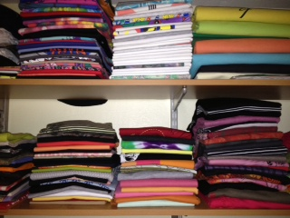
Closet Organizing Systems
3

Slide 4
Activities in a Data Warehouse Organizing System…
Selecting: which data sources should be included? How is their quality assessed?
Organizing: which data formats and schemas will enable effective processing? Are needed transformations made at load time or query time?
Supporting Interactions: what are the most important and frequent queries that need to be pre-configured?
Maintaining: data governance… retention, compliance, privacy issues
4

Slide 5
Stop and Think…
What are the consequences of using abstract terms like “resource,” “interaction,” and “maintenance” instead of more specific and domain-specific terms?
Collection development, Appraisal vs. Selecting
Acquisition, Accession, Ingesting vs. Adding to Collection
Cataloging, Indexing vs. Organizing
Curation, Governance vs. Maintenance …
Why are there FOUR activities and not 3 or 5 or some other number?
5

Slide 6
What about “Creating” Resources?
Does "intentional arrangement" imply the existence of resources?
Can "intentional arrangement" be a pre-requisite for resource creation?
6

Slide 7
INFO 202 “Information Organization & Retrieval” Fall 2015
UNIVERSITY OF CALIFORNIA, BERKELEY
SCHOOL OF INFORMATION
Robert J. Glushko glushko@berkeley.edu
@rjglushko
31 August 2015 Lecture 2.2 – Selection in Organizing Systems

Slide 8
Selecting Resources
SELECTION is the process by which resources are identified, evaluated, and added to a collection
Selection is by definition an intentional process
Selection methods and criteria vary across domains (as do the words that describe them); these can be subjective or objective
What are some synonyms or near synonyms for selection?
8

Slide 9
Selecting {and,or,vs.} Organizing
SELECT everything and keep it all --> often defaults to weak organizing principles
Selection PRECEDES Organizing --> Unique or rare resources are naturally evaluated one-at-a-time
Selection and Organizing are more CONCURRENT --> homogeneous or predictable resources
Selection FOLLOWS Organizing --> Resources created according to schema
9

Slide 10
Selection Principles
Utility or relevance
Intrinsic value
Scarcity or uniqueness
To support social or symbolic goals
To establish a brand or reputation
… many others
10

Slide 11
Selection in Different Domains
Libraries select, collect, organize, conserve, preserve and provide access to information on behalf of a community of users
Museum collections, especially of special or rare items, bring status or prestige whether or not the items have any contemporary use
Hiring decisions are rapidly moving from informal or intuitive criteria to more formal approaches using “predictive analytics” techniques that use information about successful hires to create selection models
11

Slide 12
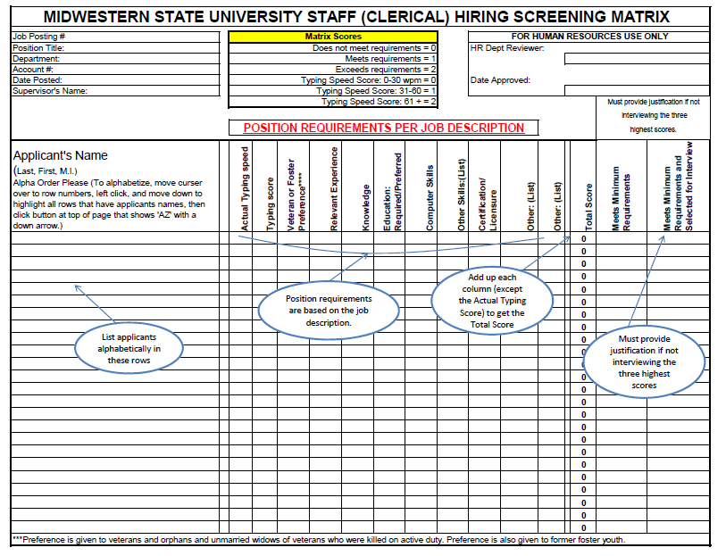
http://www.mwsu.edu/Assets/documents/humanresources/How%20to%20Complete%20a%20Matrix.ppt

Slide 13
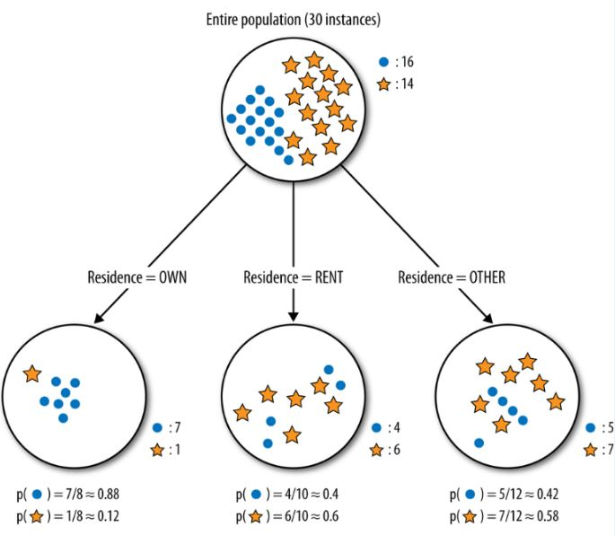
Figure 3-5 from Data Science for Business (F. Provost & T. Fawcett)

Slide 14
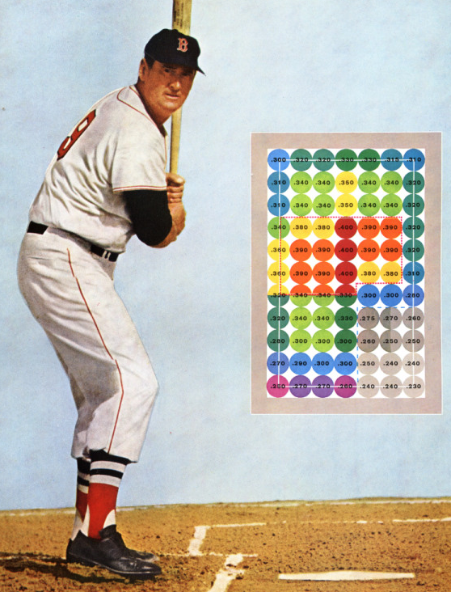
The MoneyBall Effect
Personnel selection is very task dependent and becoming highly data-intensive
http://blog.ted.com/2014/01/28/the-moneyball-effect-how-smart-data-is-transforming-criminal-justice-healthcare-music-and-even-government-spending/
http://www.hardballtimes.com/wp-content/images/tht/williamsgraphic.png

Slide 15
“Path Dependence”
Does the selection principle apply to each candidate resource in isolation?
... or does the selection decision consider the items already in the collection?
... or does the selection decision consider possible future selections?
… or does the selection decision consider selections being made by others?
in what situations does a particular selection preclude another one?
15

Slide 16
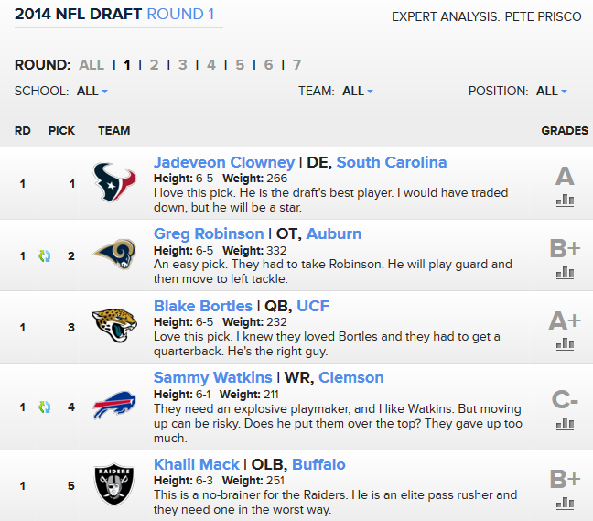
“Path Dependence” – 2014 NFL Draft of College Players

Slide 17
Adverse Selection
Adverse selection, anti-selection, or negative selection is a term used in economics, insurance, risk management, and statistics
It can occur when the “selector” does not or cannot use selection criteria that would enable “good” selection
because laws or social norms prevent the selector from obtaining information about the resources being selected that would make them undesirable
or because the selector is competing for the resources against other selectors who have better information
You can think of this as the selector having the wrong or too small a set of categories for organizing the selected resources
17

Slide 18
Trying to Capture Everything: “My Life Bits”
In 1998 Gordon Bell (MSFT research) began digitally recording as much of his life as possible
Articles, books, cards, CDs, letters, memos, papers, photos, pictures, presentations, home movies, videotaped lectures, and voice recordings...
Printed resources were scanned
Everything he did on his computer was captured
He wore a "sensecam" that took photos and logged biometric and ambient data (a precursor of the wearable computing and life logging movements)
Little or no concurrent organization but "The more that is captured, the more correlation is possible to help find things“
2009 Book: Your Life, Uploaded http://totalrecallbook.com/about-the-book/
18

Slide 19
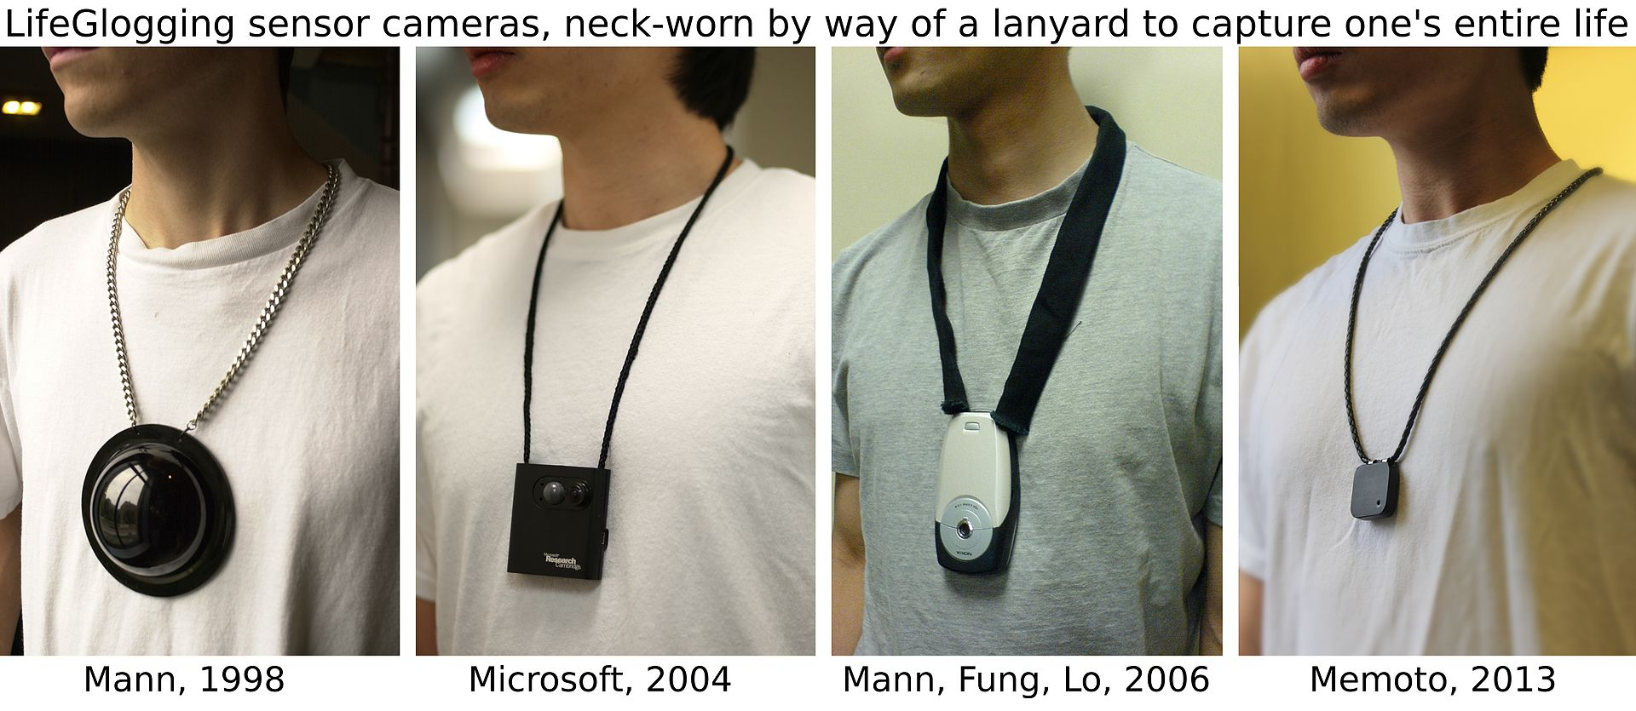
Incarnations of the “SenseCam”
See http://research.microsoft.com/en-us/um/cambridge/projects/sensecam/
"LifeGlogging cameras 1998 2004 2006 2013 labeled" by Glogger - Own work. Licensed under CC BY-SA 3.0 via Commons - https://commons.wikimedia.org/wiki/File:LifeGlogging_cameras_1998_2004_2006_2013_labeled.jpg#/media/File:LifeGlogging_cameras_1998_2004_2006_2013_labeled.jpg
19

Slide 20
Digitization and Selection
Digitization separates selection from storage concerns because access need not imply actual "holding" of the resources
Digital capture and copying of photos, videos, music and documents reduces their distinctiveness
The "digital torrent" of scientific and sensor data makes collection easy and selection more important
20

Slide 21
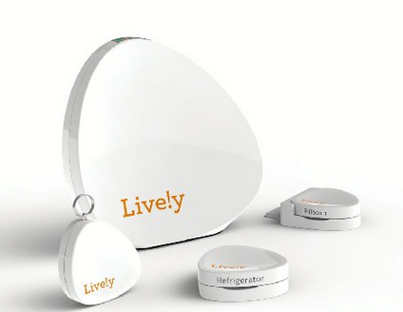
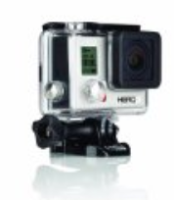
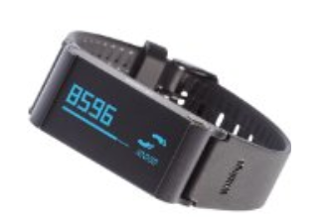
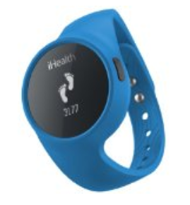
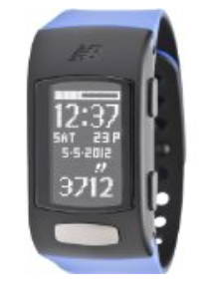

Slide 22
Selection on the Web
The web has no centralized and authoritative directory or catalog
The web can be treated as a combination of a very large number of domain- or topic-specific resource collections that are created by individuals or identified by computational analysis
22

Slide 23
INFO 202 “Information Organization & Retrieval” Fall 2015
UNIVERSITY OF CALIFORNIA, BERKELEY
SCHOOL OF INFORMATION
Robert J. Glushko glushko@berkeley.edu
@rjglushko
31 August 2015 Lecture 3.3 – Organizing in Organizing Systems

Slide 24
Organizing Resources
Almost any property of resources can be used to organize them, but the most appropriate or effective properties differ across resource types and tasks
Decisions about which resource properties will be used in organizing must often precede the creation or selection of the resources
24

Slide 25
Matching Organizing Principles to Resource Types and Interactions
25

Slide 26
Issues with Organizing Physical Resources
Physical resources are often organized according to intrinsic physical properties like their size, color, or shape, because the human visual system automatically pays a lot of attention to them
A particular physical resource can only be in one place at a time
So we might make or acquire copies to store in different locations
And we can make lots of copies of their descriptions and put them in different locations
Because physical resources take up space, you need to consider whether you are organizing the resources you have, or resources you might have in the future
Is the “storage environment” given, or can it be designed?
26

Slide 27
Mise-en-place
The kitchen organizing system known as mise-en-place, or, literally, "put in place”
Advance organization is essential to enable the rapid pace of a restaurant because “time is precious. Resources are precious. Space is precious. Your self-respect and the respect of others are precious”
Ingredients and tools for particular recipes are kept in exact locations and arranged for efficient cooking and plating
Kitchen employees are also highly organized with roles and responsibilities governed by the “brigade” system that has military origin
Orders and communications are also highly systematized using “kitchen language” that is abbreviated and unambiguous
27

Slide 28
Comparing Resource Organization
Libraries
Standardized broad bibliographic classification
Corporate knowledge management
Narrowly focused, deeper classification, proprietary
Access control is essential
Museums
Non-text resources are more semantically opaque => more description
Often have a very distinctive or idiosyncratic character because of origin as private collections
Archives
Often kept in “original order”
The "provenance" is an important set of information about the documents and influences how much they can be trusted
28

Slide 29
INFO 202 “Information Organization & Retrieval” Fall 2015
UNIVERSITY OF CALIFORNIA, BERKELEY
SCHOOL OF INFORMATION
Robert J. Glushko glushko@berkeley.edu
@rjglushko
31 August 2015 Lecture 2.4 – Interaction Design in Organizing Systems

Slide 30
Interactions in Organizing Systems
INTERACTIONS include any activity, function, or service supported by or enabled with respect to the resources in a collection or with respect the collection as a whole
ACCESS is the fundamental interaction in all organizing systems – you wouldn’t organize anything you didn’t expect to access again – but most organizing systems have additional interactions to make access more efficient and to create additional value with the resources
30

Slide 31
The Four Big Ones for Libraries…
FINDING resources
IDENTIFYING resources to confirm that that a found resource is the intended one by distinguishing it from similar ones
SELECTING a resource from a collection when more than one might seem to fit the search criteria
OBTAINING the resource if it isn’t immediately available
31

Slide 32
Designing Resource-Based Interactions
Important distinction between interactions that are directly afforded by the resources from those that must be designed
The nature of interactions depends on how we identify and define "resource"
Selecting and organizing have no purpose if you don't allow interactions to the resource (to the appropriate "agents")
Who we consider "appropriate" differs a great deal; contrast libraries, museums, archives, scientific and business data
32

Slide 33
Accessibility
A resource is only accessible when it supports interactions, and it is ineffective design to implement interactions with resources that some people are unable to perform
With physical resources, affordances and the implications for access and use can usually be easily perceived
With digital resources, most of the supported interactions are not apparent
Many of the techniques for making a resource accessible involve transforming the resource or its description into a different form
Some of these transformations are generic, built into operating systems
Others are resource specific
33

Slide 34
Interactions with Places
City plans are often grids to enable easy location and navigation
Environments can be built to encourage or discourage interactions between people, to create a sense of freedom or confinement, to reward exploration or enforce efficiency
The arrangement of the resources in a built environment also encourages or discourages interactions
Queue configurations and disciplines
34

Slide 35
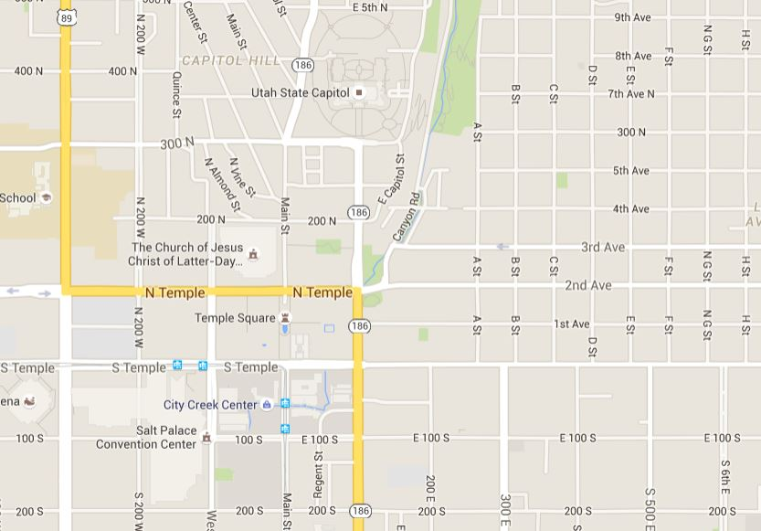
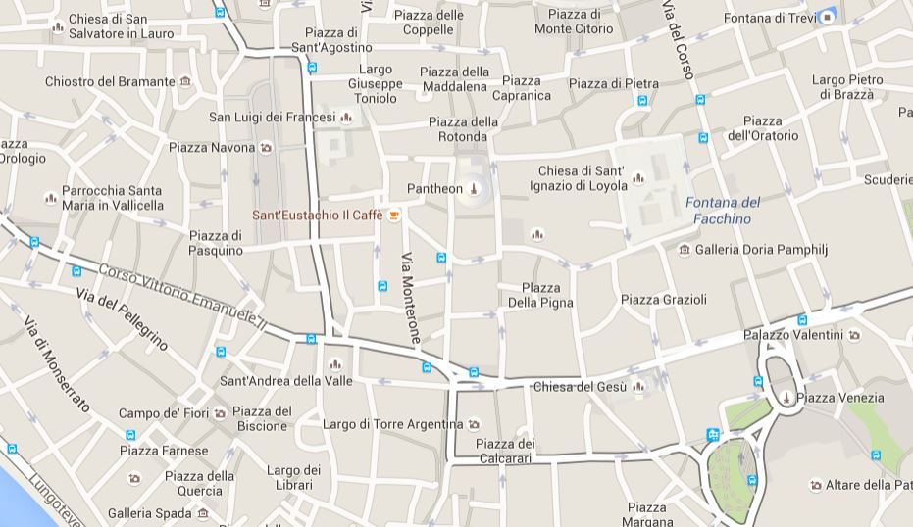
Three Different City Plans
Salt Lake City
Rome
Delhi
35

Slide 36
Digitization and Interactions
Digitization is the process of transforming a resource whose original format is physical so that it can be stored and manipulated by a computer
Digitizing resource descriptions (e.g. bibliographic catalogs) for library resources can facilitate finding, identifying, and selecting interactions even if the resources themselves are not digitized
36

Slide 37
Digitization and Interactions
The variety and functions of interactions with digital resources are determined by the amount of structure and semantics in their encoding
Access controls for the interactions involving digital resources can be very precisely defined and enforced
37

Slide 38
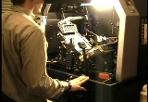
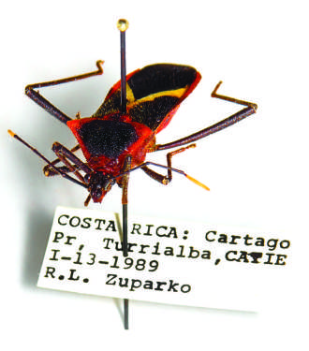
Not all Digitization is the Same
Book scanning can be highly automated
Bug label scanning is tedious. The pin or angle of the label can obstruct important information

Slide 39
Interactions with Documents & The Document Type Spectrum
From Glushko & McGrath, DOCUMENT ENGINEERING, MIT Press 2005
39

Slide 40
The Document Type Spectrum: A Continuum
There is systematic and continuous variation in document instances and types and there is no clear boundary between “documents” and “data”
But there are characteristic types of content, organizing structures, and presentation rules that characterize different regions of the spectrum
Possible interactions with documents are largely determined by their location on the document type spectrum
40

Slide 41
Organizing System Types & the DTS
41

Slide 42
Information Retrieval Models & the DTS
42

Slide 43
Preparing for the Next Lecture
Hearst, Marti. Search User Interfaces, 2009. Chapter 3 through 3.4
Bush, Vannevar. “As We May Think.” The Atlantic, 1945.
Borges, Jorge Luis. “The library of Babel.” Collected Fictions, 1998.
And some very short case study items…
43

