Slide 1
INFO 202 “Information Organization & Retrieval” Fall 2015
UNIVERSITY OF CALIFORNIA, BERKELEY
SCHOOL OF INFORMATION
Robert J. Glushko glushko@berkeley.edu
@rjglushko
9 September 2015 Lecture 4.1 – Information Architecture and Organizing Systems

Slide 2
Defining "Architecture"
An architecture describes a system's components (or "building blocks") and their relationships with each other
This gives an "architected" system an explicit model, in contrast with systems that are implemented incrementally without a master plan
Abstract patterns of information content or organization are sometimes called architectures
2

Slide 3
IA as part of TDO: Motivation
“Information” and “Architecture” are elegant and abstract concepts
But for many people, “Information Architecture” is barely more than website design, emphasizing the presentation layer – an orphan who has lost these parents
Can we reconnect the meaning of IA to its roots by thinking of IA as an organizing discipline?
3

Slide 4
Defining “Information Architecture” (TDO 2.3.2.2)
"IA is designing an abstract and effective organization of information and then exposing that organization to facilitate navigation and information use“
Intentional arrangement
Interaction support
4

Slide 5
Defining “Information Architecture” (TDO 2.3.2.2)
This definition implies a design methodology that puts conceptual modeling at the foundation, then adds organization and structure, and considers presentation or physical design issues at the end
5

Slide 6
Defining Information Architecture
6

Slide 7
A Definition of Information Architecture in User Interface Design
7

Slide 8
Defining “Information Architecture” (Tidwell 2)
“IA is the art of organizing an information space. It encompasses many things: presenting, searching, browsing,
labeling, categorizing, sorting, manipulating, and strategically hiding information.”
This definition isn’t as prescriptive about the sequence or dependencies of the activities
Arrangement
Interactions
8

Slide 9
Compare: A Typical Definition of IA
Dillon, A (2002). "Information Architecture in JASIST: Just where did we come from?" Journal of the American Society for Information Science and Technology 53 (10): 821–23. doi:10.1002/asi.1009
Davis, N (2011). “Framing the Practice of Information Architecture,” UX Matters, September 2011.
9

Slide 10
Making IA Compatible with TDO
Can we narrow the range of applications for which we use “Information Architecture” to those that are unambiguously organizing systems?
This would make it possible to base IA on design principles and patterns
10

Slide 11
Tidwell – User Interface Design Idioms
In her 2005 1st edition of Designing Interfaces Tidwell proposed a set of UI design idioms:
“large-scale patterns or recognizable types or styles of interfaces, each with its own vocabulary of objects, actions, and visuals.”
“As long as the parts are recognizable enough and the relationships among the parts are clear, then people can apply their previous knowledge to a novel interface and figure it out.”
11

Slide 12
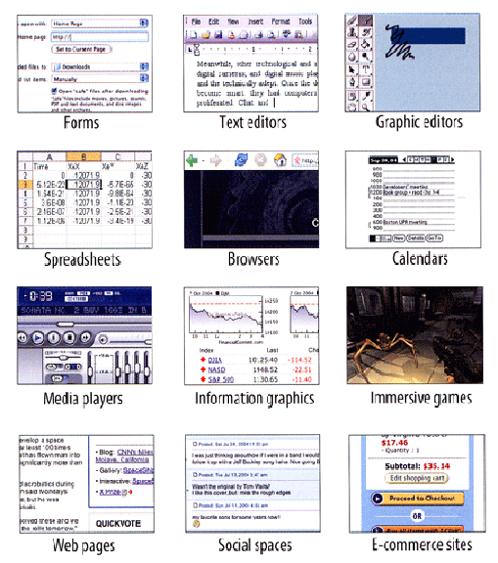
User Interface Design Idioms
Tidwell, Jenifer.
Designing Interfaces: Patterns for Effective Interaction Design
12

Slide 13
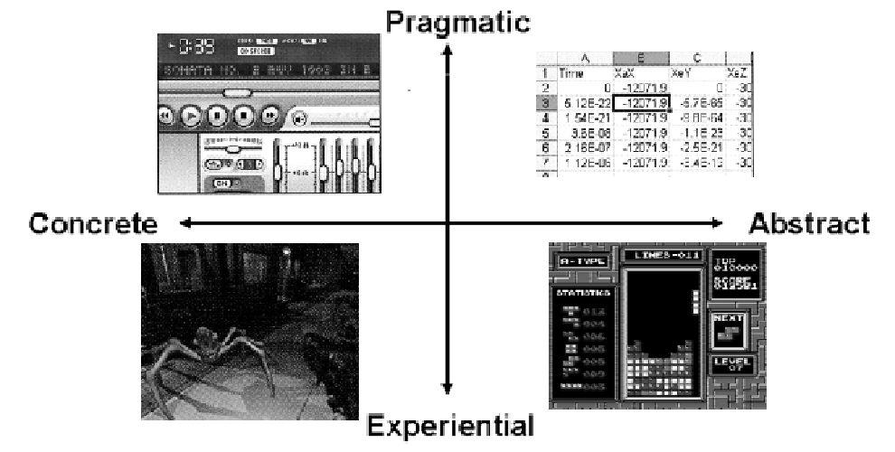
Two Dimensions: Resource Type, Interaction Type
13

Slide 14
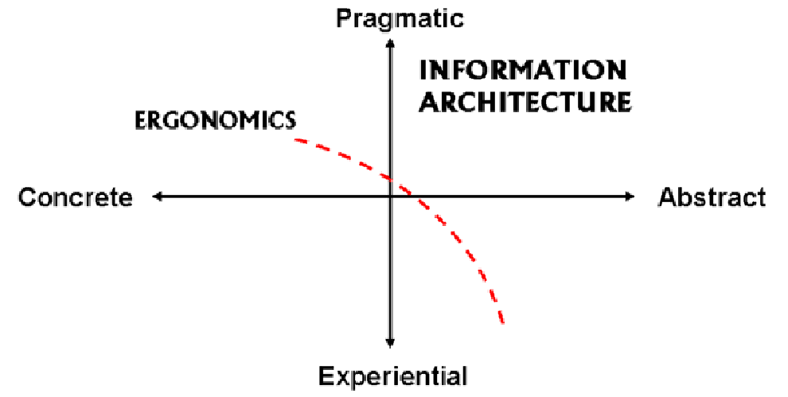
The Narrowed Scope of IA
14

Slide 15
The Narrowed Scope of IA
The abstract and pragmatic region of the application space contains information-intensive or document-centric applications governed by rules or constraints
The applications present, collect, and manipulate information according to these rules or constraints – supported interactions are precisely defined
Especially for applications on the "Transactional" end of the document type spectrum the rules are encoded in document type and process models from some domain… like these
15

Slide 16
The Narrowed Scope of IA
We can also recognize a region where we can rely more on ergonomic principles in application designs, where information-intensive applications are grounded in a physical or more concrete context whose constraints need to be represented in the application
16

Slide 17
The Activities of Information Architecture in TDO terms
Resource selection (content inventories and audits)
Resource organization (design patterns)
Interaction design (navigation patterns, responsive design, multi-channel design)
Maintenance (link management, integration of social media as content and as curation)
17

Slide 18
INFO 202 “Information Organization & Retrieval” Fall 2015
UNIVERSITY OF CALIFORNIA, BERKELEY
SCHOOL OF INFORMATION
Robert J. Glushko glushko@berkeley.edu
@rjglushko
9 September 2015 Lecture 4.2 – User Interface Design Patterns

Slide 19
Tidwell – “Designing Interfaces” (2nd edition)
“It can be helpful to think about an application in terms of its underlying data and tasks. What objects are being shown to the users? How are they categorized and ordered? What do users need to do with them? And now that you’re thinking abstractly about them, how many ways can you design a presentation of those things and tasks?”
“Several of the patterns in this chapter are large-scale, defining the interactions for large sections of applications or sites (or sometimes the entire thing).”
19

Slide 20
Tidwell – What Web Pages Do Chapter 2 of Designing Interfaces, 2nd edition
Any page will primarily do one of these things:
Show one single thing, such as a map, book, video, or game
Show a list or set of things
Provide tools to create a thing
Facilitate a task
20

Slide 21
(Interact with) One (Resource) at a Time
Show
Thing
A long, vertically scrolled page of flowed text (articles, books, and similar long-form content)
A zoomable interface for very large, fine-grained artifacts, such as maps, images, or information graphics. Map sites such as Google Maps provide some well-known examples
The media player idiom, including video and audio players
21

Slide 22
Showing a List of Things
Feature, Search, and Browse is the pattern followed by countless websites that show products and written content
Blogs, news sites, email readers, and social sites use the News Stream pattern to list their content, with the most recent updates at the top
Picture Manager is a well-defined interface type for handling photos and other pictorial documents
22

Slide 23
Providing Tools to Create a Thing
Canvas Plus Palette for visual editors sets user expectations very strongly
Almost all applications of this type provide Many Workspaces—usually windows containing different documents, which enable users to work on them in parallel
Alternative Views let users see one document or workspace through different lenses, to view various aspects of the thing they’re creating
23

Slide 24
Facilitate a Task
When a task is complicated your job is to work out how the task is structured
A Wizard can break the task down into smaller steps or groups of steps
A Settings Editor lets users change the settings or preferences of something—an application, a document, a product — and let them change only what they need, when they need it
24

Slide 25
INFO 202 “Information Organization & Retrieval” Fall 2015
UNIVERSITY OF CALIFORNIA, BERKELEY
SCHOOL OF INFORMATION
Robert J. Glushko glushko@berkeley.edu
@rjglushko
9 September 2015 Lecture 4.3 – Pre-attentive Organizing, the Gestalt Principles, and Information Visualization

Slide 26
Automatic / Pre-attentive Organizing
Physical resources are often organized according to intrinsic physical properties (like size, color, or shape) because the human visual system quickly and automatically pays a lot of attention to them (without any intentional effort)
Likewise, because people have limited attentional capacity, we ignore a lot of the ongoing complexity of visual (and auditory) stimulation, making us perceive our sensory world as simpler than it really is
These two ideas explain why we automatically or “pre-attentively” organize separate things we see as groups or complete objects
26

Slide 27
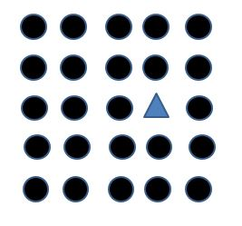
Pre-attentive Processing of Shape and Color
Does the visual array contain a triangle?
Because shape and color are pre-attentive attributes, It takes about the same time to decide over a large range of array sizes
It is easier still if the shape is of a different color

Slide 28
Pre-attentive Processing of Shape and Color
Does the visual array contain any red triangles or blue circles?
When the shape and color properties are uncorrelated, pre-attentive parallel processing isn’t possible

Slide 29
The Gestalt Principles
A century ago psychologists Max Wertheimer, Wolfgang Kohler, and Kurt Koffka proposed several principles that explain how our visual system imposes order on what it sees
The principles explain how the individual elements in the visual environment are organized into fields or structures
Proximity
Similarity
Closure
Continuity
Figure-Ground
29

Slide 30
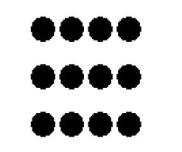
Proximity
“The law of proximity states that items placed near each other appear to be a group”
Closer elements are organized into a coherent perception according to the principle that closely spaced elements are related and those further apart are unrelated
The same array is perceived as 3 rows on the left and as 3 columns when rotated 90 degrees

Slide 31
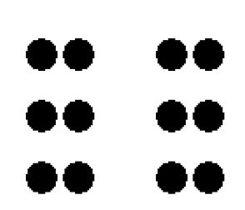
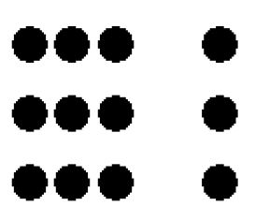
Balance / Symmetry
Balanced
Imbalanced

Slide 32
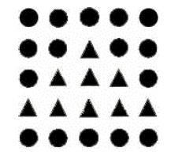
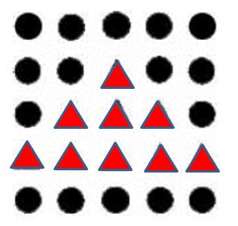
Similarity
Similarity perception means that visual properties that are salient (or pre-attentive) cause objects that share properties to be organized into groups

Slide 33
Visual stimuli that could be perceived either as open, incomplete, or unusual forms are more naturally perceived as closed, complete, and regular

Slide 34
Figure and Ground
There is a natural tendency to treat some part of the visual field as in the foreground and other parts as the background
When the visual information is ambiguous, this can result in two alternating interpretations
The contrast between the figure and ground determines how easily they are separated
Contrast Helps Legibility
Contrast Helps Legibility

Slide 35
Continuity
Aligned objects are perceived as belonging together, and are perceived as a continuous whole when that perception is a simpler interpretation

Slide 36
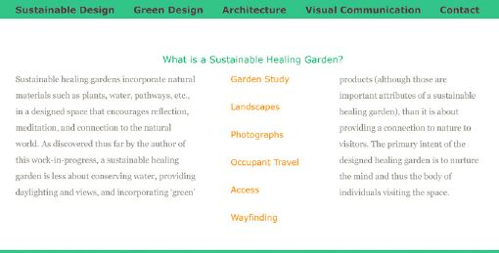
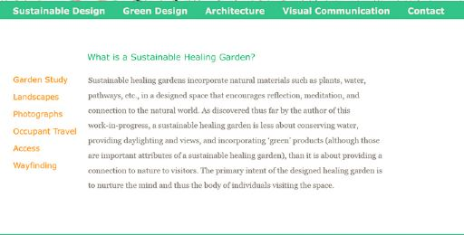
Proximity in Web Page Design
BAD! Links between columns break up the text too much
GOOD! Text is seen as a whole

Slide 37
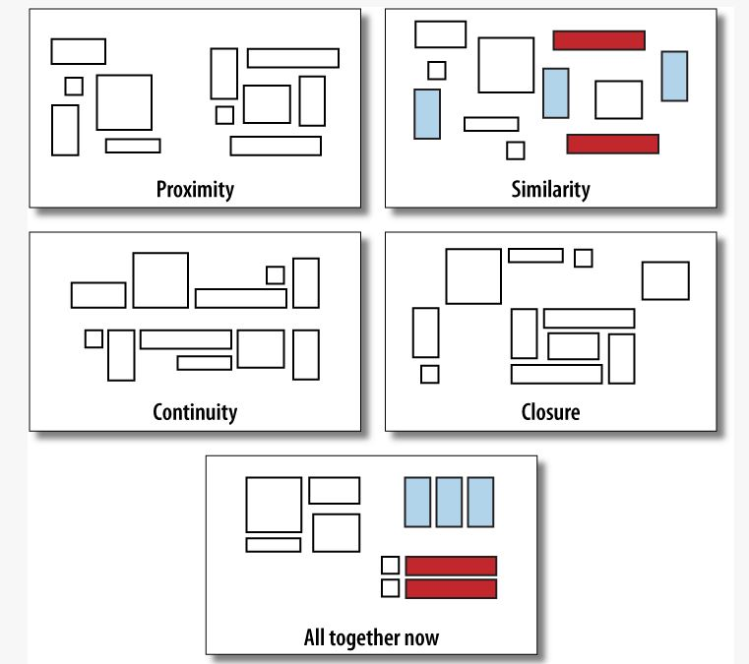
Putting the Principles Together
Tidwell,
Designing Interfaces
Figure 4-14

Slide 38
Learning More About Gestalt Principles
Gestalt theory has strongly influenced especially visual design and related areas of education
Classic texts by Rudolf Arnheim:
Art and Visual Perception (1954), still a mainstay of course syllabi, Visual Thinking (1969)
Recent design texts with Gestalt thinking Show me the Numbers (Stephen Few, 2004) Designing Interfaces (Jenifer Tidwell, 2010)
38

Slide 39
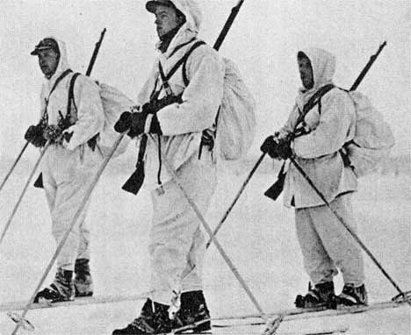
Camouflage
Disruptive coloration, colors and patterns that resemble backgrounds, countershading, shadow elimination, and techniques that disrupt edge detection prove the power of Gestalt processing
Norwegian soldiers in snow gear
Arctic Hare
Stone Flounders

Slide 40
Information Visualization
Information visualization is the depiction of information using spatial and graphical conventions
Two primary goals for IV:
Information Producer Goals: To explain, illustrate, and communicate
Information Consumer Goals: To facilitate analysis, exploration, and discovery
shifting human information processing from cognition to perception
40

Slide 41
Info Vis as a Design Specialty for Organizing Systems
Information Visualization can also be defined as a subspecialty of "designing the interactions in an organizing system"
Like IA, Info Vis pays careful attention to content models and structural relationships
Like UI design, Info Vis seeks to apply interaction structure and presentations to the underlying information
41

Slide 42
Pre-attentive Organizing and Information Visualization
Perception and Gestalt theory provide rational explanations for why shifts in spacing, timing, and configuration can have a profound effect on the meaning of presented information
They also inform us about which resource properties people notice quickly, making them good discriminators
42

Slide 43
Info Vis for Business Intelligence (1)
See also http://support.sas.com/rnd/datavisualization/dashboards/, http://robslink.com/SAS/dashboards/aaaindex.htm
43

Slide 44
IV for Business Intelligence (2)
GE Health "Infoscape" http://visualization.geblogs.com/visualization/network/
44

Slide 45
Info Vis in TDO
45

Slide 46
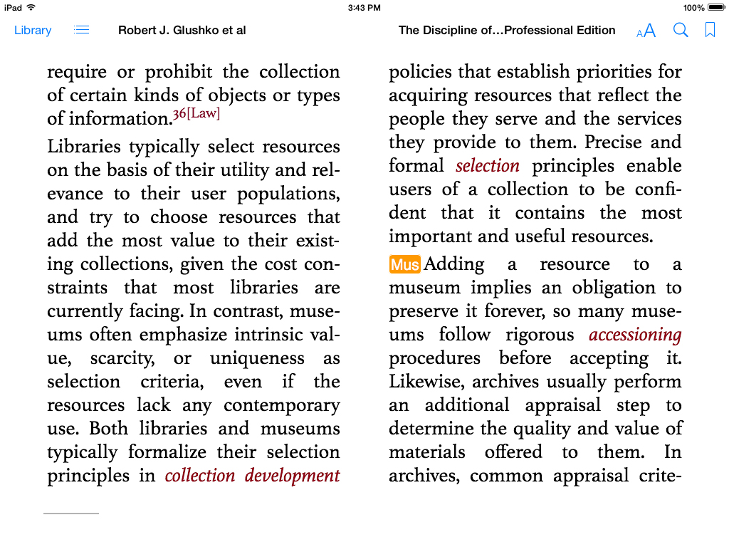
Tagged Notes and Paragraphs

Slide 47
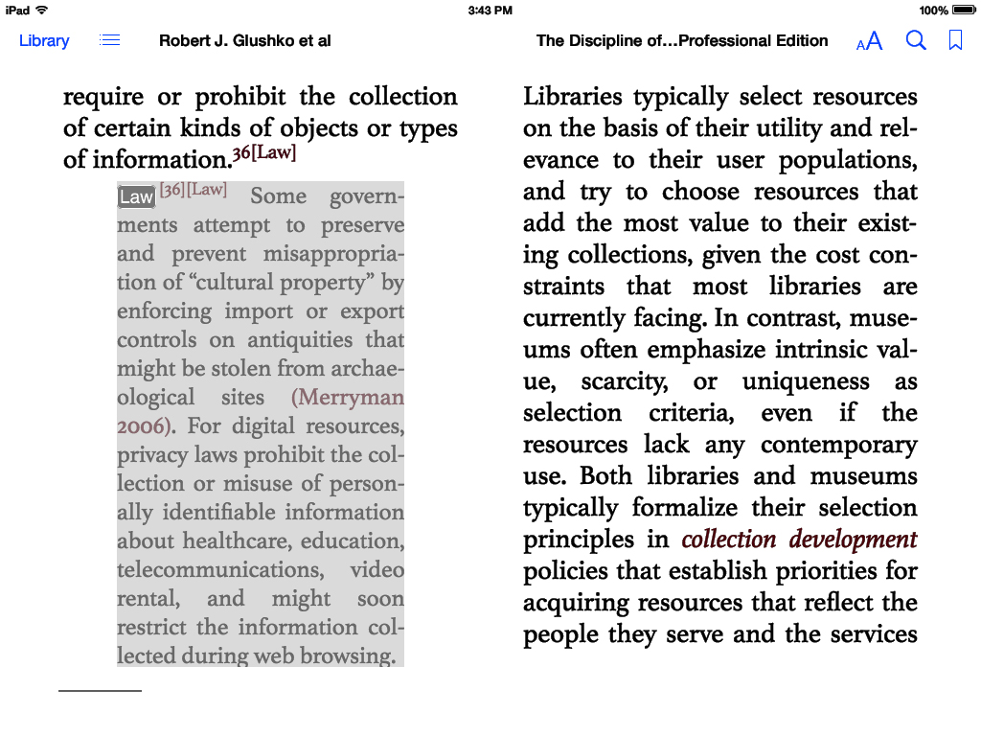
Indented and Highlighted Transclusion

Slide 48
Next Time: Roadmap / Lifecycle for Organizing Systems
TDO 10
Kitchen (11.5)
Neuroscience lab (11.18)
48

