Slide 1
INFO 202 “Information Organization & Retrieval” Fall 2015
Robert J. Glushko glushko@berkeley.edu
@rjglushko
14 September 2015 Lecture 5.1 The Organizing Systems Roadmap/Lifecycle

Slide 2
The Organizing System Lifecycle
There is always a lifecycle, but there are times when its phases need to be more explicit and formal:
In institutional contexts
In information-intensive contexts
When traceability and impact analysis are necessary
2

Slide 3
The Organizing System Lifecycle: 4 Phases in TDO Chapter 10
Defining and scoping the domain
Identifying requirements
Design and implementation
Operations and maintenance
These phases are brief and mostly inseparable for some simple organizing systems, more sequential for others, and more systematic and iterative for complex organizing systems
3

Slide 4
Stop And Think
How else might we have organized the system lifecycle in phases?
4

Slide 5
Design Methodologies: Discipline for Design
When we design something we follow – implicitly or explicitly – some steps or techniques for scoping, analysis, idea generation, and implementation
This DESIGN METHODOLOGY makes assumptions about which design questions can be separately answered, the priorities and dependencies, and who can best answer them
5

Slide 6
Design Methodologies: Discipline for Design (2)
The methodology determines
what design activities are done
the order in which they are performed
the tools and techniques used to perform them,
the notations or artifacts that result
6

Slide 7
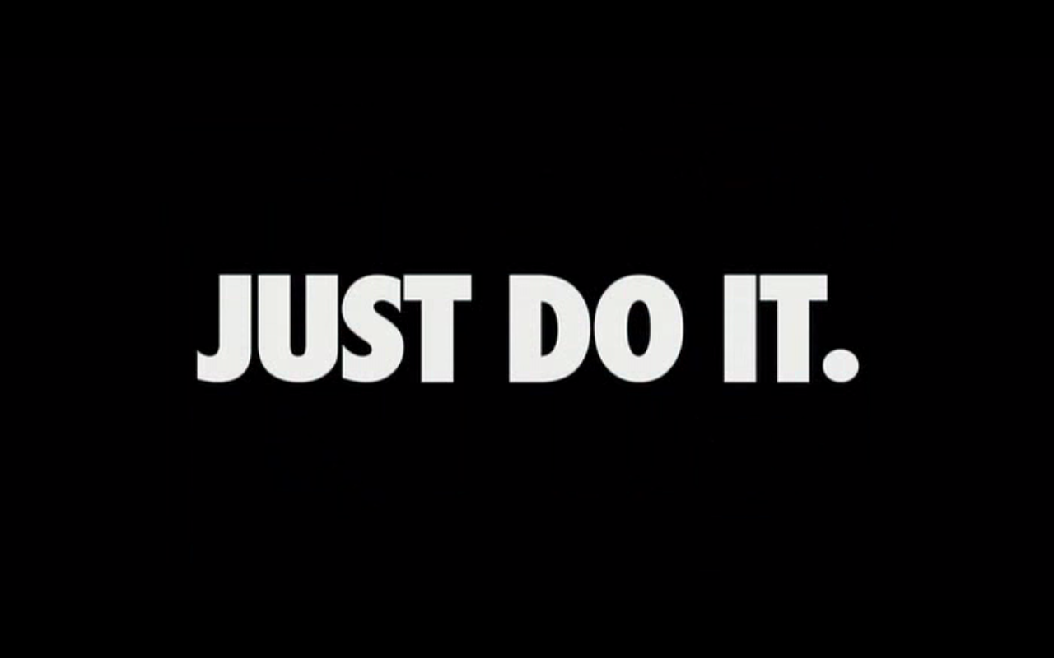
A Lifecycle with Inseparable Phases

Slide 8
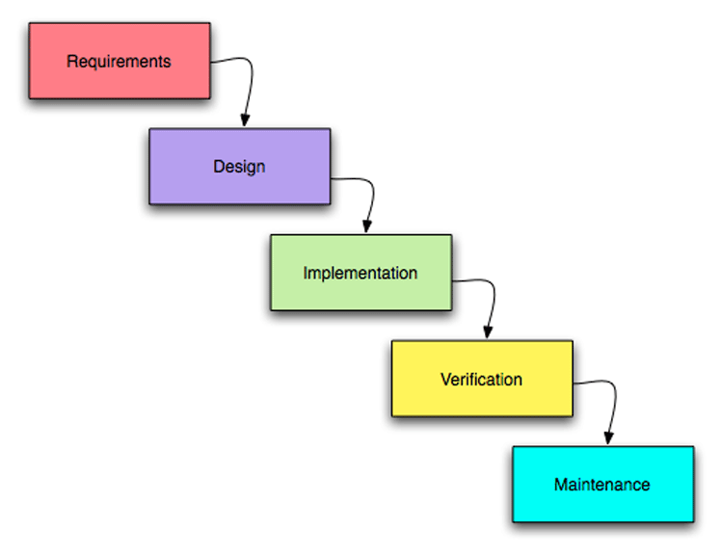
A “Waterfall” or Sequential Lifecycle

Slide 9
Waterfall Methods
Waterfall methodologies consist of a set of sequential activities in which the outputs of each step are the inputs to the next (the "waterfall“)
This approach makes sense for small, well-defined problems in a stable context
Its goal is to "get everything right before progressing to next step" to minimize rework, which assumes complete and clear requirements that can be validated at each step
9

Slide 10
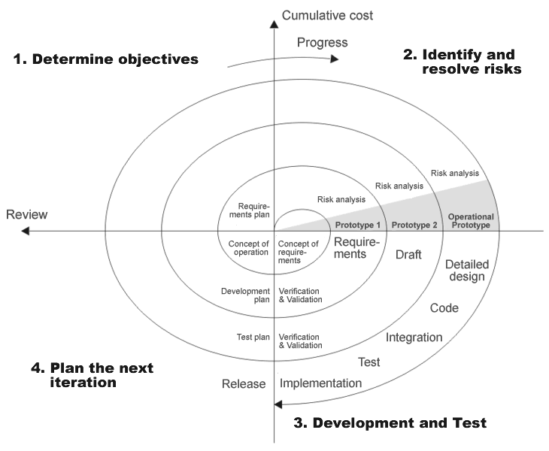
A “Spiral” or Iterative Lifecycle

Slide 11
Iterative Methods
Other methodologies are more iterative or recursive, and assume that rework is inevitable and desirable
The goal of iterative methods is "get enough right at each step to know which step to take next"
The idea is to invest to reduce risk, knowing you can never eliminate all of it
Prototyping is essential; products emerge throughout the process and quality steadily improves
11

Slide 12
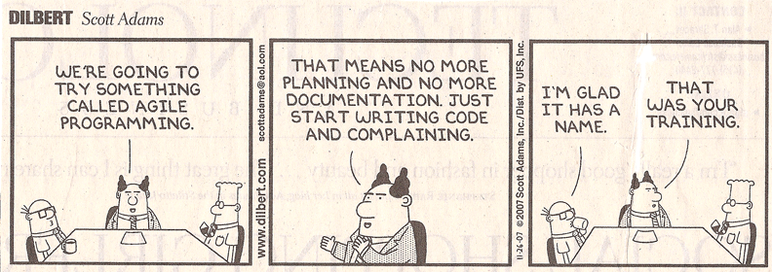
Agile Methods
"Agile“ methods for software development have become very popular and are a specialized form of iterative methods used by small design teams

Slide 13
Design Methodologies: Discipline for Design (3)
The choice of methodology sometimes reflects a management and business philosophy, and sometimes reflects a personal or ideological one -- in either case, it can be highly contentious in a project
13

Slide 14
Design Methodologies: Discipline for Design (4)
Better to be more explicit and formal than absolutely necessary than vice versa
Would you fly in an airplane whose systems were being designed with agile methods?
Would you rather cross a bridge that was said to be “overengineered” or “overbuilt” – or “under engineered”?
14

Slide 15
Stop And Think
Think of some recent design project you worked on - what methodology did you follow? Was it appropriate? Would you follow a different methodology knowing what you know now?
15

Slide 16
Requirements Traceability
A TRACE is an assumption or assertion about an interim or final requirement or design artifact that is important enough to record and follow
TRACEABILITY is the ability to describe and follow the life of a TRACE
Backwards traceability: Where did this decision or requirement come from?
Forwards traceability: What were the implications of this requirement or early design decision in the design?
16

Slide 17
Traces that VBush Might Have Recorded about the Memex
We need a way to create and name some set of information resources
It would be more desirable to arrange resources in an order that tells a story or explains something
Maybe we can package this set of resources so they can be shared with someone else
Can these packages be edited to add or rearrange the resources after they are shared?
Can we assume that cameras will evolve to be lightweight, fast, and small enough to be worn by the user to take pictures of what he reads to create new resources?

Slide 18
Practical Traceability
The design methodology determines what and when to trace
You can't trace everything you do or you'd have no time to do anything
But if you don't trace the important things in enough detail your design will miss opportunities and be magical and brittle
But if your design is only for yourself with a limited lifetime this might not matter
18

Slide 19
INFO 202 “Information Organization & Retrieval” Fall 2015
Robert J. Glushko glushko@berkeley.edu
@rjglushko
14 September 2015
Lecture 5.2 Defining the Domain for an Organizing System

Slide 20
Defining and Scoping the Domain
Determining scope and scale
Nature and number of users
Expected lifetime
Physical and technological environment
Relationship to other organizing systems
20

Slide 21
Scope and Scale
SCOPE: the breadth and variety of resource types
SCALE: the number of resource instances
Heterogeneity of resources is more important than absolute number (Scope >> Scale)
WHY? (hint)
21

Slide 22
Scope and Scale (2)
Handling resource heterogeneity:
Fewer, broader categories if possible
Less description
Standards for automated description and classification
But sometimes broad scope and scale are essential
22

Slide 23
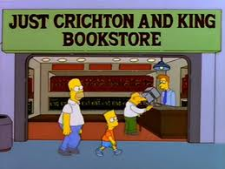
An Organizing System with Narrow Scope and Scale

Slide 24
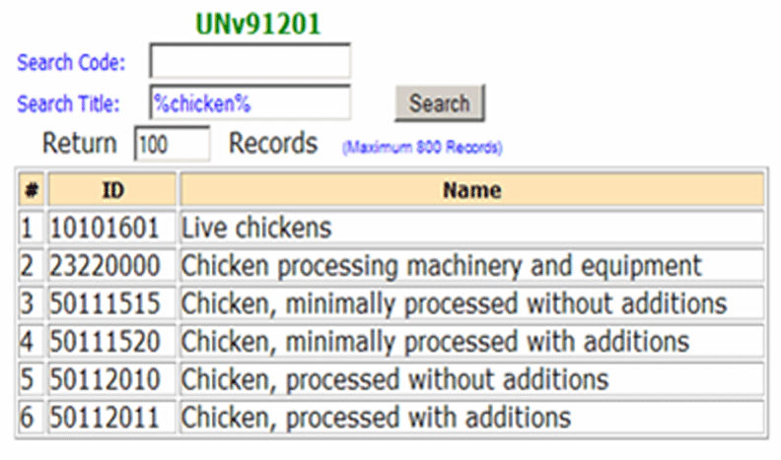
An Organizing System with Global Scope and Scale (unspsc.org)

Slide 25
Nature and Number of Users
How precisely a collection of resources can be described and organized depends on well user types and requirements are known
In some contexts, user types and individual users can be controlled and identified
In others, types and users aren’t known until the organizing system is in operation
25

Slide 26
Who Are We Designing For?
User
Operator
Customer
Patient
Client
Buyer
…

Slide 27
Stop And Think
How do these users differ?
Do they prioritize requirements in the same way?
If user types have conflicting requirements, how do we decide whose requirements are most important?
27

Slide 28
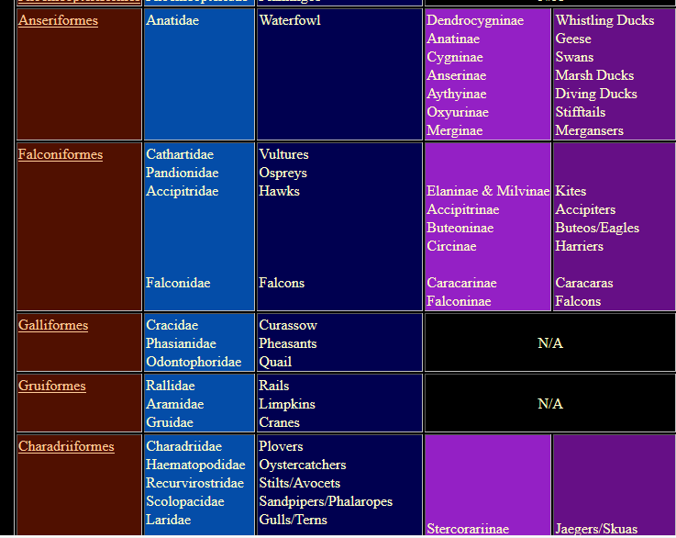
Organizing Birds for Scientists
28

Slide 29
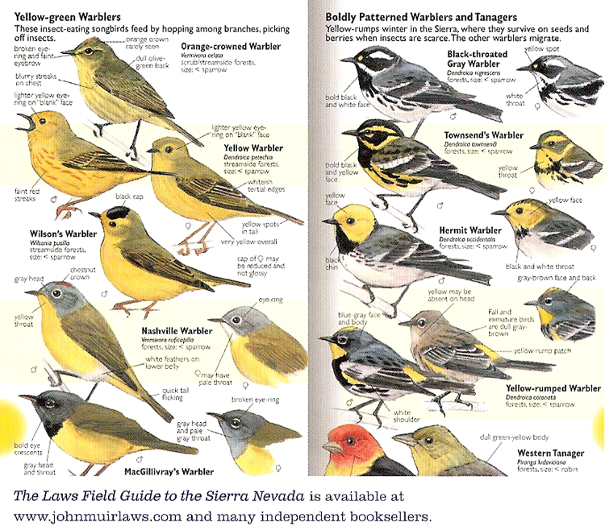
Organizing Birds for Birdwatchers
29

Slide 30
Requirements about Resource Description
The most generic interactions use descriptions that can be associated with almost any type of resource, such as the name, creator, and date
Different types of resources must have differentiating properties, otherwise there would be no reason or way to distinguish them as different types
30

Slide 31
Descriptive Precision
Poets, painters, composers, sculptors, technical writers, programmers, and devices or machines all create resources
The Dublin Core vocabulary has a single property for “creator”
Easier to use, but loses a great deal of precision

Slide 32
The Choice of Organizing Properties Matters!
Organization using behavior or preferences can make interactions highly efficient for some users and the opposite for those who act differently
When multiple properties are used to organize resources, their order determines the arrangement and the ease of interactions
This implies the need to prioritize user and interaction types
32

Slide 33
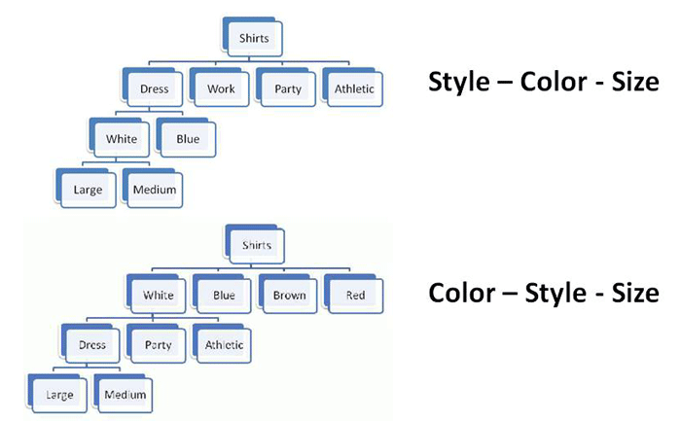
Multiple Properties in Different Order
33

Slide 34
Expected Lifetime
Usually correlated with number of users and resources; small collections with single users are often ad hoc and don’t outlive the specific tasks for which they were created
Think architecturally to enable more robustness and flexibility with respect to changes in technology or business contexts
34

Slide 35
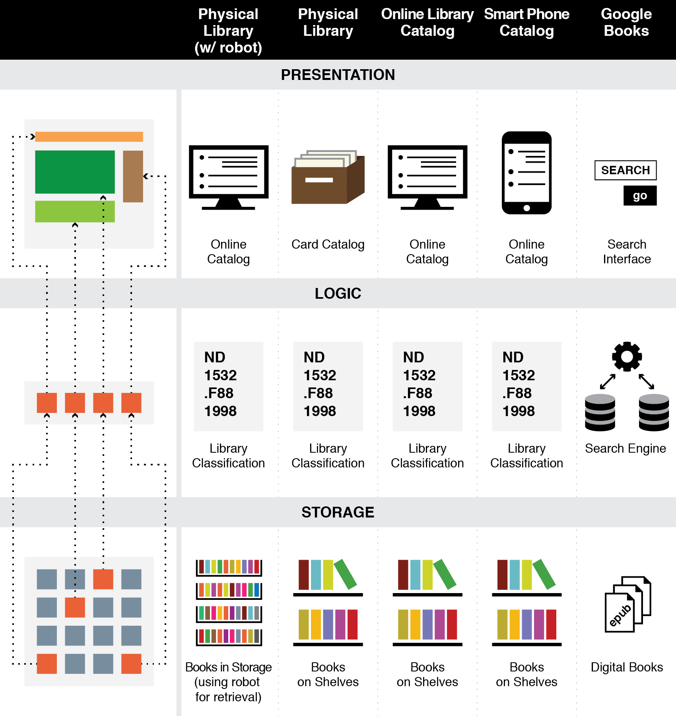
Think Architecturally
35

Slide 36
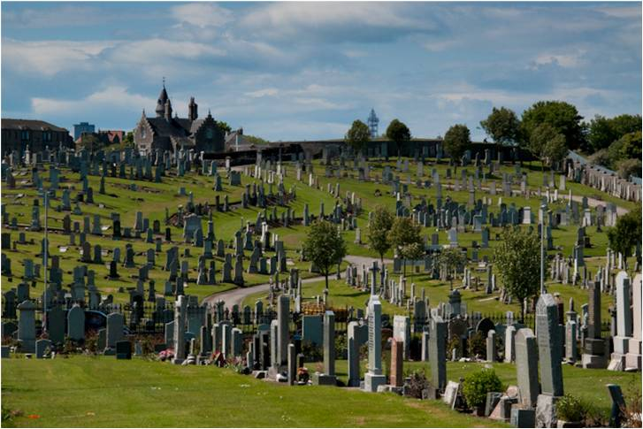
Don’t Confuse Lifetime of Resources with that of the Organizing System (1)
36

Slide 37
Don’t Confuse Lifetime of Resources with that of the Organizing System (2)
http://www.seattlemag.com/article/mise-en-place-local-dining-trend-2013
http://ateaseinnkeepers.com/mise-en-place/
Mise en place
37

Slide 38
Physical or Technological Environment
Physical environments create possibilities for organizing and interaction
But there might be constraints that limit them
“Installed base” or “legacy” concerns
Be careful if you are designing or selecting technology for an organizing system
Avoid resource-specific investments unless absolutely justified
38

Slide 39
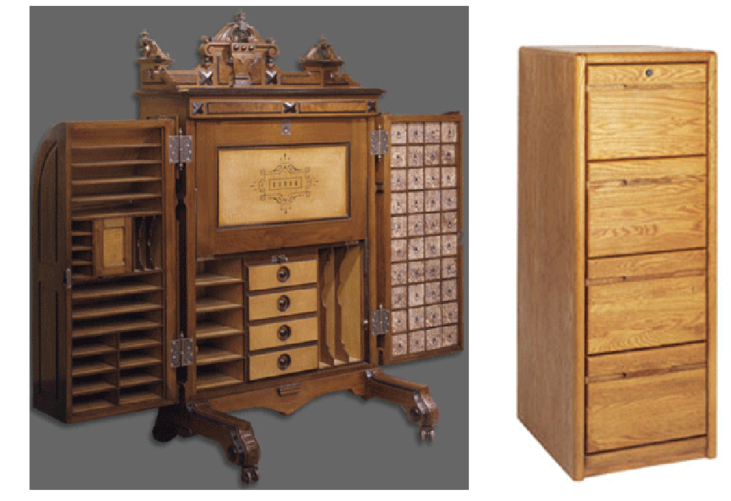
Affordances or Constraints?
39

Slide 40
Physical or Technological Environment (2)
Estimating the ultimate size of a collection at the beginning of an organizing system’s lifecycle can reduce scaling issues related to storage or interaction space
Invest in flexibility and extensibility
40

Slide 41
Physical or Technological Environment (3)
The environment influences that expectations, behavior, and experience of the people who interact with it
41

Slide 42
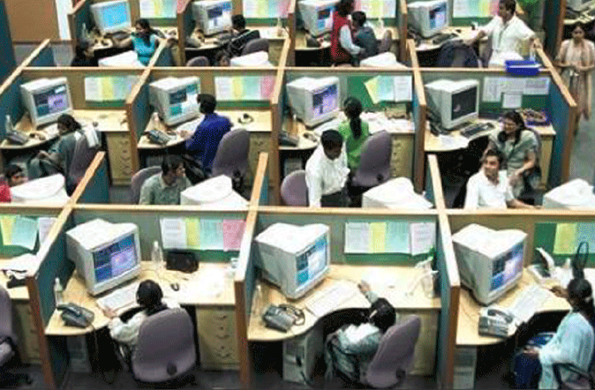
Want to Work Here?
42

Slide 43
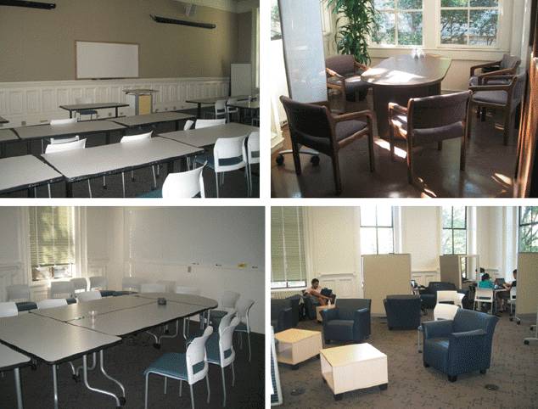
Do these Spaces Facilitate Organization and Interaction?
43

Slide 44
Relationships with Other Organizing Systems
No organizing system exists in isolation
There are always overlapping and adjacent systems from the user’s perspective
Sometimes it is possible to design these to work together to achieve integration and interoperability, or standards / ecosystem can emerge
At very least, try not to make this difficult
44

Slide 45
INFO 202 “Information Organization & Retrieval” Fall 2015
Robert J. Glushko glushko@berkeley.edu
@rjglushko
14 September 2015 Lecture 5.3 Design Patterns for Interactions

Slide 46
Requirements for Interactions
All organizing systems have some common interactions, but most of the time we want to pay attention to the more resource-specific interactions that create the most value
The priorities of different interactions are often determined by decisions about intended users
An essential requirement is ensuring that the supported interactions can be discovered and invoked by their intended users (i.e, we need good user interfaces)
46

Slide 47
“Interaction Intensity”
It is useful to treat interaction design intensity as a design parameter to differentiate service offerings of the same type or industry domain
We can define a "generic" service offering as a design pattern that can be increased or reduced in intensity by changing the number of interactions
47

Slide 48
“Touch Points” and Interaction Intensity / Quality
In service design, interaction intensity is often measured by the number of “touch points” they require to create value
This view lets us treat intensity as a design parameter to differentiate service offerings of the same type or industry domain
The “generic” service offering is a design pattern that can be increased or reduced in intensity by changing the number of touch points
Notes:
48

Slide 49
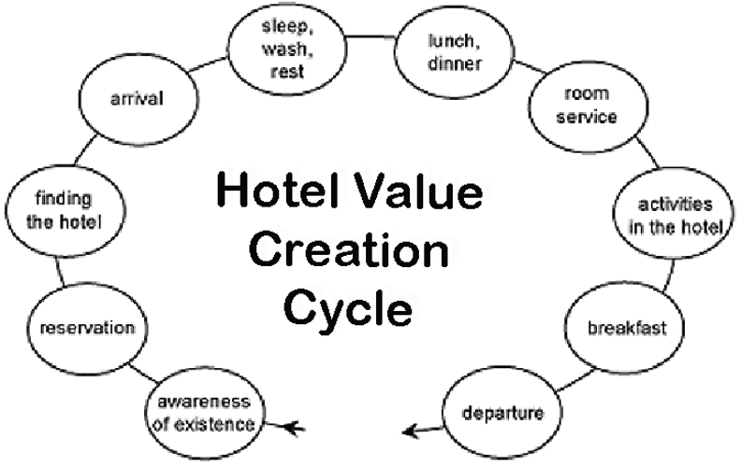
Interaction Design Pattern: “Generic” Hotel
49

Slide 50
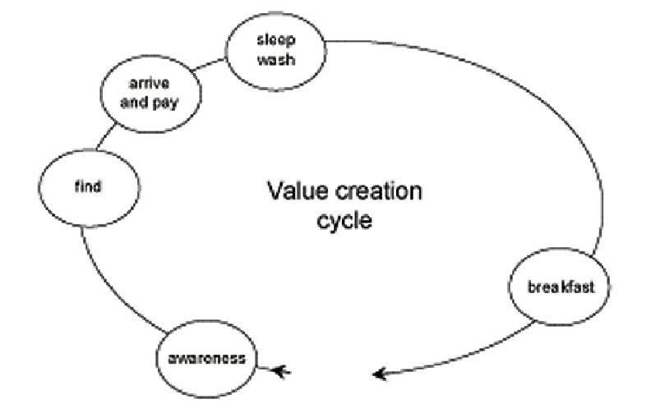
A “Budget” Hotel with Fewer Interactions
50

Slide 51
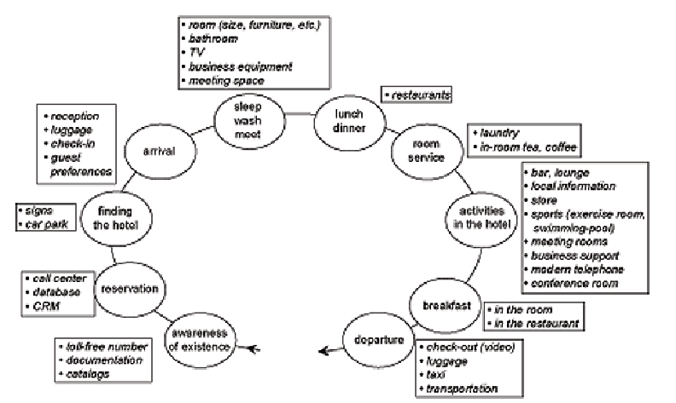
A “Luxury” Hotel with More Interactions
51

Slide 52
Interaction Alternatives Accommodate User Preferences
..and keyless entry systems let you skip the lobby and go directly to your room, using your smart phone app as the key
52

Slide 53
Tradeoffs in Interaction Design: Substituting Information for Interaction
Capturing, managing, integrating and retrieving information allows service providers to substitute information for interaction
You don’t need high intensity or many touch points if stored information makes interaction unnecessary
A hotel clerk with a database doesn’t need to ask for your room preferences; Amazon doesn’t need to ask you about what type of books you like
Design implication: hidden computational services are interchangeable with customer-facing “touch points”
Notes:
53

Slide 54
INFO 202 “Information Organization & Retrieval” Fall 2015
Robert J. Glushko glushko@berkeley.edu
@rjglushko
14 September 2015 Lecture 5.4 Design Tradeoffs for Organizing Systems

Slide 55
Fundamental Tradeoffs in an Organizing System (1)
There is a tradeoff between the amount of work that goes into describing and organizing a collection of resources and the amount of work required to find and use them
The more effort we put into describing and organizing resources, the more effectively they can support interactions
The more effort we put into retrieving resources, the less they need to be organized first
55

Slide 56
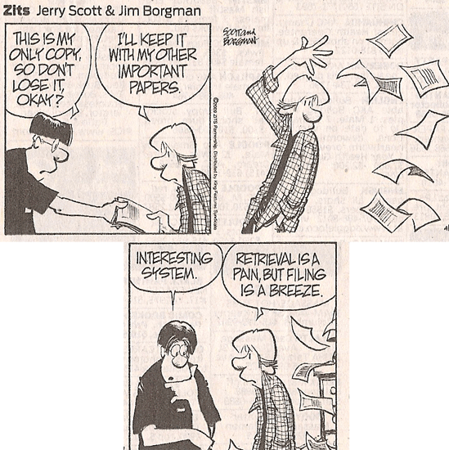
Even Comic Strips Know The Tradeoff

Slide 57
Fundamental Tradeoffs in an Organizing System (2)
We need to think in terms of investment, allocation of costs and benefits between the describer/organizer and user
The allocation differs according to the relationship between them; who does the work and who gets the benefit?
57

Slide 58
Fundamental Tradeoffs in an Organizing System (3)
It is critical to determine an appropriate mix of methods for creating and maintaining resource descriptions, because their cost, quality, consistency, completeness, and semantic richness depends on which human or computational agents do the work
58

Slide 59
Fundamental Tradeoffs in an Organizing System (4)
Business strategy and economics strongly influence the extent of resource description and the use of technology for automatic description
The tradeoffs imposed by the extent and timing of resource description arise throughout the lifecycle, with the tradeoff between recall and precision being the most salient
59

Slide 60
Readings for Next Lecture
TDO Sections 3.1-3.4
Kent Preface and Chapter 1
Some readings about the I o T
Some case studies

