Slide 1
Plan for Today’s Lecture(s)
We are trying to overcome misconceptions that people outside the computer business don’t have in the first place (Kent, preface p.23)
Resources and resource identity
An introduction to conceptual modeling
Four distinctions about resources
1

Slide 2
INFO 202 “Information Organization & Retrieval” Fall 2015
UNIVERSITY OF CALIFORNIA, BERKELEY
SCHOOL OF INFORMATION
Robert J. Glushko glushko@berkeley.edu
@rjglushko
16 September 2015 Lecture 6.1 – Resources and Resource Identity

Slide 3
What is a Resource?
When you look at, refer to, or pick up a natural physical object, it usually seems that it is "one thing"
Many things have highly visible parts or internal structures, and we must consider whether to treat them as assemblies or aggregations of these separate things
For digital and computational resources, it is much harder to know how many parts we can or should identify
Once you've decided what to treat as a resource, you can create a name or identifier so you can refer to it
3

Slide 4
The Unit of Analysis
Identifying the unit of analysis is a central problem in every intellectual or scientific discipline - and in every organizing system
But if the basic unit of an organizing system isn't usually very clear or naturally given to us, we need systematic methods for determining which resources will have separate identities and how they are related to each other
4

Slide 5
“Carving Nature at its Joints”
Over 2000 years ago Plato (in Phaedrus) has Socrates arguing that species are distinguished by "carving nature at its joints" - where the natural differences between things are the largest or most salient or where there are few connections
I.e., there are “natural kinds” – categories are discovered, not invented
"Joints" and the boundaries they create between things exist to some extent with physical resources and are manifested in their surface or perceptible properties
5

Slide 6
Carving Information at its Joints?
When we deal with resources that are made of information, any "joints" are man-made and arbitrary
There might be indications "on the surface" that suggest the "joints" between information resources, but these represent design decisions, might be more structure or presentation oriented than content oriented distinctions, and are subject to cognitive interpretation
6

Slide 7
“Thing” vs. “Type of Thing”
Identifying a resource as an instance is not the same as identifying the category or "equivalence class" to which it belongs.
At various times we can consider any given resource to be one of many members of a broad category, as one of the few members of a narrow category, or as a unique instance of a category with only one member.
7

Slide 8
Two Aspects of “Thingness”
Two separate aspects cut across the "thingness" distinctions:
Granularity
Abstraction
8

Slide 9
Granularity: Whole vs. Parts
Resources that are aggregates or composites of other resources, or that have internal structure, pose questions about the granularity of their "thingness"
We might need to organize and manage the granular resources, the composite resources, and the relationships between them - all at the same time
The "part things" can be identified at various levels of contexts/containers/collections in which they occur
The granularity of physical resources is more easily determined that for information resources
9

Slide 10
Red Car as 1 Resource
10

Slide 11
Red Car : Not 1 Resource
11

Slide 12
Abstraction - 1
We can identify a resource as a unique instance or as a member of a class of resources
The size of this class - the number of resources that are treated as equivalent - is determined by the properties or characteristics we consider when we examine any instance
The choice of these properties depends on context and intent, so the same resource can be identified abstractly in some situations and very concretely in others
12

Slide 13
Abstraction - 2
For tangible resources, there may be "natural" levels of abstraction (See Plato…)
For intangible resources, there aren't
13

Slide 14
The “Abstraction Hierarchy” of the “Work”
WORK - an abstract entity; the distinct intellectual or artistic creation; it has no single material manifestation
EXPRESSION - the multiple realizations of a work in some particular medium or notation, where it can actually be perceived
MANIFESTATION - each of the formats of an expression that have the same appearance; but not necessarily the same implementation
ITEM - a single exemplar of a manifestation; if we distinguish this level it is because otherwise identical manifestations have some differentiation
14

Slide 15
What is Macbeth?
15

Slide 16
The Equivalence Continuum (Tillett)
16

Slide 17
INFO 202 “Information Organization & Retrieval” Fall 2015
UNIVERSITY OF CALIFORNIA, BERKELEY
SCHOOL OF INFORMATION
Robert J. Glushko glushko@berkeley.edu
@rjglushko
16 September 2015 Lecture 6.2 – Introduction to Modeling

Slide 18
An Introduction to Modeling - 1
Models are simplified descriptions of a subject that abstract from its complexity to emphasize some features or characteristics while intentionally de-emphasizing others
Models enable us to describe and communicate systems regardless of the specific domain or discipline that they represent
18

Slide 19
An Introduction to Modeling - 2
A model can represent a human activity, a natural system, or a designed system
We can model structures – objects, their characteristics, their static relationships with each other like hierarchy, and reference
We can model functions, processes, behaviors – dynamic activities that create and affect structures
19

Slide 20
Recipes as Everyday Models
A recipe describes both objects and structures (ingredients) and the processes (instructions) for creating a food dish
You can FOLLOW the recipe to create the dish
You can COMMUNICATE the recipe to someone else who can then create the same dish
You can use the recipe as a GUIDE FOR EXPERIMENTATION with the objects or the processes in the recipe to create alternative dishes
20

Slide 21
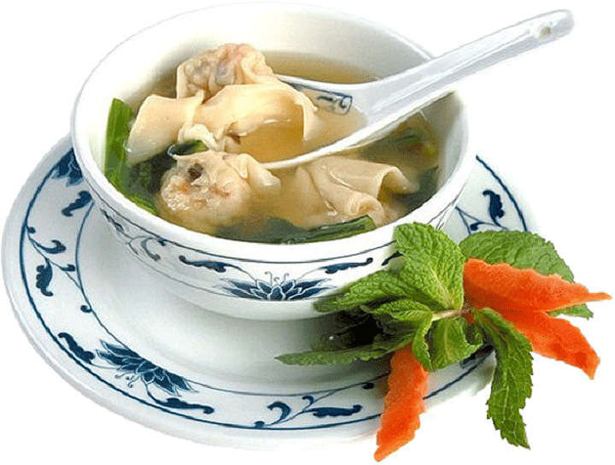
Not a Model of Wonton Soup
21

Slide 22
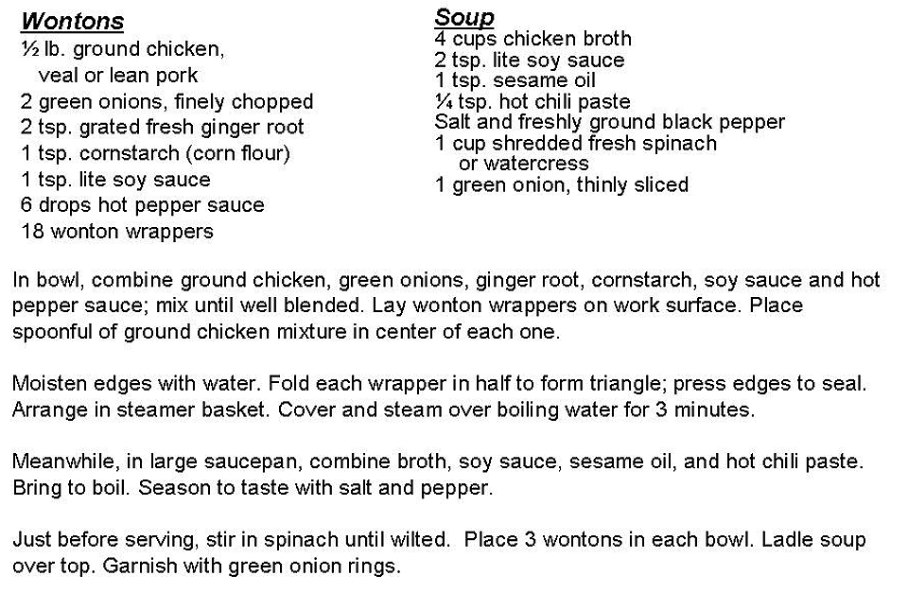
A Model of Wonton Soup
22

Slide 23
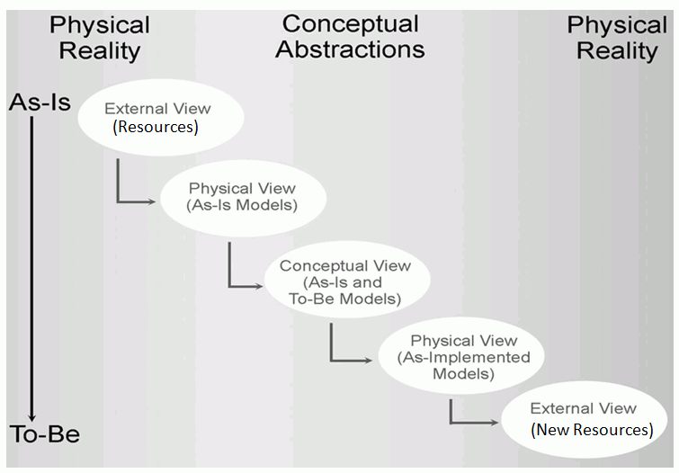
The Classical Modeling Approach
23

Slide 24
Physical Modeling for Analysis - 1
The primary purpose of modeling is to better understand some existing system or environment and its resources and to describe this understanding so it can be communicated
Models of things as they currently exist are Physical or As-Is models
This modeling activity is usually called "systems analysis" or simply "analysis"
A basic task of modeling for analysis is capturing the languages and practices of the people who work with the resources in the "real world"
24

Slide 25
Physical Modeling for Analysis - 2
Any system (especially business and other institutionalized ones) has groups of stakeholders who do not fully understand the "big picture" – an analysis model can be used to prevent or repair misunderstandings
A physical model synthesizes different views or observations into a more complete or generic perspective that accurately accounts for all of them
25

Slide 26
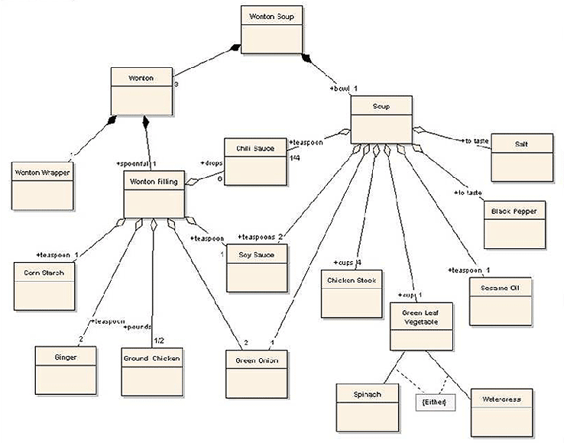
Physical View of Wonton Soup
26

Slide 27
Conceptual Modeling for (Re-)Design - 1
The next purpose of modeling is to assist in the design or re-design of a system or set of resources
This modeling activity is usually called "systems design" or simply "design"
Models of resources as they could be are Conceptual or To-Be models
Design abstracts away or generalizes from the technology and implementation details in the physical model to create a conceptual model
27

Slide 28
Conceptual Modeling for (Re-)Design - 2
A conceptual model that is implementation-independent is often easier to talk about than one that is encoded in a specific technology context
When technologies change, the implementation model may change but the conceptual model won't.
When implementations in different technologies are based on the same conceptual models, they can more readily understood because of their common conceptual components.
28

Slide 29
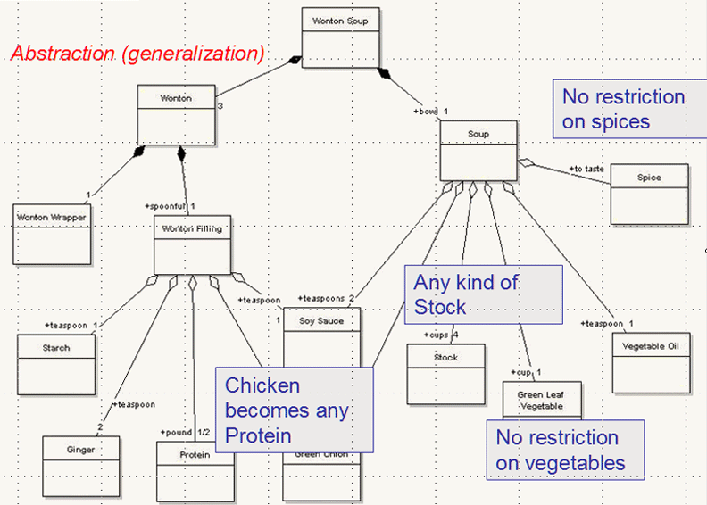
Conceptual View of Wonton Soup
29

Slide 30
Using Conceptual Models
Resources can be manipulated as conceptual components without impacting the real world that they describe, or in ways that are impossible in the real world
This encourages the re-use of common components via standardization, patterns and libraries
It facilitates the rationalization of components and the removal of redundancies and inefficiencies
30

Slide 31
The Modeling Gaps
There is an essential difference or gap between the real world being modeled and any models of it, or else the models would serve no purpose
Likewise, there is always a gap between a physical model and a conceptual model, because an analysis model is often most useful when it isn't tied to specific or feasible implementations or technologies
But this means we can sometimes see what the current world looks like and what we would like it to be without being able to see how to get from one to the other
31

Slide 32
Implementing a Conceptual Model as a Physical One
A model is purely theoretical until it is encoded in a technology that lets it operate in the real world again.
This is often a two-stage process: encoding conceptual models as physical ones, and then applying transformations to create resource instances with desired properties
When resources implemented in different technologies are generated or re-generated from models, they can more readily interoperate because of their common conceptual components
32

Slide 33
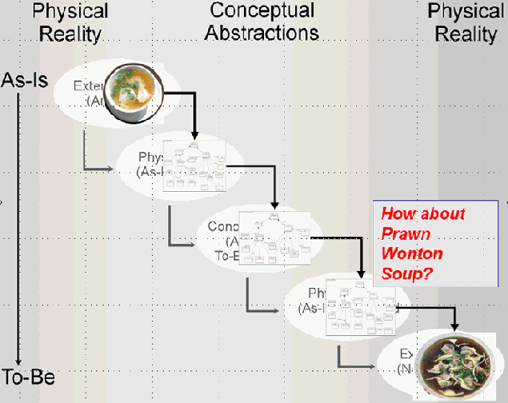
Applying the Conceptual Model
33

Slide 34
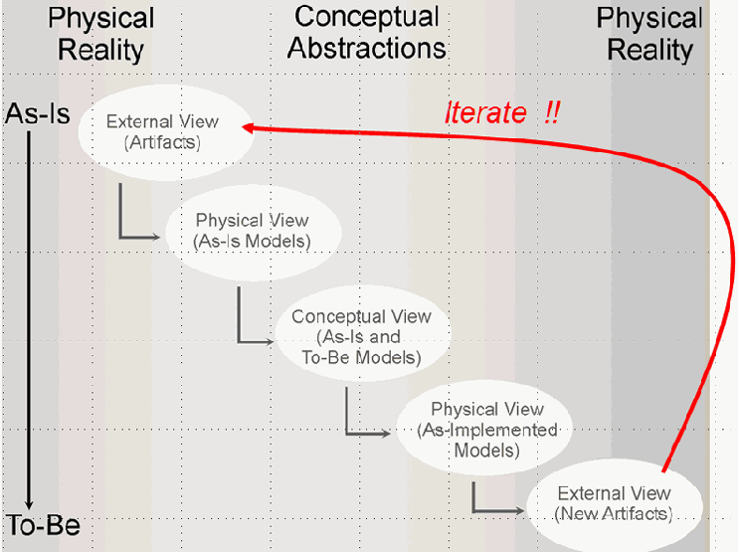
Iteration is Inevitable
34

Slide 35
Adapting the Classical Modeling Approach to TDO – 1
In an Organizing System context we can analyze a domain and analyze its resources and their processes or behaviors as we normally would
But taking an architectural perspective that distinguishes organizing principles from implementation means that we emphasize the information or intangible content of the resources
We only model those resources and their properties that are relevant to organizing them
35

Slide 36
Adapting the Classical Modeling Approach to TDO – 2
In some Organizing System contexts we start with a collection of resources to organize
So we analyze the domain and the resources to determine appropriate properties to use in descriptions and organizing principles as we would in any other modeling activity
But sometimes we concurrently design the Organizing System and the resources it will contain
Systematic modeling of information components and documents to enable efficient reuse and transformation is essential
36

Slide 37
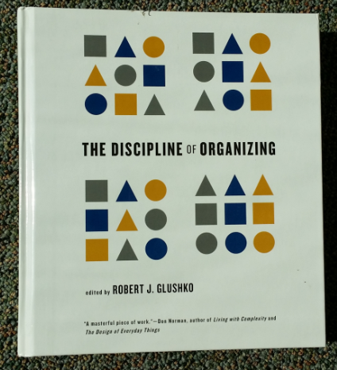
Model the Information
<Book>
<Title>The Discipline of Organizing</Title>
<Editor>Robert J. Glushko</Editor>
<Publisher>MIT Press</Publisher>
<PublicationDate>2013</PublicationDate>
<ISBN>978-0-262-51850</ISBN>
</Book>
Not the Thing
<Book>
<Weight unit=“pound”>2.58</Weight>
<Height unit=“inch”>9.25</Height>
<Width unit=“inch”>8.25</Width>
<Pages>540</Pages>
<SpineColor>White</SpineColor>
</Book>
37

Slide 38
INFO 202 “Information Organization & Retrieval” Fall 2015
UNIVERSITY OF CALIFORNIA, BERKELEY
SCHOOL OF INFORMATION
Robert J. Glushko glushko@berkeley.edu
@rjglushko
16 September 2015 Lecture 6.3 – Four Distinctions About Resources

Slide 39
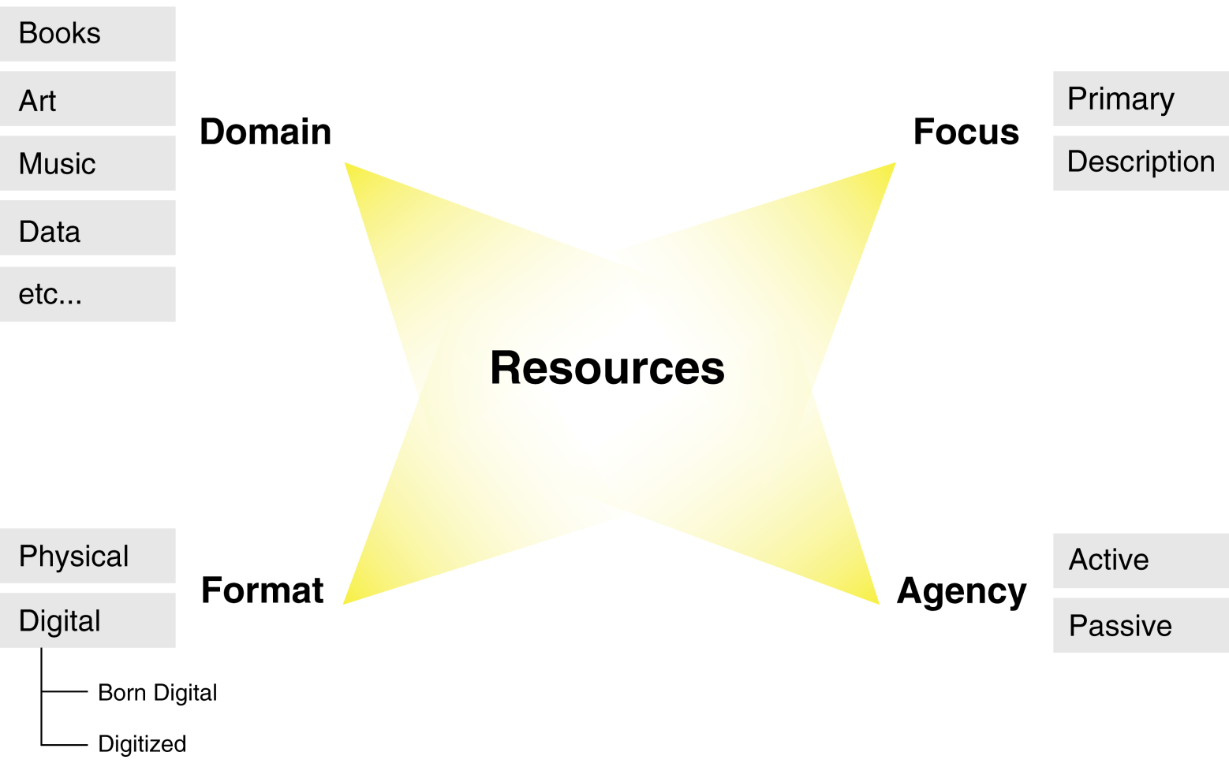
Four Distinctions About Resources
39

Slide 40
Resource Domain
Physical resources - often distinguished by material of composition and other visible properties
Bibliographic resources - traditional focus of library and information science; most commonly used cataloguing rules have 11 categories that don't cleanly distinguish semantics and formats
Information resources - the content of information-intensive artifacts and applications - "Document types"
40

Slide 41
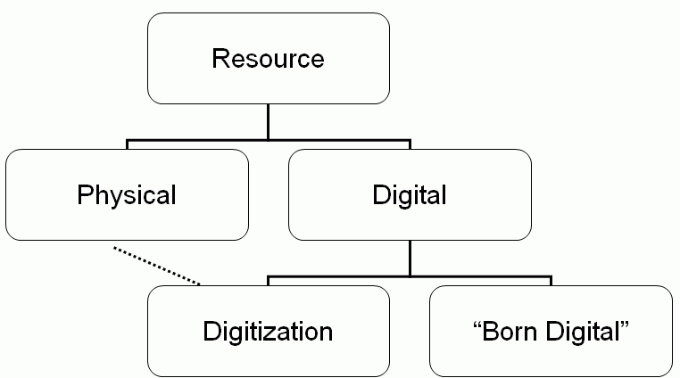
Resource Format in TDO
41

Slide 42
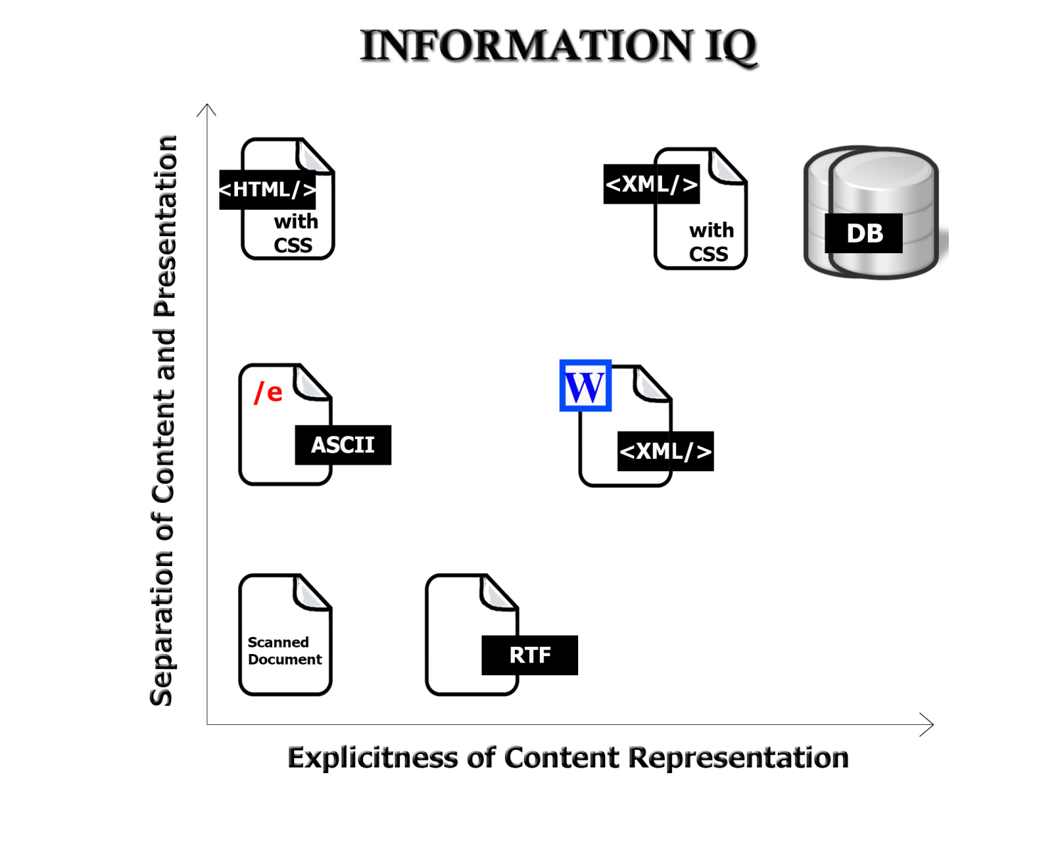
Format Matters!
42

Slide 43
Bits vs Atoms (Negroponte)
A contrast between information as "bits" and information as "atoms" was first expressed by Nicholas Negroponte of the MIT Media Lab (see Being Digital (1995)
Information encoded as bits can move several orders of magnitude faster than atoms can
It can be in many places at once (broadcasting, networking) unlike atoms that have to be in one place
43

Slide 44
Stop And Think
What are other ways in which bits and atoms differ that matter to TDO?
44

Slide 45
Moving Bits != Moving Atoms
45

Slide 46
Resource Focus
Any resource can have other resources associated with it, usually to describe it in some way to facilitate finding it, interacting with it, or interpreting it
So we can designate a resource as a primary one or as a description resource
Description resources are often called METADATA
Metadata often defined as “data about data” but all three parts of that definition are wrong
46

Slide 47
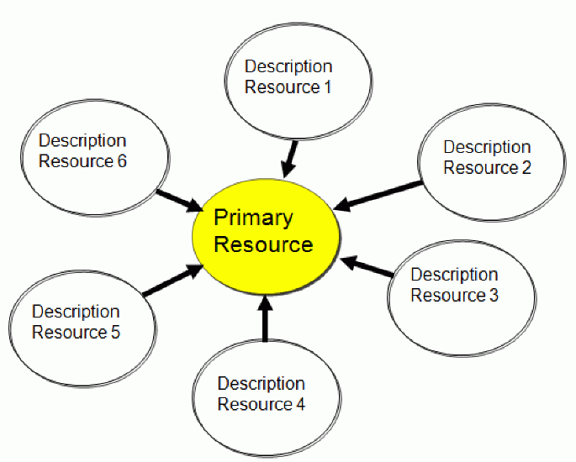
Description Resources
47

Slide 48
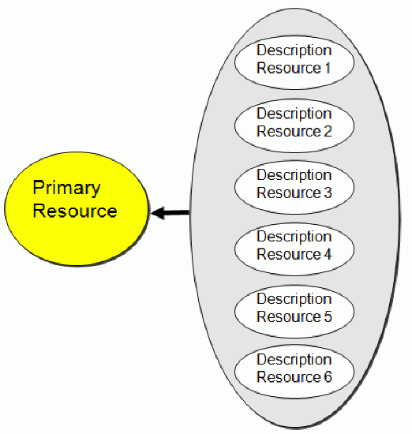
Aggregated Description Resources
48

Slide 49
Resource Focus
In the bibliographic domain the resource vs. description distinction is deeply embedded
It other domains it can be quite arbitrary and "focus" is an important decision
One person's data is another person's metadata -- and now substitute "process" for "person"
49

Slide 50
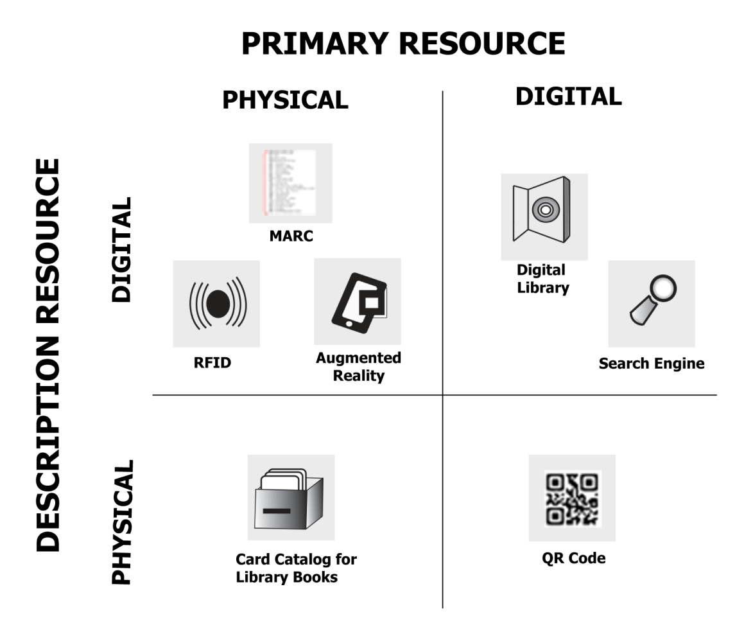
Format x Focus
50

Slide 51
Resource Agency
Passive or operand resources ("nouns") must be acted upon or interacted with to produce an effect
Traditional organizing systems contain tangible and static resources that are "natural operands"
Active or operant resources ("verbs") create effects or value on their own, sometimes when then initiate interactions with operand resources.
Sensors, web-based services, information feeds are operant resources that often are combined to implement business processes or business models
51

Slide 52
Readings for Next Lecture
TDO 3.5, TDO 8.3.1 and 8.3.2
Smith, Abby. “Authenticity in perspective”
52

