Slide 1
Plan for Today’s Lecture(s)
Smart resources
Resources over time
Resource identifiers and names
1

Slide 2
INFO 202 “Information Organization & Retrieval” Fall 2015
UNIVERSITY OF CALIFORNIA, BERKELEY
SCHOOL OF INFORMATION
Robert J. Glushko glushko@berkeley.edu
@rjglushko
21 September 2015 Lecture 7.1 – Smart Resources

Slide 3
“The Computer for the 21st Century”
“The most profound technologies are those that disappear”
“Computers in light switches, thermostats, stereos and ovens help to activate the world”
“Doors open only to the right badge wearer, rooms greet people by name…”
"Who made that dress? Are there any more in the store? What was the name of the designer of that suit I liked last week?“
What will 2025 look like?
3

Slide 4
Active / Operant / Smart Resources
“Smart” is a commonly used description of resources that can exploit sensing, computing, and communication capabilities
Virtually any product that uses electricity - toys, coffeemakers, cars, medical diagnostic machines - possesses inherent data processing capabilities. Each has a wealth of information about its current status, usage history, and performance
A “smart” resource with an IP address is said to be part of the “Internet of Things”
4

Slide 5
Everyone is Doing It
IBM
Microsoft
SAP
Oracle
EMC
HP
Cisco
Google (Nest)
AT&T
Lockheed Martin
And a few hundred startups!
5

Slide 6
What Makes A Resource Smart?
Sensing – the resource can sense, measure, track, or record some aspect of its environment or context, or its interactions with other resources
sensors that transmit other types of data about their environment

Slide 7
Some Design Issues for Smart Sensing
HOW SMART IS THE RESOURCE?
HOW SMART DOES IT NEED TO BE?
Are the sensors in known locations, or is locating and arranging them a task in its own right?
How "smart" is the information communicated by the sensor? What format? Is there any local processing?
What initiates the sending of the sensed information?
7

Slide 8
Context Awareness: Sensing People and Surroundings
Where are you?
What are you doing, looking at, looking for?
Who are you with?
What’s it like there?
8

Slide 9
Location and Activity Tracking
Objects can be "timestamped" in known locations
Objects can identify their location
Location is used to personalize information and services (“context-sensitive” or “context-aware”)
In aggregate: Supply chain and Demand chain information
what do potential customers want
when and where do they become customers by buying something
how do they use the products
9

Slide 10
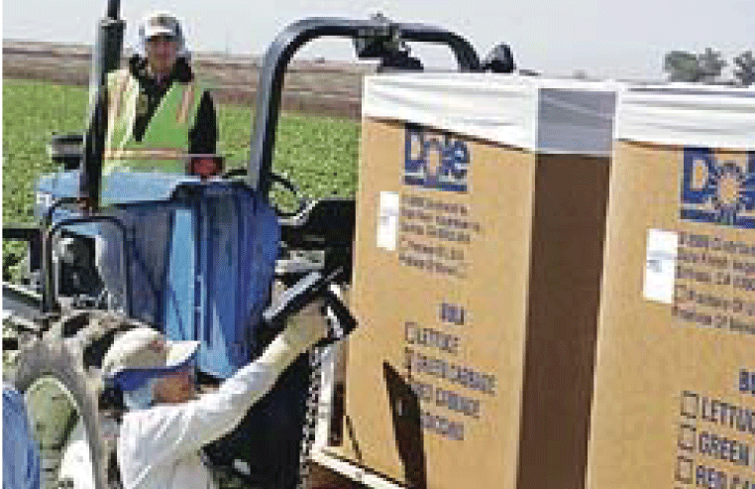
Tracking the Food Supply
10

Slide 11
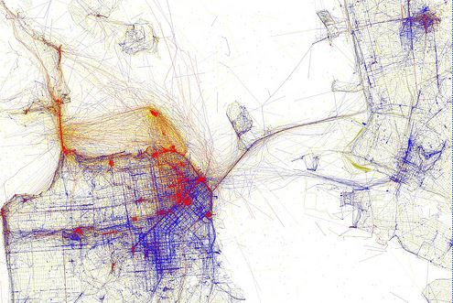
Tourist and Local Photos
Blue = Locals, Red = Tourists

Slide 12
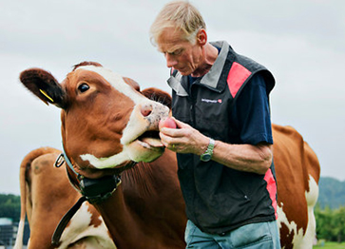
What Makes A Resource Smart?
Actuation – the resource can initiate an action based on what it senses
Turning on lights, motors, speakers, cameras
Displaying, broadcasting, or sending information about its state
A Smarter Cow can “Sext” when it is “in heat”

Slide 13
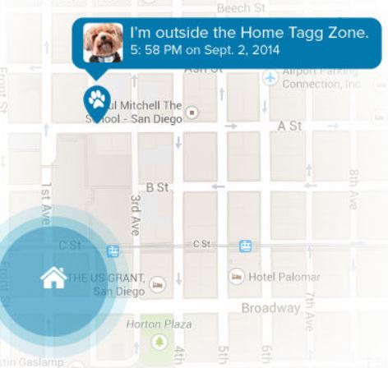
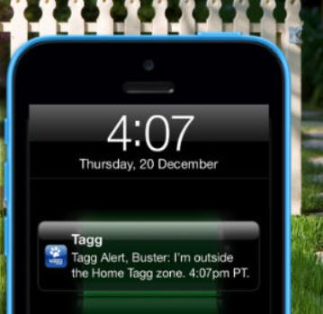
Your Dog Tells You When It is Bad
A location tracking collar on your dog can send you a text message if your dog runs away from some defined location

Slide 14
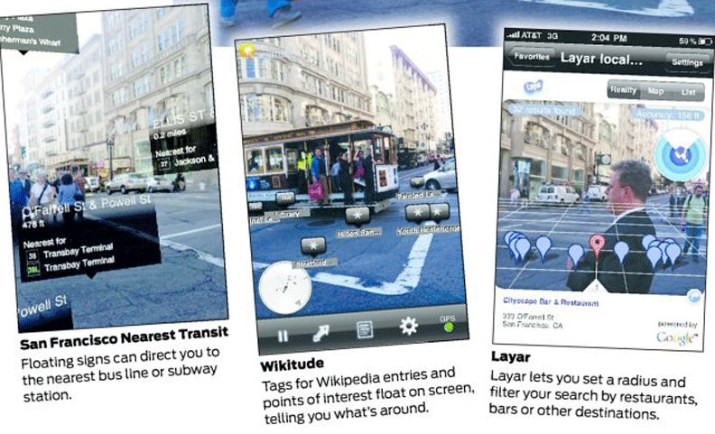
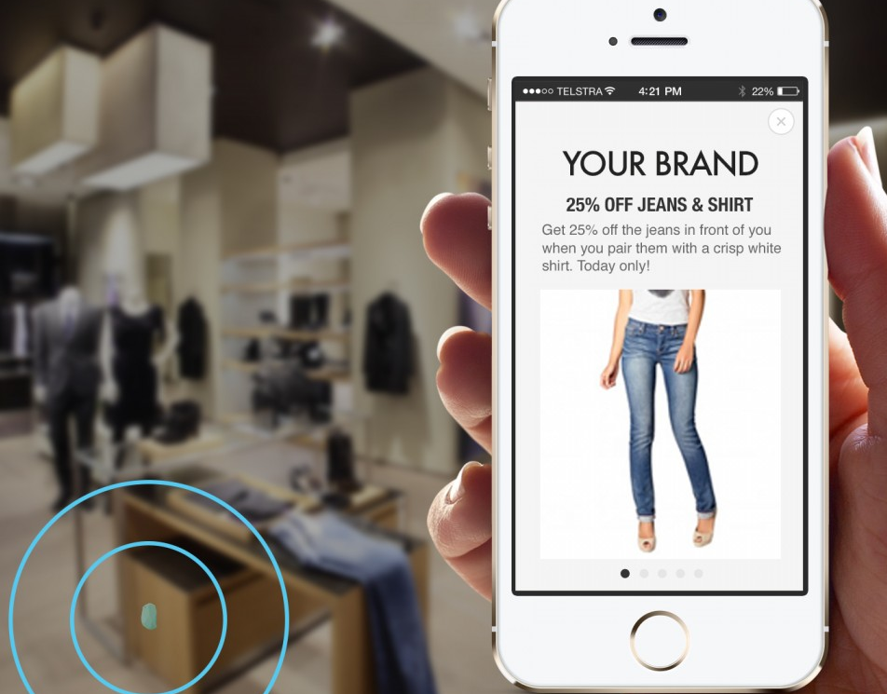
Augmented Reality
Location and resource-based information is sent to or layered on your smart phone
Resources with “beacons” can broadcast this kind of information

Slide 15
What Makes a Resource Smart?
Connectivity – physical and permanent connection, or digital (e.g., with IP)
Can enable the resource to send information to a more capable resource
Computation – analyze, refine, learn from the information it senses or obtains from connected resources
Programmable resources can have their capabilities upgraded by software updates

Slide 16
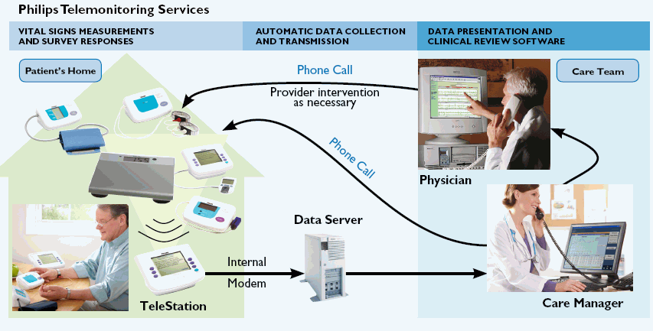
Remote Patient Monitoring
Wearable devices or home appliances can capture vital signs and activity data and inform medical personnel as needed
Enabling "aging in place" with "assistive technology" can vastly improve the quality of life for old folks
16

Slide 17
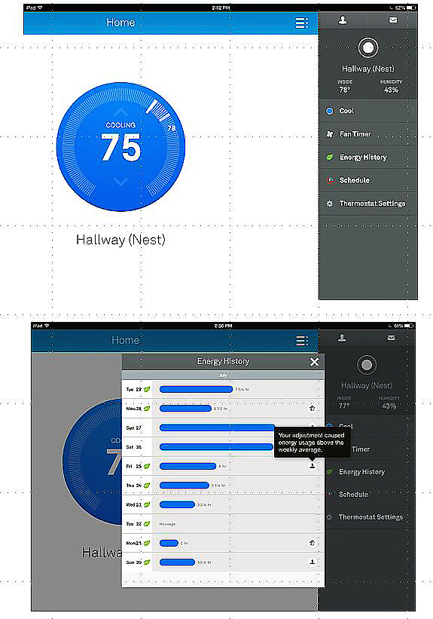
The Nest Learning Thermostat
The thermostat control panel and an energy history report
Can serve as a hub device, communicating with lights, appliances, alarms, your car, your fitness sensor, and other active resources
Resistance is futile

Slide 18
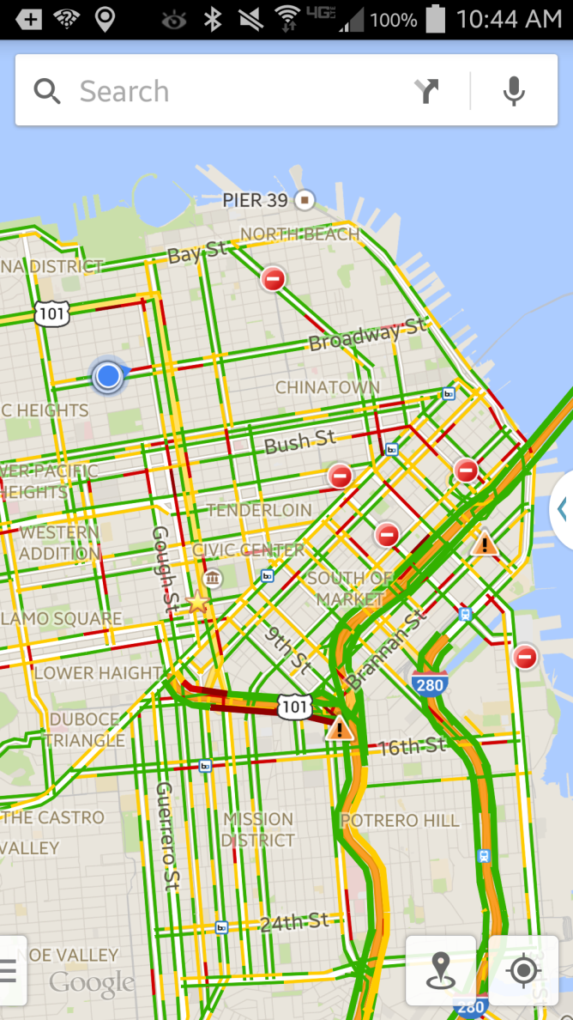
What Makes a Resource Smart?
Composability and Cooperating – independently designed and deployed resources can work together to enable services based on aggregated information

Slide 19
Smart Transportation Systems
Goal is to build a transportation system that will be more efficient, less polluting, and safer for better-informed drivers
Sensors count cars and identify their locations (from which traffic speed is calculated)
"Personal navigation devices" were once dedicated devices, often built into vehicles, but we now have them as smart phone applications
19

Slide 20
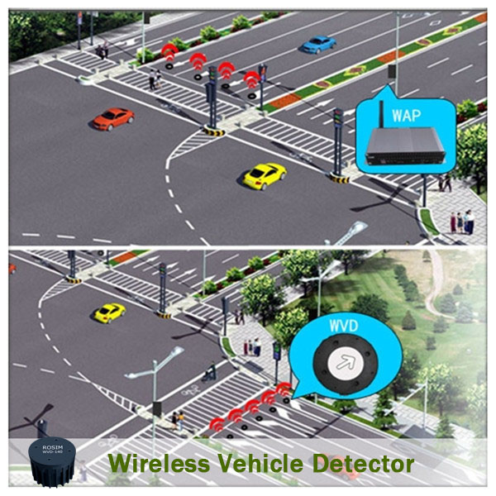
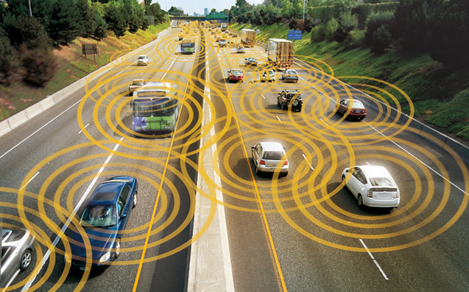
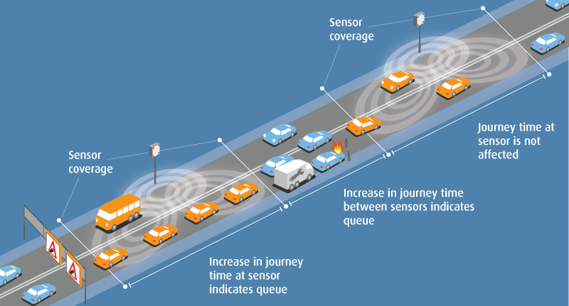
Smart Roads
V2V Networks
http://www.blipsystems.com/danish-german-partnership-disseminate-smart-city-solution-help-ease-traffic/

Slide 21
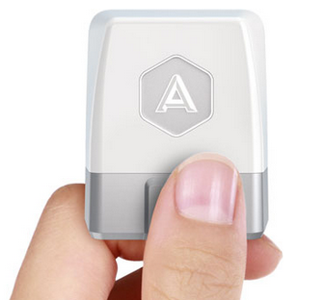
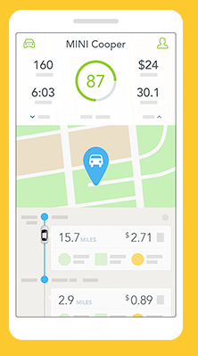
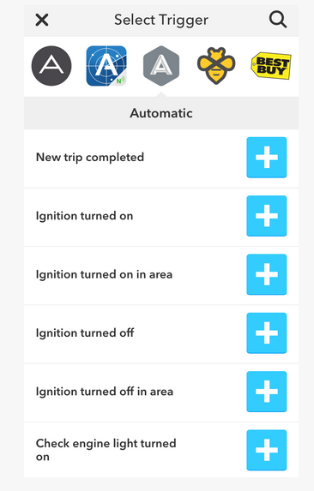
Automatic
Connect your car to the rest of your digital life
Automatic
Automatic Apps

Slide 22
Privacy as a Limiting Factor in Smart Resources
A limiting factor on context-aware smart services might well be the willingness of people to allow service providers to use information about their current or previous contexts
Nevertheless, privacy or spam concerns or other worries about annoyances from commercial firms seem minor compared to potential abuses by governments.
22

Slide 23
Stop And Think
There is a great deal of hype about the Internet of Things, and if you search for the phrase “Internet of Things” along with almost any physical resource, chances are you will find something, Try “baby,” “dog,” “fork,” “lettuce,” “pajamas,” “streetlamp,” and then a few of your own.
Target Open House
The Internet of Way Too Many Things
23

Slide 24
Smart Bookmarks
When you’re ready to continue reading, log in and the page number comes by text message
24

Slide 25
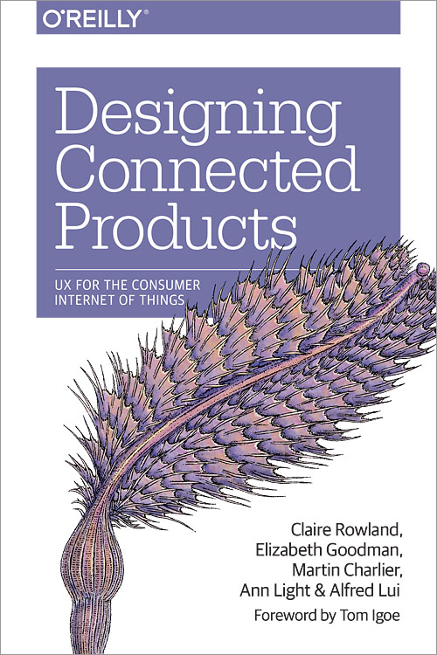
On a More Serious Note
New book – published May 2015
Co-author Liz Goodman
is a 2013 PhD from the Berkeley ISchool
25

Slide 26
INFO 202 “Information Organization & Retrieval” Fall 2015
UNIVERSITY OF CALIFORNIA, BERKELEY
SCHOOL OF INFORMATION
Robert J. Glushko glushko@berkeley.edu
@rjglushko
21 September 2015 Lecture 7.2 – Resources over Time

Slide 27
Resources over Time
Organizing systems continually need to adapt and evolve in response to changes in content and context
New resources are created or added, and other ones are destroyed or culled
Resources might change in controlled ways or in uncontrolled ways
The organizing system might need automated or formal mechanisms for ensuring persistence and authenticity
27

Slide 28
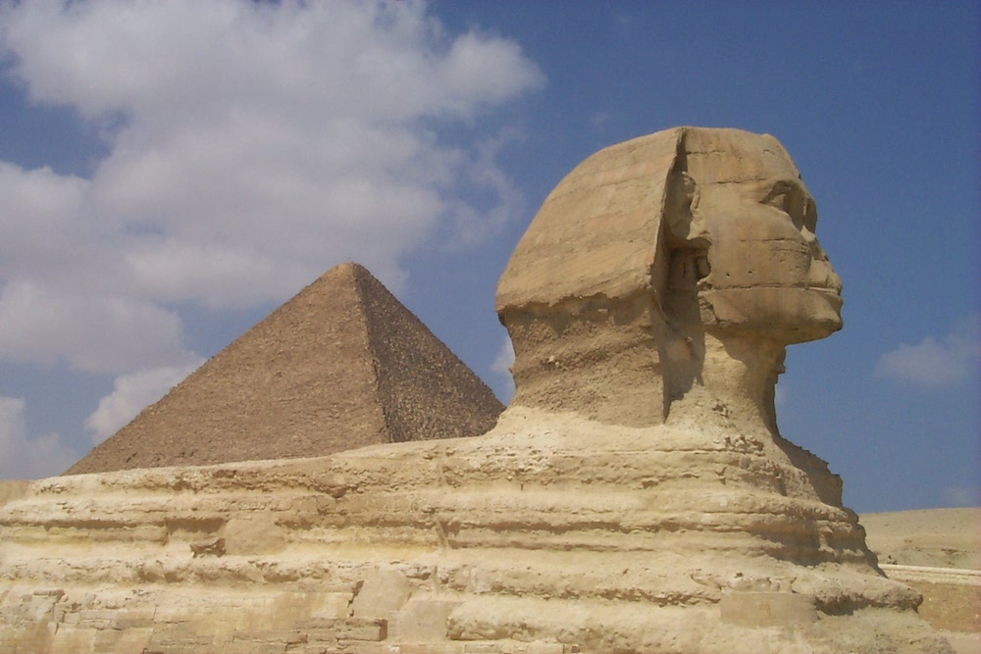
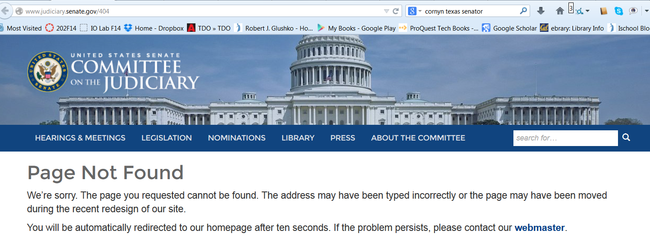
Persistence
28

Slide 29
Library of Congress Recommended Formats for Text Preservation
Formats in order of preference:
XML-based markup formats, with included or accessible DTD/schema, XSD/XSL presentation stylesheet(s), and explicitly stated character encoding
Page-layout formats (PDF variants)
Formats in which this recommendation is published: HTML, PDF
29

Slide 30
Authenticity
Buy an autographed photo from Ustar.net and get a Certificate of Authenticity
Or make your own cert?
Famous Forged Documents
Famous Forged {paintings, sculptures, signatures,…}
30

Slide 31
Authenticity in a Digital Environment – 1
We often use judgments about the physical integrity of recorded information to stand in for a judgment about the integrity of the text
Digital resources have no independent physical manifestations or indications of usage that can provide evidence "about their fate in the world”
31

Slide 32
Authenticity in a Digital Environment – 2
The "permeability" of digital environments makes it harder to ensure that resources have not been altered
Scholars trust technological solutions like time stamps. encryption, watermarks, and digital signatures; technologists are skeptical of them
In the digital world selecting for preservation has become a process of constant re-selection
32

Slide 33
Provenance
33

Slide 34
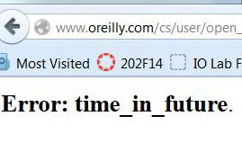
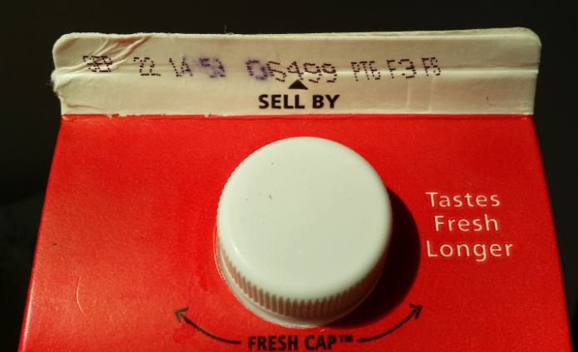
Effectivity
SEC. 108. This title shall take effect on the first day of the sixth month which begins after the date of the enactment of this title, except that the amendments regarding sections 19(b)(7) and 19(b)(8)(D) of the Federal Reserve Act shall take effect on the date of enactment of this title.
(From US Code of Federal Regulations)
34

Slide 35
Putting them all Together
TDO Figure 3.6
35

Slide 36
INFO 202 “Information Organization & Retrieval” Fall 2015
UNIVERSITY OF CALIFORNIA, BERKELEY
SCHOOL OF INFORMATION
Robert J. Glushko glushko@berkeley.edu
@rjglushko
21 September 2015 Lecture 7.3 – Resource Names and Identifiers

Slide 37
What is a Name?
A NAME is a label for some thing or some category that is used to distinguish one from another
Many surnames are literally resource descriptions
But most resource names do not convey properties of the resource
If a name is used to refer to some thing and is unique in some context it is an IDENTIFIER
37

Slide 38
Issues with Names and Naming – 1
A specific resource or type or resource can often have multiple names; these are SYNONYMS or ALIASES
Different things can sometimes have the same names -- these are HOMOGRAPHS or POLYSEMES
38

Slide 39
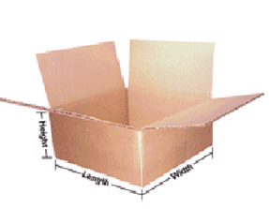
SYNONYMS: “Box,” “Carton,” or “Shipping Container” ?
39

Slide 40
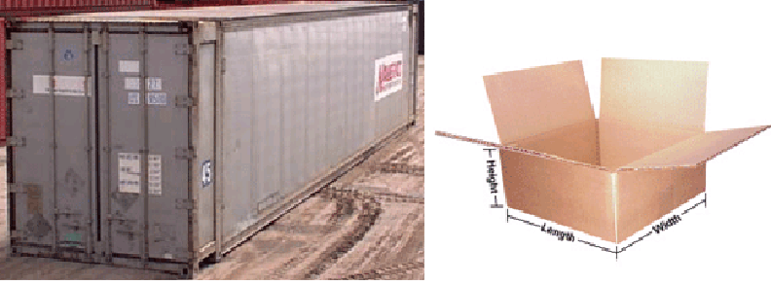
POLYSEMES: Both are “Shipping Containers”
40

Slide 41
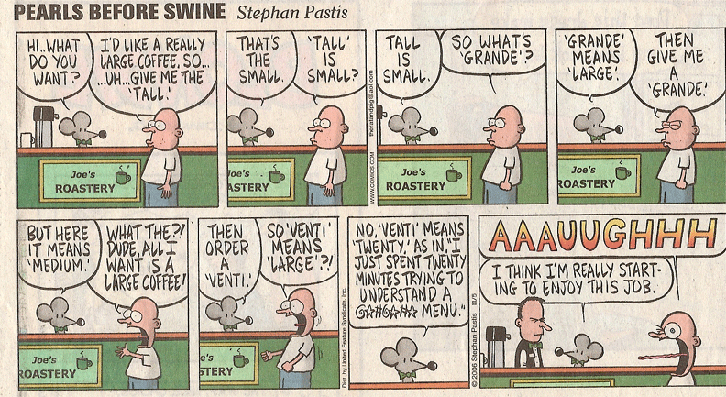
The Vocabulary Problem
41

Slide 42
The Vocabulary Problem
People use a large variety of words for the same thing or concept
Most people - especially system designers - are surprised by this because they think their own word choices are “intuitive” or "natural“
The extreme variability of word selection is an inescapable fact that has its roots in the nature of language and categorization
42

Slide 43
Issues with Names and Naming – 2
False cognates (GIFT, PAIN)
A name can have undesirable associations
A name can have assume impermanent attributes or associations (baby names over time)
Alphabetic ordering bias
Autogenerated names can't cross the "semantic gap”
43

Slide 44
“China Lucky Numbers” for Air Travel (Wikipedia)
Air Canada route, Shanghai to Toronto: Flight AC88
KLM route, Hong Kong to Amsterdam: Flight KL888
Etihad Airways route, Abu Dhabi to Beijing then onwards to Nagoya: Flight EY888
United Airlines, Beijing to San Francisco: Flight UA888, and the route from Beijing to Newark is Flight UA88
Air Astana, Beijing to Almaty: Flight KC888
British Airways, Chengdu to London: Flight BA88
Cathay Pacific's from Hong Kong to Vancouver and New York is CX888
44

Slide 45
Identifiers - 1
An identifier is a special type of name assigned in a controlled way and governed by rules that define possible values and naming conventions; "some person or organization asserts the relationship between the string and the thing” (Coyle, 2006, p. 428)
The same resource can have more than one identifier
How many different identifiers can a person have?
What if the answer is “none”?
45

Slide 46
Identifiers - 2
Identifiers are UNIQUE if they refer to one and only one resource within some defined context or scope
Identifiers are PERSISTENT if they resolve to the same referent indefinitely, or as long as needed; but "persistence is a functions of organizations, not technology
46

Slide 47
Identifiers - 3
Identifiers are UNSTRUCTURED or DUMB (as opposed to STRUCTURED or INTELLIGENT ) if they have no inherent meaning based on their values
Identifier schemes are designed to be STRUCTURED or INTELLIGENT but over time they often become less so
47

Slide 48
ISBN on Bar Code
48

Slide 49
Identifier on Milk Carton

Slide 50
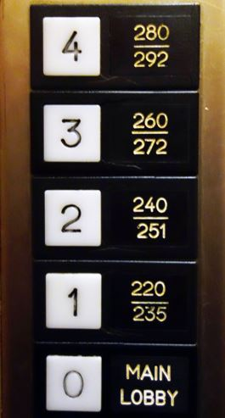
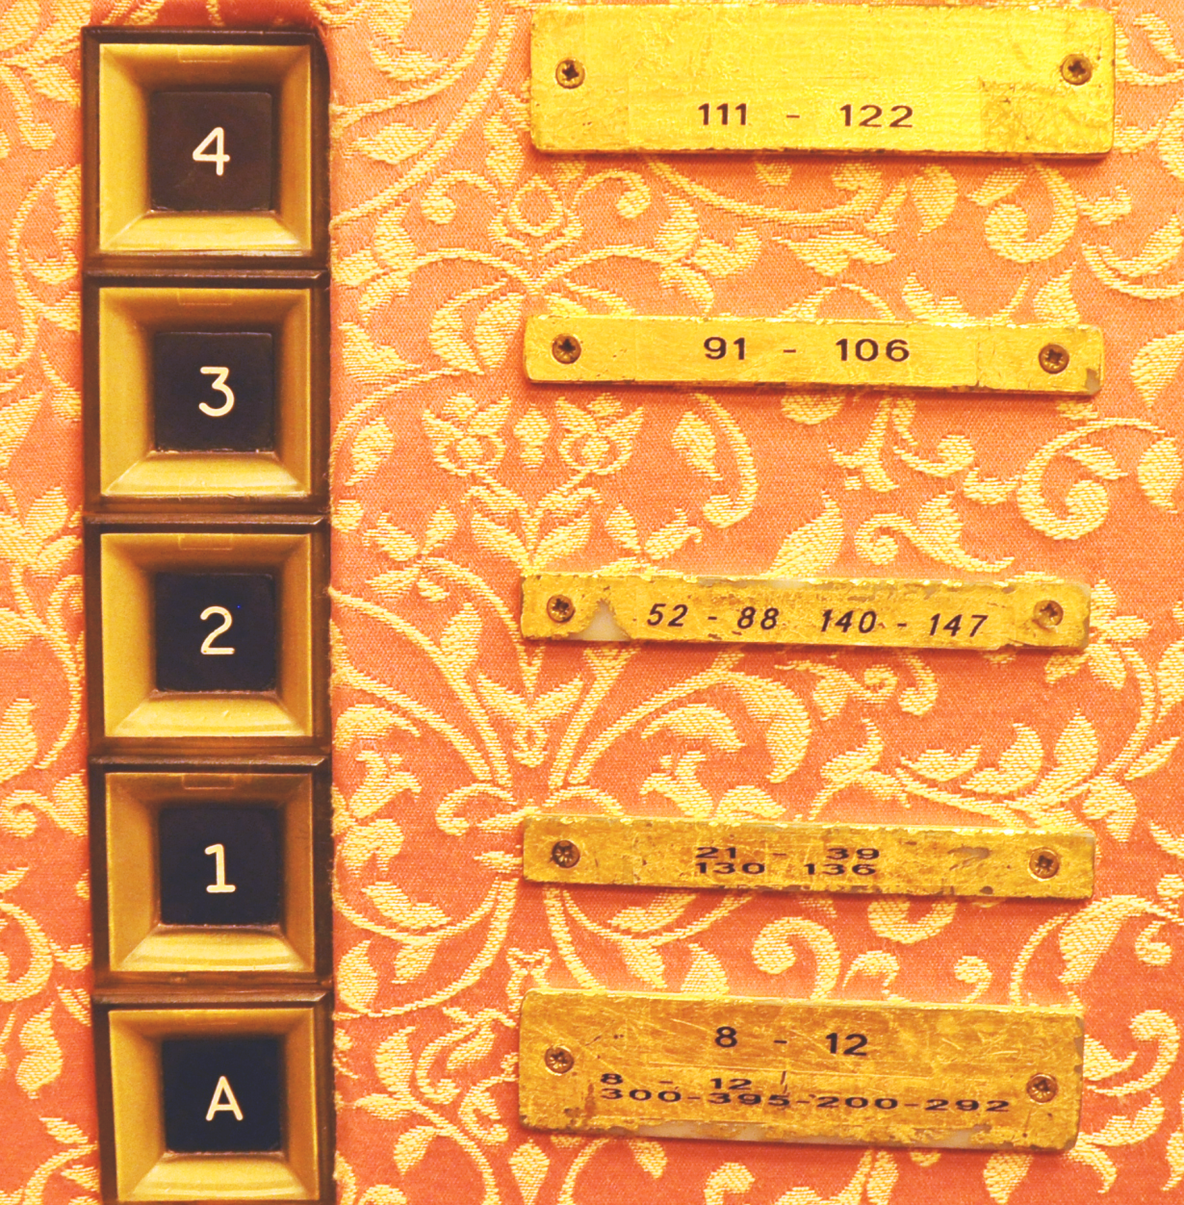
Bad Identifiers for Hotel Rooms

Slide 51
Identifying a Location
Identifiers that are well-known or highly-structured can be used to specify a location
South Hall, University of California, Berkeley
37.871432,-122.258499
But how this is done varies a lot
Addresses in Japan identify buildings by subdividing land into smaller units as needed based on population density
51

Slide 52
Primary Readings for Next Lecture
UNIVERSITY OF CALIFORNIA, BERKELEY
SCHOOL OF INFORMATION
TDO 4.1-4.3
TDO Chapter 8 through the end of 8.2.1
52

