Slide 1
Plan for Today’s Lecture(s)
Intro to Resource Description
Resource Properties and Description
Creating Resource Descriptions
1

Slide 2

INFO 202
“Information Organization & Retrieval”
Fall 2015
UNIVERSITY OF CALIFORNIA, BERKELEY
SCHOOL OF INFORMATION
Robert J. Glushko
glushko@berkeley.edu
@rjglushko
23 September 2015
Lecture 8.1 – Introduction to
Resource Description

Slide 3
An Overview of Resource Description
What is a resource description?
Why do we describe resources?
What resource properties should be described?
How are resource descriptions created?
What makes a good resource description?
3

Slide 4
What is a Resource Description?
Information that is created intentionally and associated with a resource to enable it to be organized and interacted with
A resource description is also a resource from the perspective of any other resource that uses it
Structured descriptions of information resources are often called “metadata”
4

Slide 5
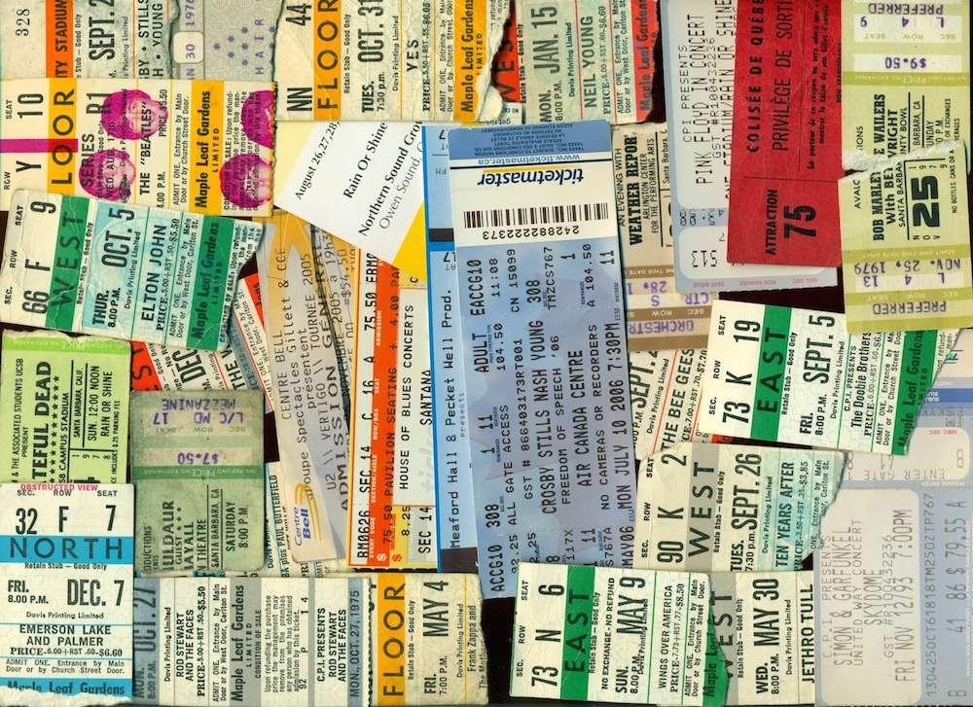
Concert Ticket: Both a Resource and a Resource Description

Slide 6

A Resource

Slide 7
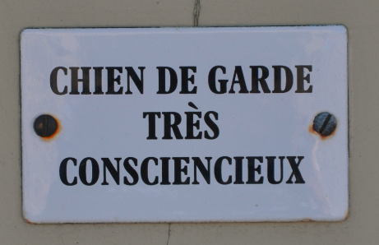
Metadog, not Metadata
dans Les Baux-de-Provence, 8 Août 2013

Slide 8
Why We Describe Resources
We describe resources so we can refer to them, select them, organize them, interact with them, and maintain them
Each purpose might require different descriptions and different methods of using them
Different resource domains can have characteristic or standard resource descriptions (or description categories)
8

Slide 9
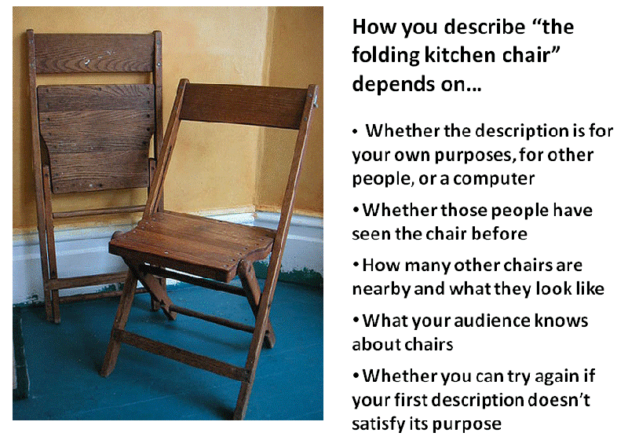
Kimra’s Kitchen Chair

Slide 10
Resource Descriptions as Substitutes
A resource description is often a functional substitute for the resource it describes when the latter can’t be accessed or used
Computer-processable descriptions of physical resources are especially good substitutes because they enable manipulations and interactions otherwise impossible
  At much larger scope and scale…
10

Slide 11
Why We Describe Resources
But different types of resources must also have differentiating properties, otherwise there would be no reason to distinguish them as different types
Over time as a collection of resources grows and as requirements for interactions change, the reasons for describing resources will also change, and the descriptions must change as well
We often combine descriptions... and we often compare them
11

Slide 12
Objectives of Bibliographic Description
Finding a resource that you know exists
Identifying a resource to make sure you have the one you were looking for
Selecting a resource from a set of candidates in a collection
Obtaining the resource if what you have at this point is just a resource description
12

Slide 13
Complications
The properties of resources that are easiest to describe are not always the most useful ones, especially for information resources
For non-text information resources this problem is magnified because the content is often in a semantically opaque format that cannot usefully be analyzed by people
Business strategy and economics strongly influence the extent of resource description
13

Slide 14
Stop and Think:
Real Estate Advertisements
Real estate advertisements are notorious for their creatively optimistic descriptions; a house that is advertised as being “convenient to transportation” is most likely next to a busy highway or bus route, and a house in a “secluded location” is in a remote and desolate part of town
How would you describe the house or apartment or room where you live in a way that turns its negatives into positives?

Slide 15
INFO 202
“Information Organization & Retrieval”
Fall 2015
UNIVERSITY OF CALIFORNIA, BERKELEY
SCHOOL OF INFORMATION
Robert J. Glushko
glushko@berkeley.edu
@rjglushko
23 September 2015
Lecture 8.2 – Resource Properties
and Description

Slide 16
Classifying Resource Properties

Slide 17
Intrinsic Properties
Intrinsic properties are inherent in a resource
Some are static, never changing their values
Others are dynamic, but they change “from the inside of the resource” not “from the outside” by actions or efforts of outside agents (like “developmental” properties – age, skill, experience)
Intrinsic properties can sometimes be used as an identifier - like a computed "signature" for a document or media object
17

Slide 18
Physical Properties 1
Physical or perceptible properties are those "at the surface" that are immediately apparent
For "natural" things, these physical properties often make excellent descriptors because they are intrinsic or inherent rather than assigned
They occur in consistent, predictable, and correlated combinations, which makes them reliable aids to identifying instances or types of things (the “joints of nature”)
18

Slide 19

Distinctive Physical Properties
19

Slide 20
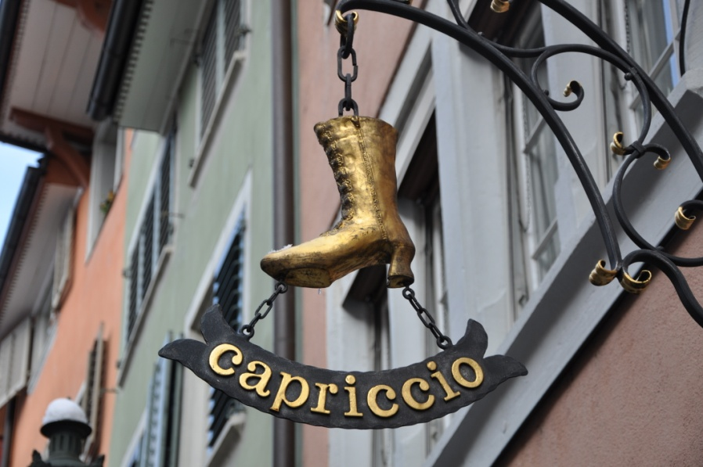


Picture and Icon Signs as Resource Descriptions

Slide 21
Physical Properties 2
For "manmade" things surface properties are less predictable ("innovation" enables the separation of form and function)
For "information" things in physical form the correlation between appearance and content varies across the Document Type Spectrum
For "born digital" resources the appearance is often extrinsic because it is assigned or associated (a style sheet, for example) instead of being an inherent part of the resource when it was created
21

Slide 22
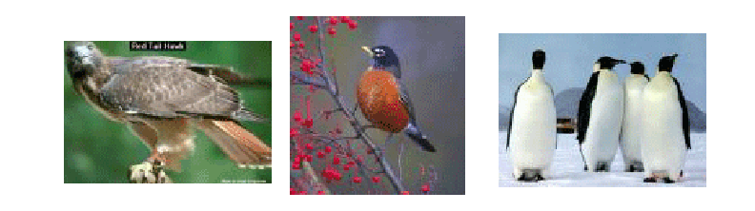
Which Properties Best Identify a Thing?
A Type of Thing?
The properties best for identifying an instance might be those that aren't typical of its class
22

Slide 23
Extrinsic Properties
Extrinsic properties are assigned to a resource rather than being inherent in it
Some extrinsic properties are static: assigned names or identifiers don’t usually change
Other extrinsic properties change often: the current location, popularity, price, etc. of a resource
23

Slide 24
Cultural Properties
Cultural properties are those that derive from conventional language use or culture and often involve analogy
Because they derive from knowledge of culture or language, they might be unintelligible to people who don't have the same perspective and experience
.. and they might lose their cultural salience
24

Slide 25
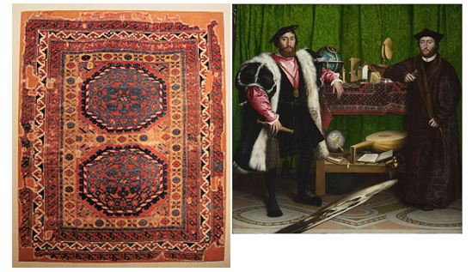
“Holbein” Carpets
The Ambassadors, 1553
Anatolian Carpet,
16th Century
Anatolian Carpet,
16th Century
Where does Holbein rank on a list of most important painters of all time?
A
More about Holbein and Henry VIII

Slide 26
Contextual Properties
Contextual properties relate to the situation or context in which the thing being described exists
Dey et al (2001) define context as “any information that characterizes a situation related to the interactions between users, applications, and the surrounding environment.”
This open-ended definition implies many contextual properties that might be used in a description
Since context changes, context-based descriptors might be appropriate when assigned but not later; see "persistence" and "effectivity"
26

Slide 27
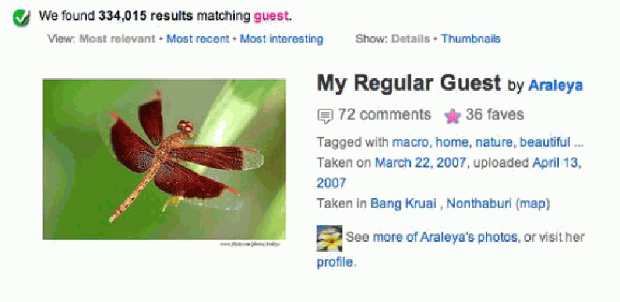
Contextual Description
== Private Language?
A "guest" tag makes sense to the photographer but no one else would use it to describe this photo if they don’t share the context

Slide 28
Structural Properties
The internal and external structure of a thing can be a useful part of its description (sometimes these are intrinsic, and other times extrinsic)
  The number and arrangement of component parts (e.g., the number of chapters or pages in a book)
  The number and type of connections with other resources (e.g., the number of Facebook friends or Twitter followers)
28

Slide 29
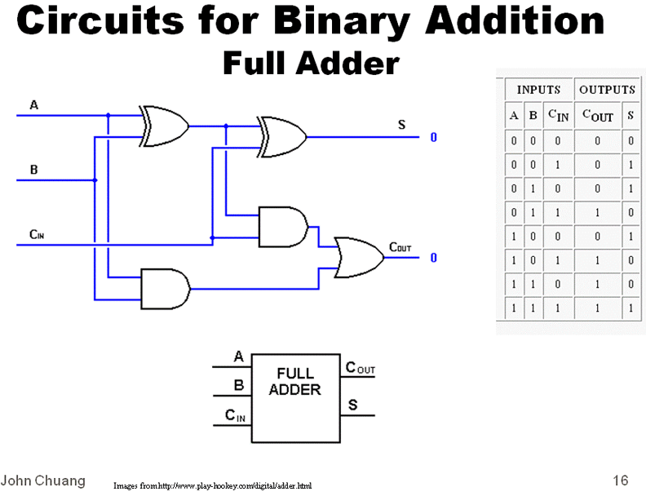
Meaning is Structure
Could you describe this without using structural concepts?

Slide 30
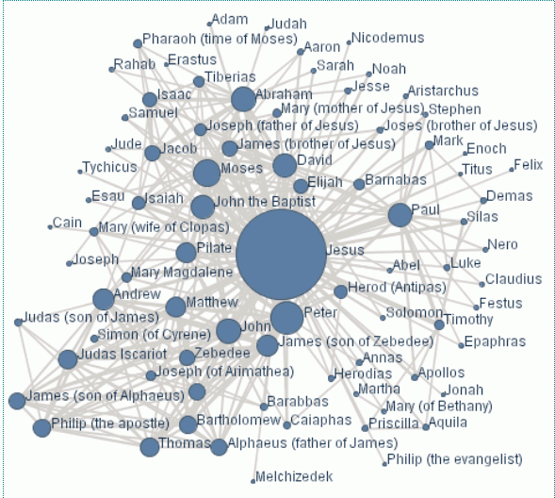
The Social Network of Jesus

Slide 31
Properties & Principles of
Kitchen Organization
  Intrinsic static properties: If you store your pots, frying pans, and baking pans and nest each set by size
  Extrinsic static properties: A spice rack with the spices arranged in alphabetical order
  Intrinsic dynamic properties if you arrange your milk and other perishable goods by expiration date, a “useful life remaining” property that decreases to zero as the expiration date approaches
  Extrinsic dynamic properties if you put the most frequently used condiments or spices in the front of a refrigerator or pantry shelf.
31

Slide 32
Properties & Principles of
Document Organization
  Intrinsic static properties: Author, date published, words in the text
  Extrinsic static properties: ISBN, LOC Classifications
  Intrinsic dynamic properties: Effectivity (e.g., laws and regulations)
  Extrinsic dynamic properties: Links/citations to and from other documents
32

Slide 33
Stop and Think:
Principles of Arrangement in a Clothing Store
  Intrinsic static properties: …
  Extrinsic static properties: …
  Intrinsic dynamic properties: …
  Extrinsic dynamic properties: …
33

Slide 34
Properties vs. Relationships
But while we can express structure within and between resources as properties, there is “better language” for expressing this as RELATIONSHIPS
  Arrangement
  Proximity
  Connectivity
  Part-whole
  …
(See TDO Chapter 5)
34

Slide 35
INFO 202
“Information Organization & Retrieval”
Fall 2015
UNIVERSITY OF CALIFORNIA, BERKELEY
SCHOOL OF INFORMATION
Robert J. Glushko
glushko@berkeley.edu
@rjglushko
23 September 2015
Lecture 8.3 – Creating Description Vocabularies
and Assigning Descriptions

Slide 36
Process of Describing Resources
Identify / scope the resources to be described
Determine the purposes or uses of the descriptions
Study the resource(s) to identify descriptive properties
Design the description vocabulary
Design the description form and implementation
Create the descriptions (either "by hand" or by some automated / computational process
Evaluate the descriptions
(TDO FIGURE 4-3)
36

Slide 37
Scoping and Description
How explicit and thorough these 7 steps need to be depends on what we are calling "scope“
Do we know who the users are? Are the describers the users?
Do we have all the resources, a representative set, or just the first set ... do we know what else is coming?
37

Slide 38
Designing the Description Vocabulary
  Good descriptions use terms that their intended users might use
  Good descriptions don't contain details that aren't necessary
  Good descriptions are created systematically and follow standards
38

Slide 39
Stop and Think:
Description and Expertise
Everyone knows something about trees, but some people know more than others, and their particular experience and perspective influences how they describe trees.
What kind of properties and descriptions would be used by university students? By research botanists? By landscape designers? By park maintenance workers? By indigenous people who live in tropical rain forests?
39

Slide 40
The Need for Controlled Vocabularies
  The words people use to describe things or concepts are "embodied" in their context and experiences... so they are often different or even "bad" with respect to the words used by others
  These naturally-occurring words are an "uncontrolled vocabulary"
40

Slide 41
The Need for Controlled Vocabularies
  Searches for resources using an uncontrolled vocabulary will not succeed when they fail to match resources described or indexed using a controlled vocabulary
  To agree on the words we use in descriptions will improve recall, but it means that we must use a subset of the words we would otherwise use
41

Slide 42
What is a Controlled Vocabulary?
  A controlled vocabulary is a standardized set of terms (such as subject headings, names, classifications, etc.) assigned by organizers / cataloguers / indexers of resources
  A CV can be a content standard for the values used in (or as) descriptive elements
  A CV can be thought of as a fixed or closed dictionary in which everything must be defined using the same set of terms
42

Slide 43
Types of Controlled Vocabularies
  Dictionaries
  Authoritative names
  Authority control for places and time periods
  Identifiers
  Code lists
  Subject heading lists (like the Library of Congress – LCSH)
  Thesauri
  Classification systems
43

Slide 44
Horizontal and Vertical Vocabularies
  Horizontal
    Concepts that are common to all (or a large number) of domains
    examples: XCBL, UBL
  Vertical
    Particular industry or vertical market
    Specialized product or process semantics
    Sometimes called “domain-specific languages”
44

Slide 45
“Dimensionality Reduction” in Descriptions
  Creating a controlled vocabulary reduces the number of descriptive terms that are or can be assigned to something
  When achieved by computational techniques, "dimensionality reduction“ goes by names like "principle components analysis," "orthogonal decomposition," "latent semantic analysis," "factor analysis," “feature extraction,” and others
  These techniques analyze the correlations between descriptors and transform a large set into a smaller set of uncorrelated ones
  But they are statistical constructs and might not have any clear interpretation
45

Slide 46
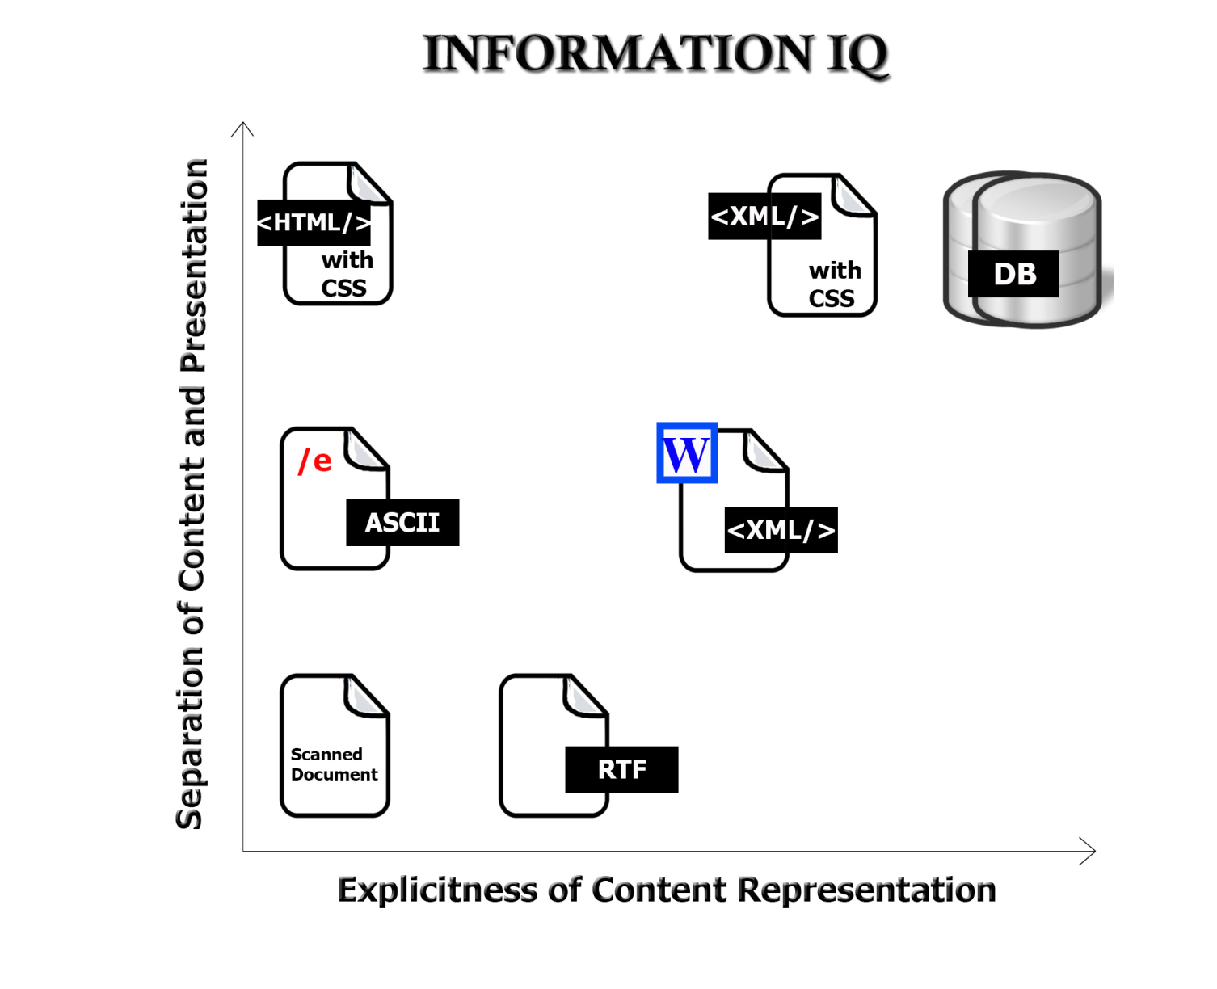
Description Form and Implementation: Format Matters!

Slide 47
Creating Resource Descriptions
  By professionals: "Institutional" descriptions that follow standards
  By authors: Best knowledge of purpose and intended audience
  By users: Most variable, influenced by social purposes
  By automated processes: Most reliable, primarily technical / objective properties but semantic description capability is emerging
47

Slide 48
Evaluating Resource Descriptions
  Quality should be evaluated with respect to intended purposes... but what if different stakeholders have different purposes?
  Creating resource descriptions can be costly; is it worth it? How and when measure the costs?
  Computational description is vastly less expensive, but is it good enough?
  How can we incent "community" or "crowdsourced" description to be of better quality?
48

Slide 49
Description Properties & Principles in Persona Design; Evaluating Personas
  A persona is a resource instance (a user model) created to stand for a resource type (a class of users)
  How much detail should a persona have? How much should this detail be based on "real" demographic, psychographic, or marketing data? Should personas evolve, or should they be static?
  Intrinsic static properties: …
  Extrinsic static properties: …
  Intrinsic dynamic properties: …
  Extrinsic dynamic properties: …
49

Slide 50
Improved Methods for Creating Personas
Pruitt & Grudin, "Personas: Practice and Theory", Proceedings of the Conference on Designing for User Experiences, 2003.
  Use market research and existing user research about actual or potential customer segments to determine which segments should be "enriched" into personas
  Begin with the existing market data and research, and don't "enrich" until this foundation work has been incorporated
  Use standard documents as templates or metamodels to guide the collection and use of the persona source information so that personas are consistent in the kinds of descriptions they contain
  Validate and prioritize personas by using them to guide subsequent usability and market research
50

Slide 51
Data-based vs. Intuitive Personality Judgments
Youyou, W., Kosinski, M., & Stillwell, D. (2015). Computer-based personality judgments are more accurate than those made by humans. Proceedings of the National Academy of Sciences, 112(4), 1036-1040..
  Use Facebook “likes” of articles, videos, artists and other items to predict a person’s self-ratings on openness, conscientiousness, extraversion, agreeableness and neuroticism
  computer could more accurately predict the subject's personality than a work colleague by analyzing just 10 likes, better than a friend with 70, a family member with 150, and a spouse with 300
  “computers could be able to infer our psychological traits and react accordingly, leading to the emergence of emotionally intelligent and socially skilled machines”
51

Slide 52
Readings for Next Lecture
Kent Chapters 2 and 3
Naumann, Felix and Herschel, Melanie. An Introduction to Duplicate Detection, Chapter 1, 2010.
52

Slide 53
Midterm #1
Available from noon Friday to midnight Sunday?
You can choose any 60 minute time period to complete the exam
Answer any 3 of the 5 questions
Answer ALL PARTS OF THE QUESTION
53

