Slide 1
Plan for Today’s Lecture(s)
XML
Metacrap
The Dublin Core
Authority Control / Duplicate Detection / Name Matching
1

Slide 2

INFO 202
“Information Organization & Retrieval”
Fall 2015
UNIVERSITY OF CALIFORNIA, BERKELEY
SCHOOL OF INFORMATION
Robert J. Glushko
glushko@berkeley.edu
@rjglushko
28 September 2015
Lecture 9.1 – XML

Slide 3
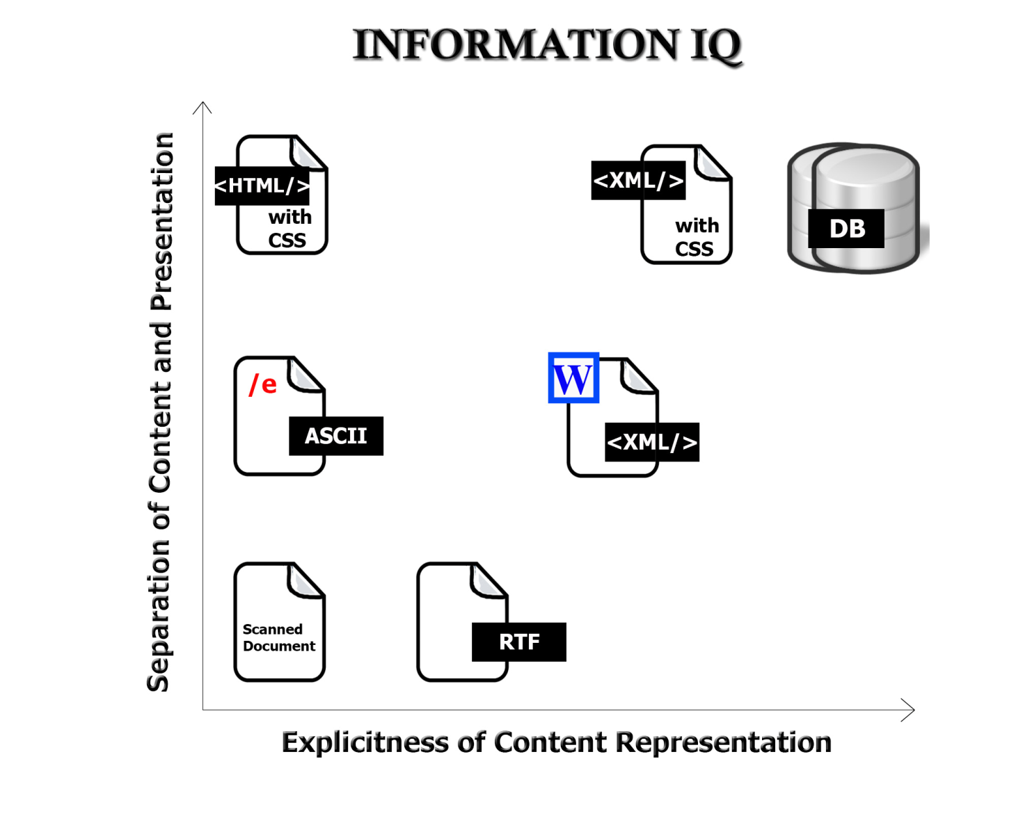
Format Matters!
3

Slide 4
XML: Explicit, Content-Oriented Markup
How much you can do with information depends on the extent and explicitness of its internal structure or "markup"
Markup transforms a flat stream of text into a set of objects or elements that can be manipulated by other applications
The smartest formats can encode a content-oriented data model: XML, SGML, or a database
4

Slide 5
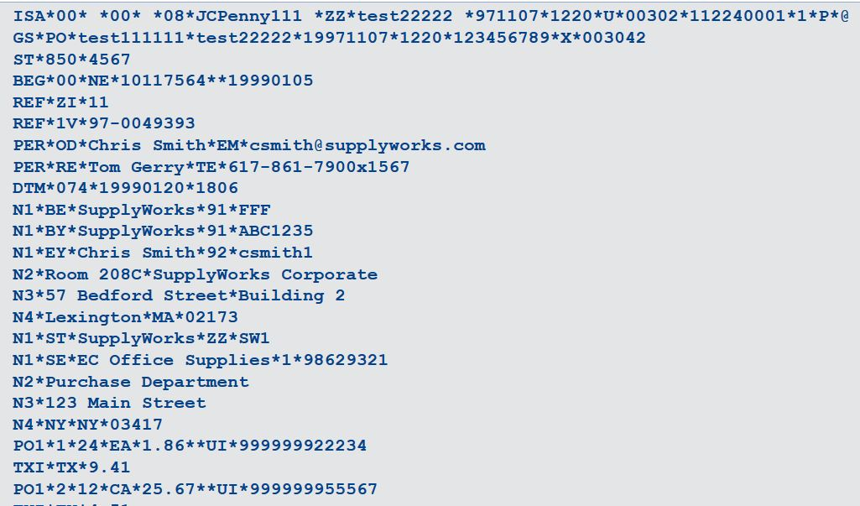
ASC X12 EDI Message Fragment
Notes:
Purchase order.. Punch card era, record-oriented syntax, positional sensitive but some attempt at content tags – DTM (date and time), N – name, PERSON

Slide 6
My Information Can Beat Up
Your Information (1)
Two separate and important ideas:
    Use a syntax capable of encoding information in a content-oriented and easily processed manner
    Use it effectively
Better to make information smart so that it can be processed by simple and generic tools than to bury the intelligence into a custom processing application tuned for a particular syntax
6
Notes:
Try to capture your data when it is smartest, when it is created, and keep it in that smart data model as long as you can

Slide 7
My Information Can Beat Up
Your Information (2)
Smart data is more portable and reusable by multiple applications
Smart data can always be turned into "dumb" data, but not vice versa
Programs that work with dumb data are always more brittle because they have to do more processing to detect and recover from data errors
7

Slide 8
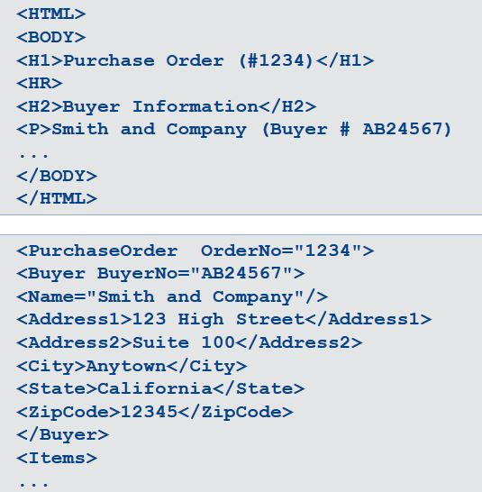
HTML
XML
Notes:
What are the key differences here:
Xml has explicit document type -= of Purchase Order
XML has content oriented element names, not presentation oriented ones
HTML has fixed set of elements

Slide 9
HTML vs. XML
HTML's idea of using tags to specify appearance is very easy to understand
XML's purpose is radically different – it is a general syntax for encoding models and instances of "things and processes"
HTML has a fixed set of element types ("tags"), while an XML document instance is potentially unlimited in what tags it can contain
So XML is a METALANGUAGE that can be used to define new languages (or “document types” or “schemas”); HTML is an example of one
XML is often used for “resource description languages”
9

Slide 10
INFO 202
“Information Organization & Retrieval”
Fall 2015
UNIVERSITY OF CALIFORNIA, BERKELEY
SCHOOL OF INFORMATION
Robert J. Glushko
glushko@berkeley.edu
@rjglushko
28 September 2015
Lecture 9.2 – Metacrap

Slide 11
The HTML META Element
In 1994 (very early in Web history) a Computer Science graduate student named Roy Fielding proposed that HTML be revised to include a META element
  "The META element can be used within the HEAD element to embed document metainformation not defined by other HTML elements. Such information can be extracted by servers/clients for use in identifying, indexing, and cataloging specialized document metainformation”
  (http://lists.w3.org/Archives/Public/www-html/1994Jun/0041.html)
11

Slide 12
What the W3C Imagined
<meta name=“description" content="accurate prose description">
<meta name=“keywords" content="useful comma-separated keywords">
12

Slide 13
What Happened
Bad (or stupid) people stuffed repetitive or inappropriate keywords into META – “an unethical search engine optimization technique”
So Google and other search engines do not use <meta> to determine relevance in search results
Nevertheless, <meta> is still used to organize information about web pages
13

Slide 14

Metacrap
"A world of exhaustive, reliable metadata would be a utopia. It's also a pipe-dream, founded on self-delusion, nerd hubris and hysterically inflated market opportunities”
Metacrap Revisited
People lie, are lazy, stupid, deluded, biased…
The vocabulary problem…
What was Doctorow's recommendation?
14

Slide 15
INFO 202
“Information Organization & Retrieval”
Fall 2015
UNIVERSITY OF CALIFORNIA, BERKELEY
SCHOOL OF INFORMATION
Robert J. Glushko
glushko@berkeley.edu
@rjglushko
28 September 2015
Lecture 9.3 – The Dublin Core

Slide 16
Dublin Core: Motivation
When the web was just a few years old, professional “metadata-makers” were already concerned that web resources would be difficult to discover and identify because they lacked good descriptions
An international, cross-disciplinary group of professionals from librarianship, computer science, text encoding, the museum community, and other related fields convened in 1995 to propose a standard set of metadata elements for web pages
16

Slide 17
Dublin Core: Goals
Simplicity: Must be usable by web page authors, because web scale defies description by professional metadata-makers
Broad semantics: Description elements must not require precise semantic distinctions that not everyone could or would want to make
Extensibility: Must be easy to extend when more precise semantic descriptions are needed
International: Element names need equivalents in all the languages used in web pages
17

Slide 18
Dublin Core
Named after the place where it was created (but not where you think)
Widely used as the basis for more specialized models (because it is the “core” of all of them)
  See http://dublincore.org/documents/profile-guidelines/
  Example: PBCORE (used by Popup Archive)
There are specifications of how to use it in numerous syntaxes (especially XML and RDF) and languages
18

Slide 19
More than a Controlled Vocabulary
A controlled vocabulary is a standardized set of terms (such as subject headings, names, classifications, etc.) assigned by organizers / cataloguers / indexers of resources
A metadata schema like the Dublin Core controls the kinds of assertions about resources that you can make in the first place
Controlled vocabularies can be very useful requirements or recommendations about the values that are contained in the assertions (the information content of the assertion)
19

Slide 20
Dublin Core: The Elements
TITLE -- a name given to the resource
IDENTIFIER -- an unambiguous reference to the resource within a given context
SUBJECT -- the topic of the resource; key words or classification phrases
CREATOR -- an entity primarily responsible for making the resource
20
Notes:
The DC says there are 15 kinds of assertions you can make. In the spec they are listed alphabetically, but I have listed these in the order that I think they are useful…
Title: the name by which the resource is formally known (IT CAN HAVE MORE THAN ONE NAME); which is why we also have an element here for identifier
CREATOR: a person, organization, or a service (in the sense of automated agent)
SUBJECT: the topic of the resource; typically keywords, key phrases, or classification codes (recommends a controlled vocabulary)
These are the BIG ONES that traditionally define the metadata description for bibliographic resources

Slide 21
Dublin Core: The Elements
CONTRIBUTOR -- An entity responsible for making contributions to the resource
PUBLISHER -- the entity primarily responsible for making the resource available
DATE -- a point or period of time associated with an event in the life cycle of the resource
FORMAT -- the file format, physical medium, or dimensions of the resource.
21
Notes:
Contributor: not the principal creator – consider in a film.. Filmaker vs actors
Publisher: could be the studio for a film; isn’t this also a kind of creator?
DATE: note how the definition allows for many different kinds… (date created, modified, deleted); and at what granularity? Recommendations for standard date format, but could say “prehistoric” or “medieval” or “renaissance”

Slide 22
Dublin Core: The Elements
DESCRIPTION -- an account of the resource; abstract, TOC, etc.
LANGUAGE -- a language of the resource
TYPE -- the nature or genre of the content of the resource
RIGHTS -- information about rights held in and over the resource
22

Slide 23
Dublin Core: The Elements
SOURCE – a related resource from which the described resource is derived
RELATION -- a related resource
COVERAGE -- the spatial or temporal topic of the resource, relevant jurisdiction
23
Notes:
SOURCE nicely illustrates the arbitrariness of resource focus…

Slide 24
Dublin Core “Content Model” is Unrestrictive
All elements are optional
All elements are repeatable
Elements can be in any order
24
Notes:
(music might not have subject)
(one or many creators)

Slide 25
Describing 202 Course Page Using <meta>
<meta name=“author” content=“Robert J. Glushko”>
<meta name=“title” content=“I202 Information Organization and Retrieval”>
<meta name=“webmaster” content=“Vijay”>
<meta name=“publisher” content=“UC Berkeley School of Information”>
<meta name=“date” content=“Fall 2015”>
25

Slide 26
“DublinCore-ized” 202 Course
Home Page
<meta name=“DC.creator” content=“Robert J. Glushko”>
<meta name=“DC.title” content=“I202 Information Organization and Retrieval”>
<meta name=“DC.contributor” content=“Vijay”>
<meta name=“DC.publisher” content=“UC Berkeley School of Information”>
<meta name=“DC.date” content=“Fall 2015”>
26

Slide 27
Dublin Core as an
XML Vocabulary
We can define the DC as an XML schema
This allows DC statements to be embedded in any XML document using a DC namespace
27

Slide 28
Dublin Core in XML as Separate Record
<?xml version=“1.0”?>
<metadata xmlns:dc=“http://purl.org/dc/elements/1.1/”>
<dc:creator>Robert J. Glushko</dc:creator>
<dc:title>I202 Information Organization and Retrieval </dc:title>
<dc:contributor>Vijay</dc:contributor>
<dc:publisher>UC Berkeley School of Information</dc:publisher>
<dc:date>Fall 2015</dc:date>
</metadata>
28
Notes:
This says we’re going to use the Dublin core “metadata” language in our document…

Slide 29
Using the Dublin Core –
Pragmatics and Problems
Some information may appear to belong in more than one metadata element
There is potential semantic overlap between some elements
There will occasionally be some judgment required from the person assigning the metadata
29

Slide 30
Metacrap
"A world of exhaustive, reliable metadata would be a utopia. It's also a pipe-dream, founded on self-delusion, nerd hubris and hysterically inflated market opportunities”
Metacrap Revisited
People lie, are lazy, stupid, deluded, biased…
The vocabulary problem…
What was Doctorow's recommendation?
30

Slide 31
INFO 202
“Information Organization & Retrieval”
Fall 2015
UNIVERSITY OF CALIFORNIA, BERKELEY
SCHOOL OF INFORMATION
Robert J. Glushko
glushko@berkeley.edu
@rjglushko
28 September 2015
Lecture 9.4 – Authority Control,
Duplicate Detection
and Name Matching

Slide 32
Variant Forms of Names
A generic problem in resource description is dealing with variant name forms
  Same person (or resource) uses or is given different names
  Different people (or resources) use the same name
32

Slide 33
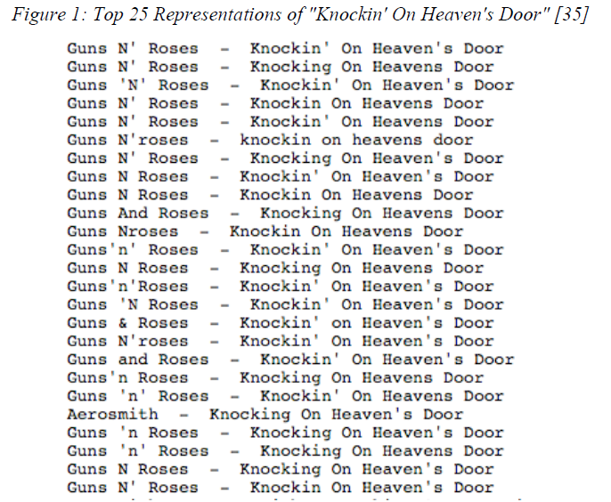
Naming the Same Song?
Hemerly 2011
33

Slide 34
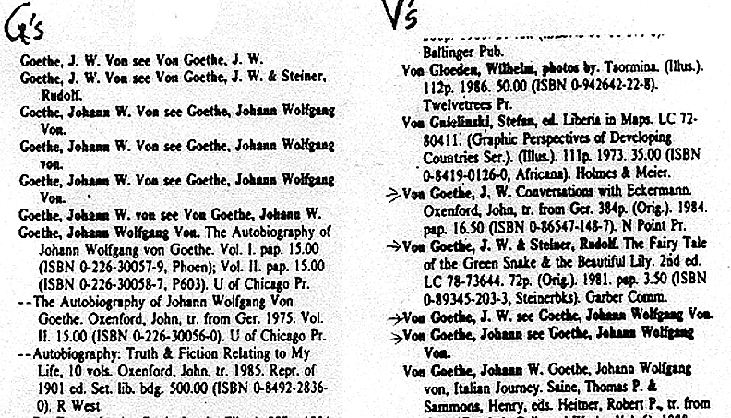
Different Forms of “Same”
Author Name
From an old version of Bowker’s Books in Print
34

Slide 35
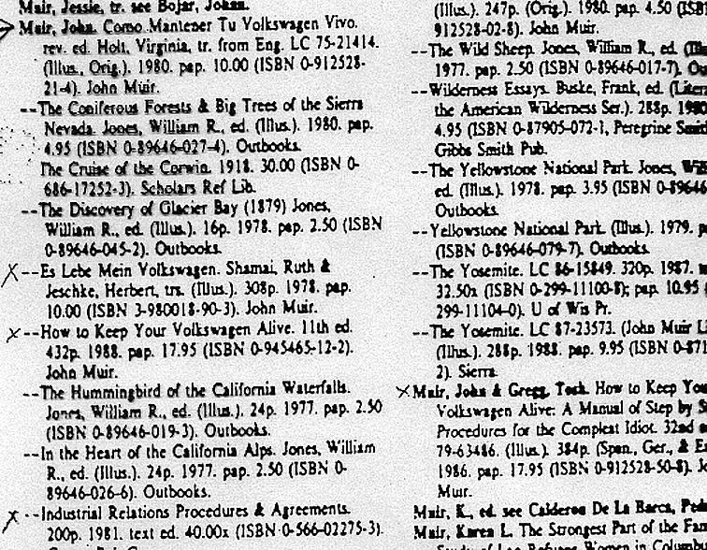
Same Name for Different Authors
35

Slide 36
Questions about Names
How many names should be associated with a information object or resource?
Should one be designated as the preferred or authoritative form?
What references should be made from other possible forms of names that haven't been used?
36

Slide 37
Authority Control
Authority control is concerned with creation and maintenance of a set of terms that have been chosen as the standard representatives for some resource based on some set of rules
The Library of Congress maintains an "authority file" (in MARC format) for the names of persons, corporate entities, geographic names of political entities, and titles of works
See http://www.loc.gov/marc/uma/ and http://authorities.loc.gov/
37

Slide 38
Normative Forms of Names
When names appear in multiple forms, one form needs to be chosen; criteria include:
  Fullness (e.g., full names vs. initials only)
  Language of the name
  Spelling (choose predominant form)
  Entry element
    "Smith, John" not "John Smith"
    "Mao Zedong" or "Zedong, Mao" or "Mao Tse Tung" or ?
38

Slide 39
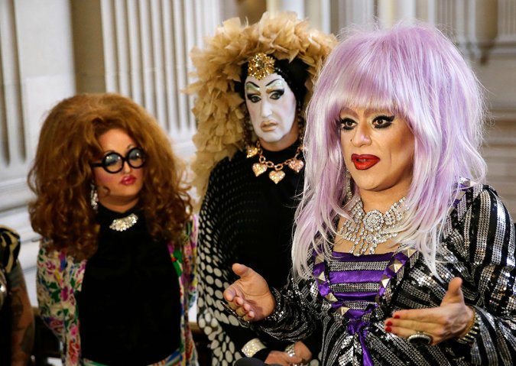
Drag Performers Fight Facebook’s
‘Real Name’ Policy (NY Times 9/24/14)
A year ago, a drag performer in San Francisco named Lil Miss Hot Mess received a notice from Facebook. Her account had been suspended because she was not using what the company considered a “real name.” Lil Miss Hot Mess could not gain access to her posts, messages or photos.
Facebook has a longstanding policy requiring users to register with a “real identity” that matches their credit cards, drivers’ licenses or student IDs.

Slide 40
Naming Problems for Places
Variant forms: St. Petersburg, Санкт Пербургскйй, Saint-Pétersbourg
Multiple names: Cluj, in Romania / Roumania / Rumania, is also called Klausenburg and Kolozsvar
Name changes: Bombay -> Mumbai.
Homographs:Vienna, VA, and Vienna, Austria; very many Springfields (the most famous one?)
Anachronisms: No Germany before 1870
Vague, e.g. Midwest, Silicon Valley
Unstable boundaries: 19th century Poland; Balkans; USSR,Ukraine
40

Slide 41
Authoritative Place Names
Places have latitude and longitude coordinates, so we can link places and spaces with a GAZETTEER
A gazetteer is a place name authority file that:
    Indicates what kind of place it is
    Objectively specifies latitude and longitude
    Disambiguates similar place names
    Brings variant names together
    Allows places to be displayed on maps
41

Slide 42
Code Sets
Code sets are constrained sets of values that are often completely arbitrary but they are unambiguous and authoritative names
The ISO code sets for countries (3166), currencies (4217), quantities and units of measure (31) are very commonly used
Most organizations have internal code sets or business rules that implicitly define them
42

Slide 43
The Name Matching Problem
Name matching" is the task of determining when two different strings denote the same person, object, or other named entity
It is ironic that this problem has many other names:
  Object consolidation
  Merge-purge
  Householding
  Fuzzy/approximate matching
  Co-reference resolution
  Duplicate detection
  Record linkage
43

Slide 44
Duplicate Detection vs. Exact Copies
Naumann, F., & Herschel, M. (2010).
44

Slide 45
Domains For The Name Matching Problem
Customer relationship management
Direct mail
Law enforcement / counter-terrrorism
Demography / population statistics (e.g. census)
Computational biology
Data mining, signal processing, and image compression tasks in numerous application areas
45

Slide 46
Causes of Duplicate Names /
Why Name Matching is Hard
Different data capture formats
Poor or mis-spellings (original, transcription, OCR, “autocorrection”)
Phonological -> orthographic alternatives (multiple ways to spell the same sound… which might not have been heard correctly)
Language transliteration ("Peking" or "Beijing")
46

Slide 47
Causes of Duplicate Names /
Why Name Matching is Hard
Nicknames and name changes
Name permutations and omissions (complex rules for language and culture apply http://en.wikipedia.org/wiki/Family_name
Definite descriptions and metonymy
47
Notes:
The 16th president of the US == Lincoln
The ham sandwich wants his check

Slide 48
Generic Approach to Name Matching
Naumann, F., & Herschel, M. (2010). Figure 1.1.
48

Slide 49
Computing Similarity between Names
Measures of orthographic similarity
    "Edit distance" - how many insertions, deletions, or substitutions to turn one string into another
    Can be weighted using likelihood or word order considerations
Measuring pronunciation similarity
    "Hash" the names into phonetic encodings with fewer characters than original
    "Soundex" function is very commonly used http://www.searchforancestors.com/soundex.html
49

Slide 50
Data Quality
Data quality problems can have any combination of technological causes, process causes, or managerial causes
Does data have to be perfectly clean? Can it ever be?
How can your own actions contribute to data quality problems or to their resolution?
50

Slide 51
Principles and Processes for
Quality Information
Prioritize the data items
Find the “headwaters” or data owners and involve / incent them
  Validate at the time of capture or creation
  Set realistic goals for data quality
51

Slide 52
Readings for Next Lecture
TDO Section 4.4
Harpring, Patricia. “The language of images: enhancing access to images by applying metadata schemas and structured vocabularies
Naaman, Mor, et al. “Context data in geo-referenced digital photo collections ” 2004.
2 TDO Case Studies
52

