Slide 1
Plan for Today’s Lecture(s)
Introduction to Non-Text and Multimedia Resource Description
“Professional” Metadata for Multimedia and Non-Text Resources
“Computational” Metadata for Multimedia and Non-Text Resources
“Contextual” Metadata
Music as an Organizing System (Graham Freeman)
1

Slide 2
INFO 202 “Information Organization & Retrieval” Fall 2015
UNIVERSITY OF CALIFORNIA, BERKELEY
SCHOOL OF INFORMATION
Robert J. Glushko glushko@berkeley.edu
@rjglushko
30 September 2015 Lecture 10.1 – Introduction to Describing Multimedia Resources

Slide 3
What is Multimedia?
Media:
Text
Audio (speech, music, sound)
Graphics and Images
Moving Images
Multimedia -- Composed of more than one form of media
Time-based media -- Audio and video
3

Slide 4
Concepts and Relationships for Multimedia Resources
playlist, album, queue
composite, collage, mix, remix
clip, sample, bite
remake, cover version
layout, presentation, performance
broad-/narrow-/simul-/tele-/web-/pod- cast
installation, environment
4

Slide 5
What's Different About Describing Multimedia?
Sensory Gap
Semantic Gap
Proliferation Problem
5

Slide 6
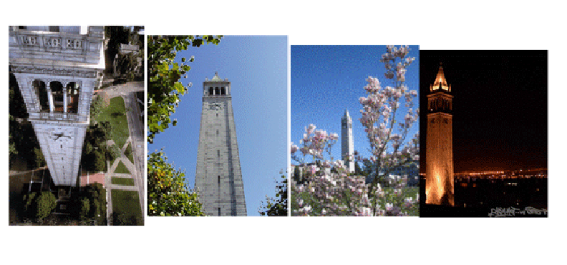
The Sensory Gap (1)

Slide 7
The Sensory Gap (2)
There is a gap between an object and a computer's ability to sense and describe the object
An infinite number of different "signals“ can be produced by the same object
…And different objects can produce similar signals
Human perceptual machinery excels at recognizing when different "signal patterns" are the same object or when similar patterns are different ones
The problem is difficult for computers (but getting easier with “deep learning”)
7

Slide 8
The Semantic Gap
Instruments, devices, and sensors encode data in formats that are optimized for efficient capture, storage, decoding, or other processing
This data is often limited to characteristics that involve coarse categorization and syntactic processing
The representation of the object can't be (easily) processed to understand what the object "means"
So there is a semantic gap between the descriptions that people assign and those that can be assigned by automated mechanisms or that are otherwise built into the storage format
8

Slide 9
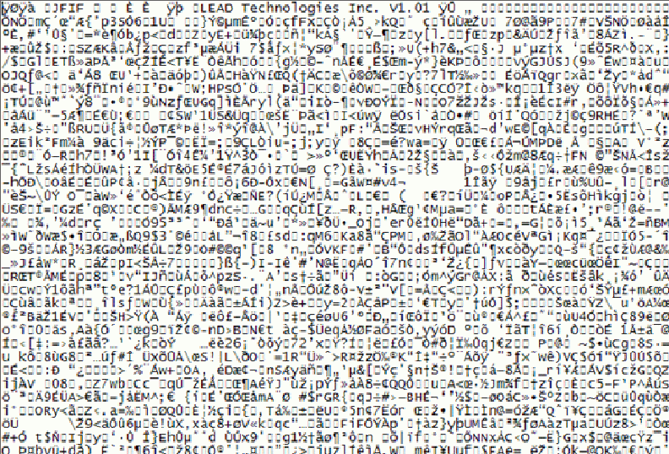
What’s this Picture About?

Slide 10
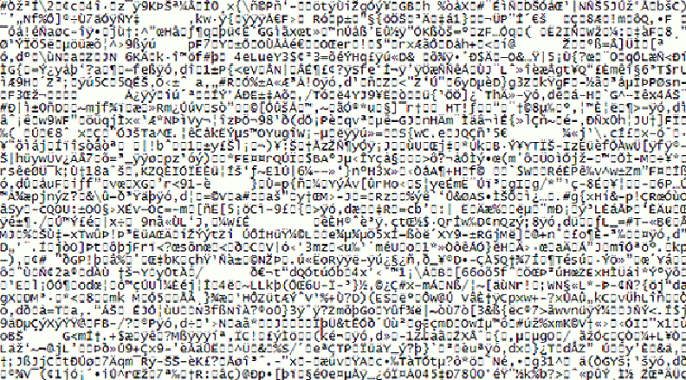
Name That Tune

Slide 11
The Proliferation Problem
Digital cameras, video recorders, and smart phones have increased resolution and greater storage capacity every year
Non-professional consumers create very large collections of multimedia objects (20 B / year)
The average object has less value and doesn't justify much effort to organize and describe it
These “objects” include audio or video “snippets” that can stand alone
11

Slide 12
Are these New Problems?
Museums face some of the same or similar problems in describing art works and artifacts:
There may be many artifacts that represent the same "work" - this is like the "sensory" gap
The materials or medium in which the artifact is embodied don't convey semantics "on their surface" - this is the semantic gap
There may be so many artifacts of a particular type that some get only limited descriptions - this is like the proliferation problem
12

Slide 13
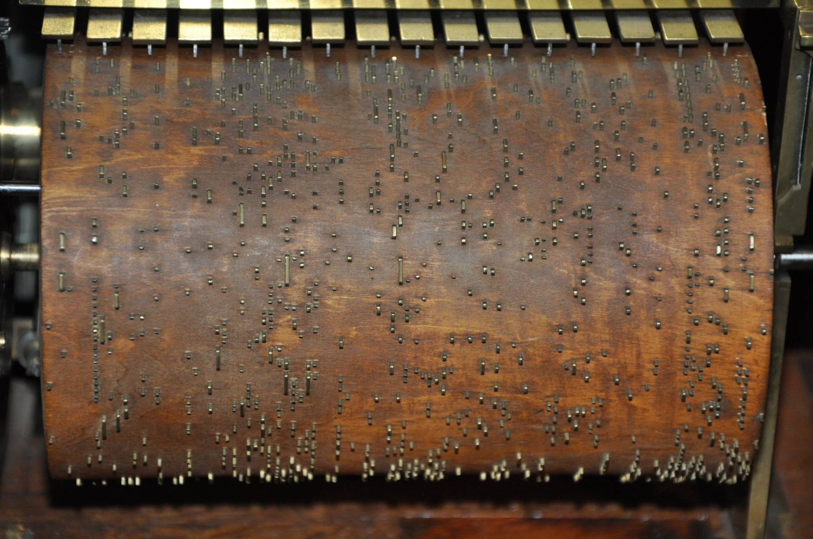
Name That Tune

Slide 14
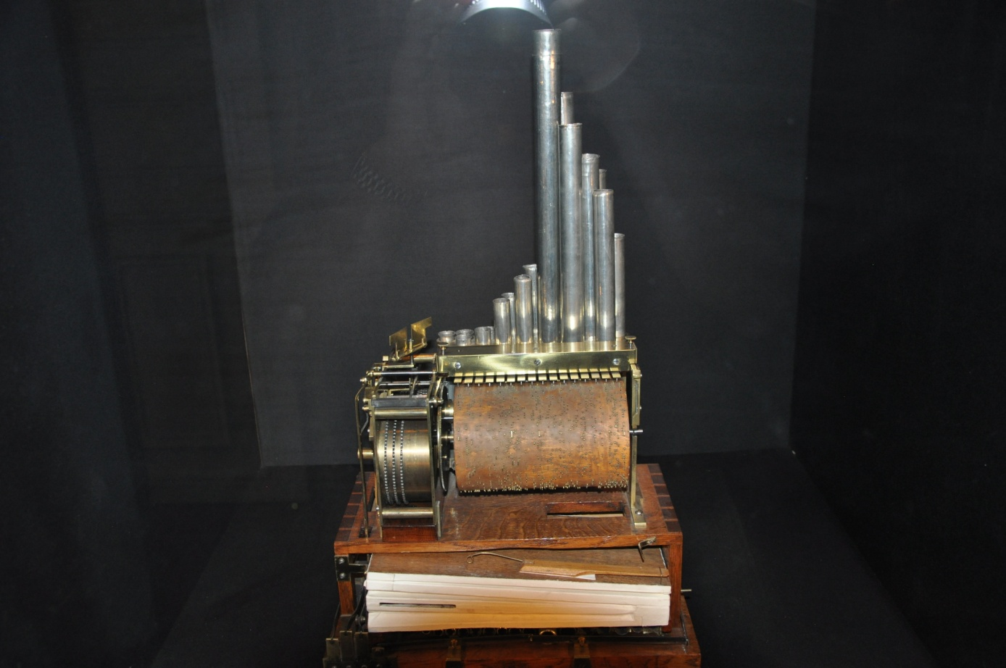
Music Box Controlled by Spoked Cylinder
Photo by R. Glushko, Musée des arts et métiers, Paris (early 19th century)

Slide 15
Some Problems May Be New
The temporal structure of music and video mandates new descriptive vocabulary and new ways to identify meaningful components
Music and video meet emotional/psychological needs that are more complex than those for "documents" - so the descriptions of the latter have to be able to address these needs
People don't usually access or retrieve music or video "to satisfy information requirements”
15

Slide 16
INFO 202 “Information Organization & Retrieval” Fall 2015
UNIVERSITY OF CALIFORNIA, BERKELEY
SCHOOL OF INFORMATION
Robert J. Glushko glushko@berkeley.edu
@rjglushko
30 September 2015 Lecture 10.2 – “Professional” Metadata for Multimedia and Non-Text Resources

Slide 17
"Professional" Metadata for Multimedia and Non-textual Works
Museum works and other non-text artifacts have long been described by professionals using structured resource descriptions according to classification rules
The descriptions are often "layered" beginning with accessible properties with more analytic descriptions added for those objects that warrant them
17

Slide 18
Panofsky's Three Levels of Meaning
Description ("Preiconographic“ or “Primary”)
Identification ("Iconographic“ or “Secondary”)
Interpretation ("Iconologic“)
18

Slide 19
Description / “Preiconographic” / Primary Level
The "primary" or "natural" subject matter of a work
The generic elements or things depicted in, on, or by an object / image / art work
These would be recognizable by anyone, regardless of their expertise or training
19

Slide 20
Identification / “Iconographic” / Secondary Level
The name of the subject or thing depicted in the work
Can require research or fact assembly from sources of social and cultural knowledge
20

Slide 21
Interpretation / “Iconologic” Level
The meaning or theme represented by the subject matter or iconography of the work
This meaning is often symbolic, and deeply grounded in the culture in which the work was created
Done by domain and methodology experts
21

Slide 22
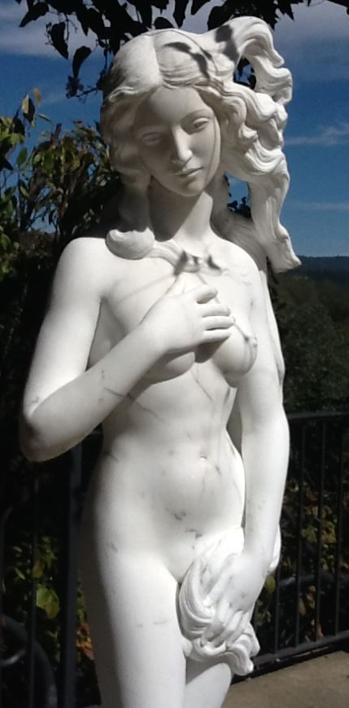
PRIMARY: Marble statue of nude woman standing on a seashell
SECONDARY: Statue made in 2005 by Lucio Carusi of Carrara, Italy, titled “Venus”, made of local marble
INTERPRETIVE: 3D transformation of 1486 painting by Italian painter Sandro Botticelli, titled “Birth of Venus,” now in the Uffizi Gallery in Florence. Carusi’s Venus is substantially slimmer in proportions because of changing notions of female beauty
(TDO Figure 4.5)
Panovsky’s 3-Level Scheme
22

Slide 23
Getty Categories for the Description of Works of Art (CDWA)
The CDWA is a massive metadata schema with 532 elements and sub-elements
Each element typically has a controlled vocabulary or recommends one (e.g, Art and Architecture Thesaurus)
There is a core set of 36 elements
CDWA-Lite is the XML specification for another simple subset of CDWA
23

Slide 24
CDWA’s First Question
You should have been able to guess the first question raised in the CDWA documentation
Section 1.1 of the CDWA (the top level element) is “Object/Work”
Works of art or architecture may be considered a single item, or they may be made up of many physical parts or arranged in separate physical groupings. It is necessary to define the particular work of art, architecture, or group of objects in question, whether it be a single painted canvas or an altarpiece made up of many panels…
24

Slide 25
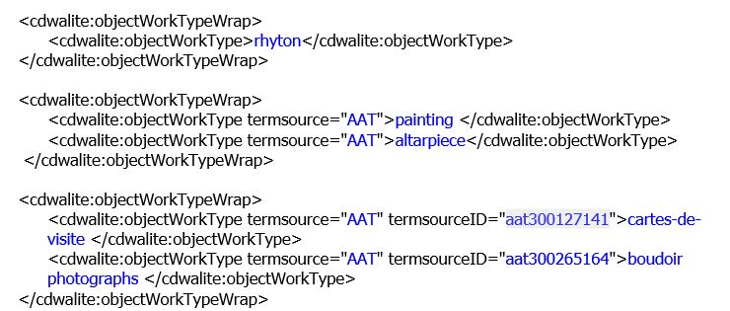
CDWA in XML – Examples
25

Slide 26
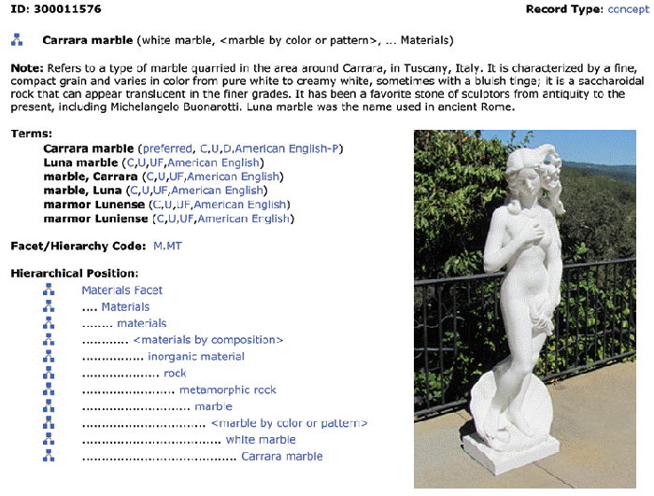
Art and Architecture Thesaurus
26

Slide 27
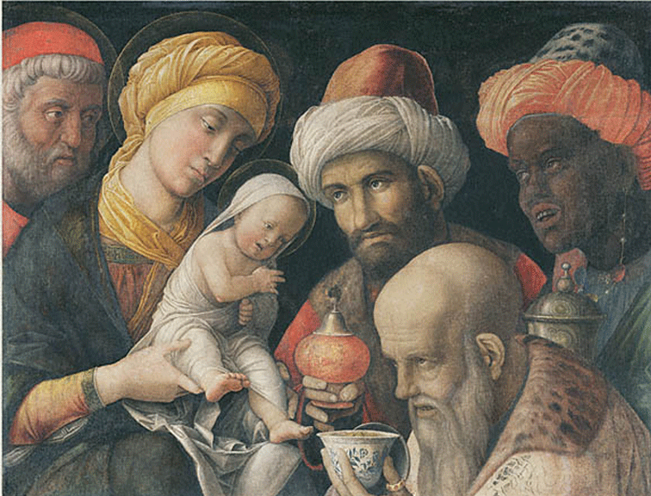
Can You Describe this Painting? At What Level(s)?
The painter
Not the only time this subject has been painted

Slide 28
INFO 202 “Information Organization & Retrieval” Fall 2015
UNIVERSITY OF CALIFORNIA, BERKELEY
SCHOOL OF INFORMATION
Robert J. Glushko glushko@berkeley.edu
@rjglushko
30 September 2015 Lecture 10.3 – “Computational” Metadata for Multimedia and Non-Text Resources

Slide 29
Bridging the Semantic Gap, or Not?
Bridging the semantic gap means extracting features from multimedia content and finding ways to infer semantic-level descriptions from them, even if those features are not interpretable
An image signature can be extracted from low-level features like color, shape, texture, and luminosity, and images are classified by computing the similarity between signatures
More recent deep learning approaches combine several layers of feature extractors to significantly improve object recognition (Hinton interview)
29

Slide 30
Image Signatures (low-level perceptual features)
Christel Figure 2.2: Example of syntactically correct matches of blue-green images to blue-green key, but with results spanning a variety of objects unlikely to be the true information targets for a user.
30

Slide 31
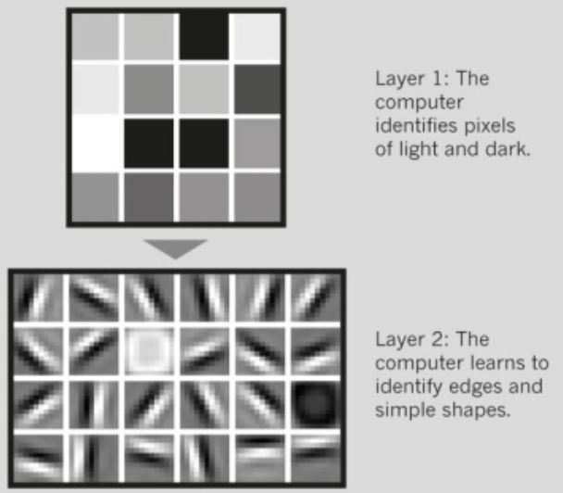
Deep Learning for Face Recognition
The “signature-like” features extracted at the initial layers combine in deeper layers to create complex features
Images by Andrew Ng. From N. Jones, The Learning Machines, Nature (2014)

Slide 32
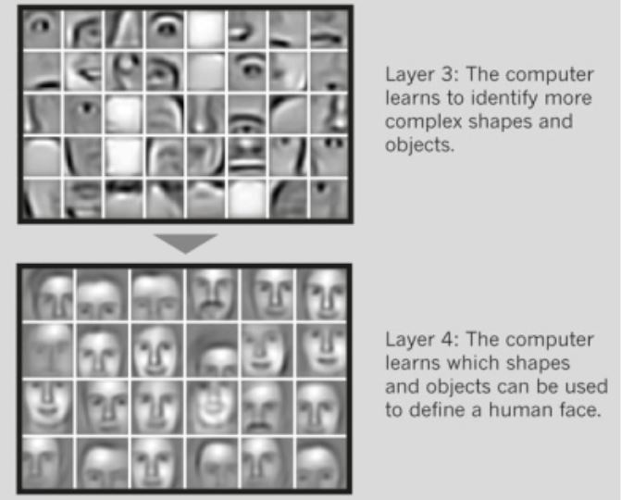
Deep Learning for Face
Recognition
For a rigorous discussion see: Krizhevsky, Alex, Ilya Sutskever, and Geoffrey E. Hinton. "Imagenet classification with deep convolutional neural networks." In Advances in neural information processing systems, pp. 1097-1105. 2012.

Slide 33
INFO 202 “Information Organization & Retrieval” Fall 2015
UNIVERSITY OF CALIFORNIA, BERKELEY
SCHOOL OF INFORMATION
Robert J. Glushko glushko@berkeley.edu
@rjglushko
30 September 2015 Lecture 10.4 – “Contextual” Metadata

Slide 34
Contextual Metadata
Metadata about the context in which some content was "captured"
Location, time, other people or things present are basic elements, but there are many more
This kind of information has often been collected, but not usually analyzed and applied to description until afterwards
34

Slide 35
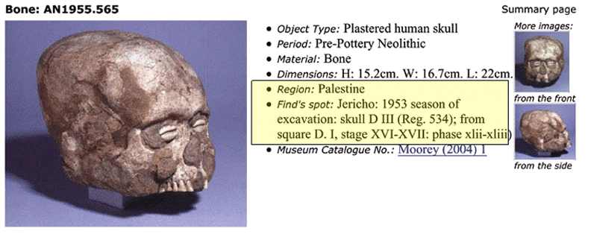
Non-Automated Contextual Metadata in Museum Catalog
35

Slide 36
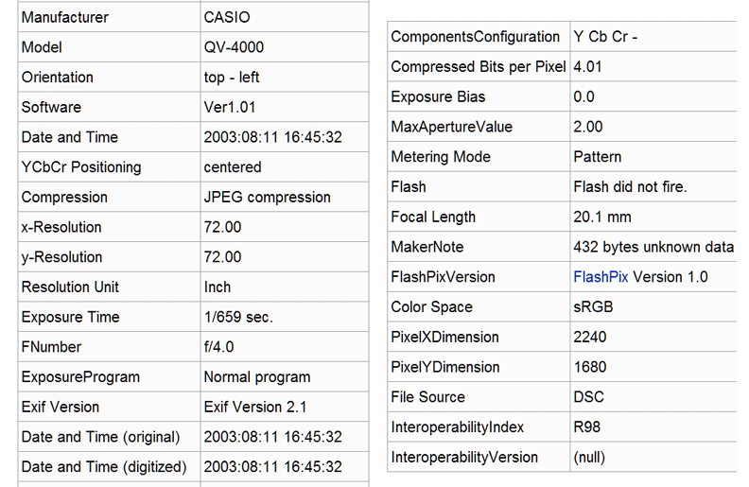
Automated Contextual Metadata in EXIF (Digital Camera)
36

Slide 37
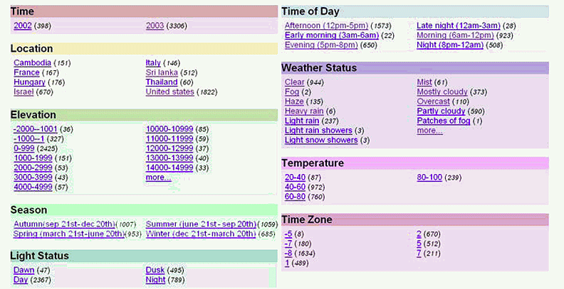
Augmenting EXIF (time) with Geo-Referenced Additional Resources
Naaman, Mor, et al. "Context data in geo-referenced digital photo collections.” 2004.
37

Slide 38
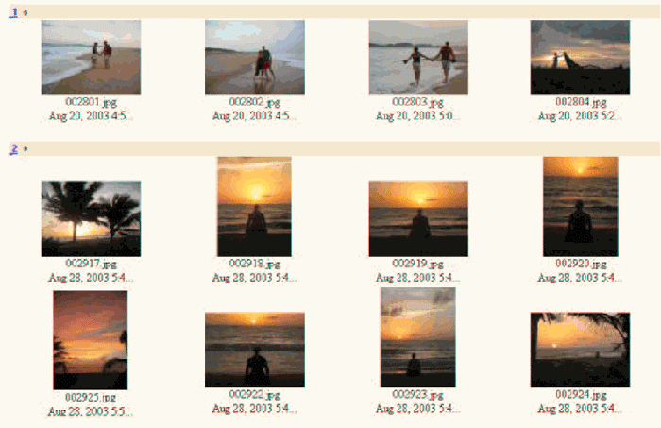
Using Contextual Metadata in Image Retrieval (Naaman et al)
38

Slide 39
Readings for Next Lecture
TDO 5 through 5.4
Kent 4
HIGHLY RECOMMENDED
Fellbaum, Christiane. Wordnet (skip sections 10.12-10.15)
39

