Slide 1
Plan for Today’s Lecture(s)
The Structural Perspective on Relationships (5.5)
Structure Between Resources; Links
Structure Within Resources
Document Types, Models, and XML
1

Slide 2
INFO 202 “Information Organization & Retrieval” Fall 2015
UNIVERSITY OF CALIFORNIA, BERKELEY
SCHOOL OF INFORMATION
Robert J. Glushko glushko@berkeley.edu
@rjglushko
7 October 2015 Lecture 12.1 – The Structural Perspective on Relationships

Slide 3
The Structural Perspective on Relationships
Analyzing the association, arrangement, proximity, or connection between resources without primary concern for their meaning or the origin of these relationships
Sometimes structure is all we know...and sometimes we ignore what we know about relationship semantics to focus on the generic aspect of structural connectivity
3

Slide 4
Internal and External Structure (1)
Resources can have INTERNAL structure as well as the EXTERNAL structure that connects them to other resources
We often make arbitrary decisions about the granularity with which we describe the internal structure of a resource
The boundaries we impose to identify resources determines whether some structure is internal or external with respect to them
4

Slide 5
Internal and External Structure (2)
Example: How do we describe the relationships between companies?
In terms of the company-to-company transactions they carry out
In terms of the business components/services that are involved
In terms of the interactions between their employees
5

Slide 6
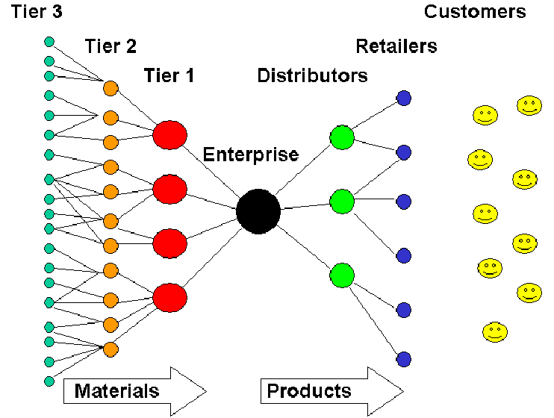
Generic Supply Chain
6

Slide 7
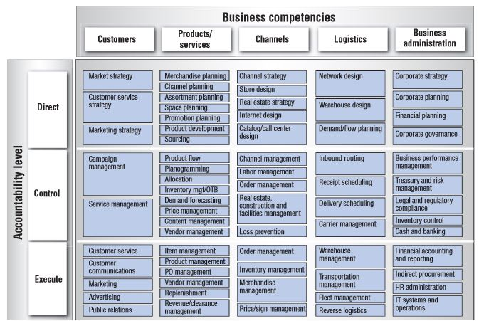
Component Business Models
7

Slide 8
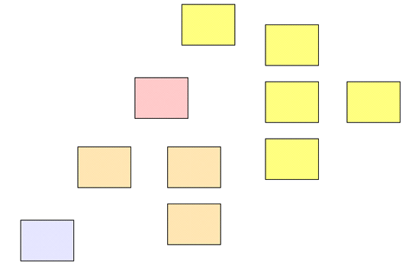
Resources or Resource Components?
8

Slide 9
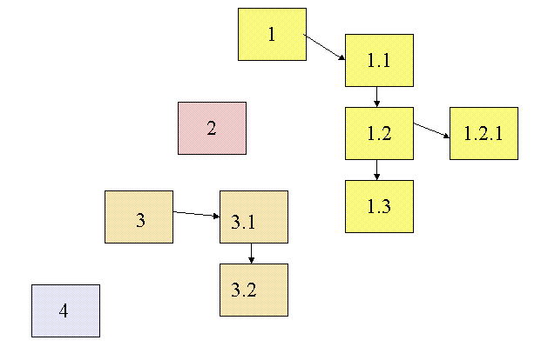
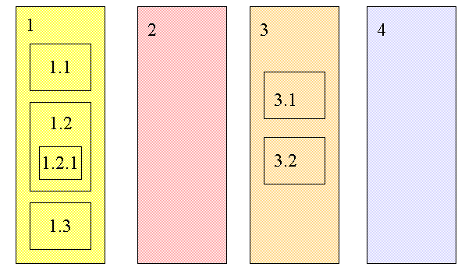
Changing Resource Boundaries Changes External to Internal Structure

Slide 10
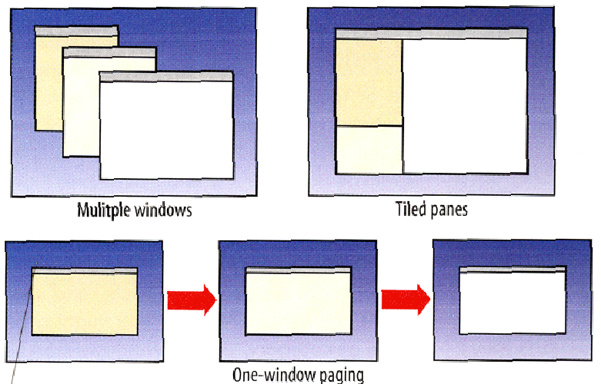
Tidwell: External or Internal Structures in a User Interface?

Slide 11
Making Implicit Structure Explicit
Some organizing principles impose very little structure and the structure might be implicit
co-location / pile of resources used together
arrangement by frequency of use
Coordinate systems enable absolute description of location, or we can use relative descriptions
in, on, above, below, in front of, behind…
Statistical techniques can make explicit the structure implied by frequency distribution or correlations between properties of resources
11

Slide 12
INFO 202 “Information Organization & Retrieval” Fall 2015
UNIVERSITY OF CALIFORNIA, BERKELEY
SCHOOL OF INFORMATION
Robert J. Glushko glushko@berkeley.edu
@rjglushko
7 October 2015 Lecture 12.2 –Describing Structure Between Resources; Links

Slide 13
“Between-Resource” Structures
Links between printed or digital documents
Links between web pages
Links – communication and information flows - between people, organizations, any other kind of interacting “actors” or resources – social networks
We can analyze all of these with some common concepts and abstractions
13

Slide 14
Between-Document Links
From document to document
From document to document component
From document component to document
From document component to document component

Slide 15
Within-Document Links
From one component to another
From document component to document component, pop-up (two-way, mandatory return link)
From document component to contained document component (call out)

Slide 16
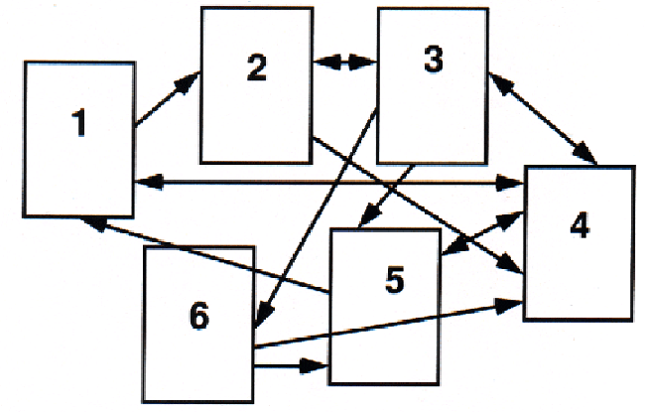
Link Network – Graphical View

Slide 17
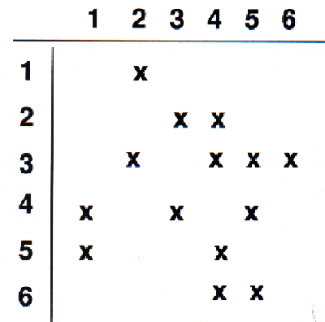
Link Network – Matrix View

Slide 18
Link Properties
Starting point of the link (the ANCHOR)
The end point of the link (the DESTINATION)
The reason for the link (the LINK TYPE)
The number of resource types (ARITY or DEGREE) or resource instances (CARDINALITY) linked to (1-1 or 1-many)
The DIRECTIONALITY
18

Slide 19
Annotation
An annotation is a link from some anchor to a newly-created destination, the contents of which are the BODY of the annotation
Highlighting can be conceived of as a link from an anchor back to itself where there is no new BODY created
19

Slide 20
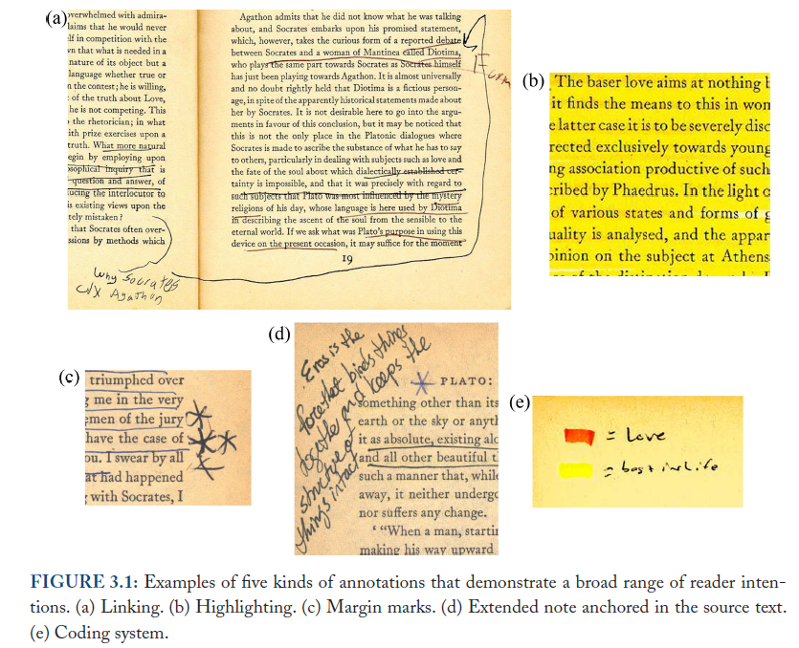
Annotation
Marshall, Reading and Writing the Electronic Book, 2010

Slide 21
Separation of Link Concerns
These structural and semantic issues are distinct from presentation ones
Is the presence of the link indicated (the LINK MARKER)?
Does the link marker change to indicate that the link has been followed?
Is the LINK TYPE indicated by some presentation convention?
Is the DESTINATION TYPE indicated by some presentation convention?
Are the links embedded in the resources, or are they architecturally distinct in a “link base”?

Slide 22
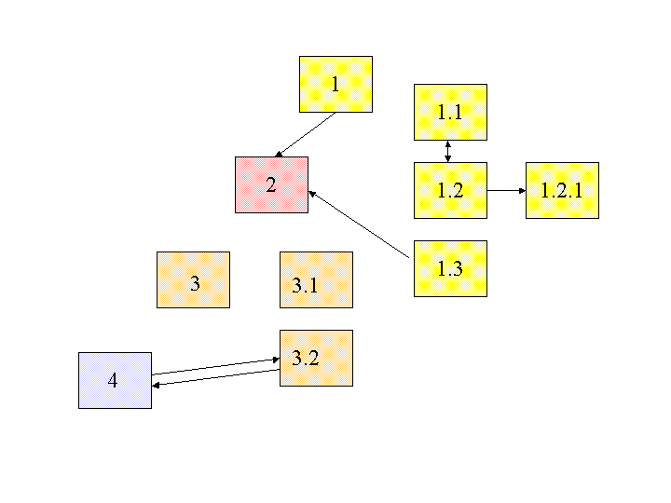
Embedded Links

Slide 23
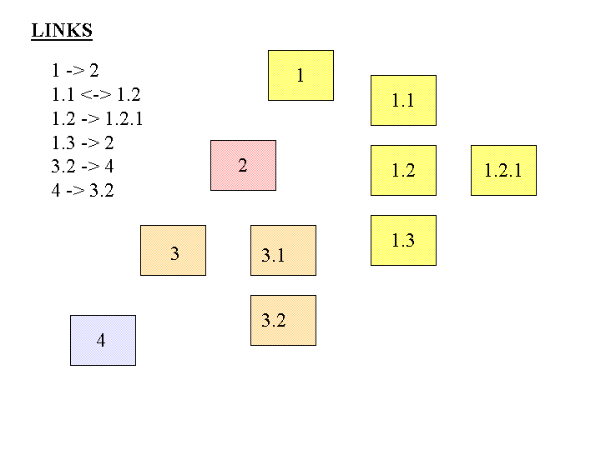
Separate Links

Slide 24
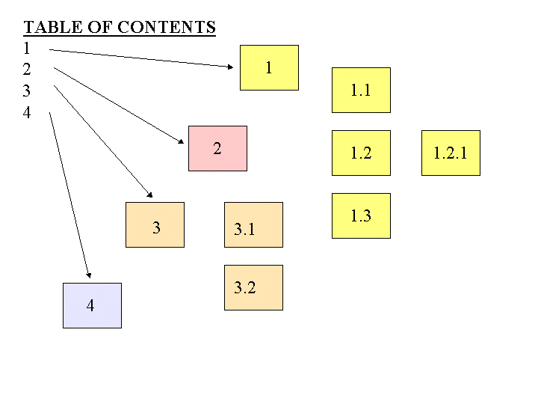
A Table of Contents is a Numeric Hierarchical Set of Structural Links to Document Components

Slide 25
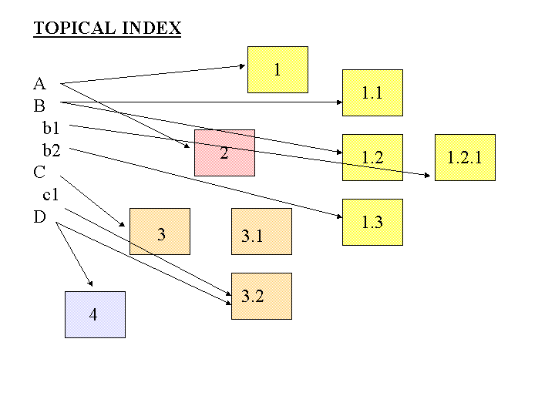
An Index is An Alphabetically Arranged Set of Semantic Links to Document Components

Slide 26
INFO 202 “Information Organization & Retrieval” Fall 2015
UNIVERSITY OF CALIFORNIA, BERKELEY
SCHOOL OF INFORMATION
Robert J. Glushko glushko@berkeley.edu
@rjglushko
7 October 2015 Lecture 12.3 – Internal Structure in Documents

Slide 27
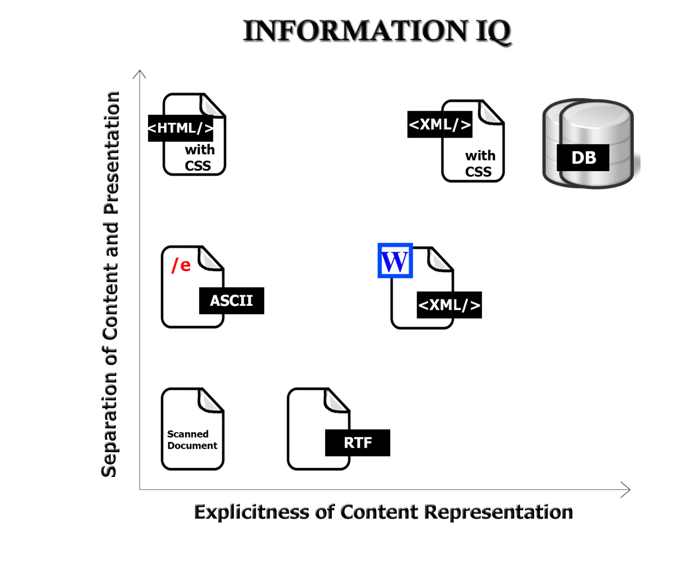
REMINDER: Format Matters!
How much you can do with information depends on the extent and explicitness of its internal structure or "markup“
Markup transforms a flat stream of text into a set of objects or elements that can be manipulated by other applications
27

Slide 28
Three Types of "Stuff“ or Kinds of Information
Content - "what does it mean" information
Structure - "where is it" or "how it is organized or assembled" information
Presentation - "how does it look" or "how is it displayed" information
28

Slide 29
Identifying Information Components
Any piece of information that can be addressed and manipulated by a person or process as a discrete entity
Any piece of information with a unique name or identifier
Any piece of information that is self-contained and comprehensible on its own
29

Slide 30
Separating Content from Structure and Presentation
An essential goal of modeling is to separate what something means from its structure and presentation
We're expressing a distinction between information as conceptual or as content and the physical container or medium, format, or technology in which the information is conveyed
Separating content from its structure and presentation is the most important principle of Information Architecture
30

Slide 31
Structural Information
Physical piece of a document or user interface (e.g. table, section, header, footer, panel, window)
Embodies the rules on how content components fit together, often hierarchical
Often driven by context of document use
Most applications and web sites are organized with a small set of structures
31

Slide 32
Applying Structure
The structural components provide the hierarchical "skeleton" or "scaffold" into which the content components are arranged; the structure remains fixed when the content changes
Frequently a close relationship between structural and presentation items, especially in documents designed for print or fixed layout
32

Slide 33
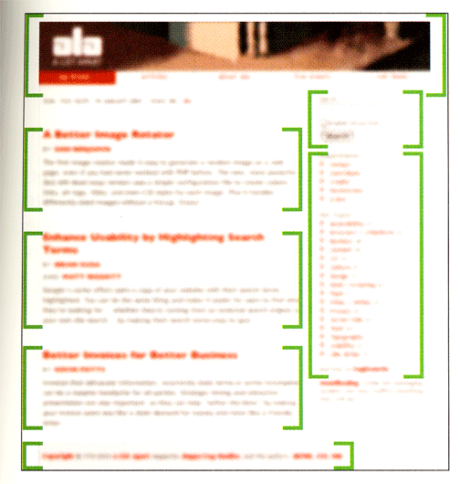
The Independence of Structure and Content

Slide 34
INFO 202 “Information Organization & Retrieval” Fall 2015
UNIVERSITY OF CALIFORNIA, BERKELEY
SCHOOL OF INFORMATION
Robert J. Glushko glushko@berkeley.edu
@rjglushko
7 October 2015 Lecture 12.4 – Document Types, Models, and XML

Slide 35
Document Types
Any definition of "document" allows for a notion of different types or classes or categories of documents
This idea can be very intuitive and very informal, or we can be more precise and define a MODEL OF A DOCUMENT TYPE as the rules or constraints that distinguish one type from another
This expression of the model is CONCEPTUAL and is independent of the syntax and technology in which document instances are ultimately implemented
But most of the time the model is ultimately implemented in some specific syntax like XML
35

Slide 36
Models of Document Types
A model of a document type captures the distinctions between documents that make a difference
Similar types of content occur in many document models and there is often overlap in information and structural patterns
Models of document types can be very specific ("purchase order for industrial chemicals when buyer and seller are in different countries") or very abstract ("fill-in-the-blank legal form for contract")
36

Slide 37
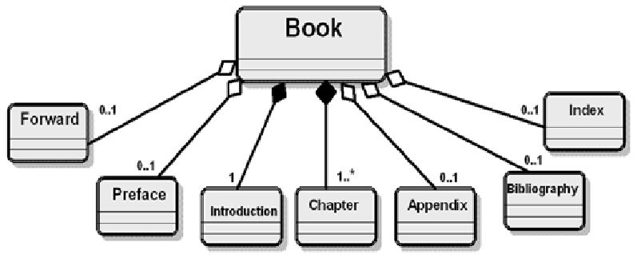
A Document Model for « Book »

Slide 38
How XML Implements Models of Document Types
XML gives the idea of document type a more physical, formal foundation
XML captures the conceptual distinctions between document types in terms of:
ELEMENTS (the "tags") and ATTRIBUTES used to encode their content
Rules that govern how elements and attributes are organized
Possible values for elements and attributes
These are the VOCABULARY and the GRAMMAR of the language defined by the document type
38

Slide 39
Schemas and Schema Languages
The formal description of a document model in XML is called its schema
XML schemas (lower case "s" for now) attempt to encode the conceptual model in terms of the syntactic constructs of elements and attributes
What elements are allowed (the vocabulary)
Where the are allowed – sequence, choice, occurrence and co-occurrence (the grammar)
What values they can take (datatypes) – string, integer, decimal, etc.
XML has several schema languages that differ in how completely they can encode a document type model
The most commonly used is XML Schema (XSD)
39

Slide 40
XSD Schema Fragment for « Book »
<?xml version="1.0" encoding="UTF-8"?>
<xs:schema xmlns:xs="http://www.w3.org/2001/XMLSchema">
<xs:element name="Book">
<xs:complexType>
<xs:sequence>
<xs:element ref="Foreword" maxOccurs="1" minOccurs="0"/>
<xs:element ref="Preface" maxOccurs="1" minOccurs="0"/>
<xs:element ref="Introduction" maxOccurs="1" minOccurs="0"/>
<xs:element ref="Chapter" maxOccurs="unbounded"/>
<xs:element ref="Appendix" maxOccurs="1" minOccurs="0"/>
<xs:element ref="Bibliography" maxOccurs="1" minOccurs="0"/>
<xs:element ref="Index" maxOccurs="1" minOccurs="0"/>
</xs:sequence>
</xs:complexType>
</xs:element>
…

Slide 41
Minimal XML Syntax: XML Document Instance
Begins with the root element that is the name of the document type
Can contain text and binary data
Text consists of markup and character data
Markup always starts with < or &
41

Slide 42
XML Elements
Elements are the building blocks in XML documents
They enclose content with both a begin and end tag
Element “containers” define inclusion relationships by providing context for understanding the child elements
42

Slide 43
XML Elements
<BookTitle>Moby Dick</BookTitle>
<BookAuthor>Melville</BookAuthor>
<BookPublicationYear>1851</BookPublicationYear>
<BookCategory>Fiction</BookCategory>
<Book>
<Title>Moby Dick</Title>
<Author>Melville</Author>
<PublicationYear>1851</PublicationYear>
<Category>Fiction</Category>
</Book>
43

Slide 44
XML Attributes
Elements may also one or more attributes (a name - value pair) associated only with their start tag and the values must always be quoted with matching ' or "
<PurchaseOrder number="12" >purchase order content </PurchaseOrder>
The order of attributes is not significant
Elements with attributes but no content are said to be "empty" and have a different tag syntax
<Portrait image="bob.gif"/>
44

Slide 45
Encoding with Elements Only
<Book>
<Title>Moby Dick</Title>
<Author>Melville</Author>
<PublicationYear>1851</PublicationYear>
<Category>Fiction</Category>
</Book>
45

Slide 46
Encoding with Attributes Only: How Do These Differ?
<Book title="Moby Dick" author="Melville" publicationYear="1851" category="Fiction"/>
<Book title="Moby Dick" author="Melville" category="Fiction" publicationYear="1851"/>
<Book title="Moby Dick" author="Melville" publicationYear="1851" fiction="True"/>
46

Slide 47
How Do These Differ?
<Book>
<Title>Moby Dick</Title> <Author>Melville</Author> <PublicationYear>1851</PublicationYear> <Categories>
<Category>Fiction<Category> <Category>Whales<Category> </Categories>
</Book>
<Book title="Moby Dick" author="Melville" publicationYear="1851" category="Fiction Whales”/>
47

Slide 48
Readings for Next Lecture
Glushko, Robert. Modeling Methods and Artifacts for Crossing the Data/Document Divide, 2005.
Glushko, Robert and McGrath, Tim. Document Engineering, Chapter 11, "Analyzing Documents"
48

Slide 49
TODAY’S MOST IMPORTANT SLIDES
49

Slide 50
Internal and External Structure (1)
Resources can have INTERNAL structure as well as the EXTERNAL structure that connects them to other resources
We often make arbitrary decisions about the granularity with which we describe the internal structure of a resource
The boundaries we impose to identify resources determines whether some structure is internal or external with respect to them
50

Slide 51
“Between-Resource” Structures
Links between printed or digital documents
Links between web pages
Links – communication and information flows - between people, organizations, any other kind of interacting “actors” or resources – social networks
We can analyze all of these with some common concepts and abstractions
51

Slide 52
REMINDER: Format Matters!
How much you can do with information depends on the extent and explicitness of its internal structure or "markup“
Markup transforms a flat stream of text into a set of objects or elements that can be manipulated by other applications
52

Slide 53
Separating Content from Structure and Presentation
An essential goal of modeling is to separate what something means from its structure and presentation
We're expressing a distinction between information as conceptual or as content and the physical container or medium, format, or technology in which the information is conveyed
Separating content from its structure and presentation is the most important principle of Information Architecture
53

Slide 54
Document Types
Any definition of "document" allows for a notion of different types or classes or categories of documents
This idea can be very intuitive and very informal, or we can be more precise and define a MODEL OF A DOCUMENT TYPE as the rules or constraints that distinguish one type from another
This expression of the model is CONCEPTUAL and is independent of the syntax and technology in which document instances are ultimately implemented
But most of the time the model is ultimately implemented in some specific syntax like XML
54

Slide 55
Models of Document Types
A model of a document type captures the distinctions between documents that make a difference
Similar types of content occur in many document models and there is often overlap in information and structural patterns
Models of document types can be very specific ("purchase order for industrial chemicals when buyer and seller are in different countries") or very abstract ("fill-in-the-blank legal form for contract")
55

