Slide 1
Plan for Today’s Lecture(s)
Structure and the Document Type Spectrum
Motivating “Document Engineering”
The Document Engineering Method
1

Slide 2
INFO 202 “Information Organization & Retrieval” Fall 2015
UNIVERSITY OF CALIFORNIA, BERKELEY
SCHOOL OF INFORMATION
Robert J. Glushko glushko@berkeley.edu
@rjglushko
12 October 2015 Lecture 13.1 Structure and the Document Type Spectrum

Slide 3
Reminder: The Document Type Spectrum

Slide 4
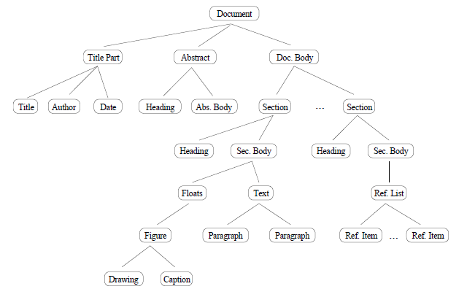
Structure in Narrative Document Types
NARRATIVE documents typically have relatively little internal structure, and that usually varies across instances of the same document type
Figure 1 in Summers, Kristen. "Toward a taxonomy of logical document structures (1995)
4

Slide 5
Structure in Hybrid Document Types
HYBRID document types are often called "semi-structured“ because they have more structure than narrative ones but less than fully-structured transactional ones
The extent of explicit structure (“mixed content”) in semi-structured document types is an important design decision
There are benefits to more granular identification of semantic “nuggets”
But who does the work, and who gets the benefits?
5

Slide 6
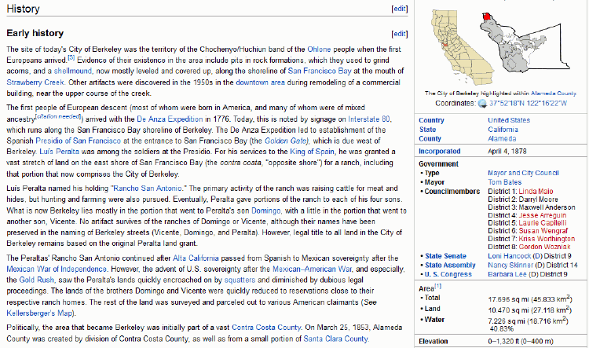
Encyclopedia: Semi-Structured Document Type

Slide 7
Structure in Transactional Documents
TRANSACTIONAL documents are completely and regularly structured because they contain many specific information components that are distinguished by their content type
These components are often organized in aggregate structures that can occur many times in the same document because they are typically created by repeated automated processes
7

Slide 8
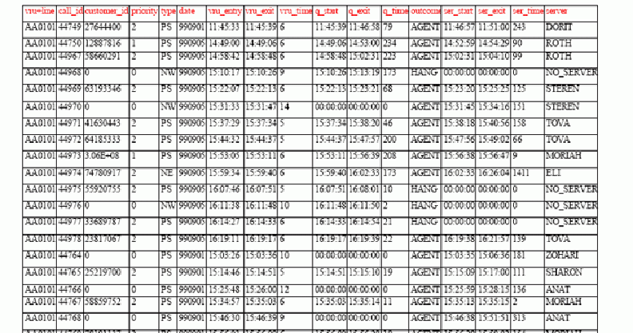
Call Center Log Transactional Document Type

Slide 9
INFO 202 “Information Organization & Retrieval” Fall 2015
UNIVERSITY OF CALIFORNIA, BERKELEY
SCHOOL OF INFORMATION
Robert J. Glushko glushko@berkeley.edu
@rjglushko
12 October 2015 Lecture 13.2 – Motivating “Document Engineering”

Slide 10
Documents vs. Data
Many people have contrasted "documents" and "data" and concluded that documents and data cannot be understood and handled with the same terminology, techniques, and tools
This document vs. data distinction is embedded and reinforced in textbooks, technology, and product marketing
“Document Analysis” vs. “Data Modeling”
But a more abstract perspective on document use and recognizing the continuum of the Document Type Spectrum motivate a more unified approach
10

Slide 11
The Document Type Spectrum is a Continuum
There is systematic and continuous variation in document instances and types and there is no clear boundary between “documents” and “data”
Many document types combine narrative and transactional content
Many familiar information processes involve both documents and data, often transforming one into the other
11

Slide 12
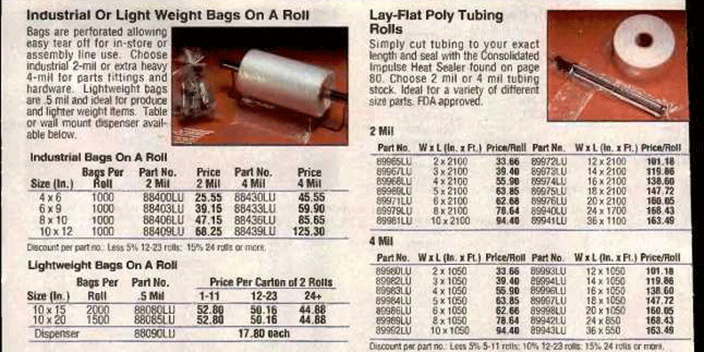
Many Document Types Combine Narrative and Transactional Content

Slide 13
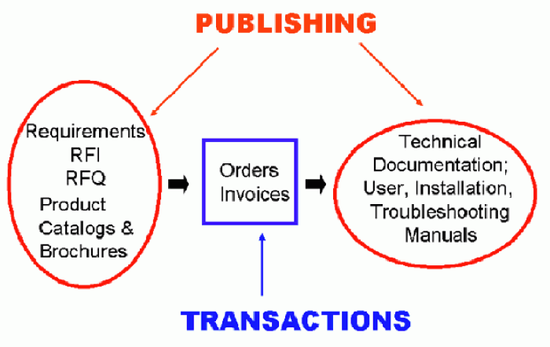
Business Models Combine and Transform Data and Documents

Slide 14
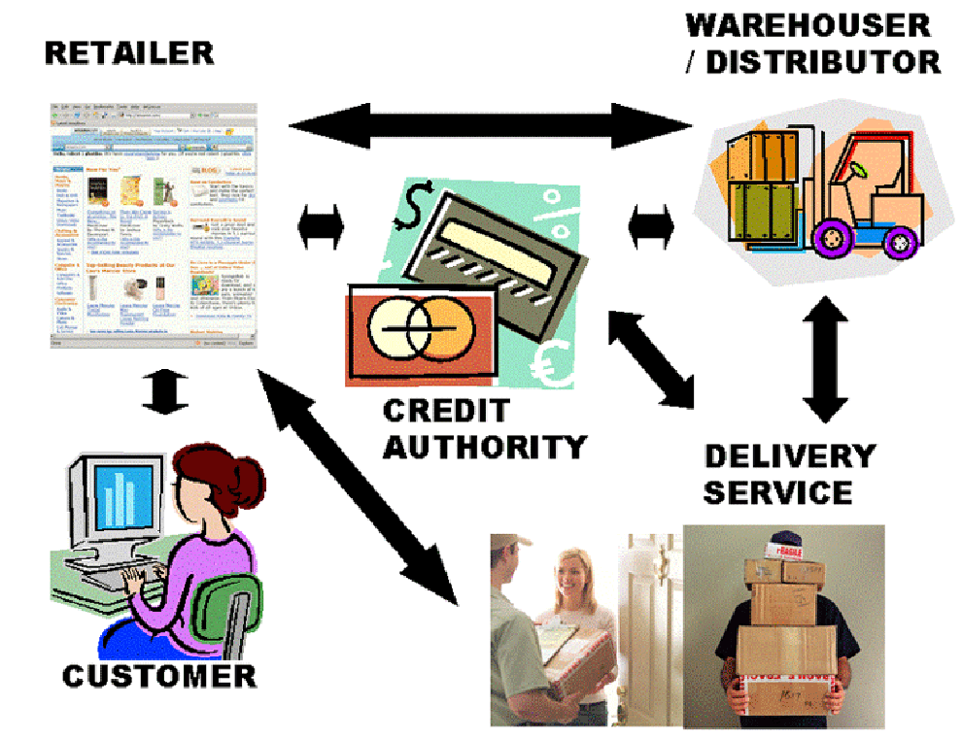
Business Models are Document Exchanges:
The “Drop Shipment” Document Exchange Choreography

Slide 15
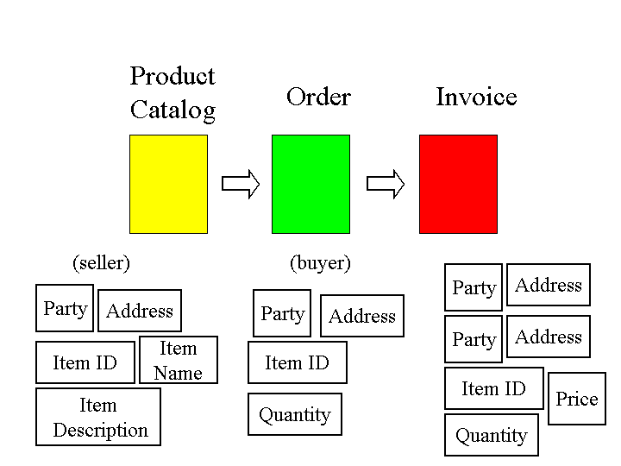
Business Processes are “Glued Together” by Overlapping Content

Slide 16
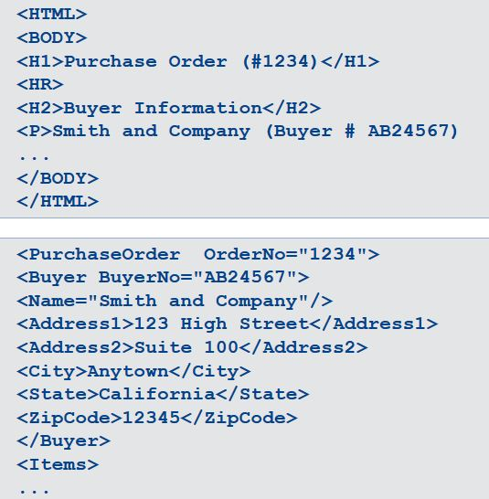
HTML is not Good Glue
XML is Good Glue

Slide 17
INFO 202 “Information Organization & Retrieval” Fall 2015
UNIVERSITY OF CALIFORNIA, BERKELEY
SCHOOL OF INFORMATION
Robert J. Glushko glushko@berkeley.edu
@rjglushko
12 October 2015 Lecture 13.3 – The “Document Engineering” Method

Slide 18
Crossing the Chasm with “Document Engineering”
The discipline of Document Engineering unifies the document analysis and data modeling disciplines
Document Engineering supports the specification, design, and implementation of the narrative and transactional documents needed in document-centric applications
It is a synthesis of information and systems analysis, business process modeling, content management, ethnography, and distributed computing
Document Engineering requires and reinforces patterns of information description and exchange from the perspective of business models, business processes, and information systems and services design
18

Slide 19
Document Engineering’s Key Ideas
Document Engineering harmonizes the terminology of document analysis and data modeling and emphasizes what they have in common rather than highlighting their differences:
Identifying the presentational, content, and structural components
Eliminating synonymy and homonymy
Identifying and organizing "good" content components
Assembling hierarchical document models to organize components to meet requirements for a specific context
19

Slide 20
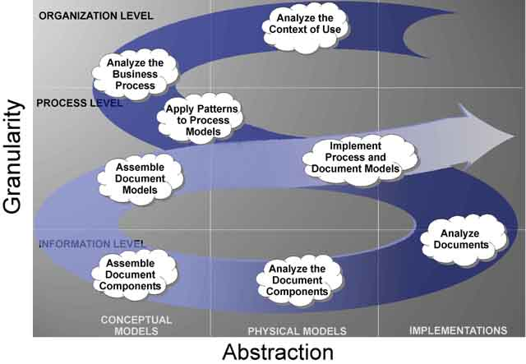
The Document Engineering Method

Slide 21
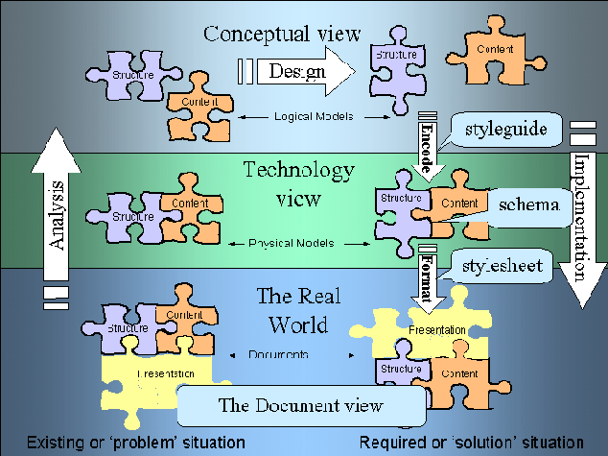
Depicted in Modeling Terms

Slide 22
From Physical to Conceptual Models (1)
When we analyze information sources: interviews, documents, sets of data, whatever - our goal is to identify and describe the "significant things" or the "information components" and their characteristics or attributes
If you conduct an interview your source will naturally talk about information components as abstract pieces of information
But when you analyze documents the information components aren't as immediately apparent because they are contained in structures and rendered in some presentation
22

Slide 23
From Physical to Conceptual Models (2)
So we have to remove the presentational information and dis-assemble the structural information to find the content information that is our highest priority
As we take away presentation and structure, we are abstracting away or generalizing from a physical implementation and creating our first conceptual or logical model of the information components
23

Slide 24
Finding the Right Documents to Analyze
Identifying all the potentially relevant documents or information sources is inherently an iterative task
We locate documents, which may refer or link to other documents, and we locate people who work with the documents, who may refer or link to other documents or people
If there are lots of documents of a particular type, we have to be concerned about representiveness and selection biases
24

Slide 25
Extracting Presentation Rules
Presentation affects structure and content by applying transformation rules to them
To understand the structure and content we must identify and record what the rules of the transformation were
Explicit transform rules can be encoded in templates, stylesheets or source code
25

Slide 26
Sometimes Rules Can’t be Extracted
No access to source formats or source code
Rules may be inaccessible in source formats ("override" formatting in word processors instead of style tags)
Rules don't exist or are inconsistently followed (author has "fontitis" with "ransom note" presentation style)
26

Slide 27
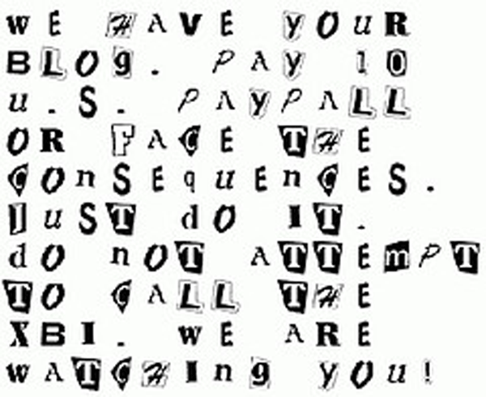
“Ransom Note” or “Fontitis” Style

Slide 28
Using Correlations or Conventions
Color, pitch, other perceptual dimensions can be correlated with semantic distinctions
Type size is correlated with structural hierarchy
Content types can have characteristic layouts or text attributes
Adjacency can suggest a semantic relationship, like that between figure and caption
Presentation order is sometimes semantically significant
28

Slide 29
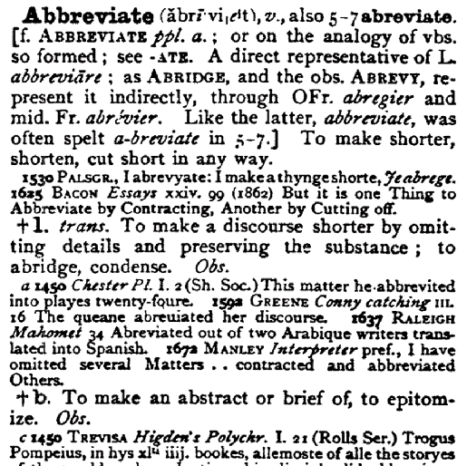
Presentation that Conveys Semantics

Slide 30
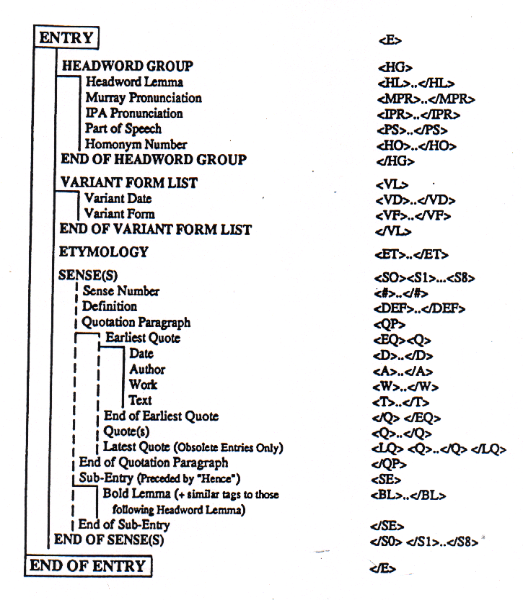
Model for OED “Entry”

Slide 31
Presentation that Hides Content Components
Address: Line 1: ________________ Line 2: _________________ City: ____________ State: ________ ZipCode: _________
“Line 1" and “Line 2" are presentation labels that are not useful for any purpose other than printing out an address label
They are not content components; they are hiding content components like "number" and "street”
31

Slide 32
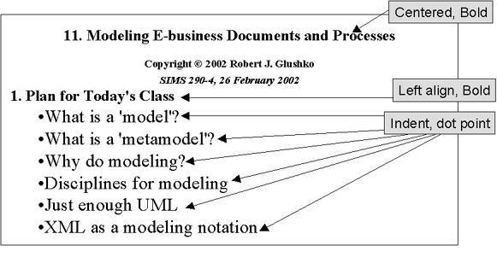
Presentation View of Lecture Slide

Slide 33
Structural Information
Removing the presentation components allows us to focus on the two remaining types, Structure and Content.
Structure is the physical or logical arrangement of components. Paragraphs, titles, sections, footnotes, tables, "parts" in a form, are all structural components.
The structural components provide the hierarchical "skeleton" or "scaffold" into which the content components are arranged
33

Slide 34
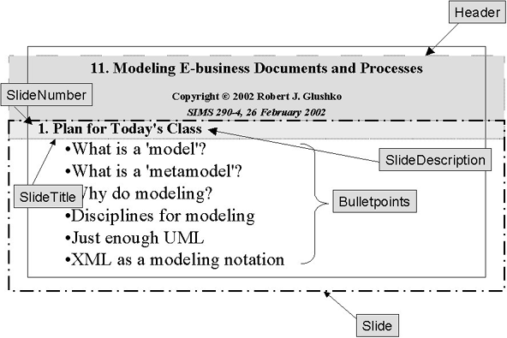
Structural View of Lecture Slide

Slide 35
Content Components
The search for “meaning” in our document analysis ends up with the content
Content components are the "nouns" in our documents or sets of data – things like "topic," "summary," "name," "address," "price"
35

Slide 36
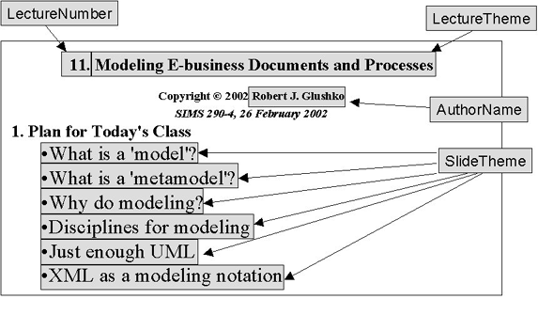
Content View of Lecture Slide

Slide 37
Generated or Derived Components
"Table of Contents," "Permuted Index," and list of figures, tables, or other types of components can usually be generated or derived from other components and are not good components in their own right
Similarly, if “TotalPrice" is "Quantity" x "UnitPrice" we might only want the latter two components in our model since collecting that first one separately could lead to data integrity problems
37

Slide 38
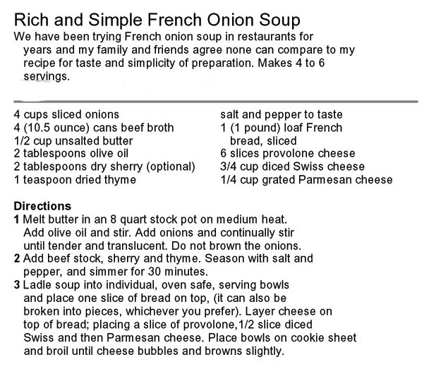
Exercise: Deconstruct into Presentation, Structure, and Content

Slide 39
Harvesting and Consolidation of Components from Multiple Instances of a Document Type
Harvesting – Create a set of candidate content components by extracting them from the information sources while removing presentation and structure
Consolidation– Identify synonyms and homonyms among the candidate content components, assigning a unique name to each unique meaning as part of a controlled vocabulary
39

Slide 40
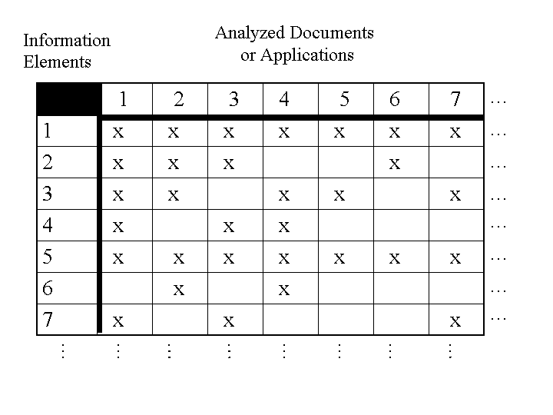
Harvesting Components from Multiple Sources

Slide 41
The Simplest Information Component Model
The simplest or minimal information component model is a glossary – a list of the words used to describe or name the "things of significance" and what they mean
This simple data model is augmented as attributes or characteristics of the significant things are identified and recorded
The model is further developed as relationships or associations or links between the "significant things" are identified and recorded
41

Slide 42
Information About Candidate Components
What attributes about each type of content might we record in our analysis?
Names/synonyms/homonyms (what it is called) and Identifiers
Definition (what it "means")
Optionality, Cardinality (occurrence rules)
Data Type (text, numbers, date, video) and possible values, code sets, defaults
Relationships/Associations
???
42

Slide 43
Analyzing "Possible Values"
It is critical to capture any rules governing the possible values for a component
Sometimes possible values are conventional, fixed, and span the entire semantic range for some domain (days of week, AM/PM)
Determine who can control the value sets (internal [Manufacturer part #s] vs external [Bar codes, AAT])
Patterns like regular expressions are often useful but not sufficient for validation
And if the set of possible values isn't well motivated, fix it in your component design
43

Slide 44
Consolidating the Harvest
We can begin our consolidation with the candidate components from any of the information sources, but we recommend using the one you believe is the most authoritative or that yielded the most components
The goal is to combine components that are synonyms (different names for the same meaning) and to distinguish any homonyms (same names for different meanings)
A good set components encourages one and only one way to describe something
44

Slide 45
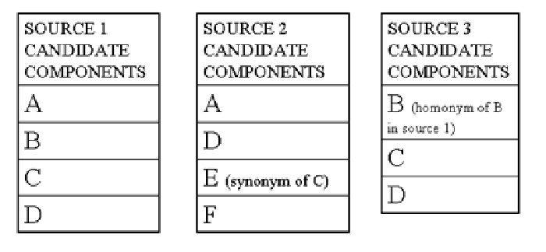
Merging Candidate Components

Slide 46
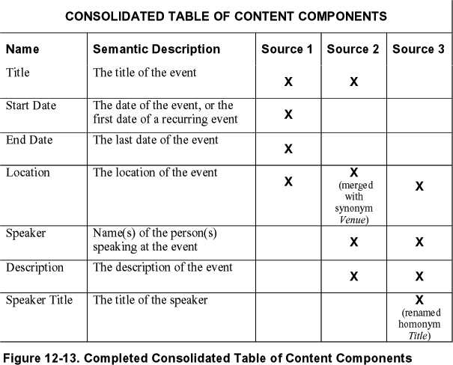
Consolidating Candidate Components

Slide 47
Readings for Next Lecture
TDO Section 5.6
Powell, James, et al. "Graphs in libraries: A primer." Information Technology and Libraries, 2011.
This Is What Controversies Look Like in the Twittersphere- Technology Review summary of Garimella, Kiran, Gianmarco De Francisci Morales, Aristides Gionis, and Michael Mathioudakis. "Quantifying Controversy in Social Media (2015).
MacRoberts, Michael H., and Barbara R. MacRoberts. “Problems of citation analysis.” Scientometrics 36, no. 3 (1996): 435-444. (just the 12 problems… skim or skip “one paper: two philosophies”)
47

Slide 48
TODAY’S MOST IMPORTANT SLIDES
48

Slide 49
The Document Type Spectrum is a Continuum
There is systematic and continuous variation in document instances and types and there is no clear boundary between “documents” and “data”
Many document types combine narrative and transactional content
Many familiar information processes involve both documents and data, often transforming one into the other
49

Slide 50
Business Processes are “Glued Together” by Overlapping Content

Slide 51
HTML is not Good Glue
XML is Good Glue

Slide 52
Document Engineering’s Key Ideas
Document Engineering harmonizes the terminology of document analysis and data modeling and emphasizes what they have in common rather than highlighting their differences:
Identifying the presentational, content, and structural components
Eliminating synonymy and homonymy
Identifying and organizing "good" content components
Assembling hierarchical document models to organize components to meet requirements for a specific context
52

Slide 53
From Physical to Conceptual Models (1)
When we analyze information sources: interviews, documents, sets of data, whatever - our goal is to identify and describe the "significant things" or the "information components" and their characteristics or attributes
If you conduct an interview your source will naturally talk about information components as abstract pieces of information
But when you analyze documents the information components aren't as immediately apparent because they are contained in structures and rendered in some presentation
53

Slide 54
Harvesting and Consolidation of Components from Multiple Instances of a Document Type
Harvesting – Create a set of candidate content components by extracting them from the information sources while removing presentation and structure
Consolidation– Identify synonyms and homonyms among the candidate content components, assigning a unique name to each unique meaning as part of a controlled vocabulary
54

