Slide 1
Plan for Today’s Lecture(s)
The Architectural Perspective on Relationships
Analyzing Links; A Little Graph Theory
Bibliometrics and Altmetrics
Page Rank
1

Slide 2
INFO 202 “Information Organization & Retrieval” Fall 2015
UNIVERSITY OF CALIFORNIA, BERKELEY
SCHOOL OF INFORMATION
Robert J. Glushko glushko@berkeley.edu
@rjglushko
14 October 2015 Lecture 14.1 – The Architectural Perspective on Relationships

Slide 3
The Architectural Perspective {and, or, vs.} the Structural Perspective
The architectural perspective is abstract and prescriptive
It defines what kinds of relationships can be created given the design of an organizing system
The structural perspective is concrete and descriptive
It says "this is what exists" and describes the actual patterns of association, arrangements, proximity, or connection between resources in a particular context
3

Slide 4
The Architectural Perspective: Degree or Arity
The architectural perspective embodies Kent’s definition of “relation” as “A sequence of categories, that includes one thing from each category”
The DEGREE or ARITY of a relationship is the number of different "entity types" or "resource categories" in the relationship
Husband is-married-to Wife is BINARY
Person is-married-to Person is UNARY
4

Slide 5
The Architectural Perspective: Cardinality
The CARDINALITY is the number of instances that can be associated with each entity type
Husband is-married-to Wife is ONE-TO-ONE, because husbands have only one wife and vice versa (in monogamous societies)
Father is-parent-of Child is ONE-TO-MANY
Homer is-parent-of Bart AND Lisa AND Maggie is one-to-three
5

Slide 6
Modeling Relationships as Binary Ones
Relationships can always be modeled as binary ones, but this makes some relationships implicit that were explicit
Binary relationships are relationship "triples" with a "subject", "predicate," and "object"
With binary relationships the reason for the relationship can often be interpreted in both directions (one is the inverse of the other)
With triples we can combine relationships into a graph and "reason" over the set of relationships when they have common components
6

Slide 7
The Architectural Perspective: Directionality
The DIRECTIONALITY of a relationship defines the order in which the arguments of the relationship are connected
A ONE-WAY or UNI-DIRECTIONAL relationship can be followed in only one direction
A BI-DIRECTIONAL one can be followed in both directions
All symmetric relationships are bi-directional, but not all bi-directional relationships are symmetric
7

Slide 8
INFO 202 “Information Organization & Retrieval” Fall 2015
UNIVERSITY OF CALIFORNIA, BERKELEY
SCHOOL OF INFORMATION
Robert J. Glushko glushko@berkeley.edu
@rjglushko
14 October 2015 Lecture 14.2 – Analyzing Links; A Little Graph Theory

Slide 9
Analyzing Patterns of Links
Analyzing the patterns of links within a large collection of documents can be necessary when:
The authors or editors are not around to explain structural decisions
The actual structure differs from the ideal or intended structure because of production or implementation decisions
Raymond, Darrell, and Frank Tompa. "Hypertext and the Oxford English dictionary." Communications of the ACM 31, no. 7 (1988): 871-879.
OED in 1980 had 569K cross references, avg. of 2.26 per entry, but very interesting distribution
9

Slide 10
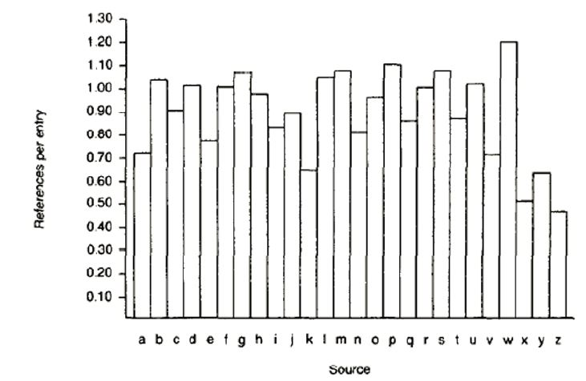
Cross References Between OED Entries
(Type S)

Slide 11
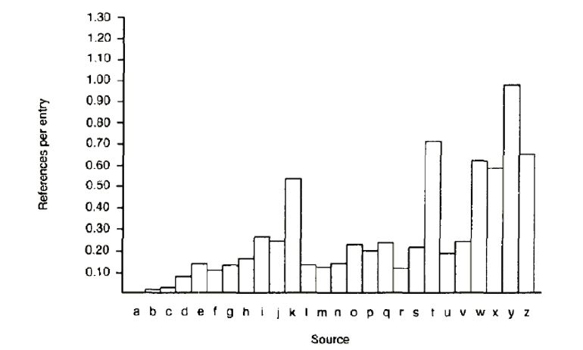
Cross References Between OED Entries (Type P)

Slide 12
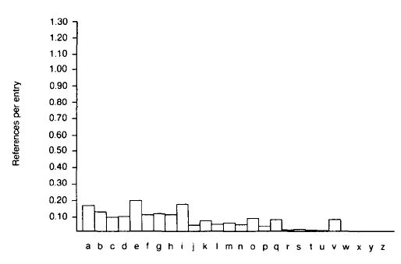
Cross References Between OED Entries
(Type F)

Slide 13
Graph Theory
We can apply graph theory to understanding relationships from a structural perspective
A GRAPH treats resources as VERTICES or NODES
The pairwise relationships between resources are represented by the EDGES that connect them
If the edges have an associated direction, this is a DIRECTED graph
A WEIGHT can be assigned to each edge if the relationship has a numerical aspect (distance, cost, time, etc.)
13

Slide 14
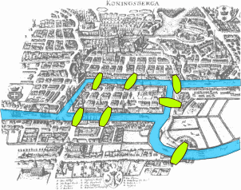
The Origins of Graph Theory (Euler 1735)
2 islands, 7 bridges – can you visit all 4 land masses without crossing any bridge more than once? Euler (1735) proved you couldn’t and invented much of graph theory to explain it
Euler’s Seven Bridges of Königsberg Problem
14

Slide 15
Computing the Properties of Graphs
Reachability – is there a path between any two nodes in the graph?
Shortest path – if there are multiple paths between two nodes, which is the shortest?
Centrality – which nodes are the most connected or have the average shortest paths to the other nodes?
Subgraph discovery – are there sub-graphs that are completely contained in a larger graph?
15

Slide 16
Reachability and Transitive Closure
The REACHABILITY property of a graph is "can you get there from here”
We can determine whether a path exists between any two nodes in a graph by calculating the transitive closure of the graph; the most commonly used approach is Warshall's algorithm
16

Slide 17
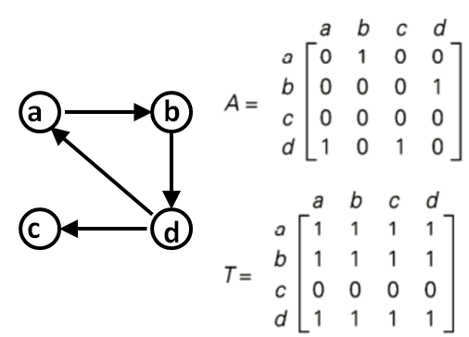
Directed Graph, Adjacency Matrix, and Transitive Closure

Slide 18
Shortest Path
The shortest path between two nodes in a graph can be calculated using Dijkstra’s algorithm
Finding the shortest path has obvious value in travel, transportation, communications, financial arbitrage, grocery shopping, language processing…
If the graph edges aren’t weighted and we only care about connectivity, we have the familiar “degrees of separation” situation
For mathematicians; for actors
“The Science of 6 Degrees” in 10 minutes
18

Slide 19
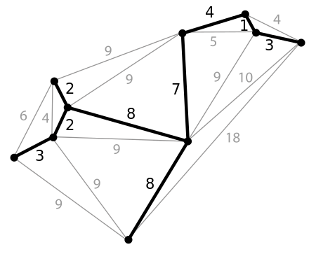
Minimum Spanning Tree
A spanning tree of a graph is a subgraph that is a tree that connects all the vertices – what’s the shortest one, and why would we care?
19

Slide 20
Moving Beyond “Reachability”
We've been treating relationships in purely structural terms - is one thing connected to another - but we can refine that into two perspectives:
RELATIONAL analysis treats links as indicators of the amount of connectedness or the direction of flow between documents, people, groups, journals, disciplines, domains, organizations, or nations
EVALUATIVE analysis treats links as indicators of the level of quality, importance, influence or performance of documents, people, groups
20

Slide 21
Analysis of Large-Scale Social & Information Networks
Many social networks are directed graphs because of asymmetries in status, power, or values
Social network firms exploit “triadic closure” – the increased tendency for two people to form a relationship when they people in common
Identifying “influencers” and predicting their influence is the billion dollar question for web-based social networks
People who are the boundaries of one’s social networks – “weak ties” – can be crucial sources of information
21

Slide 22
Measures of Centrality
Degree Centrality – number of direct connections
Betweenness – a location in the network that interconnects different clusters
Closeness – low average path length
22

Slide 23
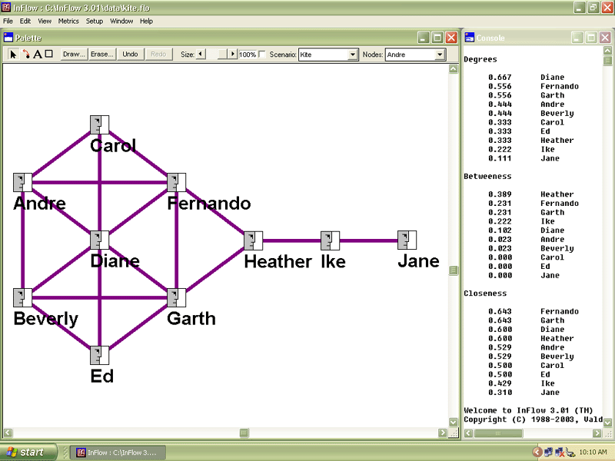
“Kite Network” Example from http://www.orgnet.com/sna.html
23

Slide 24
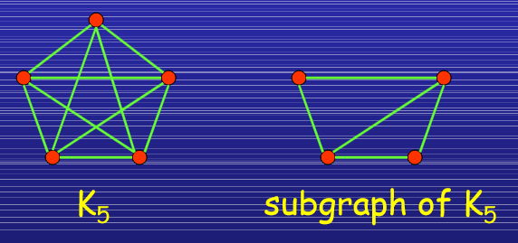
Subgraphs
In a social network setting, connection subgraphs can identify the few most likely paths of transmission for a disease (or rumor, or information-leak, or joke) or spot whether an individual has unexpected ties to any members of a list of individuals.
Faloutsos, Christos, Kevin S. McCurley, and Andrew Tomkins. "Connection subgraphs in social networks” 2004.
24

Slide 25
Graph Analysis in the Twittersphere
Analysis of “following” and “retweeting” relationships on Twitter can identify controversy in a collection of tweets
A hashtag-identified topic is represented as a graph with people as the vertices and their twitter activity as the edges
Clusters form around each side of the controversy because people tend to follow and retweet people they agree with
Garimella, Kiran, Gianmarco De Francisci Morales, Aristides Gionis, and Michael Mathioudakis. "Quantifying Controversy in Social Media”
25

Slide 26
Graph Analysis in the Twittersphere
The person endorsed the most by comments and retweets is considered the most authoritative and become the center of an opinion cluster
Various measures of centrality are used to create an overall controversy measure
Clusters are most clearly separated for the most controversial topics
26

Slide 27
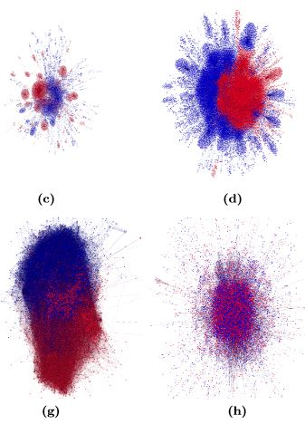
Low Controversy Topics

Slide 28
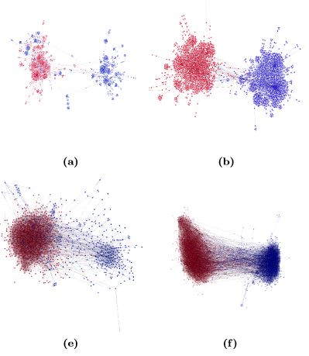
High Controversy Topics

Slide 29
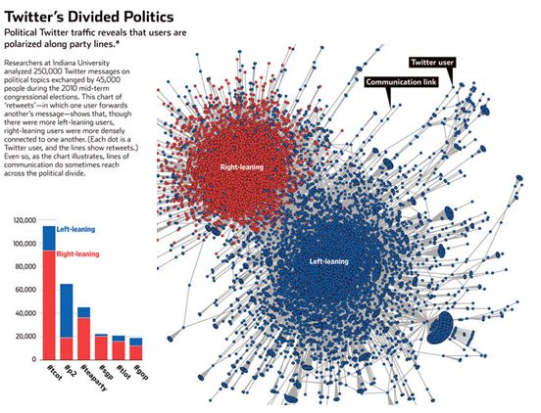
Decoding Our Chatter Wall Street Journal 1 October 2011

Slide 30
NSA’s Social Network Analysis
The agency was authorized to conduct “large-scale graph analysis on very large sets of communications metadata without having to check foreignness” of every e-mail address, phone number or other identifier, the document said.
NSA Gathers Data on Social Connections of US Citizens.
NY Times 28 Sept 2013
30

Slide 31
INFO 202 “Information Organization & Retrieval” Fall 2015
UNIVERSITY OF CALIFORNIA, BERKELEY
SCHOOL OF INFORMATION
Robert J. Glushko glushko@berkeley.edu
@rjglushko
14 October 2015 Lecture 14.3 – Bibliometrics and Altmetrics

Slide 32
Bibilometrics (or "Scientometrics"): Structure of Scientific Citation
Analysis of scientific citation began in the 1920s as a way to quantify the influence of specific documents or authors in terms of their "impact factor"
It can also identify "invisible colleges" of scientists whose citations are largely self-referential
It can recognize the emergence of new scientific disciplines
(Eugene Garfield and Derek J. de Solla Price are two of the "founding fathers" of bibliometrics)
32

Slide 33
Citation Analysis and Impact Ranking
Most articles and most journals are rarely cited
a very large fraction … must be reckoned as merely a distant background noise, and as very far from central or strategic in any of the knitted strips from which the cloth of science is woven (de Solla Price)

Slide 34
Citation Signals and Polarity (1)
When one resource cites another there is often a lexical signal that indicates how a writer views the relationship of a citation to the text from which the citation is made
This concept comes from rhetoric and critical theory but is relevant to document engineering and TDO
Pedantic folks call this "genre of invocation" -- distinguishing things like "cite, mention, acknowledged”
34

Slide 35
Citation Signals and Polarity (2)
A citation or link without a signal suggests by default that the citation supports the current text
Explicit signals that indicate positive polarity include "See," "See also," "See generally," and "Cf."
Signals that indicate negative polarity include "But see" and "Contra"
35

Slide 36
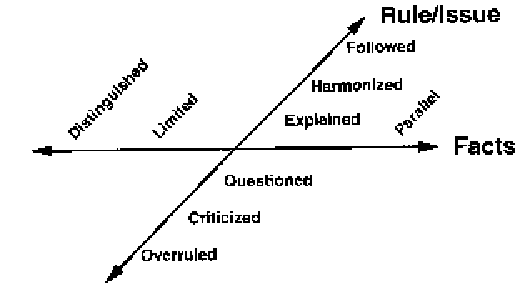
Shepardizing
Because of the use of legal cases as precedents, an entire industry in legal publishing exists to interpret any citations to cases; Shepard's is the oldest and checking a prior legal ruling to make sure it is still "good" is called "Shepardizing" a case

Slide 37
Some Problems for Citation Analysis
People lie, are lazy, stupid, biased...
Most papers cite only a small proportion of the sources that influenced them
Secondary sources are cited more than primary ones, because people don't know the literature, and informal ones aren't cited
People cite their friends and themselves more than is justified
37

Slide 38
Altmetrics
Influence measures based on total output are biased against young scholars; one of them proposed the H-Index as a better predictor of scientific impact (check both kinds of measures at Google Scholar)
The “Altmetrics” movement is trying to make non-traditional contributions count for academic evaluations
Publishing in “open publications” – measuring downloading
Sharing “raw science” like datasets, code, and experimental designs
Blogging, microblogging, and comments or annotations on existing work
38

Slide 39
INFO 202 “Information Organization & Retrieval” Fall 2015
UNIVERSITY OF CALIFORNIA, BERKELEY
SCHOOL OF INFORMATION
Robert J. Glushko glushko@berkeley.edu
@rjglushko
14 October 2015 Lecture 14.4 – Page Rank

Slide 40
Adapting Citation Analysis to the Web
The concepts and techniques of citation analysis seem applicable to the web since we can view it as a network of interlinked articles
But not everything applies because the web is different in numerous ways
40

Slide 41
The Need for Web Citation Analysis
Google revolutionized web search by using the pattern of links between web pages
Earlier search engines relied on content matching (traditional indexing) but typical short queries (1 or 2 words) would bias toward the retrieval of short documents that were often not the most relevant
And unlike documents in controlled collections, the resource descriptions associated with web pages was often missing or misleading
41

Slide 42
Using Links to Assess Relevance
Using links to assess the relevance of a web site seems intuitively sensible
Sites that are the "official" or "authoritative" or "gateway" site for an enterprise or organization will attract links from the Es & Os that have relationships with them -> we should value incoming links
Sites that these sites then link to are being endorsed by them -> we should value outgoing links from high relevance sites
42

Slide 43
Some Questions Remain
What value should we place on links from low importance or low relevance sites?
What value should we place on links to low importance or low relevance sites?
Should the number of outgoing links a site has influence how we value each link?
43

Slide 44
A Very Conceptual Description of Page Rank
Google’s algorithms for search continually evolve and use much more than Page Rank, so there’s no need to go into technical detail
The Page Rank algorithm recursively computes the importance of a web page by combining its own rank with that of the pages that link to it
It weights the contribution of the incoming links by dividing it by the number of their outgoing links
44

Slide 45
The Page Rank "Voting" Calculation
A site doesn't lose any of its own Page Rank by linking - it is just voting, as in a company shareholders meeting where you get as many votes as you have shares of stock. You don't give away your stock when you vote.
But the vote for the "linked to" site is divided by the number of outgoing links from the "voting" site to prevent ballot box stuffing with too many votes
45

Slide 46
Manipulating Page Rank
There are issues with web links that are analogous to concerns in scientific citation that self-citation and citations to classics distort the "true" link structure and relevance measures
"Search engine optimization" techniques claim to increase a page or site's page rank, sometimes by creating links to it (“link farms”)
46

Slide 47
Sociopolitical Criticism of Page Rank and Google Relevance Heuristics [1]
Google says Page Rank relies on the uniquely democratic nature of the web by using its vast link structure... and interprets a link from page A to page B as a vote. But votes cast by pages that are themselves "important" weigh more heavily
So the Page Rank algorithm favors older pages because a new page, regardless of its quality or relevance, will not have many incoming links
47

Slide 48
Sociopolitical Criticism of Page Rank and Google Relevance Heuristics [2]
Does Page Rank systematically disfavor or suppress new, underrepresented, or other voices that are critical of the "mainstream” point of view?
Is it "democratic" for the rich to have more votes and for their votes to count more? Or is this just "shareholder democracy" with "one dollar, one vote"
It may be democratic for the aggregated preferences of the majority to be put into practice, but is it democratic to allow only the majority‘s views to be heard?
48

Slide 49
Readings for Next Lecture
TDO 5.8
Berners-Lee, Tim, James Hendler, and Ora Lassila. “The semantic web.” Scientific American 284, no. 5 (2001): 28-37.
Heath, Tom, and Christian Bizer. “Linked data: Evolving the web into a global data space.” Synthesis lectures on the semantic web: theory and technology 1, no. 1 (2011). Chapters 1 and 2, pages 1-29.
Byrne, Gillian, and Lisa Goddard. “The Strongest Link: Libraries and Linked Data.” D-Lib Magazine 16, no. 11/12 (2010).
49

Slide 50
TODAY’S MOST IMPORTANT SLIDES
50

Slide 51
Modeling Relationships as Binary Ones
Relationships can always be modeled as binary ones, but this makes some relationships implicit that were explicit
Binary relationships are relationship "triples" with a "subject", "predicate," and "object"
With binary relationships the reason for the relationship can often be interpreted in both directions (one is the inverse of the other)
With triples we can combine relationships into a graph and "reason" over the set of relationships when they have common components
51

Slide 52
Computing the Properties of Graphs
Reachability – is there a path between any two nodes in the graph?
Shortest path – if there are multiple paths between two nodes, which is the shortest?
Centrality – which nodes are the most connected or have the average shortest paths to the other nodes?
Subgraph discovery – are there sub-graphs that are completely contained in a larger graph?
52

Slide 53
Moving Beyond “Reachability”
We've been treating relationships in purely structural terms - is one thing connected to another - but we can refine that into two perspectives:
RELATIONAL analysis treats links as indicators of the amount of connectedness or the direction of flow between documents, people, groups, journals, disciplines, domains, organizations, or nations
EVALUATIVE analysis treats links as indicators of the level of quality, importance, influence or performance of documents, people, groups
53

Slide 54
Analysis of Large-Scale Social & Information Networks
Many social networks are directed graphs because of asymmetries in status, power, or values
Social network firms exploit “triadic closure” – the increased tendency for two people to form a relationship when they people in common
Identifying “influencers” and predicting their influence is the billion dollar question for web-based social networks
People who are the boundaries of one’s social networks – “weak ties” – can be crucial sources of information
54

Slide 55
Adapting Citation Analysis to the Web
The concepts and techniques of citation analysis seem applicable to the web since we can view it as a network of interlinked articles
But not everything applies because the web is different in numerous ways
55

Slide 56
NSA’s Social Network Analysis
The agency was authorized to conduct “large-scale graph analysis on very large sets of communications metadata without having to check foreignness” of every e-mail address, phone number or other identifier, the document said.
NSA Gathers Data on Social Connections of US Citizens.
NY Times 28 Sept 2013
56

