Slide 1
Plan for Today’s Lecture(s)
The Semantic Web
RDF and other Semantic Web Technologies
deferred to 10/21
Linked Data
SemWeb and Linked Data and Libraries
1

Slide 2
INFO 202 “Information Organization & Retrieval” Fall 2015
UNIVERSITY OF CALIFORNIA, BERKELEY
SCHOOL OF INFORMATION
Robert J. Glushko glushko@berkeley.edu
@rjglushko
19 October 2015 Lecture 15.1 – The Semantic Web

Slide 3
Why the Web Wasn’t Born Semantic
Around 1990, when the Web was being imagined by Tim Berners-Lee, SGML (precursor of XML) was increasingly being used to define structured document models, mostly for publishing
TBL chose to create HTML as a specific and simple document language rather than use the generality, expressive power, and complexity that SGML would have meant (and he was criticized by the “experts” for doing so)
This tradeoff made it vastly easier to create web pages and software for serving and processing them
But this made the Web work “for eyes only” rather than make it work “for machines”, especially those doing business transactions
3

Slide 4
The Vision of the Semantic Web (1)
In a classic 2001 paper Sir Tim Berners-Lee says:
The Web can reach its full potential only if … data can be shared and processed by automated tools as well as by people...
The Semantic Web will bring structure to the meaningful content of Web pages...
For the Web to scale, tomorrow's programs must be able to share and process data even when these programs have been designed totally independently.
4

Slide 5
The Vision of the Semantic Web (2)
Services and agents can advertise their function by registering in directories
The service is described in a way that lets other agents discover the function offered and understand how to use it, terms and conditions, invocations…
Service discovery enables agents to delegate tasks to create the overall "value chain" in which subassemblies of information are passed from one agent to another
5

Slide 6
The Semantic Web Scenario
Lucy and Pete, 2 adult children trying to help out Mom with a medical appointment
"...Lucy instructed her Semantic Web agent through her handheld Web browser. The agent promptly retrieved information about Mom's prescribed treatment from the doctor's agent, looked up several lists of providers, and checked for the ones in-plan for Mom's insurance within a 20-mile radius of her home and with a rating of excellent or very good on trusted rating services”
STOP AND THINK: WHAT INFORMATION SOURCES NEED TO BE COMBINED?
(It doesn’t work the first time… Why not?)
6

Slide 7
Making the (Existing) Web More Semantic
How would you deal with existing web pages?
Assuming you can edit them
Assuming you can’t edit them
What would you do for new web pages?
STOP and THINK before you go to the next slide
7

Slide 8
Making the (Existing) Web More Semantic
Convert existing Web page content to semantic markup (adding internal structure and content)
Annotate existing Web page content with semantic descriptions (attaching external content)
8

Slide 9
Making the (New) Web More Semantic
Create new web page content with semantic content and semantic description
Create new pages or resources that are designed from the outset to be "meta-pages" that facilitate semantic processing of all the other resource descriptions
This is the traditional role of librarians and cataloguers
9

Slide 10
Extracting “Semantic” Markup
if the content is semi-structured (e.g., a news feed that uses a "story template" for its stories, with mixed content "semantic islands" in the text), NLP and "data mining" techniques can often extract some limited semantics -- like tagging for people, place names, product names - these usually start with "named entity recognition”
10

Slide 11
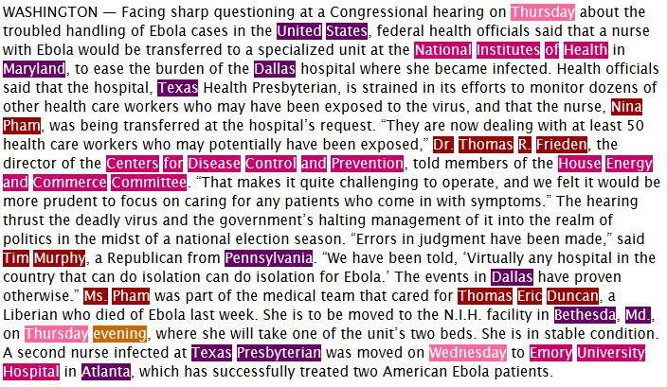
Stanford Named Entity Tagger
Demo using text from 10/16/14 NY Times story about Ebola

Slide 12
Semantic Annotation
Annotation" generally means "semantics applied to a document or information resource by a person" -- rather than by NLP
Someone other than the author can sometimes figure out the author's intent and context if:
they both belong to the same narrow organization, "community of interest" or "social network"
there are "extraction," "summarization," and other text processing tools that can help them
But suppose the annotator deliberately misleads?
12

Slide 13
Semantic Authoring
But even when an author is creating his own semantically-encoded content or annotation ...
How are semantic descriptors chosen?
What do those descriptors mean?
Can others trust what the author does?
13

Slide 14
Semantic Authoring: The 2001 Vision
“The clinic's web page will have more than just keywords; it will have computer-processable information about when specific doctors take appointments"
"These semantics were encoded into the Web page when the clinic's office manager (who never took Comp Sci 101) massaged it into shape using off-the-shelf software for writing Semantic Web pages along with resources listed on the Physical Therapy Association's site”
14

Slide 15
STOP AND THINK: Semantic Authoring
What might the office manager have learned in Comp Sci 101 (or INFO 202) that is now somehow unnecessary?
What specifically is the "off-the-shelf" software going to do?
What kinds of resources will be listed on the Physical Therapy Association site that can be of use here?
15

Slide 16
Semantic Authoring: Today’s Reality
Many current semantic web tools still require expertise in semantic technologies and web standards (e.g., Protégé )
SWAT project to put a natural language front end to semantic authoring
Refining and inferring from a verbal description
More likely to succeed are applications that aim lower, not trying to encode all the latent semantics in a document or web page
16

Slide 17
Semantic Templating with Microformats
Microformats make the web "semantic light" by embedding content annotation into web pages
Microformats currently exist for personal contact information, events, and a few other small chunks of structured data
Wikis and blogs increasingly use schema.org templates to encourage the creation of more structured and semantically-annotated content (mention a movie, get schema.org/movie)
Wikipedia has thousands of templates and "infoboxes" that encourage the creation of factual information in a uniform format
17

Slide 18
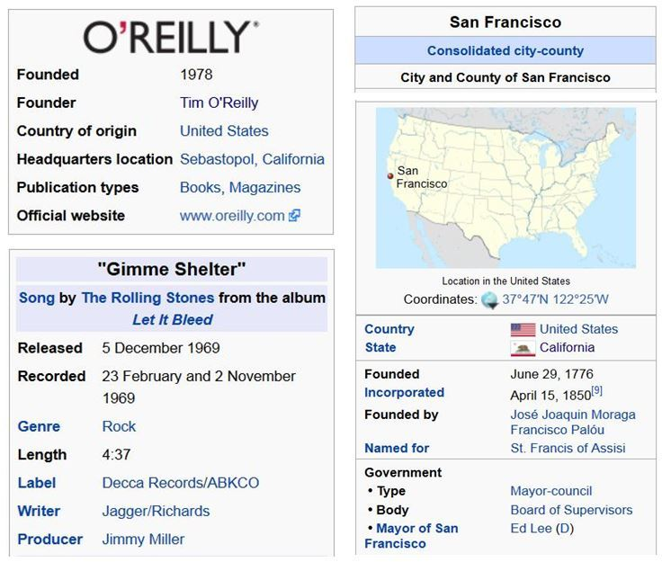
Wikipedia Infoboxes
Figure from TDO ebook Section 5.8.1

Slide 19
To Summarize…
The original vision of the Semantic Web emphasized the creation of ontologies that robustly described the semantics of particular domains or contexts
Much research was spawned by this vision, but the high bar of formal semantics and automated agents deterred “regular” people and firms from adopting it
Semantic authoring isn’t likely without tools that are simple to use as tools for designing and creating HTML pages
Why not build an application that combines the required services with robust workflow, making it unnecessary to discover providers and constraints?
19

Slide 20
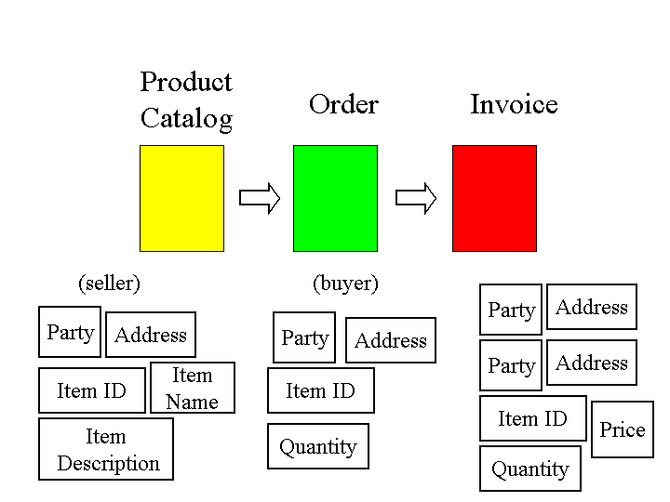
Flashback to 10/12
Business Processes are “Glued Together” by Overlapping Content

Slide 21
Glushko & Nomorosa, 2013

Slide 22
INFO 202 “Information Organization & Retrieval” Fall 2015
UNIVERSITY OF CALIFORNIA, BERKELEY
SCHOOL OF INFORMATION
Robert J. Glushko glushko@berkeley.edu
@rjglushko
19 October 2015 Lecture 15.2 – RDF and other Semantic Web Technologies

Slide 23
Technologies for the Semantic Web
XML
RDF and RDFa
Ontology languages
23

Slide 24
XML is a Good Start
You can use XML to create a content-oriented vocabulary rather than the presentation-oriented one in HTML
XML schemas allow you to specify structural, occurrence, and datatyping constraints for instances that must conform to them
You can use XML namespaces to reuse XML constructs across a set of related document types
24

Slide 25
XML Alone is NOT Sufficient
But the semantics associated with XML constructs are NOT explicitly represented in the instance or the schema
Element and attribute names, container structures, etc. can suggest semantics to people, but not in a way that is “computable” without additional documentation
What is the meaning of?
<quantity>5</quantity>
<price>100</price>
25

Slide 26
Resource Description Framework (RDF)
The Resource Description Framework (RDF) is a graph-based model for making computer-processable statements about web resources and their relationships to each other
RDF can be used to encode metadata, the usual sort of information about an information resource, like its title, author, creation date, etc.
26

Slide 27
Resource Description Framework (RDF)
In the context of RDF and the web, however, “resource” means something more specific: a resource is anything that has been given a Uniform Resource Identifier (URI)
So RDF can be used to represent information about anything that can be IDENTIFIED on the Web, not just published or retrieved on it
This broader idea about Web resource makes it a general mechanism for organizing and integrating information
27

Slide 28
RDF Data Model -- The Conceptual View
A general way to represent information about something is in three parts:
The thing (or resource) being described
The specific property of the thing
The value of the property
The data model is usually stated as Statement -> (Subject, Predicate, Object) but there are many other ways to say it
Statement (Student, attends, University)
28

Slide 29
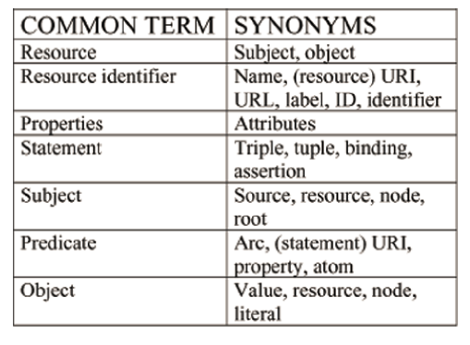
The Vocabulary Problem

Slide 30
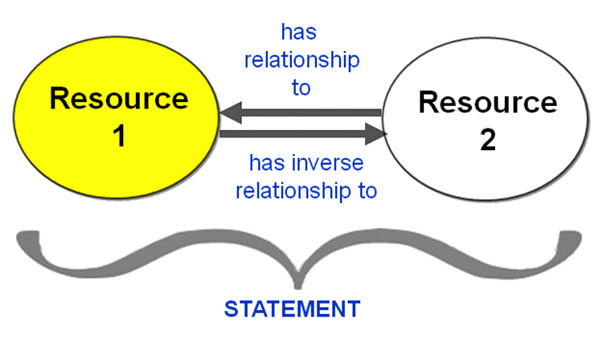
Statements About Resources

Slide 31
The Relationship is also a “Resource” with a Unique Identifier
Resource

Slide 32
Statements as Interconnecting Building Blocks
Because each resource is uniquely identified, statements that involve the same resource can be interconnected
32

Slide 33
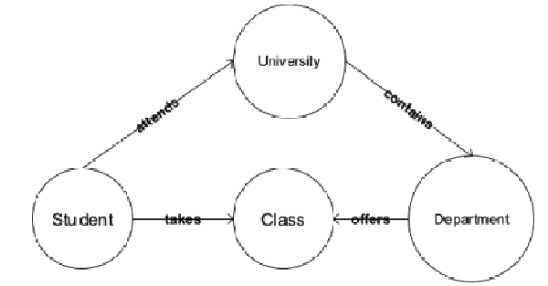
Interconnected Statements Create a Graph
These are statements about resource types that are part of the conceptual model of a domain

Slide 34
Some Statements About Instances
John Doe attends UC Berkeley
John Doe takes 202
Jane Smith attends UC Berkeley
Jane Smith takes 202
Jane Smith takes 290-1
34

Slide 35
STOP AND THINK: Can We Make These Inferences?
John Doe takes classes at the ISchool
202 is offered by UC Berkeley
Jane Smith is a classmate of John Doe
35

Slide 36
RDF Syntax – Simplified Implementation View
RDF is a conceptual model that must be “serialized” into some specific data syntax
<Description> describes a resource
Attributes or elements contained in <Description> are properties of the resource
Their content is the value of the property
<Description about=“some.uri/person/JohnDoe”>
<attends resource=“some.uri/institution/UCBerkeley”>
</attends>
</Description>
36

Slide 37
RDF Syntax – More Realistic View
If anyone can define or own the subjects, predicates, and objects we need namespaces to tell them apart
We can create standalone RDF documents into which we put statements in our own vocabulary
<rdf:RDF
xmlns:rdf=“(the RDF namespace)”
xmlns:info202=“BobBerkeley/info202/examples”>
<rdf:Description about=“some.uri/person/JohnDoe”>
<info202:attends resource=“some.uri/institution/UCBerkeley”>
</infor202:attends>
</rdf:Description>
…
37

Slide 38
RDF Description Example
(from Heath & Bizer p. 18)
Two RDF triples in the description
This URI is a person
The person is named Dave Smith

Slide 39
RDFa
RDFa is a second serialization syntax for RDF
RDFa uses attributes (hence the "a") to embed RDF statements into XHTML elements
So instead of using RDF in standalone documents, or using the RDF namespace to embed statements in other XML documents, RDFa lets you embed these statements into XHTML instances
Very useful in situations where data publishers can’t change publishing technology from HTML to XML but could change templates
39

Slide 40
RDFa {and,or,vs.} Microformats
This makes RDFa like microformats in that you can add some new attributes to an HTML document
But unlike microformats that are pre-defined for specific types of data, RDFa can be used to say anything about anything
40

Slide 41
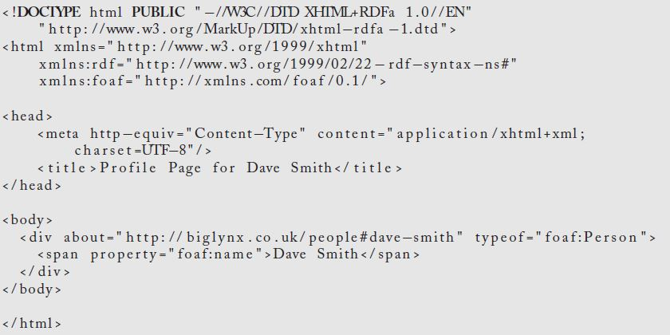
RDFa Description Example
(from Heath & Bizer p. 19)

Slide 42
The Need for Ontologies (1)
Suppose we have RDF statements:
(Bob Glushko, teaches, INFO202)
(Information System & Service Design, is-taught-by, Dr. Robert J. Glushko)
No RDF processor can link these into a graph and make the inference that both classes are taught by the same person
Why not?
42

Slide 43
The Need for Ontologies (2)
An ontology could define:
"Bob Glushko" and "Dr. Robert J. Glushko" to be the same person
"teaches" and "is-taught-by" to be inverse relationships
43

Slide 44
OWL
Ontology assertions on the Web are expressed using the OWL language
OWL is an XML vocabulary for describing properties and classes in rigorous ways that include relations between classes (e.g. equivalence, disjointness), cardinality (e.g. "exactly one"), richer typing of properties, characteristics of properties (e.g. symmetry), and enumerated classes
44

Slide 45
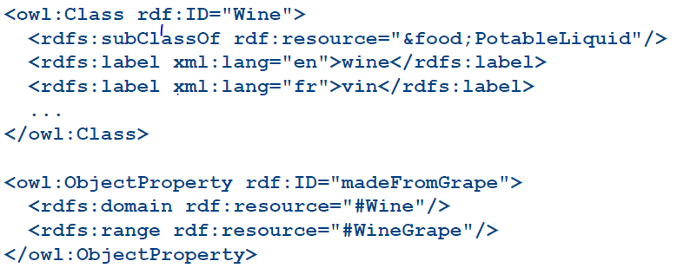
A Simplified OWL Example
Using OWL to define a “Wine” class and assign properties
OWL is ‘wrapping around” another vocabulary called “RDF Schema” that has limited capabilities for assigning semantics to RDF

Slide 46
Identity, Authority, Truthiness
The ontology assertion that "Bob Glushko" and "Dr. Robert J. Glushko" the same person enables statements about either to be interconnected
But if anyone can make assertions, how do we know whether they are correct? What authorities should we trust?
(Barack Obama, has birthplace, Hawaii)
(Barack Obama, has birthplace, Kenya)
“Defining a new URI somewhere on the Web” isn’t the same as "defining a new concept”
46

Slide 47
TODAY’S MOST IMPORTANT SLIDES
47

Slide 48
Why the Web Wasn’t Born Semantic
Around 1990, when the Web was being imagined by Tim Berners-Lee, SGML (precursor of XML) was increasingly being used to define structured document models, mostly for publishing
TBL chose to create HTML as a specific and simple document language rather than use the generality, expressive power, and complexity that SGML would have meant (and he was criticized by the “experts” for doing so)
This tradeoff made it vastly easier to create web pages and software for serving and processing them
But this made the Web work “for eyes only” rather than make it work “for machines”, especially those doing business transactions
48

Slide 49
Semantic Templating with Microformats
Microformats make the web "semantic light" by embedding content annotation into web pages
Microformats currently exist for personal contact information, events, and a few other small chunks of structured data
Wikis and blogs increasingly use schema.org templates to encourage the creation of more structured and semantically-annotated content (mention a movie, get schema.org/movie)
Wikipedia has thousands of templates and "infoboxes" that encourage the creation of factual information in a uniform format
49

Slide 50
To Summarize…
The original vision of the Semantic Web emphasized the creation of ontologies that robustly described the semantics of particular domains or contexts
Much research was spawned by this vision, but the high bar of formal semantics and automated agents deterred “regular” people and firms from adopting it
Semantic authoring isn’t likely without tools that are simple to use as tools for designing and creating HTML pages
Why not build an application that combines the required services with robust workflow, making it unnecessary to discover providers and constraints?
50

Slide 51
XML Alone is NOT Sufficient
But the semantics associated with XML constructs are NOT explicitly represented in the instance or the schema
Element and attribute names, container structures, etc. can suggest semantics to people, but not in a way that is “computable” without additional documentation
What is the meaning of?
<quantity>5</quantity>
<price>100</price>
51

Slide 52
RDF Data Model -- The Conceptual View
A general way to represent information about something is in three parts:
The thing (or resource) being described
The specific property of the thing
The value of the property
The data model is usually stated as Statement -> (Subject, Predicate, Object) but there are many other ways to say it
Statement (Student, attends, University)
52

Slide 53
RDFa
RDFa is a second serialization syntax for RDF
RDFa uses attributes (hence the "a") to embed RDF statements into XHTML elements
So instead of using RDF in standalone documents, or using the RDF namespace to embed statements in other XML documents, RDFa lets you embed these statements into XHTML instances
Very useful in situations where data publishers can’t change publishing technology from HTML to XML but could change templates
53

Slide 54
OWL
Ontology assertions on the Web are expressed using the OWL language
OWL is an XML vocabulary for describing properties and classes in rigorous ways that include relations between classes (e.g. equivalence, disjointness), cardinality (e.g. "exactly one"), richer typing of properties, characteristics of properties (e.g. symmetry), and enumerated classes
54

Slide 55
Identity, Authority, Truthiness
The ontology assertion that "Bob Glushko" and "Dr. Robert J. Glushko" the same person enables statements about either to be interconnected
But if anyone can make assertions, how do we know whether they are correct? What authorities should we trust?
(Barack Obama, has birthplace, Hawaii)
(Barack Obama, has birthplace, Kenya)
“Defining a new URI somewhere on the Web” isn’t the same as "defining a new concept”
55

