Slide 1
Plan for Today’s Lecture(s)
The Semantic Web
RDF and other Semantic Web Technologies
Deferred to 10/21
Linked Data
SemWeb and Linked Data and Libraries
Midterm Review
1

Slide 2
INFO 202 “Information Organization & Retrieval” Fall 2015
UNIVERSITY OF CALIFORNIA, BERKELEY
SCHOOL OF INFORMATION
Robert J. Glushko glushko@berkeley.edu
@rjglushko
19 October 2015 Lecture 15.3 – Linked Data

Slide 3
Linked Data
“Linked Data” is a reframing of basic Web principles for the Semantic Web
instead of links as relationships in hypertext documents written in HTML, links are between arbitrary resources described by RDF
Use URIs to identify everything (every “resource”)
Use HTTP URIs so that they can be de-referenced

Slide 4
From AI to BI (Erik Wilde)
Erik Wilde characterized the shift from the “Semantic Web” to “Linked Data” as “From AI to BI”
Semantic Web is mainly about creating new data and ontologies; its starting point was Artificial Intelligence(AI)
Linked Data changes the focus to real-world pragmatics, linking especially valuable data and making it discoverable; this is the Business Intelligence (BI) design pattern (ETL)
… allow web search engines to function more like relational databases (Byrne and Goddard)

Slide 5
ETL – Extract, Transform, Load
You EXTRACT some data from your repository
You can TRANSFORM its native data model into RDF by using custom-defined mappings into a data model that is standard (enough) to be used by the “outside world”
The RDF “triple store” can then be LOADED into the “Linked Data Cloud”
This might be a one time conversion into RDF
A better way would be to create a linked data service that responds to requests from web agents, and then transforming those requests into queries that can be handled by a “live” triple store

Slide 6
Linked Data Best Practices
When someone looks up a URI, provide useful information, including additional links
Use terms from widely-used vocabularies to facilitate data interpretation
RDF, RDFS, FOAF, OWL, DCTerms most common
Schema.org terms hardly used at all
If proprietary vocabularies are used, make sure they can be interpreted via RDF deferencing
Provide provenance and usage metadata using a VoID file

Slide 7
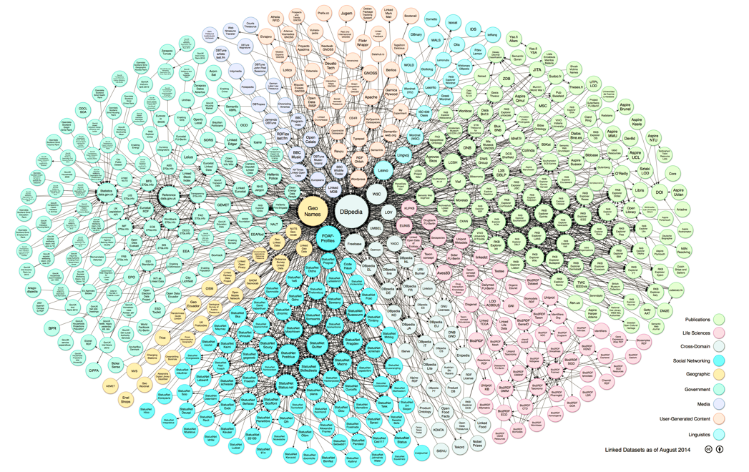
The “Linked Data Cloud”

Slide 8
The “Linked Data Cloud”
If the previous slide isn’t an interactive visualization…
The Linked Data Cloud visualizes all of the datasets that have been registered at linkedata.org
The datasets are categorized as media, government, publications, life sciences, geographic, cross-domain, user-generated content, and social networking
dbpedia (extract structured data from Wikipedia)
geoname.org (descriptions and locations of places) (San Francisco)
Data.nytimes.com (controlled vocabulary for news stories) (San Francisco)

Slide 9
Data.nytimes.com
For the last 150 years, The New York Times has maintained one of the most authoritative news vocabularies ever developed
Since 2009, this vocabulary has been published as linked open data
The New York Times uses approximately 30,000 tags to generate Times Topics Pages.
Automatically generated topic page for San Francisco

Slide 10
Libraries & Semantic Web / Linked Data : Opportunity
Semantic web standards are complex, and difficult to conceptualize, but they offer solutions to many of the issues that plague libraries, including precise web search, authority control, classification, data portability, and disambiguation
Gillian Byrne and Lisa Goddard
The Strongest Link: Libraries and Linked Data
10

Slide 11
Libraries & Semantic Web / Linked Data : Opportunity
Libraries have a very long history in trying to systematize and catalog the world's knowledge
Library data is high quality when created and is managed / maintained by people who keep it that way
This should make library data a key trusted resource about people, publications, and organizations that could be used to improve the quality of non-library data
But the Web is increasingly the first source that people search, and the library needs to interconnect with it or it will be ignored
11

Slide 12
Authoritative Library Information
Subject headings
Authoritative names
Classification
If each of the terms in these vocabularies is identified by a URI, it would be easy to detect or prevent conflicts
12

Slide 13
Libraries & Semantic Web / Linked Data
"Libraries could collaboratively develop a large shared knowledgebase that could act as a library "linking hub". The linking hub would expose a network of tightly linked information from publishers, aggregators, book and journal vendors, subject authorities, name authorities, and other libraries” (Byrne and Goddard, 2010)
13

Slide 14
Libraries & Semantic Web / Linked Data : Obstacles
Libraries are reluctant to interconnecting their resources to the open and uncontrolled web
In particular, the conceptual foundations for library data assume it will be created by professional people for people
14

Slide 15
Libraries & Semantic Web / Linked Data : Obstacles
(Karen Coyle is the best source about all of this…)
"The struggle to accommodate technological change with data created using the old rules is clearly not optimal, and hinders the ability of libraries to create innovative services” (Coyle, 2007)
“We cannot move into the rich and dynamic information environment of the 21st century with data that is based on 19th century principles” (Coyle, Library Linked Data: An Evolution, 2013)
15

Slide 16
Libraries & Semantic Web / Linked Data : Progress
Some parts of the library world are adapting to the decentralized and heterogeneous world view of the Semantic Web and Linked Data
Library of Congress BIBFRAME Initiative
Linked Data Model & Supporting Services
Library of Congress Linked Data Service
Europeana – digital collection from a range of Europe's leading galleries, libraries, archives and museums – has numerous linked datasets
16

Slide 17
TODAY’S MOST IMPORTANT SLIDES
17

Slide 18
Linked Data
“Linked Data” is a reframing of basic Web principles for the Semantic Web
instead of links as relationships in hypertext documents written in HTML, links are between arbitrary resources described by RDF
Use URIs to identify everything (every “resource”)
Use HTTP URIs so that they can be de-referenced

Slide 19
ETL – Extract, Transform, Load
You EXTRACT some data from your repository
You can TRANSFORM its native data model into RDF by using custom-defined mappings into a data model that is standard (enough) to be used by the “outside world”
The RDF “triple store” can then be LOADED into the “Linked Data Cloud”
This might be a one time conversion into RDF
A better way would be to create a linked data service that responds to requests from web agents, and then transforming those requests into queries that can be handled by a “live” triple store

Slide 20
Libraries & Semantic Web / Linked Data : Opportunity
Libraries have a very long history in trying to systematize and catalog the world's knowledge
Library data is high quality when created and is managed / maintained by people who keep it that way
This should make library data a key trusted resource about people, publications, and organizations that could be used to improve the quality of non-library data
But the Web is increasingly the first source that people search, and the library needs to interconnect with it or it will be ignored
20

Slide 21
INFO 202 “Information Organization & Retrieval” Fall 2015
UNIVERSITY OF CALIFORNIA, BERKELEY
SCHOOL OF INFORMATION
Robert J. Glushko glushko@berkeley.edu
@rjglushko
21 October 2015 Lecture 16.1 – Review

Slide 22
Defining "Relationship“ (Kent)
“An association among several things, with that association having a particular significance”
“Relationships are the stuff out of which information is made”
The reason is an important part of the relationship
Multiple relationships can exist among the same objects, so the order of the objects matters
A relationship is a pattern – a “type” of relationship is a collection of instances” of associations having the same reason
22

Slide 23
Five Perspectives on Relationships (1)
SEMANTIC: the meaning of the association
LEXICAL: how the conceptual description of a relationship is expressed using words in a specific language
STRUCTURAL: analyzes the patterns of association, arrangement, proximity, or connection between resources
23

Slide 24
Five Perspectives on Relationships (1)
ARCHITECTURAL: emphasizes the number and abstraction level of the components of a relationship, which together characterize its complexity
IMPLEMENTATION: how the relationship is implemented in a particular notation and syntax and the manner in which relationships are arranged and stored in some technology environment
24

Slide 25
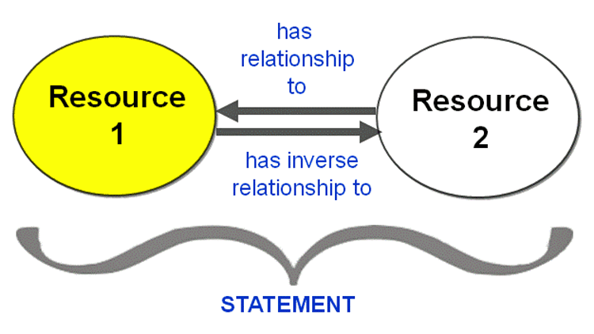
Statements About Resources

Slide 26
The SEMANTIC Perspective Focuses on the Reason for the Relationship

Slide 27
The LEXICAL Perspective Focuses on the Words that Describe the Relationship
Homer Simpson → is-married-to → Marge Simpson
Homer Simpson → Se-casado-a → Marge Simpson
Homer Simpson → est-marié-à → Marge Simpson
e.g., This is the same semantic relationship expressed in three different languages

Slide 28
The ARCHITECTURAL Perspective Focuses on the Logical Requirements or Constraints for the Relationship
e.g., Must Resource 1 and Resource 2 be of the same or different types? (the DEGREE)

Slide 29
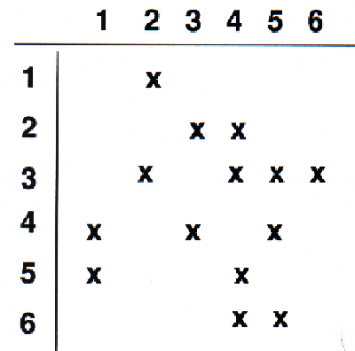
The STRUCTURAL Perspective Analyzes the Implementation Patterns of Relationships Without Concern for their Meaning
e.g., In this set of relationships between 6 resources the number of links ranges from 1 to 4, and all links are directional

Slide 30
Contrasting Implementations (TDO 5.7.1)
Natural Language
The Simpson family includes a man named Homer and a woman named Marge, the married parents of three sibling children, a boy named Bart and two girls, Lisa and Maggie
Subject-Predicate Syntax
Homer Simpson → is-married-to → Marge Simpson
Homer Simpson → is-parent-of → Bart
XML Syntax
<Family name="Simpson">
<Parents children="Bart Lisa Maggie">
<Father name="Homer" spouse="Marge" />
<Mother name="Marge" spouse="Homer" />
</Parents>
<Children parents="Homer Marge" >
<Boy name="Bart" siblings="Lisa Maggie" />
<Girl name="Lisa" siblings="Bart Maggie" />
<Girl name="Maggie" siblings="Bart Lisa" />
</Children>
</Family>
30

Slide 31
RDF Description Example
(from Heath & Bizer p. 18)
Two RDF triples in the description
This URI is a person
The person is named Dave Smith

Slide 32
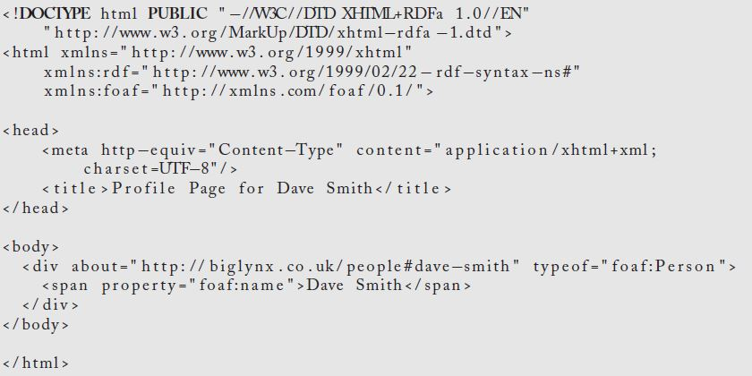
RDFa Description Example
(from Heath & Bizer p. 19)

Slide 33
Properties of Semantic Relationships
SYMMETRY: the order in which the arguments of a binary relationship doesn't matter
ASYMMETRIC relationships are those where the order of the arguments matters
When the order of the arguments in the relationship is reversed the resulting relationship is called the INVERSE
TRANSITIVITY: if X and Y have a relationship, and Y and Z have the same relationship, then X also has the relationship with Z
Any relationship that is both symmetric and transitive is an EQUIVALENCE relationship
33

Slide 34
The Semantics of "Inclusion"
One class or type of resources logically contains another; predicate is usually is-a or "is-a-type-of"
A set of interconnected class inclusion relationships defines a HIERARCHY or TAXONOMY
An inclusion relationship between an instance and a class -- assigning an instance to a class - is CLASSIFICATION
34

Slide 35
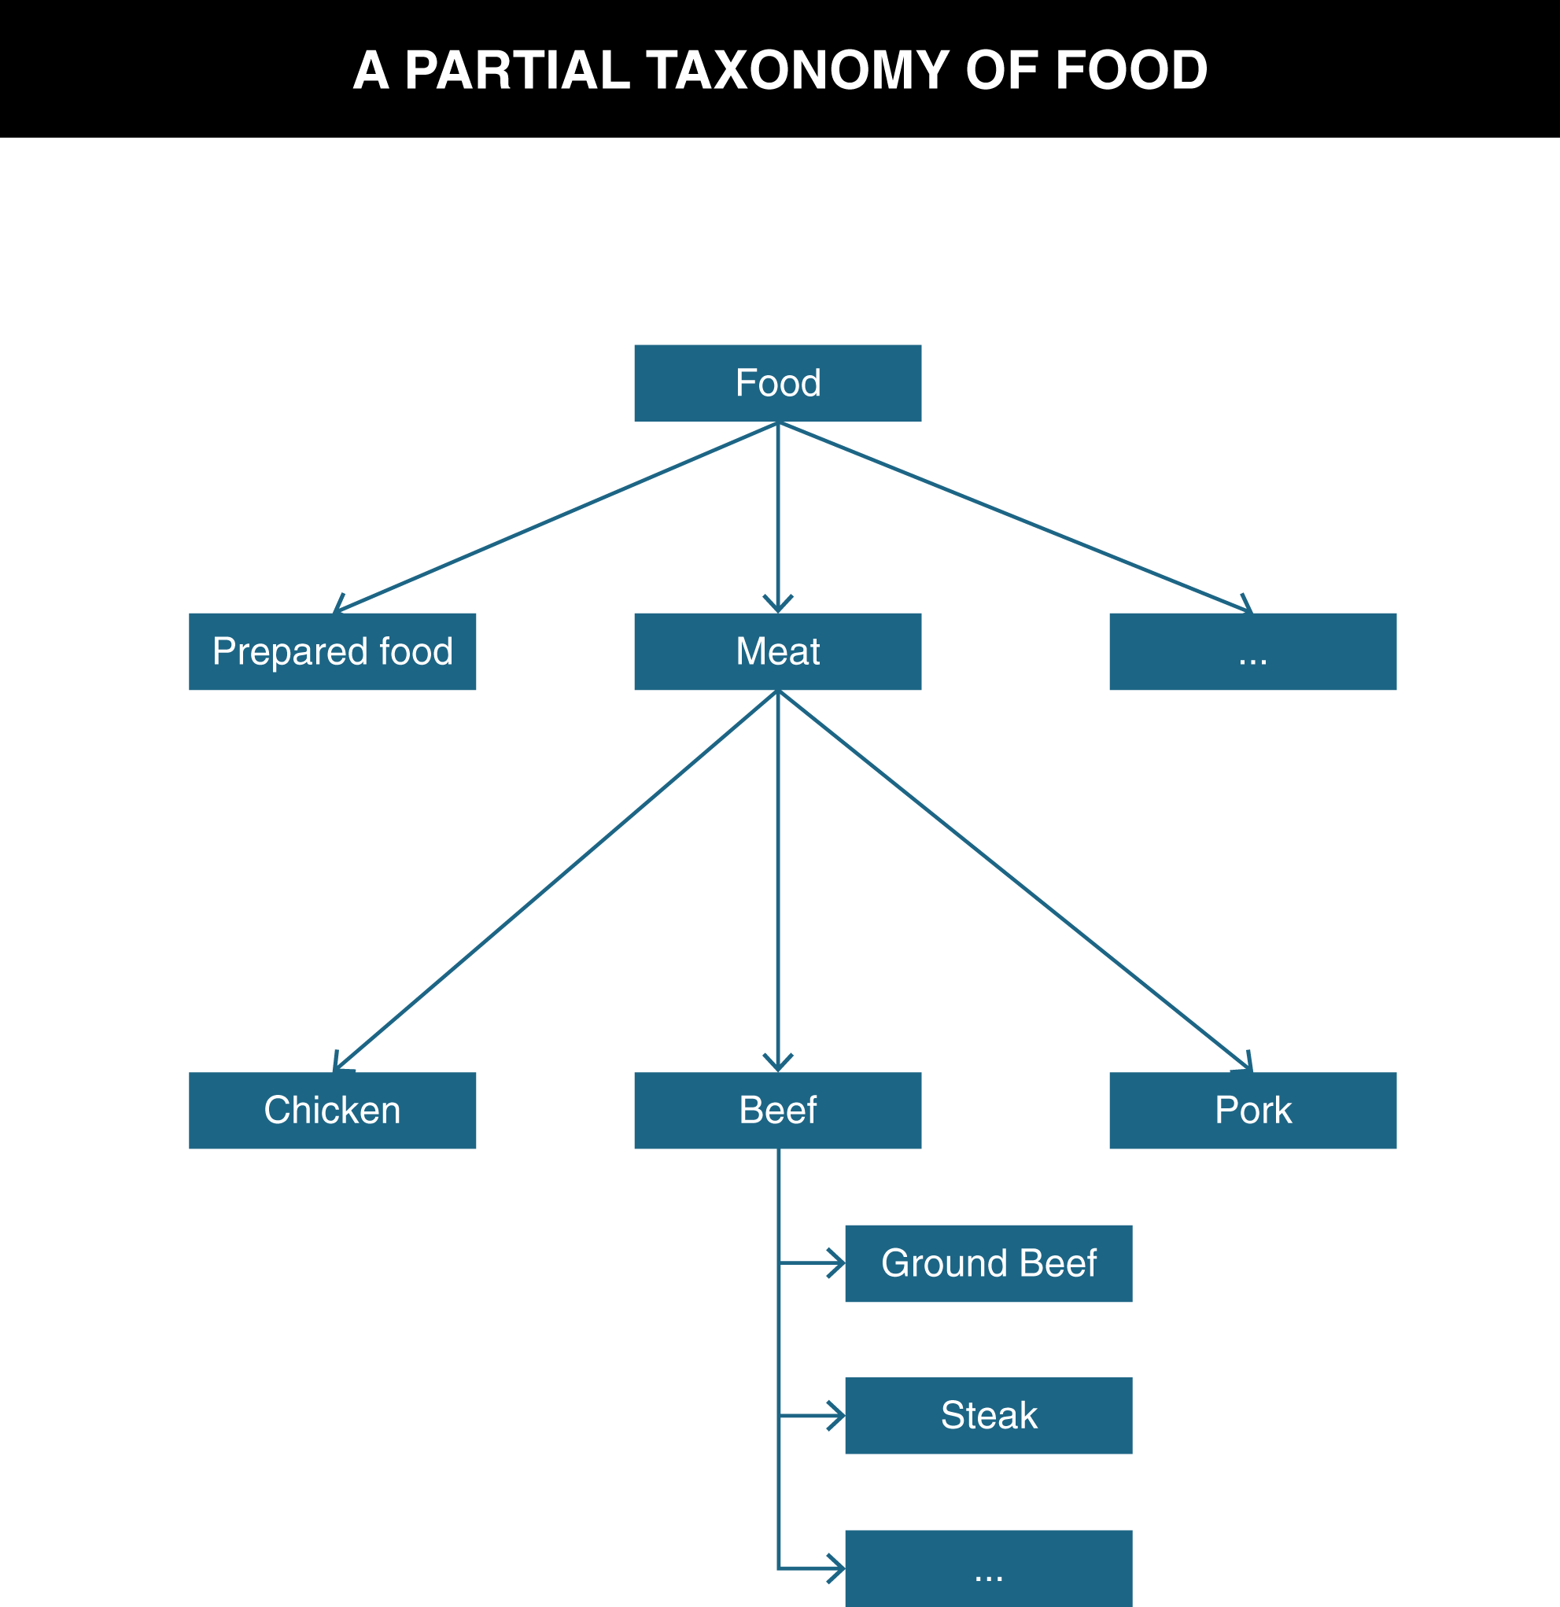
TDO Figure 5.1

Slide 36
Ontology
An ontology defines the concepts and terms used to describe and represent some domain or area of knowledge
To fully understand a domain you need to know class and part-whole inclusion, attribution, equivalence, and many other relationships about and between the resources it contains
Class inclusion relationships form a kind of backbone or framework to which other kinds of relationships attach, creating a network of relationships
36

Slide 37
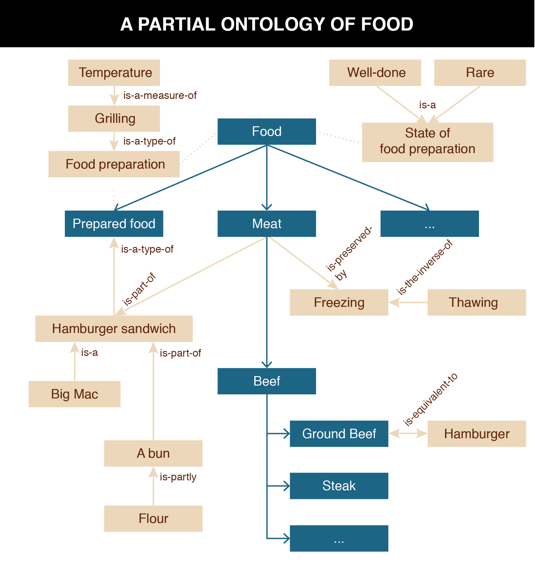
TDO Figure 5.2

Slide 38
The Lexical Perspective on Relationships
A prototypical word is the minimal "meaning bearing" element of language
Words express concepts and relationships, but not all concepts and relationships have words for them (are "lexicalized")
These "lexical gaps" differ from language to language
Whereas "conceptual gaps" -- the things we can't think of -- may be innate and universal
38

Slide 39
The Lexicon of Semantic Relationships
When words encode IS-A or inclusion relationships, the word for the more specific class is the HYPONYM and the other is the HYPERNYM
SYNONYMS are different word forms that can express the same concept
ANTONYMS are lexical opposites
39

Slide 40
Implications for Vocabulary Design
Choosing vocabulary terms, and precisely defining their semantics, is essential but impossible to do perfectly
Your vocabulary must express what YOU intend, so you "look inward" -- analyze how you think about a domain
You want others to understand what you mean, so you need to "look outward" -- analyze the terms used by your users, competitors, or subject matter experts
You should reuse other vocabularies or thesauri if they exist, especially for any "horizontal" components, to improve transformability and interoperability
But these three approaches may suggest different terms
40

Slide 41
Internal and External Structure (1)
Resources can have INTERNAL structure as well as the EXTERNAL structure that connects them to other resources
We often make arbitrary decisions about the granularity with which we describe the internal structure of a resource
The boundaries we impose to identify resources determines whether some structure is internal or external with respect to them
41

Slide 42
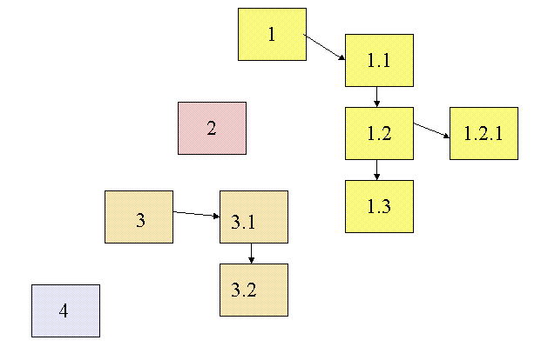
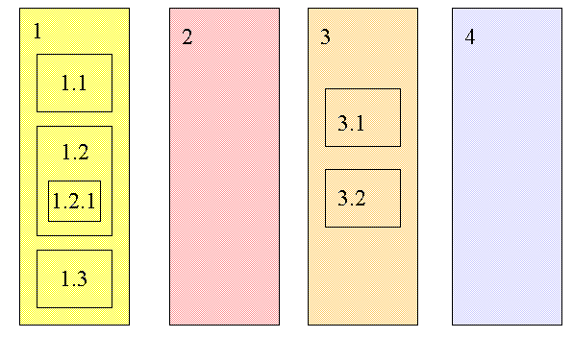
Changing Resource Boundaries Changes External to Internal Structure

Slide 43
“Between-Resource” Structures
Links between printed or digital documents
Links between web pages
Links – communication and information flows - between people, organizations, any other kind of interacting “actors” or resources – social networks
We can analyze all of these with some common concepts and abstractions
43

Slide 44
Graph Theory
We can apply graph theory to understanding relationships from a structural perspective
A GRAPH treats resources as VERTICES or NODES
The pairwise relationships between resources are represented by the EDGES that connect them
If the edges have an associated direction, this is a DIRECTED graph
A WEIGHT can be assigned to each edge if the relationship has a numerical aspect (distance, cost, time, etc.)
44

Slide 45
Computing the Properties of Graphs
Reachability – is there a path between any two nodes in the graph?
Shortest path – if there are multiple paths between two nodes, which is the shortest?
Centrality – which nodes are the most connected or have the average shortest paths to the other nodes?
Subgraph discovery – are there sub-graphs that are completely contained in a larger graph?
45

Slide 46
Moving Beyond “Reachability”
We've been treating relationships in purely structural terms - is one thing connected to another - but we can refine that into two perspectives:
RELATIONAL analysis treats links as indicators of the amount of connectedness or the direction of flow between documents, people, groups, journals, disciplines, domains, organizations, or nations
EVALUATIVE analysis treats links as indicators of the level of quality, importance, influence or performance of documents, people, groups
46

Slide 47
Bibilometrics (or "Scientometrics"): Structure of Scientific Citation
Analysis of scientific citation began in the 1920s as a way to quantify the influence of specific documents or authors in terms of their "impact factor"
It can also identify "invisible colleges" of scientists whose citations are largely self-referential
It can recognize the emergence of new scientific disciplines
(Eugene Garfield and Derek J. de Solla Price are two of the "founding fathers" of bibliometrics)
47

Slide 48
Adapting Citation Analysis to the Web
The concepts and techniques of citation analysis seem applicable to the web since we can view it as a network of interlinked articles
But not everything applies because the web is different in numerous ways
48

Slide 49
Architecture of Relationships
The architectural perspective embodies Kent’s definition of “relation” as “A sequence of categories, that includes one thing from each category”
The DEGREE or ARITY of a relationship is the number of different "entity types" or "resource categories" in the relationship
The CARDINALITY is the number of instances that can be associated with each entity type
49

Slide 50
The Architectural Perspective: Directionality
The DIRECTIONALITY of a relationship defines the order in which the arguments of the relationship are connected
A ONE-WAY or UNI-DIRECTIONAL relationship can be followed in only one direction
A BI-DIRECTIONAL one can be followed in both directions
All symmetric relationships are bi-directional, but not all bi-directional relationships are symmetric
50

Slide 51
Link Properties
Starting point of the link (the ANCHOR)
The end point of the link (the DESTINATION)
The reason for the link (the LINK TYPE)
The number of resource types (ARITY or DEGREE) or resource instances (CARDINALITY) linked to (1-1 or 1-many)
The DIRECTIONALITY
51

Slide 52
Document Engineering and the Document Type Spectrum
Document Engineering combines concepts and methods for analyzing and modeling “data” and “documents” because information-intensive processes and services involve both of them in combination
The Document Type Spectrum captures this “unification” of document type models by showing the systematic variation of content, structure, and presentation among document types
52

Slide 53
Document Engineering’s Key Ideas
Document Engineering harmonizes the terminology of document analysis and data modeling and emphasizes what they have in common rather than highlighting their differences:
Identifying the presentational, content, and structural components
Eliminating synonymy and homonymy
Identifying and organizing "good" content components
Assembling hierarchical document models to organize components to meet requirements for a specific context
53

Slide 54
Reminder: The Document Type Spectrum

Slide 55
From Physical to Conceptual Models (1)
When we analyze information sources: interviews, documents, sets of data, whatever - our goal is to identify and describe the "significant things" or the "information components" and their characteristics or attributes
If you conduct an interview your source will naturally talk about information components as abstract pieces of information
But when you analyze documents the information components aren't as immediately apparent because they are contained in structures and rendered in some presentation
55

Slide 56
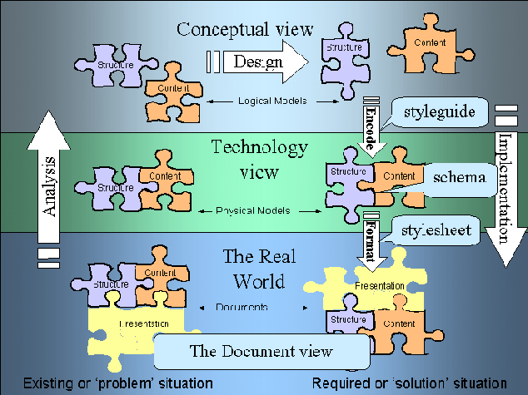
Depicted in Modeling Terms

Slide 57
From Physical to Conceptual Models (2)
So we have to remove the presentational information and dis-assemble the structural information to find the content information that is our highest priority
As we take away presentation and structure, we are abstracting away or generalizing from a physical implementation and creating our first conceptual or logical model of the information components
57

Slide 58
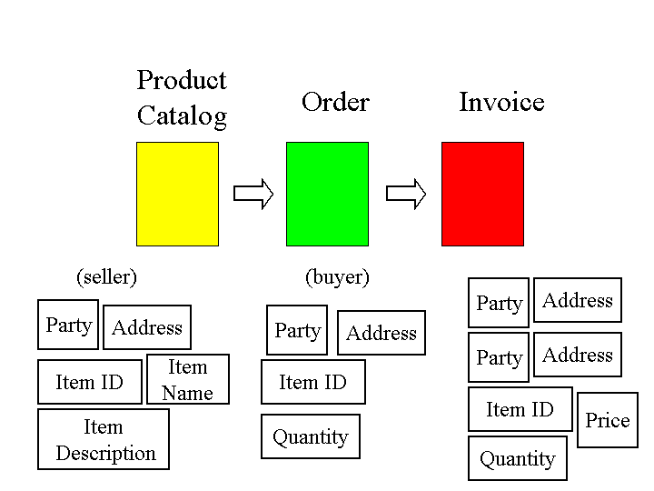
Business Processes are “Glued Together” by Overlapping Content

Slide 59
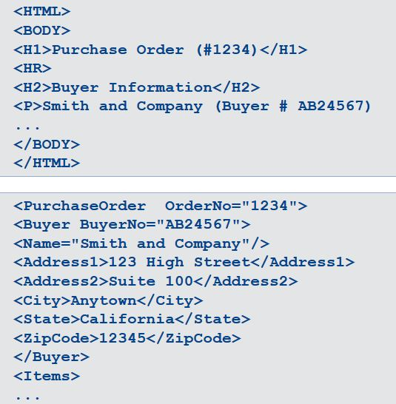
HTML is not Good Glue
XML is Good Glue

Slide 60
HTML {and,or,vs} XML
HTML is a presentation vocabulary and XML is a metalanguage for creating vocabularies; these concerns are orthogonal to the DTS concept
The latest specification of HTML is as XHTML, as an XML vocabulary, and browsers are “hard-wired” to render the HTML elements with characteristic presentations
Since XML can be used to create any vocabulary, it can’t have any pre-defined presentation or behavior in browsers; you need a style sheet
But this separation of content and presentation is architectural thinking; a feature and not a bug.

Slide 61
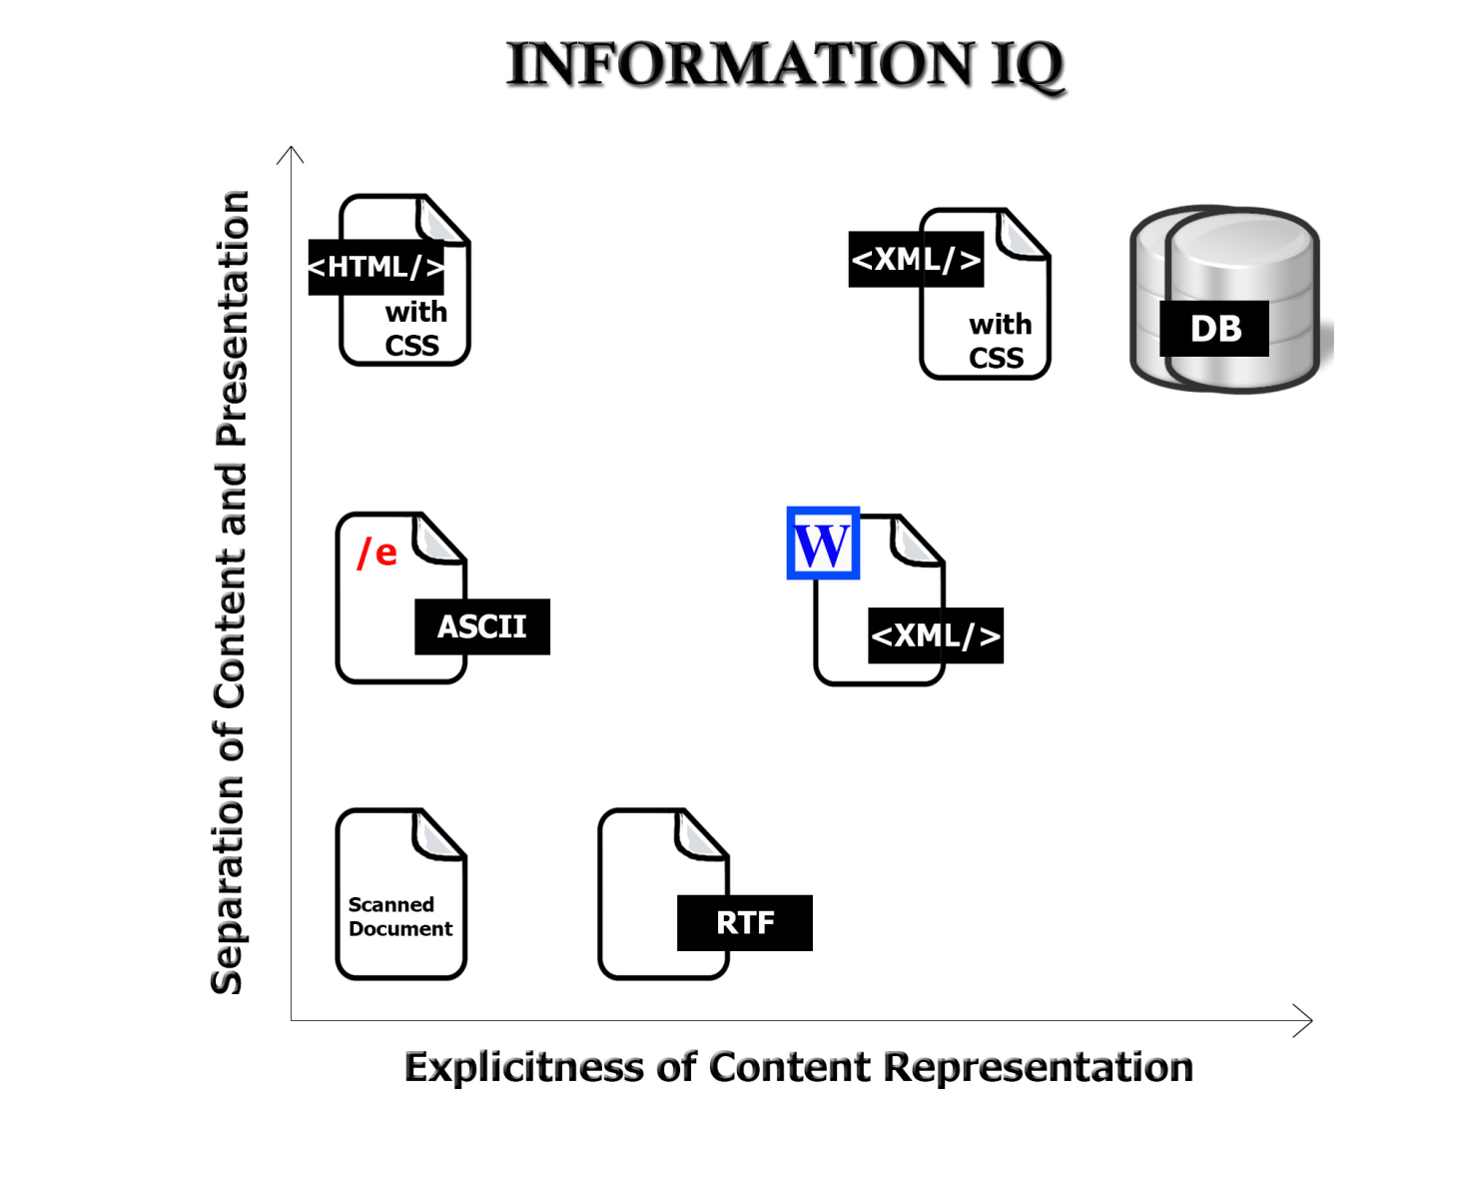
Format Matters!
61

Slide 62
Semantic Web and Linked Data
Are ideas that are reactions to the limitations of a web built on HTML
Key questions are “can we get there from here” and we concluded that small steps might be better strategy
We analyzed the building blocks talked about the implementation of the semantic perspective
62

