Slide 1
Plan for Today’s Lecture(s)
The What and Why of Categories
Cultural, Individual, and Institutional categories
Principles for creating categories
1

Slide 2
INFO 202 “Information Organization & Retrieval” Fall 2015
UNIVERSITY OF CALIFORNIA, BERKELEY
SCHOOL OF INFORMATION
Robert J. Glushko glushko@berkeley.edu
@rjglushko
26 October 2015 Lecture 17.1 – The What and Why of Categories

Slide 3
How Do We Understand each Other?
You’ve seen in your last few assignments how differently people can organize and describe the world
We can sometimes negotiate or iterate in our interactions to reach an understanding
We can use more precise or infrequent terms
But the basic problems are deeply rooted in how we perceive things and create concepts
3

Slide 4
Categories are “Equivalence Classes”
Categories are sets or groups of resources or abstract entities that are treated the same
This almost never means that every instance of the category is identical
It only means that for some purpose we treat them in the same way
4

Slide 5
Categories are Essential
Categories are involved whenever we perceive, communicate, analyze, predict, classify – or otherwise attempt to make sense of our experiences
All human languages and cultures divide the physical and experiential “worlds” into categories
Some of this “sense-making” is discovering categories and some is creating them, but these aspects are often interconnected
5

Slide 6
Categories are Created
Categories can be created in many different ways according to many different types of principles
The equivalence classes that are created depend on which aspects / roles / properties / meanings of the category members are used
6

Slide 7
Borges’ Classification of Animals
In a certain Chinese encyclopedia "it is written that 'animals are divided into:
(a) belonging to the Emperor, (b) embalmed, (c) tame, (d) suckling pigs, (e) sirens, (f) fabulous, (g) stray dogs, (h) included in the present classification, (i) frenzied, (j) innumerable, (k) drawn with a very fine camelhair brush, (l) et cetera, (m) having just broken the water pitcher, (n) that from a long way off look like flies.'“
7

Slide 8
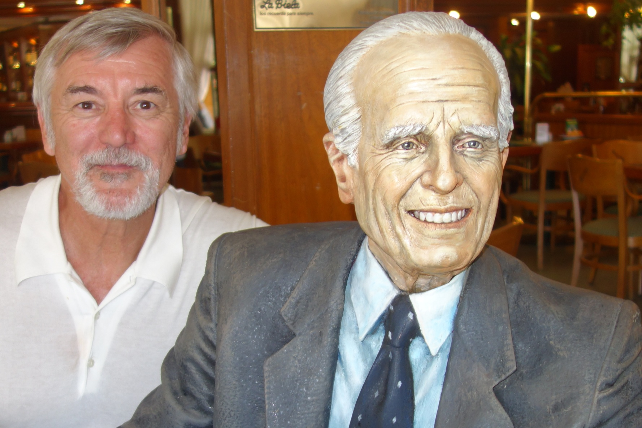
Meeting Borges at Café Tortoni in Buenos Aires (14 Feb 2014)
8

Slide 9
INFO 202 “Information Organization & Retrieval” Fall 2015
UNIVERSITY OF CALIFORNIA, BERKELEY
SCHOOL OF INFORMATION
Robert J. Glushko glushko@berkeley.edu
@rjglushko
26 October 2015 Lecture 17.2 – Category Categories, or Contexts for Categorization

Slide 10
Category Categories
Cultural Categorization
Individual Categorization
Institutional Categorization
10

Slide 11
Cultural Categories
We use tens of thousands of categories that are embodied in our culture and language
They develop slowly and typically change slowly
Many have a perceptual or sensorimotor origin based on natural boundaries or discontinuities in perception and experience
Learned implicitly through development via parent-child interactions, language, and experience
Informal and contextual acquisition makes cultural categories flexible, creative, generative, and biased
11

Slide 12
Cultural Categories
When properties or behaviors co-occur in predictable ways, it is useful to have category words that name them => emergence of language
Formal education can teach cultural categories but the non-formal mechanisms often dominate or interfere
Thinking and research about categorization is primarily about cultural categories
12

Slide 13
Linguistic Relativity
Languages differ a great deal in the words they contain (which concepts are lexicalized)
They also differ in more fundamental ways by requiring speakers or writers to attend to details about the world or aspects of experience that another language allows them to ignore
But this doesn't mean that people can't understand concepts that are not lexicalized
13

Slide 14
The Whorfian Hypothesis
Benjamin Whorf (mid 20th century) is widely credited and miscredited with the hypothesis that "language shapes thought" - that the categories embodied in languages shape or even constrain how people perceive and understand the world
Popular argument: Eskimos have lots of words for different kinds of snow, so they think about snow differently than native speakers of other languages
14

Slide 15
Linguistic Relativity in Icelandic Advertisement

Slide 16
A More Nuanced View (from Boraditsky)
English uses relative frames of reference when talking about space and direction (right, left, forward, back)
Some Aboriginal languages use absolute reference frames (north, south, east, west)
“There’s an ant on your southeast leg”
“Move the cup to the northeast a little bit”
This requires people to stay oriented at all times, and they are much better at navigation and spatial memory than native English speakers
16

Slide 17
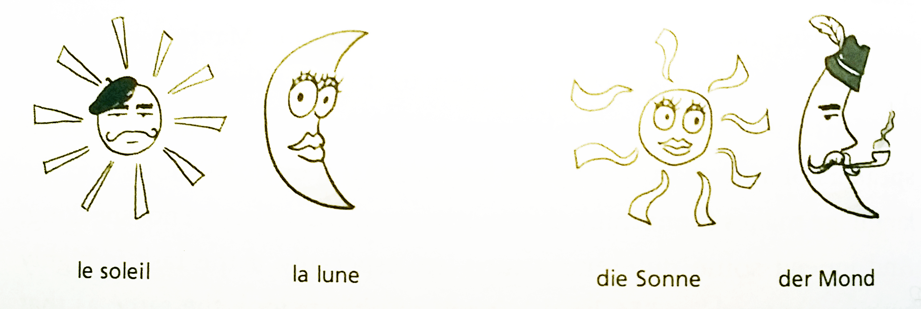
Another Example where Language Matters
In languages in which nouns have gender, people associate gender-specific characteristics
French: Sun is M, Moon is F
German: Sun is F, Moon is M
From Ray Jackendoff, “A User’s Guide to Thought and Meaning”, 2012

Slide 18
Culture is More Important than Language
English-speaking Americans “on the left” and “on the right” use the same words but with very different meanings
Marriage, freedom, liberty, responsibility
They use words that frame issues in very different ways
“Pro-life” vs. “Pro-choice”, “Spending” vs. Stimulus”
George Lakoff, Berkeley linguistics prof, is left-wing “father of framing”
18

Slide 19
Individual Categories
Created to satisfy ad hoc requirements that emerge from an individual’s unique experiences, preferences, and resource collections
Created intentionally in response to specific organizing requirements
Can have an imaginative or metaphorical basis that distorts or misinterpret cultural categories
Collection hobbies often embody peculiar individual categories
19

Slide 20
Individual Categories
Often have short lifetimes because they are designed to support specific tasks
People differ greatly in preferences, tradeoffs, utility functions about how, how much, and when to create categories
“Pilers” vs. “Filers” is classic contrast framed by Malone and a recurring theme in popular culture
With digital resources, increasingly common for individual categories to be intentionally or accidentally revealed via tagging etc.
20

Slide 21
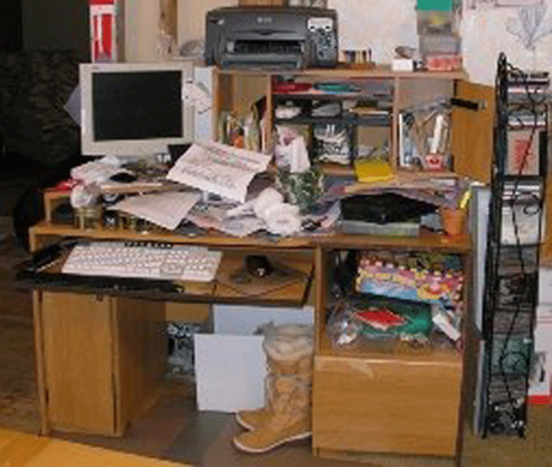
Piler’s Office

Slide 22
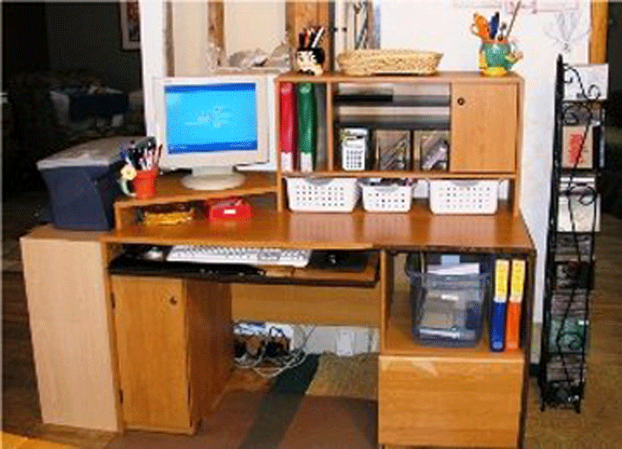
Filer’s Office

Slide 23
Pilers and Filers – Stop and Think
Characterize each philosophy in TDO terms
Organizing principles used by pilers?
Organizing principles used by filers?
Best argument for being a filer
Best argument for being a piler

Slide 24
Institutional Categorization
Explicit construction of a semantic model of a domain to enable more control, robustness, and interoperability than is possible with just the cultural system
Essential in abstract, information-intensive domains where semantic precision is essential for processes and transactions (especially automated ones)
Often the collaborative artifact of many individuals who represent different organizational or business perspectives
24

Slide 25
Institutional Categorization
Usually developed via rigorous and formal processes (e.g., in standards organizations or legislative bodies)
Laws, regulations, and standards often define institutional categories and the rules for creating and maintaining them
Require ongoing governance and maintenance because of continuous changes taking place in related cultural and individual systems
…FLASHBACK to “Effectivity” (TDO 3.5.2)
25

Slide 26
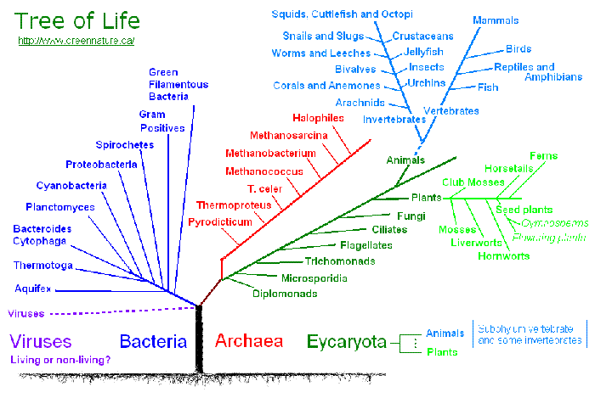
Institutional Categorization of Life Forms
26

Slide 27
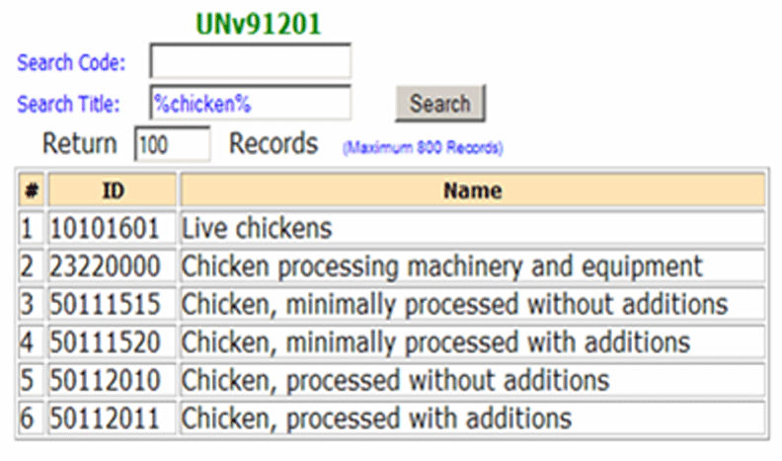
UN Standard Products and Services Codes for "Chicken"
27

Slide 28
Institutional != Unbiased
Creating institutional categories by more systematic processes than cultural or individual categories does not prevent them from being biased
Indeed, the goal of institutional categories is often to impose or incentivize biases in interpretation or behavior
28

Slide 29
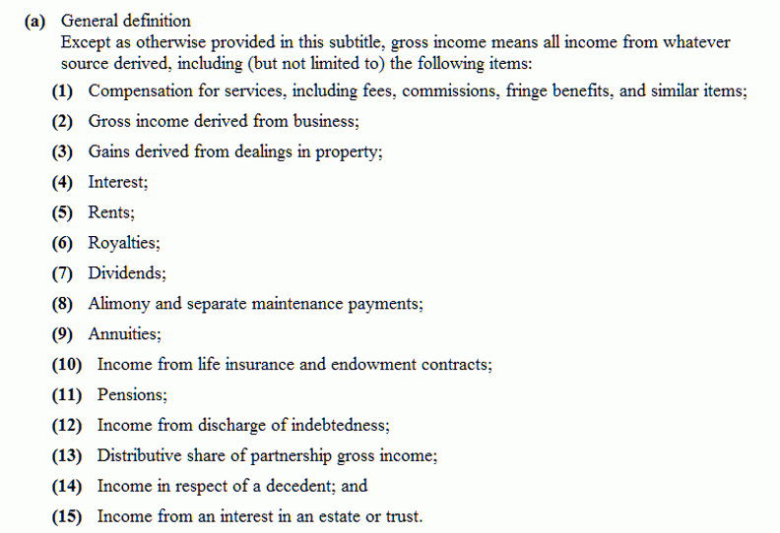
"Gross Income" Tax Code Categories
Should dividends be taxable income?
29

Slide 30
INFO 202 “Information Organization & Retrieval” Fall 2015
UNIVERSITY OF CALIFORNIA, BERKELEY
SCHOOL OF INFORMATION
Robert J. Glushko glushko@berkeley.edu
@rjglushko
26 October 2015 Lecture 17.3 – Principles for Creating Categories

Slide 31
Principles for Creating Categories
Enumeration
Single Properties
Multiple Properties
Family Resemblance
Similarity
Theory-Based
Goal-Derived
31

Slide 32
Defining Categories by Enumeration
Simplest way to define a category is by enumerating (listing) its members
This principle is also called EXTENSIONAL definition; the members of the set are called the EXTENSION
This principle is easy to understand and implement; the meaning of a category or concept is the specific set of resources associated with it
32

Slide 33
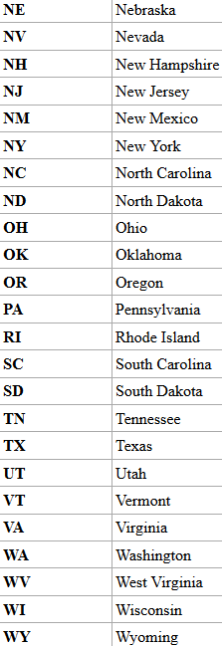
The 50 United States of America

Slide 34
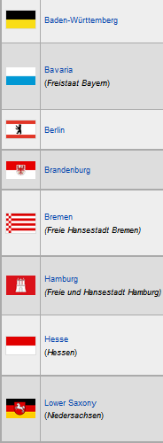
16 German States
29 Indian States
STOP AND THINK: WHAT OTHER FAMILIAR CATEGORIES ARE DEFINED BY ENUMERATION?

Slide 35
Enumeration is NOT a Property Test
(Traditional Definition of) Planet =
{Mercury, Venus, Earth, Mars, Jupiter, Saturn, Uranus, Neptune, Pluto}
NOT
Solar System Body Planet? Asteroid?
Mercury yes no
Venus yes no
Earth yes no
Mars yes no
Ceres no yes
Jupiter yes no
Saturn yes no
Uranus yes no
Neptune yes no
Pluto yes no
35

Slide 36
The Limits of Enumerative Definition
Enumerative categories enable membership to be unambiguously determined, but that doesn’t mean that they are uncontroversial – there might be competing enumerations
At some point an enumerative category definition contains so many members that the category either must be sub-divided or be given a definition based on principles other than enumeration
36

Slide 37
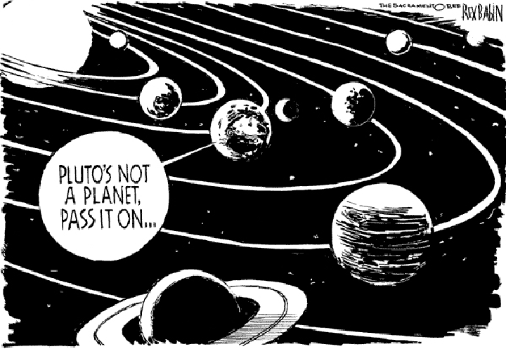
Sorry, Pluto
Not so fast…
37

Slide 38
Specifying Enumerations (1)
You should be excruciatingly careful when you define a category by enumeration
Legal disputes often reflect different interpretations of category membership and whether a list of category members is exhaustive or merely illustrative
The legal principle of “implied exclusion” - Expressio Unius Est Exclusio Alterius – says that if you “expressly name” or “designate” some list anything not named is excluded
38

Slide 39
Specifying Enumerations (2)
But “such as”, “including”, or “like” in a list of examples suggest that there are others
However, the doctrine of Noscitur A Sociis (“it is known by its associates”) says that the meaning of an unclear or ambiguous word should be determined by the words in its context
… which is why a fish – even though it is a “tangible object” – isn’t a document in the context of “record, document, or tangible object” under 18 U.S.C. § 1519 (Yates v. United States)
39

Slide 40
The Classical View of Categories
“Classical” categories have clear boundaries defined by a small number of ESSENTIAL or necessary and sufficient properties
Necessary means that every instance must have the property to be in the category
Sufficient means that any instance that has the necessary properties is in the category
Example: A Prime Number is an integer divisible only by itself and 1
Every prime number has these properties
If a number has these properties, it is prime
40

Slide 41
Implications of “Necessary and Sufficient” Properties
All members of the category have equal status in the equivalence class
Classical categories are conceptually simple and have straightforward implementations in technologies like database schemas, decision trees, and classes in programming languages
But most categories are not this simple
41

Slide 42
Categories Defined by Single Properties
Another way to create a simple category system is to use only the values of any single property, especially when the possible values are discrete and not very numerous
Intrinsic static properties are often the easiest ones to use
You can always define ranges for continuous value properties: low, moderate, high cost; new, almost new, old, very old…
42

Slide 43
Organizing A Collection of Shirts
Style Color Size Sleeve Maker
Shirt 1
Shirt 2
Shirt 3
Shirt 4
Shirt 5
Shirt 6
Shirt 7
Shirt 8
Shirt 9
Shirt 10
…
Dress
Dress
Dress
Dress
Work
Party
Athletic
Work
Party
Work
White
Blue
White
Blue
White
Red
Red
Brown
Brown
White
Large
Large
Med
Med
Med
Small
Med
Large
Med
Med
Long
Long
Long
Short
Long
Short
Long
Long
Short
Short
Boss
Klein
Boss
Klein
LL Bean
Tommy
Nike
LL Bean
Tommy
REI
43

Slide 44
A Category System for Shirts Using just the “Style” Property
SHIRTS
Dress
Work
Party
Athletic
Each value of the Style property becomes a sub-category

Slide 45
Categories Defined by Single Properties have Limitations
Whenever a single property is used to define a system of categories, the choice of property is critical
A single-property category with a large number of items in it might lack coherence because differences on other properties will be too apparent
Stereotypes: All people with property X are …
45

Slide 46
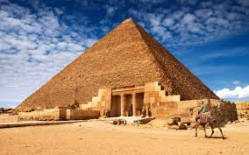
Single Property Category
46

Slide 47
Pyramid Man-Made? Location? Shape?
Yes Yes Egypt
Yes No Glacier Park
Yes Yes UC San Diego
47

Slide 48
Single Property Category
48

Slide 49
Orange Alive? People Can Color Food? Swim?
Yes Yes No No
Yes No No No
Yes Yes No Yes
Yes No Yes No
49

Slide 50
Categories Defined by Multiple Properties
Categories based on multiple properties form a hierarchy
Each successive property differentiates the items in a category to create sub-categories
Property order determines the hierarchy
STOP AND THINK - When there are many properties, how do you select from them and how do you order them?
50

Slide 51
A Collection of Shirts
Style Color Size Sleeve Maker
Shirt 1
Shirt 2
Shirt 3
Shirt 4
Shirt 5
Shirt 6
Shirt 7
Shirt 8
Shirt 9
Shirt 10
…
Dress
Dress
Dress
Dress
Work
Party
Athletic
Work
Party
Work
White
Blue
White
Blue
White
Red
Red
Brown
Brown
White
Large
Large
Med
Med
Med
Small
Med
Large
Med
Med
Long
Long
Long
Short
Long
Short
Long
Long
Short
Short
Boss
Klein
Boss
Klein
LL Bean
Tommy
Nike
LL Bean
Tommy
REI
51

Slide 52
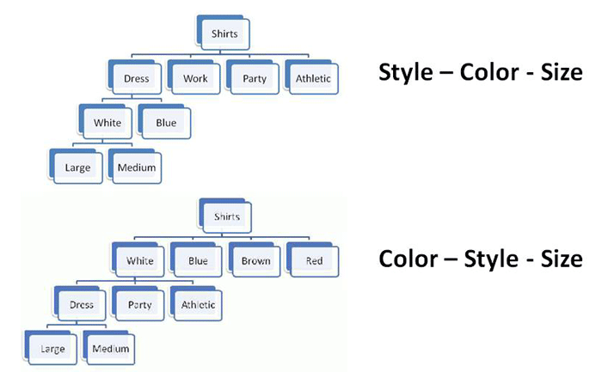
Property Order Determines the Category Hierarchy
52

Slide 53
TODAY’S MOST IMPORTANT SLIDES
53

Slide 54
Categories are “Equivalence Classes”
Categories are sets or groups of resources or abstract entities that are treated the same
This almost never means that every instance of the category is identical
It only means that for some purpose we treat them in the same way
54

Slide 55
Linguistic Relativity
Languages differ a great deal in the words they contain (which concepts are lexicalized)
They also differ in more fundamental ways by requiring speakers or writers to attend to details about the world or aspects of experience that another language allows them to ignore
But this doesn't mean that people can't understand concepts that are not lexicalized
55

Slide 56
Institutional Categorization
Explicit construction of a semantic model of a domain to enable more control, robustness, and interoperability than is possible with just the cultural system
Essential in abstract, information-intensive domains where semantic precision is essential for processes and transactions (especially automated ones)
Often the collaborative artifact of many individuals who represent different organizational or business perspectives
56

Slide 57
Institutional != Unbiased
Creating institutional categories by more systematic processes than cultural or individual categories does not prevent them from being biased
Indeed, the goal of institutional categories is often to impose or incentivize biases in interpretation or behavior
57

Slide 58
Defining Categories by Enumeration
Simplest way to define a category is by enumerating (listing) its members
This principle is also called EXTENSIONAL definition; the members of the set are called the EXTENSION
This principle is easy to understand and implement; the meaning of a category or concept is the specific set of resources associated with it
58

Slide 59
The Classical View of Categories
“Classical” categories have clear boundaries defined by a small number of ESSENTIAL or necessary and sufficient properties
Necessary means that every instance must have the property to be in the category
Sufficient means that any instance that has the necessary properties is in the category
Example: A Prime Number is an integer divisible only by itself and 1
Every prime number has these properties
If a number has these properties, it is prime
59

Slide 60
Categories Defined by Single Properties have Limitations
Whenever a single property is used to define a system of categories, the choice of property is critical
A single-property category with a large number of items in it might lack coherence because differences on other properties will be too apparent
Stereotypes: All people with property X are …
60

Slide 61
Categories Defined by Multiple Properties
Categories based on multiple properties form a hierarchy
Each successive property differentiates the items in a category to create sub-categories
Property order determines the hierarchy
STOP AND THINK - When there are many properties, how do you select from them and how do you order them?
61

