Slide 1
Plan for Today’s Lecture(s)
Principles for creating categories
Limits of Property-Based Categorization
Categorization Models and Models of Information Retrieval
1

Slide 2
INFO 202 “Information Organization & Retrieval” Fall 2015
UNIVERSITY OF CALIFORNIA, BERKELEY
SCHOOL OF INFORMATION
Robert J. Glushko glushko@berkeley.edu
@rjglushko
28 October 2015 Lecture 18.1– Limits of Property-Based Categorization

Slide 3
FLASHBACK: Classical View of Categories
“Classical” categories have clear boundaries defined by a small number of ESSENTIAL or necessary and sufficient properties
Necessary means that every instance must have the property to be in the category
Sufficient means that any instance that has the necessary properties is in the category
3

Slide 4
Wittgenstein
Ludwig Wittgenstein (1889-1951) – "philosophy of ordinary language" - first to discuss problems with classical category theory
Enumerative categories embody the idea that “meaning is reference” – a concept means what it refers to; you understand words by following the association to their “extensions”
Wittgenstein argued that most words don’t have fixed extensions because what they refer to can depend on context: “meaning is use”
4

Slide 5
If Meaning was just Reference...
If "meaning" was just based on reference would we need all that complicated ontology machinery and common sense to understand each other? Would names matter?
Prune == Dried Plum
Chinese Gooseberry == Kiwi Fruit
Patagonian Toothfish == Antarctic Cod == Chilean Sea Bass
Sectarian Conflict == Civil War
Terrorists == Insurgents == Resistance == Freedom Fighters
5

Slide 6
Implications of “Meaning is Use”
There may be defining features for typical instances
But there are no features that are necessary and sufficient for all examples of the category
Even when features can be identified, they change in different contexts and over time
Different instances vary substantially in how typical or representative they are of the category even though they share all the required features
6

Slide 7
Necessary and Sufficient Properties - Not!
Wittgenstein's classic counterexample is "Game"
No common properties are shared by all games
Some involve competition, others are cooperative
Some involve physical skill, others more mental skills, others luck
Some require equipment, others don't
Some involve teams, others are solitary
No fixed category boundary - we can extend game category to include video games, networked games, word games, mind games, …
7

Slide 8
Other Limits of Property-Based Categorization
Some properties cannot be directly perceived: e.g., “aboutness” for information resources
Some properties can be perceived but they are not separable because they co-occur with other properties
Many properties of resources are extrinsic and incidental and not relevant to most of their categorizations
8

Slide 9
Implications of these Limits
Family resemblances
Typicality or centrality effects
Fuzzy and flexible category boundaries
9

Slide 10
INFO 202 “Information Organization & Retrieval” Fall 2015
UNIVERSITY OF CALIFORNIA, BERKELEY
SCHOOL OF INFORMATION
Robert J. Glushko glushko@berkeley.edu
@rjglushko
28 October 2015 Lecture 18.2– Other Principles for Creating Categories

Slide 11
Categorization by Family Resemblance
Instances of a category often share many features, but some instances might have properties that are not widely shared
These widely shared though not universal properties produce FAMILY RESEMBLANCES among the members
The resemblances among the members of a category might be based on different subsets of their properties or features when different members are compared
11

Slide 12
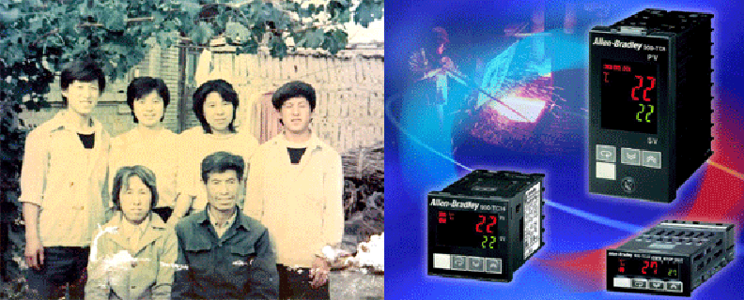
Family Resemblance
Chen Family
Allan Bradley Power Supply Product Family
12

Slide 13
Characteristic Features
Perceived degree of category membership has to do with which features help define the category
Members usually do not have ALL the necessary features, but have some subset
Those members that have more of the central features are seen as more central members
13

Slide 14
Gradience in Category Membership
The perceived centrality or typicality of category membership depends on the extent to which the most characteristic properties are shared
"Someone says to me 'Show the children a game.' I teach them gaming with dice, and the other says 'I didn't mean that kind of game.' " (Wittgenstein)
14

Slide 15
Gradience in Category Membership
Which bird is most typical of the category?
15

Slide 16
Similarity as a Categorization Principle
It is often said that we can define categories on the basis of resource similarity:
Something is categorized as an A and not a B if it is more similar to A’s best or most typical member rather than it is to B’s
Similarity is a very intuitive notion and it underlies the idea that some kinds of categories are more natural or basic than others
16

Slide 17
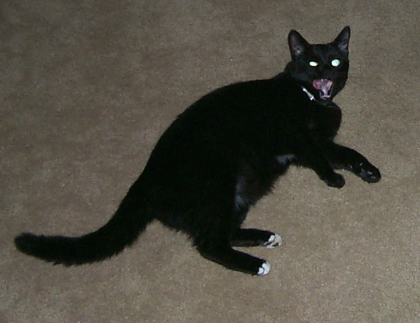
Category Hierarchies
Categories can be organized into a hierarchy from the most general to the most specific
My cat can be described as
An animal
A mammal
A cat
An American Shorthair
Boris
(No intent to line up completely with biological classification)
17

Slide 18
Basic-Level Categories
In the middle of category hierarchies are those that are more "basic" because the within-category similarity is greatest and the between-category similarity is the smallest
This means that perceptual, cognitive, and motor functions are "sharpest" at this level at identifying and thinking about category membership
These are the categories when Plato “carves nature at the joints”
18

Slide 19
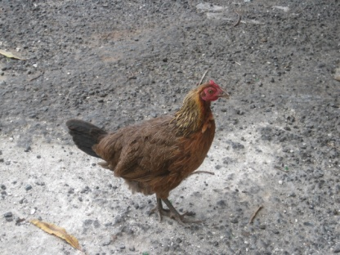
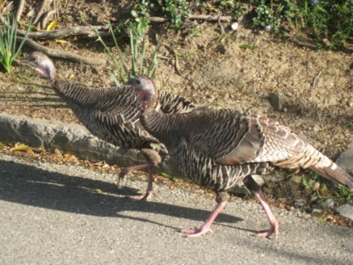
Basic-Level Categories
Members tend to have the same shape
They tend to "share parts"
The same motor movements are involved in interacting with them
19

Slide 20
Defining Similarity
STOP and THINK: We haven’t defined similarity!
Some people say that similarity is a meaningless and "mostly vacuous" concept because there must always be some unstated set of properties
So the meaning of similarity is defined by the specific properties and metrics used to compare them
Once we identify the properties and how they are used, there is nothing for a "similarity" mechanism to do
20

Slide 21
Measuring Similarity
We can sometimes represent resources as sets of properties; some will be shared, and others will be distinctive and not shared
We could measure the differences between the values on each shared property separately and combine these “difference measures” to calculate a composite similarity measure
How do “not shared” properties contribute to the similarity measure?
21

Slide 22
Geometric or Distance Models
If the property values are metric, each resource is represented as a point in N-dimensional space, with property values as the coordinates
Similarity is inversely related to distance computed as
Euclidean metric (r = 2) is the Pythagorean Theorem, better when properties are “fused” and not analyzed into their component dimensions
“City block” metric (r = 1) is better for separable properties
22

Slide 23
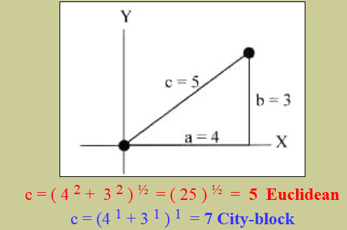
Calculating Distances

Slide 24
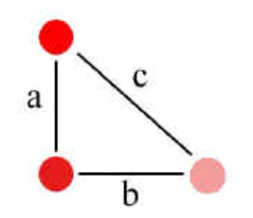
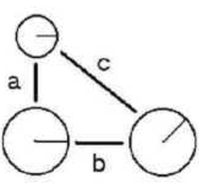
Fused vs. Separable Properties
Properties of color and saturation are fused, and Euclidean metrics better fit similarity judgments
Circle size and radius angle are separable properties, and City Block metric better fits similarity judgments

Slide 25
STOP AND THINK: Is Similarity a Symmetric Relationship?
Does “A is similar to B”
(or “A is like B”)
mean the same thing as “B is similar to A”
(or “B is like A”)?
25

Slide 26
Similarity Asymmetry
When we compare an A with a B with a statement about similarity, we order A and B to make the more salient or “feature complex” one as the referent
“the portrait resembles the father” NOT “The father resembles the portrait”
The more salient resource is less similar to the less salient one than vice versa
North Korea is judged more similar to China than China is judged similar to North Korea
26

Slide 27
Contrast Models
Tversky proposed to measure similarity using a formula that considers both shared and distinctive features
Each of these three sets can be weighted differently
This model can explain why similarity judgments are not always symmetric
27

Slide 28
A Few Shared and Many Distinctive Features:
Not Very Similar
F1
F2
F12
F3
F4
F9
F5
F13
F14
F10
F6
F15
F7
F11
F8
F16
F17
F18
Object A
Object B

Slide 29
The Features of Shirts
Style Color Size Sleeve Maker
Shirt 1
Shirt 2
Shirt 3
Shirt 4
Shirt 5
Shirt 6
Shirt 7
Shirt 8
Shirt 9
Shirt 10
…
Dress
Dress
Dress
Dress
Work
Party
Athletic
Work
Party
Work
White
Blue
White
Blue
White
Red
Red
Brown
Brown
White
Large
Large
Med
Med
Med
Small
Med
Large
Med
Med
Long
Long
Long
Short
Long
Short
Long
Long
Short
Short
Boss
Klein
Boss
Klein
LL Bean
Tommy
Nike
LL Bean
Tommy
REI
29

Slide 30
A Few Shared and Many Distinctive Features:
Not Very Similar
Dress Style
Large Size
Work Style
Long Sleeve
WhiteColor
Medium Size
Maker Boss
Short Sleeve
Maker REI
Shirt 1
Shirt 10

Slide 31
STOP AND THINK: HOW SIMILAR ARE A AND B?
CASE 1
Object A
CASE 2
Object A
P1
P2
P9
P4
P2
P3
P5
P1
P3
P4
P7
P6
P11
P5
P6
P8
P10
P7
P12
P13
Object B
Object B

Slide 32
Missing Data != Distinctive Features
CASE 2 might look like this
Object A
P1
P2
P9
P4
P3
P5
P6
P7
P11
P8
P10
P12
Object B
P13

Slide 33
Structure Models
Geometric and Feature models don’t work well when comparing things that have lots of internal hierarchical or relational structure
In these cases, comparing matching features is insufficient; you need to compare features with similar roles in structures or relationships
Similarity is like analogy
In analogies, relationships are shared
In similarity, both relationships and features are shared
33

Slide 34
Theory-Based Categories
Sometimes a category can be defined even when there are no family resemblances or similarity based on surface or perceivable properties
Instead, there is a theory of causation or capability that explains why some collection of things go together
34

Slide 35
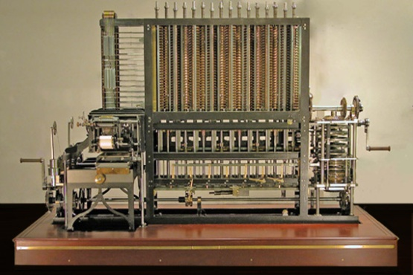
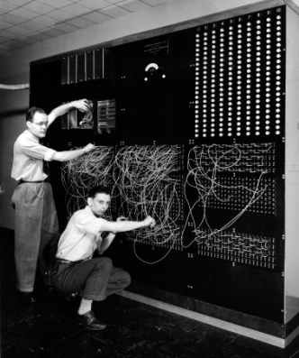
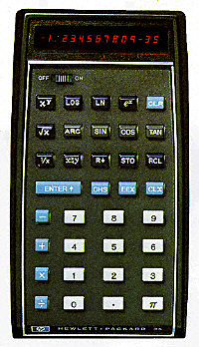
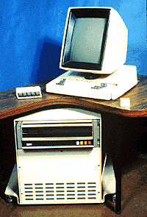
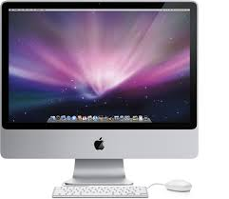
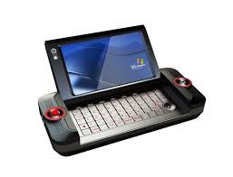
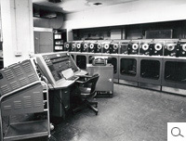
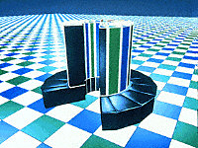
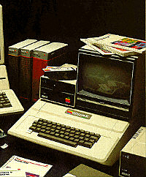
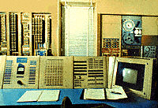
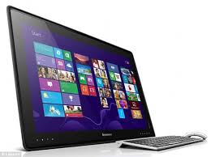
Theory-Based Category: Computer
Category of "computer" is based on being able to compute
35

Slide 36
Goal-Derived (or “Ad Hoc”) Categories
Another way of defining categories for things that have no discernible properties in common is based on their value with respect to a common goal or task
Imagine you are in a city about to be hit by a hurricane and you have 10 minutes to take any of your possessions and evacuate. How do you define the category of what to take?
You might have a set of properties, but they are not likely to be ones that are easy to define: irreplaceable, priceless, sentimentally valuable, etc.
36

Slide 37
Goal-Derived Personal Category?
37

Slide 38
INFO 202 “Information Organization & Retrieval” Fall 2015
UNIVERSITY OF CALIFORNIA, BERKELEY
SCHOOL OF INFORMATION
Robert J. Glushko glushko@berkeley.edu
@rjglushko
28 October 2015 Lecture 18.3 – Category Models and Models of Information Retrieval

Slide 39
Models of Information Retrieval (1)
The core problems of information retrieval are finding relevant documents and ordering the found documents according to relevance
The IR model explains how these problems are solved:
...By specifying the representations of queries and documents in the collection being searched
...And the information used, and the calculations performed, that order the retrieved documents by relevance
39

Slide 40
Models of Information Retrieval (2)
Different IR models solve these problems in different ways; the better they solve it, the more conceptually and computationally complex they are, so there are tradeoffs
Identifying relevant documents is equivalent to defining a category to which the query and retrieved information (document) both belong
So there is a correspondence between models of categories and models of information retrieval
40

Slide 41
The Boolean Model
The Boolean model of IR represents documents and queries as sets of index terms that are either present or absent
Term frequency is not represented in any way; terms are either present or absent
This enables comparisons between queries and document collections using set theory operations with Boolean algebra, making relevance a binary decision
THIS IS THE CLASSICAL MODEL OF CATEGORIES WITH NECESSARY AND SUFFIEICENT PROPERTIES
41

Slide 42
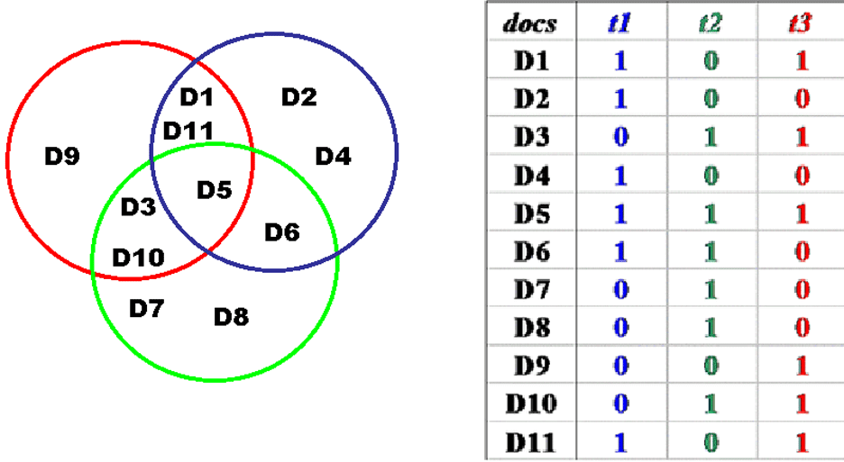
Example of Boolean Representation
42

Slide 43
Relevance in the Boolean Model
Because terms are either present or absent, a document is either relevant or not relevant
But this is clearly flawed -- if a query is "a and b" the Boolean model retrieves only those documents that contain both of them, and treats documents that contain only a or only b as equally irrelevant
THIS IS EQUIVALENT TO SAYING THAT THE BOOLEAN MODEL HAS NO WAY TO REPRESENT TYPICALITY OR GRADED MEMBERSHIP IN A CATEGORY
43

Slide 44
Overview of Vector Model
Documents and queries are represented in the same way as word or term vectors
Each dimension is the count of occurrences for a term
Vector algebra provides a model for computing similarity between queries and documents and between documents because of assumption that "closeness in space" means "closeness in meaning”
44

Slide 45
Overview of Vector Model
Because the model represents term frequency and not just presence or absence, terms can be weighted to reflect the importance of the term in discriminating the document in the collection
THIS WILL PRODUCE A CONTINUOUS RATHER THAN A BINARY MEASURE OF SIMILARITY
45

Slide 46
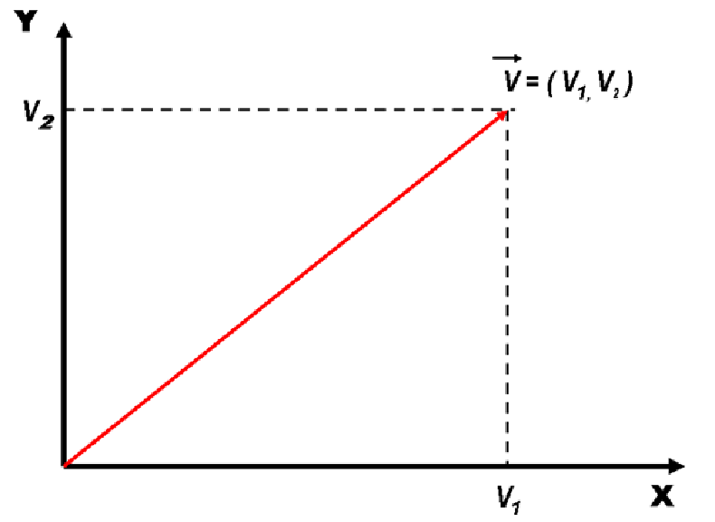
Vectors
46

Slide 47
Vectors
Vectors are an abstract way to think about a list of numbers
Any point in a vector space can be represented as a list of numbers called "coordinates" which represent values on the "axes" or "basis vectors" of the space
47

Slide 48
Vectors
Adding and multiplying vectors gives us a way to represent a continuous space in any number of dimensions
We can multiply a coordinate value in a vector to "scale" its length on a particular basic vector to "weight" that value (or axis)
48

Slide 49
Calculating Similarity in Vector Models
The similarity between a query and a document, or between two documents, is defined as the "inner product" of their vectors
The inner product of two vectors is the sum of the products of their overlapping terms (so similarity increases when they have more terms in common)
v1 = (3, 8, 4) v2 = (2, 3, 1)
(3, 8, 4) x (2, 3, 1) = (3 x 2) + (8 x 3) + (4 x 1) = 34
49

Slide 50
Calculating Similarity in Vector Models
Qualitatively or intuitively this means that documents are more likely to be about the same topics when they use the same terms in the same proportions
When vectors are normalized (to length 1) compensate for different lengths, the inner product calculation is the cosine between the vectors
50

Slide 51
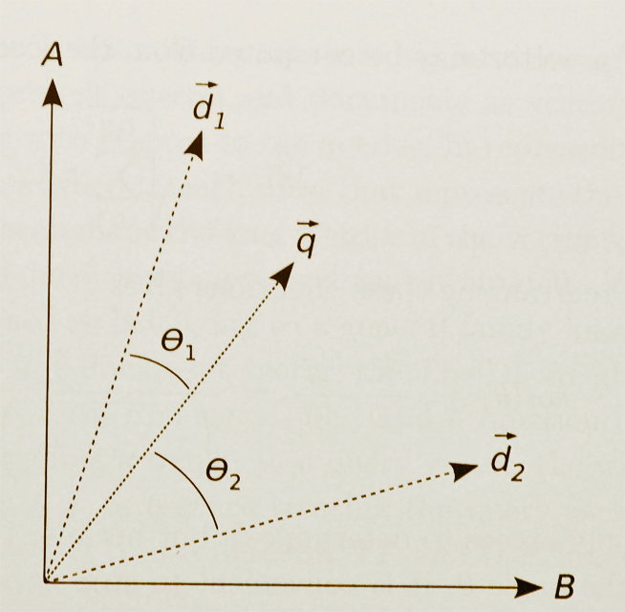
Similarity in Vector Models (Graphical Depiction)
51

Slide 52
Summary: Why Study Categorization?
Categorization is central to how we organize information and the world, and categories are involved whenever we communicate, analyze, predict, or classify
Whenever we design data structures, programming language class hierarchies, user or application interfaces, ...
Categorization is much messier than our computer systems and applications would like
But understanding how people (and each of us) categorize can help us design better systems and interfaces
52

Slide 53
Core Readings for Next Lecture
TDO 7 through 7.2
Rosenthal, Arnon, Len Seligman, and Scott Renner. “From semantic integration to semantics management: case studies and a way forward.” ACM SIGMOD Record 33, no. 4 (2004): 44-50.
53

Slide 54
TODAY’S MOST IMPORTANT SLIDES
54

Slide 55
Implications of “Meaning is Use”
There may be defining features for typical instances
But there are no features that are necessary and sufficient for all examples of the category
Even when features can be identified, they change in different contexts and over time
Different instances vary substantially in how typical or representative they are of the category even though they share all the required features
55

Slide 56
Other Limits of Property-Based Categorization
Some properties cannot be directly perceived: e.g., “aboutness” for information resources
Some properties can be perceived but they are not separable because they co-occur with other properties
Many properties of resources are extrinsic and incidental and not relevant to most of their categorizations
56

Slide 57
Characteristic Features
Perceived degree of category membership has to do with which features help define the category
Members usually do not have ALL the necessary features, but have some subset
Those members that have more of the central features are seen as more central members
57

Slide 58
Basic-Level Categories
In the middle of category hierarchies are those that are more "basic" because the within-category similarity is greatest and the between-category similarity is the smallest
This means that perceptual, cognitive, and motor functions are "sharpest" at this level at identifying and thinking about category membership
These are the categories when Plato “carves nature at the joints”
58

Slide 59
Measuring Similarity
We can sometimes represent resources as sets of properties; some will be shared, and others will be distinctive and not shared
We could measure the differences between the values on each shared property separately and combine these “difference measures” to calculate a composite similarity measure
How do “not shared” properties contribute to the similarity measure?
59

Slide 60
Geometric or Distance Models
If the property values are metric, each resource is represented as a point in N-dimensional space, with property values as the coordinates
Similarity is inversely related to distance computed as
Euclidean metric (r = 2) is the Pythagorean Theorem, better when properties are “fused” and not analyzed into their component dimensions
“City block” metric (r = 1) is better for separable properties
60

Slide 61
Contrast Models
Tversky proposed to measure similarity using a formula that considers both shared and distinctive features
Each of these three sets can be weighted differently
This model can explain why similarity judgments are not always symmetric
61

Slide 62
Models of Information Retrieval (1)
The core problems of information retrieval are finding relevant documents and ordering the found documents according to relevance
The IR model explains how these problems are solved:
...By specifying the representations of queries and documents in the collection being searched
...And the information used, and the calculations performed, that order the retrieved documents by relevance
62

Slide 63
Models of Information Retrieval (2)
Different IR models solve these problems in different ways; the better they solve it, the more conceptually and computationally complex they are, so there are tradeoffs
Identifying relevant documents is equivalent to defining a category to which the query and retrieved information (document) both belong
So there is a correspondence between models of categories and models of information retrieval
63

