Slide 1
Plan for Today’s Lecture(s)
Introduction to Classification
Classification is Purposeful, Principled, and Biased
Classification and Standardization
1

Slide 2
INFO 202 “Information Organization & Retrieval” Fall 2015
UNIVERSITY OF CALIFORNIA, BERKELEY
SCHOOL OF INFORMATION
Robert J. Glushko glushko@berkeley.edu
@rjglushko
2 November 2015 Lecture 19.1 – Introduction to Classification

Slide 3
What is Classification?
"Classification is a higher order thinking skill requiring the fusion of the naturalist's eye for relationships...
...with the logician's desire for structured order...
...the mathematician's compulsion to achieve consistent, predictable results...
...and the linguist's interest in explicit and tacit expressions of meaning“
-- Louise Gruenberg, "Faceted Classification, Facet Analysis and the Web“
3

Slide 4
Distinguishing Categorization and Classification
Categories are EQUIVALENCE CLASSES - sets of resources, processes, and events that we treat the same
A Classification (noun) (or Classification Scheme) is a SYSTEM OF CATEGORIES, ordered according to a PRE-DETERMINED SET OF PRINCIPLES and used to organize a collection of resources
Classification (verb) is the process of systematically assigning resources to intentional (often institutional) categories in a classification system
4

Slide 5
Classification Schemes (1)
A CLASSIFICATION SCHEME follows one or more organizing principles
An ENUMERATIVE scheme itemizes all possible categories to which resources can be assigned (into one and only one of the categories)
5

Slide 6
Classification Schemes (2)
A HIERARCHICAL or TAXONOMIC scheme emerges when multiple resource properties are used by organizing principles; each property creates another level
A scheme can be both HIERARCHICAL and ENUMERATIVE at the lowest level where resources are categorized
A FACETED classification scheme uses multiple resource properties, but does not require every resource to have a value for every property and allows the properties to be considered in any order
6

Slide 7
Classification {and,or,vs.} “Tagging”
Many applications, especially social ones, allow people to assign tags in the form of words or phrases todescribe a resource
The aggregated results of individual tags have been described as social, collaborative, or user-generated classifications or as a folksonomy, a word created to mean something like “the people’s taxonomy”
But tagging a photo as “red” or “car” is an act of resource description, not classification, because the other tags that would serve as the alternative classifications are unspecified – there is no system of categories
7

Slide 8
Types of Tags
Subject /Taxonomic or Keyword Tags (most common, but rarely from a controlled vocabulary)
Non-taxonomic tags:
Property or Attribute Tags ("red," "expensive“)
"Purpose" Tags (e.g, "toread" or "buythis" or "tagthis“)
Evaluative Tags ("interesting," "good)
8

Slide 9
“Tag Soup”
Users are free to assign any number of labels or tags they choose
No vocabulary control
No text processing in most apps that allow tagging to handle derivational and morphological variants
So if we consider tagging as classification, it is very poor classification
9

Slide 10
INFO 202 “Information Organization & Retrieval” Fall 2015
UNIVERSITY OF CALIFORNIA, BERKELEY
SCHOOL OF INFORMATION
Robert J. Glushko glushko@berkeley.edu
@rjglushko
2 November 2015 Lecture 19.2 – Classification is Purposeful, Principled, and Biased

Slide 11
Classification Is Purposeful
Classifications arrange resources to provide structure for and increase the precision of INTERACTIONS in organizing systems by human or computational agents
Classifications are essential in useful work
They serve as a reference model (a semantic road map) to individual domains and the relationships among them to help people understand and communicate the concepts and relationships
11

Slide 12
STOP and THINK
The Diagnostic and Statistical Manual of Mental Disorders (DSM) is a classification of psychiatric diagnoses; likewise, the International Classification of Diseases (ICD) is a classification of diseases and related health problems
What kinds of “useful work” do the DSM and ICD enable, and for whom?
Was all of this work anticipated when the DSM and ICD were first created?
Are there ways in which the DSM and ICD interfere with doing useful work?
12

Slide 13
Classification and Interactions
Effective user interfaces to physical or digital systems present and reinforce the logical classifications embodied in the system
… while poor user interfaces don’t
Standard classifications for products and business services make it easier to discover suitable resources and integrate them into your own processes
With physical resources, activity-based classification makes co-location more useful
13

Slide 14
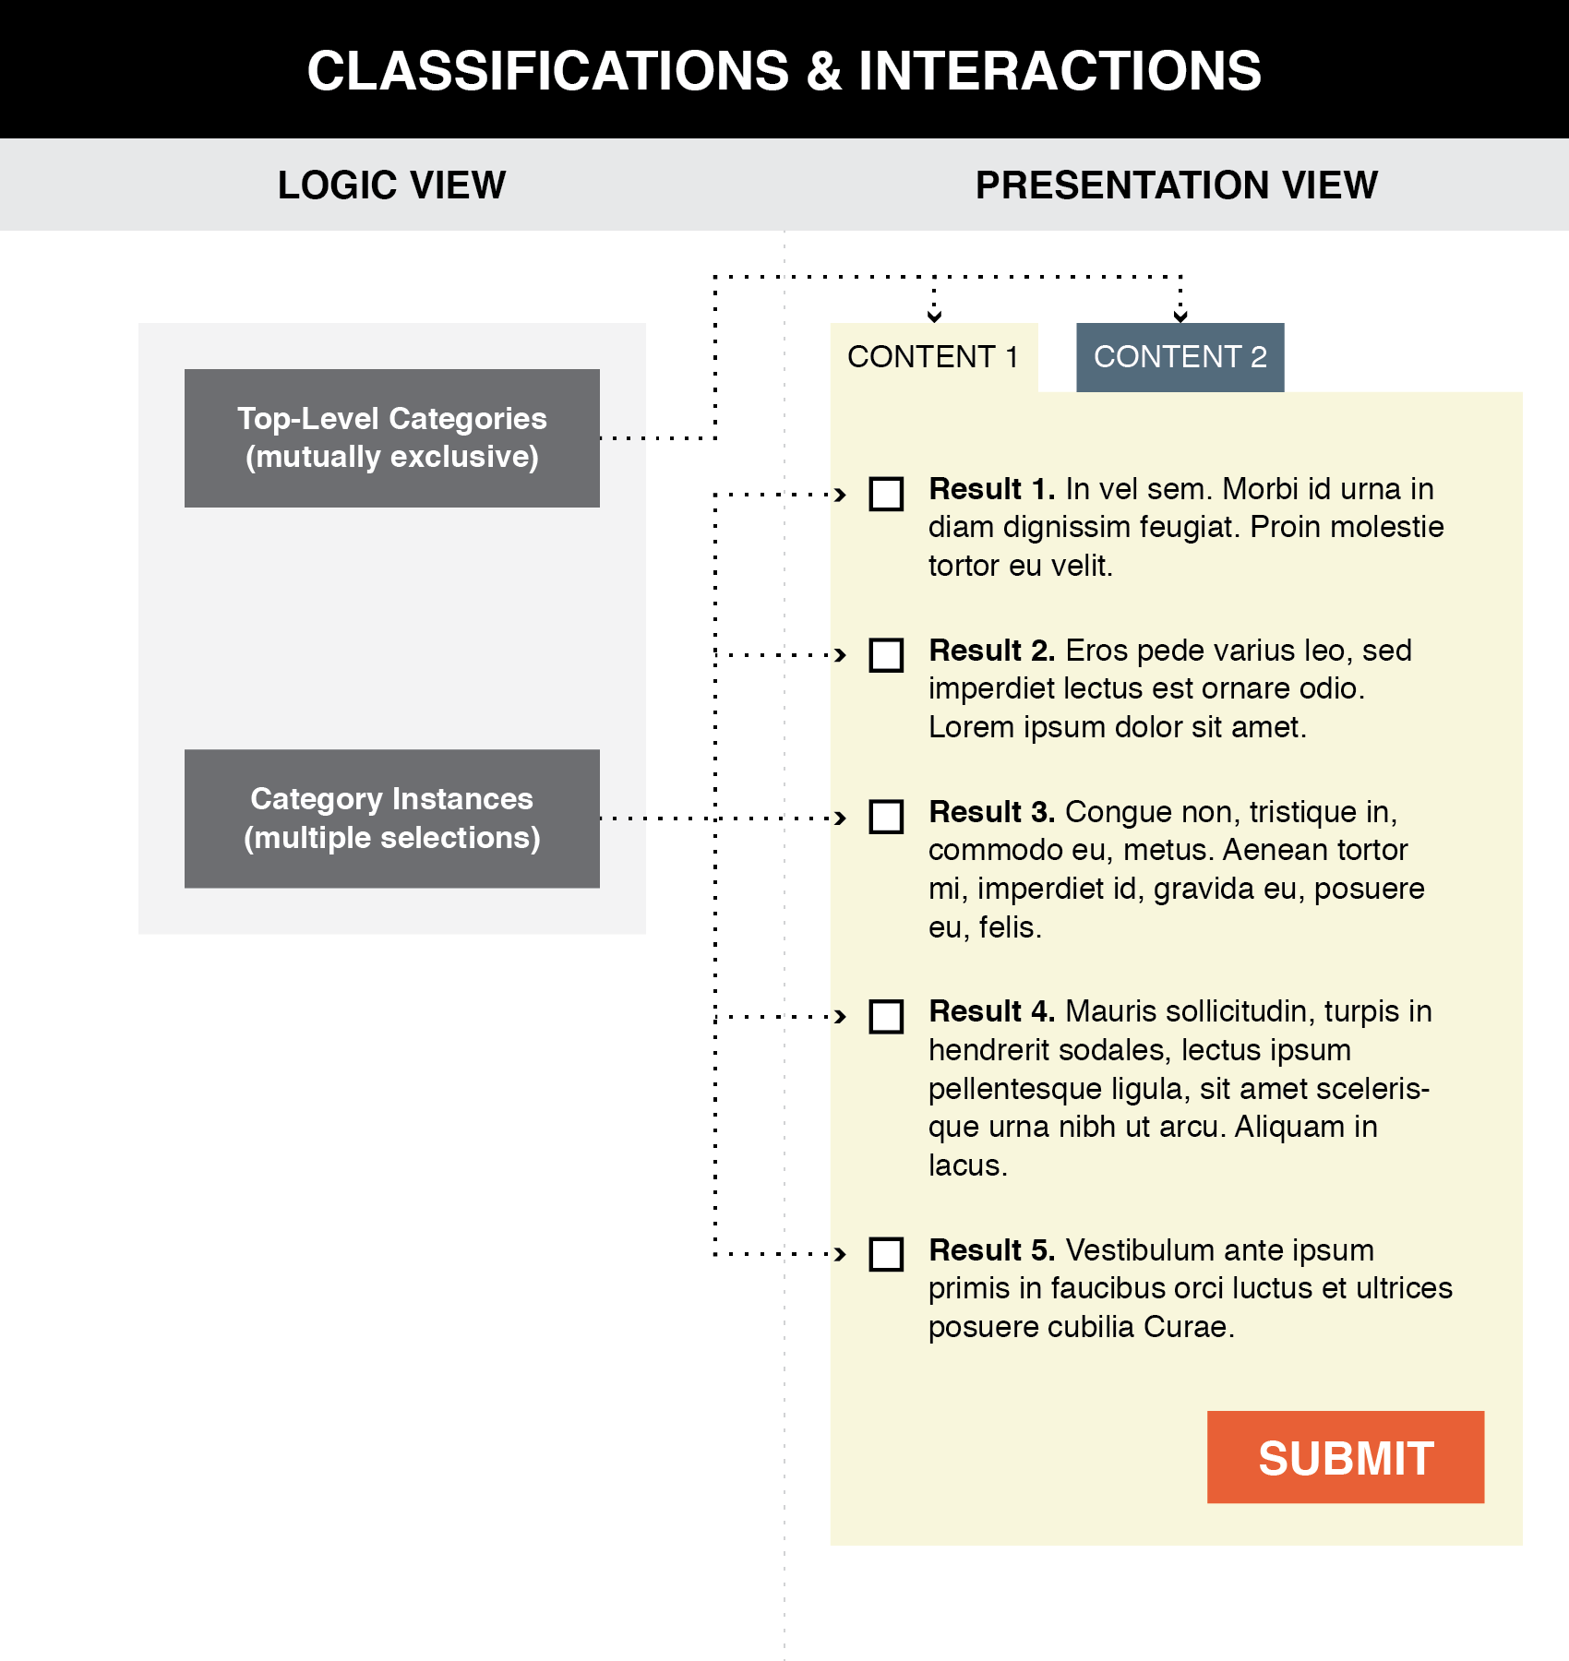
Good user interface design creates a clear mapping between a classification scheme and the arrangements and interactions that users see (TDO, Figure 7.1)
14

Slide 15
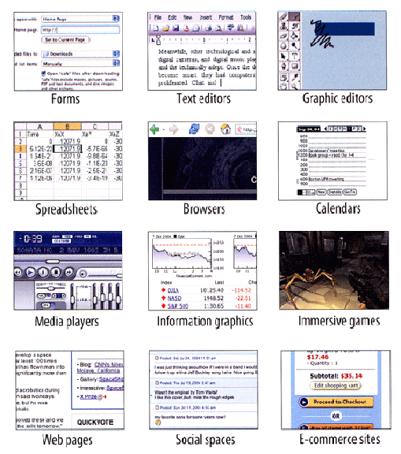
User Interface Design Idioms
Flashback to 9 September
Tidwell, Jenifer.
Designing Interfaces: Patterns for Effective Interaction Design
www.amazon.com/dp/1449379702
15

Slide 16
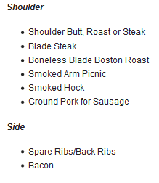
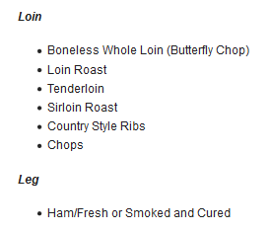

Slide 17
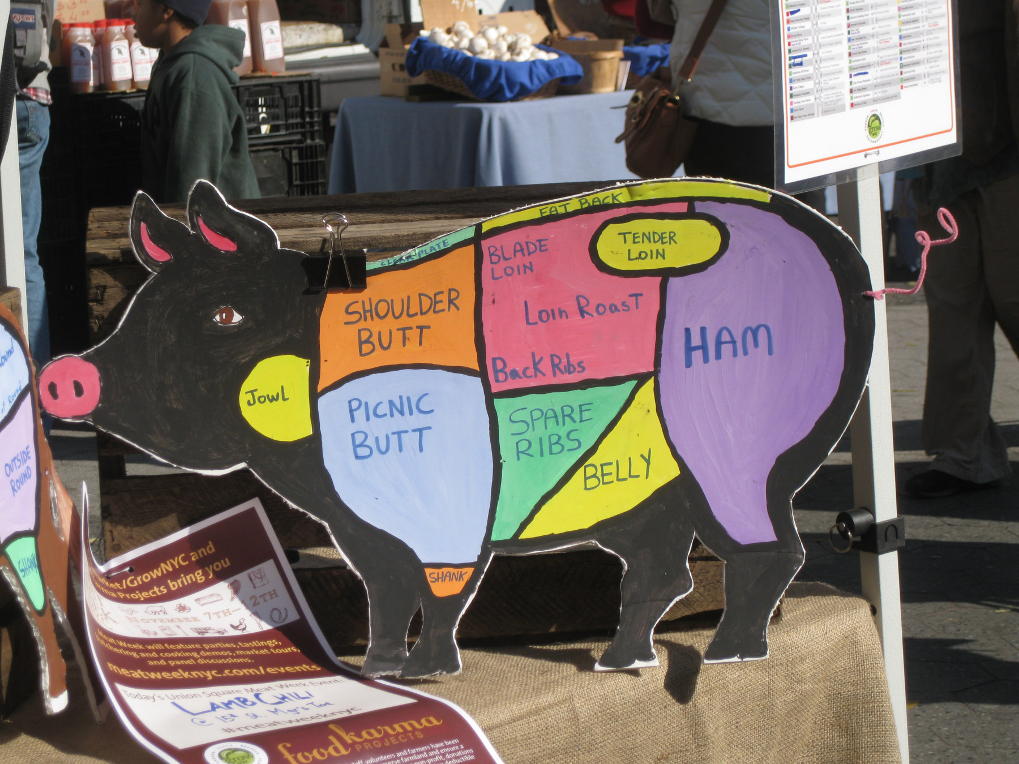
Better Communication of a Classification Scheme
Photo taken by Bob Glushko at Union Square Greenmarket, NYC

Slide 18
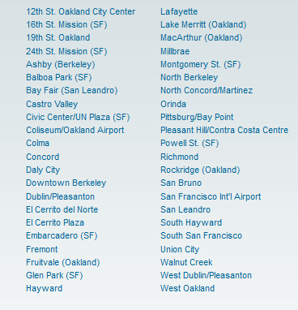
Poor Communication of a Classification Scheme
BART Station List
Better Might Be Something Like…
San Francisco
Embarcadero
Montgomery
Powell
Civic Center
…
Oakland
West Oakland
12 Street
19 Street
MacArthur
Rockridge
…
Berkeley
Ashby
Berkeley Downtown
Berkeley North

Slide 19
Classification is “Principled”
The principles for defining categories (enumeration, properties, similarity, family resemblance, etc.) are embodied in the classifications that use these principles
But the emergent classification system follows other principles that reflect its purposes, scope, scale, intended lifetime, extensibility, and other considerations
Being "principled" means that once these design choices are made they should be consistently followed
19

Slide 20
“Principled” Does Not Imply “Good” or “the Only Way”
Many of the choices can be arbitrary and others may involve tradeoffs that depend on:
the nature of the resources and the complexity of the resource domain
the purposes of the classification
the amount of effort available
the capabilities of the people doing the classification and of the people using it
(flashback to TDO 6.4, “Category Design Issues and Implications” and to TDO 10.3, “Defining and Scoping”)
20

Slide 21
FLASHBACK: Scope and Scale
SCOPE: the breadth and variety of resource types
SCALE: the number of resource instances
Heterogeneity of resources is more important than absolute number (Scope >> Scale)
Handling resource heterogeneity:
Fewer, broader categories if possible
Less description
Standards for automated description and classification
21

Slide 22
Category Abstraction and Granularity
We can identify any resource as a unique instance or as a member of a category of resources
The size of this category —the number of resources that are treated as equivalent—is determined by the properties or characteristics we consider when we examine the resources in some domain
People differ in their preferences or tolerances for the amount of granularity in an organizing system and we need to expect and respect these differences
(we’ll talk more about “choice architecture” in a few weeks)
22

Slide 23
Tradeoffs in Abstraction and Granularity
The abstraction level we choose determines how precisely we identify resources. When we want to make a general claim, or communicate that the scope of our interest is broad, we use superordinate categories
More fine-grained organization reduces recall, the number of resources you find or retrieve in response to a query, but increases the precision of the recalled set, the proportion of recalled items that are relevant
But not always - there is often a tradeoff between precision and validity
23

Slide 24
Principles Embodied in the Classification Scheme
Warrant: What is the justification for the choice of categories and their names?
Literary Warrant: Classify only the resources we have?
Scientific Warrant: Use expert categories and names
Use Warrant: Use categories and names from “ordinary” people
Breadth and depth of classification hierarchy
Degree of enumerativeness (synonym for “granularity”)
24

Slide 25
Hierarchy and Uniqueness Principles
Deeply engrained in our intellectual and physical worlds
Hierarchy: Each category is successively divided into smaller subdivisions according to a feature or property
Uniqueness: Every (type of) resource is classified in only one subdivision
STOP AND THINK: IS UNIQUENESS IMPLIED BY HIERARCHY?
25

Slide 26
The "One and Only One Place" Rule in Library Classification
If each resource goes in one and only one category it won't always be easy to decide what description or property determines the categorization
For example, a book's title is often a clue to the subject, but should never be the only thing analyzed
Who Moved My Cheese? is a work on coping with change, not a work related to the culinary arts
Should Leaves of Grass be assigned to the "Gardening" category?
26

Slide 27
Principles for Maintaining the Classification
Lifetime management
Category integrity: Classify once and for all, or change categories and assignments over time?
STOP AND THINK: How can a classification have flexibility / extensibility / hospitality?
27

Slide 28
"Principled" Maybe ... But Every Classification is "Biased"
Every classification is arbitrary to some extent because the criteria used to establish the categories reflect a point of view or perspective on the domain that intentionally excludes all other perspectives
There is no "one true way" about how things go together
Every classification system implicitly or explicitly distinguishes between "good" or "standard" and "bad" or "nonstandard" ways of understanding things
Borges: “there is no classification of the Universe that is not arbitrary and full of conjectures”
28

Slide 29
Classification Biases
Natural vs. man-made disaster?
Welfare vs. entitlement?
Taxes vs. government investments?
Illegal vs. undocumented immigrants?
Coup or regime change?
Dietary supplement vs. beverage?
Employee vs. contractor, full vs. part time?
Unemployed
29

Slide 30
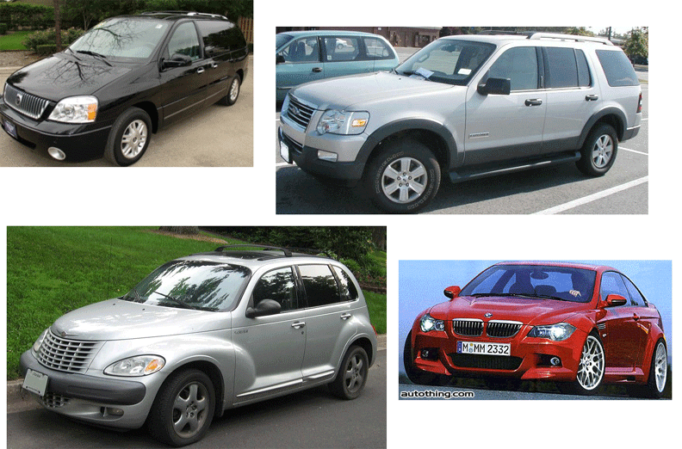
CAFE Categories: Find the Truck(s)
30

Slide 31
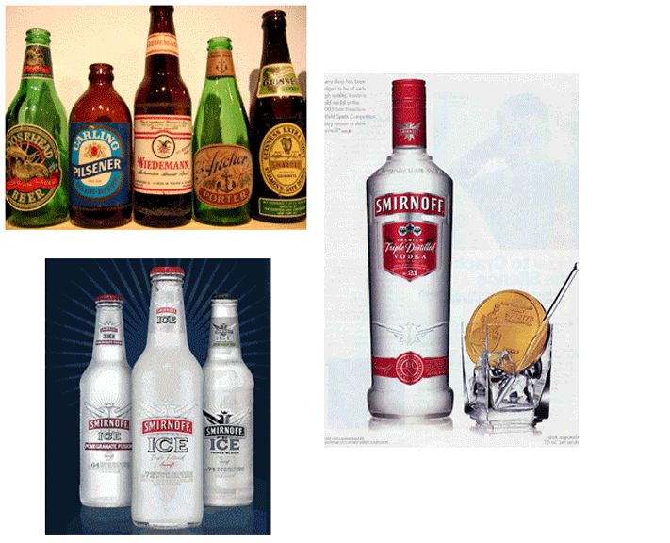
Beverage Categories: Find the Beer
31

Slide 32
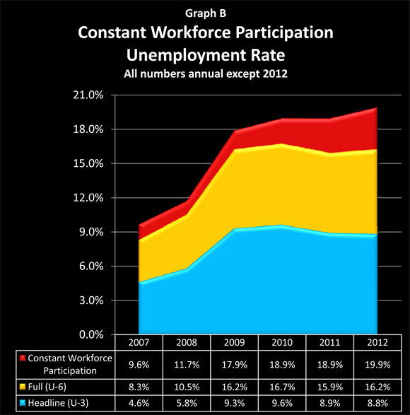
Making 9 Million Jobless People Vanish
When you give up looking for a job, you’re not unemployed
32

Slide 33
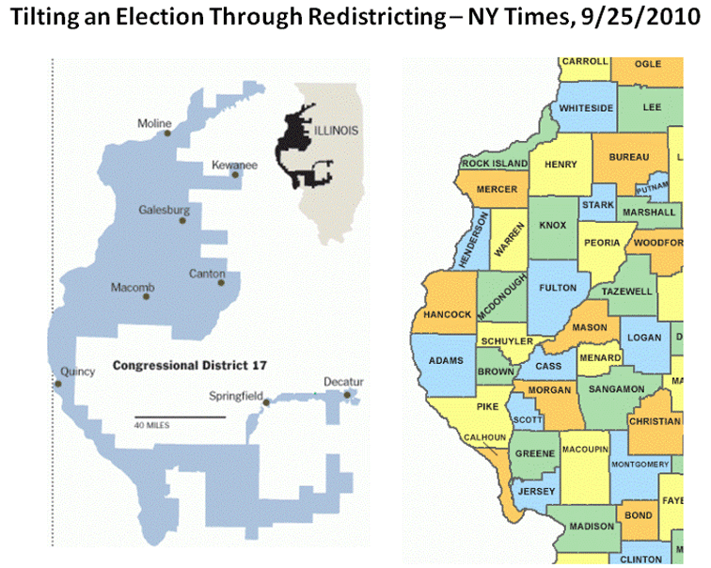
Gerrymandering: Find the Democrats
Illinois is famous for its corrupt politicians….
33

Slide 34
INFO 202 “Information Organization & Retrieval” Fall 2015
UNIVERSITY OF CALIFORNIA, BERKELEY
SCHOOL OF INFORMATION
Robert J. Glushko glushko@berkeley.edu
@rjglushko
2 November 2015 Lecture 19.3 – Classification and Standardization

Slide 35
Classification and Standardization (1)
Classifications and standards both impose order on resources
They both distinguish, explicitly or implicitly, between standard / appropriate / effective and nonstandard / inappropriate / ineffective ways of creating organizing, and using resources
But this does not imply that a standard is a good one or that the best one will win a "standards war“
STOP AND THINK: Examples of standards wars?
35

Slide 36
Classification and Standardization (2)
Some classifications become standards
Every successful standard imposes a classification system
Standards and classification systems can have significant inertia, becoming part of the "installed base" or "infrastructure" and difficult to change
36

Slide 37
"Specifications"
A specification is an explicit and detailed description about how something (a product, system, service, or practice) works that might include:
the definitions of the key concepts or terms used in the description
the materials from which it is made
the components (tangible or intangible) that are arranged or assembled to make it work
the methods or processes by which it operates
the inputs and outputs for each method or process
37

Slide 38
"Standards"
A standard is a published specification that is developed and maintained by consensus of all the relevant stakeholders in some domain
following a defined and transparent process
usually under the auspices of a dedicated organization with the authority to create standards
The rigor and transparency of the process by which a standard is created is essential to its legitimacy
Some governments or other large procurers or products of systems require that they be based on these "de jure" standards
38

Slide 39
Why Standards Exist (1)
Standards serve as a coordinating mechanism whenever there are alternative ways of doing or making something that might be incompatible or that otherwise wouldn't be possible
Standards can also serve as a regulating mechanism to restrict behavior or operation that might be unsafe, unfair, or otherwise "harmful“
39

Slide 40
Why Standards Exist (2)
Many standards define technical specifications and procedures to ensure a "common design" or "interoperability"-- TDO calls these "institutional semantics"
Standards define institutional categories about models, behaviors, or processes - TDO calls these "institutional taxonomies" (like the UNSPSC)
40

Slide 41
Who Sets Standards? (1)
Some technical standards are set by governments in order to protect the public interest
Other standards are set by organizations created precisely for the purpose of setting standards
Other standards are set by groups of companies who may or may not establish an ongoing organization and governance procedures to maintain and extend a standards "family" around the initial standard
41

Slide 42
Who Sets Standards? (2)
Other "standards" begin as proprietary vendor specifications that will become "de facto" standards if they are widely adopted and achieve market dominance
Often "de facto" standards are submitted to a standards organization with the goal of "rubber stamping" them as "de jure" ones
42

Slide 43
Standards and Network Effects
Standards are especially important in industries or domains that have significant "network effects" where the value of a product or service depends on the number of interoperable or compatible ones
These contexts are sometimes called "winner take all" markets, which is why standards wars take place - because of the economic implications
How do you encourage and enable others to conform to a standard?
43

Slide 44
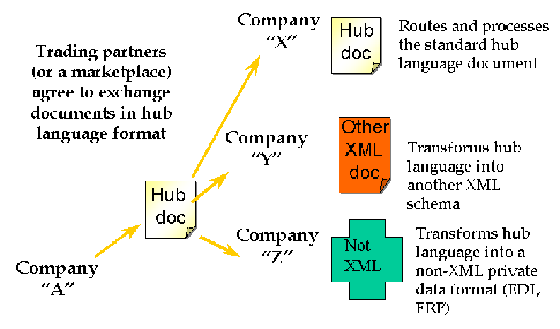
Interchange / Hub Languages
44

Slide 45
Mapping in and out of Hub Language
If all parties/applications/services rely on a hub language for their external interfaces, an exponential interoperability challenge becomes a linear one
Mapping tools for transforming instances from an internal information model to another one are ubiquitous as standalone tools and as parts of application servers
EXAMPLE: Altova MapForce
45

Slide 46
Using Standards in Organizing Systems
You may be required by the government, by your customers, or by "business partners" to conform to some organizing standards
But to the extent that standards embody best practices, it is a good idea to follow them anyway
46

Slide 47
Standards for Document Description in Organizing Systems (1)
For specific vocabularies or "domain-specific languages" (e.g., HTML, UBL, SPL, DocBook, DITA, EPUB, SVG)
For schema languages that formally define the domain-specific languages (e.g., XSD)
For "profiles" that suggest modeling practices like degree of abstraction and granularity, or constrain the possible values for some descriptor
For the metalanguages used to encode the DSLs and schema languages (e.g., XML, SGML)
47

Slide 48
Standards for Document Description in Organizing Systems (2)
For the construction of file and document names
For identifying resources and namespaces
For specifying versions, stages or revisions of documents or other resources
48

Slide 49
Other Standards for Organizing Systems
Metadata standards (MARC, Dublin Core, EAD, METS, RDF, OWL)
Standards for classification (LoC, DD, BISAC)
Standards for thesaurus construction
Standards for processes (WS-*)
Standards for communication protocols
49

Slide 50
Readings for Next Lecture
TDO Sections 7.3-7.6
Nonprofit book publisher (11.19)
Norman, D. A. (2006). Logic versus usage: the case for activity-centered design. Interactions, 13(6), 45-ff.
Hearst, Marti. Search User Interfaces, 2009. Section 8.6 "Faceted Navigation"
50

Slide 51
TODAY’S MOST IMPORTANT SLIDES
51

Slide 52
Distinguishing Categorization and Classification
Categories are EQUIVALENCE CLASSES - sets of resources, processes, and events that we treat the same
A Classification (noun) (or Classification Scheme) is a SYSTEM OF CATEGORIES, ordered according to a PRE-DETERMINED SET OF PRINCIPLES and used to organize a collection of resources
Classification (verb) is the process of systematically assigning resources to intentional (often institutional) categories in a classification system
52

Slide 53
Classification Is Purposeful
Classifications arrange resources to provide structure for and increase the precision of interactions in organizing systems by human or computational agents
Classifications are essential in useful work
They serve as a reference model (a semantic road map) to individual domains and the relationships among them to help people understand and communicate the concepts and relationships
53

Slide 54
“Principled” Does Not Imply “Good” or “the Only Way”
Many of the choices can be arbitrary and others may involve tradeoffs that depend on:
the nature of the resources and the complexity of the resource domain
the purposes of the classification
the amount of effort available
the capabilities of the people doing the classification and of the people using it
(flashback to TDO 6.4, “Category Design Issues and Implications” and to TDO 10.3, “Defining and Scoping”)
54

Slide 55
Principles Embodied in the Classification Scheme
Warrant: What is the justification for the choice of categories and their names?
Literary Warrant: Classify only the resources we have?
Scientific Warrant: Use expert categories and names
Use Warrant: Use categories and names from “ordinary” people
Breadth and depth of classification hierarchy
Degree of enumerativeness (synonym for “granularity”)
55

Slide 56
"Principled" Maybe ... But Every Classification is "Biased"
Every classification is arbitrary to some extent because the criteria used to establish the categories reflect a point of view or perspective on the domain that intentionally excludes all other perspectives
There is no "one true way" about how things go together
Every classification system implicitly or explicitly distinguishes between "good" or "standard" and "bad" or "nonstandard" ways of understanding things
Borges: “there is no classification of the Universe that is not arbitrary and full of conjectures”
56

Slide 57
Classification and Standardization (1)
Classifications and standards both impose order on resources
They both distinguish, explicitly or implicitly, between standard / appropriate / effective and nonstandard / inappropriate / ineffective ways of creating organizing, and using resources
But this does not imply that a standard is a good one or that the best one will win a "standards war“
STOP AND THINK: Examples of standards wars?
57

Slide 58
Classification and Standardization (2)
Some classifications become standards
Every successful standard imposes a classification system
Standards and classification systems can have significant inertia, becoming part of the "installed base" or "infrastructure" and difficult to change
58

Slide 59
Standards and Network Effects
Standards are especially important in industries or domains that have significant "network effects" where the value of a product or service depends on the number of interoperable or compatible ones
These contexts are sometimes called "winner take all" markets, which is why standards wars take place - because of the economic implications
How do you encourage and enable others to conform to a standard?
59

