Slide 1
Plan for Today’s Lecture(s)
Interoperability
MITRE Reference Model for Understanding and Comparing Standards
Bibliographic Classification
Faceted Classification
“Taskonomic” or Activity-based Classification
1

Slide 2
INFO 202 “Information Organization & Retrieval” Fall 2015
UNIVERSITY OF CALIFORNIA, BERKELEY
SCHOOL OF INFORMATION
Robert J. Glushko glushko@berkeley.edu
@rjglushko
4 November 2015 Lecture 19.4 – Interoperability

Slide 3
Interoperability
"Common design" or "interoperability" aren't always clearly defined, but what they mean in practice is that two different companies or vendors could each implement specifications or follow the “same” procedures and produce equivalent results
Interoperability isn’t “all or none” because good specifications and standards often leave some implementation choices
3

Slide 4
Interoperability – Not All or None

Slide 5
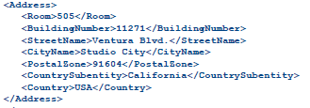
Example: Model of a Purchase Order
EXPECTED ADDRESS

Slide 6
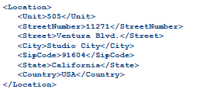
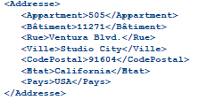
Conceptual Agreement, Implementation Disagreement: Easy to Make Interoperable

Slide 7
<Address>
<Latitude direction=“N”>37.871</Latitude>
<Longitude direction=“W”>-122.271</Longitude>
</Address>

Slide 8
INFO 202 “Information Organization & Retrieval” Fall 2015
UNIVERSITY OF CALIFORNIA, BERKELEY
SCHOOL OF INFORMATION
Robert J. Glushko glushko@berkeley.edu
@rjglushko
4 November 2015 Lecture 19.5 – MITRE Reference Model for Understanding and Comparing Standards

Slide 9
MITRE Reference Model for Understanding and Comparing Standards
"We need to proactively produce new areas of useful semantic agreement, and not simply document correspondences among existing systems"
"An approach to semantics management must tolerate organizational realities that are often ignored“
Rosenthal, A., Seligman, L., and Renner, S. 2004. From semantic integration to semantics management: case studies and a way forward. SIGMOD Rec. 33, 4 (Dec. 2004), 44-50
9

Slide 10
Lessons From Standards Making: The "Person-Concept" Tradeoff
Semantic agreement comes at a cost driven by the number of people who require a shared understanding, and by the number of concepts they must all understand
So a small set of people can agree on a complex standard, or a large set of people can agree on a simple one
…especially when participants are just trying to agree on how to describe pre-existing shared concepts rather than having to define them first
10

Slide 11
Lessons from Standards Making: Incentives and Disincentives
Approaches that require perfect coordination and altruism are of no practical interest
Disincentives to agree on semantics arise if agreement means that someone has to change an implementation and pay the cost of doing so
Model-driven development tools that generate needed software artifacts (e.g., system and user interfaces) from specifications can encourage standards adoption by reducing the transition costs
11

Slide 12
MITRE Reference Model for Comparing Standards: Data Objects
What is the semantic granularity of the concepts being standardized?
Is there also a standard for how the concepts are encoded in some syntactic or physical representation?
Does the standard also specify "instance sets" or possible values for each data element concept?
12

Slide 13
MITRE Reference Model for Comparing Standards: Structures
In addition to standards for data objects, are there standards for schemas or "document architectures" that structurally organize them?
Are there standards for the instances or interchange formats used by publishers/producers or expected by subscribers/consumers?
13

Slide 14
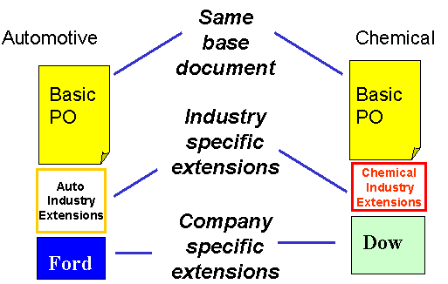
Horizontal and Vertical Document Components
14

Slide 15
MITRE Reference Model for Comparing Standards: Community Characteristics
Is there a primary stakeholder with decision making authority, or is authority distributed?
What are participants' obligations to support the standard?
Do the participants already share an understand of the domain to be standardized?
15

Slide 16
Lessons from Standards Making: Enterprise Data Standards
Standards-making can be successful when a "single authority exercises effective control over the system requirements, funding, the developers, and the users"
But a very large enterprise cannot hope to construct a single data model (or even a single-set of universally understood concept definitions) for all the data it requires
16

Slide 17
Lessons from Standards Making: "Communities of Interest"
Standards making is best organized around naturally formed communities of interest rather than "org chart" organizations
Different types of communities might be needed to develop, deploy, and maintain a standard
17

Slide 18
INFO 202 “Information Organization & Retrieval” Fall 2015
UNIVERSITY OF CALIFORNIA, BERKELEY
SCHOOL OF INFORMATION
Robert J. Glushko glushko@berkeley.edu
@rjglushko
4 November 2015 Lecture 20.1 – Bibliographic Classification

Slide 19
Bibliographic Classification
Much of our thinking about classification systems comes from the bibliographic domain, which is distinctive because of:
Scale, complexity, and degree of standardization
Standards and rules for classification
Legacy of physical arrangement, user access, circulation
19

Slide 20
Dewey Decimal Classification
Started in 1876, the DDC is the most widely used classification system in the world, especially in public libraries
Easy to use to locate resources in libraries because of its numerical notation
The DDC is proprietary and must be licensed from OCLC in Dublin OH
20

Slide 21
Dewey Decimal Classification
The DDC is divided into ten main classes, which together cover the entire world of knowledge. Each main class is further divided into ten divisions, and each division into ten sections
Melvil Dewey wanted to develop a universal classification, but it was done in the context of the library of Amherst College, which introduced significant bias because of the contents of its collection and school’s religious orientation at the time
21

Slide 22
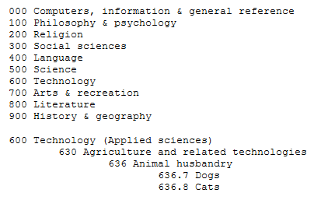
Dewey Decimal Classification
22

Slide 23
DDC on Literature
800 – Literature
• 800 Literature, rhetoric & criticism • 810 American literature in English
• 820 English & Old English literatures
• 830 German & related literatures • 840 Literatures of Romance languages
• 850 Italian, Romanian, Rhaeto-Romanic
• 860 Spanish & Portuguese literatures
• 870 Italic literatures; Latin literature
• 880 Hellenic literatures; Classical Greek
890 Literatures of other languages
o 891 East Indo-European & Celtic
o 892 Afro-Asiatic literatures Semitic
o 893 Non-Semitic Afro-Asiatic literatures
o 894 Ural–Altaic, Paleosiberian, Dravidian
o 895 Literatures of East & Southeast Asia
o 897 North American native literatures
o 898 South American native literatures
o 899 Other literatures

Slide 24
Library of Congress Classification
The US Library of Congress was established in 1800 with a very practical focus, with no intent to devise an organizing scheme that could be used elsewhere
It got off to a bad start when the British burned it down (along with the White House) during the “War of 1812” in 1814
The library was restarted with Thomas Jefferson’s personal library, which broadened its scope, influenced the subsequent LCC scheme
24

Slide 25
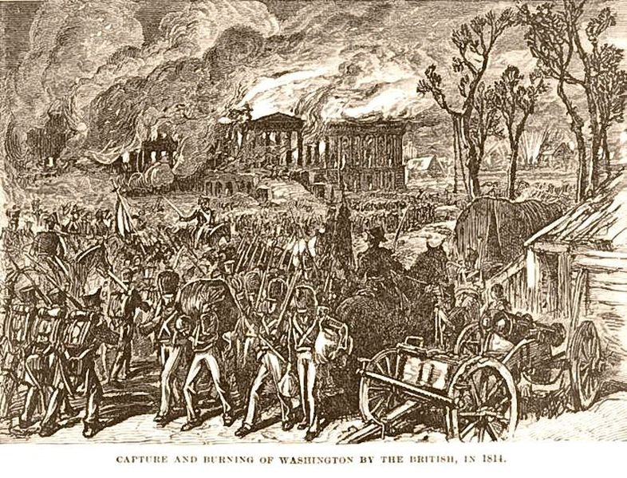
British Burn the White House (1814)
25

Slide 26
An Important Distinction
The LCC is not the same as the LCSH, the controlled vocabulary for subject description
The LCSH is used to describe individual resources
The LCC positions them in a collection
These two activities are distinguished in LIS education and practice
In non-library organizing contexts, describing resources and organizing them are much more intertwined activities
26

Slide 27
Library of Congress Classification
The LCC has 21 top level categories, identified by (arbitrary?) letters instead of numbers like the DCC
Each top level category is further divided, and then once again… a very deep system that makes it practical but not theoretically grounded
The LCC is biased toward the US and toward the needs of a national government, and definitely shows its age
27

Slide 28
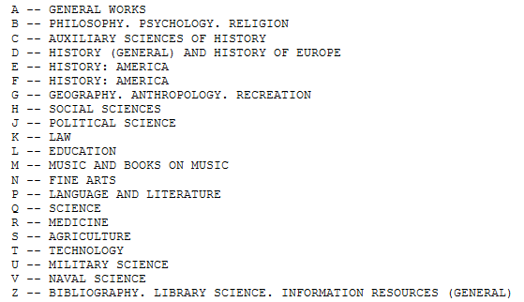
Library of Congress Classification
28

Slide 29
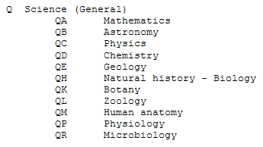
Where’s Computer Science?
29

Slide 30
BISAC
The Book Industry Standards Advisory Committee Classification (BISAC) differs substantially in intent and design from the DDC and LCC schemes
BISAC is developed by the Book Industry Study Group, an organization with a business efficiency focus (logistics, marketing)
BISAC is used by publishers to suggest how a book should be classified in physical and online bookstores, so its categories are biased toward common language usage and popular culture
30

Slide 31
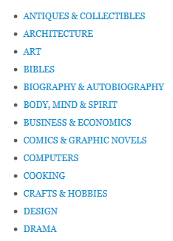
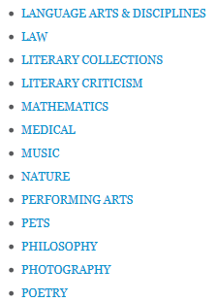
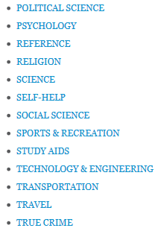
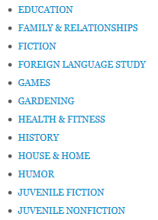
Top Level BISAC Categories
31

Slide 32
The New Press (Emily Paul 2014 Case Study, TDO 11.19)
Custom classification to communicate the narrow coverage of a niche publisher
Category names use words that frame the concept from a clear point of view that expresses the values and politics of the publisher
32

Slide 33
INFO 202 “Information Organization & Retrieval” Fall 2015
UNIVERSITY OF CALIFORNIA, BERKELEY
SCHOOL OF INFORMATION
Robert J. Glushko glushko@berkeley.edu
@rjglushko
4 November 2015 Lecture 20.2 – Faceted Classification

Slide 34
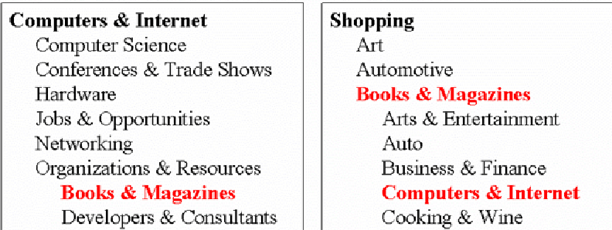
The Need For Multiple Classifications
34

Slide 35
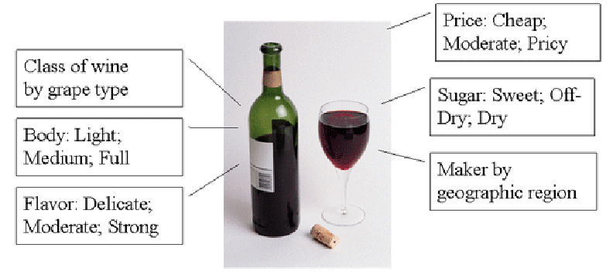
Wine Classifications
35

Slide 36
Faceted Classification
FACETS are an alternative to hierarchical classification that overcome many of its limitations
Instead of creating a deep category hierarchy, facets create multi-dimensional categories that are defined (or generated) through grammatical composition (or combination) from the (characteristics or dimensions or relations) in the domain
Facets divide a domain or subject into "homogeneous" or "semantically cohesive" categories of manageable size
36

Slide 37
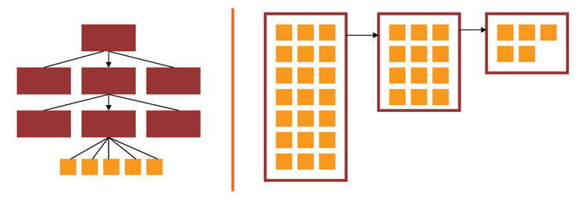
Facets and User Interfaces
Sequential category selection, results only at leaf nodes
Each selection yields results, subsequent selections refine the results set
37

Slide 38
Facets as a Controlled Vocabulary
The relationships between the facets enable a small CONTROLLED VOCABULARY to generate:
Many structured descriptions
That are complex, but formally structured
That enable us to describe things we don't have words for
38

Slide 39
Some Live Examples
Epicurious
Hearst Museum
(important ISchool connection…)
39

Slide 40
Father of Faceted Classification - Condorcet
40

Slide 41
Marti Hearst and Faceted UIs
Professor Marti Hearst did much of the fundamental research on faceted user interfaces for search and navigation in large resource collections
Section 8.6 of “Search User Interfaces”
"Faceted metadata for image search and browsing." In Proceedings of the SIGCHI conference on Human factors in computing systems, pp. 401-408. ACM, 2003.
41

Slide 42
Facets in the Library of Congress Subject Headings
LCSH uses facets for Topic, Place, Time, and Form (but they can be ordered in a variety of ways)
(Topic Main Heading - Place - Topic - Time - Form)
Art criticism - France - Paris - History - Nineteenth Century - Bibliography
(Topic Main Heading - Topic - Place - Time - Form)
Art - Censorship - Europe - Twentieth Century - Exhibitions
42

Slide 43
Designing a Faceted Classification (TDO 7.4.4)
Collect examples that need to be classified
Identify candidates for facets and subfacets by analyzing the examples
Order foci within facets
Determine grammar for ordering and combining facets and subfacets
Create new facets and subfacets where needed
Test classification scheme on new examples
Iterate and refine throughout
43

Slide 44
Types of Facets
Enumerative -- a set of mutually exclusive possible values
Boolean -- yes or no on some dimension
Hierarchical or taxonomic -- organize the instances by logical containment
Spectrum -- numerical attributes on some range, with min and max
44

Slide 45
Choosing Facets
ORTHOGONALITY - facets are independent dimensions
SEMANTIC BALANCE - top level facets are the most important semantic dimensions of the domain; values within facets are at equal semantic level
COVERAGE - all current instances can be classified
SCALABILITY - future instances can be classified
OBJECTIVITY - instances can be objectively classified; might also be called CONCRETENESS
NOT IDIOSYNCRATIC - facet semantics should be "mainstream" or "normative" and not rely on clever, fanciful or metaphoric interpretation
45

Slide 46
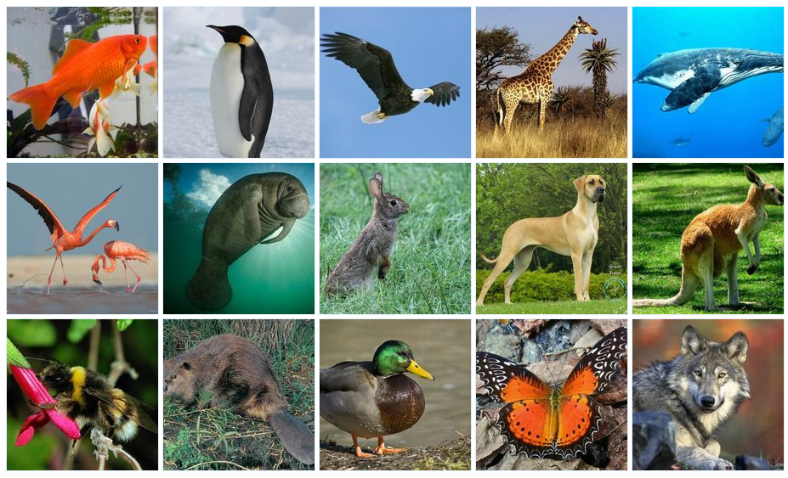
Organizing the Animals
46

Slide 47
INFO 202 “Information Organization & Retrieval” Fall 2015
UNIVERSITY OF CALIFORNIA, BERKELEY
SCHOOL OF INFORMATION
Robert J. Glushko glushko@berkeley.edu
@rjglushko
4 November 2015 Lecture 20.3 – Taskonomic Classification

Slide 48
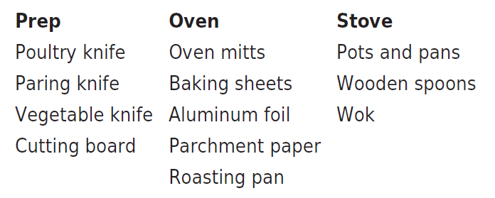
Taskonomy
In contrast to "taxonomy" - an approach to organization based on similarity of content or characteristics - a "taskonomy" organizes on the basis of purpose or "activity structure“
A COOK’S TASKONOMY (Figure 7.1 in TDO)
FLASHBACK TO mise-en-place, or, literally, "put in place” --“time is precious. Resources are precious. Space is precious. Your self-respect and the respect of others are precious”
48

Slide 49
“Distributed Cognition”
"Distributed cognition" is a "dialect" of cognitive science that views cognitive activity as not just something that takes place within the mind of a single person a some moment in time; it is:
Distributed across the members of a social or goal-oriented group
Distributed and coordinated between people and the technology and artifacts they create and use
Hollan, Hutchins, & Kirsh, "Distributed Cognition: Toward a New Foundation for Human-Computer Interaction Research," ACM TOCHI, 2000
49

Slide 50
“The Intelligent Use of Space”
"Whether we are aware of it or not, we are constantly organizing and reorganizing our workplace to enhance performance"
"The physics of the world is such that at times the histories of use are perceptually available to us in ways that support the tasks we are doing"
"When space is used well, it reduces the time and memory demands of our tasks... to simplify choice, to simplify perception, and simplify internal computation”
Kirsh, David. "The intelligent use of space." Artificial intelligence 73, no. 1 (1995): 31-68.
50

Slide 51
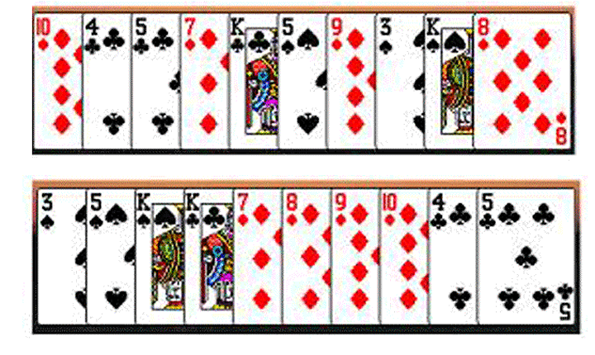
Task-Based Card Sorting
“When space is used well, it reduces the time and memory demands of our tasks... to simplify choice, to simplify perception, and simplify internal computation“ –
David Kirsh on “Cognitive Overload”
51

Slide 52
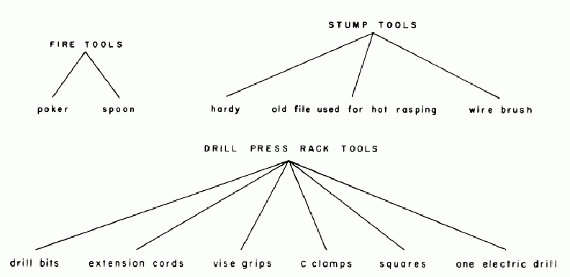
The Blacksmith’s Taxonomy
Janet W. D. Dougherty and Charles M. Keller, "Taskonomy: A Practical Approach to Knowledge Structures," American Ethnologist, Vol. 9, No. 4, Symbolism and Cognition II (Nov., 1982), pp. 763-774
52

Slide 53
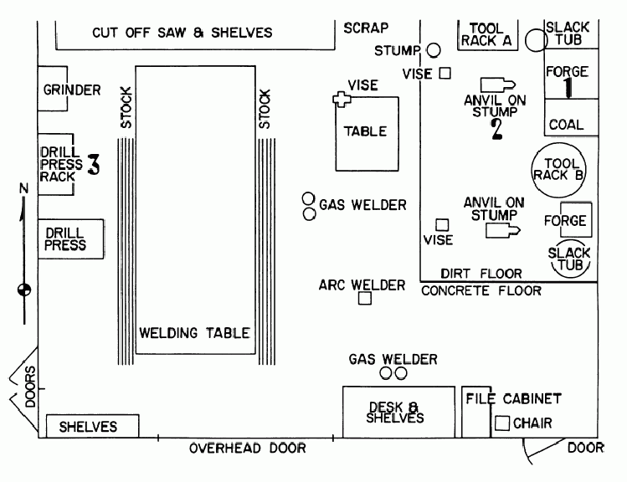
The Blacksmith’s Use of Space
53

Slide 54
Readings for Next Lecture
Taming Text-
Chapter 1, "Getting started taming text" (p 1-16)
Chapter 2, "Foundations of taming text", (p 16-33)
Chapter 3, "Searching" (p 46-49)
54

Slide 55
TODAY’S MOST IMPORTANT SLIDES
55

Slide 56
Interoperability – Not All or None

Slide 57
Lessons From Standards Making: The "Person-Concept" Tradeoff
Semantic agreement comes at a cost driven by the number of people who require a shared understanding, and by the number of concepts they must all understand
So a small set of people can agree on a complex standard, or a large set of people can agree on a simple one
…especially when participants are just trying to agree on how to describe pre-existing shared concepts rather than having to define them first
57

Slide 58
MITRE Reference Model for Comparing Standards: Community Characteristics
Is there a primary stakeholder with decision making authority, or is authority distributed?
What are participants' obligations to support the standard?
Do the participants already share an understand of the domain to be standardized?
58

Slide 59
Bibliographic Classification
Much of our thinking about classification systems comes from the bibliographic domain, which is distinctive because of:
Scale, complexity, and degree of standardization
Standards and rules for classification
Legacy of physical arrangement, user access, circulation
59

Slide 60
Faceted Classification
FACETS are an alternative to hierarchical classification that overcome many of its limitations
Instead of creating a deep category hierarchy, facets create multi-dimensional categories that are defined (or generated) through grammatical composition (or combination) from the (characteristics or dimensions or relations) in the domain
Facets divide a domain or subject into "homogeneous" or "semantically cohesive" categories of manageable size
60

Slide 61
Designing a Faceted Classification (TDO 7.4.4)
Collect examples that need to be classified
Identify candidates for facets and subfacets by analyzing the examples
Order foci within facets
Determine grammar for ordering and combining facets and subfacets
Create new facets and subfacets where needed
Test classification scheme on new examples
Iterate and refine throughout
61

Slide 62
Taskonomy
In contrast to "taxonomy" - an approach to organization based on similarity of content or characteristics - a "taskonomy" organizes on the basis of purpose or "activity structure“
A COOK’S TASKONOMY (Figure 7.1 in TDO)
FLASHBACK TO mise-en-place, or, literally, "put in place” --“time is precious. Resources are precious. Space is precious. Your self-respect and the respect of others are precious”
62

