Slide 1
Plan for Today’s Lecture(s)
Text processing
Boolean models of resource description
Term weighting in resource description
Dimensionality reduction / feature extraction in resource description
1
Notes:
In data science and machine learning contexts. What I’m calling “resource description” is

Slide 2
INFO 202 “Information Organization & Retrieval” Fall 2015
UNIVERSITY OF CALIFORNIA, BERKELEY
SCHOOL OF INFORMATION
Robert J. Glushko glushko@berkeley.edu
@rjglushko
9 November 2015 Lecture 21.1 – Text Processing

Slide 3
Text Processing
Computer processes for creating effective resource descriptions
When there are too few
When there are too many
Traditionally taught with a focus on information retrieval
We will broaden the scope to include more data science and machine learning, especially for “computational classification”
3
Notes:
Something I tried to do at the end of TDO 6 and 7 was to motivate how categories can be created and resources assigned to them by computational means, I will discuss that and more in the next lecture (which is next Monday 11/16 because this Wednesday is a national holiday 11/11)

Slide 4
Text Processing - Motivation
Extracting a set of terms for describing the documents in a collection is the foundation for information retrieval
Small collections might be adequately described by traditional bibliographic descriptors based on intrinsic properties (author, title) or with assigned keywords
But these aren’t precise enough to distinguish documents in large collections
The words in the documents can be used as additional descriptions
Text processing “gets the words out”
4

Slide 5
Glossary: Information Retrieval
The “IR model” specifies the representations of queries and documents in the collection being searched
“Text processing” extracts and merges multiple word forms into a single form or “index term”
The set of terms in a search query or document to be matched is compared against the term representation for each document in the collection
5
Notes:
This is a logical story of how it works… I am grossly simplifying the implementation issues

Slide 6
Glossary: Data Science & Machine Learning
The process of choosing a set of properties or attributes of resources is called “Feature Selection”
When multiple candidate properties or attributes are combined into a new feature this is “Feature Engineering” or “Feature Extraction”
Determining how these features are used to classify or predict something is called “Model Construction”
6

Slide 7
Text Processing: Operational Overview
DECODING -- extracting the text to be processed from its stored representation, turning the bits and bytes into characters in some language
FILTERING -- creating a stream of characters by removing formatting or non-semantic markup
TOKENIZATION -- segmenting the character stream into linguistic units
NORMALIZATION -- creating “terms” - equivalence classes from tokens with superficially different character sequences
7
Notes:
More complete version of table 3.1 in Taming Text
We’re going to focus on the ones that are most interesting and where you make decisions

Slide 8
Text Processing: Operational Overview
STEMMING -- removing affixes and suffixes to allow the retrieval of syntactic and morphological variations of query terms
STOPWORD ELIMINATION -- remove words that poorly discriminate between documents
SELECTING INDEX TERMS -- choosing terms (or groups of them) as indexing elements
8

Slide 9
Decoding
The sequence of characters in a stored document might be represented in any number of single- or multi-byte encoding schemes
Determining this encoding can be easy (file extensions, internal or external metadata, MIME types) -- but not always
Text encoding specs are well-documented but "commercial products can easily live or die by the range of encodings they support“
Some formats are hard to decode; XML in UTF-8 is easy
9
Notes:
that's because most people don't realize that every application might have its own optimized file format and so they're not aware of this problem (this is why XML as a human-readable text format is so important)

Slide 10
Sentence Segmentation
Many IR and text processing applications (translation, summarization) require that the documents be broken into their constituent sentences
STOP AND THINK: Define “sentence” so that a computer program can identify them
Punctuation marks like -- . , ! ? " -- can make this easy; but not always
But abbreviations like “Dr.” break the obvious rule, and even more complex rules like "period-space-capital letter" signals a sentence break still makes a lot of mistakes
10
Notes:
A sentence is the longest string between two sentence delimiters
Dr. Glushko, this is too hard.
did you appreciate my example here? It turns out that the period is the tough case because it has both a sentence-ending and an abbreviation-ending function
turns out to do this really well requires a list of common abbreviations and lots of heuristics, like the fact that abbreviated words tend to be short

Slide 11
Tokenization
Another problem that seems trivial -- just use white space, right?
But what about:
abbreviations (Dr. is a word)
hyphens (sometimes part of a word, but sometimes a result of formatting)
case (do we distinguish Bank from bank?)
11

Slide 12
Tokenization Challenges [1]
Character sequences where the tokens include complex alphanumeric structure or punctuation syntax:
glushko@ischool.berkeley.edu
10/26/53
October 26, 1953
55 B.C
B-52
501(c)(3)
128.32.226.140
My PGP key is 324a3df234ch23e
http://people.ischool.berkeley.edu/~glushko/
12
Notes:
search for 501(c)(3) in google, see alternatives suggested because people are obviously a little concerned that the punct gets stripped or lost
What is a rule for treating parentheses as parts of words by following these two rules: if no space to left of left paren, treat it and its matching right paren as part of the word to the left of the left paren. if no space to right of right paren, treat it as part of the word to its right... etc.

Slide 13
Tokenization Challenges [2]
We've seen that treating numbers and number-like-things as indexable tokens is important
Is 1998 the same as 1,998?
Is 103 the same as .103?
How many different numbers might appear in texts? More than the number of word tokens?
Maybe we should only index numbers when they are combined with letters or punctuation
13

Slide 14
Tokenization Challenges [3]
The language that the characters represent needs to be identified during decoding because it influences the order and nature of tokenization
In languages that are written right-to-left like Arabic and Hebrew, left-to-right text can be interspersed, like numbers and dollar amounts
In German compound nouns don't have spaces between the tokens
14
Notes:
How we identify the language is a classification problem we’ll talk about next time

Slide 15
Tokenization in "Non-Segmented" Languages
And these problems in "segmented languages" that use white space and punctuation to delimit words seem trivial compared to problems tokenizing Oriental languages that are "non-segmented"
These languages have ideographic characters that can appear as one-character words but they also can combine to create new words.
15
Notes:
The analogous problem in English would be the word "TOGETHER" -- do we treat it as one word or is three separate words "TO GET HER"

Slide 16
Normalization [1]
Often two character sequences are not exactly the same but you want to treat them as equivalent
Capital and lower-case characters are typically "case-folded" or “downcased” to lower-case
Lets you find matches at beginning of sentences, but watch out for proper names like General Electric, Bush which should not be case-folded
16
Notes:
The GE and Bush cases are named entities and we want to identify them… in the next lecture

Slide 17
Normalization [2]
Apostrophes, hyphens, accents, and diacritics are often removed
anti-discriminatory and antidiscrimatory, cliché and cliche
But in some languages diacritics distinguish words
pena and peña mean different things in Spanish
17
Notes:
Christian Garay?
pain and rock

Slide 18
INFO 202 “Information Organization & Retrieval” Fall 2015
UNIVERSITY OF CALIFORNIA, BERKELEY
SCHOOL OF INFORMATION
Robert J. Glushko glushko@berkeley.edu
@rjglushko
9 November 2015 Lecture 21.2 – Morphological Processing

Slide 19
One Minute Morphology
Whenever we create, combine, or compare resource descriptions we need to pay attention to word forms
MORPHOLOGY is the part of linguistics concerned with the mechanisms by which all natural languages create words and word forms from smaller units
These basic building blocks are called MORPHEMES and can express semantic concepts (when they are called ROOTS, or abstract features like "pastness" or "plural")
Every natural language contains about 10,000 morphemes and because of how they combine to create words, the number of words is an order of magnitude greater
19

Slide 20
Why Do We Care About Morphology?
Morphological analysis of a language is often used in information retrieval and other low-level text processing applications (hyphenation, spelling correction) because solving problems using root forms and rules is more scalable and robust than solving them using word lists
Natural languages are generative, with new words continually being invented,
Many misspellings of common words are obscure low frequency words
20
Notes:
, so if you add adding them to a misspelling list would make it impossible to check spellings for the latter; minute, minuet

Slide 21
Derivation and Inflection
DERIVATION is the mechanism for creating new words, usually of a different part-of-speech category, by adding a BOUND MORPH to a BASE MORPH
build + ing -> building; health + y -> healthy
INFLECTION is the morphological mechanism that changes the form of a word to handle tense, aspect, agreement, etc. It never changes the part-of-speech (grammatical category)
dog, dogs
tengo, tienes, tenemos, tienen
21
Notes:
I have, you have, we have, they have

Slide 22
Stemming
STEMMING is morphological processing to remove prefixes and suffixes to leave the root form of words
Stemming reduces many related words and word forms to a common canonical form
This makes it possible to retrieve documents when they contain the meaning we're looking for even if the form of the search word doesn't exactly match what's in the documents
22

Slide 23
Stemming
In English, inflectional morphology is relatively easy to handle (derivational is hard)
So "dumb" stemmers (e.g., iteratively remove suffixes, matching longest sequence in rewrite rule) perform acceptably
one rule might say if you see an “s” at the end of the word, remove it
another one might say if you see “sses” at the end, change it to “ss” (do this one first)
Stemmers differ in how many affixes they handle
23
Notes:
; one called Lovins has 260, a more popular stemming algorithm is Porter's Algorithm that is much easier to implement because is has only 60 so it makes a lot more mistakes

Slide 24
Stemming Mistakes
OVERSTEMMING results when stemming reduces words that are not morphologically related to the same root
Organization, organ
Policy, police
Arm, army
UNDERSTEMMING results when stemming does not reduce morphologically related words to the same root
acquire, acquiring, acquired -> acquir
acquisition -> acquis
24
Notes:
Stemming affects the recall/precision tradeoff

Slide 25
INFO 202 “Information Organization & Retrieval” Fall 2015
UNIVERSITY OF CALIFORNIA, BERKELEY
SCHOOL OF INFORMATION
Robert J. Glushko glushko@berkeley.edu
@rjglushko
9 November 2015 Lecture 21.3 – Selecting Terms

Slide 26
What Words Best Describe a Document?
Not all words are equally useful indicators of what a document is about; many are irrelevant or redundant
Nouns and noun groups carry more "aboutness" than adjectives, adverbs, and verbs
Very frequent words that occur in all or most documents add NOISE because they cannot discriminate between documents
So it is worthwhile to pre-process the text of documents to select / create a smaller set of terms that better represent them; in IR these are called the INDEX terms
26
Notes:
You can think of this as creating a controlled vocabulary - a more carefully chosen set of words to describe the contents of a document. All the benefits and costs of CVs that you know from earlier in the semester arise in indexing.
I say “select / create” because in most cases we will do some text processing to make small but important changes to the words in the document, so we won’t be using them exactly “as is”

Slide 27
Selecting Index Terms
At this stage in text processing the text collection is represented as a set of stems or phrases
This is a “bag of words” – no sentence structure or languageness remains
But not all of them should be kept; some will retrieve too many, and some too few documents
We can select better index terms if we analyze the frequency distribution of the words in the collection
27
Notes:
And we add additional terms like synonyms – as if they were in the document to begin with - but it is simpler to explain the process of creating an index if we defer that step for a while, and this is often done at query time, not at indexing time
“Negative Features” whose presence can reliably predict or classify because they are negatively correlated are important but in IR we don’t put them in indexes

Slide 28
Stop or Noise Words [1]
Any word that doesn't convey meaning by itself can't help us "find out about" anything and would never help in a query so it can be discarded
In English these STOP or NOISE words include:
determiners, such as "the" and "a(n)"
auxiliaries, such as "might," "have," and "be"
conjunctions, such as "and," "that," and "whether"
degree adverbs, such as "very" and "too"
28

Slide 29
Stop or Noise Words [2]
The 10 most frequent words in English can account for 20% of the words in a document; you've never noticed that because they are everywhere
These words are always among the most frequent in a collection
So stop or noise words are usually not determined by frequency analysis – they are used as a kind of negative dictionary; it a word in in this dictionary it gets discarded
29

Slide 30
But Stop Words are Needed for Phrases
A phrase is a group of words that needs to be treated as a unit because the meaning of its constituent words can't be combined into the meaning of the phrase
"birth control" is not "birth" + "control"
"venetian blinds" are not disabled Italians
"united states" ...
Phrases can be identified "by hand," using grammatical analysis, and by a "try everything" or “collocation extraction” automated approach that finds phrases that occur with non-negligible frequency
30
Notes:
birth control as a phrase means "conception prevention" - "birth" + "control" is abortion

Slide 31
Reminder: Boolean IR Model
The simplest IR model to implement is the Boolean one because it has a very direct correspondence to the text processing story we just told
Boolean queries are expressed as Terms + Operators
Terms are words or stemmed words
Operators are AND, OR, NOT
31

Slide 32
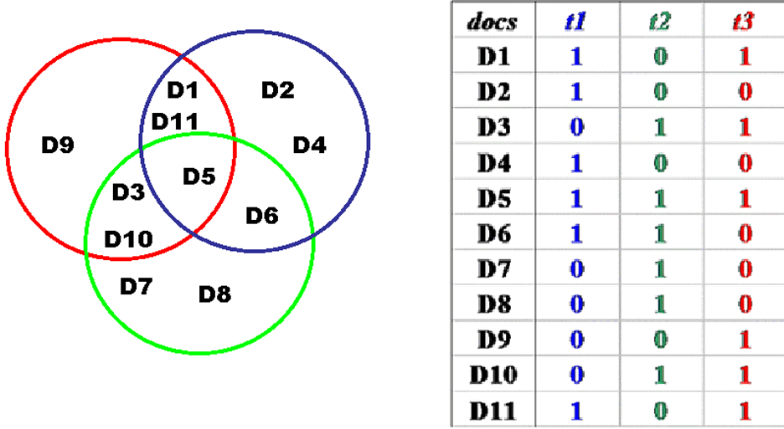
Example of Boolean Representation
32

Slide 33
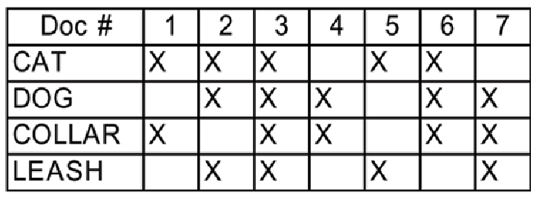
Boolean Representation of a Document Collection
(Cat AND Dog) OR Collar
(Cat AND Dog) OR (Collar AND Leash)
(Cat OR Dog) AND (Collar OR Leash)
Cat
Cat OR Dog
Cat AND Dog

Slide 34
INFO 202 “Information Organization & Retrieval” Fall 2015
UNIVERSITY OF CALIFORNIA, BERKELEY
SCHOOL OF INFORMATION
Robert J. Glushko glushko@berkeley.edu
@rjglushko
9 November 2015 Lecture 21.3 – Term Selection and Weighting

Slide 35
The Zipf Distribution
In any natural language, we can observe that:
A few items occur very frequently
A medium number of items have medium frequency
Very many items occur very infrequently (the “long tail”)
35

Slide 36
The Zipf Distribution
An approximate model of this distribution is the Zipf Distribution, which says that the frequency of the i-th most frequent word is 1/(i^a) times that of the most frequent word
Because of the huge range in frequency and the long tail, the distribution is often drawn on a log-log scale
36

Slide 37
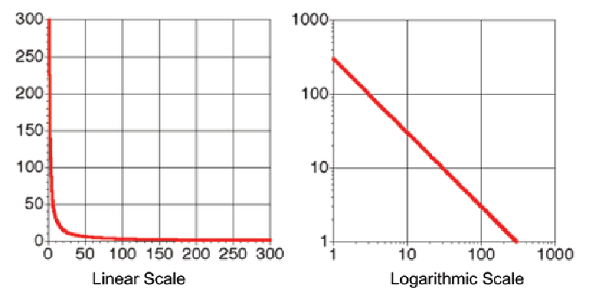
Zipf Distribution – Linear vs. Log Plotting
37

Slide 38
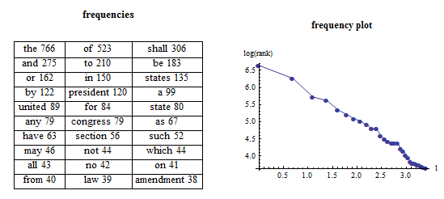
Zipf Distribution – US Constitution
The shape looks the same for almost every document type
38

Slide 39
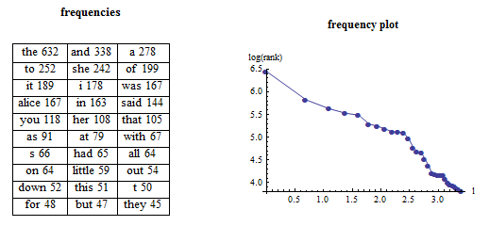
Zipf Distribution – Alice in Wonderland
39

Slide 40
Resolving Power
The term distribution lets us distinguish terms on the basis of how well they discriminate between the documents in the collection.
The value of a term varies inversely with the number of documents in which it occurs
The most informative words are those that occur infrequently but when they occur they occur in clusters
40

Slide 41
Resolving Power and Term Weighting
Terms that appear in every document have no resolving power because including them retrieves every document
Terms that appear very infrequently have great resolving power, but don’t turn out to be very useful because they so rare that most people will never use them in queries, or they won’t be in documents that need to be classified
So the most useful terms are those that are of intermediate frequency but which tend to occur in clusters, so most of their occurrences are in a small number of documents in the collection
41

Slide 42
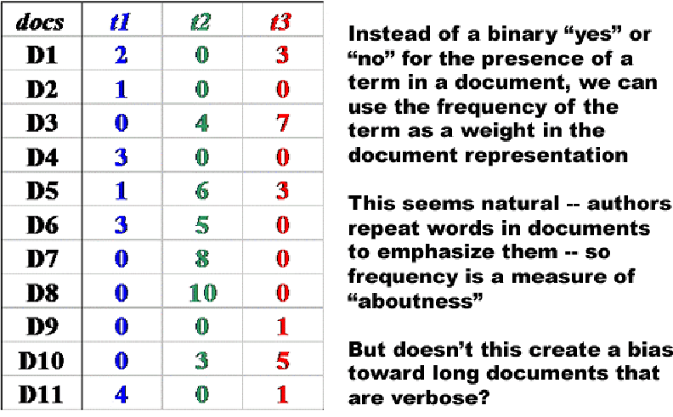
Weighting Using Term Frequency
42

Slide 43
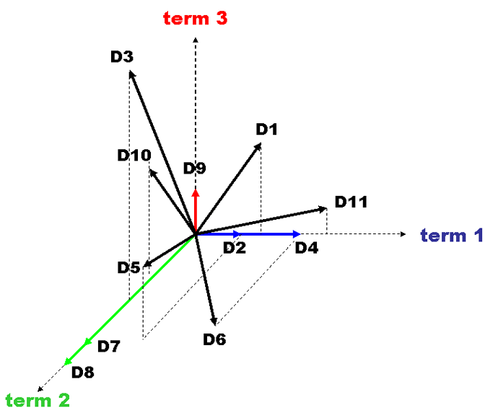
Term Frequency Weighted Vectors
43

Slide 44
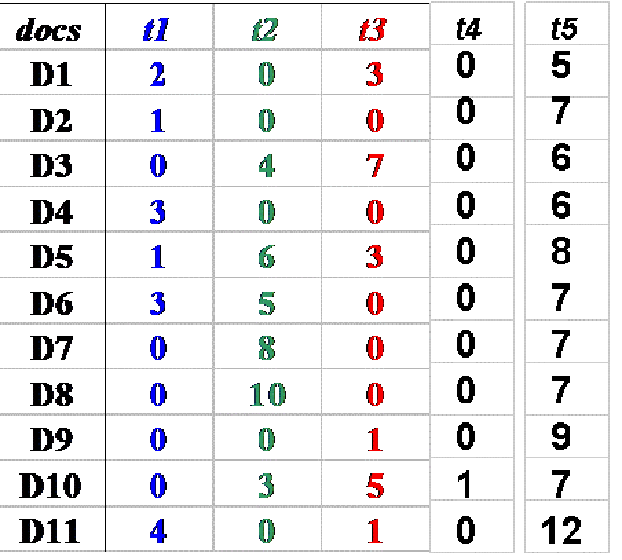
Term Resolving Power
44
Notes:
I drew this in 3 dimensions, but the document had 5 different words in it… I can’t draw in 5 dimensions, but fortunately t4 and t5 I could safely drop because they are too rare or too common to discriminate documents

Slide 45
Inverse Document Frequency
We need a way to penalize the words that are too frequent so they don't get in the way of the terms that have greater resolving power
We will replace the actual term frequency in the vector with one that we calculate using some weighting function
“Inverse document frequency” is the weighting function that “penalizes” the too frequent words
45

Slide 46
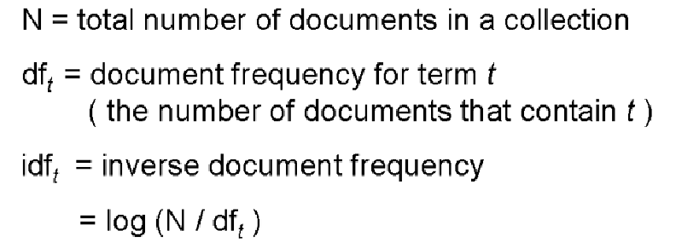
Inverse Document Frequency
46

Slide 47
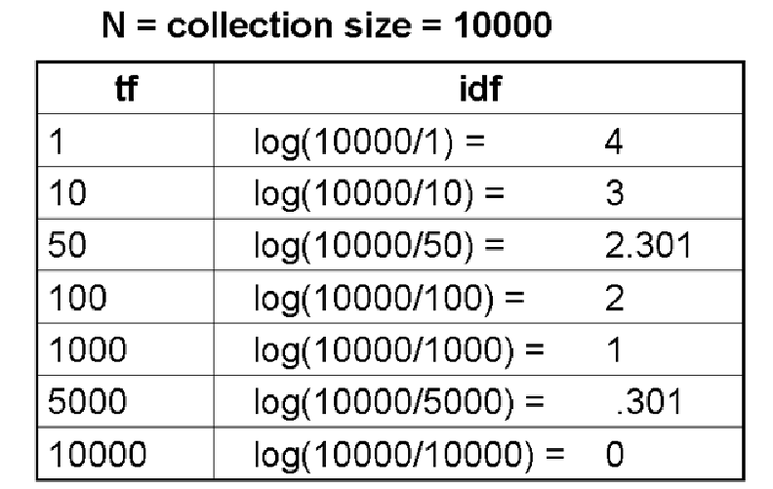
IDF Examples
47

Slide 48
Rationale for TF x IDF
The IDF calculation gives us a measure of how important the term overall is in the collection
But we need to do another calculation to get at the "clustering" intuition that the terms that do the best job finding relevant documents are those that occur in clumps to indicate the aboutness of a document
So we will multiply IDF by TF (i.e. the count) within each document to compute the term weights
48

Slide 49
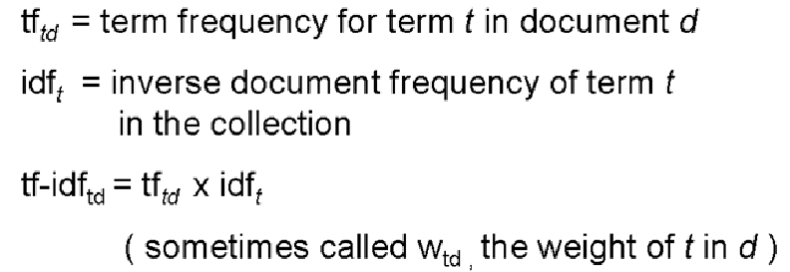
Calculating Term Weights
49

Slide 50
Calculated Term Weights for TF x IDF
Term weights are highest for terms that occur many times within a small number of documents (high IDF)
They are lower when the term occurs fewer times in a document (low TF), or occurs in many documents (low IDF)
They are lowest when the term occurs in virtually all documents (almost 0 IDF)
50

Slide 51
INFO 202 “Information Organization & Retrieval” Fall 2015
UNIVERSITY OF CALIFORNIA, BERKELEY
SCHOOL OF INFORMATION
Robert J. Glushko glushko@berkeley.edu
@rjglushko
9 November 2015 Lecture 21.4 – Limitations of Term Weighting Models

Slide 52
Limitations of Term Weighting Models
The calculations used by simple vector models are about the frequency of words and word forms (e.g., stemmed) in texts
This means that they are measuring the "surface" usage of words as patterns of letters
Polysemy leads to overestimates of similarity
Synonymy leads to underestimates
=> Motivation for dimensionality reduction to transform “terms” into “topics” or composite features
52

Slide 53
Limitations of Term Weighting Models
Synonymy leads to underestimates
Example: you’re trying to measure unemployment trends using Google searches or social media posts
“unemployed”, “lost job”, “laid off”, “looking for a job” all signal unemployment, but each is a separate term
“laid off” is the most highly correlated with unemployment data; “looking for a job” the least
53

Slide 54
Informal Motivation for Dimensionality Reduction
Reducing the number of dimensions in a description to the "principal" ones is a common goal in psychology or marketing to transform a large population of people or customers with complex descriptions for each into a small set of “personality types” or "customer segments"
For example, if you have lots of people answer the questions on a personality test, you want to reduce the "person x question" matrix to a "person x PersonalityDimension" one
54
Notes:
4 personality dimensions in the Myers-briggs framework
Extraversion or Introversion E or I
Sensing or Intuition S or N
Thinking or Feeling T or F
Judging or Perceiving J or P
So there are 16 types of people… that’s all

Slide 55
From Terms to Topics
The dimensionality of the space in the simple vector model is the number of different terms in it
But the "semantic dimensionality" of the space is the number of distinct topics represented in it
The number of topics is much lower than the number of terms
Documents can be similar in the topics they contain even if they have no words in common
55
Notes:
University, college, institution of higher learning, academy

Slide 56
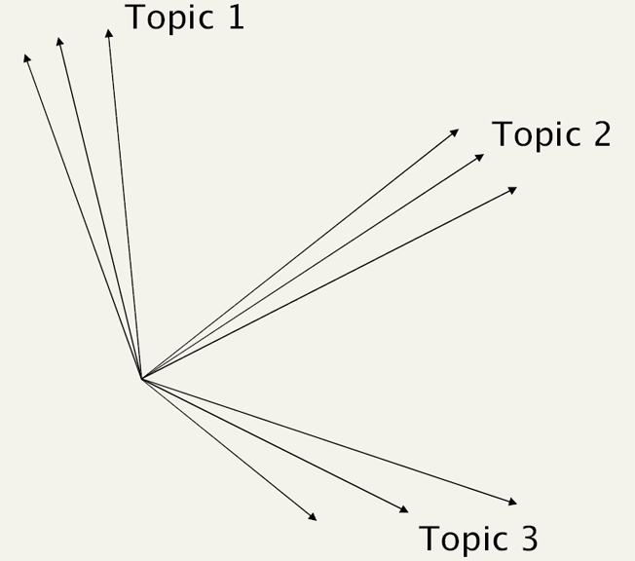
Conceptual View: Sets of Synonymous Terms are Merged into Topics
56

Slide 57
Dimensionality Reduction in “DataScienceSpeak”
Eliminating irrelevant or redundant features by “selection” is one approach to “dimensionality reduction”
But we can often reduce to a much smaller set of features if we combine features that are correlated into new “extracted features”
These features are statistical creations of machine learning algorithms and are not easily interpreted, but for many IR, classification, or prediction tasks this isn’t important
57

Slide 58
Readings for Next Lecture
TDO
Section 6.5, "Implementing Categories"
Section 7.6, "Computational Classification"
Section 9.4, "Implementing Interactions" (9.4, 9.4.1, and 9.4.2)
Taming Text
Chapter 5, "Identifying People, Places, and Things", (p 115-120)
Chapter 6, "Clustering Text" (p 140-148)
Chapter 7, "Classification, Categorization, and Tagging", (p 175-188)
58

Slide 59
TODAY’S MOST IMPORTANT SLIDES
59

Slide 60
Text Processing - Motivation
Extracting a set of terms for describing the documents in a collection is the foundation for information retrieval
Small collections might be adequately described by traditional bibliographic descriptors based on intrinsic properties (author, title) or with assigned keywords
But these aren’t precise enough to distinguish documents in large collections
The words in the documents can be used as additional descriptions
Text processing “gets the words out”
60

Slide 61
Text Processing: Operational Overview
DECODING -- extracting the text to be processed from its stored representation, turning the bits and bytes into characters in some language
FILTERING -- creating a stream of characters by removing formatting or non-semantic markup
TOKENIZATION -- segmenting the character stream into linguistic units
NORMALIZATION -- creating “terms” - equivalence classes from tokens with superficially different character sequences
61
Notes:
More complete version of table 3.1 in Taming Text
We’re going to focus on the ones that are most interesting and where you make decisions

Slide 62
Text Processing: Operational Overview
STEMMING -- removing affixes and suffixes to allow the retrieval of syntactic and morphological variations of query terms
STOPWORD ELIMINATION -- remove words that poorly discriminate between documents
SELECTING INDEX TERMS -- choosing terms (or groups of them) as indexing elements
62

Slide 63
Why Do We Care About Morphology?
Morphological analysis of a language is often used in information retrieval and other low-level text processing applications (hyphenation, spelling correction) because solving problems using root forms and rules is more scalable and robust than solving them using word lists
Natural languages are generative, with new words continually being invented,
Many misspellings of common words are obscure low frequency words
63
Notes:
, so if you add adding them to a misspelling list would make it impossible to check spellings for the latter; minute, minuet

Slide 64
Derivation and Inflection
DERIVATION is the mechanism for creating new words, usually of a different part-of-speech category, by adding a BOUND MORPH to a BASE MORPH
build + ing -> building; health + y -> healthy
INFLECTION is the morphological mechanism that changes the form of a word to handle tense, aspect, agreement, etc. It never changes the part-of-speech (grammatical category)
dog, dogs
tengo, tienes, tenemos, tienen
64
Notes:
I have, you have, we have, they have

Slide 65
Selecting Index Terms
At this stage in text processing the text collection is represented as a set of stems or phrases
This is a “bag of words” – no sentence structure or languageness remains
But not all of them should be kept; some will retrieve too many, and some too few documents
We can select better index terms if we analyze the frequency distribution of the words in the collection
65
Notes:
And we add additional terms like synonyms – as if they were in the document to begin with - but it is simpler to explain the process of creating an index if we defer that step for a while, and this is often done at query time, not at indexing time
“Negative Features” whose presence can reliably predict or classify because they are negatively correlated are important but in IR we don’t put them in indexes

Slide 66
Resolving Power and Term Weighting
Terms that appear in every document have no resolving power because including them retrieves every document
Terms that appear very infrequently have great resolving power, but don’t turn out to be very useful because they so rare that most people will never use them in queries, or they won’t be in documents that need to be classified
So the most useful terms are those that are of intermediate frequency but which tend to occur in clusters, so most of their occurrences are in a small number of documents in the collection
66

Slide 67
Inverse Document Frequency
We need a way to penalize the words that are too frequent so they don't get in the way of the terms that have greater resolving power
We will replace the actual term frequency in the vector with one that we calculate using some weighting function
“Inverse document frequency” is the weighting function that “penalizes” the too frequent words
67

Slide 68
Limitations of Term Weighting Models
The calculations used by simple vector models are about the frequency of words and word forms (e.g., stemmed) in texts
This means that they are measuring the "surface" usage of words as patterns of letters
Polysemy leads to overestimates of similarity
Synonymy leads to underestimates
=> Motivation for dimensionality reduction to transform “terms” into “topics” or composite features
68

