Slide 1
Plan for Today’s Lecture(s)
Introducing NLP
Entity and Relation Extraction
“Robo-Journalism”
Computational Classification
Unsupervised learning
Supervised learning
Some examples
1

Slide 2
INFO 202 “Information Organization & Retrieval” Fall 2015
Robert J. Glushko glushko@berkeley.edu
@rjglushko
16 November 2015 Lecture 22.1 – Introducing Natural Language Processing

Slide 3
Natural Language Processing
NLP has the goal of creating computers and machines that can use natural language as their inputs and outputs
The field is broad, and involves computer science, linguistics, cognitive psychology, statistics
3

Slide 4
Natural Language Processing
Every NLP application needs to identify and classify the words, phrases, structures, documents in some context or domain
The earliest NLP applications were very narrow in scope, relying on “hand crafted” and highly-specific content and language rules to implement the required knowledge and to identify a pre-specified set of entities and relationships (e.g., terrorism events)
But the emergence of the web made it clear that hand-crafting techniques can’t possibly scale to more open-ended environments where identifying the domain is a problem in its own right
4

Slide 5
Natural Language Processing: Scaling Up
Language-based NLP approaches “scale up” by relying on the fact that semantic relationships in sentences and in larger text units like stories follow a small number of patterns
Nevertheless, the statistics of co-occurrence / conditional probability yield many practical techniques for analyzing and generating language that make no use of “languageness” per se
This is where “machine learning” comes into the picture
5

Slide 6
Real World NLP Applications
Information extraction
Summarization
Auto-journalism (story generation)
Machine translation
Speech recognition and synthesis
Question answering, automated customer service, recommendations
Computational classification
Topic identification
Author identification
Spam detection
Sentiment analysis
6

Slide 7
INFO 202 “Information Organization & Retrieval” Fall 2015
Robert J. Glushko glushko@berkeley.edu
@rjglushko
16 November 2015 Lecture 22.2 – Entity and Relation Extraction

Slide 8
Application Areas for IE
Sales intelligence and lead generation (customers)
Market intelligence (competitors, pricing)
Business intelligence (aggregating information)
"Central Intelligence" and Homeland Security

Slide 9
Understanding Information Extraction
What type of information is being extracted?
How (little or much) structure already exists in the source input?
What resources are available to guide the extraction?
What extraction techniques are employed?
What is the format of the extracted information?
(IE typically starts after tokenization, part-of-speech tagging, and phrase identification steps of text processing)

Slide 10
"Named Entity" Recognition
People, organizations, locations, dates, etc. can be identified with high accuracy in most kinds of documents using a combination of dictionaries, directories, gazetteers and rules – many are domain-specific
Named entity recognition is especially essential for machine translation because if multi-word names are missed, translating them word-for-word will cause errors (e.g., Golden Gate Park, Walnut Creek)
Important entities are likely to be mentioned many times in a text, but are often described by different noun phrases each time, requiring co-reference resolution

Slide 11
Entity Types
People—Bill Clinton, Mr. Clinton, President Clinton
Locations—Alabama, Montgomery, Guam
Organizations—Microsoft Corp., Internal Revenue Service, IRS, Congress
Dates—Sept. 3, Saturday, Easter
Times—6 minutes 20 seconds, 4:04 a.m., afternoon
Percentages—10 percent, 45.5 percent, 37.5%
Money—$90,000, $35 billion, one euro, 36 pesos
…
Email addresses
Software names
Phone numbers

Slide 12
Extraction Rules – Regular Expressions
Capitalized-word + “Corp.” → finds company names
“Mr.” capitalized-word+ → finds person names
Capitalized-word+ “,” number-below-100 “,” → finds person names
Mark Zuckerberg, 29, …
STOP AND THINK: How identify a phone number? An email address?
Examples from Grishman, Ralph. "Information extraction." The Handbook of Computational Linguistics and Natural Language Processing (2003): 515-530.

Slide 13
Extraction Rules - Context
“Mark Zuckerberg” and “Mr. Zuckerberg” are probably the same entity if these two phrases occur near each other
But “Golden Gate Park” and “Mr. Park” aren’t …
A word that could be more than one entity type like “Washington” is more likely to be a location in the context “in Washington” and a person in the context “Washington said”
Entity classifiers are trained for a particular domain, or kind of document collection (the “language model”)
If your domain is different from the one the classifier was trained on, not likely to work well

Slide 14
Open NLP (Taming Text 5.2)
OpenNLP is a machine learning based toolkit for the processing of natural language text. It supports the most common NLP tasks, such as tokenization, sentence segmentation, part-of-speech tagging, named entity extraction, chunking, parsing, and coreference resolution. The OpenNLP project has several choices of language models.
https://opennlp.apache.org/documentation/manual/opennlp.html#opennlp
http://opennlp.sourceforge.net/models-1.5/ list of models for Open NLP

Slide 15
Binary Relationship Patterns
Two relationship types account for 60% of them and 8 relationship types account for 95% of them
Etzioni, Oren, et al. "Open information extraction from the web." Communications of the ACM 51.12 (2008): 68-74)

Slide 16
Identifying Hyponyms
Hearst, Marti A. "Automatic acquisition of hyponyms from large text corpora." In Proceedings of the 14th conference on Computational linguistics-Volume 2, pp. 539-545. Association for Computational Linguistics, 1992.

Slide 17
Identifying Hyponyms

Slide 18
Extracting Multi-Way Relationships
Often called "record extraction"
Some N-way extractions are easy because of conventional ordering of the entities in the unstructured input (e.g., creating structured address records)
But the goal of most N-way extractions is to populate schemas involving causal relations and dependencies (e.g., for "events" like disease outbreaks, news about company reorganizations and employee promotions)

Slide 19
Story Templates and Grammars
Some document types have a regular "discourse" or "frame" structure that makes it easier to find information that fills the key relational “slots”
What are the relational slots in a generic sports story? What if the sports are subdivided?
Election story? “Weather event” story?
And by trading off writing style for automation, almost any domain dominated by data sets with known relationships can be explained using auto-generated text

Slide 20
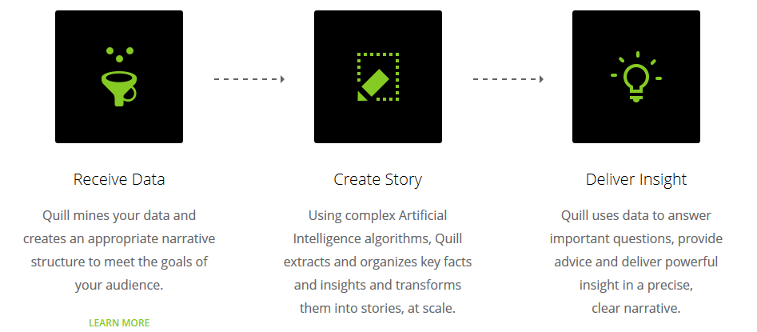
Robo-Journalism
Domains in which the most important information is inherently highly structured can do the inverse of information extraction
Narrative science pioneered this idea to generate sports and finance stories, which follow templates and grammars

Slide 21
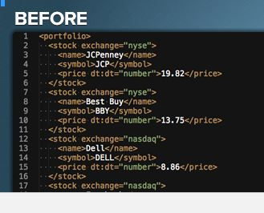
“Automated Insights”
“Our patented artificial intelligence platform sifts through large data sets and identifies key patterns and trends, then describes those insights in plain English with the tone, personality and variability of a human writer”

Slide 22
INFO 202 “Information Organization & Retrieval” Fall 2015
Robert J. Glushko glushko@berkeley.edu
@rjglushko
16 November 2015 Lecture 22.3 – Computational Classification

Slide 23
FLASHBACK: Distinguishing Categorization and Classification
Categories are EQUIVALENCE CLASSES - sets of resources, processes, and events that we treat the same
A Classification (noun) (or Classification Scheme) is a SYSTEM OF CATEGORIES, ordered according to a PRE-DETERMINED SET OF PRINCIPLES and used to organize a collection of resources
Classification (verb) is the process of systematically assigning resources to intentional (often institutional) categories in a classification system
23

Slide 24
Classifiers
A classifier is a system whose input is a vector of discrete or continuous feature (or attribute) values and whose output is the name of the class
This vector might be the description of a document, an image, a person, a molecule, just about anything
Classifiers for text identify its language, topic, author, sentiment, or other characteristics
Recommendation systems identify “matching” resources in different categories
Classifiers can identify categories of people who are likely or not likely to do something (“behavior prediction”)
24

Slide 25
Classifying Classification Tasks
Binary classification – example: spam or not?
Multi-class
1 of M – where does this resource fit into some set of categories
N of M – topic or keyword identification; but we can consider this as multiple binary classifications

Slide 26
Simple Classification Problem: Adult or Child?
Person Height Age Class Bill 6’3” 43 Adult
John 5’7” 29 Adult
Sally 5’6” 32 Adult Pete 41 6’0” ?
Jane 5’5” 51 Adult Robyn 28 5’6” ?
Joe 5’4” 28 Adult Sam 9 4’0” ?
Kelly 4’11” 22 Adult
Tiffany 4’7” 12 Child
Tom 4’6” 10 Child
Kevin 4’5” 8 Child
Mimi 3’0” 5 Child

Slide 27
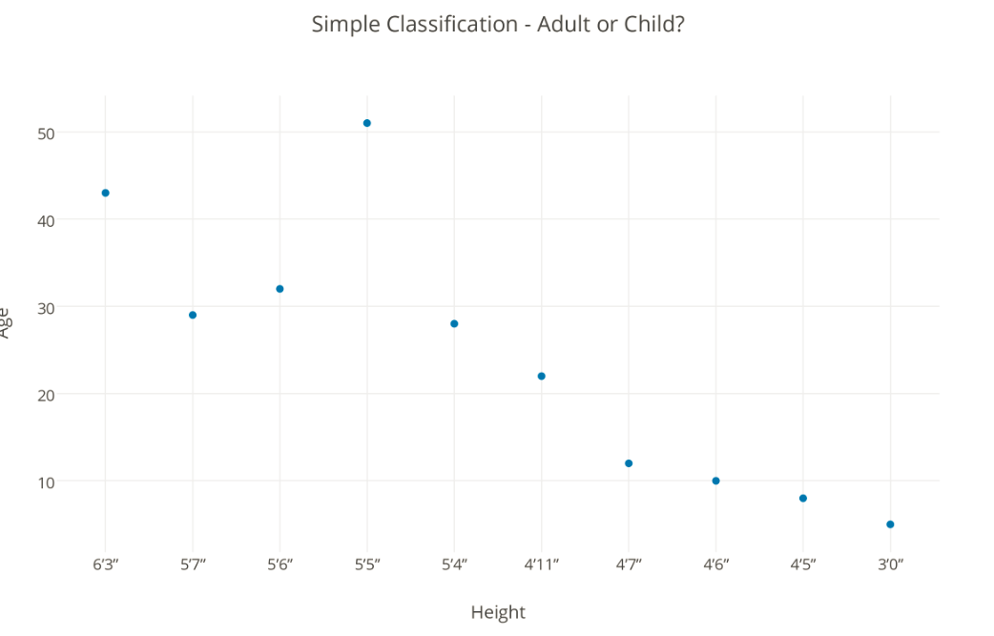
You Don’t Need Labeled Data or Computation to Distinguish the Categories
HEIGHT = 4’10”
PETE
AG
E
ROBYN
AGE = 18
HEIGHT
SAM

Slide 28
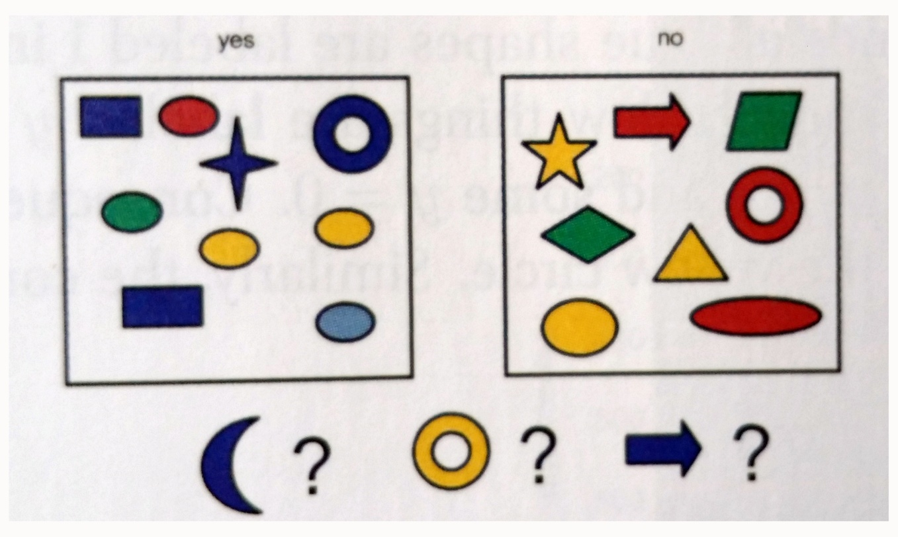
A More Complex Problem
COLOR SHAPE SIZE LABEL
Blue Square 10 1
Red Ellipse 2.4 1
Red Ellipse 20.7 0
…
Murphy. Machine Learning, 2012 (Figure 1.1)

Slide 29
Why Computational Classification?
Some classification tasks are simple because the categories are “far apart” and the resource properties or features involved are easy to understand and use
Sometimes these classification tasks can't be done by people at the needed scale or speed
Some classification tasks are inherently difficult because
they require feature selection or extraction from a large candidate set
the methods by which the classier learns and uses the features are complex

Slide 30
Learners (computer science definition)
A (machine) learner takes a set of pairs of inputs and outputs and devises a mapping between them
If the outputs are “labeled” or categorized already, this is SUPERVISED learning
If the learner has to discover the mapping by detecting the “interesting patterns” in the data, this is UNSUPERVISED learning (also called “statistical pattern recognition”)
Most human learning is unsupervised; even when labels are provided, they rarely cover more than a fraction of the possible examples of the category
“Machine Learning” is a hypernym that includes both supervised and unsupervised approaches

Slide 31
Unsupervised Learning: Clustering
Clustering is an unsupervised learning method to automatically group related content or resources by discovering the correlations between features or properties of the things to be classified (usually via computations that maximize similarity within categories and minimize it between them)
Similarity, in many clustering algorithms, is implemented as a measure of the distance between two documents
Similarity is iteratively recalculated each time an item is added to a cluster
With text resources, clustering can try to assign labels to the groups or create summaries of their members

Slide 32
Clustering Search Results
Search result clustering can be quite effective when users enter generic or ambiguous terms (such as apple) or when the dataset contains a disparate set of categories
Labels take on more significance, since users will likely treat them like facets to make decisions about how to further navigate the result set
Descriptions of the clusters can be generated from the most important terms (determined by some weighting mechanism such as TF-IDF) in documents closest to the center of the cluster

Slide 33
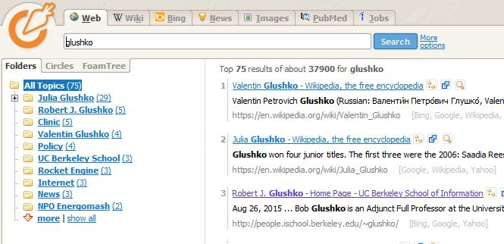
Clustered Search Results (http://carrotsearch.com/ & TT 6.4)

Slide 34
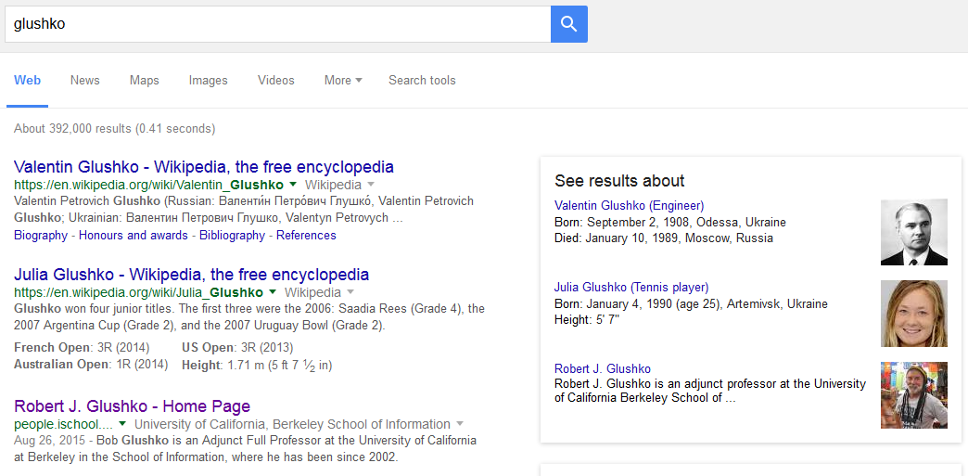
Compare to Categorized Search Results

Slide 35
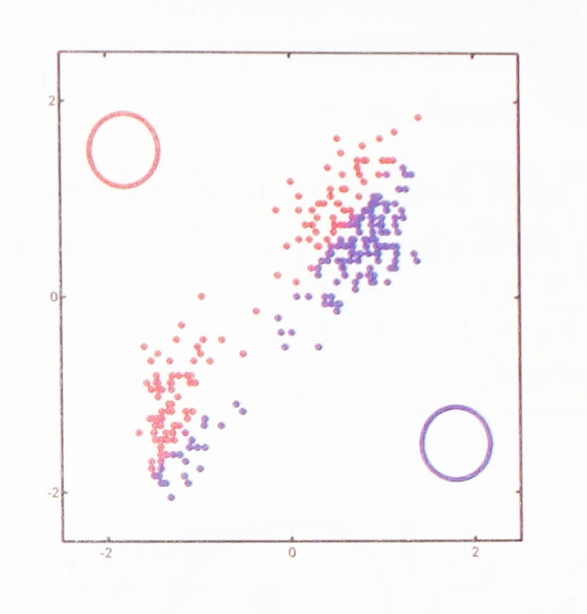
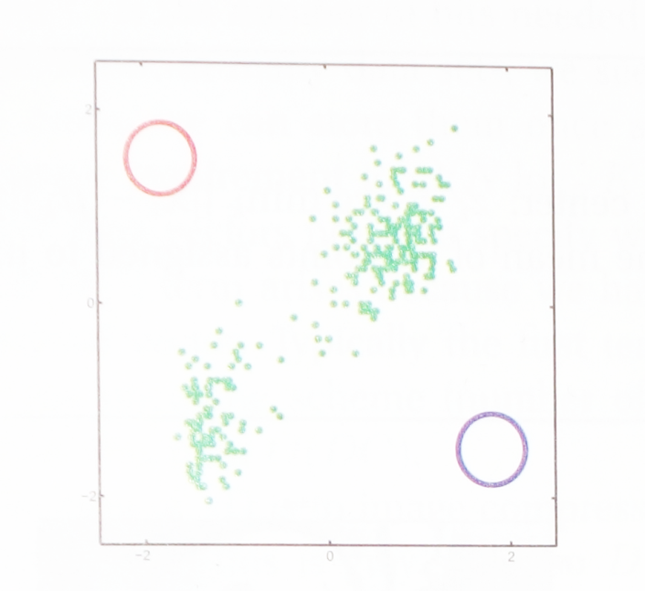
Clustering Example
From Murphy, “Machine Learning”, p 353
2 dimensional dataset
First distance measurement
Red and purple rings are initial random values of “cluster centers”
Distance from each data point calculated to red and purple point; color shows which is closer

Slide 36
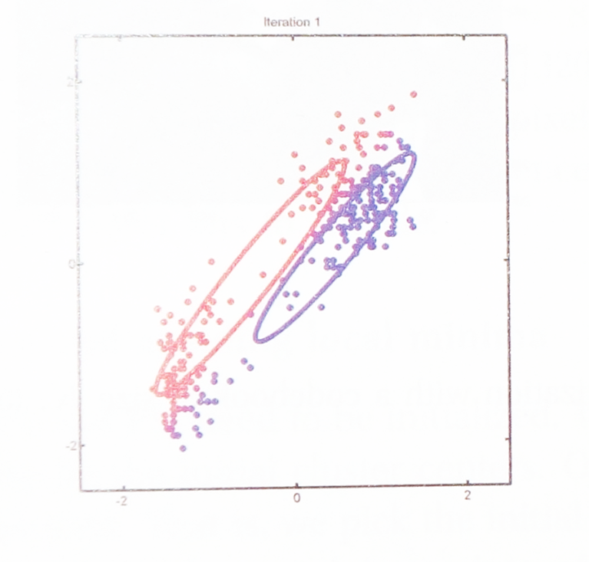
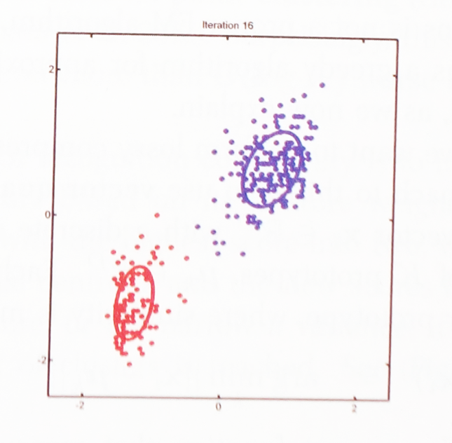
Clustering Example
From Murphy, “Machine Learning”, p 353
First recalculation
After 16 recalculations
Average of points assigned to each color becomes new value of parameter
The parameters have converged to clearly identify the centers of the red and purple clusters

Slide 37
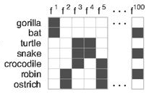
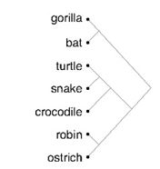
Hierarchical Clustering Example
Charles Kemp, and Joshua B. Tenenbaum PNAS, “The Discovery of Structural Form” 2008;105:10687-10692

Slide 38
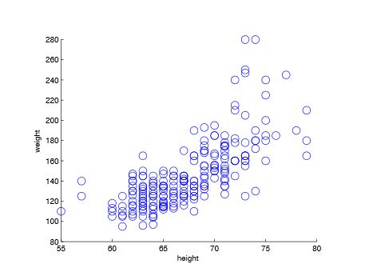
How Many Categories Here?

Slide 39
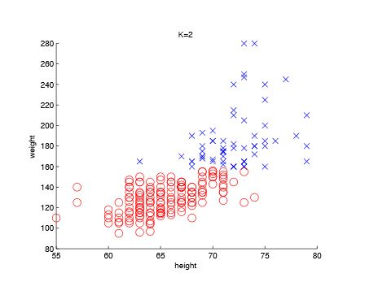
K=2

Slide 40
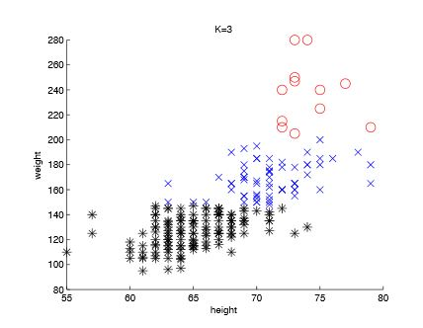
K=3

Slide 41
Topic Modeling (TT 6.6)
Topic modeling is an unsupervised learning technique for organizing collections of unstructured (toward the narrative end of the DTS) documents by discovering patterns or clusters in the words they contain
Starts with a document x term matrix and extracts topics by reducing the dimensionality through linear algebra techniques
Basic intuition is that the words in a document are probabilistic indications of what the document is about, so the set of topics is an overview or browsing aid for a collection
In digital humanities, topic models have been used to discover changes in “what’s written about” by some author or resource (like a newspaper) over time
Web commerce companies use topic models to recommend products or books

Slide 42
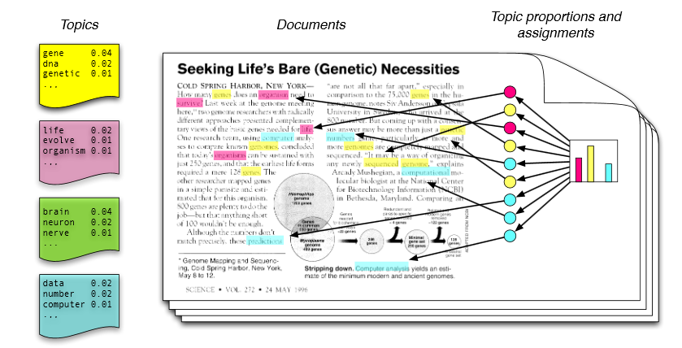
Topic Modeling: Intuitive View
Figure 1 of Blei, Probabalistic Topic Models, 2012
Words in a document can be associated with different topics; imagine using text highlighters with different colors for each topic

Slide 43
The Classification Process – Supervised Learning (as computer science sees it)
Specify classes (“categories”)
Label examples (the “training set”)
Extract features / Choose a classifier algorithm
These are interdependent. Choose some set of features and run an algorithm; try some other features with the same algorithm; try other algorithms with the same features…

Slide 44
The Classification Process
Train and test
after you've chosen features and an algorithm, you let it "learn" - adjusting the weights it gives to each feature....
Classify new examples
Analyze the results
Modify the training data, adjust the learning algorithm, and train again

Slide 45
The Classification Process (with TDO perspective)
Specify classes (categories)
How many classes should there be? What biases does the system embody? What is the “warrant” for the classes?
Label examples
In any domain the set of possible examples will be much larger than the training set; Are the examples representative? How are they selected? If you use a larger training set you might discover more classes.
Who does the labeling? Can you find enough experts to label a large enough training set? Is the labeling process reliable?
Extract features / Choose a classifier algorithm
How are the features that are identified influenced by the system of classes? More classes means that more features will be needed.

Slide 46
Three Parts in Every Classifier
Representation
the formal language used by the classifier: what kind of model can the learner learn?
Evaluation
the “objective” or scoring” function: how good is the classifier?
Optimization
how does the learning algorithm search for a better solution?

Slide 47
Some Useful Tricks
Create more than one classifier with different learning algorithms and combine them in an “ensemble” model where they vote
Create different random samples of the training data, train a classifier on each one, and then combine the results by voting, the combined classifier is better than any one of them
Randomly exclude some of the attributes for consideration at each node when we infer a decision tree
Retrain a classifier and give more weight to misclassified examples after each round of learning so it gets better because it pays more attention to hard examples

Slide 48
Easiest Learner to Understand: Decision Trees
Multiple binary classifiers can be arranged in a hierarchy
Given an input matrix of labeled data, choose properties that in the order that creates subsets that are as homogeneous as possible
This creates a classifier that can be easily interpreted as a set of IF-THEN rules

Slide 49
Should You Golf Today? – Training Data
Four possible variables on which to base decision
“Temperature” alone doesn’t seem to predict well, nor does “humidity”
“Outlook” does the best job at creating subcategories where the “target decision” is the same, so we make that the top level decision

Slide 50
Should You Golf Today? – Decision Tree

Slide 51
INFO 202 “Information Organization & Retrieval” Fall 2015
Robert J. Glushko glushko@berkeley.edu
@rjglushko
16 November 2015 Lecture 22.4 – Text Classification

Slide 52
Text Classification Problems
Classification assigns objects in some domain to one of at least two classes or categories
words - determine part of speech
words - disambiguate polysemy
author identification - Shakespeare or not?
sentiment classification - positive or negative affect? urgent or not urgent?
language - English, Spanish, whatever?

Slide 53
Features for Text Classification
Linguistic Features (lexical and syntactic)
Words (stems?)
Phrases
Word and character level "N-grams“
Punctuation
Part of speech
Non-linguistic features (structure and formatting)

Slide 54
Classification using N-Grams
A text can be sliced into a set of overlapping N-grams, an N-character contiguous “slice”
The word “TEXT” can be composed of these N-grams:
Uni-grams: _, T, E, X, T, _
Bi-grams: _T, TE, EX, XT, T_
Tri-grams: _TE, TEX, EXT, XT_, T__
Quad-grams: _TEX, TEXT, EXT_, XT__, T___
(The Google Books “N-gram viewer” enables the “quantitative analysis of culture” via analysis of usage trends for words and grammatical constructions)

Slide 55
N-Gram Frequency in European Languages
The highest frequency N-grams are generally single characters, function words, and the most common prefixes and suffixes
(Grefenstette, “Comparing two language identification schemes,” 1995)

Slide 56
Identifying a Language
The N-grams in collections of documents from known languages are arranged in decreasing frequency (or probability) order (cf. Zipf’s Law)
The same representation is created for a document in the unknown language
The document N-gram vector is compared to the N-gram vectors for each language, and the nearest vector identifies the document’s language

Slide 57
Author Classification: Motivation and Applications

Slide 58
Authorship Classification Use Cases
Authorship IDENTIFICATION determines the likelihood of a particular author having written a piece of work by examining other works produced by that author
Authorship CHARACTERIZATION is aimed at inferring an author’s background characteristics rather than identity
Similarity detection compares multiple pieces of writing without identifying the author
(related use case: plagiarism detection)

Slide 59
The Authorship Identification NLP Model
Goal is to identify a set of features that remain relatively constant among a number of writings by a particular author
Given n predefined features, each piece of writing can be represented by an n-Dimensional feature vector.
Supervised learning techniques can train and generate a classifier that can to determine the category of a new vector to identify the authorship of an anonymous (or disputed) writing

Slide 60
Authorship Identification
Given:
A text with unknown author
A list of possible authors
A sample of their writing
Can we automatically determine which person wrote the text?

Slide 61
From Fingerprint to “Writeprint”
A writeprint is composed of multiple features, such as vocabulary richness, length of sentence, use of function words, layout of paragraphs, and keywords
These writeprint features can represent an author's writing style, which is usually consistent across his or her writings, and further become the basis of authorship analysis

Slide 62
Features used in Writeprints

Slide 63
How Many Authors?
Who wrote “The Cukoo’s Calling?”

Slide 64
The Disputed Federalist Papers
The Federalist papers were 77 short essays written in 1787-1788 by Hamilton, Jay and Madison to persuade NY to ratify the US Constitution; published under a pseudonym
Historians disputed the authorship of 12 of the papers
Two statisticians (Mosteller and Wallace, 1964) solved the problem by identifying 70 words whose usage patterns distinguished the papers with known authors
Their statistical classifier concluded that the author was Madison

Slide 65
Author Identification for the Federalist Papers

Slide 66
Sentiment Analysis
Sentiment analysis (aka "opinion mining") can be thought of a three-stage classification problem
Entity extraction to locate text of interest
Classifying texts as opinions or facts
Classifying the opinions according to polarity - positive vs. negative (or on some numerical scale)
This is challenging because these classes are really continuaa without sharp boundaries
...and because sarcasm, slang, cliches, and cultural norms obscure the content used to make the classification

Slide 67
The Challenge of Sarcasm

Slide 68
TODAY’S MOST IMPORTANT SLIDES
68

Slide 69
Real World NLP Applications
Information extraction
Summarization
Auto-journalism (story generation)
Machine translation
Speech recognition and synthesis
Question answering, automated customer service, recommendations
Computational classification
Topic identification
Author identification
Spam detection
Sentiment analysis
69

Slide 70
"Named Entity" Recognition
People, organizations, locations, dates, etc. can be identified with high accuracy in most kinds of documents using a combination of dictionaries, directories, gazetteers and rules – many are domain-specific
Named entity recognition is especially essential for machine translation because if multi-word names are missed, translating them word-for-word will cause errors (e.g., Golden Gate Park, Walnut Creek)
Important entities are likely to be mentioned many times in a text, but are often described by different noun phrases each time, requiring co-reference resolution

Slide 71
Entity Types
People—Bill Clinton, Mr. Clinton, President Clinton
Locations—Alabama, Montgomery, Guam
Organizations—Microsoft Corp., Internal Revenue Service, IRS, Congress
Dates—Sept. 3, Saturday, Easter
Times—6 minutes 20 seconds, 4:04 a.m., afternoon
Percentages—10 percent, 45.5 percent, 37.5%
Money—$90,000, $35 billion, one euro, 36 pesos
…
Email addresses
Software names
Phone numbers

Slide 72
Binary Relationship Patterns
Two relationship types account for 60% of them and 8 relationship types account for 95% of them
Etzioni, Oren, et al. "Open information extraction from the web." Communications of the ACM 51.12 (2008): 68-74)

Slide 73
Story Templates and Grammars
Some document types have a regular "discourse" or "frame" structure that makes it easier to find information that fills the key relational “slots”
What are the relational slots in a generic sports story? What if the sports are subdivided?
Election story? “Weather event” story?
And by trading off writing style for automation, almost any domain dominated by data sets with known relationships can be explained using auto-generated text

Slide 74
Classifiers
A classifier is a system whose input is a vector of discrete or continuous feature (or attribute) values and whose output is the name of the class
This vector might be the description of a document, an image, a person, a molecule, just about anything
Classifiers for text identify its language, topic, author, sentiment, or other characteristics
Recommendation systems identify “matching” resources in different categories
Classifiers can identify categories of people who are likely or not likely to do something (“behavior prediction”)
74

Slide 75
Learners (computer science definition)
A (machine) learner takes a set of pairs of inputs and outputs and devises a mapping between them
If the outputs are “labeled” or categorized already, this is SUPERVISED learning
If the learner has to discover the mapping by detecting the “interesting patterns” in the data, this is UNSUPERVISED learning (also called “statistical pattern recognition”)
Most human learning is unsupervised; even when labels are provided, they rarely cover more than a fraction of the possible examples of the category
“Machine Learning” is a hypernym that includes both supervised and unsupervised approaches

Slide 76
Unsupervised Learning: Clustering
Clustering is an unsupervised learning method to automatically group related content or resources by discovering the correlations between features or properties of the things to be classified (usually via computations that maximize similarity within categories and minimize it between them)
Similarity, in many clustering algorithms, is implemented as a measure of the distance between two documents.
With text resources, clustering can try to assign labels to the groups or create summaries of their members

Slide 77
The Classification Process – Supervised Learning (as computer science sees it)
Specify classes (“categories”)
Label examples (the “training set”)
Extract features / Choose a classifier algorithm
These are interdependent. Choose some set of features and run an algorithm; try some other features with the same algorithm; try other algorithms with the same features…

Slide 78
The Classification Process
Train and test
after you've chosen features and an algorithm, you let it "learn" - adjusting the weights it gives to each feature....
Classify new examples
Analyze the results
Modify the training data, adjust the learning algorithm, and train again

Slide 79
Three Parts in Every Classifier
Representation
the formal language used by the classifier: what kind of model can the learner learn?
Evaluation
the “objective” or scoring” function: how good is the classifier?
Optimization
how does the learning algorithm search for a better solution?

Slide 80
Text Classification Problems
Classification assigns objects in some domain to one of at least two classes or categories
words - determine part of speech
words - disambiguate polysemy
author identification - Shakespeare or not?
sentiment classification - positive or negative affect? urgent or not urgent?
language - English, Spanish, whatever?

