Slide 1
Plan for Today’s Lecture(s)
Introduction to Interactions
Pivoting from “design for interactions” to “design of interactions”
Ways of Thinking About Interaction and Value Creation
Affordances and Interactions
1

Slide 2
INFO 202 “Information Organization & Retrieval” Fall 2015
UNIVERSITY OF CALIFORNIA, BERKELEY
SCHOOL OF INFORMATION
Robert J. Glushko glushko@berkeley.edu
@rjglushko
30 November 2015 Lecture 24.1 – Interactions in Organizing Systems

Slide 3
Interactions –The Why of Organizing Systems
INTERACTIONS include any activity, function, or service supported by or enabled with respect to the resources in a collection or with respect the collection as a whole
The interaction of ACCESS is fundamental in any collection of resources –why would you collect and organize resources you didn’t expect to access in the future?
3

Slide 4
Interactions –The Why of Organizing Systems
Whenever we select a resource for inclusion in an organizing system, describe it, or arrange it according to an organizing principle, we (should) have an interaction in mind
We include a resource in our system because our users will need it; we assign a resource to one or more categories to help our users find it, understand it, and connect it with other resources in a meaningful way
TDO calls this “organizing on the way in”
4

Slide 5
Interactions Enabled by Re-organizing
If a collection of resources isn’t organized to support our desired interactions, computational techniques can re-organize them (if they are digital) or their digital resource descriptions
… by indexing, searching, sorting, transforming, translating, labeling, categorizing, combining, summarizing… (IR, ML, NLP)
This doesn’t always mean that the collection was organized poorly; it might just be organized for different interactions than the ones we want
TDO calls this “organizing on the way out”
5

Slide 6
Classifying Interactions
Type of resource involved (physical or digital)
How value is created
Generality (generic to domain or resource-specific)
Extent of mediation (none, partial, complete)
“Property layer” involved (properties of individual resources, properties of collections)
Initiative (by user, by resource, mixed initiative)
6

Slide 7
Classifying Interactions
Implementation technology or algorithm (person to person, self-service, mechanical, IR, machine learning, NLP,...)
Impact on the resources or collection (unchanged, translated, transformed, consumed, destroyed)?
Are new resources created as a result of the interaction?
7

Slide 8
Generic and Domain-Specific Interactions
Some interactions can be enabled with any type of resource, while others are tied to resource types
The supported interactions depend on the nature and extent of the resource descriptions and arrangement
Different principles, or different implementations of the same organizing principles, determine the efficiency or effectiveness of the interactions
8

Slide 9
The Most Generic Interactions
Finding a resource that you know exists
Identifying a resource to make sure you have the one you were looking for
Selecting a resource from a set of candidates in a collection
Obtaining the resource if what you have at this point is just a resource description
9

Slide 10
Direct vs. Mediated Interactions
Interactions with a resource can be direct, mediated or indirect, or limited to interactions with resource copies or descriptions
Many of the interactions with individual physical resources seem unmediated when they take place
This means we don't always realize the role of additional descriptions or organization in supporting or improving interactions
10

Slide 11
Classifying Interactions by Resource Property Layers
The resource properties that enable interactions can be distinguished in three layers:
Properties of individual resources
Properties of resource collections
Derived or computed properties
11

Slide 12
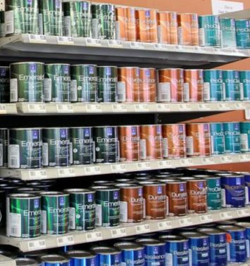
Organizing Paints by Color
Sometimes color is the most appropriate resource property to use as an organizing principle
12

Slide 13
Properties of Individual Information Resources
<Book> <Title>Moby Dick</Title> <Author>Melville</Author> <PublicationYear>1851</PublicationYear> <Category>Fiction</Category> </Book>
13

Slide 14
Properties of Resource Collections
Statistics like the average age, size, usage of the resources
For documents with text content, statistics like term distributions
14

Slide 15
Derived or Computed Properties
For individual resources: image or audio signatures, sentiment analysis, summaries
For collections: inter-item similarity, inter-item relationships/links, discriminating terms (inverse document frequency), statistically improbable phrases, principal components/factor analysis/LSI
15

Slide 16
Principles, Implementation, Efficiency and Effectiveness
The organizing principle largely determines the effectiveness of designed interactions
But different implementations of interactions that use the same principle can vary greatly in their efficiency
Choices about descriptions and organizing principles involve tradeoffs to determine which interactions are efficient, possible, difficult, or impossible
16

Slide 17
INFO 202 “Information Organization & Retrieval” Fall 2015
UNIVERSITY OF CALIFORNIA, BERKELEY
SCHOOL OF INFORMATION
Robert J. Glushko glushko@berkeley.edu
@rjglushko
30 November 2015 Lecture 24.2 – Ways of Thinking About Interaction and Value Creation

Slide 18
Interaction and Value Creation
Interactions differ in the absolute and relative amounts of physical manipulation, interpersonal or empathetic contact, and symbolic manipulation or information exchange involved in the interaction
Physical Object Manipulation
Symbolic Manipulation
Interpersonal Interaction
Apte, U. and Mason, R. Global Disaggregation of Information-Intensive Services. Management Science (1995).
18

Slide 19
Value Creation with Physical Resources
Physical manipulation is often the intrinsic type of interaction with physical resources
The resource might have to be handled or directly perceived in order to interact with it
Physical manipulation and interpersonal contact might be required to interact with information resources in physical form like printed books in libraries or music in CDs or albums
Interactions involving physical resources often emphasize generic aesthetic or emotional goals and are not always “purposeful”
19

Slide 20
Value Creation with Digital Resources
With digital resources, neither physical manipulation nor interpersonal contact is required for interactions
The essence of the interaction is information exchange or symbolic manipulation of the information contained in the resource
By replacing interactions that involve people and physical resources with symbolic ones, organizing systems can lower their costs without reducing user satisfaction (automation, self-service, outsourcing…)
20

Slide 21
Disaggregation of Symbolic Interaction and Other Impacts of Technology
Information can augment interpersonal and physical interactions
And can also replace them
Robotics,
Remote
manipulation?
Symbolic
Manipulation
(Part 2)
Symbolic Manipulation
(Part 1)
Telepresence?
21

Slide 22
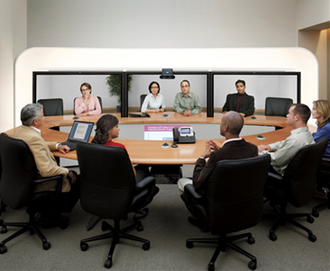
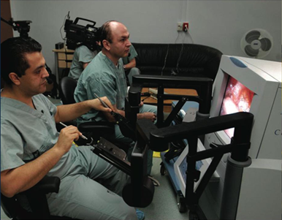
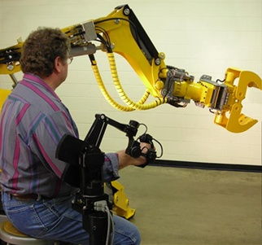
Telepresence & Telerobotics

Slide 23
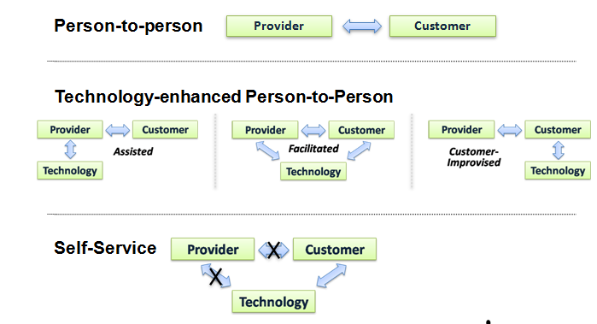
A Continuum of Technology Support in Interactions
Glushko, Robert J. "Seven Contexts for Service System Design," in Maglio, P. P., et al. (Eds.), Handbook of Service Science, 219-249, 2010.
23

Slide 24
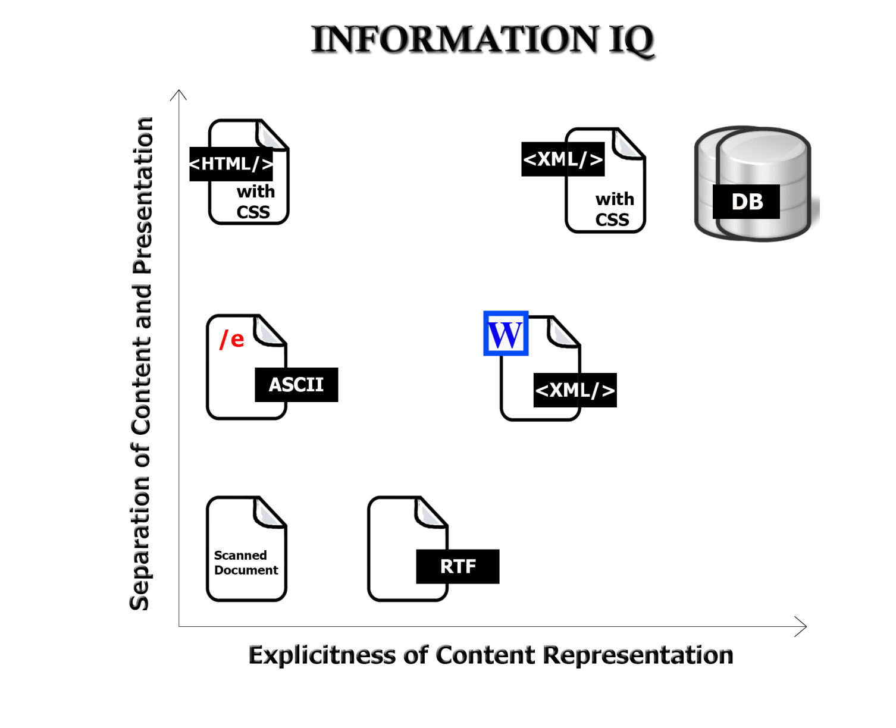
Value Creation with “Smart” Resources
The variety and functions of interactions with digital resources are determined by the amount of structure and semantics represented in their digital encoding, in the descriptions associated with the resources, or by the intelligence of the
computational processes applied to them
24

Slide 25
INFO 202 “Information Organization & Retrieval” Fall 2015
UNIVERSITY OF CALIFORNIA, BERKELEY
SCHOOL OF INFORMATION
Robert J. Glushko glushko@berkeley.edu
@rjglushko
30 November 2015 Lecture 24.3 – Affordances and Interactions

Slide 26
“The Design of Everyday Things” (new edition Nov 2013)
Design must convey the essence of a device’s operation
The way it works
The possible actions that can be taken
Just what it is doing at any particular moment
26

Slide 27
Affordances (1)
For physical resources, many potential interactions are inherent in their affordances – perceptible and actionable properties that determine what can be done with them (given some capabilities of the entities interacting with them)
Affordances can also be analyzed as constraints that limit what can be done with a resource
Creating affordances is often the purpose of design
27

Slide 28
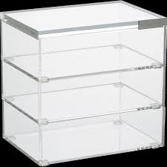
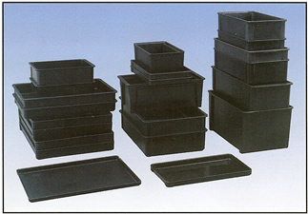
Easily Perceivable Affordances
28

Slide 29
Affordances (2)
Many organizing systems use the readily perceived properties that create affordances as the basis for resource selection, arrangement, and interaction design
(this is especially true with “taskonomic” classification)
But not every affordance makes sense as an organizing principle, and not every affordance is related to a useful interaction
29

Slide 30
Designed vs. Afforded Interactions
Make sure you understand that the interactions that are “afforded” are not the same as the “designed interactions” that are made possible by intentional acts of description, arrangement, or technological mediation
For example, when a book is checked out of a library it might be read, translated, summarized, criticized, or otherwise used — but none of these interactions are directly designed into the library
A digital library, however, might design in support for translation, summarization, annotation, and other services
30

Slide 31
Design to Support Interaction (1)
With physical resources, good design makes it easy to distinguish between parts and properties that are functional and those that are decorative or otherwise non-functional
With digital and computational resources, it is often impossible to discern capability in the “presentation layer”
So designing the interactions isn't sufficient; we must also make them discoverable and comprehensible
31

Slide 32
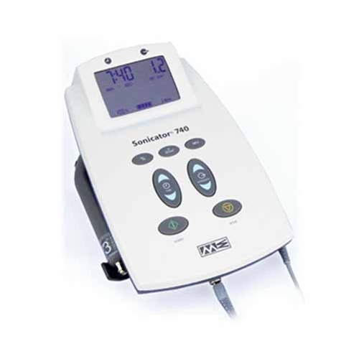
Interactions with Digital and Computerized Resources (1)
We often can’t perceive the designed interactions with digital and computerized resources, because their capabilities are internally implemented rather than inherent in perceptible surface properties or file names
Sonicator
32

Slide 33
Interactions with Digital and Computerized Resources (2)
Even when we see some indications of potential interactions we can't directly understand or compare their capability
33

Slide 34
Design to Support Interaction (2)
Many interactions with physical and digital resources are invoked and performed using controls or other “user interface elements”
These controls and UI elements have affordances too, and good design makes it easy to see how to use them
Does the arrangement of the controls map well to the arrangement of the resources they control?
If the resources belong to logical groups or categories, does the arrangement of the controls reflect them?
34

Slide 35
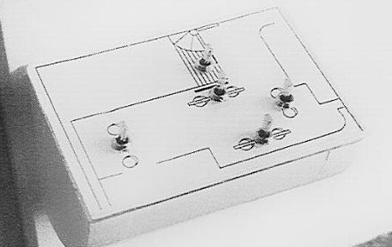
AFTER: Switches arranged to match room layout
BEFORE: Array of 6 light switches
Donald Norman, The Design of Everyday Things

Slide 36
Beer tap handles used to distinguish identical knobs in control room of a nuclear power plant
Donald Norman, The Design of Everyday Things

Slide 37
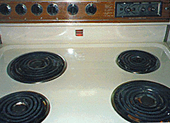
Good and Bad Mappings
37

Slide 38
Design and Organizing
“intentional arrangement of resources and the interactions they support? – that’s what design does” (Don Norman)
38

Slide 39
INFO 202 “Information Organization & Retrieval” Fall 2015
UNIVERSITY OF CALIFORNIA, BERKELEY
SCHOOL OF INFORMATION
Robert J. Glushko glushko@berkeley.edu
@rjglushko
30 November 2015 Lecture 24.4 – Business Patterns as Organizing Systems

Slide 40
Business Patterns as Organizing Systems
The definition of Organizing System as an intentionally arranged collection of resources can be applied to business design and operation
It is also easy to see that at an abstract level almost all businesses are organized according to similar principles and patterns
Businesses share common external influences, especially those in the same industry
They also share common internal influences and goals
40

Slide 41
What Businesses Do
Design and Engineering – figuring out how to make stuff, increasingly by collaborating with people who make the materials and components; if the stuff is intangible, this activity means “how to deliver it successfully to customers”
Manufacturing – making stuff, often with much of the assembly done “upstream” in a supply chain or by collaborating with people who are "downstream" toward the customer to customize it; intangible stuff often is delivered in more tangible packages
Human Resources, Finance, MIS – organizing and taking care of the people who do everything
Information Systems – designing, deploying, supporting computing and communications infrastructure
41

Slide 42
Describing What Businesses Do
Organization-level or business model patterns: marketplace, auction, supply chain, build to order, drop shipment, vendor managed inventory, etc.
Business process patterns: procurement, payment, shipment, reconciliation, etc.
Business information patterns: document models for catalog, purchase order, invoice, etc., and models for the components they contain for party, time, location, measurement, price, etc.
42

Slide 44
Generalizing Business Patterns
You can identify business model patterns inductively, by looking at specific examples of businesses and factoring out repeating elements
Bank in supermarket
Fast food franchise in supermarket
Post office in supermarket
==> PATTERN: Complementary product or service for supermarket customers "plugged into" supermarket
How is “complementary” defined?
Can we further generalize the pattern?
44

Slide 45
The Co-evolution of Technology and Business Organization
Info & Com technology has changed the structure and operation of firms; less hierarchical and more network forms
Information about goods becomes a good (or a service)
From forecast/schedule-driven to demand/event-driven business models
From from tightly to loosely coupled relationships/architectures
From proprietary to standard models with reusable components
45

Slide 46
The Data-Driven Business
No forecast can ever be as accurate as actual sales and demand information
The key to business optimization isn't doing things faster according to plans, it is doing things smarter according to actual demand
"Information-driven decisions" can be make more reliably and with less latency when applications and sensor networks collect information
46

Slide 47
Core Readings for Next Lecture
Johnson, Eric J., et al. "Beyond nudges: Tools of a choice architecture.”Marketing Letters 23.2 (2012): 487-504.
Glushko, R. J., & Nomorosa, K. J. (2013). "Substituting Information for Interaction: A Framework for Personalization in Service Encounters and Service Systems." Journal of Service Research, 16(1), 21-38.
47

Slide 48
TODAY’S MOST IMPORTANT SLIDES
48

Slide 49
Classifying Interactions
Type of resource involved (physical or digital)
How value is created
Generality (generic to domain or resource-specific)
Extent of mediation (none, partial, complete)
“Property layer” involved (properties of individual resources, properties of collections)
Initiative (by user, by resource, mixed initiative)
49

Slide 50
Classifying Interactions
Implementation technology or algorithm (person to person, self-service, mechanical, IR, machine learning, NLP,...)
Impact on the resources or collection (unchanged, translated, transformed, consumed, destroyed)?
Are new resources created as a result of the interaction?
50

Slide 51
Classifying Interactions by Resource Property Layers
The resource properties that enable interactions can be distinguished in three layers:
Properties of individual resources
Properties of resource collections
Derived or computed properties
51

Slide 52
Interaction and Value Creation
Interactions differ in the absolute and relative amounts of physical manipulation, interpersonal or empathetic contact, and symbolic manipulation or information exchange involved in the interaction
Physical Object Manipulation
Symbolic Manipulation
Interpersonal Interaction
Apte, U. and Mason, R. Global Disaggregation of Information-Intensive Services. Management Science (1995).
52

Slide 53
“The Design of Everyday Things” (new edition Nov 2013)
Design must convey the essence of a device’s operation
The way it works
The possible actions that can be taken
Just what it is doing at any particular moment
53

Slide 54
Designed vs. Afforded Interactions
Make sure you understand that the interactions that are “afforded” are not the same as the “designed interactions” that are made possible by intentional acts of description, arrangement, or technological mediation
For example, when a book is checked out of a library it might be read, translated, summarized, criticized, or otherwise used — but none of these interactions are directly designed into the library
A digital library, however, might design in support for translation, summarization, annotation, and other services
54

Slide 55
Design and Organizing
“intentional arrangement of resources and the interactions they support? – that’s what design does” (Don Norman)
55

Slide 56
Business Patterns as Organizing Systems
The definition of Organizing System as an intentionally arranged collection of resources can be applied to business design and operation
It is also easy to see that at an abstract level almost all businesses are organized according to similar principles and patterns
Businesses share common external influences, especially those in the same industry
They also share common internal influences and goals
56

Slide 57
The Co-evolution of Technology and Business Organization
Info & Com technology has changed the structure and operation of firms; less hierarchical and more network forms
Information about goods becomes a good (or a service)
From forecast/schedule-driven to demand/event-driven business models
From from tightly to loosely coupled relationships/architectures
From proprietary to standard models with reusable components
57

