Slide 1
Plan for Today’s Lecture(s)
The 202 end game
Alumni day
Wrap-up day
Case studies
Optional Quiz 4
Choice Architecture
Personalization and Customization
Substituting Information for Interaction
1

Slide 2
Alumni Day (Monday 12/7)
Katey Bayse, Salesforce
Paul Goodman, Mapbox
Sayantan Mukhopadhyay, Twitter
Jacob Portnoff, Linguastat
Nick Rabinowitz, Uber
Kenichi Ueda, inaturalist, California Academy of Sciences
2

Slide 3
Wrap-Up Day (Wednesday 12/9)
Syllabus Reading: TDO Chapter 10, The Organizing System Roadmap
A review of the big ideas
Some case study “sketches”
3

Slide 4
Case Studies
Aspire to have your case study in next year’s 202 syllabus; tell an interesting story well
Your “artifact” should NOT be an afterthought; it should be an essential part of how you understand and communicate your case
Not everything is equally important; choose some design / implementation / deployment issue(s) to highlight so that your case has a natural place in the syllabus
Due on December 16
4

Slide 5
Optional Quiz 4 (Friday 12/11)
In room 210, 9-10:35 am
Same structure and content as before
3 of 5 questions
Open book, open notes
Cumulative
Arrive on time!
If you are planning on taking the exam, please let your TA know by this Friday (12/4)
5

Slide 6
INFO 202 “Information Organization & Retrieval” Fall 2015
UNIVERSITY OF CALIFORNIA, BERKELEY
SCHOOL OF INFORMATION
Robert J. Glushko glushko@berkeley.edu
@rjglushko
2 December 2015 Lecture 25.1 – Choice Architecture

Slide 7
Bounded Rationality, Applied Behavioral Economics, and the Discipline of Organizing
People are not perfectly capable and rational decision makers. Limited memory and attention capacities prevent people from remembering everything and make them unable to consider more than a few things or choices at once
The emerging field of applied behavioral economics, popularized in books like Freakonomics and Nudge, explains how “Choice Architecture” can have substantial effects on the decisions people make
We can recast these insights into TDOspeak

Slide 8
FLASHBACK from 11/30 and earlier
Many of the interactions with physical resources seem unmediated when they take place
This means we don't always realize the role of additional descriptions or organization in supporting or improving interactions
Choices about descriptions and organizing principles involve tradeoffs that determine which interactions are efficient, possible, difficult, or impossible
If the resources belong to logical groups or categories, does the arrangement of the controls reflect them?
8

Slide 9
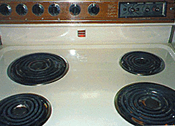
Good and Bad Mappings
9

Slide 10
TDO Figure 7.1
Good user interface design creates a clear mapping between the logic of a classification scheme and the selection methods and arrangements presented to users. Categories that are mutually exclusive imply different tabs or other visualizations that imply a single selection

Slide 11
“The Tools of Choice Architecture”
Johnson, Eric J., et al. "Beyond nudges: Tools of a choice architecture." Marketing Letters 23.2 (2012): 487-504.
The way a choice is presented influences what a decision-maker chooses. We divide these tools into two categories:
those used in structuring the choice task
those used in describing the choice options
11

Slide 12
Choice Architecture in TDOspeak
Choice Architecture says:
TDO says:
There is no neutral architecture
We can vary the order of choice alternatives
We can change the number of categories
We can change the labels of alternatives or categories
People prefer choices that are easier to describe
TRADEOFFS
All systems of categories are biased
We can use different organizing principles
We can vary the abstraction and granularity of categories
Naming and resource description is difficult, contentious, and makes a difference
TRADEOFFS

Slide 13
STOP AND THNK: Organizing Food…
If school kids are more likely to eat foods at eye level at the beginning and end of the cafeteria buffet, how do you arrange the food? (Thaler and Sunstein’s example in Nudge)
Arrange the food to make the students best off
Arrange the food at random.
Arrange the food to get the kids to pick the same foods they would choose on their own.
Maximize the sales of the items from the suppliers that are willing to offer the largest bribes.
Maximize profits
13

Slide 14
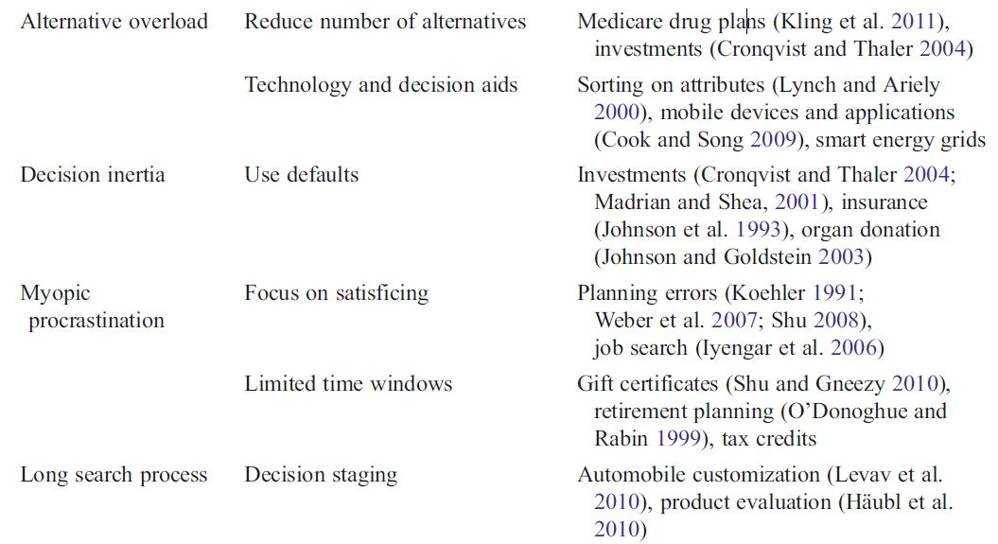
Structuring the Choice Task
14

Slide 15
How Many Alternatives?
Need to enable “a reasoned consideration of tradeoffs among conflicting values” but “not seem overwhelming”
“information overload” a consideration, but don’t fixate on 7 +/- 2
Too few options may generate context-specific preference where the presence or absence of one option influences what is chosen
Too many options create “choice overload” or the “paradox of choice” because the initial attractiveness of many alternatives decreases the motivation to choose any particular one
15

Slide 16
Defaults
For any choice that needs to be made, there must be an associated default rule that determines what happens to the decision maker if she does nothing
Usually the answer is that if you do nothing, nothing changes; whatever is happening continues to happen
For “opt-out” defaults a majority of choosers will do nothing, and things can happen that the chooser might not want or not know about
16

Slide 17
Types of Defaults
Configuration defaults apply at the first encounter with a choice
Could be the same for everyone, a normative or recommended alternative
Mandated choice
Reuse defaults apply to subsequent encounters
Persistence of original choice
Reverting to original default
Predictive defaults based on user modeling
17

Slide 18
Decision Staging
When facing a small number of well understood alternatives, people will try to examine all the attributes of all the alternatives and then make tradeoffs when necessary
If consumers are rational, “utility-maximizing agents”, their preferences for any finished product should be independent of the order in which they considered its attributes: any order should yield an equivalent “final” bundle
But as the choices become more numerous or vary on more dimensions, people are more likely to adopt simplifying strategies that aren’t entirely rational
18

Slide 19
Serial Position Effects in Choice
When people sample a set of items in order knowing they need to choose one of them, they compare each new option with their current favorite
Since the first item starts out as the favorite, will it have an advantage as the incumbent in each subsequent comparison?
Or will a pair-wise competitive-evaluation strategy produce an advantage for later items, because early options have to win all comparisons and the last item only one?
19

Slide 20
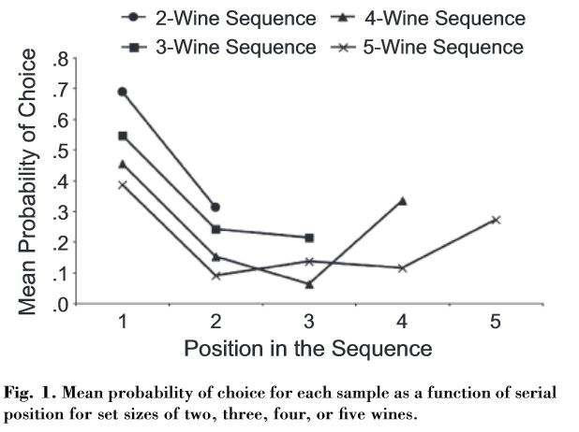
Which Wine Is Your Favorite?

Slide 21
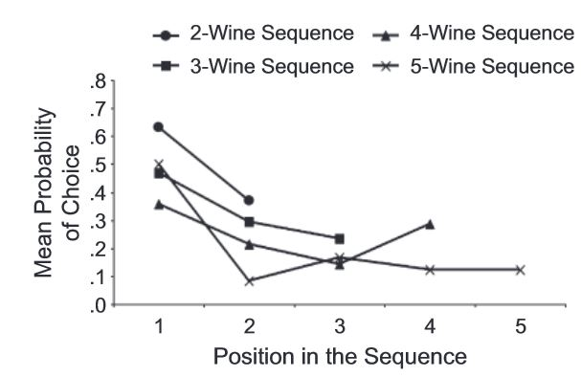
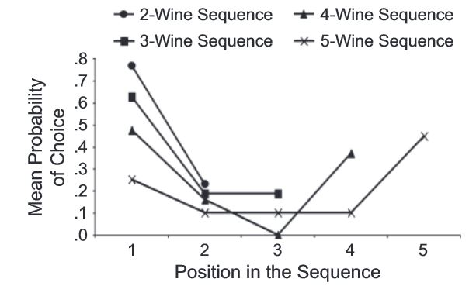
It Depends on Your Knowledge of Wine
Low Knowledge
High Knowledge

Slide 22
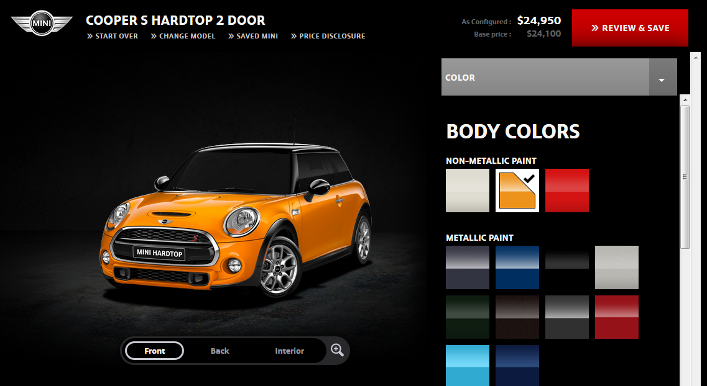
Product Configuration (miniusa.com)
Constructing the preferred product via a sequence of attribute decisions

Slide 23
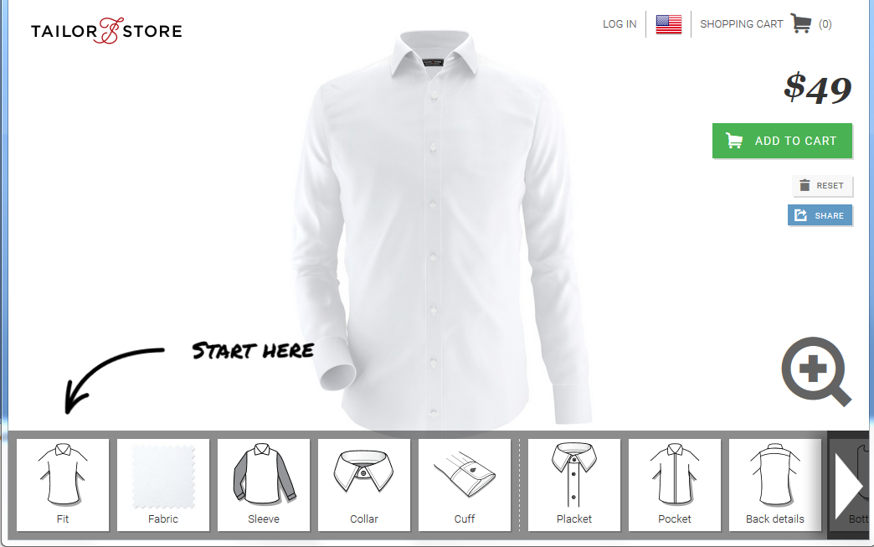
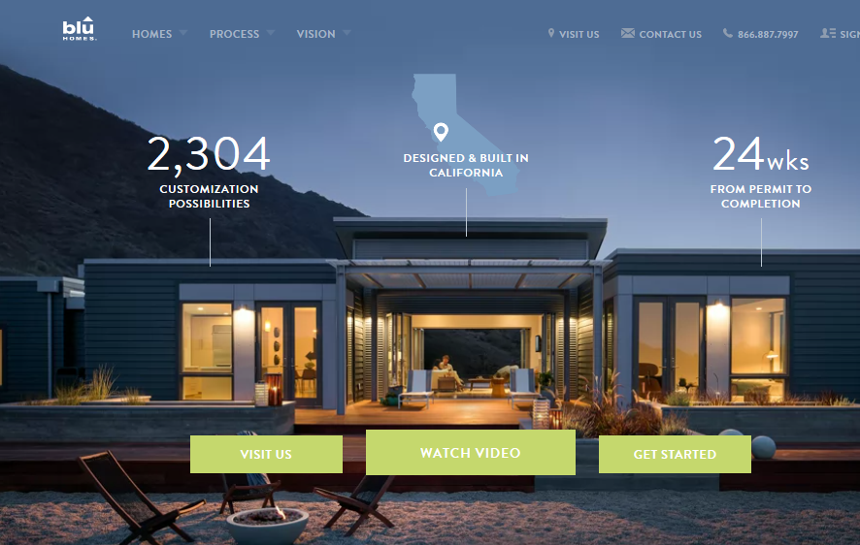
Configure a Shirt (tailorshirt.com)
Configure a House (bluhomes.com)

Slide 24
How Attribute Order Affects Choice
Changes in the order by which the attributes are considered can substantially influence the choices made
If you start with attributes with lots of options, the chooser is more likely to accept default alternatives on later attributes, even if these decisions involve relatively few options that would ordinarily require less capacity to evaluate
This effect occurs across entirely unrelated product categories that are characterized by completely different attributes
STOP and THINK
What would cause this? How would a choice architect use this to his advantage?
24

Slide 25
Describing the Choice Options
25

Slide 26
Naïve Diversification / Partition Dependence
The is a general psychological tendency or preference towards equal amounts or proportions when given a set of allocation choices
If there are 3 categories you put 1/3 in each
Such “naive diversification" is thought to arise from a desire for variety-seeking, to hedge against risky or uncertain prospects, and minimize potential regret
Effects are stronger for people with weaker intrinsic preferences or knowledge

Slide 27
401K Allocation?
Imagine an employee is asked to determine her 401(k) asset allocation from one of one of two sets
Domestic stocks
International stocks
Bonds
Domestic stocks
Domestic bonds
International bonds
If she follows a naïve diversification strategy, first portfolio is stock heavy and more risky than bond-heavy than second

Slide 28
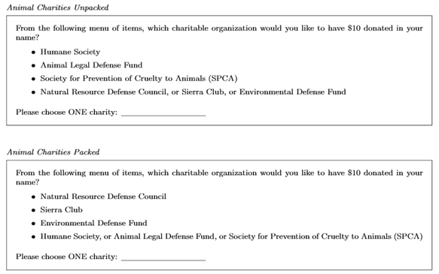
Animal and Environmental Charities?

Slide 29
Vacation Planning?
What information is being conveyed by listing some items separately and others in a category?

Slide 30
FLASHBACK: Basic-Level Categories
In the middle of category hierarchies are those that are more "basic" because the within-category similarity is greatest and the between-category similarity is the smallest
This means that perceptual, cognitive, and motor functions are "sharpest" at this level at identifying and thinking about category membership
IS THIS WHY PEOPLE PREFER THE SEPARATE ITEMS RATHER THAN THE “PACKED” CATEGORIES?
30

Slide 31
Stop and Think: Supermarket Shopping
What categories do you use when you make a list (explicit or implicit) for supermarket shopping?
Do these categories align with those used by the store to organize the goods, or are they different (e.g., healthy, party foods, cheap?) than the store ones?
Are you influenced by the placement of items in the store to buy things not on your list?
If you wanted people to eat healthier, how would you redesign the store or shopping carts to do that?

Slide 32
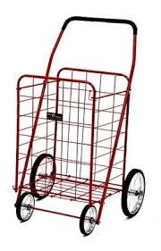
Shopping Cart Size and Partition Effects
When you go to the store, do you choose a shopping basket or shopping cart? Even if you didn’t intend to, do you often buy more if you pick the shopping cart?
Two grocery store studies found that most shoppers purchased fruits and vegetables in quantities relative to the size of their allocated partition within a shopping cart
Partitions are effective because they suggest purchase norms

Slide 33
Attribute Descriptions
People make comparisons on the basis of resource attributes, and ideal decisions would consider all attributes and weight them according to their importance to the decider
But choice architects can manipulate the salience of attributes
Choice sets that can be described simply are preferred over other sets that seem more complicated, even when the complicated ones offer more objective value
People like things that are orderly in arrangement

Slide 34
FLASHBACK: Automatic / Pre-attentive Organizing
Physical resources are often organized according to intrinsic physical properties like their size, color, or shape, because the human visual system quickly and automatically pays a lot of attention to them (without any intentional effort)
Likewise, because people have limited attentional capacity, we ignore a lot of the ongoing complexity of visual (and auditory) stimulation, making us perceive our sensory world as simpler than it really is.
Taken together, these two ideas explain why we automatically or “pre-attentively” organize separate things we see as groups or patterns based on their proximity and similarity
34

Slide 35
Choosing Beer Bundles
Two bundles differ only on the third beer
Some bundles have beers from 4 different breweries
People have a preference for all the same or all different bundles
Evers, Ellen R.K. and Inbar, Yoel and Loewenstein, George and Zeelenberg, Marcel, Order Preference (July 16, 2014). http://ssrn.com/abstract=2466991

Slide 36
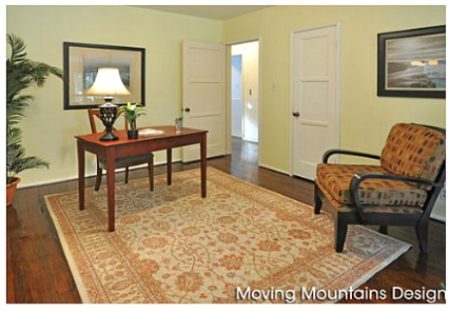
“Staging” Helps Sell a House

Slide 37
Typical Advice on House Staging
Depersonalize and remove clutter
Clutter makes homes seem smaller and disorganized
Buyers need to see your home, not your stuff. Excessive personal items like photos, collections, personal awards, electronics and collectibles will make it difficult for buyers to see past your personal style and may deter a sale
Remove excess and oversized furniture. Rearrange furniture to maximize space. Organize room closets and store out-of-season clothes. Remove items from the garage and store them off site

Slide 38
Attribute Translation: The MPG Illusion
People focus on the difference in MPG (16, 10, 6, 4, 2) instead of the difference in gas consumption. The choice of measurement biases them to spend more money on Priuses than is justified by fuel savings
Larrick, Richard P., and Jack B. Soll. "The MPG illusion." SCIENCE-NEW YORK THEN WASHINGTON- 320, no. 5883 (2008): 1593.

Slide 39
INFO 202 “Information Organization & Retrieval” Fall 2015
UNIVERSITY OF CALIFORNIA, BERKELEY
SCHOOL OF INFORMATION
Robert J. Glushko glushko@berkeley.edu
@rjglushko
2 December 2015 Lecture 25.2 – Personalization and Customization

Slide 40
Customer Segments
Every business must decide "what market it is in" -- what products and services it offers, to whom they will be offered, in which geographic area, in what time frames, and which firms are its competitors
Some businesses decide to serve only a single customer segment... which means they treat all customers the same
A business can refine "to whom it offers" its products and services into multiple customer or market segments
Each segment should define a customer segment "is coming from" using attributes that ideally explain why

Slide 41
Motivating Segmentation
ALL CUSTOMERS ARE NOT THE SAME
The relative costs of acquiring and keeping different groups of customers can differ a great deal
Even within the same demographic group, customers can differ substantially on "psychographic" dimensions
These differences determine which customers buy most often, contribute most to sales, and are most profitable
Some customers deserve more attention and service than others
You'd be better off if you got rid of some of your customers

Slide 42
Segmentation Attributes
Demographic / "life phase“
Age, gender, education, marital status, ethnicity, religion, family life cycle
Psychographic / behavioral
Lifestyle: conservative, exciting, trendy, economical
Social class: lower, middle, upper
Activities and interests: sports, physical fitness, shopping, books
Attitudes and beliefs: environmentalist, security conscious.
Profitability - value to the business

Slide 43
RFM Segmentation
Recency - when did a customer last buy from you
Frequency - how often in some time period
Monetary value - total monetary value of the customer's transactions
Typically segment customers into 5 20% segments on each dimension, creating 125 different RFM codes
An RFM code ranks a single customer against other customers for likelihood to respond and future value. High scores equal high future value; low scores equal low future value.

Slide 44
RFM and Response to Targeted Marketing

Slide 45
Getting from Segmentation to Personalization
Businesses have targeted their products and services to different customer segments and engaged in "relationship marketing" as long as there have been businesses
But industrialization and economies of scale introduced "middlemen" and required a more transactional approach to marketing that wasn't as connected to the customer
Information about specific customers is required to personalize products and services, and for those that are mostly or entirely "offline" it is nearly impossible to obtain it

Slide 46
Personalization is “Micro-segmentation”
Systems and services can be personalized to the degree that the customer is willing to provide information about preferences and behavior
For many automated and interactive services that are used repeatedly (online shopping, banking, ...), personalization is effectively on a customer-by-customer basis
This is sometimes called "micro-segmentation" or "segments of 1”

Slide 47
Architectures for Personalization
Adomavicius, G., & Tuzhilin, A. (2005). Personalization technologies: a process-oriented perspective. Communications of the ACM, 48(10), 83-90.

Slide 48
INFO 202 “Information Organization & Retrieval” Fall 2015
UNIVERSITY OF CALIFORNIA, BERKELEY
SCHOOL OF INFORMATION
Robert J. Glushko glushko@berkeley.edu
@rjglushko
2 December 2015 Lecture 25.3 – Substituting Information for Interaction

Slide 49
Interaction and Value Creation
Interactions differ in the absolute and relative amounts of physical manipulation, interpersonal or empathetic contact, and symbolic manipulation or information exchange involved in the interaction
Physical Object Manipulation
Symbolic Manipulation
Interpersonal Interaction
Apte, U. and Mason, R. Global Disaggregation of Information-Intensive Services. Management Science (1995).
49

Slide 50
Disaggregation of Symbolic Interaction and Other Impacts of Technology
Information can augment interpersonal and physical interactions
And can also replace them
Robotics,
Remote
manipulation?
Symbolic
Manipulation
(Part 2)
Symbolic Manipulation
(Part 1)
Telepresence?
50

Slide 51
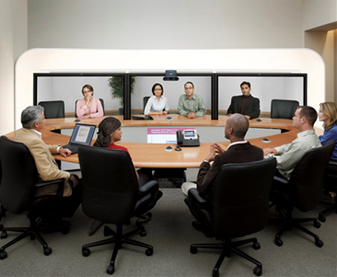
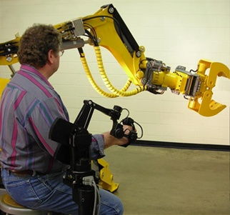
Telepresence & Telerobotics

Slide 52
Modeling for Personalization
The information provided explicitly or implicitly by the consumer can be used to build a model or profile
This "model" can be trivial - like the set of "cookies" from previously visited sites, and simple "been there before" information can be used to personalize
Or it can be much more sophisticated and robust, based not just on a single customer but on other consumers who are similar to the target consumer
52

Slide 53
Data Mining for Prediction and Personalization
Data mining is a generic term for the collection of analysis techniques used to infer rules from or build models from large data sets
There are two distinct goals in data mining - knowledge discovery (or learning) and prediction
Knowledge discovery identifies association rules between one data item and another (like the tendency to purchase together or in a predictable temporal sequence)
A human analyst is usually involved to determine which associations are exploitable
53

Slide 54
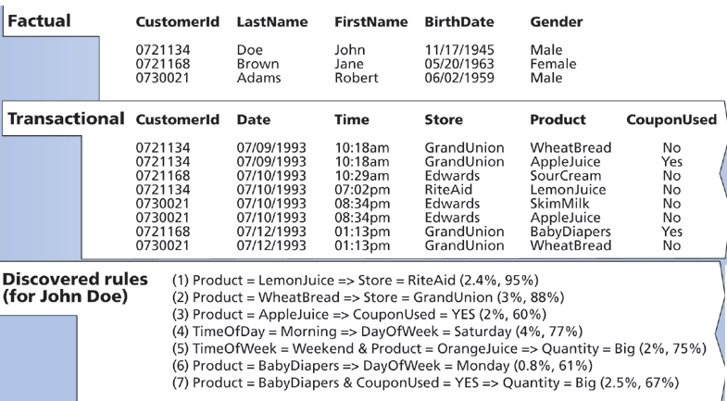
Building a Customer Profile with Data Mining

Slide 55
Personalizing Information-Intensive Services by Substituting Information for Interaction
A “smart resource” or organizing system that can capture, manage, integrate and retrieve information about the customer / user and prior interactions can substitute information for interaction
A hotel clerk with a CRM database doesn’t need to ask for your room preferences; Amazon doesn’t need to ask you about what type of books you like
Design implication: hidden computational services are substitutable for customer-facing “touch points” where P2P information exchanges would occur
Glushko, R. J., & Nomorosa, K. J. (2013). "Substituting Information for Interaction: A Framework for Personalization in Service Encounters and Service Systems." Journal of Service Research, 16(1), 21-38.
55

Slide 56
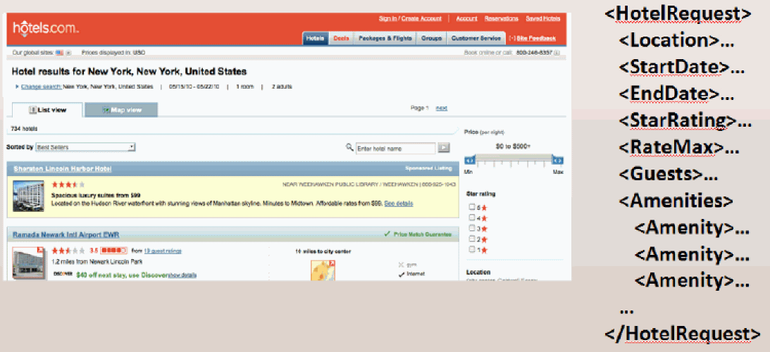
The Information Needed for a Service

Slide 57
Overlapping “Service Models”

Slide 58
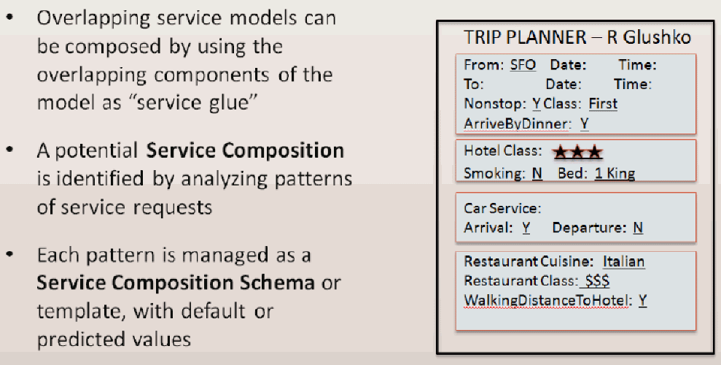
“Service Composition Schemas” Exploit the Overlap

Slide 59
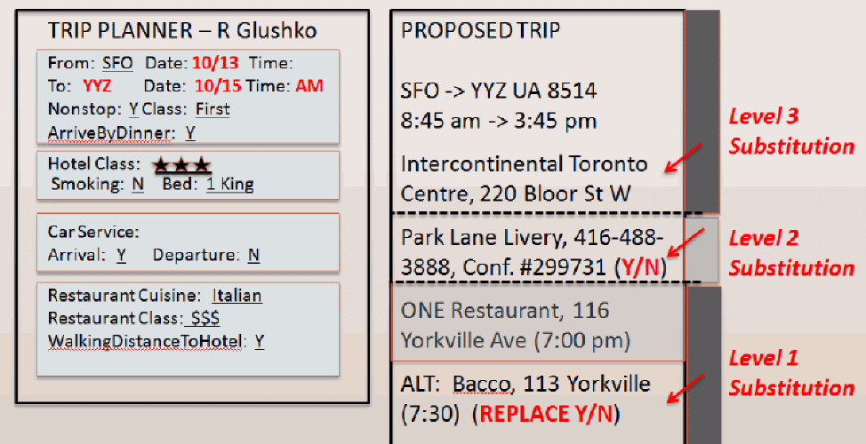
Personalized Recommendations with Minimal Interaction Requirements
Levels of substitution are based on the confidence in the prediction

Slide 60
TODAY’S MOST IMPORTANT SLIDES
60

Slide 61
Choice Architecture in TDOspeak
Choice Architecture says:
TDO says:
There is no neutral architecture
We can vary the order of choice alternatives
We can change the number of categories
We can change the labels of alternatives or categories
People prefer choices that are easier to describe
TRADEOFFS
All systems of categories are biased
We can use different organizing principles
We can vary the abstraction and granularity of categories
Naming and resource description is difficult, contentious, and makes a difference
TRADEOFFS

Slide 62
Types of Defaults
Configuration defaults apply at the first encounter with a choice
Could be the same for everyone, a normative or recommended alternative
Mandated choice
Reuse defaults apply to subsequent encounters
Persistence of original choice
Reverting to original default
Predictive defaults based on user modeling
62

Slide 63
Naïve Diversification / Partition Dependence
The is a general psychological tendency or preference towards equal amounts or proportions when given a set of allocation choices
If there are 3 categories you put 1/3 in each
Such “naive diversification" is thought to arise from a desire for variety-seeking, to hedge against risky or uncertain prospects, and minimize potential regret
Effects are stronger for people with weaker intrinsic preferences or knowledge

Slide 64
Attribute Descriptions
People make comparisons on the basis of resource attributes, and ideal decisions would consider all attributes and weight them according to their importance to the decider
But choice architects can manipulate the salience of attributes
Choice sets that can be described simply are preferred over other sets that seem more complicated, even when the complicated ones offer more objective value
People like things that are orderly in arrangement

Slide 65
Personalization is “Micro-segmentation”
Systems and services can be personalized to the degree that the customer is willing to provide information about preferences and behavior
For many automated and interactive services that are used repeatedly (online shopping, banking, ...), personalization is effectively on a customer-by-customer basis
(This is sometimes called "micro-segmentation" or "segments of 1")
Nevertheless, the design of systems and services and especially the "dimensions of personalization" is strongly determined by customer segmentation

Slide 66
Modeling for Personalization
The information provided explicitly or implicitly by the consumer can be used to build a model or profile
This "model" can be trivial - like the set of "cookies" from previously visited sites, and simple "been there before" information can be used to personalize
Or it can be much more sophisticated and robust, based not just on a single customer but on other consumers who are similar to the target consumer
66

Slide 67
Personalizing Information-Intensive Services by Substituting Information for Interaction
A “smart resource” or organizing system that can capture, manage, integrate and retrieve information about the customer / user and prior interactions can substitute information for interaction
A hotel clerk with a CRM database doesn’t need to ask for your room preferences; Amazon doesn’t need to ask you about what type of books you like
Design implication: hidden computational services are substitutable for customer-facing “touch points” where P2P information exchanges would occur
Glushko, R. J., & Nomorosa, K. J. (2013). "Substituting Information for Interaction: A Framework for Personalization in Service Encounters and Service Systems." Journal of Service Research, 16(1), 21-38.
67

