Slide 1
INFO 202 “Information Organization & Retrieval” Fall 2016
UNIVERSITY OF CALIFORNIA, BERKELEY
SCHOOL OF INFORMATION
Robert J. Glushko glushko@berkeley.edu
@rjglushko
Maintenance in Organizing Systems

Slide 2
Maintaining Resources
Maintaining includes any activity whose purpose is to ensure that a resource will be available at some future time for use or reuse
Note that the intended future "user" of a resource might be a computational process or service
For many kinds of resources, you need to preserve more than the "primary resource" for it to have future use
Maintenance has many synonyms or near-synonyms across domains: Preservation, curation, governance, storage…
2

Slide 3
Organizing {and,or,vs.} Maintaining
How we organize a collection of resources can determine what kinds of maintenance we can do and how hard it is to do it
How well can we anticipate future changes to the collection or the desired interactions?
Designing / organizing for maintainability and extensibility
Resource properties or the intended interactions might change over time
3

Slide 4
Selecting {and,or,vs.} Maintaining
SELECTION is based on some set of implicit or explicit criteria applied to resources
MAINTENANCE activities should be consistent with the selection criteria
More carefully selected resources should be maintained more carefully
4

Slide 5
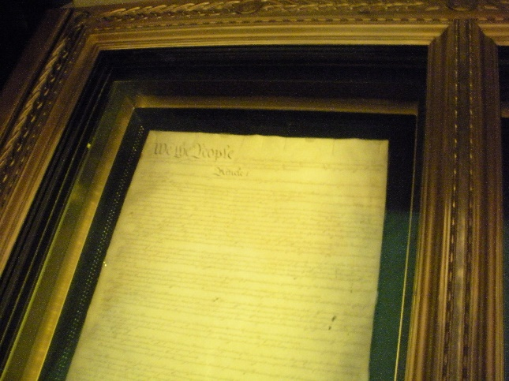
Preservation
Preservation of physical resources requires that they be kept in conditions that prevent their deterioration
It might also include actions to improve access or to restore the resource
1776 Declaration of Independence in the National Archives (probably a copy made in 1823)
B-52 “Boneyard” in Arizona desert
5

Slide 6
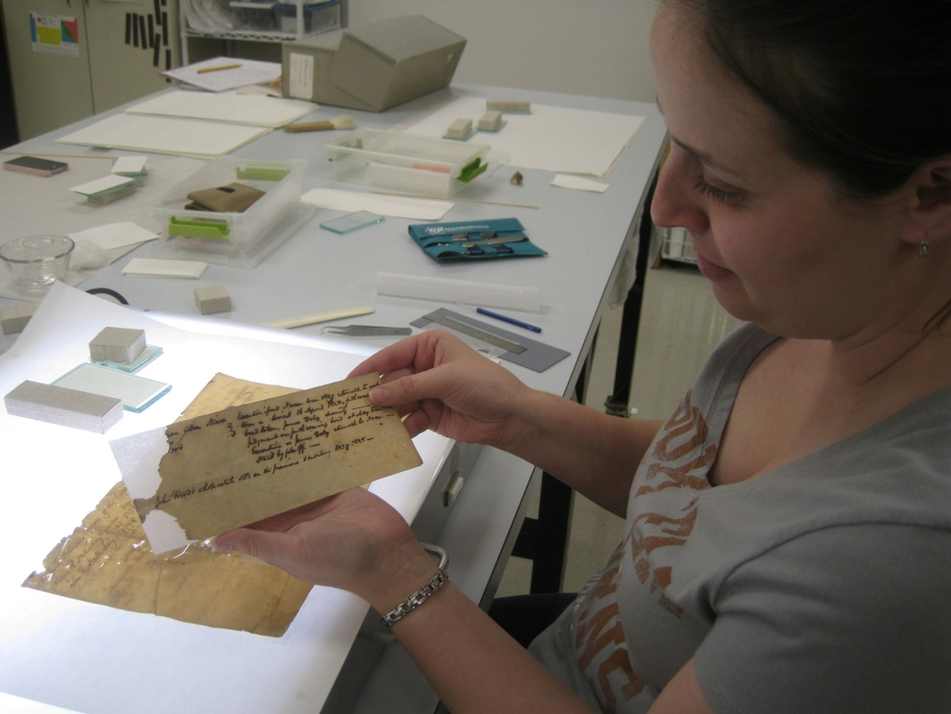
Document Restoration
Using a light table to see the tears and losses in a 19th century document
Repairing a similar document with conservation tissue and wheat starch paste
6

Slide 7
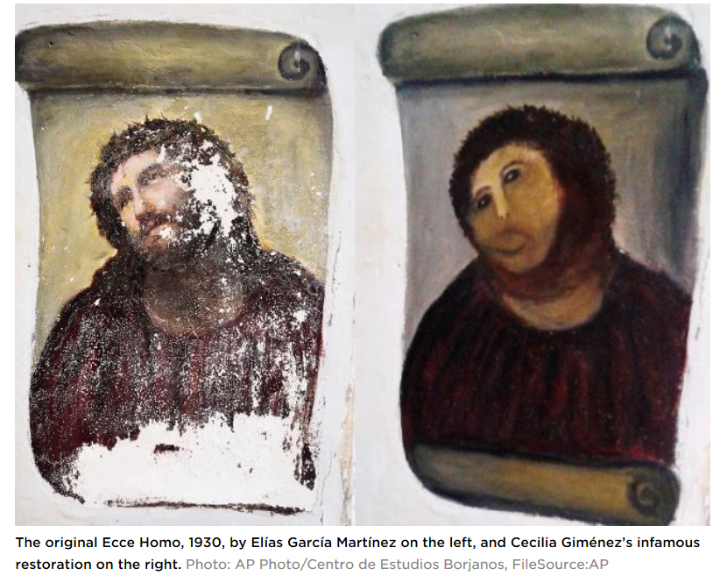
Botched “Restoration” that Saved a Spanish Town

Slide 8
Digital Preservation
Preservation of digital copies might seem easier, but other issues arise:
How many copies do we need to ensure preservation?
Do we care about which copy is the original?
How do we prevent or at least detect tampering?
Technological obsolescence of storage media and software requires that preserved digital resources might become inaccessible (compare books on library shelves with files on some storage medium)
8

Slide 9
Preservation (or not) and the Law
Laws requiring it
Sarbanes-Oxley Act – requirement to keep transactional and accounting records to enable traceability
Civil procedure rules to enable document discovery
Government accountability FOIAs
Laws prohibiting keeping personally identifiable information
HIPPA, FERPA, European “right to be forgotten”
Laws dealing with “failed” preservation
SB 1386 and similar state statues mandating disclosure of data breaches
9

Slide 10
Records Management
“Records management” and “compliance” are old terms but the concerns about what information a government or business needs to preserve are very important today
Retention requirements
Non-retention requirements
Access control, especially for classified information
Prohibitions about keeping personally identifiable information
Purging requirements and authority
10

Slide 11
Ken Lay does the “Perp Walk” after the Enron Fraud
Projected Long-term Revenue Reported as Current Income
Creating “off balance sheet” Partnerships to Hide Losses, using inflated stock as the collateral for loans from partners
11

Slide 12
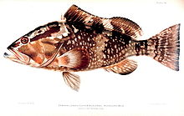
Is A Fish a Document?
John Yates, a commercial fisherman in Florida, was found with red groupers in his catch below the legal size limit. An inspector ordered him to return to port and hand the fish over to the authorities
When he dumped them overboard instead, he was charged with violating the Sarbanes-Oxley Act, which imposes harsh penalties for destroying “any record, document, or tangible object” to impede a federal investigation
The US Supreme Court ruled in favor of the fisherman (Yates v. United States 2015), finding that “tangible object” must be interpreted in the context of “record” and “document” and, as such, only applies to an object “used to record or preserve information”
12

Slide 13
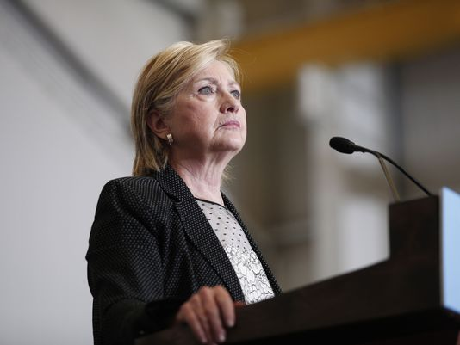
Didn’t Follow Recordkeeping Rules
Oliver North
Hillary Clinton
13

Slide 14
Curation
CURATION a common term for maintenance activities in "memory institutions“
It includes work to improve access (through better organization or description) or to restore / transform the resource
Curation decisions are often on an item-by-item basis, or for a set of closely related ones
Some people call "Crowdsourcing" and similar activities "community curation" but professional curators deprecate this usage
14

Slide 15
Crowdsourcing Digitization / Citizen Science
Many museums or scientific repositories are asking for help in digitizing their collections
Typically this involves the transcription of “pictures of documents” or preliminary classification so that scarce experts can focus on resources likely to be more important
Calbug: newscenter.berkeley.edu/2013/05/22/citizen-scientists-help-calbug/
Smithsonian Transcription Center:
WSJ Article 9/13/14
15

Slide 16
“Computational Curation” Restoration of Digital Resources
Manipulating the 3-D model of the partially restored parchment
The Great Parchment Book
http://reality.cs.ucl.ac.uk/projects/gpb/
16

Slide 17
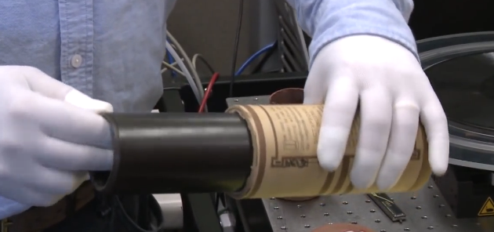
Restoration of Audio Resources
http://www.macfound.org/fellows/892/
17

Slide 18
Governance
GOVERNANCE and Curation overlap, but the former term is more associated with corporate or enterprise data management and focuses more on policy than on process
Governance often has an economic basis or metaphor at its foundation
"IT Governance" has broad scope, applying to the management of the complete technological environment in which information resources are maintained
18

Slide 19
INFO 202 “Information Organization & Retrieval” Fall 2016
Robert J. Glushko glushko@berkeley.edu
@rjglushko
7 September 2016 The Organizing Systems Roadmap/Lifecycle

Slide 20
The Organizing System Lifecycle: 4 Phases
Defining and scoping the domain
Identifying requirements
Design and implementation
Operations and maintenance
There is always a lifecycle, but these phases are brief and mostly inseparable for some simple organizing systems, more sequential for others, and more systematic and iterative for complex organizing systems
20

Slide 21
Design Methodologies: Discipline for Design
When we design something we follow – implicitly or explicitly – some steps or techniques for scoping, analysis, idea generation, and implementation
This DESIGN METHODOLOGY makes assumptions about which design questions can be separately answered, the priorities and dependencies, and who can best answer them
21

Slide 22
Design Methodologies: Discipline for Design (2)
The methodology determines
what design activities are done
the order in which they are performed
the tools and techniques used to perform them,
the notations or artifacts that result
22

Slide 23
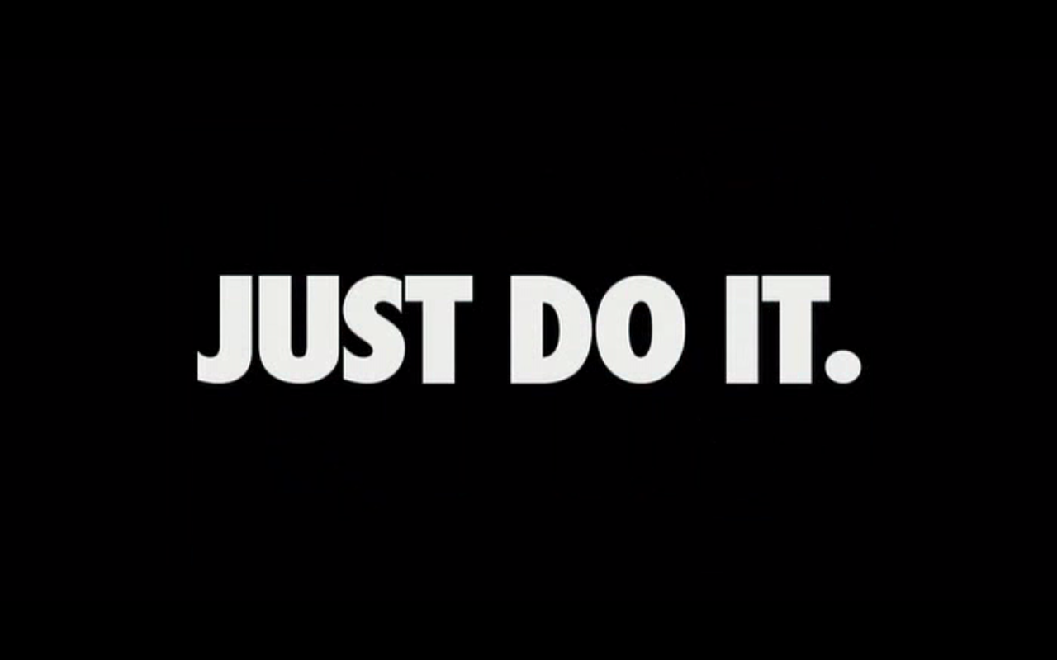
A Lifecycle with Inseparable Phases

Slide 24
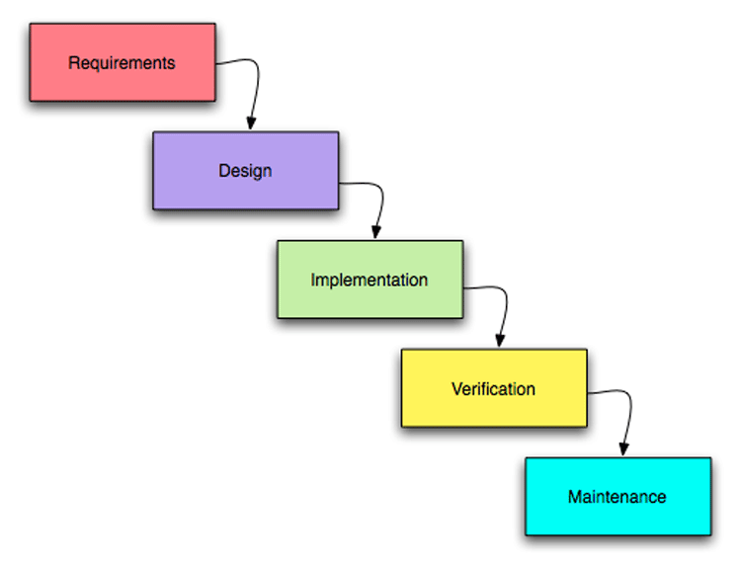
A “Waterfall” or Sequential Lifecycle

Slide 25
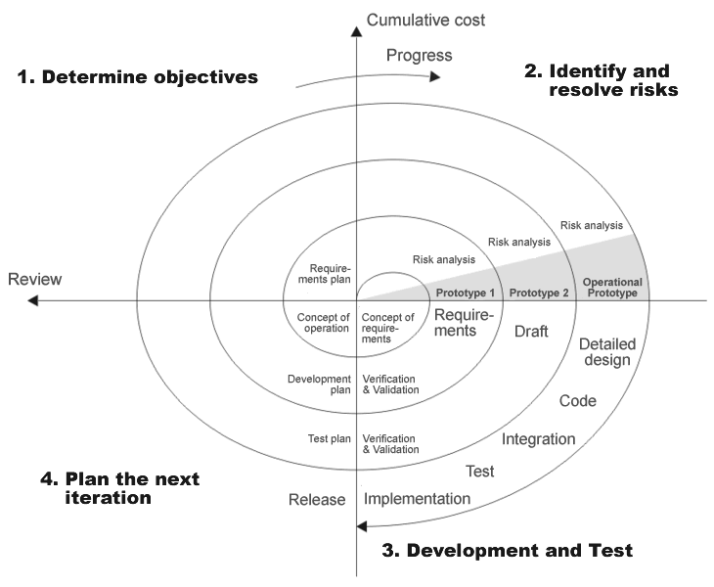
A “Spiral” or Iterative Lifecycle

Slide 26
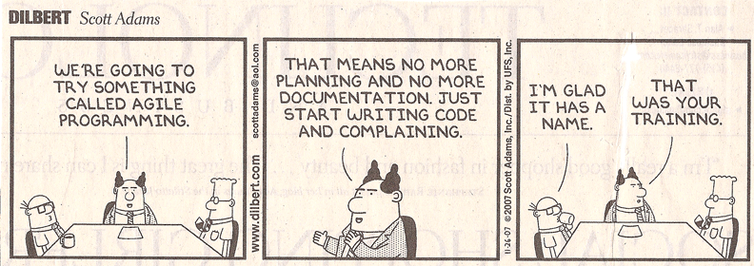
Agile Methods
"Agile“ methods for software development have become very popular and are a specialized form of iterative methods used by small design teams

Slide 27
Why Methodology Matters
The choice of methodology sometimes reflects a management and business philosophy, and sometimes reflects a personal or ideological one -- in either case, it can be highly contentious in a project
Methodology matters most:
When traceability and impact analysis are necessary
When decisions about scope, requirements, or implementation will be difficult to change
27

Slide 28
Requirements Traceability
A TRACE is an assumption or assertion about an interim or final requirement or design artifact that is important enough to record and follow
TRACEABILITY is the ability to describe and follow the life of a TRACE
Backwards traceability: Where did this decision or requirement come from?
Forwards traceability: What were the implications of this requirement or early design decision in the design?
28

Slide 29
Traces that VBush Might Have Recorded about the Memex
We need a way to create and name some set of information resources
It would be more desirable to arrange resources in an order that tells a story or explains something
Maybe we can package this set of resources so they can be shared with someone else
Can these packages be edited to add or rearrange the resources after they are shared?
Can we assume that cameras will evolve to be lightweight, fast, and small enough to be worn by the user to take pictures of what he reads to create new resources?

Slide 30
Practical Traceability
The design methodology determines what and when to trace
You can't trace everything you do or you'd have no time to do anything
But if you don't trace the important things in enough detail your design will miss opportunities and be magical and brittle
But if your design is only for yourself with a limited lifetime this might not matter
30

Slide 31
INFO 202 “Information Organization & Retrieval” Fall 2016
Robert J. Glushko glushko@berkeley.edu
@rjglushko
7 September 2016
Defining the Domain for an Organizing System

Slide 32
Defining and Scoping the Domain
Determining scope and scale
Nature and number of users
Expected lifetime
Physical and technological environment
Relationship to other organizing systems
32

Slide 33
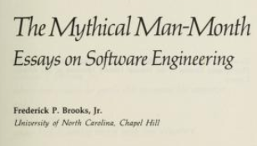
Scope and Scale
SCOPE: the breadth and variety of resource types
SCALE: the number of resource instances
Heterogeneity of resources is more important than absolute number (Scope >> Scale)
WHY? …hint:
33

Slide 34
Scope and Scale (2)
Handling resource heterogeneity:
Fewer, broader categories if possible
Less description
Standards for automated description and classification
But sometimes broad scope and scale are essential
34

Slide 35
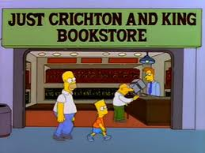
An Organizing System with Narrow Scope and Scale

Slide 36
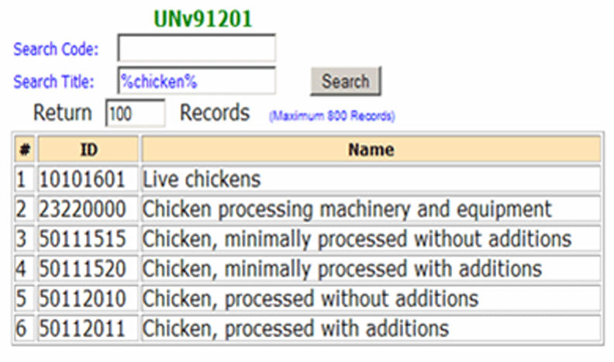
An Organizing System with Global Scope and Scale (unspsc.org)

Slide 37
Nature and Number of Users
How precisely a collection of resources can be described and organized depends on well user types and requirements are known
In some contexts, user types and individual users can be controlled and identified
In others, types and users aren’t known until the organizing system is in operation
37

Slide 38
Who Are We Designing For?
User
Operator
Customer
Patient
Client
Buyer
…

Slide 39
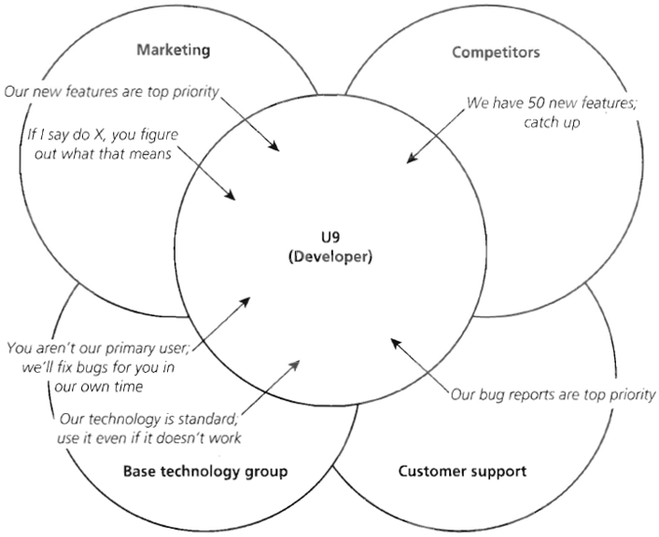
Stakeholder Conflicts

Slide 40
Requirements about Resource Description
The most generic interactions use descriptions that can be associated with almost any type of resource, such as the name, creator, and date
Different types of resources must have differentiating properties, otherwise there would be no reason or way to distinguish them as different types
40

Slide 41
Descriptive Precision
Writers, poets, painters, composers, sculptors, technical writers, programmers, producers, architects, designers, and devices or machines can all create resources
The Dublin Core vocabulary has a single property for indicating a “creator”
Easier to use, but loses a great deal of precision

Slide 42
The Choice of Organizing Properties Matters!
Organization using behavior or preferences can make interactions highly efficient for some users and the opposite for those who act differently
When multiple properties are used to organize resources, their order determines the arrangement and the ease of interactions
This implies the need to prioritize user and interaction types
42

Slide 43
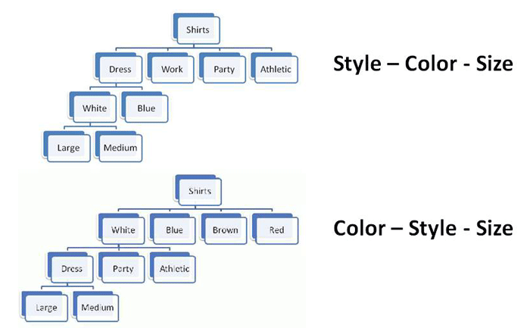
Multiple Properties in Different Order
43

Slide 44
Expected Lifetime
Usually correlated with number of users and resources; small collections with single users are often ad hoc and don’t outlive the specific tasks for which they were created
Think architecturally to enable more robustness and flexibility with respect to changes in technology or business contexts
44

Slide 45
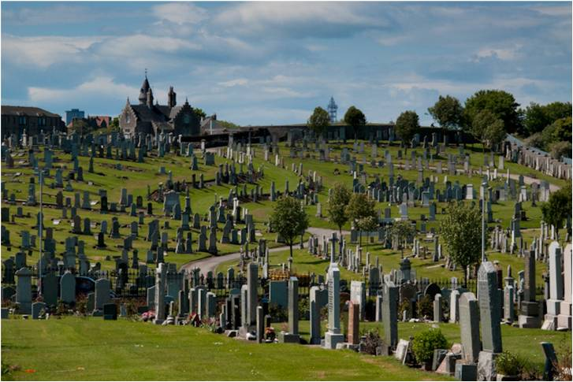
Don’t Confuse Lifetime of Resources with that of the Organizing System (1)
45

Slide 46
Don’t Confuse Lifetime of Resources with that of the Organizing System (2)
http://www.seattlemag.com/article/mise-en-place-local-dining-trend-2013
http://ateaseinnkeepers.com/mise-en-place/
Mise en place
46

Slide 47
Physical or Technological Environment
Physical environments create possibilities for organizing and interaction
But there might be constraints that limit them
“Installed base” or “legacy” concerns
Be careful if you are designing or selecting technology for an organizing system
Avoid resource-specific investments unless absolutely justified
47

Slide 48
Physical or Technological Environment (2)
Estimating the ultimate size of a collection at the beginning of an organizing system’s lifecycle can reduce scaling issues related to storage or interaction space
Invest in flexibility and extensibility
=> cloud computing, SOA
48

Slide 49
Physical or Technological Environment (3)
The environment influences that expectations, behavior, and experience of the people who interact with it
49

Slide 50
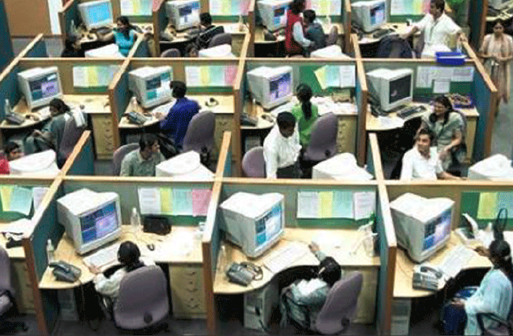
Want to Work Here?
50

Slide 51
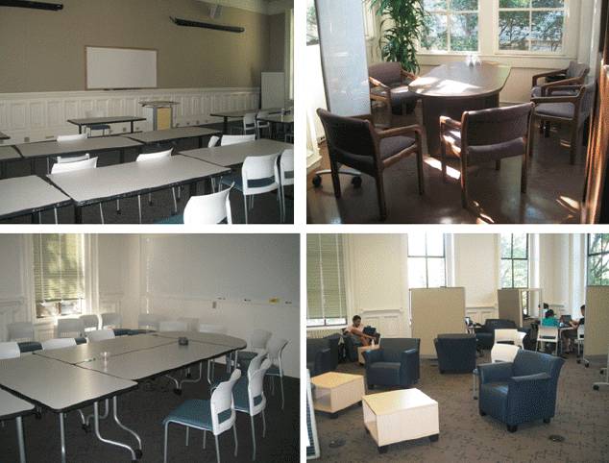
Do these Spaces Facilitate Organization and Interaction?
51

Slide 52
Relationships with Other Organizing Systems
No organizing system exists in isolation
There are always overlapping and adjacent systems from the user’s perspective
Sometimes it is possible to design these to work together to achieve integration and interoperability, or standards / ecosystem can emerge
At very least, try not to make this difficult
52

Slide 53
INFO 202 “Information Organization & Retrieval” Fall 2016
Robert J. Glushko glushko@berkeley.edu
@rjglushko
7 September 2016 Summary of Design Tradeoffs for Organizing Systems

Slide 54
Fundamental Tradeoffs in an Organizing System (1)
There is a tradeoff between the amount of work that goes into describing and organizing a collection of resources and the amount of work required to find and use them
The more effort we put into describing and organizing resources, the more effectively they can support interactions
The more effort we put into interacting with resources, the less they need to be organized first
54

Slide 55
Fundamental Tradeoffs in an Organizing System (2)
We need to think in terms of investment, allocation of costs and benefits between the describer/organizer and user
The allocation differs according to the relationship between them; who does the work and who gets the benefit?
55

Slide 56
Fundamental Tradeoffs in an Organizing System (3)
It is critical to determine an appropriate mix of methods for creating and maintaining resource descriptions, because their cost, quality, consistency, completeness, and semantic richness depends on which human or computational agents do the work
56

Slide 57
Fundamental Tradeoffs in an Organizing System (4)
Business strategy and economics strongly influence the extent of resource description and the use of technology for automatic description
The tradeoffs imposed by the extent and timing of resource description arise throughout the lifecycle, with the tradeoff between recall and precision being the most salient
57

Slide 58
Summary: Architectural Thinking

Slide 59
Next Week
Monday 9/12 is ALUMNI DAY
Chance to catch up/get ahead on reading!
Read 2 case studies (Rail transit, Neuroscience lab)
Wednesday 9/14
Resources (TDO 4)

