Slide 1

INFO 202
“Information Organization & Retrieval”
Fall 2016
UNIVERSITY OF CALIFORNIA, BERKELEY
SCHOOL OF INFORMATION
Robert J. Glushko
glushko@berkeley.edu
@rjglushko
21 September 2016
The Document Type Spectrum

Slide 2
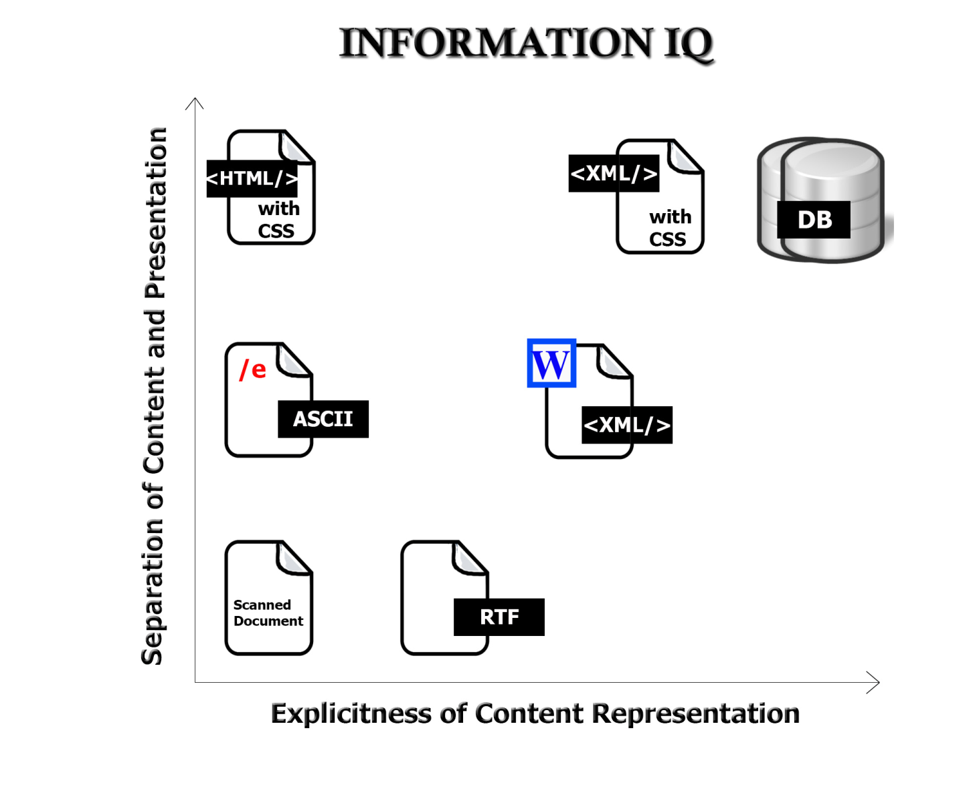
The Digital Format Matters!
2

Slide 3
Documents vs. Data
Many people have contrasted "documents" and "data" as resource types and concluded that documents and data cannot be understood and handled with the same terminology, techniques, and tools
This document vs. data distinction is embedded and reinforced in textbooks, technology, and product marketing
But a more abstract perspective on document use and recognizing the continuum of the Document Type Spectrum motivate a more unified approach
3

Slide 4
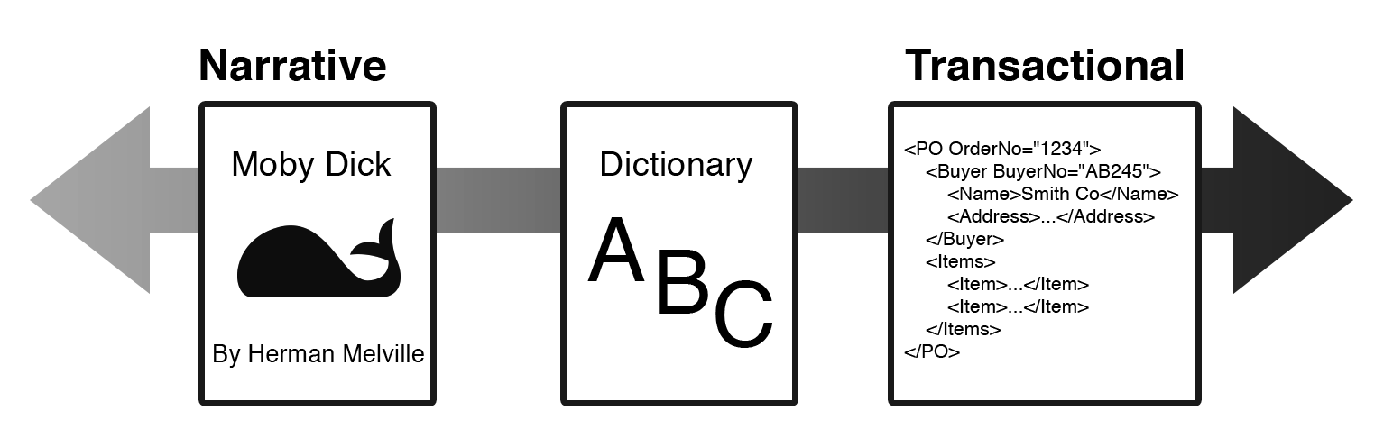
The Document Type Spectrum
There is systematic and continuous variation in document instances and types and there is no clear boundary between “documents” and “data”
Many familiar information processes involve both documents and data, often transforming one into the other

Slide 5
The Spectrum of Structure
NARRATIVE documents typically have relatively little internal structure, and that usually varies across instances of the same document type
HYBRID document types are often called "semi-structured“ because they have more structure than narrative ones but less than fully-structured transactional ones
TRANSACTIONAL documents are completely and regularly structured because they contain many specific information components that are distinguished by their content type
5

Slide 6
INFO 202
“Information Organization & Retrieval”
Fall 2016
UNIVERSITY OF CALIFORNIA, BERKELEY
SCHOOL OF INFORMATION
Robert J. Glushko
glushko@berkeley.edu
@rjglushko
21 September 2016
Introduction to
Resource Description

Slide 7
An Introduction to Resource Description
What is a resource description?
Why do we describe resources?
What resource properties should be described?
How are resource descriptions created?
What makes a good resource description?
7

Slide 8
What is a Resource Description?
Information that is created intentionally and associated with a resource to enable it to be organized and interacted with
A resource description is also a resource from the perspective of any other resource that uses it, ad infinitum
Structured descriptions of information resources are often called “metadata” but… ☹
8

Slide 9

A Resource

Slide 10
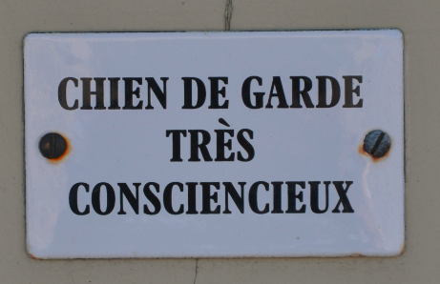
Metadog, not Metadata
dans Les Baux-de-Provence, 8 Août 2013

Slide 11
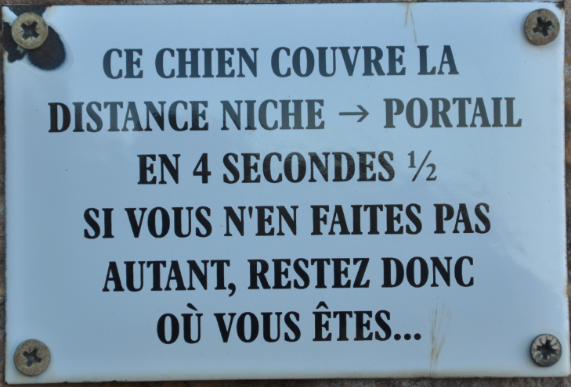
Metadog 2
Poleymieux, 21 février 2016

Slide 12
Why We Describe Resources
We describe resources so we can refer to them, select them, organize them, interact with them (especially to compare them), and maintain them
Each purpose might require different descriptions and different methods of using them
Different resource domains can have characteristic or standard resource descriptions (or description categories)
But different types of resources must also have differentiating properties, or there would be no basis or reason to distinguish them
12

Slide 13
Objectives of Bibliographic Description (FRBR)
Finding a resource that you know exists
Identifying a resource to make sure you have the one you were looking for
Selecting a resource from a set of candidates in a collection
Obtaining the resource if what you have at this point is just a resource description
Exploring a set of resources by following relationships among them
13

Slide 14
Resource Descriptions as Substitutes
A resource description is often a functional substitute for the resource it describes when the latter can’t be accessed or used
Computer-processable descriptions of physical resources are especially good substitutes because they enable manipulations and interactions otherwise impossible (atoms vs. bits)
We collect data about people, analyze it, organize it…. and use it to organize the people
14

Slide 15
Complications
The properties of resources that are easiest to describe are not always the most useful ones, especially for information resources
“The context of description” influences (or biases) the descriptions
15

Slide 16
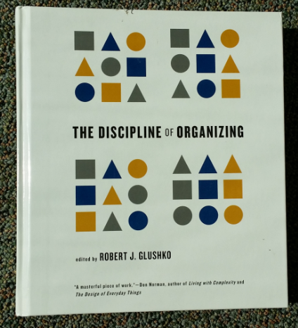
Describing the Information
<Book>
<Title>The Discipline of Organizing</Title>
<Editor>Robert J. Glushko</Editor>
<Publisher>MIT Press</Publisher>
<PublicationDate>2013</PublicationDate>
<ISBN>978-0-262-51850</ISBN>
<Keyword>Classification</Keyword>
<Keyword>Resource Description</Keyword>
</Book>
Describing the Thing
<Book>
<Weight unit=“pound”>2.58</Weight>
<Height unit=“inch”>9.25</Height>
<Width unit=“inch”>8.25</Width>
<Pages>540</Pages>
<SpineColor>White</SpineColor>
</Book>
16

Slide 17
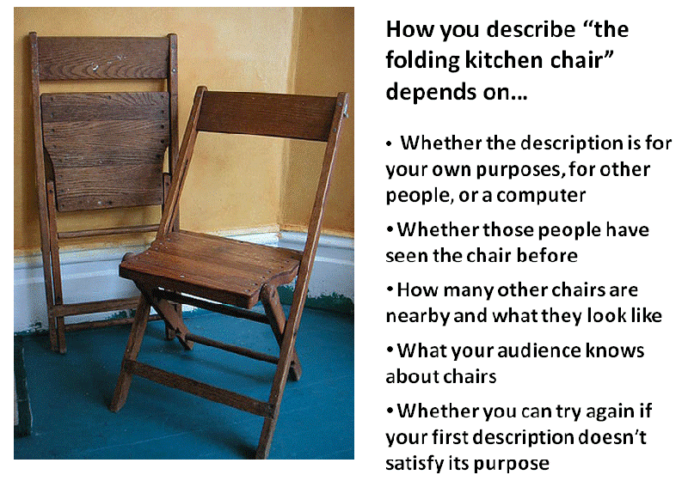
The Kitchen Chair

Slide 18
INFO 202
“Information Organization & Retrieval”
Fall 2016
UNIVERSITY OF CALIFORNIA, BERKELEY
SCHOOL OF INFORMATION
Robert J. Glushko
glushko@berkeley.edu
@rjglushko
21 September 2016
Resource Properties
and Description

Slide 19
Classifying Resource Properties

Slide 20
Intrinsic Properties
Intrinsic properties are inherent in a resource
Some are static, never changing their values
Others are dynamic, but they change “from the inside of the resource” not “from the outside” by actions or efforts of outside agents (like “developmental” properties – age, skill, experience)
Intrinsic properties can sometimes be used as an identifier - like a computed "signature" for a document or media object
20

Slide 21
Physical Properties 1
Physical or perceptible properties are those "at the surface" that are immediately apparent
For "natural" things, these physical properties often make excellent descriptors because they are intrinsic or inherent rather than assigned
Some properties are very distinctive or occur in consistent, predictable, and correlated combinations, which make them reliable aids to identifying instances or classifying types of things (the “joints of nature”)
21

Slide 22
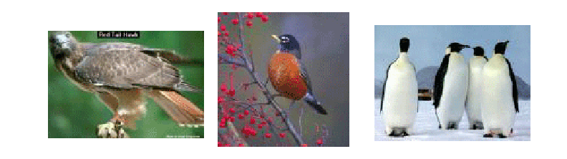
Which Properties Best Identify a Thing?
A Type of Thing?
The properties best for identifying an instance might be those that aren't typical of its class
22

Slide 23

Distinctive Physical Properties
23

Slide 24

Physical Properties 2
For "manmade" things surface properties are less predictable because functionality can be implemented below the surface
For "information" things in physical form the correlation between appearance and content varies across the Document Type Spectrum
For "born digital" resources the appearance is often extrinsic because it is assigned or associated instead of being an inherent part of the resource when it was created
24

Slide 25
Extrinsic Properties
Extrinsic properties are assigned to a resource rather than being inherent in it
Some extrinsic properties are static: assigned names or identifiers don’t usually change
Other extrinsic properties change often: the current location, popularity, price, etc. of a resource
25

Slide 26

Cultural Properties
Cultural properties are those that derive from conventional language use or culture and often involve analogy
Because they derive from knowledge of culture or language, they might be unintelligible to people who don't have the same perspective and experience
“Holbein” Carpets
26

Slide 27
Contextual Properties
Contextual properties relate to the situation or context in which the thing being described exists
Context: “any information that characterizes a situation related to the interactions between users, applications, and the surrounding environment” (Dey et al 2001)
Since context changes, context-based descriptors might be appropriate when assigned but not later; see "persistence" and "effectivity"
27

Slide 28
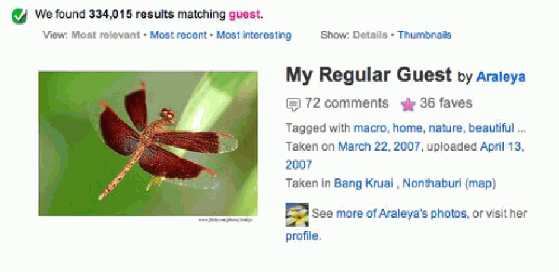
Contextual Description:
Private Language? Relational Property?
A "guest" tag makes sense to the photographer but no one else would use it to describe this photo if they don’t share the context

Slide 29
Structural Properties
The internal and external structure of a thing can be a useful part of its description (sometimes these are intrinsic, and other times extrinsic)
  The number and arrangement of component parts (e.g., the number of chapters or pages in a book)
  The number and type of connections with other resources (e.g., the number of Facebook friends or Twitter followers)
29

Slide 30
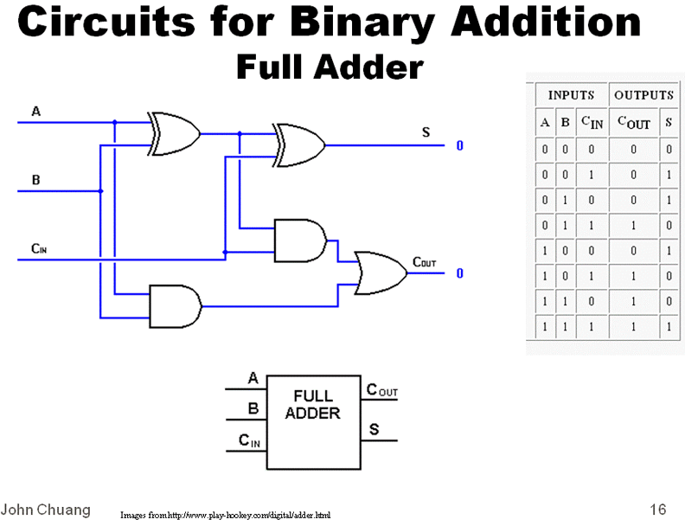
Meaning is Structure
Could you describe this without using structural concepts?

Slide 31
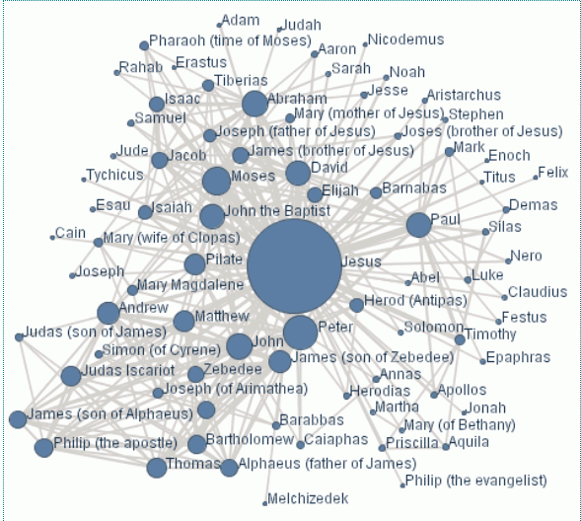
The Social Network of Jesus

Slide 32
Properties & Principles for
Organizing System of a Kitchen
  Intrinsic static properties: If you store your pots, frying pans, and baking pans and nest each set by size
  Extrinsic static properties: A spice rack with the spices arranged in alphabetical order
  Intrinsic dynamic properties if you arrange your milk and other perishable goods by expiration date, a “useful life remaining” property that decreases to zero as the expiration date approaches
  Extrinsic dynamic properties if you put the most frequently used condiments or spices in the front of a refrigerator or pantry shelf
32

Slide 33
Properties & Principles for a
Document Organizing System
  Intrinsic static properties: Author, date published, words in the text
  Extrinsic static properties: ISBN, LOC Classifications
  Intrinsic dynamic properties: Effectivity (e.g., laws and regulations)
  Extrinsic dynamic properties: Links/citations to and from other documents
33

Slide 34
Stop and Think:
Principles of Arrangement in
{a Clothing Store, …}
  Intrinsic static properties: …
  Extrinsic static properties: …
  Intrinsic dynamic properties: …
  Extrinsic dynamic properties: …
34

Slide 35
Properties vs. Relationships
But while we can express structure within and between resources as properties, there is “better language” for expressing this as RELATIONSHIPS
  Arrangement
  Proximity
  Connectivity
  Part-whole
  …
(See TDO Chapter 6, “Describing Relationships and Structures”)
35

Slide 36
INFO 202
“Information Organization & Retrieval”
Fall 2016
UNIVERSITY OF CALIFORNIA, BERKELEY
SCHOOL OF INFORMATION
Robert J. Glushko
glushko@berkeley.edu
@rjglushko
21 September 2016
Creating Description Vocabularies
and Assigning Descriptions

Slide 37
Process of Describing Resources
Identify / scope the resources to be described
Determine the purposes or uses of the descriptions
Study the resource(s) to identify descriptive properties
Design the description vocabulary
Design the description form and implementation
Create the descriptions (either "by hand" or by some automated / computational process
Evaluate the descriptions
(TDO FIGURE 5-3)
37

Slide 38
Complications
Do we know who the users are? Are the describers the users?
Do we have all the resources, a representative set, or just the first set ... do we know what else is coming?
  As a collection of resources grows, its requirements for interactions can change, and if the reasons for describing resources change, and the descriptions must change as well
Business strategy, economics, and technology context strongly influence the extent of resource description
38

Slide 39
Designing the Description Vocabulary
  Good descriptions use terms that their intended users might use
  Good descriptions don't contain details that aren't necessary
  Good descriptions are created systematically and follow standards
39

Slide 40
The Need for Controlled Vocabularies
  The words people use to describe things or concepts are "embodied" in their context and experiences... so they are often different or even "bad" with respect to the words used by others
  These naturally-occurring words are an "uncontrolled vocabulary"
40

Slide 41
The Need for Controlled Vocabularies
  Searches for resources using an uncontrolled vocabulary will not succeed when they fail to match resources described or indexed using a controlled vocabulary
  To agree on the words we use in descriptions will improve recall, but it means that we must use a subset of the words we would otherwise use
41

Slide 42
What is a Controlled Vocabulary?
  A controlled vocabulary is a standardized set of terms (such as subject headings, names, classifications, etc.) assigned by organizers / cataloguers / indexers of resources
  A CV can be a content standard for the values used in (or as) descriptive elements
  A CV can be thought of as a fixed or closed dictionary in which everything must be defined using the same set of terms
42

Slide 43
Types of Controlled Vocabularies
  Dictionaries
  Authoritative names
  Authority control for places and time periods
  Identifiers
  Code lists
  Subject heading lists (like the Library of Congress – LCSH)
  Thesauri
  Classification systems
43

Slide 44
Horizontal and Vertical Vocabularies
  Horizontal
    Concepts that are common to all (or a large number) of domains
    examples: XCBL, UBL
  Vertical
    Particular industry or vertical market
    Specialized product or process semantics
    Sometimes called “domain-specific languages”
44

Slide 45
“Dimensionality Reduction” in Descriptions
  Creating a controlled vocabulary reduces the number of descriptive terms that are or can be assigned to something
  When achieved by computational techniques, “dimensionality reduction” goes by names like "principle components analysis," "orthogonal decomposition," "latent semantic analysis," "factor analysis," “feature extraction,” and others
  These techniques analyze the correlations between descriptors and transform a large set into a smaller set of uncorrelated ones
  But they are statistical constructs and might not have any clear interpretation
45

Slide 46

Description Form and Implementation: Format Matters!

Slide 47
Creating Resource Descriptions
  By professionals: "Institutional" descriptions that follow standards
  By authors: Best knowledge of purpose and intended audience
  By users: Most variable, influenced by social purposes
  By automated processes: Most reliable, primarily technical / objective properties but semantic description capability is emerging
47

Slide 48
Evaluating Resource Descriptions
  Quality should be evaluated with respect to intended purposes... but what if different stakeholders have different purposes?
  Creating resource descriptions can be costly; is it worth it? How and when measure the costs?
  Computational description is vastly less expensive, but is it good enough?
  How can we incent "community" or "crowdsourced" description to be of better quality?
48

Slide 49
Stop and Think:
Description and Expertise
Everyone knows something about trees, but some people know more than others, and their particular experience and perspective influences how they describe trees.
What kind of properties and descriptions would be used by university students? By research botanists? By landscape designers? By park maintenance workers? By indigenous people who live in tropical rain forests?
49

Slide 50
Readings for Next Lecture
TDO on “Describing Non-Text Resources”
Graham Freeman’s recorded presentation
Case studies: Art Genome, Documentary Film
Harpring on “The Language of Images”
50

Slide 51
Prep for Graham Freeman
Compare shazam and midomi with respect to the “Shamu” question
Describe (a few sentences) the Bach (slide 4) and Mozart (slide 6) pieces of music
Did you use “resource descriptions” that can be easily compared?
Do you agree with Stravinsky that you need constraints to be creative?
51

