Slide 1
INFO 202 “Information Organization & Retrieval” Fall 2016
UNIVERSITY OF CALIFORNIA, BERKELEY
SCHOOL OF INFORMATION
Robert J. Glushko glushko@berkeley.edu
@rjglushko
5 October 2016 The Structural Perspective on Relationships

Slide 2
The Structural Perspective on Relationships
Analyzing the association, arrangement, proximity, or connection between resources without primary concern for their meaning or the origin of these relationships
Sometimes structure is all we know...and sometimes we ignore what we know about relationship semantics to focus on the generic aspect of structural connectivity
2

Slide 3
Internal and External Structure
Resources can have INTERNAL structure as well as EXTERNAL structure that connects them to other resources
We often make arbitrary decisions about how the granularity with which we describe the internal structure of a resource
The boundaries we impose to identify resources determines whether some structure is internal or external with respect to them
3

Slide 4
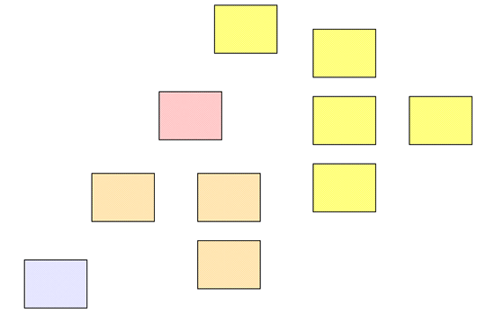
Separate Resources or Resource Components?
4

Slide 5
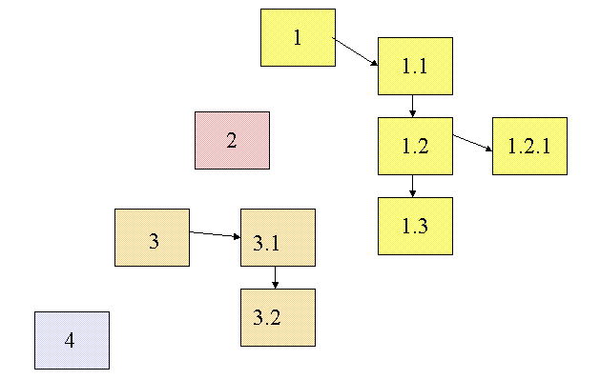
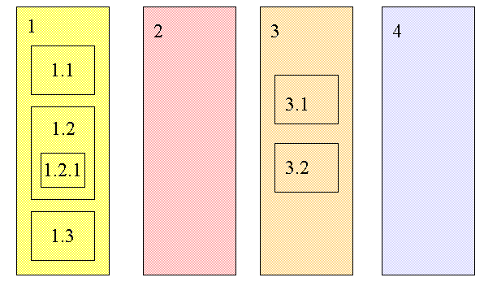
Changing Resource Boundaries Changes External to Internal Structure

Slide 6
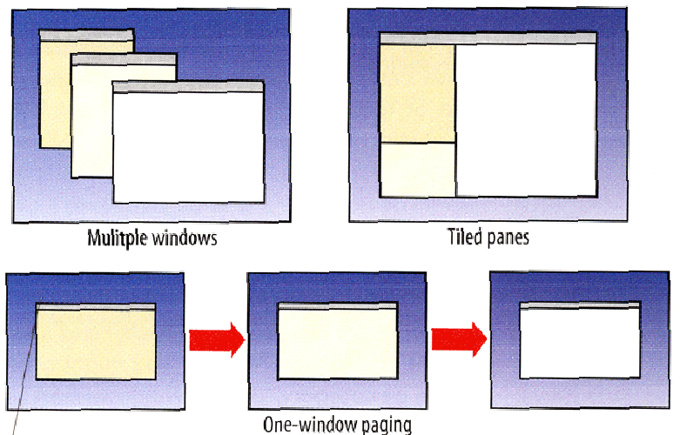
External or Internal Structures in a User Interface?

Slide 7
INFO 202 “Information Organization & Retrieval” Fall 2016
UNIVERSITY OF CALIFORNIA, BERKELEY
SCHOOL OF INFORMATION
Robert J. Glushko glushko@berkeley.edu
@rjglushko
5 October 2016 Document Structure & The Document Type Spectrum

Slide 8
The Document Type Spectrum
There is systematic and continuous variation in document instances and types and there is no clear boundary between “documents” and “data”
Many familiar information processes involve both documents and data, often transforming one into the other

Slide 9
The Spectrum of Structure
NARRATIVE documents typically have relatively little internal structure, and that usually varies across instances of the same document type
HYBRID document types are often called "semi-structured“ because they have more structure than narrative ones but less than fully-structured transactional ones
TRANSACTIONAL documents are completely and regularly structured because they contain many specific information components that are distinguished by their content type
9

Slide 10
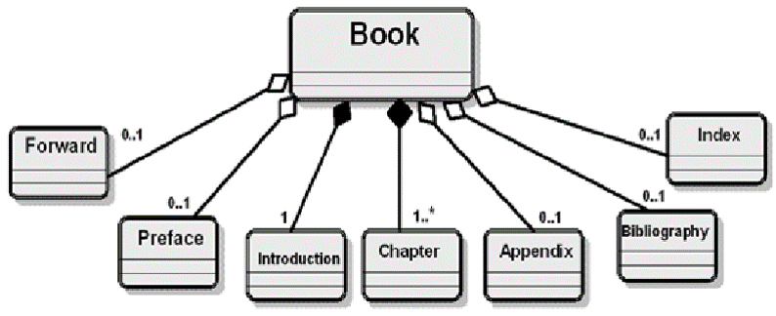
Structure in Narrative Document Types
NARRATIVE documents typically have relatively little internal structure, and that usually varies across instances of the same document type
10

Slide 11
Structure in Hybrid Document Types
HYBRID document types are often called "semi-structured“ because they have more structure than narrative ones but less than fully-structured transactional ones
The extent of explicit structure (“mixed content”) in semi-structured document types is an important design decision
There are benefits to more granular identification of semantic “nuggets”
But who does the work, and who gets the benefits?
11

Slide 12
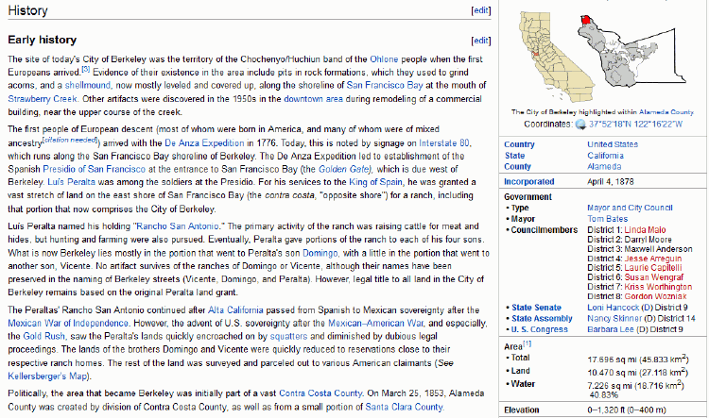
Encyclopedia: Semi-Structured Document Type

Slide 13
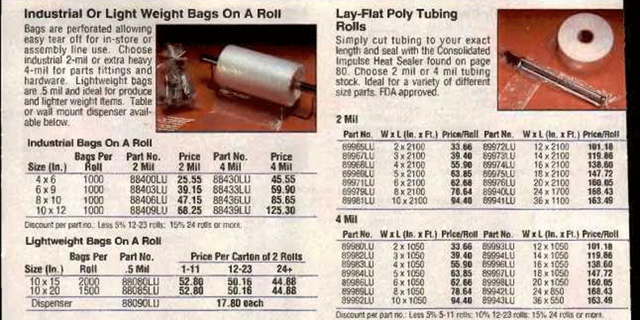
Catalogs Often Combine Narrative and Transactional Content

Slide 14
Structure in Transactional Documents
TRANSACTIONAL documents are completely and regularly structured because they contain many specific information components that are distinguished by their content type
These components are often organized in aggregate structures that can occur many times in the same document because they are typically created by repeated automated processes
14

Slide 15
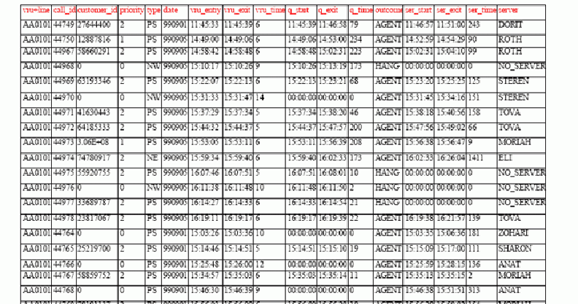
Call Center Log Transactional Document Type

Slide 16
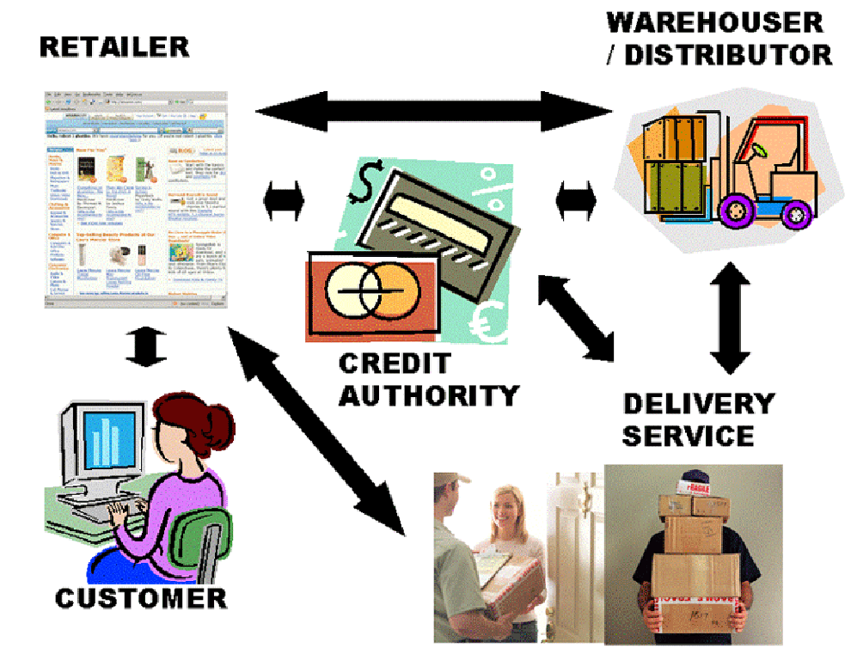
Business Models are Document Exchanges:
The “Drop Shipment” Document Exchange Choreography

Slide 17
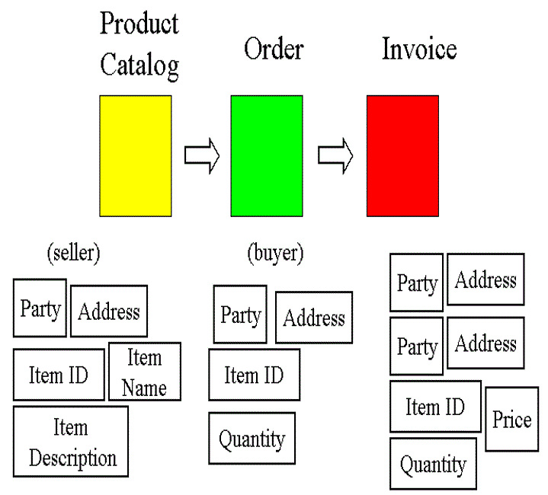

Slide 18
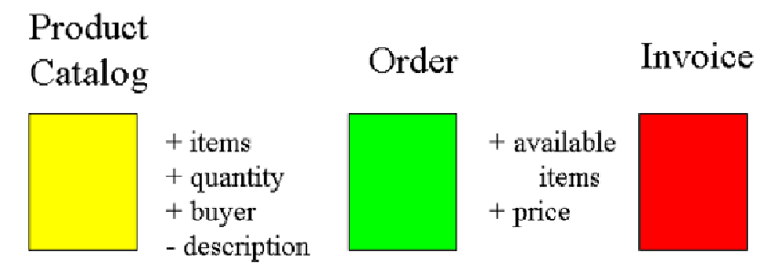
“Gluing” the Process Together with Shared Information Components

Slide 19
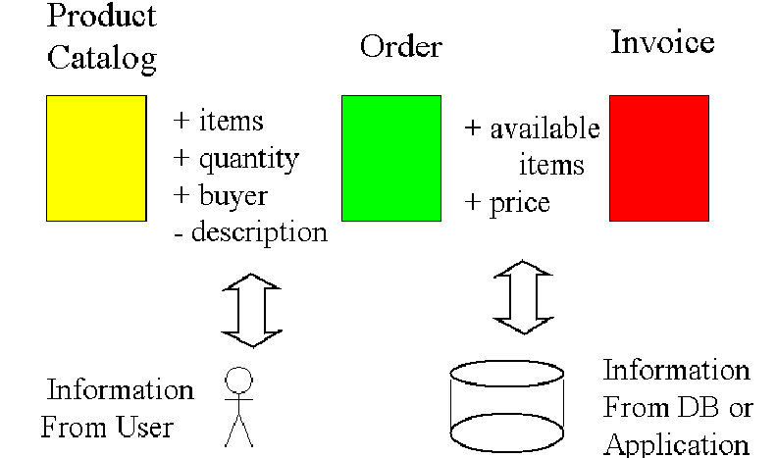
Shared Information Components Define the Application Architecture

