Slide 1
Plan for Today’s Lecture(s)
Classification and Standardization
MITRE Reference Model for Understanding and Comparing Standards
Businesses as Organizing Systems
Supply chains and information supply chains
Integration and Interoperability
1

Slide 2
INFO 202 “Information Organization & Retrieval” Fall 2016
UNIVERSITY OF CALIFORNIA, BERKELEY
SCHOOL OF INFORMATION
Robert J. Glushko glushko@berkeley.edu
@rjglushko
31 October 2016 Classification and Standardization

Slide 3
Classification and Standardization (1)
Classifications and standards both impose order on resources
They both distinguish, explicitly or implicitly, between standard / appropriate / effective and nonstandard / inappropriate / ineffective ways of creating organizing, and using resources
But this does not imply that a standard is a good one or that the best one will win a "standards war“
STOP AND THINK: Examples of standards wars?
3

Slide 4
Classification and Standardization (2)
Some classifications become standards
Every successful standard imposes a classification system
Standards and classification systems can have significant inertia, becoming part of the "installed base" or "infrastructure" and difficult to change
4

Slide 5
"Specifications"
A specification is an explicit and detailed description about how something (a product, system, service, or practice) works that might include:
the definitions of the key concepts or terms used in the description
the materials from which it is made
the components (tangible or intangible) that are arranged or assembled to make it work
the methods or processes by which it operates
the inputs and outputs for each method or process
5

Slide 6
"Standards"
A standard is a published specification that is developed and maintained by consensus of all the relevant stakeholders in some domain
following a defined and transparent process
usually under the auspices of a dedicated organization with the authority to create standards
6

Slide 7
Why Standards Exist (1)
Standards serve as a coordinating mechanism whenever there are alternative ways of doing or making something that might be incompatible or that otherwise wouldn't be possible
Standards can also serve as a regulating mechanism to restrict behavior or operation that might be unsafe, unfair, or otherwise "harmful“
7

Slide 8
Why Standards Exist (2)
Many standards define technical specifications and procedures to ensure a "common design" or "interoperability"
Standards define institutional categories about models, behaviors, or processes
8

Slide 9
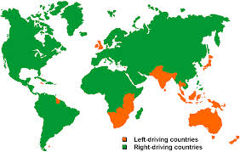
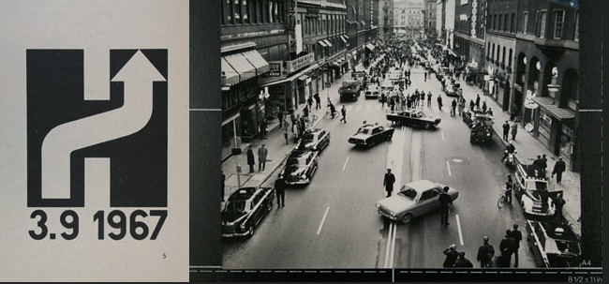
Which Side to Drive On?
‘Högertrafikomläggningen’ in Sweden

Slide 10
Who Sets Standards? (1)
Some technical standards are set by governments in order to protect the public interest
Other standards are set by organizations created precisely for the purpose of setting standards
Other standards are set by groups of companies who may or may not establish an ongoing organization
10

Slide 11
Who Sets Standards? (2)
Other "standards" begin as proprietary vendor specifications that will become "de facto" standards if they are widely adopted and achieve market dominance
Often "de facto" standards are submitted to a standards organization with the goal of "rubber stamping" them as "de jure" ones
11

Slide 12
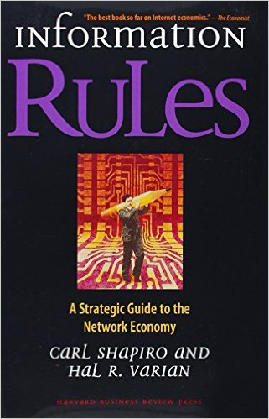
Standards and Network Effects
Standards are especially important in industries or domains that have significant "network effects" where the value of a product or service depends on the number of interoperable or compatible ones
These contexts are sometimes called "winner take all" markets, which is why standards wars take place - because of the economic implications
How do you encourage and enable others to conform to a standard?
12

Slide 13
Standards for Document Description in Organizing Systems (1)
For specific vocabularies or "domain-specific languages" (e.g., HTML, UBL, SPL, DocBook, DITA, EPUB, SVG)
For schema languages that formally define the domain-specific languages (e.g., XSD)
For "profiles" that suggest modeling practices like degree of abstraction and granularity, or constrain the possible values for some descriptor (e.g., AAT)
For the metalanguages used to encode the DSLs and schema languages (e.g., XML, SGML)
13

Slide 14
Standards for Document Description in Organizing Systems (2)
For the construction of file and document names
For identifying resources and namespaces
For specifying versions, stages or revisions of documents or other resources
14

Slide 15
Other Standards for Organizing Systems
Metadata standards (MARC, Dublin Core, EAD, METS, RDF, OWL)
Standards for classification (LoC, DD, BISAC)
Standards for thesaurus construction
Standards for processes (WS-*)
Standards for communication protocols
15

Slide 16
Using Standards in Organizing Systems
You may be required by the government, by your customers, or by "business partners" to conform to some organizing standards
But to the extent that standards embody best practices, it is a good idea to follow them anyway
Key Questions: When should you use an externally-required standard as your internal standard, and when should you “conform” by conversion or transformation “on the way out”
16

Slide 17
INFO 202 “Information Organization & Retrieval” Fall 2016
UNIVERSITY OF CALIFORNIA, BERKELEY
SCHOOL OF INFORMATION
Robert J. Glushko glushko@berkeley.edu
@rjglushko
31 October 2016 MITRE Reference Model for Understanding and Comparing Standards

Slide 18
MITRE Reference Model for Understanding and Comparing Standards
"We need to proactively produce new areas of useful semantic agreement, and not simply document correspondences among existing systems"
"An approach to semantics management must tolerate organizational realities that are often ignored“
18

Slide 19
Lessons From Standards Making: The "Person-Concept" Tradeoff
Semantic agreement comes at a cost driven by the number of people who require a shared understanding, and by the number of concepts they must all understand
A small group of people can agree on a complex standard, or a large group of people can agree on a simple one
19

Slide 20
Lessons from Standards Making: Incentives and Disincentives
Approaches that require perfect coordination and altruism are of no practical interest
Disincentives to agree on semantics arise if agreement means that someone has to change an implementation and pay the cost of doing so
20

Slide 21
MITRE Reference Model for Comparing Standards: Data Objects
What is the semantic granularity of the concepts being standardized?
Is there also a standard for how the concepts are encoded in some syntactic or physical representation?
Does the standard also specify "instance sets" or possible values for each data element concept?
21

Slide 22
MITRE Reference Model for Comparing Standards: Structures
In addition to standards for data objects, are there standards for schemas or "document architectures" that structurally organize them?
Are there standards for the instances or interchange formats used by publishers/producers or expected by subscribers/consumers?
22

Slide 23
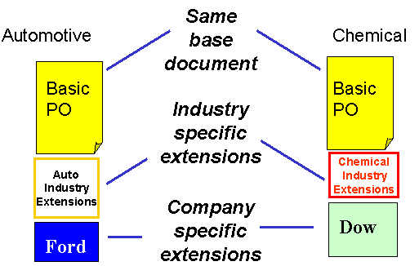
Horizontal and Vertical Document Components
23

Slide 24
MITRE Reference Model for Comparing Standards: Community Characteristics
Is there a primary stakeholder with decision making authority, or is authority distributed?
What are participants' obligations to support the standard?
Do the participants already share an understand of the domain to be standardized?
24

Slide 25
Lessons from Standards Making: Enterprise Data Standards
Standards-making can be successful when a "single authority exercises effective control over the system requirements, funding, the developers, and the users"
But a very large enterprise cannot hope to construct a single data model (or even a single-set of universally understood concept definitions) for all the data it requires
25

Slide 26
Lessons from Standards Making: "Communities of Interest"
Standards making is best organized around naturally formed communities of interest rather than "org chart" organizations
Different types of communities might be needed to develop, deploy, and maintain a standard
Who should be involved in creating a standard vocabulary for describing a sporting event?
26

Slide 27
INFO 202 “Information Organization & Retrieval” Fall 2016
UNIVERSITY OF CALIFORNIA, BERKELEY
SCHOOL OF INFORMATION
Robert J. Glushko glushko@berkeley.edu
@rjglushko
31 October 2016 Businesses as Organizing Systems

Slide 28
Businesses as Organizing Systems
The definition of Organizing System as an intentionally arranged collection of resources can be applied to business design and operation
It is also easy to see that at an abstract level almost all businesses are organized according to similar principles and patterns
Businesses share common external influences, especially those in the same industry
They also share common internal influences and goals
28

Slide 29
What Businesses Do
Design and Engineering – figuring out how to make stuff, increasingly by collaborating with people who make the materials and components
Manufacturing – making stuff, often with much of the assembly done “upstream” in a supply chain or by collaborating with people who are "downstream" toward the customer to customize it; intangible stuff often is delivered in more tangible packages
Human Resources, Finance, MIS – organizing and taking care of the people who do everything
Information Systems – designing, deploying, supporting computing and communications infrastructure
29

Slide 30
Describing What Businesses Do
Organization-level or business model patterns: marketplace, auction, supply chain, build to order, drop shipment, vendor managed inventory, etc.
Business process patterns: procurement, payment, shipment, reconciliation, etc.
Business information patterns: document models for catalog, purchase order, invoice, etc., and models for the components they contain for party, time, location, measurement, price, etc.
➔ Universal Business Language
30

Slide 31
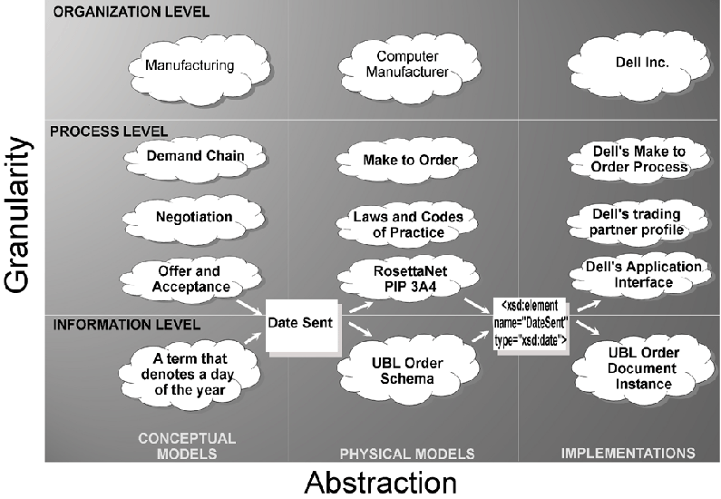

Slide 32
Generalizing Business Patterns
You can identify business model patterns inductively, by looking at specific examples of businesses and factoring out repeating elements
Bank in supermarket
Fast food franchise in supermarket
Post office in supermarket
==> PATTERN: Complementary product or service for supermarket customers "plugged into" supermarket
32

Slide 33
The Co-evolution of Technology and Business Organization
Info & Com technology has changed the structure and operation of firms; less hierarchical and more network forms
Information about goods becomes a good (or a service)
From forecast/schedule-driven to demand/event-driven business models
From tightly to loosely coupled relationships/architectures
From proprietary to standard models with reusable components
33

Slide 34
The Data-Driven Business
No forecast can ever be as accurate as actual sales and demand information
The key to business optimization isn't doing things faster according to plans, it is doing things smarter according to actual demand
"Information-driven decisions" can be make more reliably and with less latency when applications and sensor networks collect information
34

Slide 35
INFO 202 “Information Organization & Retrieval” Fall 2016
UNIVERSITY OF CALIFORNIA, BERKELEY
SCHOOL OF INFORMATION
Robert J. Glushko glushko@berkeley.edu
@rjglushko
31 October 2016 Supply Chains and Inter-Enterprise Information Exchange

Slide 36
The Supply Chain Pattern
A supply chain is an organizing system that defines the end-to-end view of the buy-side and sell-side relationships of an enterprise
A supply chain is the network of facilities and distribution capabilities an enterprise uses to:
"Source" (or "procure") raw materials (chemicals, ores, grains, ...) or components
Transform the materials or assemble the components into products
Deliver the products to customers (indirectly through distributors or stores or directly to the purchaser)
36

Slide 37
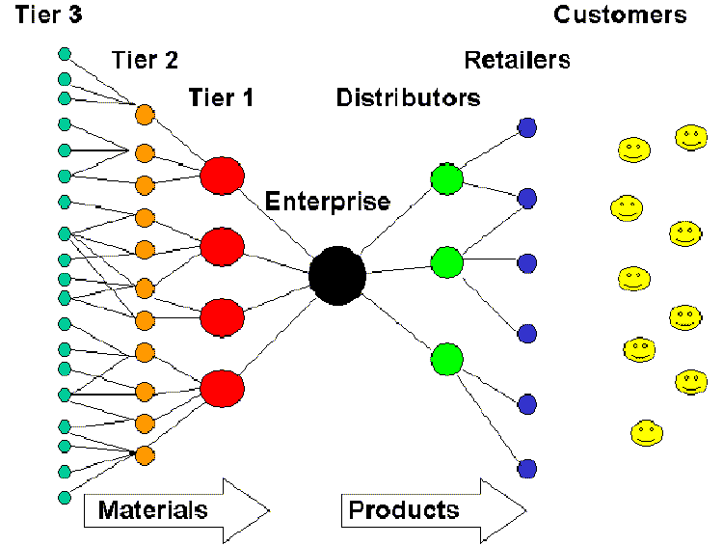
Conceptual Model of a Supply Chain
37

Slide 38
The Information Supply Chain
The flow of materials and goods in a supply chain is accompanied by information about it
But information about supply chain activities and processes is increasingly separated from the physical flow of materials and goods, and for information-based services there are no physical resources to move
38

Slide 39
The Information Supply Chain
Information also flows in the opposite direction from the customer, retailers, and distributors back into the supply chain – this is also called the DEMAND CHAIN
The information supply chain has become especially important because increased global competition and better informed customers are forcing forms to shift from forecast to demand (i.e. customer) driven business models
39

Slide 40
Design Issues for the Information Supply Chain
What information is exchanged? Why?
Which entities in the supply chain are able to exchange information?
What is the frequency of this information exchange?
Which entity or event initiates the exchange?
40

Slide 41
INFO 202 “Information Organization & Retrieval” Fall 2016
UNIVERSITY OF CALIFORNIA, BERKELEY
SCHOOL OF INFORMATION
Robert J. Glushko glushko@berkeley.edu
@rjglushko
31 October 2016 Integration and Interoperability

Slide 42
Integration
Integration is the "controlled sharing of information" between two (or more) business systems, applications, or services within or between firms
Integration means that one application can extract or obtain information from another one
It doesn't mean that the information will work "as is" in the target application
"Enterprise integration" - making different applications share information - has long been a substantial portion of the IT activities in many companies
42

Slide 43
Inter-Enterprise Data Integration
Data integration between companies so they can do business with each other is also a huge IT challenge
Suppose you publish your web service interface description; this says "my ordering service requires a purchase order that conforms to this schema"
This says "send me MY purchase order" not "send me YOUR purchase order"
Will the purchase orders being used by other firms meet your interface requirement, either directly or after being transformed?
43

Slide 44
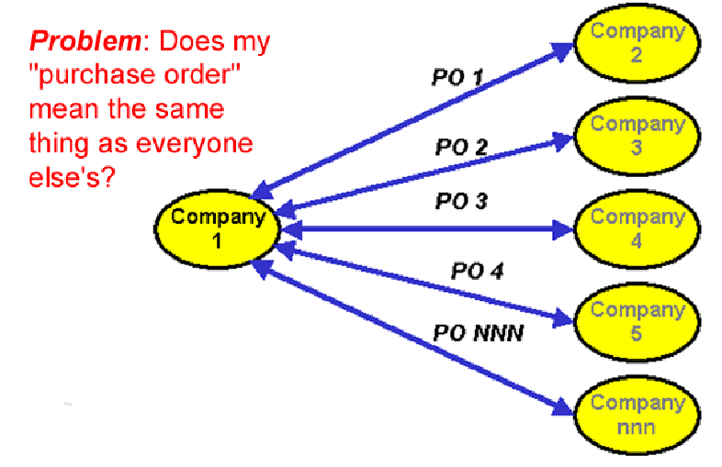
To Interoperate, or not to Interoperate?
44

Slide 45
Syntactic, Structural, & Semantic Interoperability
SYNTACTIC interoperability is just the ability to exchange information
STRUCTURAL interoperability means that all of the expected information components are present with the same arrangement and granularity
SEMANTIC interoperability requires that the content of the message be understood by the recipient application or process
Semantic integration is the process by which this common semantic model is created
45

Slide 46
Interoperability isn't All or None
Some interoperability problems can be detected and resolved by completely automated means
Other problems can be detected and resolved with some human intervention
Other problems can be detected but not resolved
Some problems can go undetected
46

Slide 47
Ways NOT to Interoperate
Elements with the same meaning can have different names ("IssueDate" vs "OrderIssueDate")
Elements with the same meaning can have different names or different formats even when they have the same name (September 11, 2001, 9/11/2001 and 9-11-01; 11/09/01 in Europe)
Same meaning, but encoded differently: in XML using attributes instead of elements
47

Slide 48
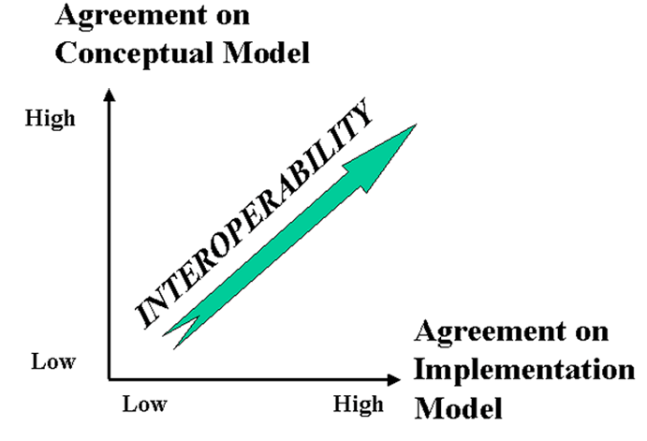
The Dimensions of Interoperability
48

Slide 49
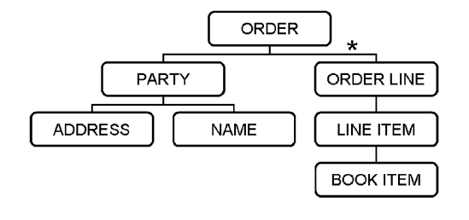
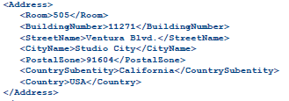
Example: Model of a Purchase Order
EXPECTED ADDRESS

Slide 50
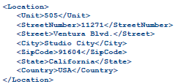
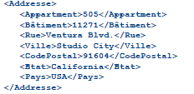
Conceptual Agreement, Implementation Disagreement: Easy to Make Interoperable

Slide 51
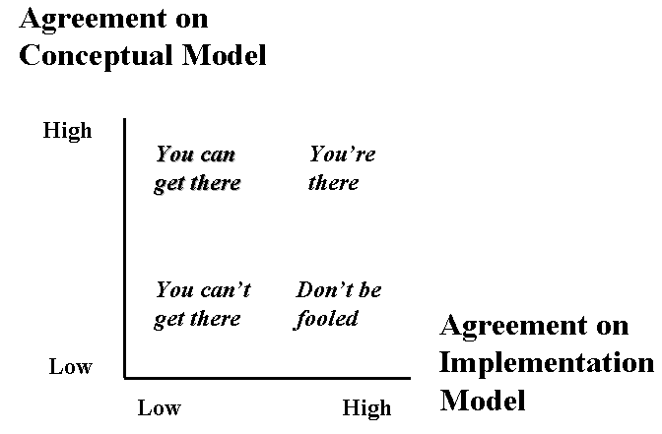
Conceptual Disagreement
<Address>
<Latitude direction=“N”>37.871</Latitude>
<Longitude direction=“W”>-122.271</Longitude>
</Address>
If you give this address to the postal service… will your package get there?

Slide 52
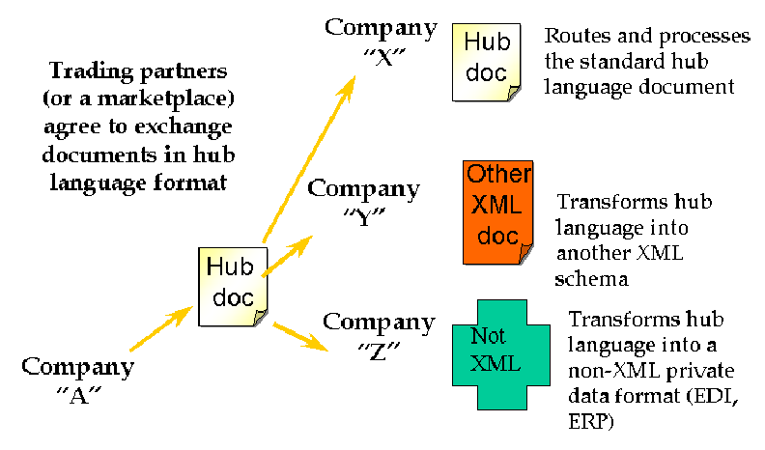
Interchange / Hub Languages
52

Slide 53
Mapping in and out of a Hub Language
If all parties/applications/services rely on a hub language for their external interfaces, an exponential interoperability challenge becomes a linear one
Mapping tools for transforming instances from an internal information model to another one are ubiquitous as standalone tools and as parts of application servers
EXAMPLE: Altova MapForce
53

