Slide 1
CS294-129: Designing, Visualizing and Understanding Deep Neural Networks
John Canny
Fall 2016
Lecture 4: Optimization
Based on notes from Andrej Karpathy, Fei-Fei Li, Justin Johnson
Notes:
Where to put block multi-vector algorithms?
Percentage of Future Work
Diagram

Slide 2
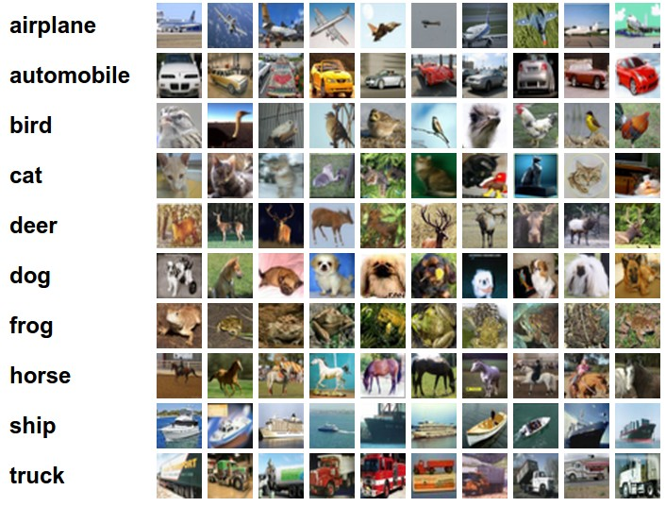
Last Time: Linear Classifier
Example trained weights of a linear classifier trained on CIFAR-10:

Slide 3
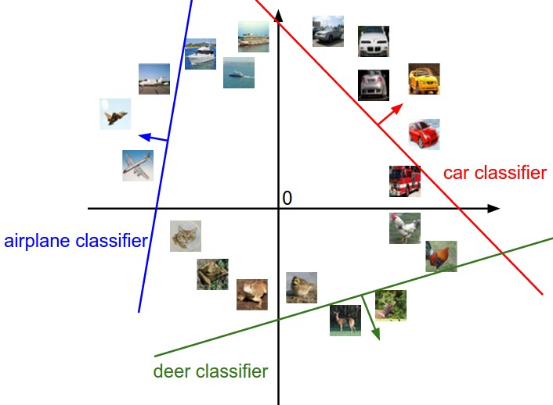
Interpreting a Linear Classifier
[32x32x3]
array of numbers 0...1
(3072 numbers total)

Slide 4
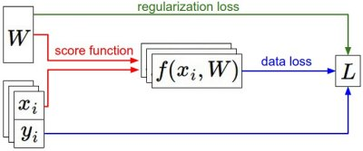
Last Time: Loss Functions
We have some dataset of (x,y)
We have a score function:
We have a loss function:
e.g.
Softmax
SVM
Full loss

Slide 5
Optimization

Slide 6
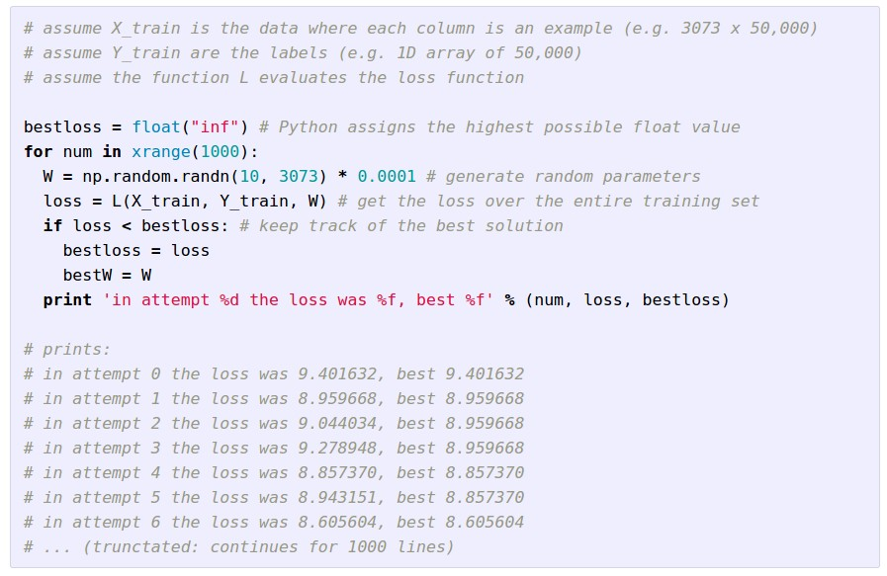
Strategy #1: A first very bad idea solution: Random search

Slide 7
Lets see how well this works on the test set...
15.5% accuracy! not bad!
(State of the art is ~95%)

Slide 10
Strategy #2: Follow the slope
In 1-dimension, the derivative of a function:
In multiple dimensions, the gradient is the vector of (partial derivatives).

Slide 11
current W:
[0.34,
-1.11,
0.78,
0.12,
0.55,
2.81,
-3.1,
-1.5,
0.33,…]
loss 1.25347
gradient dW:
[?,
?,
?,
?,
?,
?,
?,
?,
?,…]

Slide 12
current W:
[0.34,
-1.11,
0.78,
0.12,
0.55,
2.81,
-3.1,
-1.5,
0.33,…]
loss 1.25347
W + h (first dim):
[0.34 + 0.0001,
-1.11,
0.78,
0.12,
0.55,
2.81,
-3.1,
-1.5,
0.33,…]
loss 1.25322
gradient dW:
[?,
?,
?,
?,
?,
?,
?,
?,
?,…]

Slide 13
current W:
[0.34,
-1.11,
0.78,
0.12,
0.55,
2.81,
-3.1,
-1.5,
0.33,…]
loss 1.25347
W + h (first dim):
[0.34 + 0.0001,
-1.11,
0.78,
0.12,
0.55,
2.81,
-3.1,
-1.5,
0.33,…]
loss 1.25322
gradient dW:
[-2.5,
?,
?,
?,
?,
?,
?,
?,
?,…]
(1.25322 - 1.25347)/0.0001
= -2.5

Slide 14
current W:
[0.34,
-1.11,
0.78,
0.12,
0.55,
2.81,
-3.1,
-1.5,
0.33,…]
loss 1.25347
W + h (second dim):
[0.34,
-1.11 + 0.0001,
0.78,
0.12,
0.55,
2.81,
-3.1,
-1.5,
0.33,…]
loss 1.25353
gradient dW:
[-2.5,
?,
?,
?,
?,
?,
?,
?,
?,…]

Slide 15
current W:
[0.34,
-1.11,
0.78,
0.12,
0.55,
2.81,
-3.1,
-1.5,
0.33,…]
loss 1.25347
W + h (second dim):
[0.34,
-1.11 + 0.0001,
0.78,
0.12,
0.55,
2.81,
-3.1,
-1.5,
0.33,…]
loss 1.25353
gradient dW:
[-2.5,
0.6,
?,
?,
?,
?,
?,
?,
?,…]
(1.25353 - 1.25347)/0.0001
= 0.6

Slide 16
current W:
[0.34,
-1.11,
0.78,
0.12,
0.55,
2.81,
-3.1,
-1.5,
0.33,…]
loss 1.25347
W + h (third dim):
[0.34,
-1.11,
0.78 + 0.0001,
0.12,
0.55,
2.81,
-3.1,
-1.5,
0.33,…]
loss 1.25347
gradient dW:
[-2.5,
0.6,
?,
?,
?,
?,
?,
?,
?,…]

Slide 17
current W:
[0.34,
-1.11,
0.78,
0.12,
0.55,
2.81,
-3.1,
-1.5,
0.33,…]
loss 1.25347
W + h (third dim):
[0.34,
-1.11,
0.78 + 0.0001,
0.12,
0.55,
2.81,
-3.1,
-1.5,
0.33,…]
loss 1.25347
gradient dW:
[-2.5,
0.6,
0,
?,
?,
?,
?,
?,
?,…]
(1.25347 - 1.25347)/0.0001
= 0

Slide 18
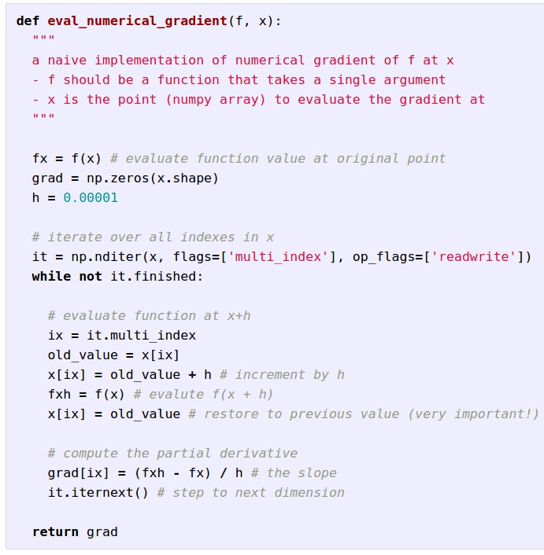
Evaluating the
gradient numerically

Slide 19
Evaluating the
gradient numerically
approximate
very slow to evaluate

Slide 20
This is silly. The loss is just a function of W:
want

Slide 21
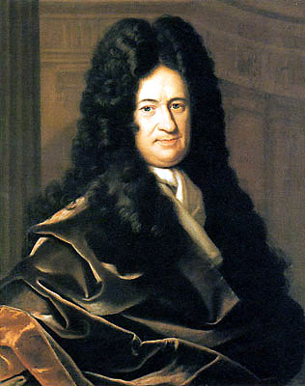
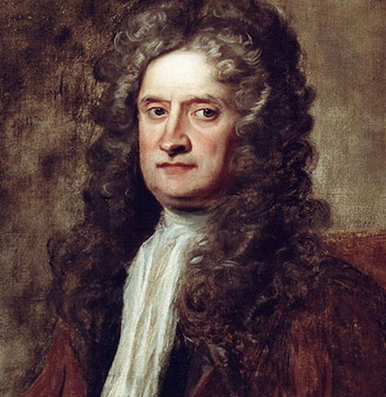
This is silly. The loss is just a function of W:
want

Slide 22
This is silly. The loss is just a function of W:
want
Calculus

Slide 23
This is silly. The loss is just a function of W:
= ...

Slide 24
current W:
[0.34,
-1.11,
0.78,
0.12,
0.55,
2.81,
-3.1,
-1.5,
0.33,…]
loss 1.25347
gradient dW:
[-2.5,
0.6,
0,
0.2,
0.7,
-0.5,
1.1,
1.3,
-2.1,…]
dW = ...
(some function data and W)

Slide 25
In summary:
Numerical gradient: approximate, slow, easy to write
Analytic gradient: exact, fast, error-prone
=>
In practice: Always use analytic gradient, but check implementation with numerical gradient. This is called a gradient check.

Slide 26
Gradient Descent

Slide 27
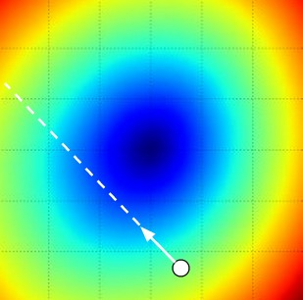
W_2
original W
W_1
negative gradient direction

Slide 28
Mini-batch Gradient Descent
only use a small portion of the training set to compute the gradient.
Common mini-batch sizes are 32/64/128 examples
e.g. Krizhevsky ILSVRC ConvNet used 256 examples

Slide 29
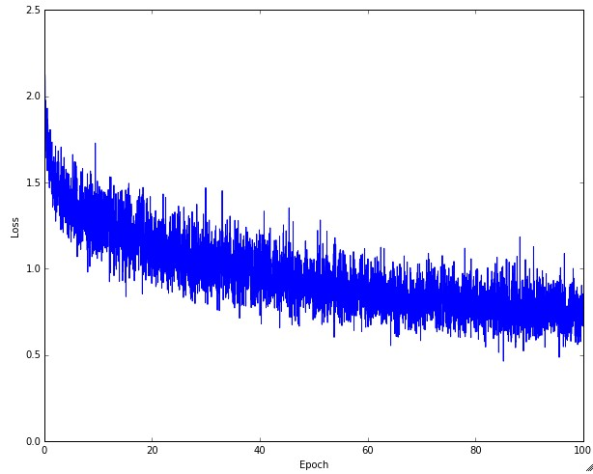
Example of optimization progress while training a neural network.
(Loss over mini-batches goes down over time.)

Slide 30
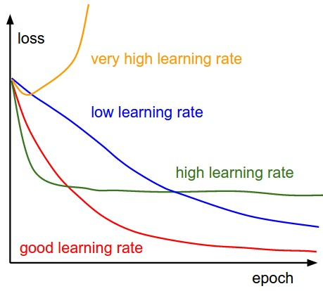
The effects of step size (or “learning rate”)

Slide 31
Mini-batch Gradient Descent
only use a small portion of the training set to compute the gradient.
we will look at more fancy update formulas
(momentum, Adagrad, RMSProp, Adam, …)
Common mini-batch sizes are 32/64/128 examples
e.g. Krizhevsky ILSVRC ConvNet used 256 examples

Slide 32
Minibatch updates
W_2
True negative gradient direction
W_1
original W

Slide 33
Stochastic Gradient
W_2
noisy gradient from minibatch
W_1
original W

Slide 34
Stochastic Gradient Descent
W_2
True gradients in blue minibatch gradients in red
W_1
original W
Gradients are noisy but still make good progress on average

Slide 35
Updates
We have a GSI, looking for a second.
Recording is happening from today, should be posted on Youtube soon after class.
Trying to increase enrollment. Depends on:
Petition to the Dean, fire approval.
New students should be willing to view video lectures.
Assignment 1 is out, due Sept 14. Please start soon.

Slide 36
You might be wondering…
W_2
Standard gradient
Can we compute this?
W_1

Slide 37
Newton’s method for zeros of a function
Based on the Taylor Series for $f\left(x+h\right)$:
$$f\left(x+h\right)=f\left(x\right)+hf^{′}\left(x\right)+ O\left(h^{2}\right)$$
To find a zero of f, assume $f\left(x+h\right)=0$, so
$$h≈−\frac{f\left(x\right)}{f′\left(x\right)}$$
And as an iteration:
$$x_{n+1}= x_{n} − \frac{f\left(x_{n}\right)}{f′\left(x_{n}\right)}$$

Slide 38
Newton’s method for optima
For zeros of $f(x)$:
$$x_{n+1}= x_{n} − \frac{f\left(x_{n}\right)}{f′\left(x_{n}\right)}$$
At a local optima, $f^{′}\left(x\right)=0$, so we use:
$$x_{n+1}= x_{n} − \frac{f′\left(x_{n}\right)}{f′′\left(x_{n}\right)}$$
If $f′′\left(x\right)$ is constant ($f$ is quadratic), then Newton’s method finds the optimum in one step.
More generally, Newton’s method has quadratic converge.

Slide 39
Newton’s method for gradients:
To find an optimum of a function $f(x)$ for high-dimensional $x$, we want zeros of its gradient: $∇f\left(x\right)=0$
For zeros of $∇f(x)$ with a vector displacement $h$, Taylor’s expansion is:
$$∇f\left(x+h\right)=∇f\left(x\right)+h^{T}H_{f}\left(x\right)+ O\left({|\left|h\right||}^{2}\right)$$
Where $H_{f}$ is the Hessian matrix of second derivatives of $f$. The update is:
$$x_{n+1}= x_{n} − {H_{f}\left(x_{n}\right)}^{−1}∇f\left(x_{n}\right)$$

Slide 40
Newton step
W_2
Standard gradient
Newton gradient step
W_1

Slide 41
Newton’s method for gradients:
The Newton update is:
$$x_{n+1}= x_{n} − {H_{f}\left(x_{n}\right)}^{−1}∇f\left(x_{n}\right)$$
Converges very fast, but rarely used in DL. Why?

Slide 42
Newton’s method for gradients:
The Newton update is:
$$x_{n+1}= x_{n} − {H_{f}\left(x_{n}\right)}^{−1}∇f\left(x_{n}\right)$$
Converges very fast, but rarely used in DL. Why?
Too expensive: if $x_{n}$ has dimension M, the Hessian ${H_{f}\left(x_{n}\right)}^{}$has dimension M² and takes O(M³) time to invert.

Slide 43
Newton’s method for gradients:
The Newton update is:
$$x_{n+1}= x_{n} − {H_{f}\left(x_{n}\right)}^{−1}∇f\left(x_{n}\right)$$
Converges very fast, but rarely used in DL. Why?
Too expensive: if $x_{n}$ has dimension M, the Hessian ${H_{f}\left(x_{n}\right)}^{}$has dimension M² and takes O(M³) time to invert.
Too unstable: it involves a high-dimensional matrix inverse, which has poor numerical stability. The Hessian may even be singular.

Slide 44
L-BFGS
There is an approximate Newton method that addresses these issues called L-BGFS, (Limited memory BFGS).
BFGS is Broyden-Fletcher-Goldfarb-Shanno.
Idea: compute a low-dimensional approximation of ${H_{f}\left(x_{n}\right)}^{−1}$ directly.
Expense: use a k-dimensional approximation of ${H_{f}\left(x_{n}\right)}^{−1}$,
Size is O(kM), cost is O(k² M).
Stability: much better. Depends on largest singular values of $H_{f}\left(x_{n}\right)$.

Slide 45
Convergence Nomenclature
Quadratic Convergence: error decreases quadratically (Newton’s Method):
${ε }_{n+1} ∝{ ε }_{n}^{2}$ where $ε_{n}=x_{opt} − x_{n}$
Linearly Convergence: error decreases linearly:
${ε }_{n+1} ≤{ μ ε }_{n}^{}$ where $μ$ is the rate of convergence.
SGD: ??

Slide 46
Convergence Behavior
Quadratic Convergence: error decreases quadratically
${ε }_{n+1} ∝{ ε }_{n}^{2}$ so $ε_{n}$ is $O\left(μ^{2^{n}}\right)$
Linearly Convergence: error decreases linearly:
${ε }_{n+1} ≤{ μ ε }_{n}^{}$ so $ε_{n}$ is $O\left(μ^{n}\right)$.
SGD: If learning rate is adjusted as 1/n, then (Nemirofski)
$ε_{n}$ is O(1/n).

Slide 47
Convergence Comparison
Quadratic Convergence: $ε_{n}$ is $O\left(μ^{2^{n}}\right)$, time $\text{log}\left(log⁡\left(ε\right)\right)$
Linearly Convergence: $ε_{n}$ is $O\left(μ^{n}\right)$, time $\text{log}\left(ε\right)$
SGD: $ε_{n}$ is O(1/n), time $1/ε$
SGD is terrible compared to the others. Why is it used?

Slide 48
Convergence Comparison
Quadratic Convergence: $ε_{n}$ is $O\left(μ^{2^{n}}\right)$, time $\text{log}\left(log⁡\left(ε\right)\right)$
Linearly Convergence: $ε_{n}$ is $O\left(μ^{n}\right)$, time $\text{log}\left(ε\right)$
SGD: $ε_{n}$ is O(1/n), time $1/ε$
SGD is good enough for machine learning applications.
Remember “n” for SGD is minibatch count.
After 1 million updates, $ε$ is order O(1/n) which is approaching floating point single precision.

Slide 49
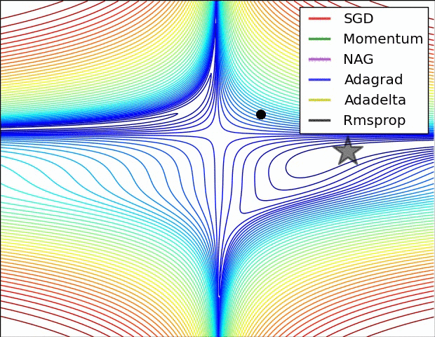
The effects of different update formulas
(image credits to Alec Radford)

Slide 50
Another approach to poor gradients:
Q: What is the trajectory along which we converge towards the minimum with SGD?

Slide 51
Another approach to poor gradients:
Q: What is the trajectory along which we converge towards the minimum with SGD? very slow progress along flat direction, jitter along steep one

Slide 52
Momentum update
- Physical interpretation as ball rolling down the loss function + friction (mu coefficient).
- mu = usually ~0.5, 0.9, or 0.99 (Sometimes annealed over time, e.g. from 0.5 -> 0.99)

Slide 53
Momentum update
Allows a velocity to “build up” along shallow directions
Velocity becomes damped in steep direction due to quickly changing sign

Slide 54
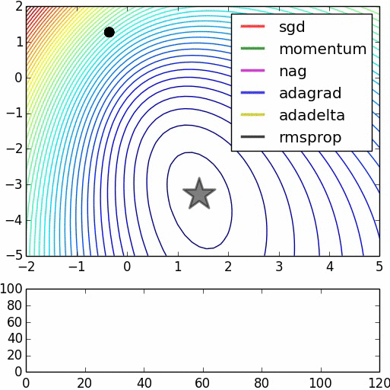
SGD
vs
Momentum
notice momentum
overshooting the target, but overall getting to the minimum much faster than vanilla SGD.

Slide 55
Nesterov Momentum update
Ordinary momentum update:
momentum
step
actual step
gradient
step

Slide 56
Nesterov Momentum update
Momentum update
Nesterov momentum update
“lookahead” gradient step (bit different than original)
momentum
step
momentum
step
actual step
actual step
gradient
step

Slide 57
Nesterov Momentum update
Momentum update
Nesterov momentum update
“lookahead” gradient step (bit different than original)
momentum
step
momentum
step
actual step
actual step
gradient
step
Nesterov: the only difference...

Slide 58
Nesterov Momentum update
Slightly inconvenient…
usually we have :

Slide 59
Nesterov Momentum update
Slightly inconvenient…
usually we have :
Variable transform and rearranging saves the day:

Slide 60
Nesterov Momentum update
Slightly inconvenient…
usually we have :
Variable transform and rearranging saves the day:
Replace all thetas with phis, rearrange and obtain:

Slide 61
nag =
Nesterov Accelerated Gradient

Slide 62
AdaGrad update
[Duchi et al., 2011]
Added element-wise scaling of the gradient based on the historical sum of squares in each dimension

Slide 63
AdaGrad update
Q: What happens with AdaGrad?

Slide 64
AdaGrad update
Q2: What happens to the step size over long time?

Slide 65
RMSProp update
[Tieleman and Hinton, 2012]

Slide 66
Introduced in a slide in Geoff Hinton’s Coursera class, lecture 6

Slide 67
Introduced in a slide in Geoff Hinton’s Coursera class, lecture 6
Cited by several papers as:

Slide 68
adagrad
rmsprop

Slide 69
Adam update
[Kingma and Ba, 2014]
(incomplete, but close)

Slide 70
Adam update
[Kingma and Ba, 2014]
(incomplete, but close)
momentum
RMSProp-like
Looks a bit like RMSProp with momentum

Slide 71
Adam update
[Kingma and Ba, 2014]
(incomplete, but close)
momentum
RMSProp-like
Looks a bit like RMSProp with momentum

Slide 72
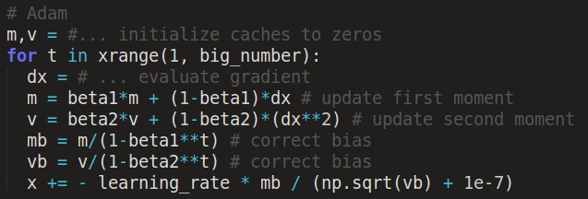
Adam update
[Kingma and Ba, 2014]
momentum
bias correction
(only relevant in first few iterations when t is small)
RMSProp-like
The bias correction compensates for the fact that m,v are initialized at zero and need some time to “warm up”.

Slide 73
SGD, SGD+Momentum, Adagrad, RMSProp, Adam all have learning rate as a hyperparameter.
Q: Which one of these learning rates is best to use?

Slide 74
SGD, SGD+Momentum, Adagrad, RMSProp, Adam all have learning rate as a hyperparameter.
=> Learning rate decay over time!
step decay:
e.g. decay learning rate by half every few epochs.
exponential decay:
1/t decay:

Slide 75
Summary
Simple Gradient Methods like SGD can make adequate progress to an optimum when used on minibatches of data.
Second-order methods make much better progress toward the goal, but are more expensive and unstable.
Convergence rates: quadratic, linear, O(1/n).
Momentum: is another method to produce better effective gradients.
ADAGRAD, RMSprop diagonally scale the gradient. ADAM scales and applies momentum.
Assignment 1 is out, due Sept 14. Please start soon.

