Slide 1
CS194/294-129: Designing, Visualizing and Understanding Deep Neural Networks
John Canny
Spring 2018
Lecture 12: Text Semantics
Some slide content from Stanford’s CS224n, R. Socher

Slide 2
Outline
Text Semantics
Propositional models
Matrix factorization
Word2vec
Skip-Thought vectors
Siamese models

Slide 3
Outline
Updates
Assignment 2 deadline extended to 11pm Wednesday.
Midterm grades about 2 days away.

Slide 4
Text Semantics
In Natural Language Processing (NLP), semantics is concerned with the meanings of texts.
There are two main approaches:
  Propositional or formal semantics: A block of text is to converted into a formula in a logical language, e.g. predicate calculus.
  Vector representation. Texts are embedded into a high-dimensional space. Used for neural models…

Slide 5
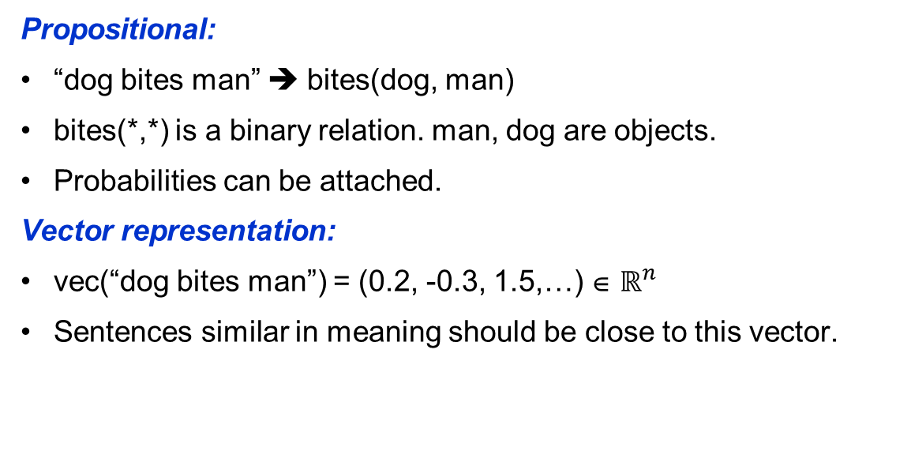
Semantic Approaches
Propositional:
“dog bites man” ➔ bites(dog, man)
bites(*,*) is a binary relation. man, dog are objects.
Probabilities can be attached.
Vector representation:
vec(“dog bites man”) = (0.2, -0.3, 1.5,…) ∈ $ℝ^{n}$
Sentences similar in meaning should be close to this vector.

Slide 6
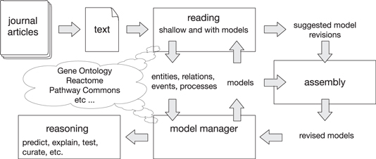
Propositional Semantics
Allow logical inferences “Socrates is a man,” + “all men are mortal” → “Socrates is mortal”
Important for inference in well-defined domains, e.g. inferring gene regulation from medical journals.
See DARPA’s “Big Mechanism” project
From “DARPAʼs Big Mechanism program” Paul R Cohen, Phys. Biol. 12 (2015)

Slide 7

Vector Embedding of Words
Much recent work on text semantics has used word embeddings and bag-of-words representation:
vec(“dog”) = (0.2, -0.3, 1.5,…)
vec(“bites”) = (0.5, 1.0, -0.4,…)
vec(“man”) = (-0.1, 2.3, -1.5,…)
vec(“dog bites man”) = (0.6, 3.0, -0.4,…)
But notice that vec(“dog bites man”) = vec(“man bites dog”)

Slide 8
Vector Embedding: Word Similarity
Word embeddings depend on a notion of word similarity.
A very useful definition is paradigmatic similarity (Saussure 1916):
Similar words occur in similar contexts. They are exchangable.
This definition supports unsupervised learning: cluster or embed words according to their contexts.
government debt problems turning into banking crises as has happened in
saying that Europe needs unified banking regulation to replace the hodgepodge
Surrounding words represent “banking”

Slide 9
Vector Embedding: Dimension Reduction
An embedding method should give different embeddings to different words, but a naïve (one-hot encoding) is very expensive:
Dog [0, 0, 0, 0,…, 0, 0, 1, 0, 0, 0, 0,…,0]
Man [0, 0, 0, 0,…, 0, 0, 0, 0, 1, 0, 0,…,0]
Words are too different (inner products always zero) in this representation.
Its more effective to use a dimension reduction method like PCA.
Vector size = vocabulary size

Slide 10
Vector Embedding: Dimension Reduction
LSA: Dimensions of a few 100 are common
Word2vec: Dimensions of around 300 are common.
State-of-the-art sentence embedding methods may use dimensions of several thousand.

Slide 11
Word Embedding: Latent Semantic Analysis
Latent semantic analysis processes documents in bag-of-words (BoW) format (1988).
Encode a set of documents in a matrix T:
T_{ij} is the count* of word j in document i. Most entries are 0.
* Often tfidf or other “squashing” functions of the word counts are used.
M word features
T
N docs

Slide 12
Word Matrix Example
Example corpus: (R. Socher)
• I like deep learning.
• I like NLP.
• I enjoy flying.
Note: this matrix is extremely sparse (mostly zero), which allows efficient sparse matrix methods to be used.
 | I | like | deep | learning | NLP | enjoy | flying
S1 | 1 | 1 | 1 | 1 | 0 | 0 | 0
S2 | 1 | 1 | 0 | 0 | 1 | 0 | 0
S3 | 1 | 0 | 0 | 0 | 0 | 1 | 1

Slide 13
Word Embedding: Latent Semantic Analysis
Given a bag-of-words matrix T, compute a factorization T ≈ U^{T} * V (e.g. a best L₂ approximation to T) where K << M, N
Factors encode similar whole document contexts.
Factors are rows of V.
K latent dims
M features
M word features
T
U^{T}
V
K
≈
N
N docs

Slide 14

Embedding: Latent Semantic Analysis
If in addition U and V are orthogonal, S a diagonal matrix of singular values, then if $t$ is a document (row of $T$):
$v=Vt$ is an embedding of the document in the latent space.
$t′=V^{T}v=V^{T}Vt$ is the decoding of the document from its embedding.
K latent dims
M word features
M word features
T
U^{T}
S
V
≈
N
N docs

Slide 15

Embedding: Latent Semantic Analysis
$t′=V^{T}v=V^{T}Vt$ is the decoding of the sentence from its embedding.
An SVD (Singular Value Decomposition) factorization gives the best possible reconstructions of the documents $t′$ from their embeddings.
K latent dims
M word features
M word features
T
U^{T}
S
V
≈
N
N docs

Slide 16
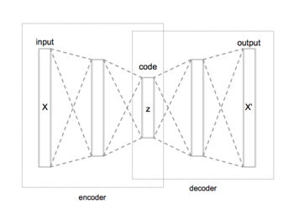




Embedding: Latent Semantic Analysis
Thus LSA is an auto-encoding method, in fact the optimal linear auto-encoder for documents with L2 error.
$$T$$
$$T′$$
$$Z=TV^{T}$$
$$T′=ZV$$

Slide 17

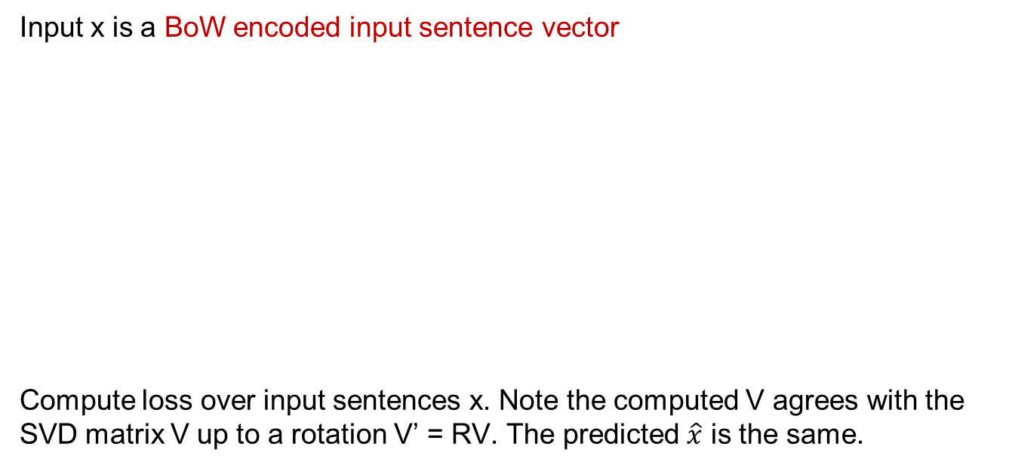






LSA as a Deep Network
Input x is a BoW encoded input sentence vector
Compute loss over input sentences x. Note the computed V agrees with the SVD matrix V up to a rotation V’ = RV. The predicted $\hat{x}$ is the same.
$$V$$
$$x$$
$$x$$
$$\hat{x}$$
$$h$$
Affine
$$Vx$$
Affine
$$V^{T}h$$
Squared
L2
loss
Bottleneck
layer dim ~ 100s

Slide 18

t-SNE of Word Embeddings
From: “Word representations: A simple and general method for semi-supervised learning” Joseph Turian, Lev Ratinov, Yoshua Bengio, ACL 2010.

Slide 19
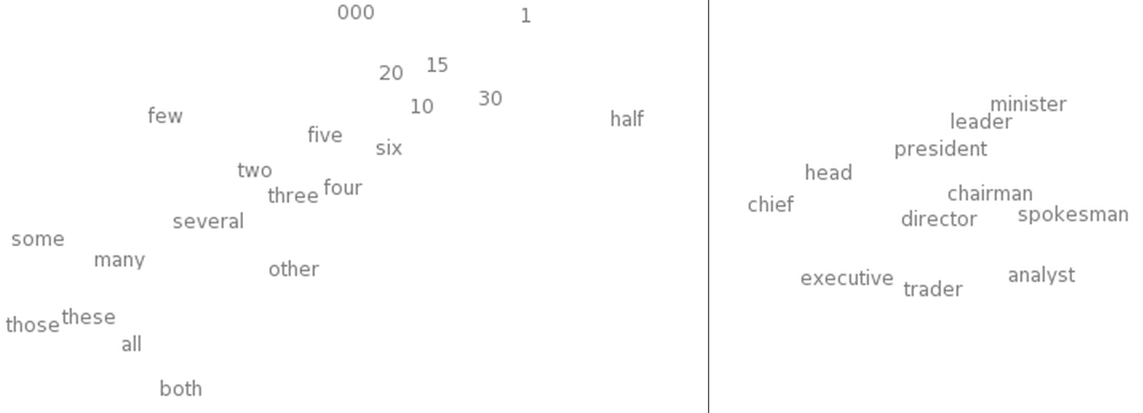
t-SNE of Word Embeddings
Left: Number Region; Right: Jobs Region
from “Deep Learning, NLP, and Representations” by Chris Olah. See also
http://colah.github.io/posts/2015-01-Visualizing-Representations/

Slide 20
Word2vec: Local contexts
Instead of entire documents, Word2vec uses words a few positions away from each center word. The pairs of center word/context word are called “skip-grams.”
“It was a bright cold day in April, and the clocks were striking”
Center word: red
Context words: blue
Word2vec considers all words as center words, and all their context words.

Slide 21
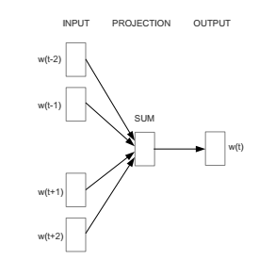
Word2vec: Local contexts
Models can predict center word from context, CBOW model. “Contextual Bag-Of-Words”. The context words are unordered.
Context words
Center word
Distributed Representations of Words and Phrases and their Compositionality
Tomas Mikolov, Ilya Sutskever, Kai Chen, Greg Corrado, Jeffrey Dean, NIPS 2013

Slide 22
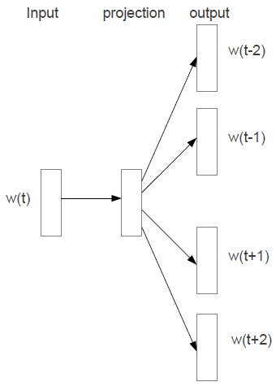
Word2vec: Local contexts
The pairs of center word/context word are called “skip-grams.” Typical distances are 3-5 word positions. Skip-gram model:
Context words
Center word
Distributed Representations of Words and Phrases and their Compositionality
Tomas Mikolov, Ilya Sutskever, Kai Chen, Greg Corrado, Jeffrey Dean, NIPS 2013

Slide 23
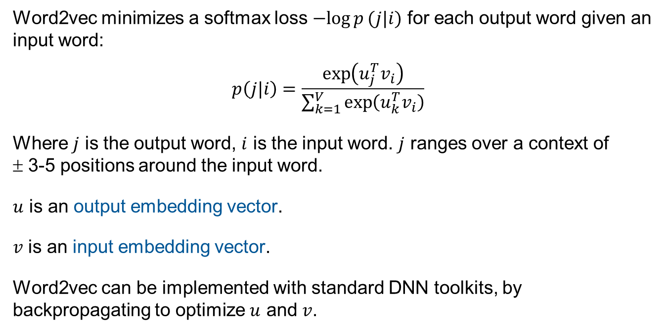
Word2vec: Local contexts
Word2vec minimizes a softmax loss $−log{p}(j|i)$ for each output word given an input word:
$$p\left(j|i\right)=\frac{\exp\left(u_{j}^{T}v_{i}\right)}{\sum_{k=1}^{V}{\exp\left(u_{k}^{T}v_{i}\right)}}$$
Where $j$ is the output word, $i$ is the input word. $j$ ranges over a context of
± 3-5 positions around the input word.
$u$ is an output embedding vector.
$v$ is an input embedding vector.
Word2vec can be implemented with standard DNN toolkits, by backpropagating to optimize $u$ and $v$.

Slide 24







Word2vec: As a Deep Network
Input x is a one-hot encoded input word, y is the index of the output (context) word:
Compute loss over all (x,y), (input, context) word pairs.
$$V$$
$$U$$
$$y$$
$$x$$
$$s$$
$$h$$
$$σ{\left(s\right)}_{y}$$
Affine
$$Vx$$
Affine
$$Uh$$
Softmax
$$−log$$
loss
Bottleneck
layer dim ~ 300

Slide 25
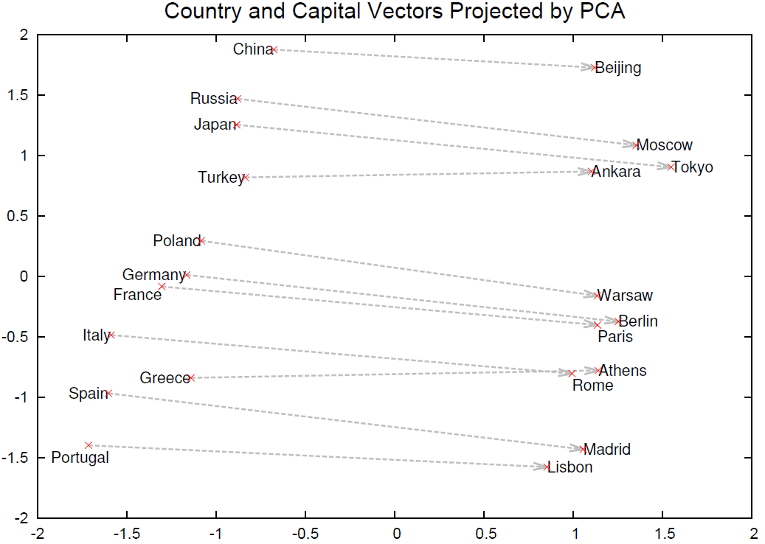
Word2vec: Local contexts
Local contexts capture more information about relations and properties than LSA:

Slide 26
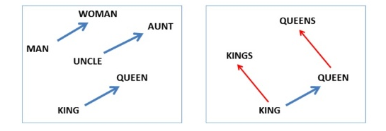
Composition
Algebraic relations:
vec(‘‘woman")−vec(‘‘man") ≃ vec(‘‘aunt")−vec(‘‘uncle")
vec(‘‘woman")−vec(‘‘man") ≃ vec(‘‘queen")−vec(‘‘king")
From “Linguistic Regularities in Continuous Space Word Representations”
Tomas Mikolov , Wen-tau Yih, Geoffrey Zweig, NAACL-HLT 2013

Slide 27
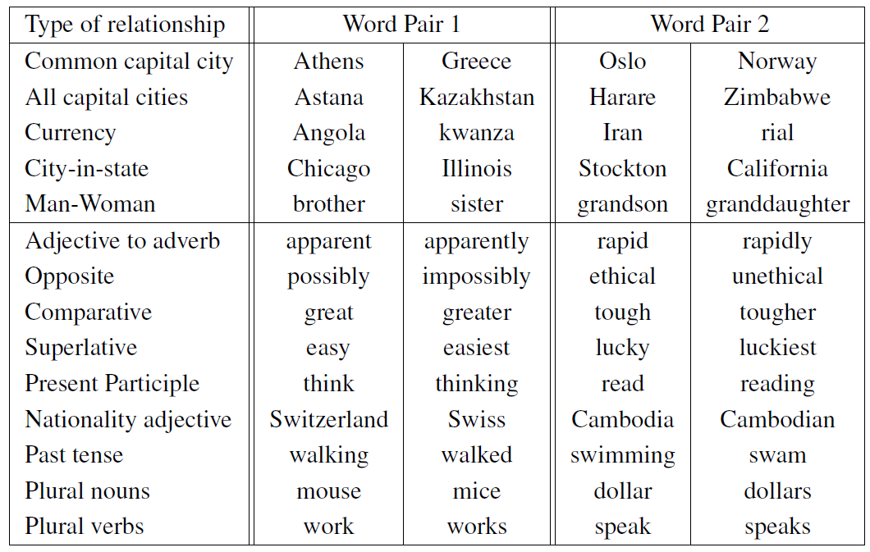
Relations Learned by Word2vec
Word2vec model computed from 6 billion word corpus of news articles
“Efficient Estimation of Word Representations in Vector Space” Tomas Mikolov, Kai Chen, Greg Corrado, Jeffrey Dean, Arxiv 2013

Slide 28
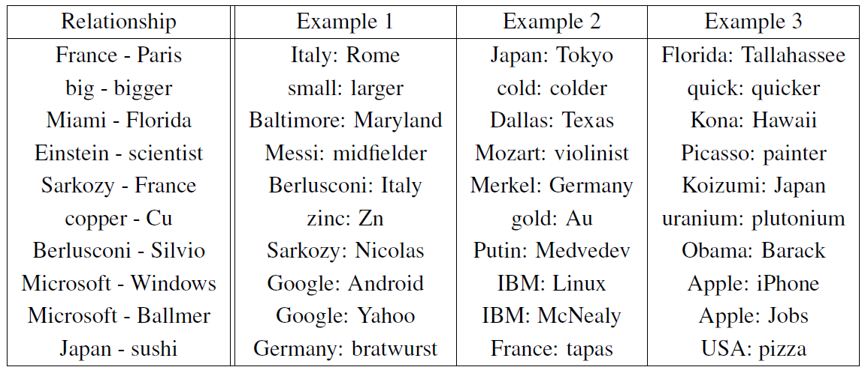
Relations Learned by Word2vec
A relation is defined by the vector displacement in the first column. For each start word in the other column, the closest displaced word is shown.
“Efficient Estimation of Word Representations in Vector Space” Tomas Mikolov, Kai Chen, Greg Corrado, Jeffrey Dean, Arxiv 2013

Slide 29
Relations Learned by Word2vec
A relation is defined by the vector displacement in the first column. For each start word in the other column, the closest displaced word is shown.
“Efficient Estimation of Word Representations in Vector Space” Tomas Mikolov, Kai Chen, Greg Corrado, Jeffrey Dean, Arxiv 2013

Slide 30
Relations Learned by Word2vec
A relation is defined by the vector displacement in the first column. For each start word in the other column, the closest displaced word is shown.
“Efficient Estimation of Word Representations in Vector Space” Tomas Mikolov, Kai Chen, Greg Corrado, Jeffrey Dean, Arxiv 2013

Slide 31
Relations Learned by Word2vec
A relation is defined by the vector displacement in the first column. For each start word in the other column, the closest displaced word is shown.
“Efficient Estimation of Word Representations in Vector Space” Tomas Mikolov, Kai Chen, Greg Corrado, Jeffrey Dean, Arxiv 2013

Slide 32
Relations Learned by Word2vec
A relation is defined by the vector displacement in the first column. For each start word in the other column, the closest displaced word is shown.
“Efficient Estimation of Word Representations in Vector Space” Tomas Mikolov, Kai Chen, Greg Corrado, Jeffrey Dean, Arxiv 2013

Slide 33
Relations Learned by Word2vec
A relation is defined by the vector displacement in the first column. For each start word in the other column, the closest displaced word is shown.
“Efficient Estimation of Word Representations in Vector Space” Tomas Mikolov, Kai Chen, Greg Corrado, Jeffrey Dean, Arxiv 2013

Slide 34
Relations Learned by Word2vec
A relation is defined by the vector displacement in the first column. For each start word in the other column, the closest displaced word is shown.
“Efficient Estimation of Word Representations in Vector Space” Tomas Mikolov, Kai Chen, Greg Corrado, Jeffrey Dean, Arxiv 2013

Slide 35
Word2vec: Criticisms
Use of cross-entropy loss puts much emphasis on small (unlikely) combinations of word/contexts.
Very expensive to normalize the softmax over all words (can be 10s or 100s of thousands of them). Approximations are often used.
Uses heuristic down-weighting of frequent words

Slide 36
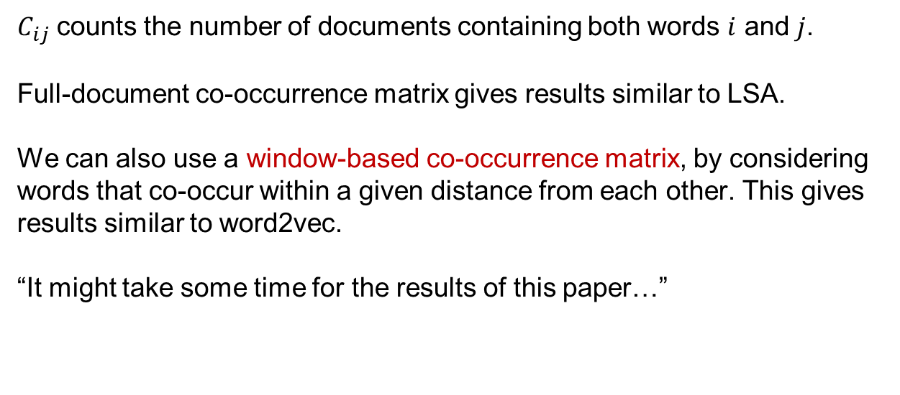
Co-occurrence Matrices
$C_{ij}$ counts the number of documents containing both words $i$ and $j$.
Full-document co-occurrence matrix gives results similar to LSA.
We can also use a window-based co-occurrence matrix, by considering words that co-occur within a given distance from each other. This gives results similar to word2vec.
“It might take some time for the results of this paper…”

Slide 37
Window-Based Co-occurrence Matrix Example
Example corpus: (R. Socher)
• I like deep learning.
• I like NLP.
• I enjoy flying.
What’s the window size here?
Notes:
+- 1

Slide 38
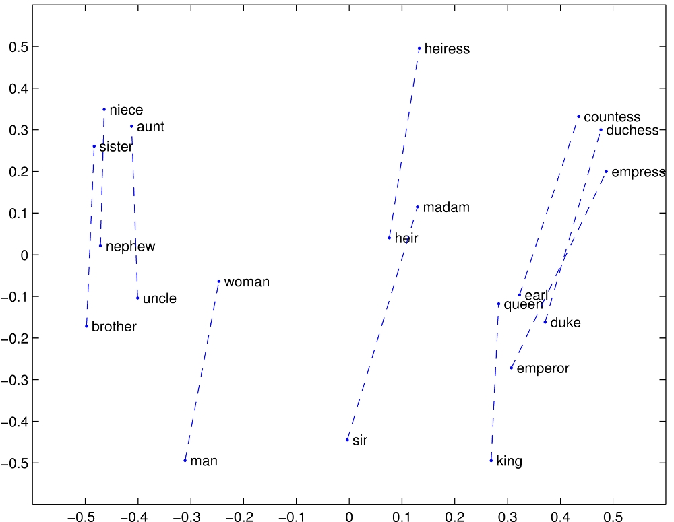
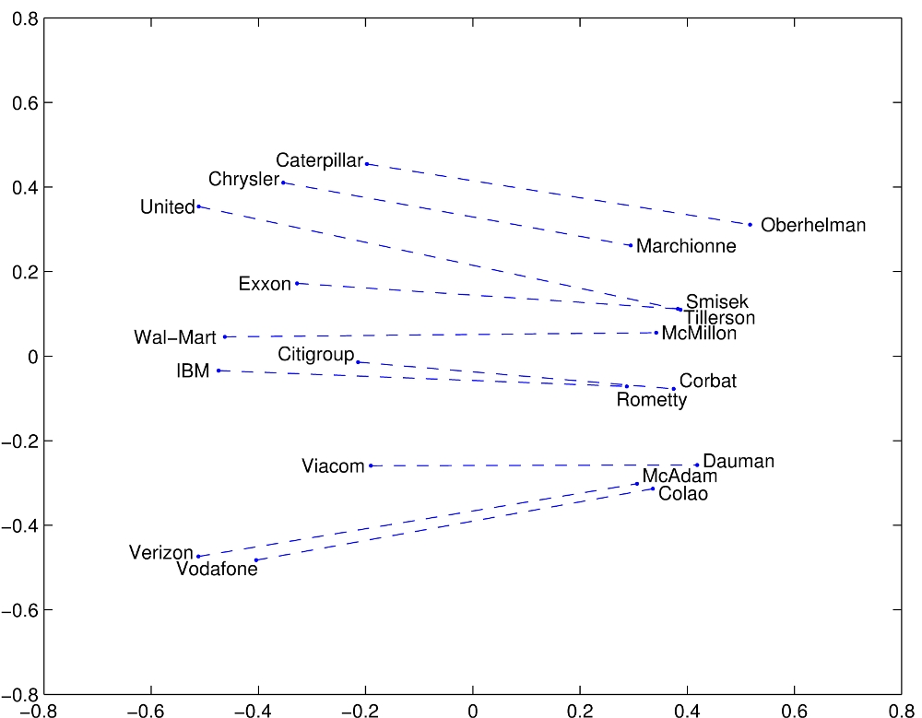
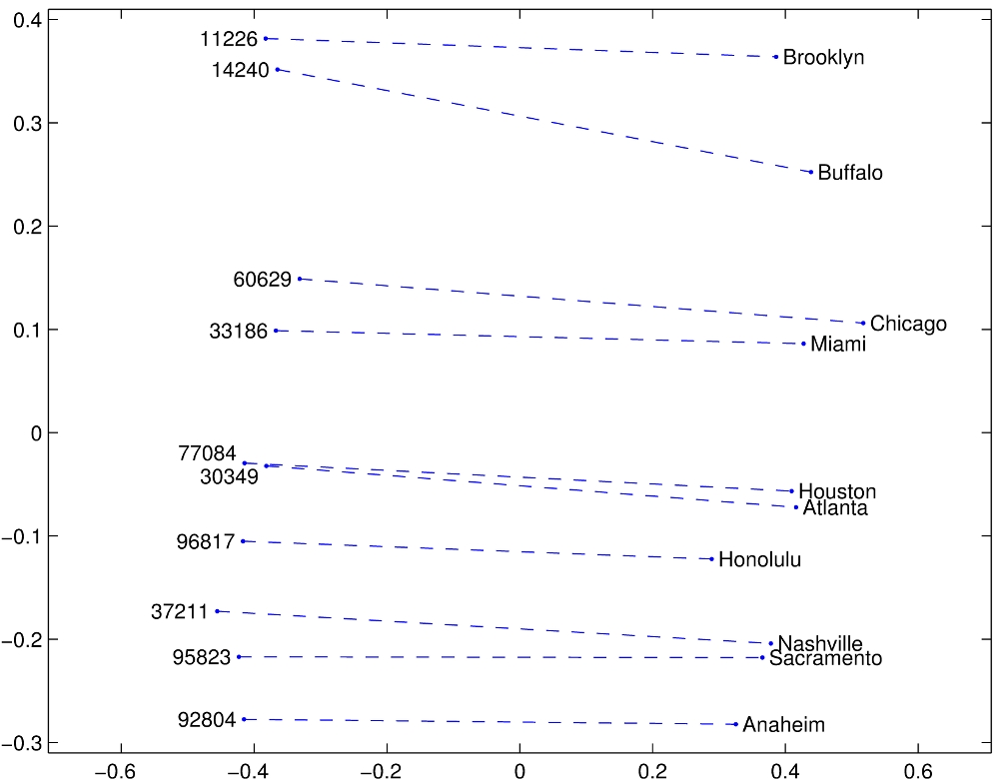
A different model: GloVe
We can optimize a model explicitly for analogies:

Slide 39
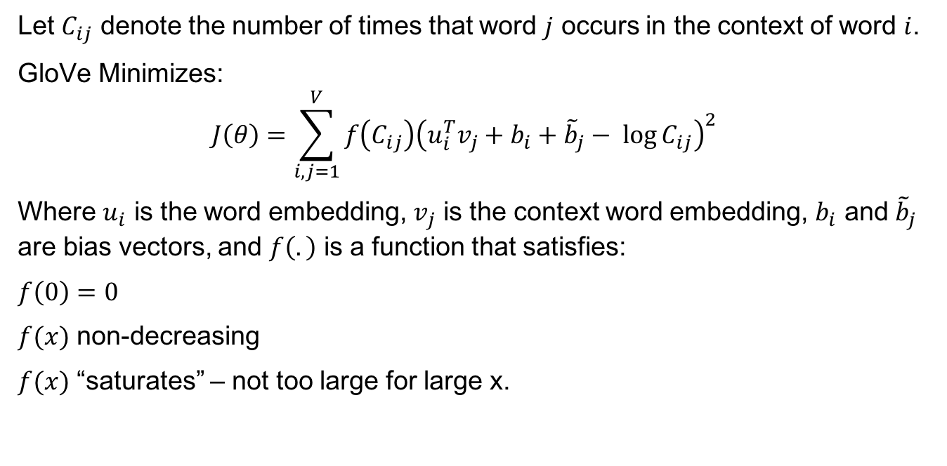
A different model: GloVe
Let $C_{ij}$ denote the number of times that word $j$ occurs in the context of word $i$.
GloVe Minimizes:
$$J\left(θ\right)=\sum_{i,j=1}^{V}{f\left(C_{ij}\right){\left(u_{i}^{T}v_{j}+b_{i}+{\tilde{b}}_{j}− \log{C_{ij}}\right)}^{2}}$$
Where $u_{i}$ is the word embedding, $v_{j}$ is the context word embedding, $b_{i}$ and ${\tilde{b}}_{j}$ are bias vectors, and $f\left(.\right)$ is a function that satisfies:
$f\left(0\right)=0$
$f(x)$ non-decreasing
$f(x)$ “saturates” – not too large for large x.

Slide 40
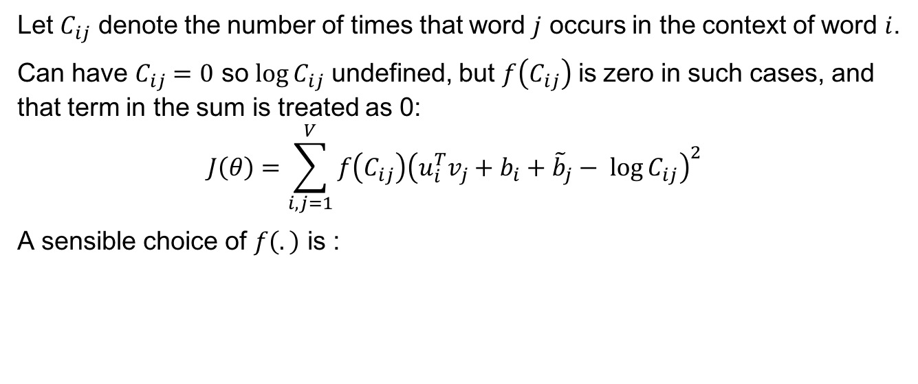

A different model: GloVe
Let $C_{ij}$ denote the number of times that word $j$ occurs in the context of word $i$.
Can have $C_{ij}=0$ so $log⁡C_{ij}$ undefined, but $f\left(C_{ij}\right)$ is zero in such cases, and that term in the sum is treated as 0:
$$J\left(θ\right)=\sum_{i,j=1}^{V}{f\left(C_{ij}\right){\left(u_{i}^{T}v_{j}+b_{i}+{\tilde{b}}_{j}− \log{C_{ij}}\right)}^{2}}$$
A sensible choice of $f\left(.\right)$ is :
Typical $α$ = ¾, $x_{max}$=100

Slide 42

Lexical and Compositional Semantics
Lexical Semantics: focuses on the meaning of individual words.
Compositional Semantics: meaning depends on the words, and on how they are combined.

Slide 43
Beyond Bag-Of-Words: Skip-Thought Vectors
The models we discussed so far embed texts as the sum of their words (lexical semantics).
Clearly there is a lot missing from these representations:
“man bites dog” = “dog bites man”
“the quick, brown fox jumps over the lazy dog” =
“the lazy fox over the brown dog jumps quick”
…
How can we model text structure as well as word meanings?

Slide 44
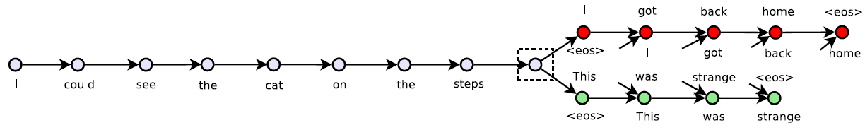
Beyond Bag-Of-Words: Skip-Thought Vectors
Skip-thought embeddings use sequence-to-sequence RNNs to predict the next and previous sentences.
The output state vector of the boundary layer (dotted box) forms the embedding. RNN units are GRU units.
Once the network is trained, we can discard the red and green sections of the network.
From “Skip-Thought Vectors,” Ryan Kiros et al., Arxiv 2015.

Slide 45




Beyond Bag-Of-Words: Skip-Thought Vectors
Skip-thought embeddings use sequence-to-sequence RNNs to predict the next and previous sentences.
Encoding doesn’t require backpropagation, so we can represent the encoder as a (truly) recurrent network.
Thus we can encode longer units of text: sentences or paragraphs.
$$x_{t}$$
$$y_{t}$$
$$z_{t−1}$$
$$z_{t}$$

Slide 46
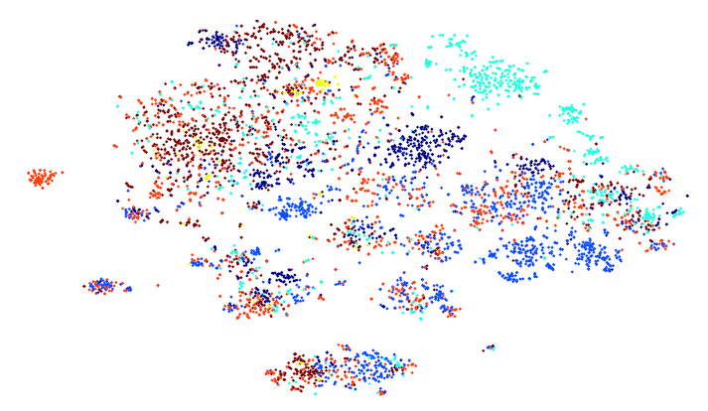
Embedding of TREC queries
Points are colored by query type (t-SNE embedding):
From “Skip-Thought Vectors,” Ryan Kiros et al., Arxiv 2015.

Slide 47
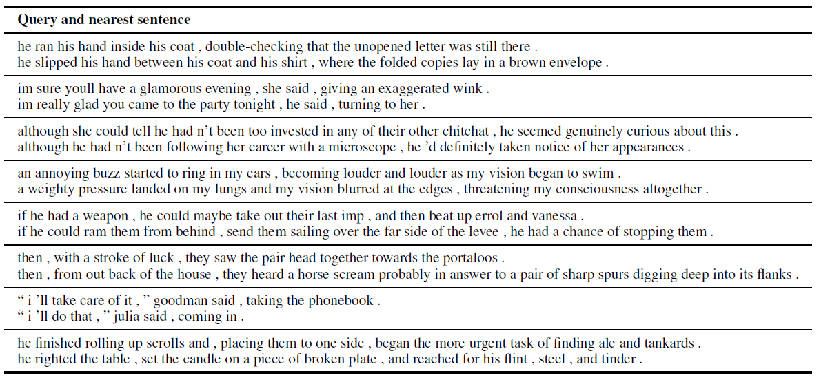
Sentence Similarity
Approximately two weeks of training on a billion-word Books corpus

Slide 48
Semantic Relatedness Evaluation
SICK semantic relatedness task: score sentences for semantic similarity from 1 to 5 (average of 10 human ratings)
Sentence A: A man is jumping into an empty pool
Sentence B: There is no biker jumping in the air
Relatedness score: 1.6
Sentence A: Two children are lying in the snow and are making snow angels
Sentence B: Two angels are making snow on the lying children
Relatedness score: 2.9
Sentence A: The young boys are playing outdoors and the man is smiling nearby
Sentence B: There is no boy playing outdoors and there is no man smiling
Relatedness score: 3.6
Sentence A: A person in a black jacket is doing tricks on a motorbike
Sentence B: A man in a black jacket is doing tricks on a motorbike
Relatedness score: 4.9

Slide 49
Semantic Relatedness Evaluation
Note: a separate model is trained to predict the scores from pairs of embedded sentences.
Sentence A: A man is jumping into an empty pool
Sentence B: There is no biker jumping in the air
Relatedness score: 1.6
Sentence A: Two children are lying in the snow and are making snow angels
Sentence B: Two angels are making snow on the lying children
Relatedness score: 2.9
Sentence A: The young boys are playing outdoors and the man is smiling nearby
Sentence B: There is no boy playing outdoors and there is no man smiling
Relatedness score: 3.6
Sentence A: A person in a black jacket is doing tricks on a motorbike
Sentence B: A man in a black jacket is doing tricks on a motorbike
Relatedness score: 4.9

Slide 50
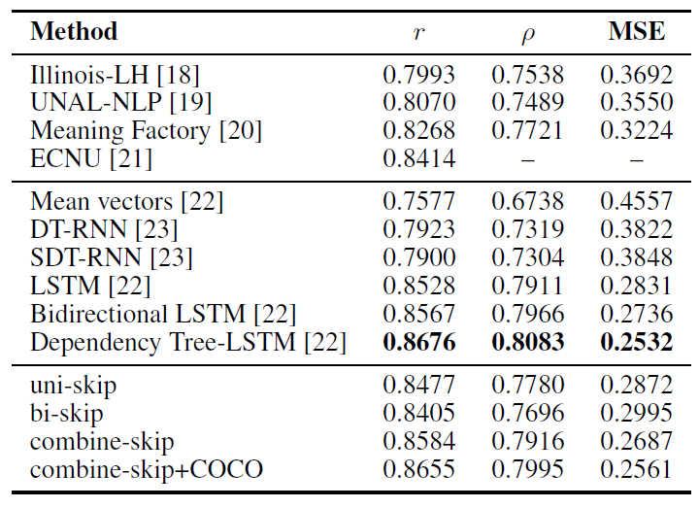
Semantic Relatedness Evaluation
SICK semantic relatedness scores for skip-thought methods:

Slide 51
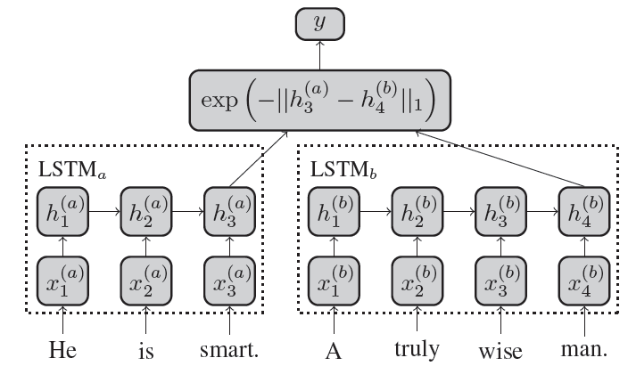
A Siamese Network for Semantic Relatedness
This network is trained on pairs of sentences a, b with a similarity label y.
Parameters are shared between the two networks.
From “Siamese Recurrent Architectures for Learning Sentence Similarity” Jonas Mueller, Aditya Thyagarajan, AAAI-2016
Manhattan distance
50 dims
300-dimensional
word2vec embeddings

Slide 52
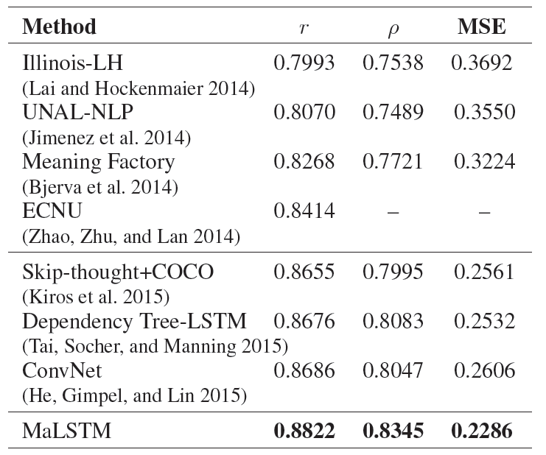
A Siamese Network for Semantic Relatedness
The network is trained on Semeval similar sentence pairs, expanded by substituting for random words using WordNet (a dataset of synonyms). Results:
From “Siamese Recurrent Architectures for Learning Sentence Similarity” Jonas Mueller, Aditya Thyagarajan, AAAI-2016

Slide 53
A Siamese Network for Semantic Relatedness
The network is trained on Semeval similar sentence pairs, expanded by substituting for random words using WordNet (a dataset of synonyms). Results:
r = Pearson correlation, ρ = Spearman’s rank correlation.

Slide 54
A Siamese Network for Semantic Relatedness
Moral: Train for your evaluation metric!

Slide 55
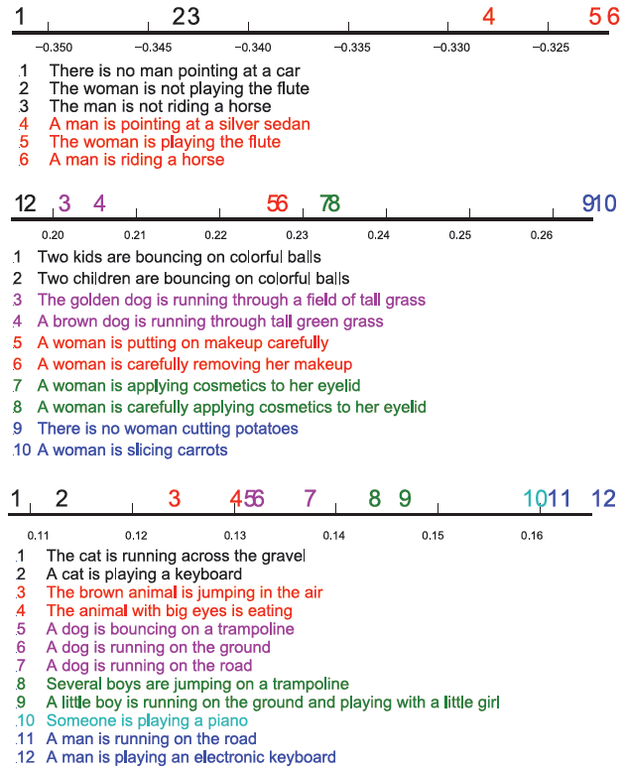
Hidden Unit Factors 1,2, and 6
Notes:
Negation, classification by object (or action)?, classification by subject.

Slide 56
Semantic Entailment Evaluation
SICK semantic entailment task: score sentences for relations: ENTAILMENT, CONTRADICTION, NEUTRAL:
Sentence A: Two teams are competing in a football match
Sentence B: Two groups of people are playing football
Entailment judgment: ENTAILMENT
Sentence A: The brown horse is near a red barrel at the rodeo
Sentence B: The brown horse is far from a red barrel at the rodeo
Entailment judgment: CONTRADICTION
Sentence A: A man in a black jacket is doing tricks on a motorbike
Sentence B: A person is riding the bicycle on one wheel
Entailment judgment: NEUTRAL

Slide 57
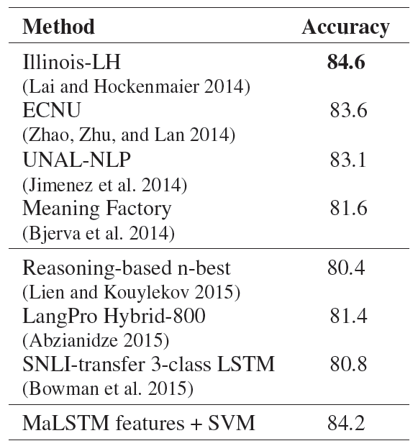
Semantic Entailment for MaLSTM

Slide 58
Outline
Summary
Embed text using word vectors
Auto-encoder perspective: LSA
Local contexts: Word2vec
Bespoke (custom) performance measures for analogies: GloVe.
Skip-Thought vectors
Siamese models

