Slide 1
CogSci 190 “Sensemaking and Organizing” Spring 2019
Robert J. Glushko glushko@berkeley.edu
@rjglushko
22 January 2019
1) Course Introduction;
the Concept of the “Organizing System”

Slide 2
Outline
Introductions
Motivating the Discipline of Organizing
Definitions for Organizing Systems
Course Plan and Administrivia
Notes:
I use lots of slides with extensive notes and picture examples… SO DON’T FRANTICALLY TYPE EVERYTHING I SAY. I don’t mind if you take notes, but trust yourself to listen more and then afterwards review my slides..

Slide 3
The Teaching Team
Bob Glushko
Intellectual roots are in cogsci (UCSD PhD), but spent over 20 years in industry R&D and as entrepreneur
“Retired” to Berkeley in 2002
Until 2017 on the School of Information faculty
Joined the CogSci program faculty in 2017
Lauren Stoops
Senior CogSci major, took course last year
3
Notes:
Any of you doing or planning to do an honors thesis in cogsci? Glushko prize given each year at graduation, one of several prizes in cogsci that I fund..

Slide 4
Who You Are (Survey, N=31)
87% cogsci majors
Other minors/dual majors: neuroscience, CS, DS, economics, music, education
Disciplinary emphasis (rank order)
Neuroscience, psych, CS, DS… anthropology
Work and research experience
Many said “none” but many have lab experience and several have worked at established tech firms or start-ups
Writing skills – you all claim proficiency or at least competency
Notes:
(two of you have the same first name- Jo)…
And I think one of mistyped your name : Konrad? Or Konraf?
Very informative for me, Will use this info to tailor syllabus and lectures, especially examples and case studies
Cogsci is inherently multi disciplinary, and your survey confirms that
I have a sense of who to call on for different topics… and I won’t expect you to know or learn everything equally well

Slide 5
The Course in One Slide
When something "makes sense” or " is organized” we are imposing or discovering order in the arrangement of concepts, events, or resources of some kind.
Sensemaking and organizing are fundamental human activities that raise many multi- or trans-disciplinary questions about perception, knowledge, decision making, interaction with things and with other people, values and value creation.
Notes:
Second time teaching this course. I developed this course for cogsci when I realized that the cogsci program didn’t have as strong a core as I hoped. Seems like cogsci 1 students were being expected to make sense of cogsci by taking courses in other departments rather than getting courses specifically designed to organize and integrate their thinking about cognition. So my goal is to look at many different disciplines and domains from a cogsci perspective so we can bring them together for you – and the unifying idea that all the disciplines try to organize and make sense in different but complementary ways
After this semester the course will be in the catalog as cogsci 150
This is likely to be a different kind of course than most of you have taken. We will discuss a very broad range of content, but my goal is not primarily to get to learn all the details. Instead, this course is going to raise a lot of questions and propose some ways of answering them… but most people don’t even realize that these are important questions. If this doesn’t radically change how you look at the world, then I’ve failed you as the teacher and you’ll failed as the student. So let’s talk and listen and try to absorb a lot of new ideas and don’t worry about writing everything down and getting it on the first pass.

Slide 6
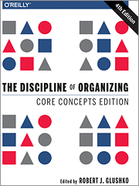
Organizing
Creating capabilities by intentionally imposing order and structure
Notes:
I sent out the first two chapters of this book, which is the primary text for the course. This idea that organizing is an inherently multi or transdisciplinary concept is why I wrote the textbook - to transcend the disciplinary boundaries by proposing a new discipline at their intersection
I didn’t put the textbook in the bookstore for two reasons – the only edition in print is the first one, and the current 4th edition is only in ebook form. And second - I negotiated with the publisher to give the book away for free with a creative commons license, so if you stay in the course your book will be free.
So let me motivate this idea of a discipline of organizing.

Slide 7
Everything is Organized
In our daily lives organizing is a fundamental cognitive activity that we often do without thinking much about it
It is also an important part of most business and professional activities
Organizing in any context can be more effective and satisfying if we are more self-aware and systematic about how we organize
7

Slide 8
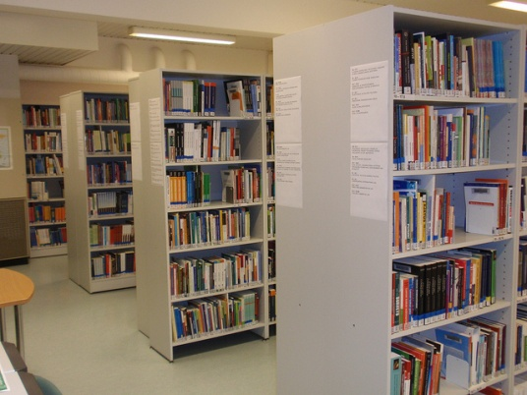
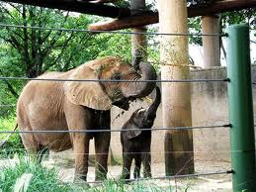
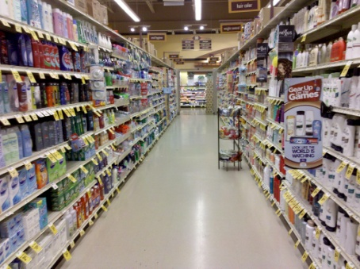
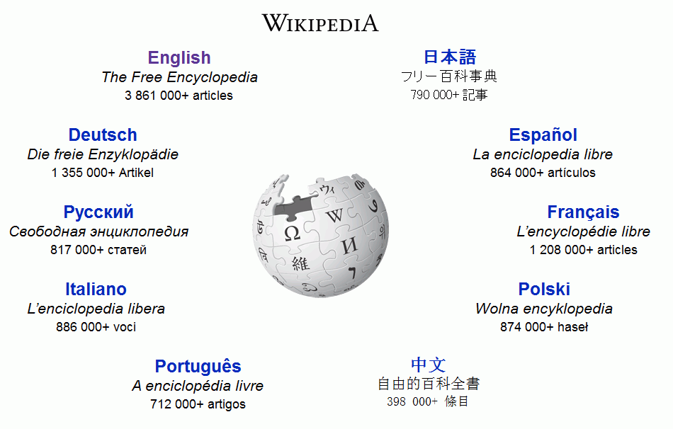
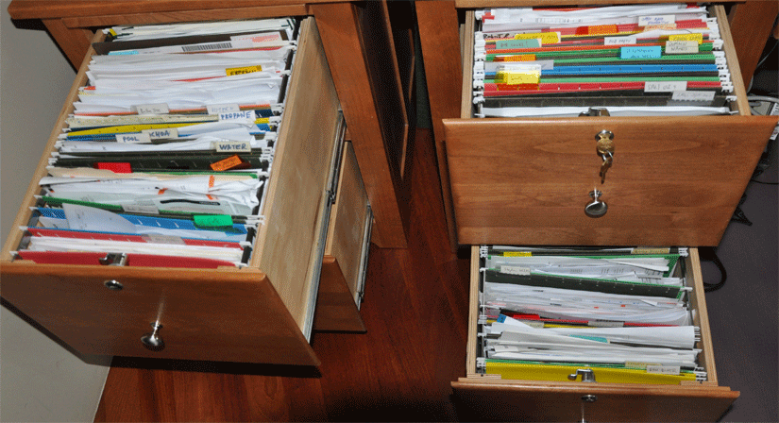
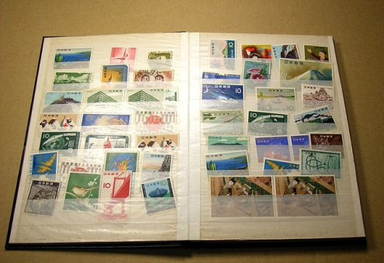
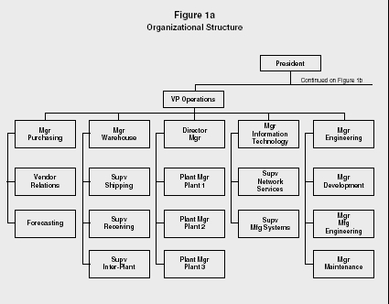
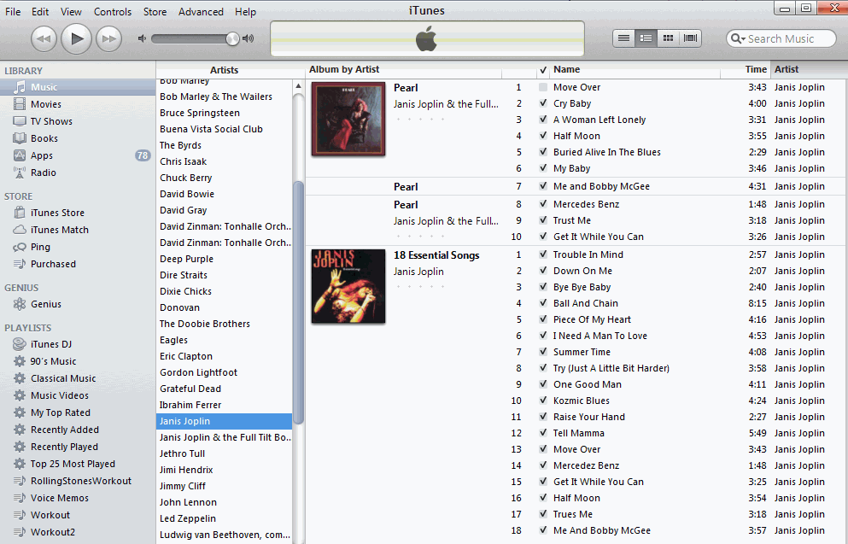
8

Slide 9
What We Organize…
Libraries, museums, business information systems, scientific data… and other institutional resource collections
Different types of documents
Personal information and artifacts of all kinds in our kitchens, closets, personal computers, smartphones…
People
Focus on commonalities, not differences !
9
Notes:
It is easy to find differences among these domains and how the resources in them are organized, but if we take a more abstract view it is possible to see many commonalities and apply principles and methods from one domain to another. That is essentially what this course is going to do to you. If you don’t fundamentally change how you think about organizing we will both have failed this course.

Slide 10
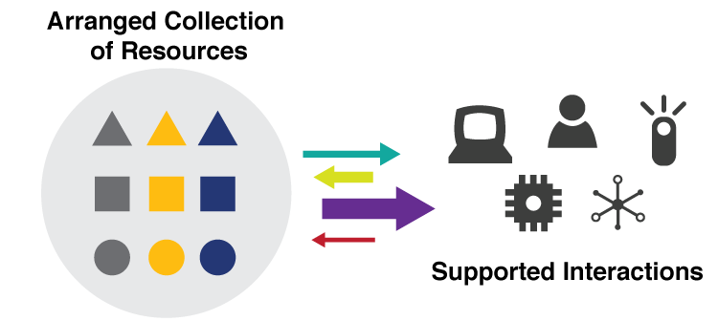
They are all “Organizing Systems”
A collection of resources intentionally arranged to enable some set of interactions
10
Notes:
We can emphasize how all of these domains and types of collections differ… or we can emphasize what they have in common. We will spend a few weeks discussing these core concepts like resource, collection, intentional arrangement, and interaction.

Slide 11
The 6 Dimensions of an Organizing System – Organizing as a Design Problem
What Is Being Organized?
Why Is It Being Organized?
How Much Is It Being Organized?
When Is It Being Organized?
Who (or What) is Organizing It?
Where is it Organized?
11
Notes:
Chapter 2 – for next time – unpacks these questions – but I wanted to hint at them here
Contrasts very strongly with two common beliefs about organizing: that its goal is to find the right kind of example – category – “this is a library problem” – or the right kind of container/physical system. I will spend a lot of time this semester trying to convince you that thinking of organizing as design is a better approach

Slide 12
Sensemaking
Making sense of, or giving meaning to something, especially observations or experiences
Some sensemaking is automatic, done by hard-wired brain mechanisms that simplify and organize sensory and perceptual input
Sensemaking is a superset of, or a more generic perspective, on organizing… in this course we are more concerned with intentional sensemaking and organizing
Notes:
We have a powerful impulse to interpret our sensations and perceptions. When we see something, we see it as a kind of thing… fundamentally an act of categorization and organization.
Example :Aligned objects are perceived as belonging together, and are perceived as a continuous whole when that perception is a simpler interpretation
Another example =- not shown here - A visual sequence – one object moves, then another – is often interpreted as causal where the first object moving caused the other to move.

Slide 13
Intentional Sensemaking
What representations best facilitate awareness, insight, and action? (psychology, HCI, information organization, knowledge management)
How do groups coordinate their interpretations of situations or events to create or restore order? (Sociology, organizational behavior)
What methods do “systematic sensemakers” use to organize and extract meaning from collections of samples, observations, or measurements?
13
Notes:
We can look at 2nd topic in a more sinister way by phrasing it as “How can you get other people to understand things in some particular way… that suits YOU. Fake news, etc”
The point I’m making here is that sensemaking and organizing are interrelated or intertwined and you can’t define sensemaking with invoking concepts of organizing and organization, which as you see here arise in many different disciplines.

Slide 14
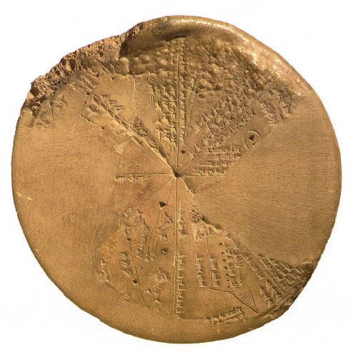
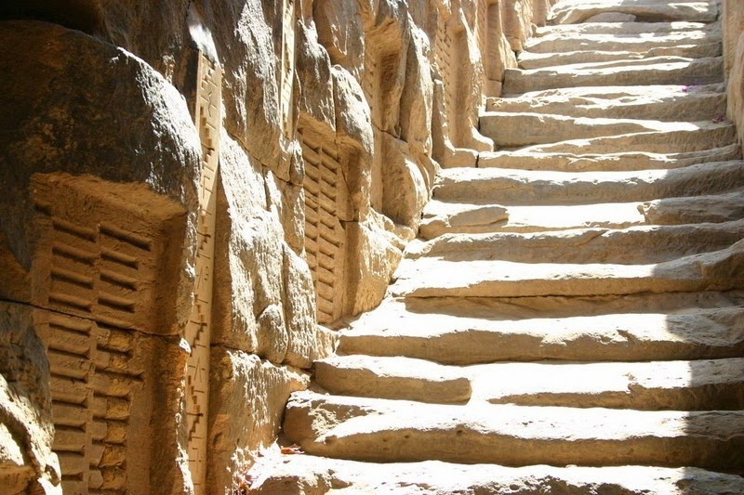
We Have Always Organized/
Tried to Make Sense
For thousands of years, even before the invention of written language, people have systematically collected things, information about those things, and observations of all kinds to understand how their world works
Babylonian Astronomy
Ancient Egyptian Hydrology – Nile Flood Records
14

Slide 15
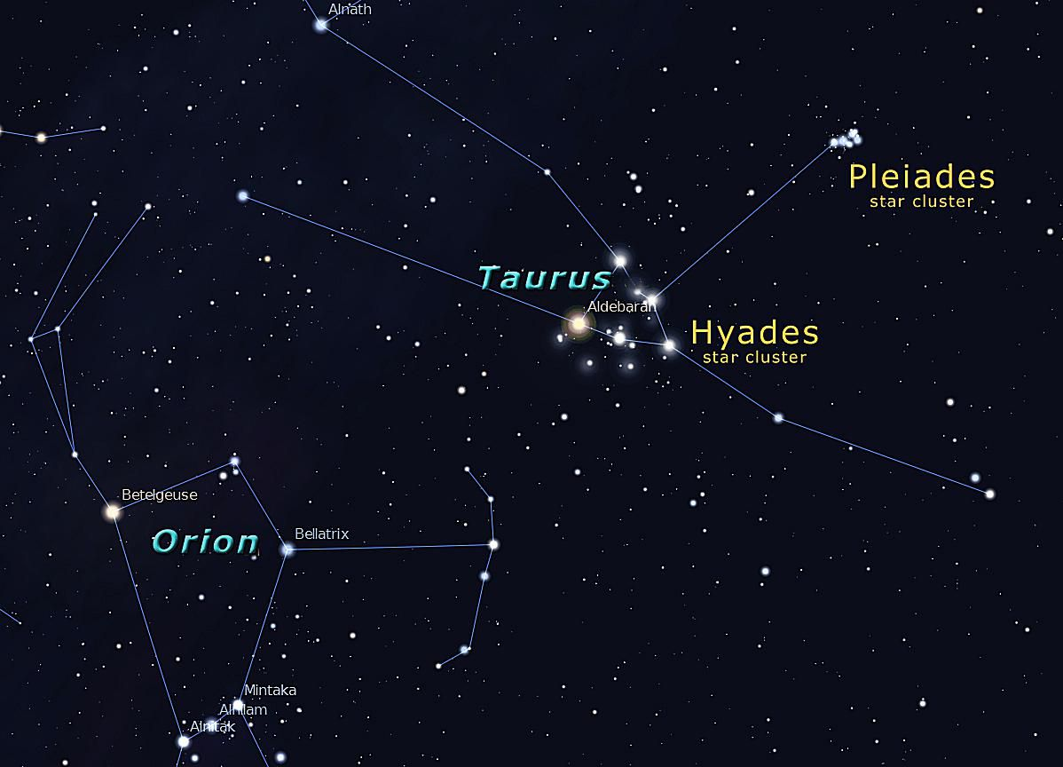
“People organize to make sense of equivocal inputs and enact this sense back into the world to make it more orderly” - (Weick 2005)
FOR EXAMPLE: ancient astronomers imposed “constellations” on star observations so they could represent and communicate about them
LASCAUX CAVE PAINTINGS
WINTER SKY, NORTHERN HEMISPHERE
Notes:
This quote comes from an article called “organizing and the process of sensemaking” and it nicely captures the relationship between the two concepts”
Cave paintings discovered in 1940s…. Animals AND STAR CHARTS. 16000 years old
BUT WHY DID PEOPLE NEED TO UNDERSTAND THE PATTERNS OF THE STARS? Egyptian floods and irrigation made civilization in the desert possible)

Slide 16
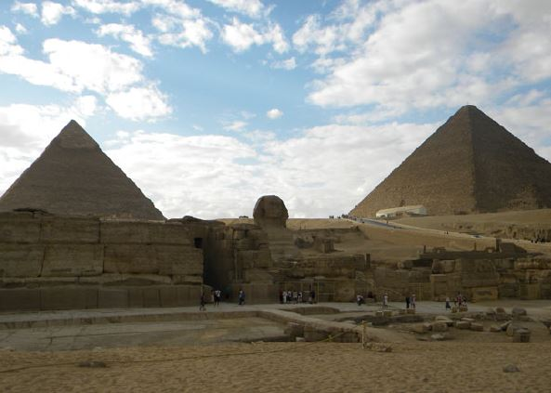
Sensemaking in Ancient Egypt
The pyramids of Giza in Egypt, the Great Sphinx that stands between them, and an observation terrace are aligned according to two events of critical religious and economic importance:
Sunset on the summer solstice
The onset of the Nile floods
The hieroglyph symbol AKHET has two meanings: horizon
flood season
Notes:
The Sphinx sits between two artificial mountains, symbolizing the passage to the afterlife.

Slide 17
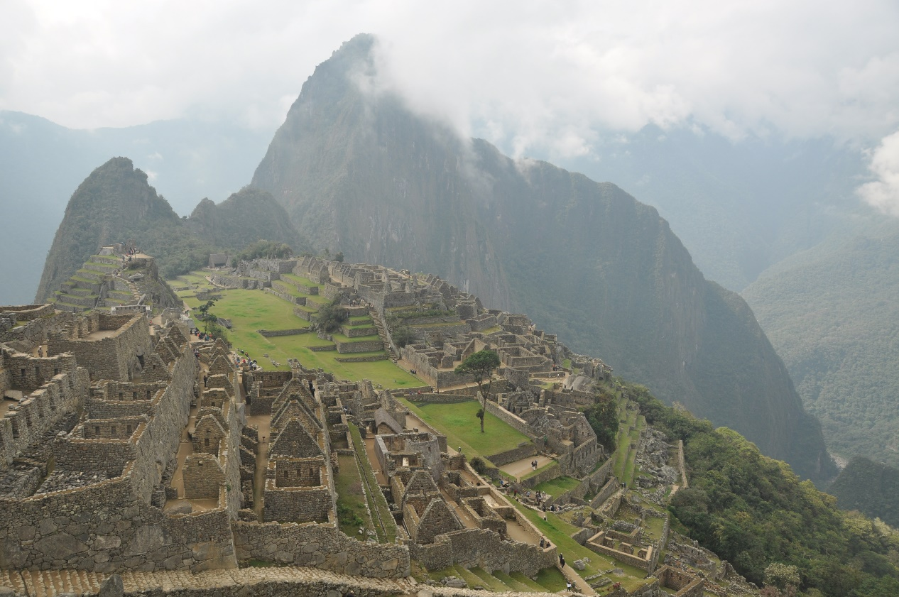
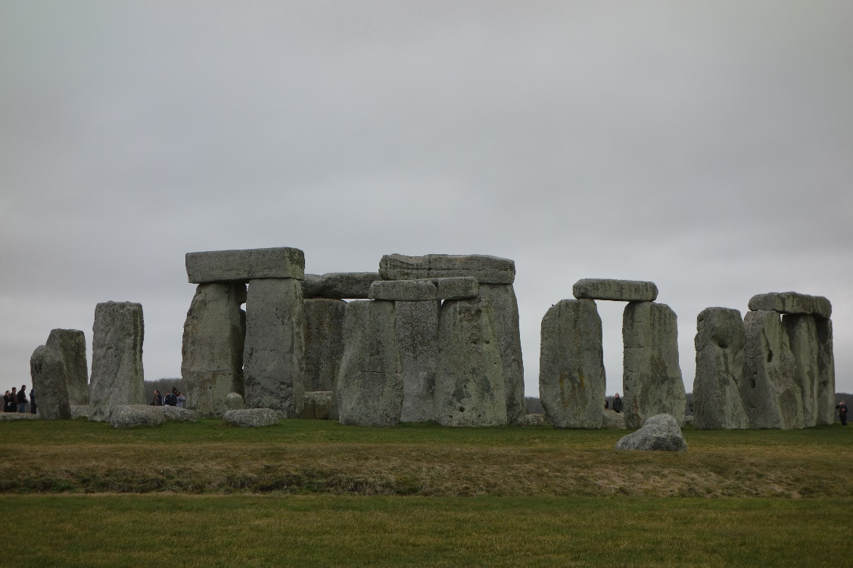
OTHER “ARCHEO-ASTRONOMY” SITES
Machu Picchu (Peru)
Stonehenge (England)
Notes:
There are many more examples of this kind of alignment between archeology and astronomy, and even a name for field that studies is: Archeoastronomy. : how people in the past "have understood the phenomena in the sky, how they used these phenomena and what role the sky played in their cultures. Stonehenge, Mayan and Incan temples …

Slide 18
Sensemaking and Science
A fundamental challenge in sensemaking is balancing the competing goals of understanding a particular collection or dataset and applying that understanding to new instances
The highest level of sensemaking is the creation of scientific theories, with a preference for “more organized” or simpler explanations for the observations
18
Notes:
There’s a name for this preference for simpler explanations…. Anyone remember it? Occam’s Razor. It doesn’t mean that the simpler explanation (as measured maybe by the number of variables or rules) is more likely to be right, just that it will be easier to understand

Slide 19
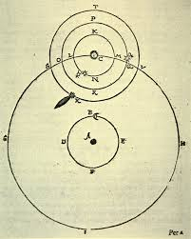
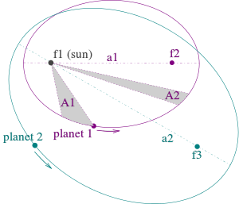
Tycho Brahe vs. Johannes Kepler same data, different theories
Heliocentric elliptical orbits follow “Kepler’s Laws” – simple and elegant theory
Reconciling data with a geocentric organizing principle makes the Tychonic system complex
Notes:
But sometimes if you explanation has to be very complex, it might be that you’ve got some fundamental assumptions wrong. Plato - famous Greek philosopher – wrote about many things that we’ll touch on in this course, but one thing he got famously wrong was what we call “cosmology” – theories about the origin, evolution, structure of the universe. Plato had an intellectual infatuation with the idea that all orbits of celestial objects had to be perfect circles, and astronomers struggled for about 2000 years to fit their observations given that assumption. It was possible, but only with total kludges that didn’t fit any laws of physics – like epicycles. Finally copernicus and kepler said the hell with plato – there is a better explanation.

Slide 20
Notes:
Good place to stop for a bit. I hope that you’re making some sense of my organization for this course.

Slide 21
Foundational Concepts
Resources
Intentional Arrangement
Organizing Principles and Properties
Interactions

Slide 22
Resources:
Anything of value that can support goal-oriented activity
Notes:
Like organizing, “resource” is a multi- or trans- disciplinary concept.

Slide 23
ANYTHING! Chapter 12 Case Studies
§12.1, “A Multi-generational Photo Collection”
§12.3, “Smarter Farming in Japan”
§12.4, “Single-Source Textbook Publishing”
§12.5, “Organizing a Kitchen”
§12.6, “Earth Orbiting Satellites”
§12.16, “The Dabbawalas of Mumbai”
§12.18, “Neuroscience Lab”
Cases in green are assigned for today; blue next time; black ones later in semester; underlined are CogSci 190 2018
Notes:
Very wide range of domains to which we apply the TDO perspective. I wrote the first 4 for the first edition of the book, but 13 of the others were written by Ischool students in the last 4 years as their final course assignment. You’ll do the same, but you’ll benefit from reading most of these before you have to decide on your topic.
I hope you’ve read the first two case studies – I chose two were maximally different; organizing kitchens and organizing the earth into time zones. to make the point that the new framework and design patterns we’ll learn about organizing can apply very broadly. We will take some time to talk about them in just a minute

Slide 24
ANYTHING! Other Case Studies
Cognitive Neuroscience
What3Words
Diagnostic and Statistical Manual of Mental Disorders
Occupational Classification
Time Zones
Organized Crime
NBA Player Tracking
Universal Vending Machine
Medical Emergencies
Notes:
Underlined ones were written last semester by cogsci undergrads like you (that’s one reason why I asked about your writing and interests in the survey). As you read the cases this semester, I hope they inspire you to want to write a case study that finds its way into a future course syllabus

Slide 25
Organizing System: Home Kitchen
Photo by Emilie Hardman (http://www.flickr.com/photos/quintanaroo/2741672230//) Used by permission
25
Notes:
Each case study uses the design questions --- the what, why, how much, by what means, when – as its outline, which makes them easier to analyze and compare. We’ll talk a lot of things like kitchens and closets in this course, not because I am training you to be home designers, but because you are very familiar with them. But we’ll learn to look at them in entirely new ways.
What did you think of the kitchen case study.
Talk about intrinsic./ extrinsic/static/dynamic ?

Slide 26
Organizing Principles
Exploit the constraints of the physical environment
Exploit the physical properties (especially shape and size) of the resources being organized
Organize by task
Organize by frequency of use
Organize by the “social dimensions” of interaction
Organize alphabetically
Notes:
Here are some of organizing principles mentioned in the kitchen case study…. I’ve phrased them more abstractly to help you see that none of them are kitchen-specific and could be used in other organizing systems

Slide 27
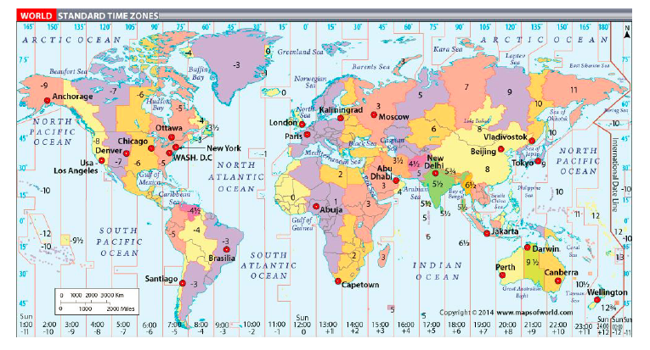
Organizing System: Time Zones
Notes:
The first time zone proposals divided the globe into 24 15-degrees of longitude zones

Slide 28
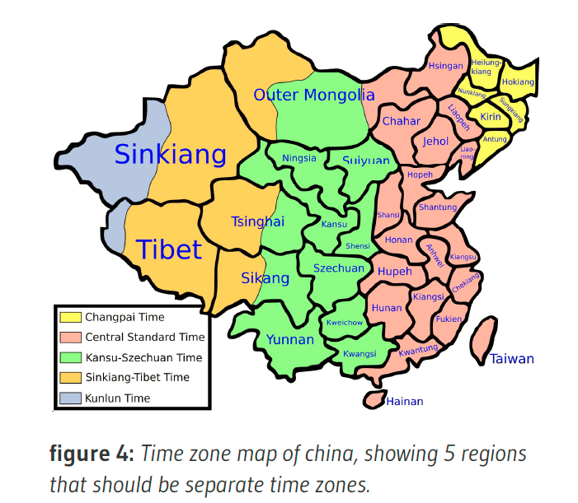
Notes:
The geopolitics of time zones are most visible in the western Pacific and in China, where the 15-degree principle is greatly distorted
This case study illustrates a very important point about organizing systems.- that they exist to enable interactions, and so the choice or priority of those interactions (and the people who will be interacting) inevitable introduces biases

Slide 29
Intentional Arrangement:
Explicit or implicit acts of organization by human or computational agents

Slide 30
Organizing Principles [1]
The resource arrangements follow one or more ORGANIZING PRINCIPLES, ideally expressed in an implementation-neutral way
ORGANIZING PRINCIPLES use properties or DESCRIPTIONS that are associated with the resources; organizing and describing resources are inherently interconnected activities
Interactions with resources are determined by their organizing principles and descriptions
30
Notes:
Organizing, resource description, and interaction design are inherently interconnected.

Slide 31
Organizing Principles [2]
For physical resources the properties are often:
Perceptual – what does it look like?
Material – what is it made of?
Task-oriented – how is it used?
For information resources the properties are often semantic ones – what is it about?
31
Notes:
Data science more often calls resource properties “features”

Slide 32
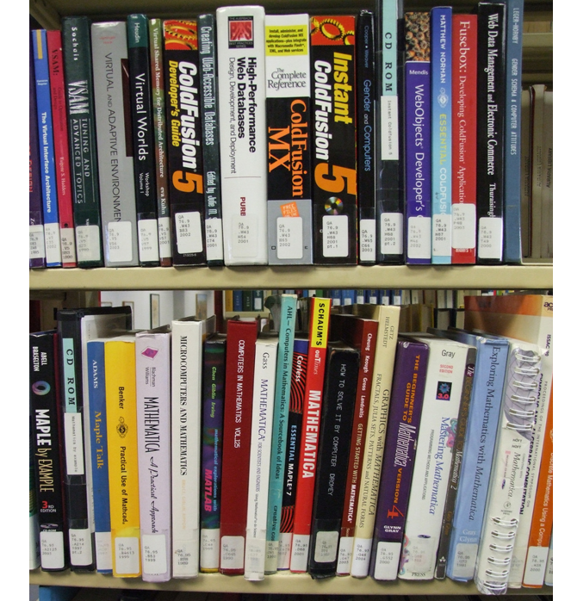
Organizing Books
By Content
Organizing Books
By Color
Notes:
More aesthetic… but doesn’t scale

Slide 33
Organizing Spices by Cuisine
33

Slide 34
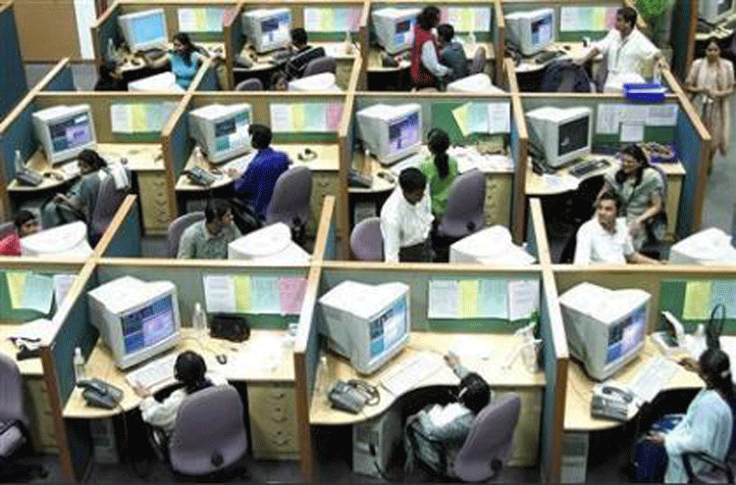
Organizing People by Work Role
Logical model
Physical model
34

Slide 35
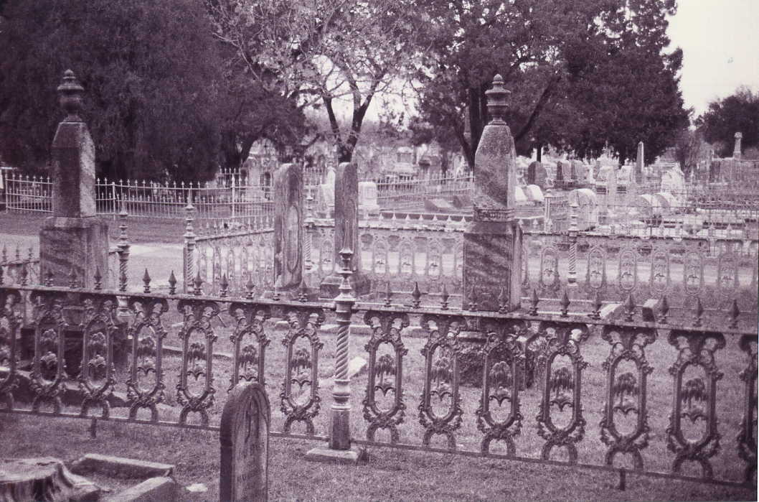
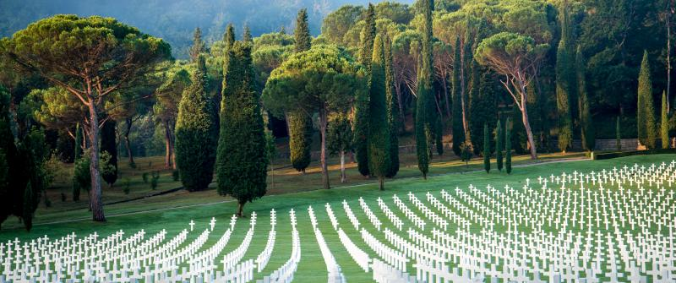
Organizing People by Family, Religion, Class, Race, Year of Death, Cause of Death…

Slide 36
Organizing Principles [3]
Other typical arrangements are based on ownership, origin, taxonomic, or “taskonomic” or behavioral properties (usage frequency, correlated usage)
Any resource with a orderable name or identifier can have alphabetic or numeric ordering
Any resource with an associated date (creation, acquisition) can have chronological ordering
36

Slide 37
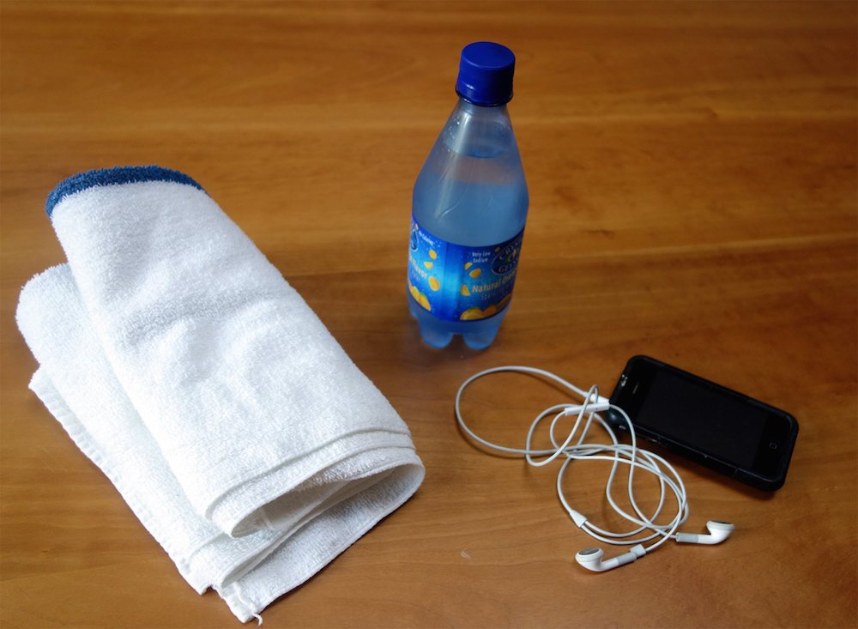
Task-Oriented Organization
37
Notes:
What is the organizing principle that brings these resources together?

Slide 38
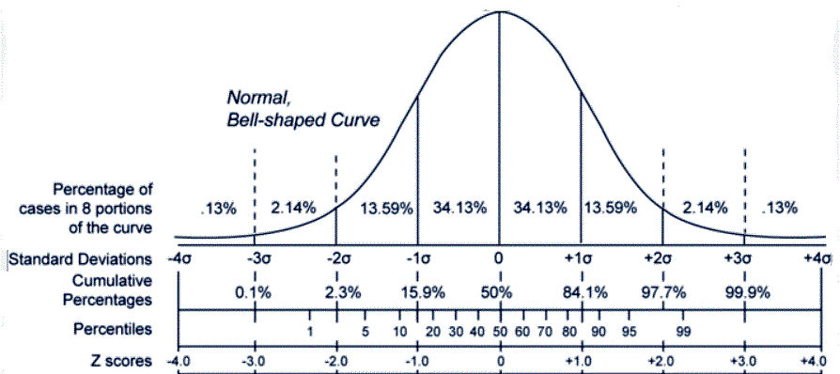
Organizing Principles [4]
Properties can be computed, or inferred (descriptive statistics, data science techniques)
Notes:
Is this property value common or typical, or is it an outlier? What property values are correlated with each other? Machine learning techniques seek correlations between the values of the features or properties of things or resources to identify the categories that best organize them

Slide 39
Are Categories Discovered or Created? “Carving Nature at its Joints”
Over 2000 years ago Plato proposed that species are distinguished by "carving nature at its joints" - where the natural differences between things are the largest or most salient or where there are few connections
I.e., there are “natural kinds” – categories are discovered, not invented
"Joints" and the boundaries they create between things exist to some extent with physical resources and are manifested in their surface or perceptible properties
39
Notes:
I was using modern vocabulary there – correlations of feature values--- but this is a very old idea.
Some of you have studied philosophy already – and I know that you have to take at least one course to graduate with a cogsci major. A lot of the issues we’ll discuss this semester have been discussed for very long time by philosophers.

Slide 40
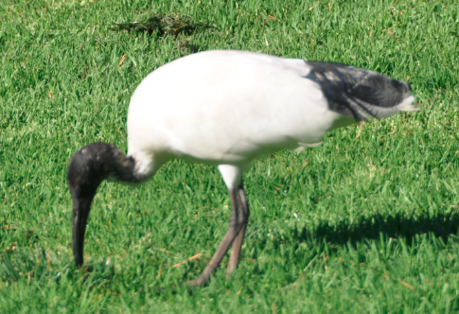
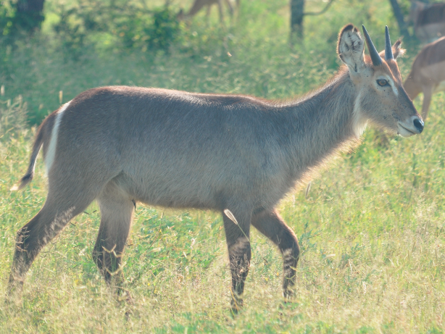
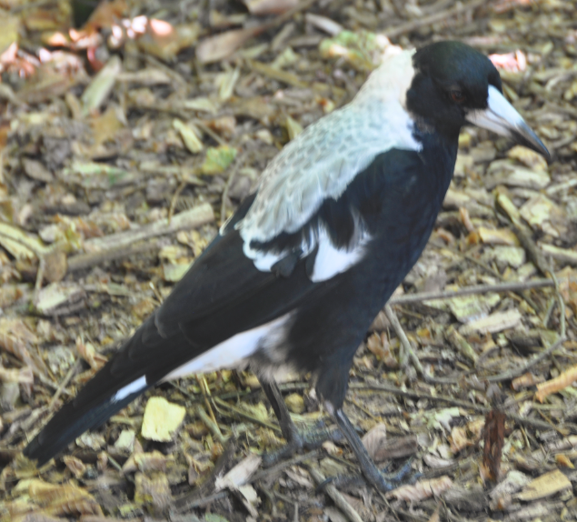
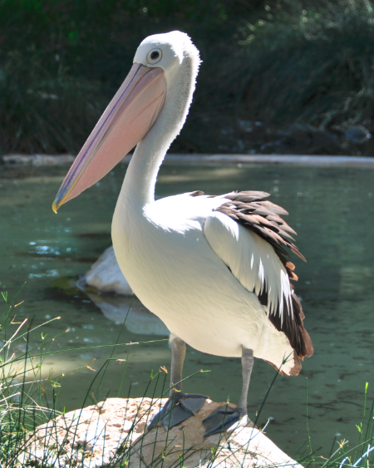
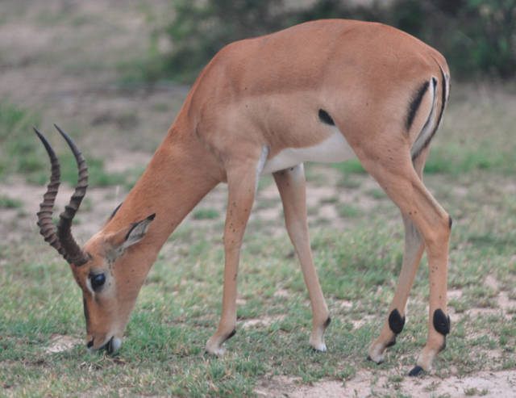
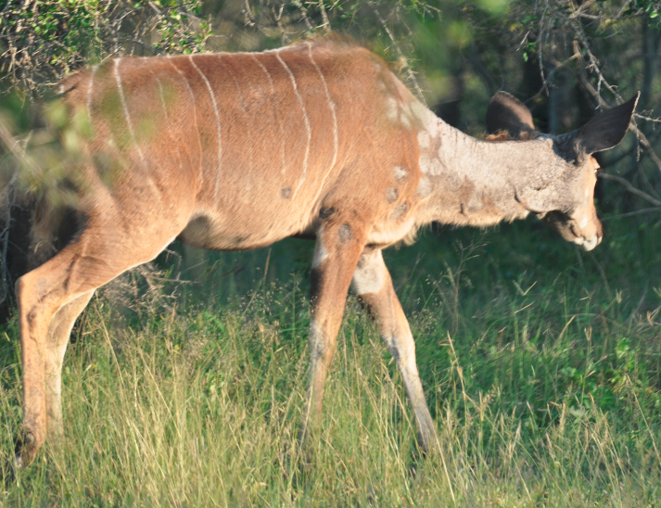
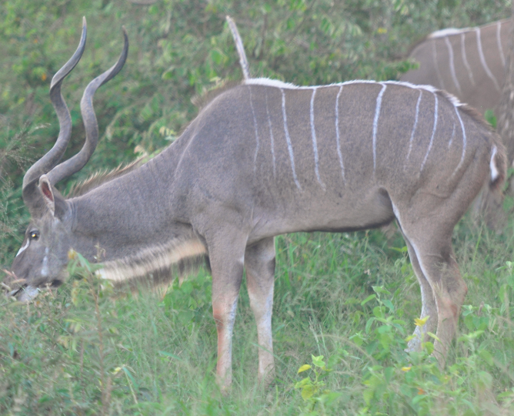
Shared Visible Features Carve These Animals into Two Categories
Notes:
So it seems like at least some kinds of categories exist to be discovered….

Slide 41
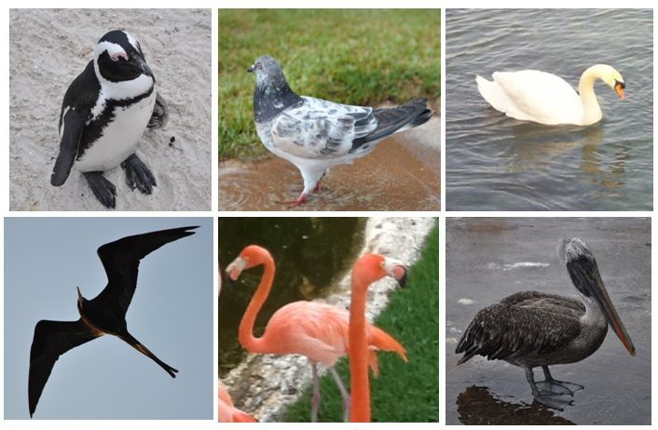
But “Cue Validity” Depends on Context
Shared features that “carve” the categories in one context might not work in another
41
Notes:
I won’t say anything more about this now… but this point is extremely important if you apply it to problems of trying to classify things. Who has taken cogsci 131 computational modeling and can say something more here? (or maybe you are taking it this semester)
What examples do you use to train your classifier?

Slide 42
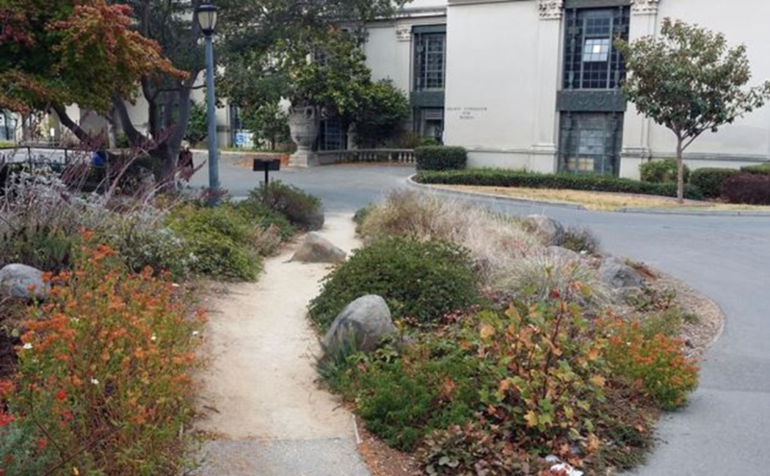
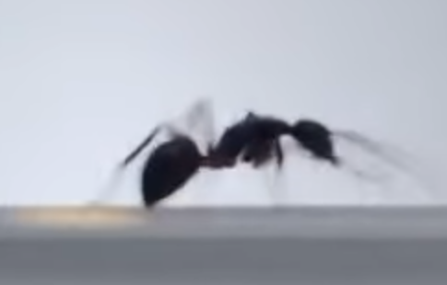
Intentional Arrangement
If the organization isn’t intentional, we can’t reuse or recreate it with our own efforts
The agents might also organize themselves in a bottom-up or “collective intelligence” fashion, especially human agents (and some insects!)
This requires explicit or implicit communication between the agents
42
Notes:
Why do I emphasize “intentional”///
There is structure in the piles of debris left after a hurricane or tsunami, but even if you could describe it, you can’t reproduce is. People can also impose structure on random inputs – think Rorshach tests – but very low reliability or predictability
You might recognize the place on the left on the berkeley campus where people have created a new pathway… and the ant on the right is emitting a chemical to mark the path to a food source

Slide 43
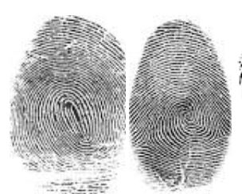
Organizing using “Interaction Resources”
Interactions with physical resources sometimes leave traces or other evidence that an interaction has taken place
With digital resources, or physical resources augmented by sensing, recording, or communication capabilities, interaction traces can be predictable, persistent, and consistent
These “interaction resources” – data about interactions – can be analyzed to reorganize the resource collection or otherwise influence subsequent interactions
43
Notes:
And finally, to draw another connection between cognitive science and data science…..as we saw with people cutting corners to make a new path and the ant leaving a chemical trail
And of course using interaction traces is the basis for google. Facebook, yelp and countless other internet business models
This is record of my “fast tag” tracker in my car. Amazing what you can infer

Slide 44
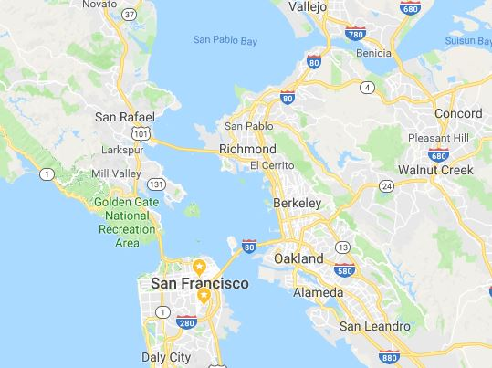
Where’s Bob and Where Has He Been?
3
4
2
1
Notes:
Last week of spring semester 2016. Final project presentations at the Information school late on Thursday may 12, and I drove home to SF, going through Bay Bridge toll plaza at 8:36 pm (arrow 1)… Because tolls are only charged in one direction, you have to make some inferences that I went someplace on Friday, but Saturday morning I drove back into SF at 9:33 in the morning, (arrow 2) and then after graduation Saturday afternoon I went North across the Benicia bridge toward the Napa Valley and then didn’t come back to SF for a week. I have a second home in the Napa Valley… and if you know that one fact then you make perfect sense of this

Slide 45
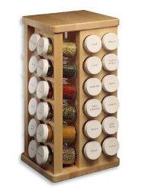
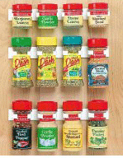
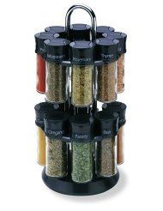
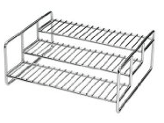
Principles don’t Specify Implementation: “Organize Spices Alphabetically”
THINK ARCHITECTURALLY!
45
Notes:
Think architecturally
What does this mean: see next slide!

Slide 46
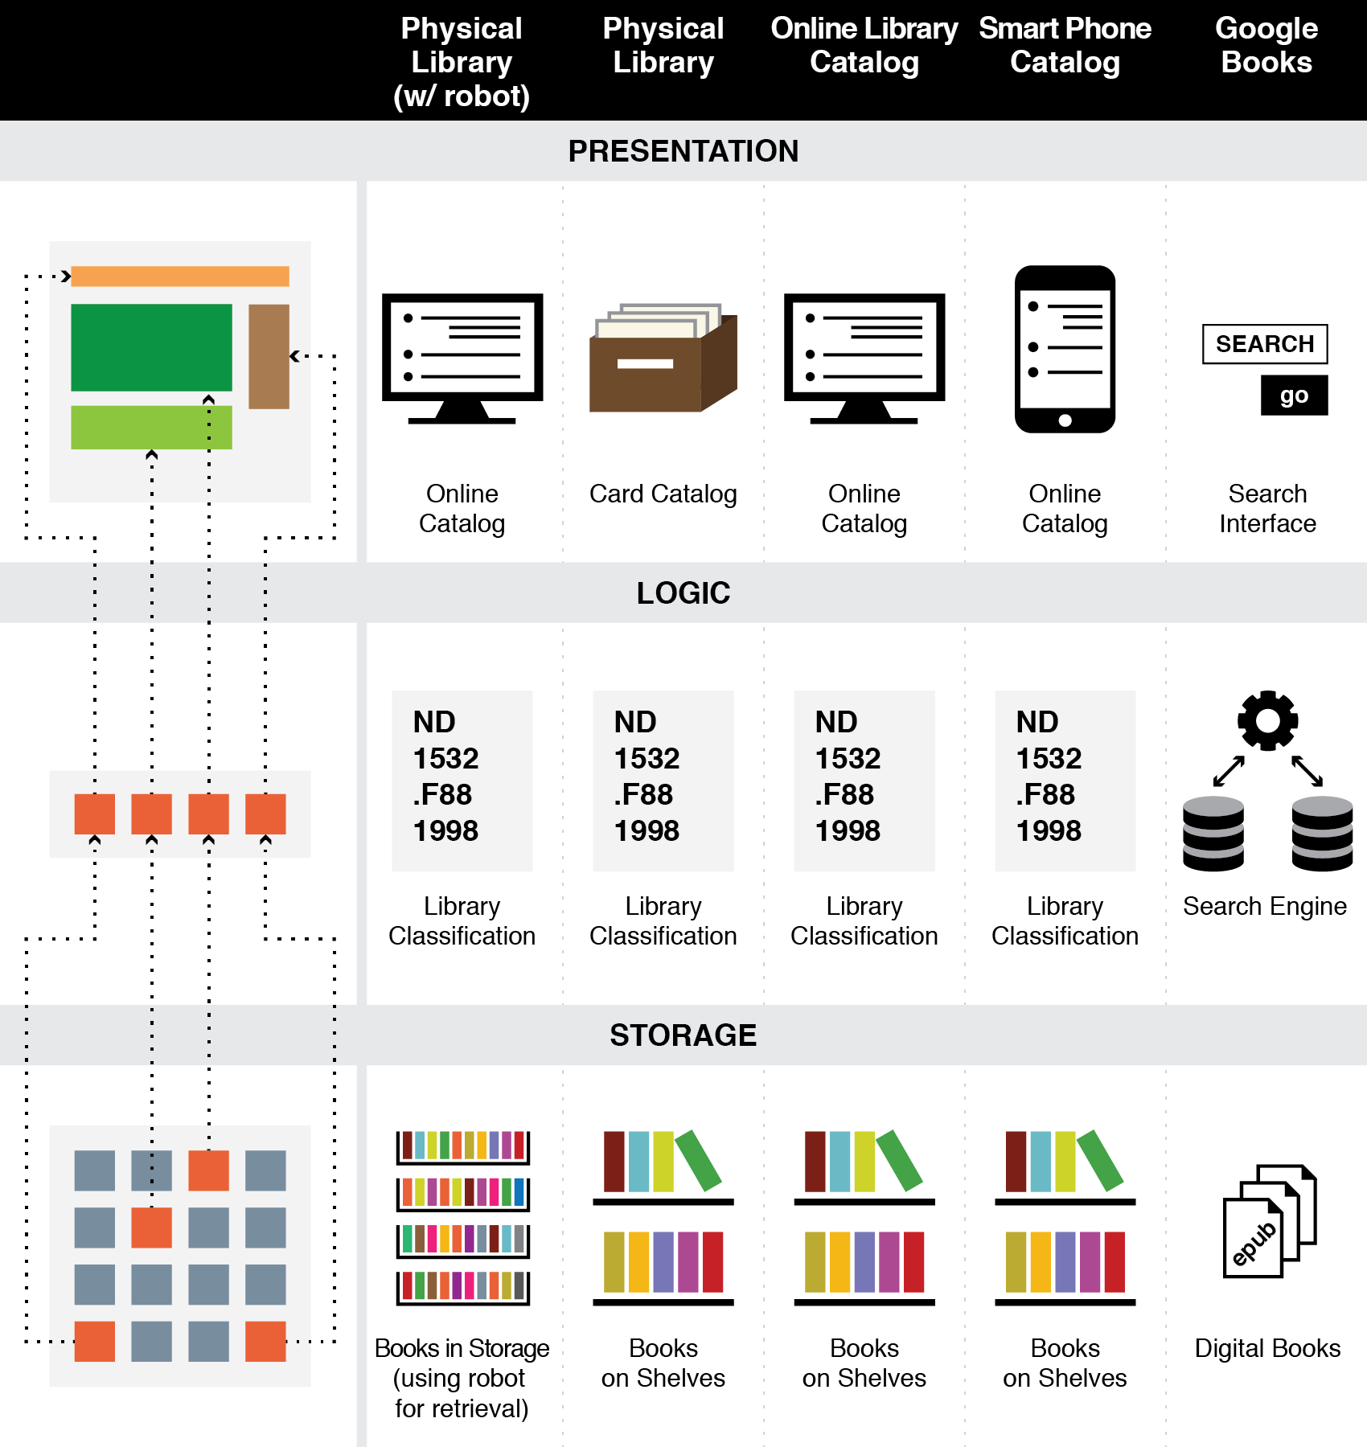
The Three-Tier Architecture
Organizing Principles are logically separated from Implementation and Presentation Tiers
Notes:
So if we think of this in terms of the 4 disciplines of psych, cs. Ling. Neuro – you shouldn’t be surprised that of those 4 I have least to say about neuroscience, because it is primarily an implementation level concern. This course is much more about architecture and interaction

Slide 47
A “Library Robot” Changes Only the Storage Tier
47

Slide 48
Interactions –The Why of Organizing Systems
INTERACTIONS include any activity, function, or service supported by or enabled with respect to the resources in a collection or with respect the collection as a whole
Interactions can include access, reuse, copying, transforming, translating, comparing, combining, visualizing, recommending… anything that a person or process can do with the resources…
48

Slide 49
Interactions
Some interactions can be enabled with any type of resource, while others are tied to resource types
The supported interactions depend on the nature and extent of the resource descriptions and arrangement
Finding the optimal descriptions is an important goal but not always possible
49

Slide 50
Organizing and Interaction Tradeoffs
How does recycling in Hong Kong compare with recycling here?
What does this imply about the interactions with resources throughout the entire recycling system?
Notes:
The granularity of the classification determines the specificity of the interactions. People do more of the work of recycling in HK than here, but doing the sorting at throwaway time is much more effective than doing it later. Analyze any org system: who does the work and who gets the benefits? What are the biases?

Slide 51
ORGANIZING SYSTEMS BIG IDEAS
Every organizing system must enable users to interact with its collection of resources
The possible interactions depend primarily on the nature and extent of the descriptions associated with the resources
Intentional arrangement emerges when one or more resource descriptions are used by organizing principles
51

Slide 53
A Tour of the Syllabus
The TDO book was written to implement my model of how best to teach a course on “Information Organization and Retrieval”
But S&O is structured by “contexts” so we sample from TDO rather than read it straight through
We also need additional texts and readings that cover topics from psychology, philosophy, and other disciplines
We’ll read many TDO case studies to illustrate disciplinary and domain breadth
YOU WON’T LIKE OR UNDERSTAND EVERTHING TO THE SAME DEGREE. THAT’S EXPECTED AND IS OK!
53

Slide 54
Plan for the Course
We can analyze sensemaking and organizing from four interrelated perspectives:
As a member of a social, cultural, or language community (linguistics, sociology, social network analysis)
As an individual (psychology and philosophy)
In institutional contexts (law and business)
In data-intensive or scientific contexts (statistics, computer science, info visualization).
Notes:
5 parts of this course. After a couple of weeks of discussing the foundational concepts of the discipline of organizing, we’ll apply them in four interrelated contexts in this order because individual, institutional, and statistical organizing build on the language and cultural foundations

Slide 55
Along the Way…
Gestalt perception
Perception of causality
Basic level categories
The narrative fallacy
Judgment under uncertainty
Behavioral economics
Information overload
Distributed cognition
Metaphor
Linguistic relativity
Cultural categorization & “folk biology”
Analyzing your “Interaction traces”
Describing relationships and structures
Social network analysis
Wisdom of crowds, groupthink, “fake news”
Controlled vocabularies
Domain ontologies
Visualizing thoughts and data
Scientific method
Paradigm shifts
Computational description
Computational classification
Notes:
This 4 contexts approach to understanding S & O enables us to talk (briefly) about a very wide range of topics that I think of as cognitive science. I know from the survey that some of you are familiar with some of these, but none of you is familiar with all of them, so we’ll have a great time learning from each other as we go through the semester

Slide 56
Class Participation
You are expected to have read the assigned readings before the class meets
You are expected to participate in class and in online contexts to demonstrate your reading and reflection
Everyone will need to demonstrate some participation, but you can distribute your participation somewhat according to your personal preferences
56
Notes:
Some of you come from academic settings where classroom discussion and questioning of the instructor or other students is highly deprecated… but not here
We have bcourses discussion lists…. Have you used these before? Have you used twitter with a course hashtag? (#cogsci190)

Slide 57
Assignments, Exam, Grading
10 Weekly Assignments (50%)
1 Take Home Final Exam (time-limited, using bCourses) (20%)
Case Study (20%)
Class preparation and participation (10%)
57
Notes:
First assignment is next Monday, jan 29 – due a week later… and we’ll have one a week for the next 4 or 5 weeks after that. They are short assignments…

Slide 58
Your Case Study
You will write a case study like those in TDO Chapter 12
Aspire to have your case study in next year’s CogSci 190 syllabus; tell an interesting story well
Propose a topic by March 5
Present your case study during RRR week (on May 7 or May 9)
Final case study report due May 10
58

Slide 59
Academic and Personal Integrity
Unless otherwise instructed, homework assignments are to be completed independently
Exams and assignments are "open book," meaning that you can refer to the instructor's lecture notes, your notes, and anything in the course syllabus. But this is because you will be never be tested on simple facts, definitions, or anything else you can locate in a text somewhere. To copy text or ideas from another source without appropriate reference is PLAGIARISM. You will fail the assignment or exam and there might be further disciplinary action.
59
Notes:
…and materials submitted as homework should be the result of your own work.
est for me to make a book not-copy protected, much more convenient – different devices, easier to take notes, etc
Show cover
18 named ischool master’s or phd students
Including two of this year’s TAs. Who worked this past summer on the 3rd edition.,

Slide 60
Other Class Policies and Expectations
Your computer and other devices you might use for reading and writing are essential tools and you can use them in the classroom. But…
Class begins promptly at 12:40 pm
My office hours: Tu 2-3, Th 2-3 (Evans 557)
THIS WEEK: Tu 2-4, W 1-4, Th 2-4
Lauren Stoops will also have office hours (Tu 4-5)
Lecture notes will be posted before class
60
Notes:
…But if you decide you want to use Facebook or other applications rather than paying attention in class, you should leave... and you might even be asked to leave if we see you doing this (
Likewise, if your phone rings during class you will be asked to leave the classroom to answer it and will not be invited back
. Be in your seat. Being late shows no respect for your classmates and the instructor, and proves you haven’t calculated what you are paying for each class meeting.
Last day to add is feb 13, but you’ll need to decide before that because we’ll have a few assignments by then and you need to do them to keep up
If you’re not a calfornia resident, you’re paying (or someone is paying for you) 18370 per semester.
4 courses, 27 class meetings – roughly 170 dollars a lecture
I’m worth it, but can you afford to waste money by not showing up?
The Tas sit in the back row
They can see your laptop screens

Slide 61
Upcoming Syllabus
For 24 January (Design Decisions)
TDO Chapter 2
12.1 Multi-generational photo collection
12.3 Smarter farming in Japan
12.7 Medical Emergencies (Delzompo 2018)
For 29 January (Case Studies)
12.4 Single-source textbook publishing
12.6 Earth orbiting satellites (Brenners 2014)
12.18 Neuroscience lab (Gerber 2013)
Cognitive Neuroscience (Griffith 2018)
Organized Crime (Sondhi 2015)
NBA Player Tracking (Mon 2016)
61
Notes:
My experience teaching a course on Organizing at the Ischool was that the best way to get a firm grasp of the foundational concepts was to see them applied in a wide variety of case studies
The ones with 12 something are in the TDO book in chapter 12. the other ones were written by ischool grad students as a course assignment. You’ll be writing one too.

