Slide 1
CogSci 190 “Sensemaking and Organizing” Spring 2019
Robert J. Glushko glushko@berkeley.edu
24 January 2019
2) Design Decisions for Organizing Systems

Slide 2
Outline
Organizing Organizing Systems
Category Perspective {and, or, vs.} Dimensional/Design Space Perspective
The Six Design Questions:
What
Why
How Much
When
How
Where

Slide 3
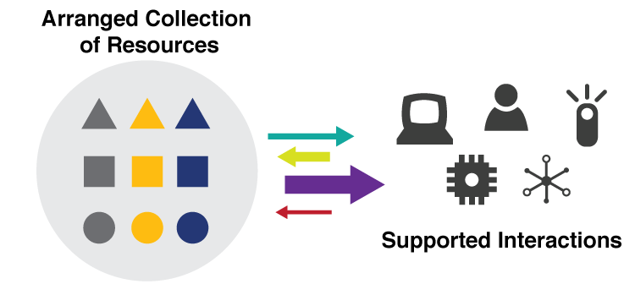
They are all “Organizing Systems”
FLASHBACK
A collection of resources intentionally arranged to enable some set of interactions
3

Slide 4
Organizing Organizing Systems
We can classify organizing systems by:
resource type
dominant purpose
creator
intended user community
or many other ways
4

Slide 5
Categorizing by Resource Type
Organizing Systems
Collections of Books
(Libraries)
Collections of Art
(Museum)
Collections of Documents
(Archive)
Collections of Data
(Repository)
Collections of Spices (Pantry) …
5

Slide 6
Categorizing by Purpose: Resource Preservation as Means vs. End
Organizing Systems
Memory Institutions
Libraries
Museums
Business Info Systems
Content Management
Archives
CRM
ERP
6

Slide 7
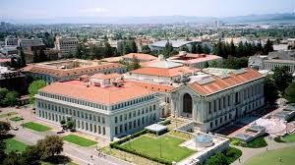
A Library
7

Slide 8
A Library
8

Slide 9
What Is a Library?
What is being organized?
Why?
How much?
By what means?
When?
Define “library” as a category of organizing systems
9

Slide 10
What Is a Library?
A collection of resources
Organized to enable “access” and “reuse”
Curated for “public good” and “community creation”
Conventional interaction is “circulation” – borrowing and return of resources…
10

Slide 11
A Library?
11

Slide 12
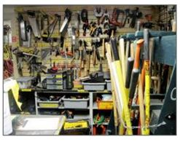
A Library?
12

Slide 13
A Library?
13

Slide 14
A Library?
14

Slide 15
Consequences of Category Thinking
Many types of resource collections have conventional characteristics that are deeply embedded in cultural and linguistic categories
How does this affect how we think of and design a new organizing system?
15

Slide 16
Consequences of Category Thinking
Using an established category to describe an organizing system reinforces these conventional characteristics, even if we add qualifiers
… and marginalizes any atypical characteristics of the organizing system being categorized
16

Slide 17
A “Design Space” or “Dimensional” Perspective
In addition to using categories like Library or Museum or Business Information System, consider a specific organizing system as a point in a multidimensional design space and these categories as regions in that space
This treats the familiar categories as “design patterns” that embody typical configurations of design choices
17

Slide 18
Consequences of Dimensional Thinking
Overcomes the bias and conservatism inherent in familiar categories
Design patterns support multi-disciplinary work that cuts across familiar categories and applies knowledge about them to new domains
Creates a design vocabulary for translating concepts and concerns from category and discipline-specific vocabularies
18

Slide 19
Analogical and “White Space” Thinking
We can reason by analogy to identify and apply the principles used in one organizing system to understand or design others
If we think metaphorically of this design space as a map of organizing systems, we might see empty regions or “white space” between the densely-populated centers of the traditional categories
What does this “white space” represent?
19

Slide 20
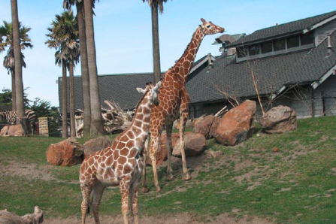
A Zoo
Is a zoo an animal library? If not, what category should it be classified in?

Slide 21
What Is a Museum?
A collection of artifacts and other objects
… of artistic, cultural, historical, or scientific importance
… available for public viewing
(Wikipedia)
How do museums differ from libraries?
21

Slide 22
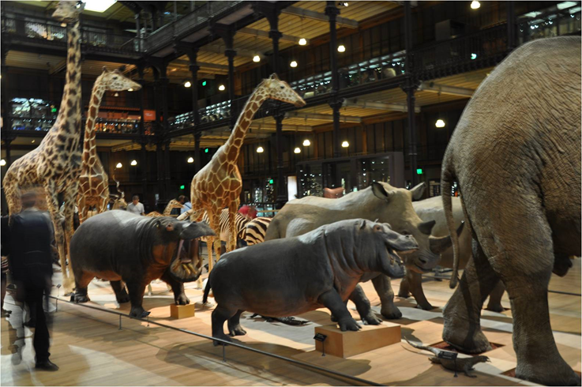
Natural History Museum
How does a natural history museum differ from a zoo?

Slide 23
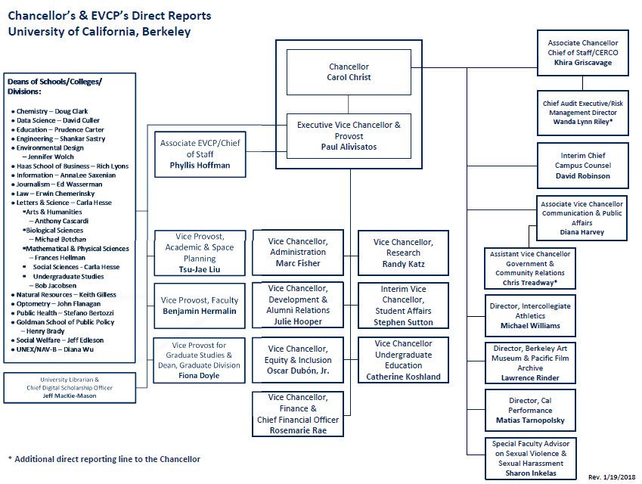
Workforce Organization
23

Slide 24
ZOO : NATURAL HISTORY MUSEUM
WORKFORCE ORGANIZATION : ( ? )
:
?
:
24

Slide 25
Cemetery == Memory Institution? == Human Resource Organization?
25

Slide 26
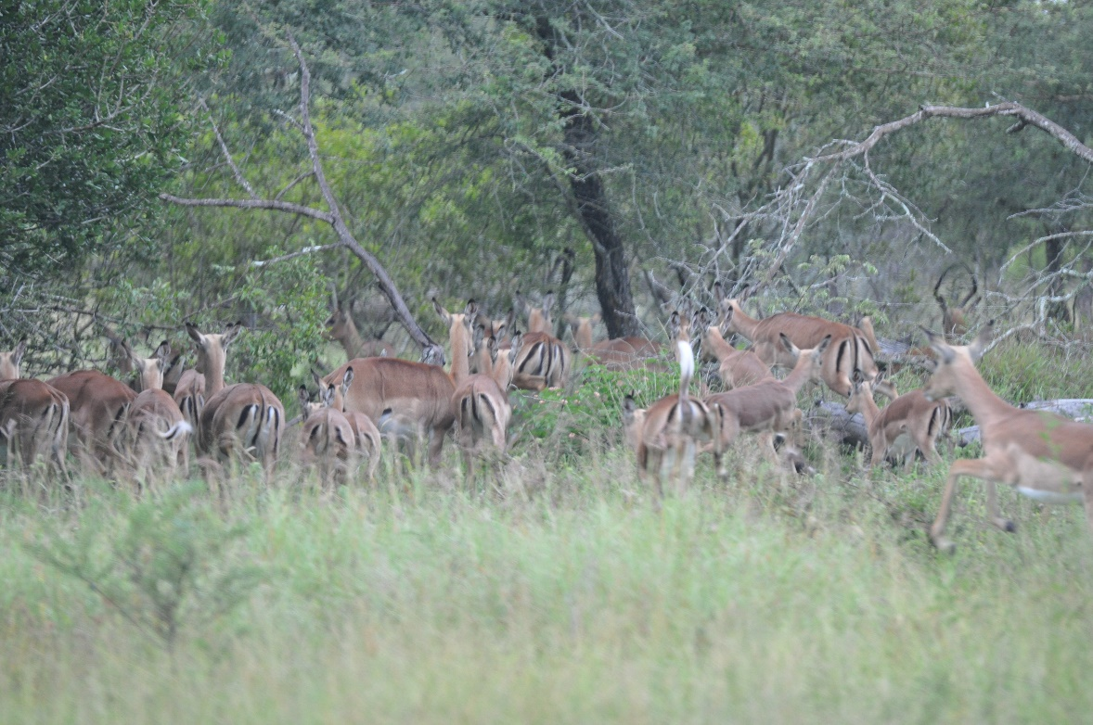
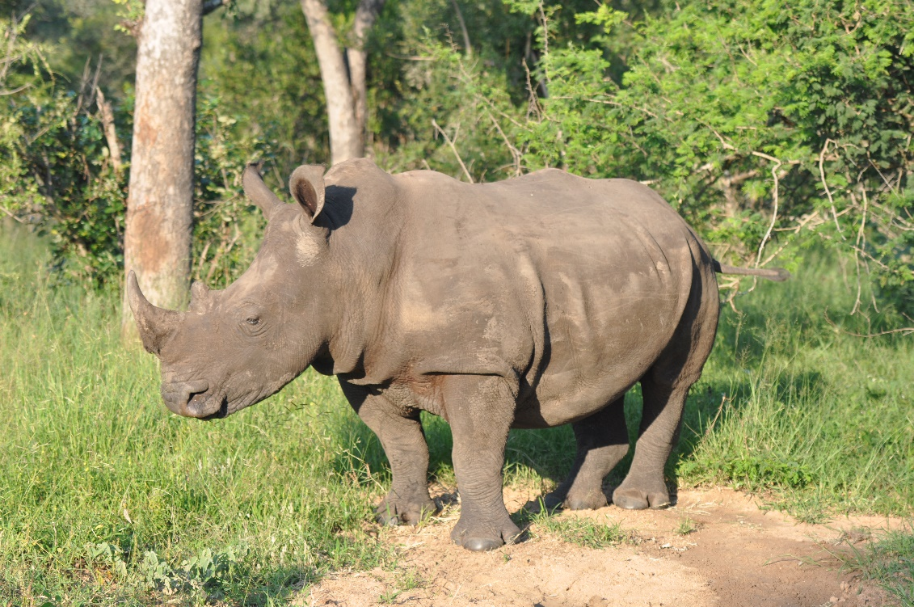
Wild Animal Park
How does a wild animal park differ from a zoo?

Slide 27
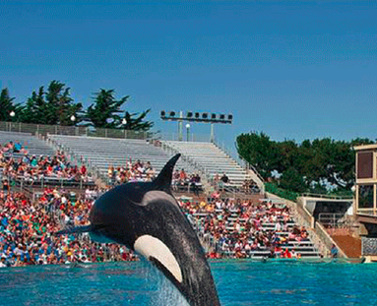
Animal Theme Park (Sea World)
How does an animal theme park differ from a wild animal park?
From a zoo?
From a
natural history museum?

Slide 28
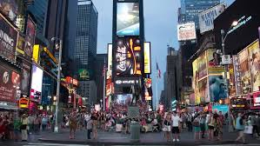
WILD ANIMAL PARK : ANIMAL THEME PARK
CITY : ( ? )
:
?
:
28

Slide 29
Williamsburg == Human Theme Park? == Living History Museum?
29

Slide 30
The 6 Dimensions of an Organizing System
What Is Being Organized?
Why Is It Being Organized?
How Much Is It Being Organized?
When Is It Being Organized?
Who (or What) is Organizing It?
Where is it Organized?
30

Slide 31
Resources:
FLASHBACK
Anything of value that can support goal-oriented activity

Slide 34
Resource
“anything of value that can support goal-oriented activity”
Is it possible for someone to have a goal that makes them consider something to be a resource when someone else wouldn’t?
In different domains a resource might be called: object, item, instance, document, artifact, asset, entity. Can you distinguish these terms?

Slide 35
What Is Being Organized?
Identifying the unit of analysis is a central problem in every intellectual or scientific discipline – “what exactly are we talking about?” – and in every organizing system
Resources that are aggregates or composites of other resources, or that have internal structure, or that can have many attributes, pose questions about the granularity of their "thingness”
35

Slide 36
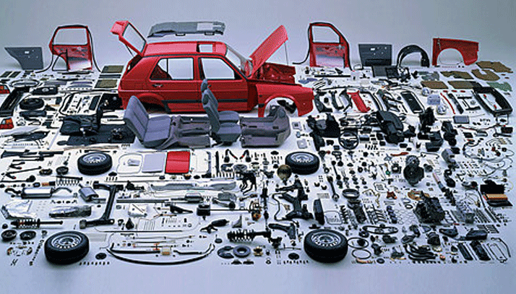
How Many Things is a Car?
When is it built? When it is sold? When it is repaired?

Slide 37
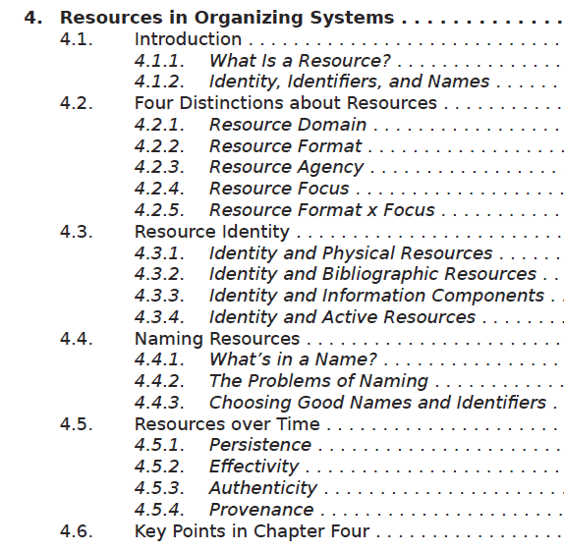
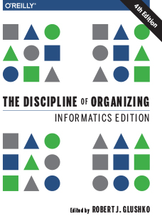
How Many Things is a Book?

Slide 38
Resource Abstraction: “Thing” vs. “Type of Thing”
We often blur the distinction between individual things (or instances of things) and classes of things
We say that that two objects are the "same thing" when we mean they are the same "type of thing“
Identifying a resource as an instance is not the same as identifying the category or "equivalence class" to which it belongs
38

Slide 39
“Shamu” -- Instance or Type?
39

Slide 40
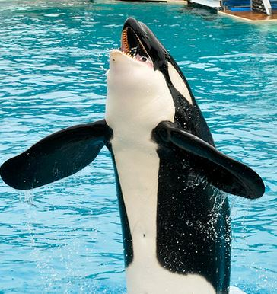
How Big is the Category?
This is an orca (N > 100K)
This is an orca trained to perform at a marine park (N about 100)
This is an orca that used the stage name “Shamu” at Sea World ( N = 28)
https://www.flickr.com/photos/saechang/4496400672/in/photostream/
This is the orca that performed at San Diego Sea World on April 5, 2010 (N = 1)
40

Slide 41
Describing and Organizing Classes of Things
Categories are sets or groups of resources, “classes of things” or abstract entities, that are treated the same
We all create individual categories to satisfy ad hoc requirements that emerge from our unique experiences, preferences, and resource collections
Cultural categories are embodied in culture and language and have imprecise / flexible boundaries
Institutional categories are explicitly constructed to create a precise semantic model (of what might otherwise be treated as cultural categories)
In addition to these three “category categories” created by people, computers can create computational categories
41

Slide 42
Different Types of “Category Categories” to Organize People
Individual categories – how you distinguish different types of friends
Best friend, family friend, work friend, school friends
Cultural categories
jock, nerd, slacker, hipster…
Institutional categories used by governments, business management, industrial organization
Computational organizing of individuals
User models, indexes used for predictive analytics, recommendations
42

Slide 43
Computational Categorization of People
43

Slide 44
Interactions –The Why of Organizing Systems
INTERACTIONS include any activity, function, or service supported by or enabled with respect to the resources in a collection or with respect the collection as a whole
The interaction of ACCESS is fundamental in any collection of resources –why would you collect and organize resources you didn’t expect to access in the future?
44

Slide 45
The Most Generic Interactions
Finding a resource that you know exists
Identifying a resource to make sure you have the one you were looking for
Selecting a resource from a set of candidates in a collection
Obtaining the resource if what you have at this point is just a resource description
45

Slide 46
“Why” is much about “Who”
What interactions or services will be supported, and for whom?
Are the uses and users known or unknown?
Are the users primarily people or computational processes?
46

Slide 47
Is “Who” Just You?
Organizing systems that we create for our personal use will naturally embody our individual goals and preferences
But those used by more than one person or for more than one interaction must prioritize the users and the interactions
This means that the organizing system will be more efficient or create more value for some users than for others
47

Slide 48
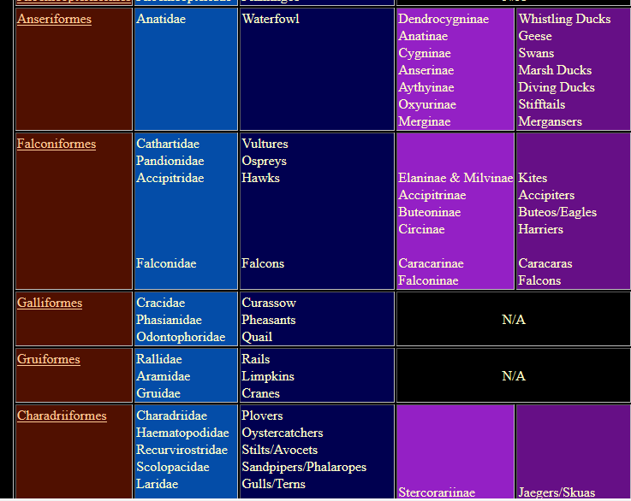
Organizing Birds for Scientists
48

Slide 49
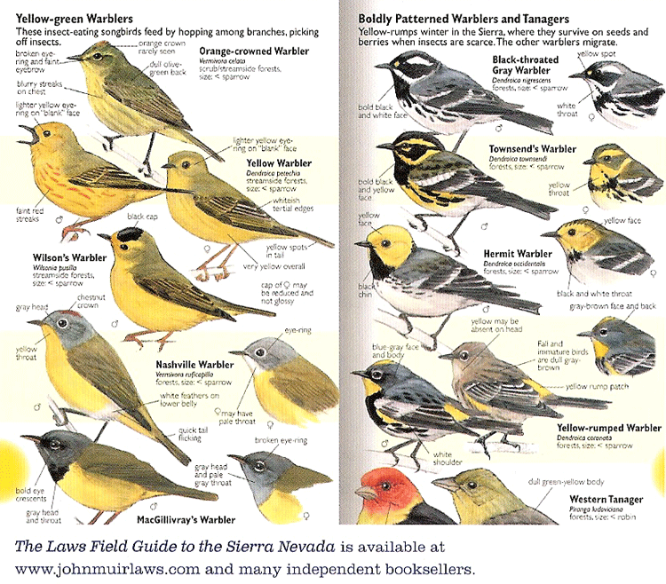
Organizing Birds for Birdwatchers
49

Slide 50
Why => Bias in Organizing Systems
Personal and cultural categories and organizing systems are highly biased
Creating institutional categories using more systematic processes does not prevent them from being biased
Indeed, the goal of institutional categories is often to impose or incentivize biases in interpretation or behavior
50

Slide 51
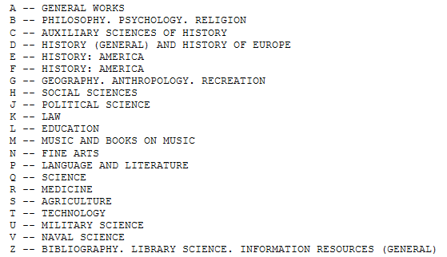
Library of Congress Classification
51

Slide 52
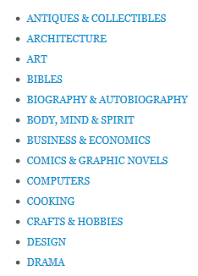
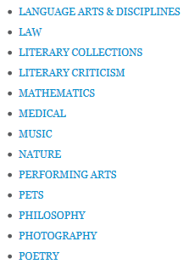
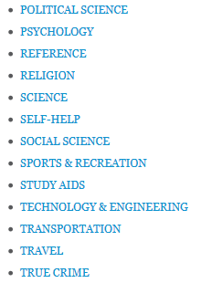
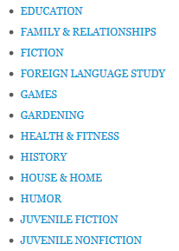
Top Level BISAC Categories (used in bookstores)
52

Slide 53
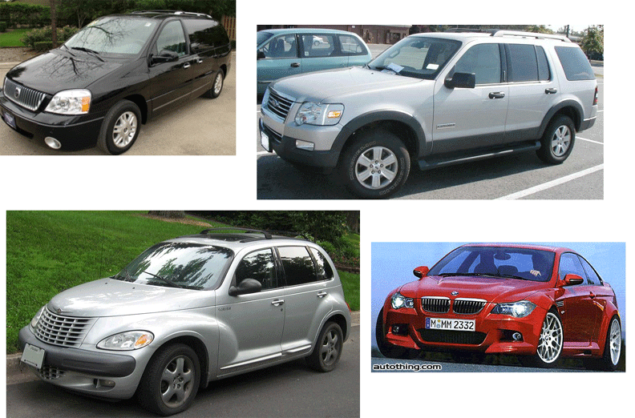
CAFE Categories: Find the Truck(s)
(See sidebar near TDO 7.2.4)
53

Slide 54
Organizing Creates Winners and Losers
Organizing systems embody the priorities and values of those designing them, yielding arrangements and interactions designed to control or change the behaviors of the users
Priority queues
Choice architecture, default values
Segregation and discrimination
54

Slide 55
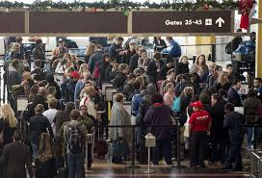
Winners and Losers in Airport Organizing Systems

Slide 56
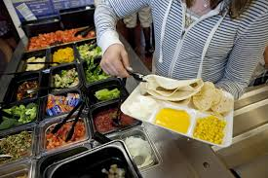
If school kids are more likely to eat foods at eye level at the beginning and end of the cafeteria buffet, how do you arrange the food?

Slide 57
How Much Is It Being Organized?
Not everything is equally organizable, because not everything is equally describable
A controlled vocabulary can yield more consistent organization
If you are organizing a fixed collection of resources, you might organize it more than if you need an organizing system that can accommodate resources that you might have in the future
57

Slide 58
Factors that Influence “How Much”
Scope and size of the resource collection
Number and variety of intended users
Available technology
58

Slide 59
When Is It Being Organized?
When the resource is created
When it is added to some collection
Just in time when it is about to be used
Never
All the time - continuous or incremental
59

Slide 60
The Tradeoff
60

Slide 61
Organizing “On the Way In”
Whenever we select a resource for inclusion in an organizing system, describe it, or arrange it according to an organizing principle, we (should) have an interaction in mind
We include a resource in our system because our users will need it; we assign a resource to one or more categories to help our users find it, understand it, and connect it with other resources in a meaningful way
TDO calls this “organizing on the way in”
61

Slide 62
“Just in Case” Organization
62

Slide 63
Postponing Organization
63

Slide 64
Organizing “On the Way Out”
If a collection of resources isn’t organized to support our desired interactions, computational techniques can re-organize them (if they are digital) or their digital resource descriptions
… by indexing, searching, sorting, transforming, translating, labeling, categorizing, combining, summarizing… (IR, ML, NLP)
This doesn’t always mean that the collection was organized poorly; it might just be organized for different interactions than the ones we want
TDO calls this “organizing on the way out”
64

Slide 65
Who or What Is Organizing?
Authors or creators
Professional organizers
Users “in the wild”
Users "in institutional contexts“
Automated or computerized processes
65

Slide 66
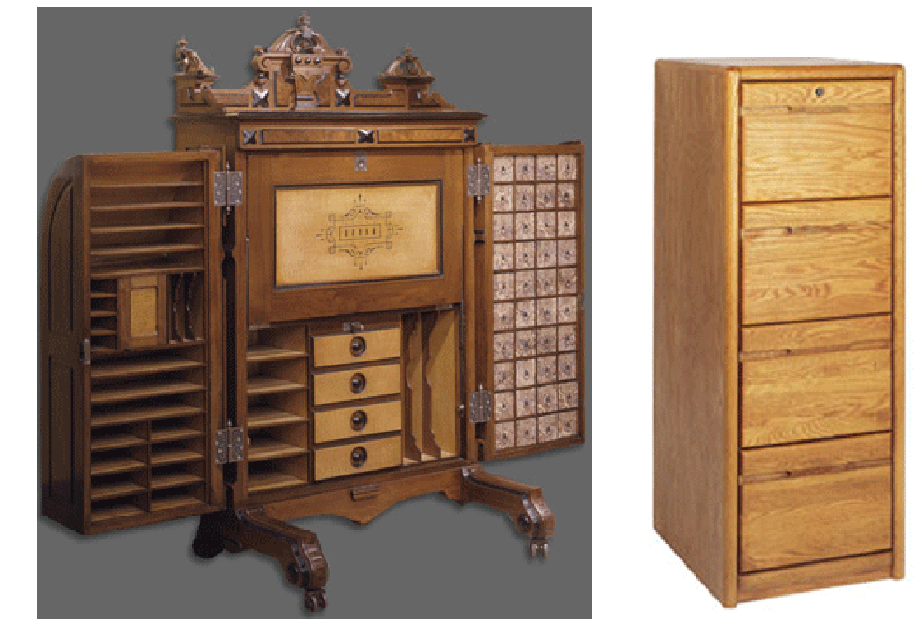
Where is it Organized?
Physical locations can enable or constrain
66

Slide 67
Where is it Organized?
Resources can be organized in physical arrangements that:
enforce efficiency
or reward exploration
Resource arrangements can encourage or discourage interactions between people, to create a sense of freedom, security, or confinement
67

Slide 68
Built Environments and City Plans
Built environments / city plans are places, but are usually organizing people and their interactions rather than “the land”
The easiest and most efficient way to organize space is using a coordinate grid, with streets intersecting at perpendicular angles
Hills, rivers, and other natural features make it more difficult to impose systematic organization
Most cities developed over long time periods and their “legacy organization” constrains their current organization
68

Slide 69
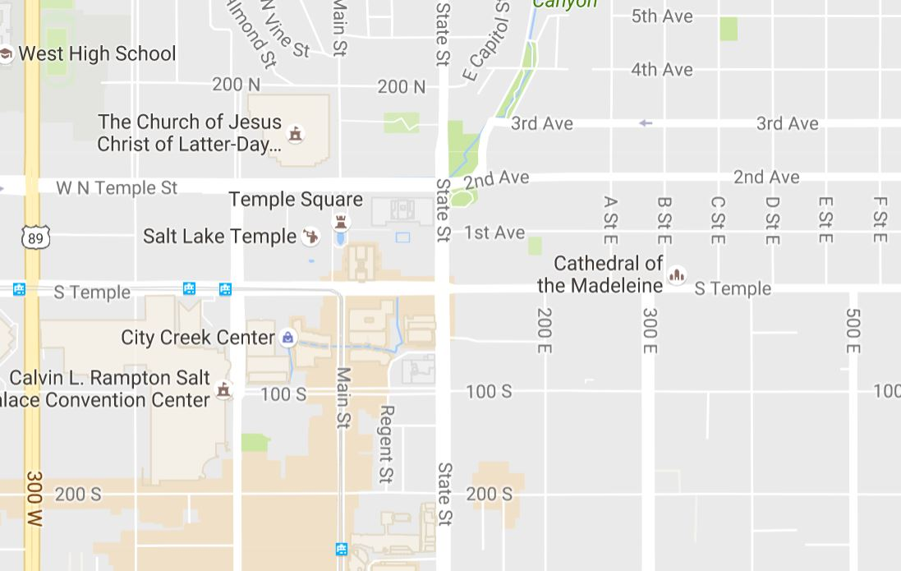
Salt Lake City

Slide 70
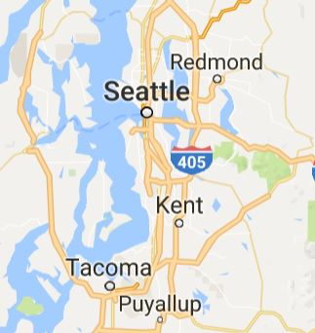
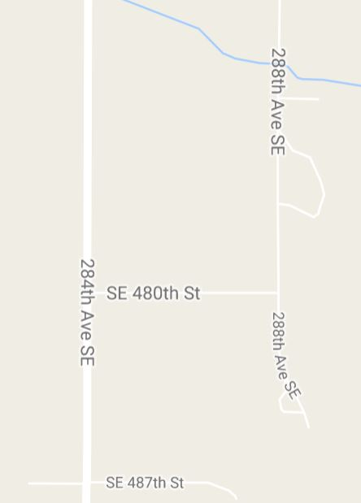
Seattle: Architectural Thinking
40 Miles from Downtown Seattle

Slide 71
Where Digital Resources Are Organized
For digital resources, where they are organized is often invisible or irrelevant except…
When that would be bad for business
When the law constrains how or what information is organized
71

Slide 72
The 6 Dimensions of an Organizing System
What Is Being Organized?
Why Is It Being Organized?
How Much Is It Being Organized?
When Is It Being Organized?
Who (or What) is Organizing It?
Where is it Organized?
72

Slide 73
For Next Time: Case Studies
For 1/29 you’ve been assigned 5 short case studies to read, bringing the total to 10
I recommend that for each case you first read the overview, and before reading the rest of the case, try to answer the design questions and anticipate some of the answers. You’ll more easily see what the design choices were, especially when things turned out differently than how you imagined it.
If the domain is very unfamiliar, and you don't feel that you understand the case, don't stress over it. Better to think hard about the ones you understand or like.
As you read each case, you will at times be reminded of a previous case you've read. Make a note…
73

