Slide 1
CogSci 190 “Sensemaking and Organizing” Spring 2019
Robert J. Glushko glushko@berkeley.edu
29 January 2019 3) Case Studies

Slide 2
Outline
Review of the 10 case studies to date
Small group analyses of the cases
Identify interesting/important design issues
Identify cases with similar design issues
Identify cases with contrasting design issues
Identify opportunities to apply the different depictions of the organizing system
Invent some analogy questions?

Slide 3
Case Studies
1/22
TDO 12.5 Organizing a kitchen (Hardman 2013)
Time Zones (Volkov 2015)
1/24
TDO 12.1 Multi-generational photo collection
TDO 12.3 Smarter farming in Japan
Medical Emergencies (Delzompo 2018)
1/29
TDO 12.4 Single-source textbook publishing
TDO 12.6 Earth orbiting satellites (Brenners 2014)
TDO 12.18 Neuroscience lab (Gerber 2013)
Cognitive Neuroscience (Griffith 2018)
Organized Crime (Sondhi 2015)
3

Slide 4
Organizing System: Home Kitchen
Photo by Emilie Hardman (http://www.flickr.com/photos/quintanaroo/2741672230//) Used by permission
4

Slide 5
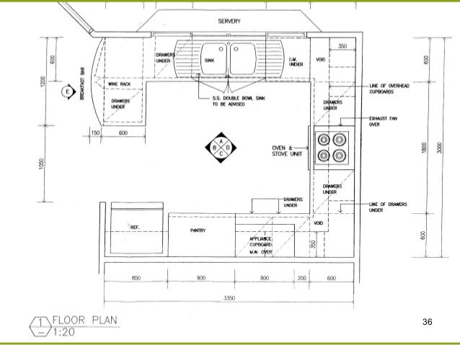
An Alternative Representation of a Kitchen

Slide 6
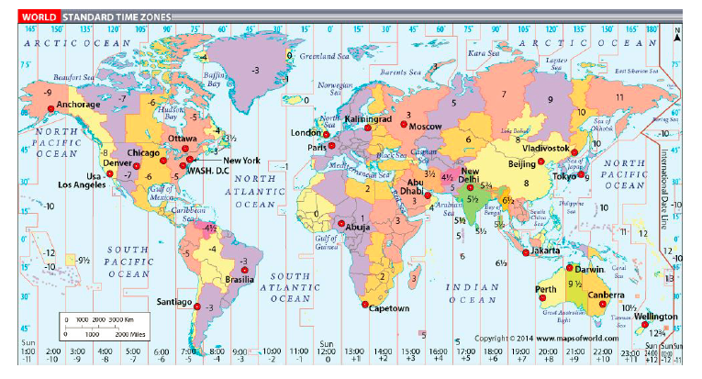
Organizing System: Time Zones

Slide 7
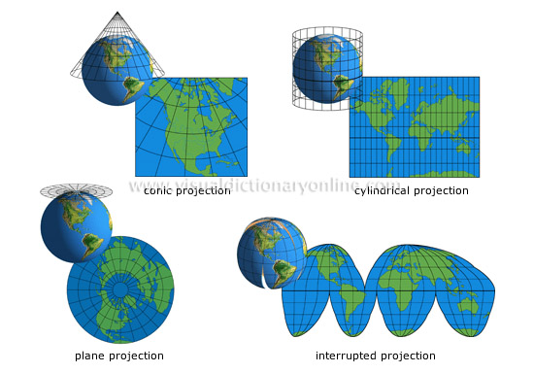
Alternative Map “Projections” of the Earth

Slide 8
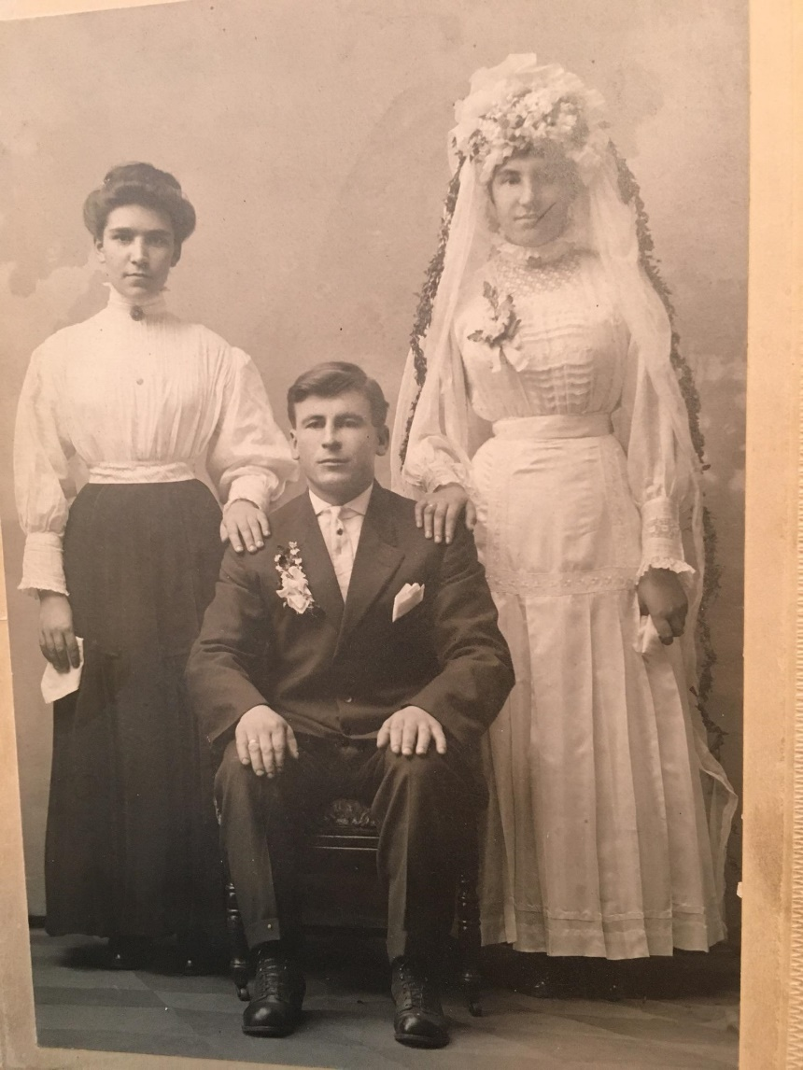
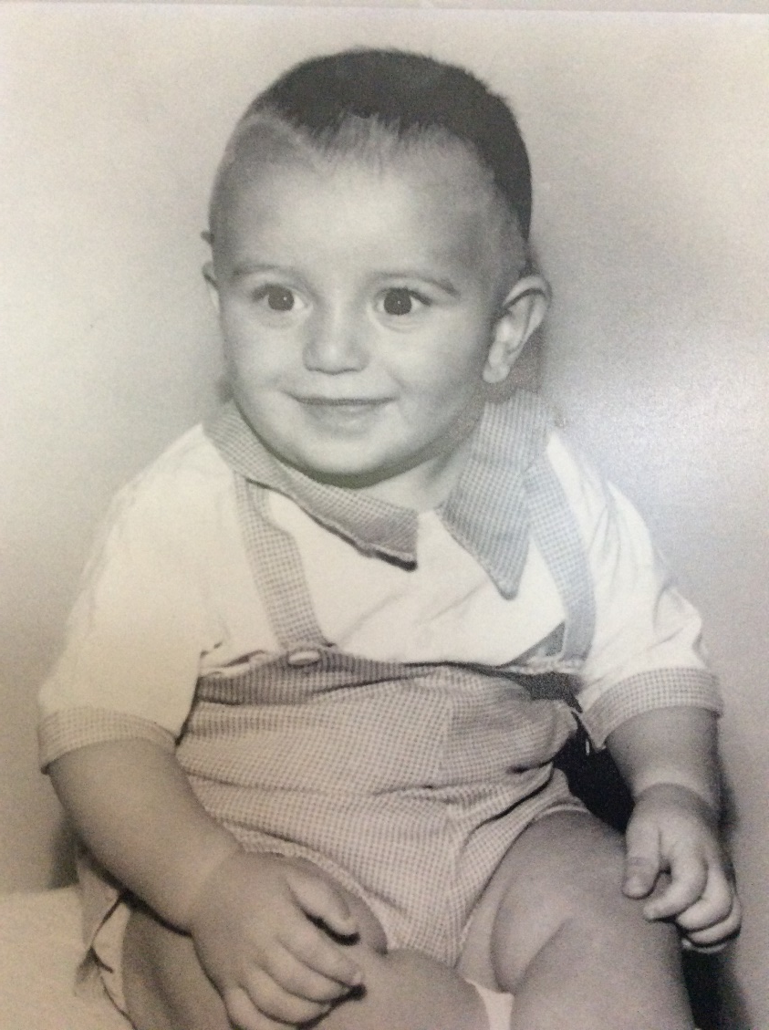
From MY Grandpa’s Photo Collection
Wedding Day, 1919
Grandson, 1954

Slide 9
Multigenerational Photo Collection
What issues arise with respect to the scope of the organizing system whose design was motivated by the discovery of Grandpa’s photos?
Preservation is a primary motivation. What are others? Are you preserving printed photos, digital photos, or an abstract photo that contains both formats?
What are the costs and benefits of standard categories or tags for the photos?
How do formats/technologies for digital photo storage and processing enable or constrain the organizing system?
What is the expected lifetime of the organizing system? Why does this matter?
9

Slide 10
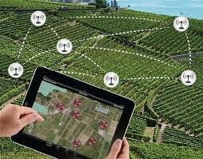
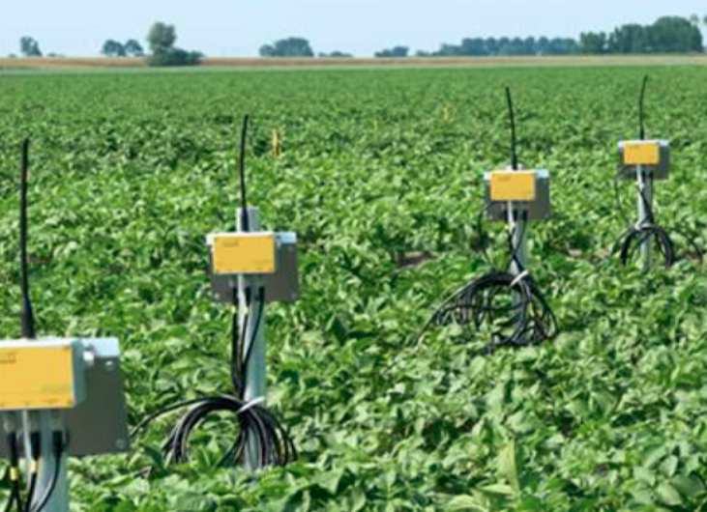
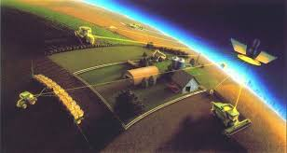
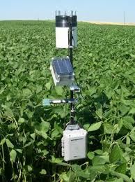
Smart Farms
“Precision Agriculture”

Slide 11
Smarter Farming in Japan
Why does farming in Japan need to be smarter?
Which resources are smarter than before? Which ones are less smart?
How does the smart farm system become smarter over time?
What other domains besides farming could potentially use this system or one similar to it?
11

Slide 12
Farming in the Cloud
Precision agriculture uses GPS, sensors, satellites or aerial images, and information management tools (GIS) to assess and understand the heterogeneous conditions across farm acreage because of soil, topography, sunlight, etc.
Sensor information can enable optimum sowing density, irrigation, fertilizer application, and more accurately predict harvest dates and crop yields
A company doing a lot of this R&D that you might not think of
12

Slide 13
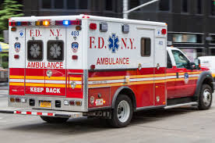
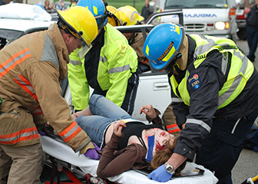
Medical Emergencies

Slide 14
Medical Emergencies
What are the resources that need to be organized to enable effective response to medical emergencies?
What factors make it challenging to manage these resources?
How are emergencies classified and how this determine the use of the EMS resources?
How do standards for resources and processes improve the effectiveness of EMS responses?
14

Slide 15
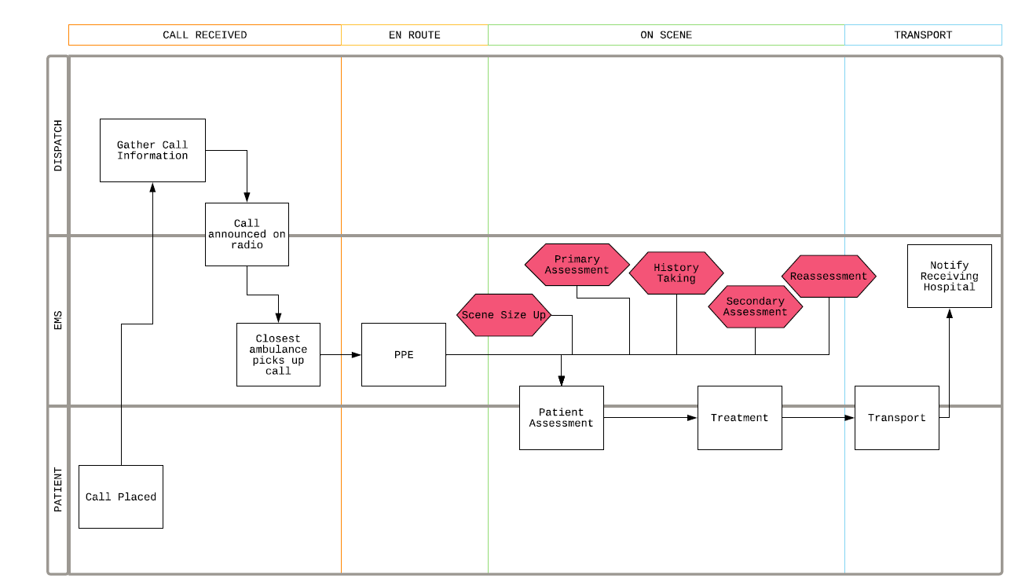
Medical Emergencies – “Service Blueprint”

Slide 16
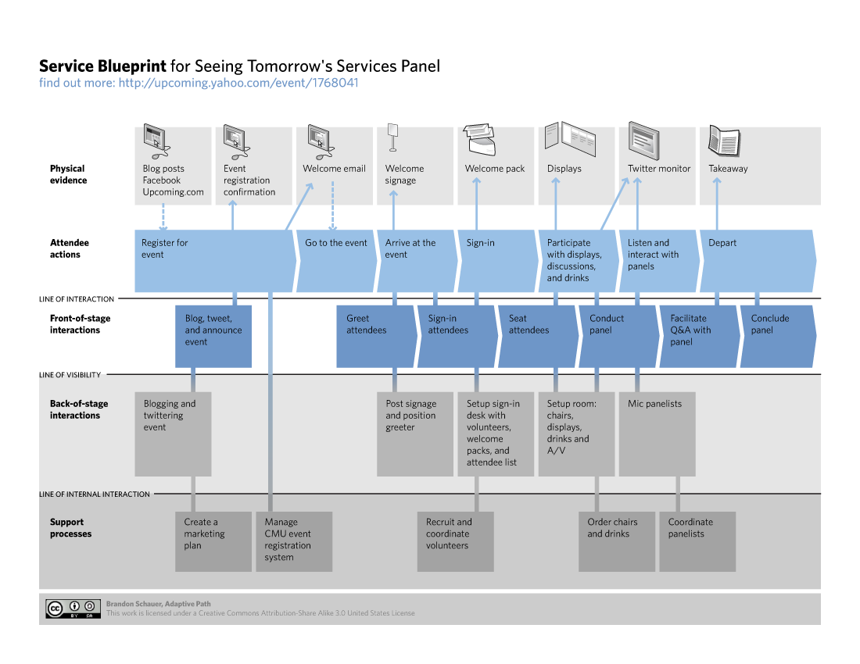

Slide 17
Single-Source Textbook Publishing
“Single-source” is a popular slogan in content management. What does it mean?
How is single-source publishing like an automobile assembly line?
When is single-source publishing most necessary and useful?
How does the format and granularity of the source files influence the value of single-sourcing?
17

Slide 18
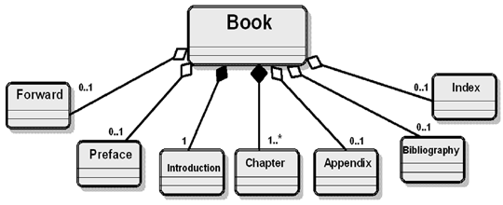

Slide 19
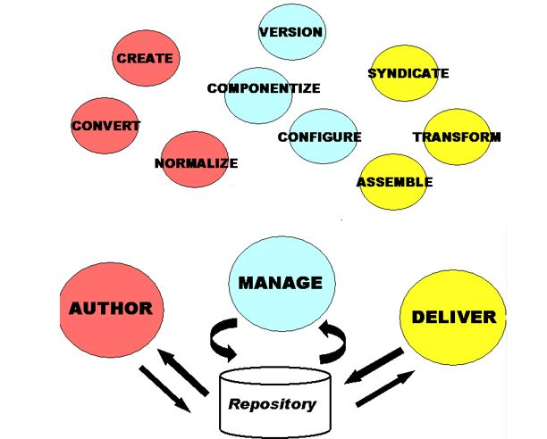
Single-Source Textbook Publishing

Slide 20
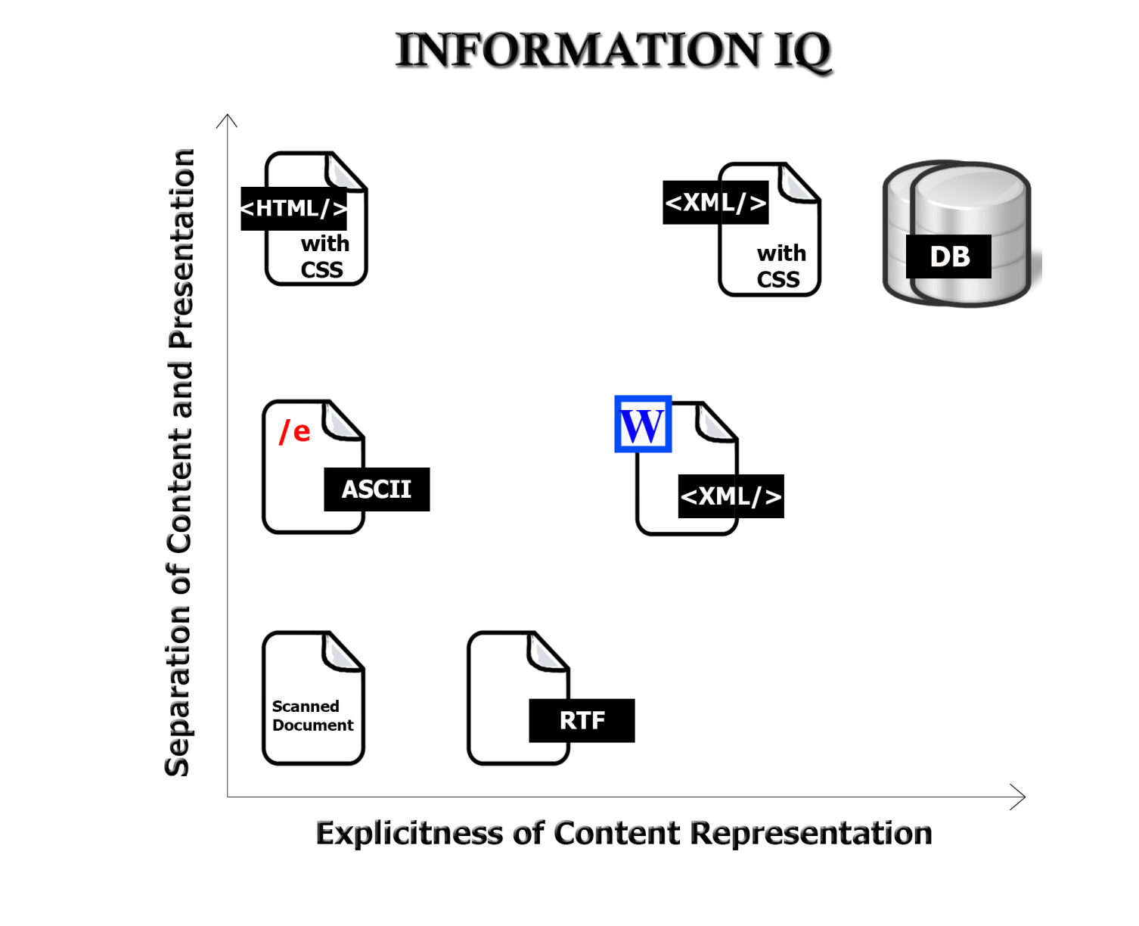
Value Creation with Information Resources
The variety and functions of interactions with digital resources are determined by the amount of structure and semantics represented in their digital encoding, in the descriptions associated with the resources, or by the intelligence of the
computational processes applied to them
20

Slide 21
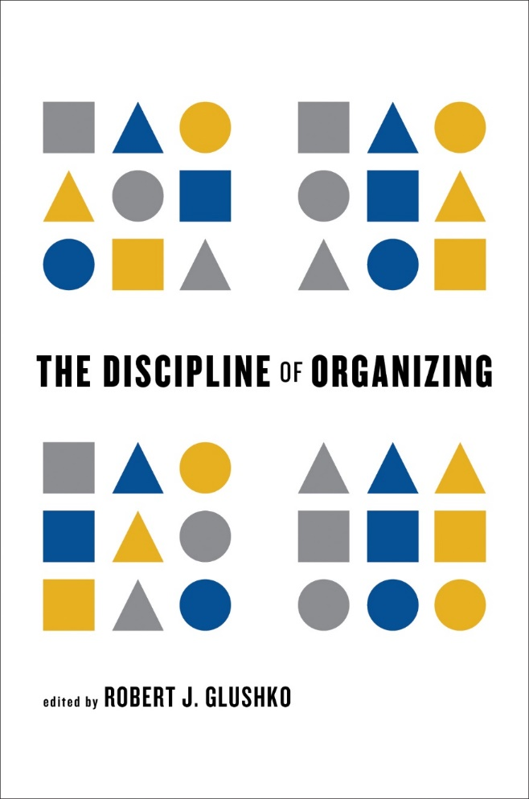
Published by MIT Press (2013) as a printed book and in ebook formats “Enhanced ebook” editions published by O’Reilly Media in 2014, 2015, & 2016 In use in > 85 courses in > 20 countries as of March 2017 Named an “Information Science Book of the Year” in 2014
The Discipline of Organizing: The Book

Slide 22
The Mandate and Challenge with Multiple Disciplines
The concept of “organizing system” as the transdisciplinary synthesis of the disciplines that deal with “organizing” mandates a book with many authors
It must balance the breadth of representing all the contributing disciplines with enough depth for each to be credible
It must introduce vocabulary that is discipline-neutral to enable interdisciplinary communication
It must incorporate discipline-specific concepts and examples in the context of the transdisciplinary content and vocabulary
22

Slide 23
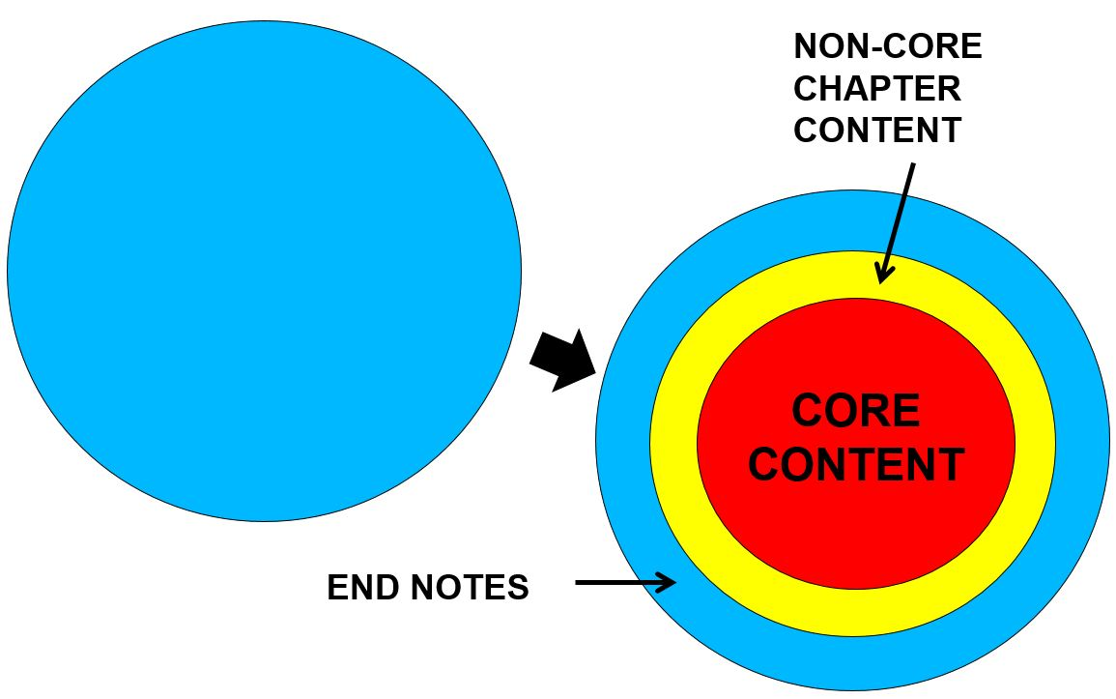
Re-Factoring and “Tagging” the Book’s Content to Address the “Breadth vs. “Depth” Challenge

Slide 24
TDO – May 2014
Museums
Library Science
Archives
Cognitive Science
Law
The “Discipline of Organizing” Core
Linguistics
Business
Computer Science
Philosophy
Web Architecture

Slide 25
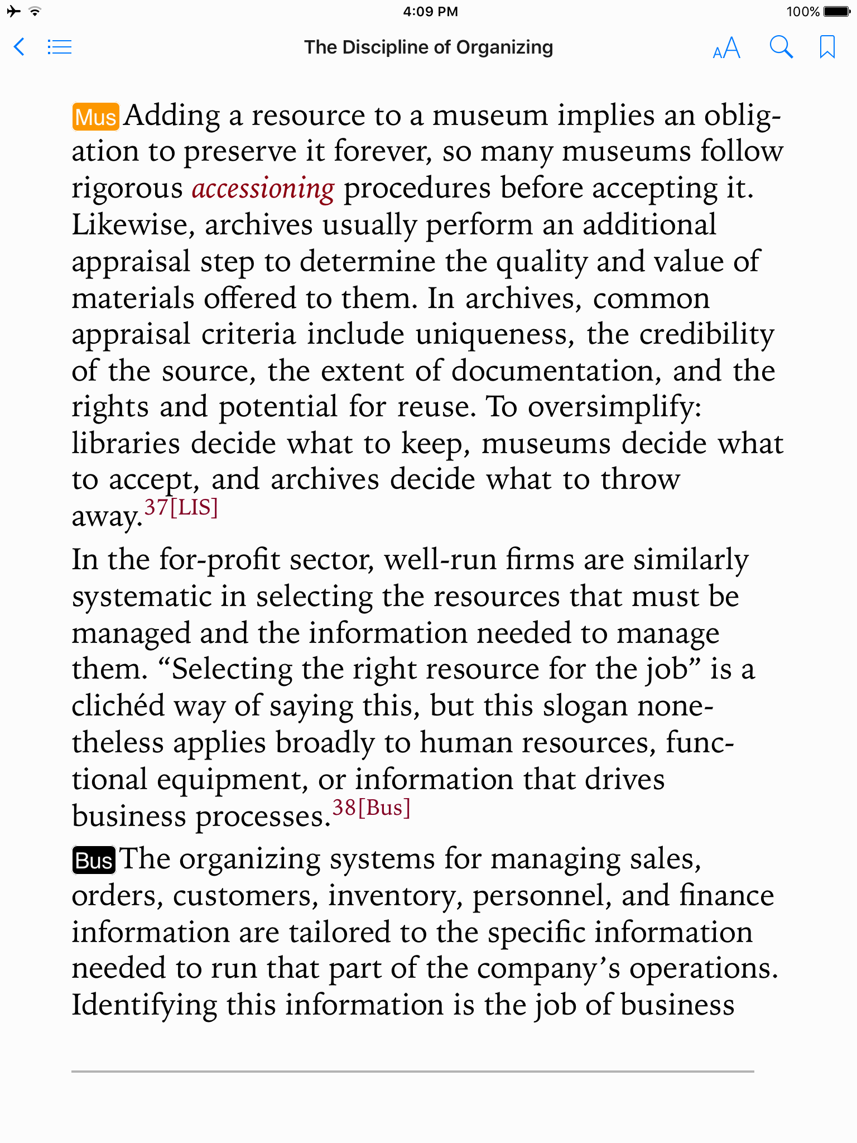
Core and Supplemental Content in TDO ebook
Paragraph text tagged by discipline
Text without tag is core content
All endnotes are tagged by discipline

Slide 26
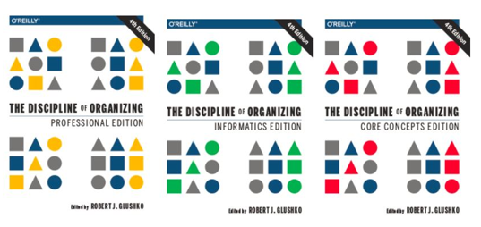
Single-Source Textbook Publishing
TDO’s very detailed document model and precise tagging of content by discipline enabled much more customization – in principle, any of several thousand different combinations
Unfortunately, publisher only let us publish 3 combinations
26

Slide 27
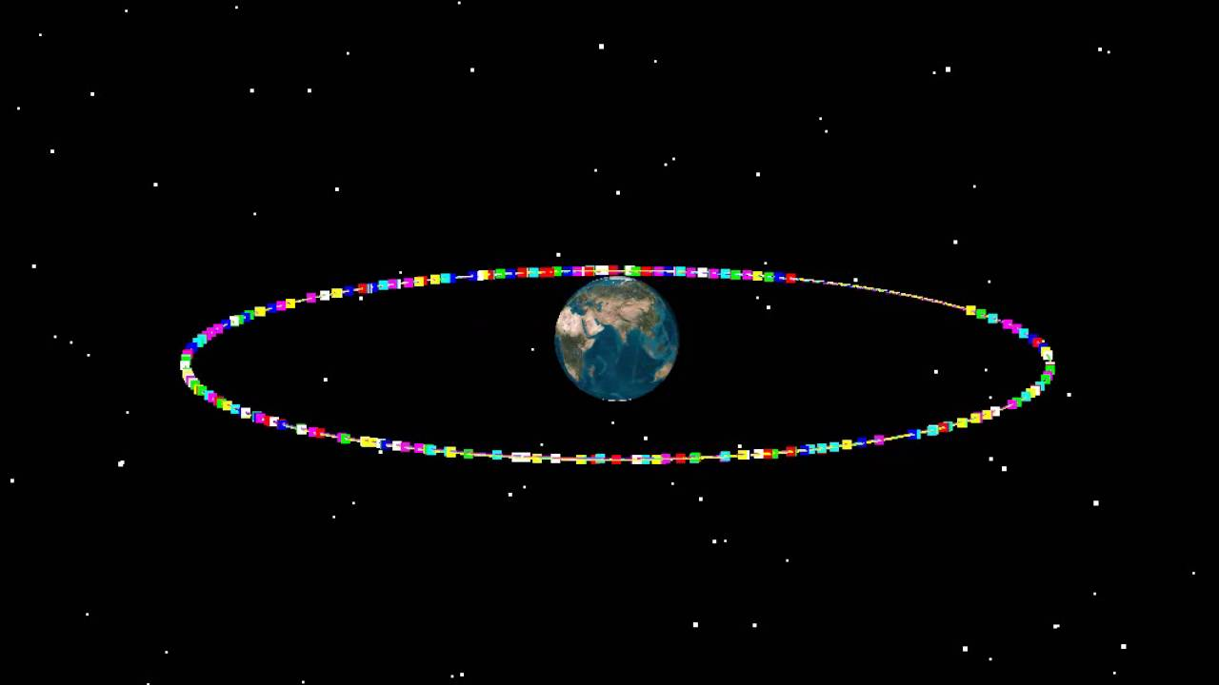
Earth Orbiting Satellites

Slide 28
Earth Orbiting Satellites
Why is it essential for some kinds of satellites to be geostationary?
What are the properties of geostationary orbits?
Who has the authority to organize the satellites?
Why is there contention or competition for the slots?
Is the system for assigning satellites to orbits fair?
28

Slide 29
Earth Orbiting Satellites
A satellite in geosynchronous orbit stays “fixed” above the same region of Earth by traveling at the same speed as the planet's rotation
Satellites at a radius of 24000 miles orbit the earth at the same period as the earth rotates so they stay above the same place on earth
29

Slide 30
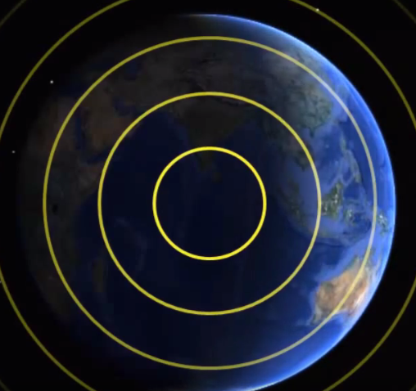
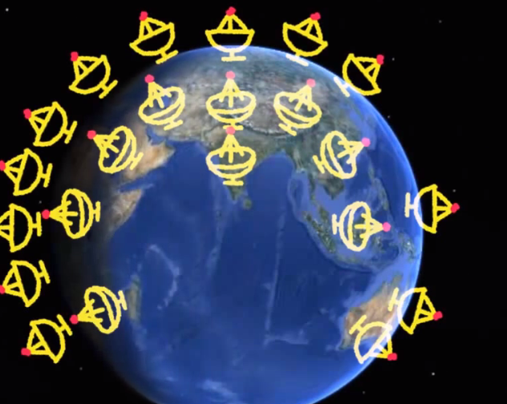
A Satellite Broadcasting a TV signal from a Geostationary Orbit
Enables TV satellite receivers to be fixed in place

Slide 31
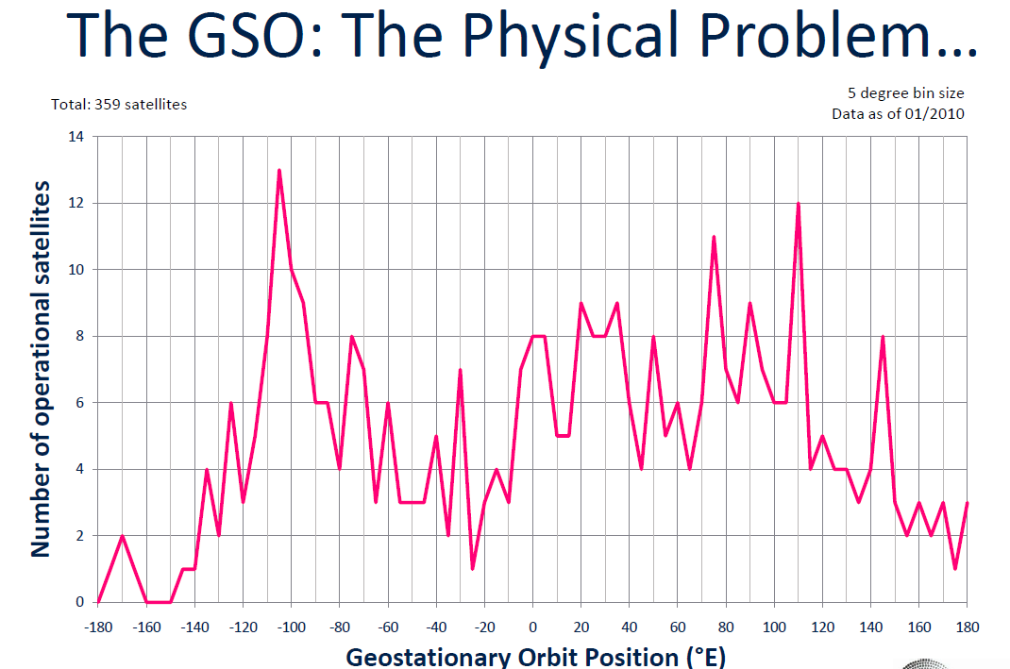
California
Europe
Middle of Atlantic Ocean
Beijing
Tokyo
Middle of Pacific Ocean

Slide 32
Neuroscience Lab
The lab organizing system is essentially an information management system, but rats are a primary resource type in the lab. What other types of resources are managed by the lab organizing system?
Rat resources are initially interchangeable in most respects, but later must be treated as unique resources. Why? How are the rats organized?
The system supports interactions with several user types who have different priorities about resources and interactions. What are some examples?
The lab system described in the case is one of several organizing systems in the lab. What are some of the other systems? What are the pros and cons of separate organizing systems rather than a single comprehensive one?
32

Slide 33
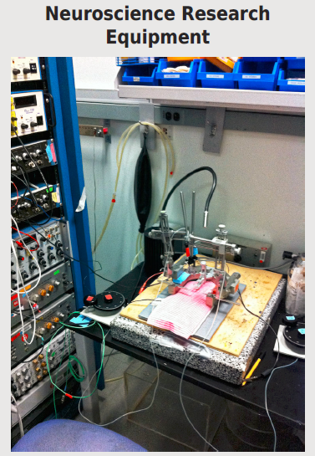
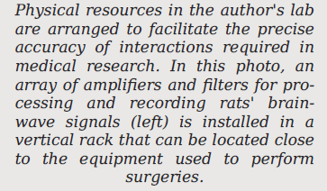

Slide 34
Cognitive Neuroscience
How is the field of cognitive neuroscience science organized on a topic/domain level?
What are the resources that must be organized, and how do they differ across domains?
How is this “intellectual” organization reflected in the organization of neuroscience research at the lab/academic institutional level?
What other aspects of the research “ecosystem” are determined or constrained by these organizing principles?
34

Slide 35
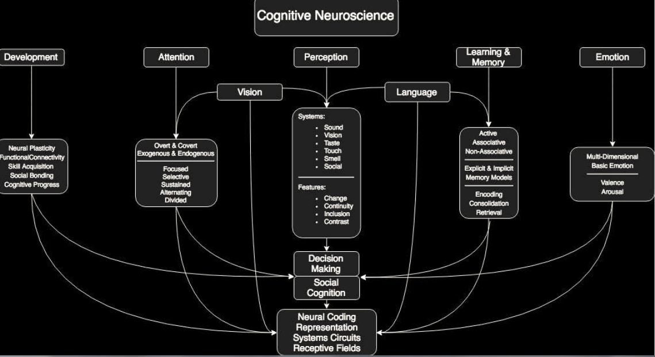

Slide 36
Organized Crime
What distinguishes “organized” crime from “unorganized” crime?
Why are many criminal organizations called “crime families”?
Which organizing principles use a criminal’s skills independent of their identity?
How and why have the organizing principles changed over time?
36

Slide 37
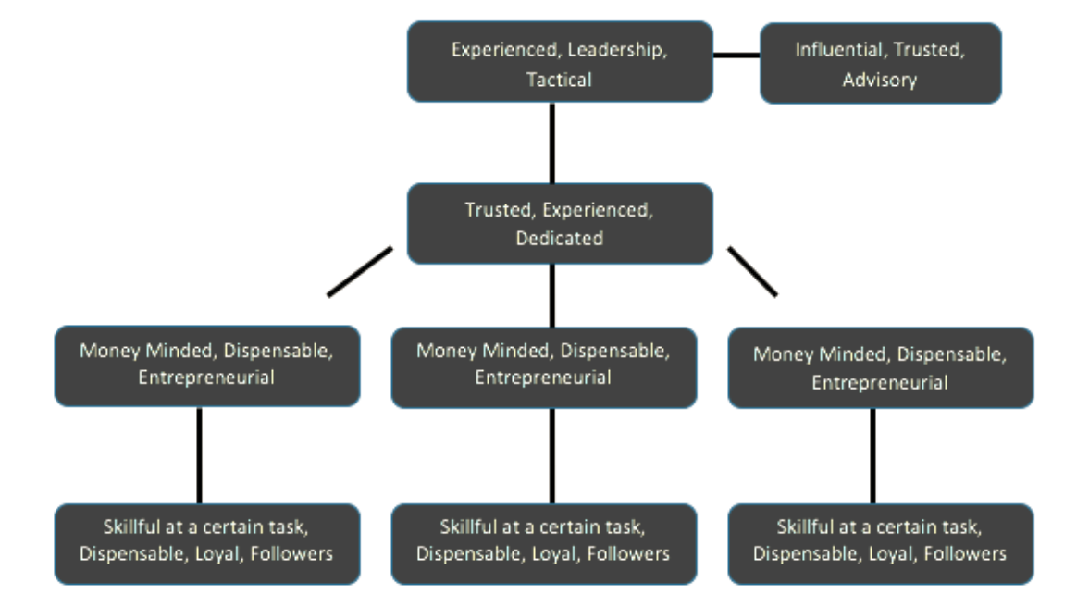
Skills Needed to Succeed at Different Levels of the Crime Organization

Slide 38
Document Type Spectrum
Crime Type Spectrum

Slide 39
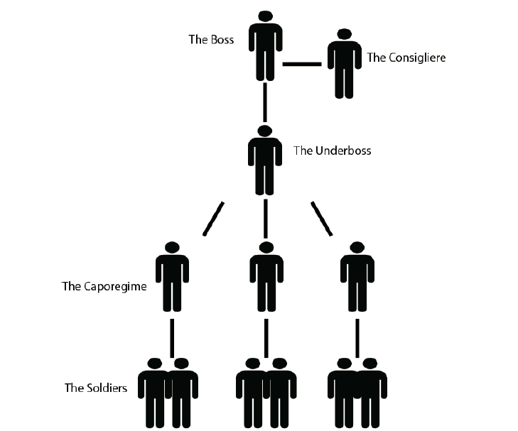
CRIME FAMILY (strong fixed hierarchy)
http://godfather.wikia.com/wiki/Corleone_crime_family

Slide 40
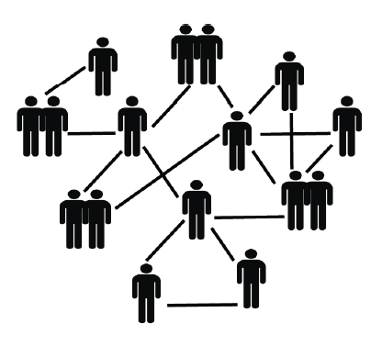
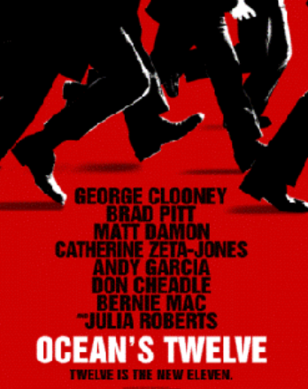
CRIMINAL NETWORK
(ad hoc team selection for each crime)

Slide 42
Small group analyses of the cases
Identify interesting/important design issues
Identify cases with similar design issues
Identify cases with contrasting design issues
Identify opportunities to apply the different depictions of the organizing system
Invent some analogy questions?

Slide 43
Some Things to Think About
Organizing systems for physical resources often have a lot in common because of the constraints like size, shape, etc that all physical things embody
The scope of an organizing system is always an issue, but sometimes the choice of the “boundaries” of the system are obvious and sometimes there are a great many choices
Sometimes setting the scope can be difficult because there are many other organizing systems in the same or related environment/domain
Some organizing systems can be started small and then incrementally grow in scope and scale. Others must be completely designed before they can be deployed
Some organizing systems have very clearly defined users or user types. Others might have much greater variety or much less well defined user types.
Sometimes users share most of their goals and priorities for interactions, but sometimes they can be in conflict
Preservation is a primary motivation. What are others? Are you preserving printed photos, digital photos, or an abstract photo that contains both formats?
What are the costs and benefits of standard categories or tags for the photos?
How do technologies for digital photo storage and processing enable or constrain the organizing system?
What is the expected lifetime of the organizing system? Why does this matter?
43

Slide 45
Assignment 1 – Granddad’s Records
Your grandfather just left you his collection of a few hundred record albums. You need to organize them.
Your assignment is to explain your organizing system in terms of three sets of design questions
Put yourself in the role of the DESIGNER of the organizing system who is writing instructions for another person who is the IMPLEMENTER of the organizing system
Compare your organizing system for the record albums with the organizing system you use for digital music
You’ll get more detailed instructions. Due in one week on Feb 5

