Slide 1
CogSci 190 “Sensemaking and Organizing” Spring 2019
Robert J. Glushko glushko@berkeley.edu
@rjglushko
31 January 2019 4) The Activities of Sensemaking and Organizing

Slide 2
The Activities in Organizing Systems
We can identify four activities in the lifecycle of every organizing system:
Selecting resources
Organizing resources
Supporting resource-based interactions and services
Maintaining resources
2

Slide 3
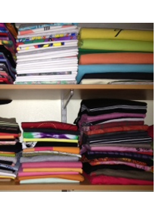
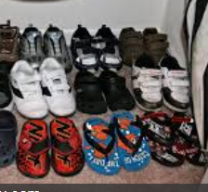
An Organized Closet
3

Slide 4
Activities in a Closet Organizing System…
Selecting: Should I hang up my sweaters in the closet or put them in a drawer?
Organizing: Should I sort my shirts by color, sleeve type, or season?
Supporting Interactions: Do I need separate places for laundry or dry cleaning?
Maintaining: When do I get rid of something?
4

Slide 5
An Organized Data Warehouse
By Hhultgren - Own work, Public Domain, https://commons.wikimedia.org/w/index.php?curid=3552549
5

Slide 6
Activities in a Data Warehouse Organizing System…
Selecting: which data sources should be included? How is their quality assessed?
Organizing: which data formats and schemas will enable effective processing? Are needed transformations made at load time or query time?
Supporting Interactions: what are the most important and frequent queries that need to be pre-configured?
Maintaining: data governance… retention, compliance, privacy issues
6

Slide 7
Selecting Resources

Slide 8
Selecting Resources
SELECTION is the process by which resources are identified, evaluated, and added to a collection
Selection is by definition an intentional process
Selection methods and criteria vary across domains (as do the words that describe them)
Selection criteria can be subjective or objective
What are some synonyms or near synonyms for selection?
What are some typical selection criteria?
8

Slide 9
Selection Criteria
Utility for some specific purpose
Intrinsic value
Scarcity or uniqueness
Newest
To establish a brand or reputation
…
FITNESS FOR USE
9

Slide 10
Is “Who” Just You?
Organizing systems that we create for our personal use will naturally embody our individual goals and preferences
What are the implications for the selection criteria?
Organizing systems used by more than one person or for more than one interaction must prioritize the users and the interactions they want
Which users and which interactions do we need to consider?
Which users and their requirements should have priority?
10

Slide 11
Selection in Different Domains
Libraries select, collect, organize, conserve, preserve and provide access to information on behalf of a community of users
Museum collections, especially of special or rare items, bring status or prestige whether or not the items have any contemporary use
Hiring decisions are rapidly moving from informal or intuitive criteria to more formal approaches using “predictive analytics” techniques that use information about successful hires to create selection models
11

Slide 12
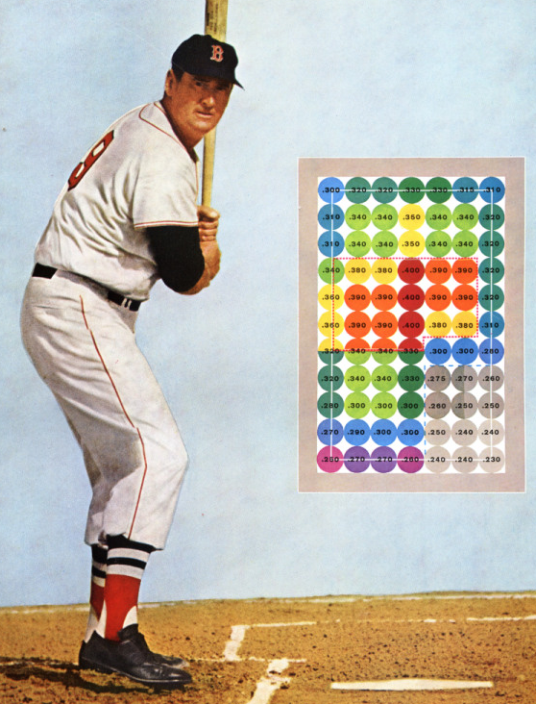
The MoneyBall Effect
Personnel selection is very task dependent and becoming highly data-intensive
http://blog.ted.com/2014/01/28/the-moneyball-effect-how-smart-data-is-transforming-criminal-justice-healthcare-music-and-even-government-spending/
http://www.hardballtimes.com/wp-content/images/tht/williamsgraphic.png

Slide 13
Upstream and Downstream Selection
Selection based on predictions of future capability or suitability can be thought of as “downstream” selection
But it is also useful to select resources by looking “upstream” and evaluating the people, processes, or systems that create them
Because the quality of these upstream factors determines the quality of the resource
You can’t “test in” quality
It is more effective and efficient to improve quality at the source … this is the basis of the “quality movement”
13

Slide 14
“Path Dependence”
Does the selection principle apply to each candidate resource in isolation?
... or does the selection decision consider the items already in the collection?
... or does the selection decision consider possible future selections?
… or does the selection decision consider selections being made by others?
in what situations does a particular selection preclude another one?
14

Slide 15
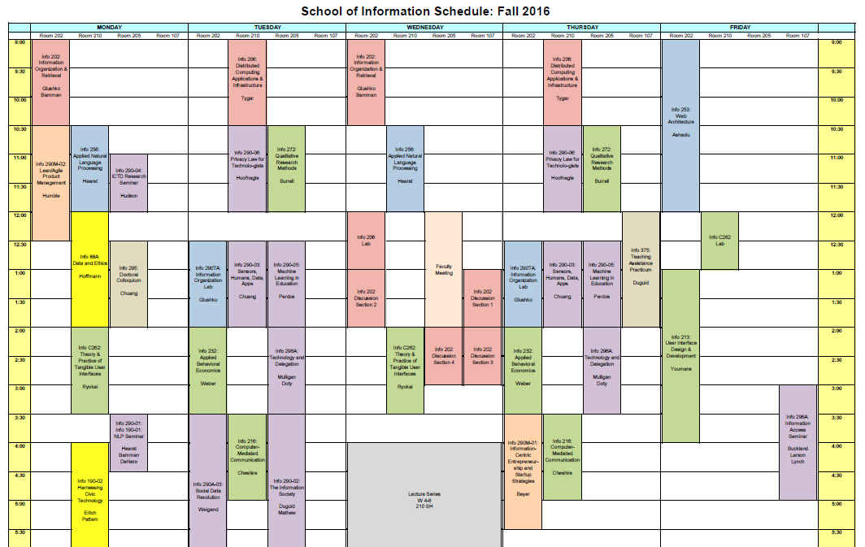
Stop and Think: Course Selection

Slide 16
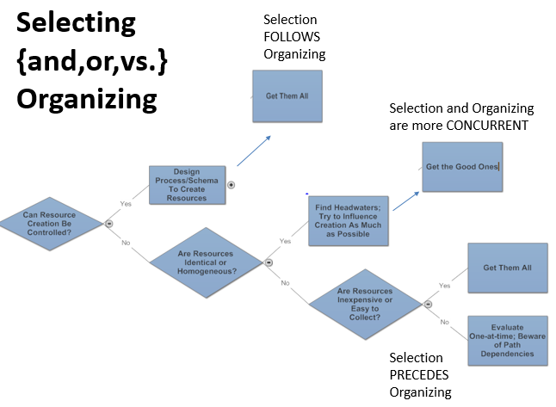

Slide 17
Organizing Resources

Slide 18
Organizing Resources
Almost any property of resources can be used to organize them, but the most appropriate or effective properties differ across resource types and tasks
Decisions about which resource properties will be used in organizing must often precede the creation or selection of the resources
In what domains is this especially critical?
18

Slide 19
Organizing Physical Resources
A physical resource can only be in one place at a time
But what if it is used in more than one place?
Because physical resources take up space, you need to consider whether you are organizing the resources you have, or resources you might have in the future
But how much of a future should you plan for?
19

Slide 20
Mise-en-place
The kitchen organizing system: "put in place”
Advance organization is essential to enable the rapid pace of a restaurant
Ingredients and tools for particular recipes are pre-arranged for efficient cooking and plating
20

Slide 21
Mise-en-place
21

Slide 22
Designing Interactions with Resources

Slide 23
Requirements for Interactions
All organizing systems have some common interactions, but most of the time we want to pay attention to the more resource-specific interactions that create the most value
The priorities of different interactions are often determined by decisions about intended users
An essential requirement is ensuring that the supported interactions can be discovered and invoked by their intended users (i.e, we need good user interfaces)
23

Slide 24
Interaction and Value Creation
Interactions differ in the absolute and relative amounts of physical manipulation, interpersonal or empathetic contact, and symbolic manipulation or information exchange involved in the interaction
Physical Object Manipulation
Symbolic Manipulation
Interpersonal Interaction
Apte, U. and Mason, R. Global Disaggregation of Information-Intensive Services. Management Science (1995).
24

Slide 25
Value Creation with Physical Resources
Physical manipulation is often the intrinsic type of interaction with physical resources
The resource might have to be handled or directly perceived in order to interact with it
Physical manipulation and interpersonal contact might be required to interact with information resources in physical form like printed books in libraries or music in CDs or albums
Interactions involving physical resources often emphasize generic aesthetic or emotional goals and are not always “purposeful”
25

Slide 26
Value Creation with Digital Resources
With digital resources, neither physical manipulation nor interpersonal contact is required for interactions
The essence of the interaction is information exchange or symbolic manipulation of the information contained in the resource
By replacing interactions that involve people and physical resources with symbolic ones, organizing systems can lower their costs without reducing user satisfaction (automation, self-service, outsourcing…)
Digital resource descriptions for information resources can facilitate finding, identifying, selecting, and other “value-creating” interactions even if the resources themselves are not digitized
26
Notes:
(Apte and Mason don’t consider “value creation with data” that doesn’t require people because the point of their analysis was to identify which jobs could be outsourced by “disaggregation”)

Slide 27
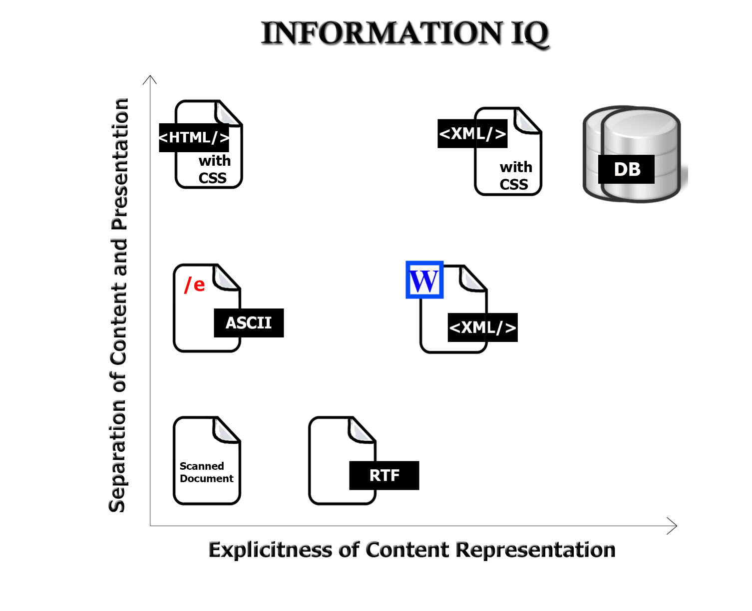
Value Creation with “Smart” Resources
The variety and functions of interactions with digital resources are determined by the amount of structure and semantics represented in their digital encoding, in the descriptions associated with the resources, or by the intelligence of the
computational processes applied to them
27

Slide 28
Disaggregation of Symbolic Interaction and Other Impacts of Technology
Information can augment interpersonal and physical interactions
And can also replace them
Robotics,
Remote
manipulation?
Symbolic
Manipulation
(Part 2)
Symbolic Manipulation
(Part 1)
Telepresence?
28

Slide 29
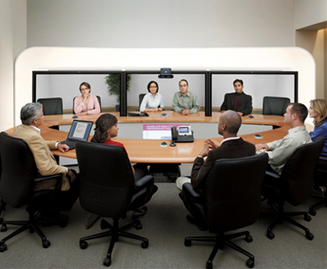
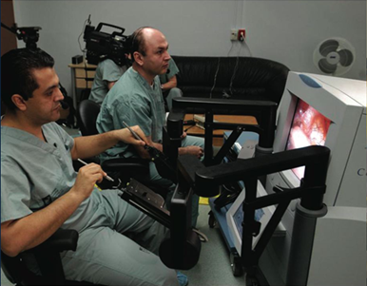
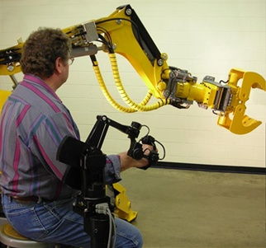
Telepresence & Telerobotics

Slide 30
Maintaining Resources

Slide 31
Resource Preservation as Means vs. End
Organizing Systems
Memory Institutions
Libraries
Museums
Business Info Systems
Content Management
Archives
CRM
ERP
31

Slide 32
Maintaining Resources
Maintaining includes any activity whose purpose is to ensure that a resource will be available at some future time for use or reuse
Note that the intended future "user" of a resource might be a computational process or service
For many kinds of resources, you need to preserve more than the "primary resource" for it to have future use
Maintenance has many synonyms or near-synonyms across domains: Preservation, curation, governance, storage…
32

Slide 33
Organizing {and,or,vs.} Maintaining
How we organize a collection of resources can determine what kinds of maintenance we can do and how hard it is to do it
How well can we anticipate future changes to the collection or the desired interactions?
Designing / organizing for maintainability and extensibility
Resource properties or the intended interactions might change over time
33

Slide 34
Selecting {and,or,vs.} Maintaining
SELECTION is based on some set of implicit or explicit criteria applied to resources
MAINTENANCE activities should be consistent with the selection criteria
More carefully selected resources should be maintained more carefully
34

Slide 35
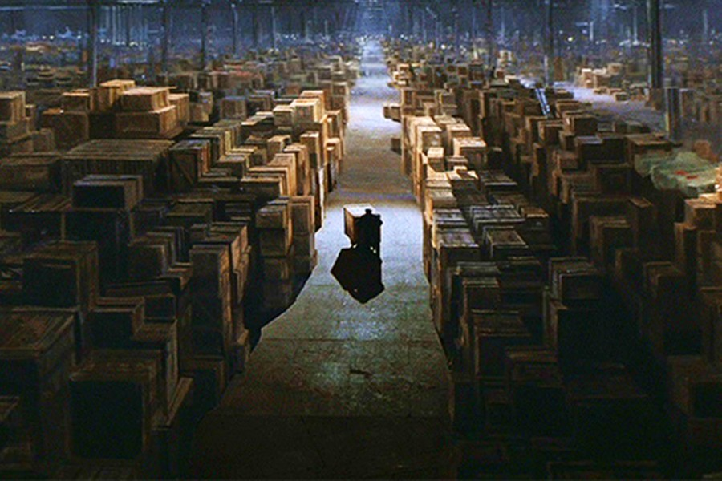
Preservation
Preservation of physical resources requires that they be kept in conditions that prevent their deterioration
It might also include actions to improve access or to restore the resource
B-52 “Boneyard” in Arizona desert
Final scene in ”Raiders of the Lost Ark”
35

Slide 36
The Ship of Theseus Paradox
The ship of Theseus was preserved by the Athenians down even to the time of Demetrius Phalereus, for they took away the old planks as they decayed, putting in new and stronger timber in their place
This ship became a standing example among the philosophers, for the logical question of things that grow; one side holding that the ship remained the same, and the other contending that it was not the same
- Plutarch (2000 years ago)

Slide 37
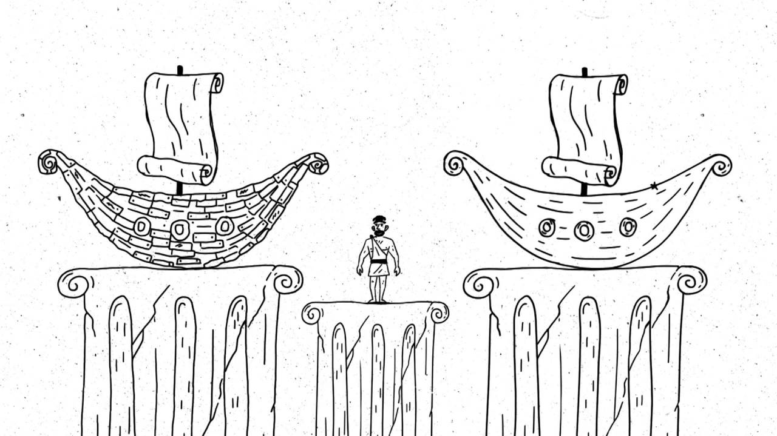
Ship built from parts of original ship
Original ship repaired with all new parts

Slide 38
Digital Preservation
Preservation of digital copies might seem easier, but other issues arise:
How many copies do we need to ensure preservation?
Do we care about which copy is the original?
How do we prevent or at least detect tampering?
Technological obsolescence of storage media and software requires that preserved digital resources might become inaccessible (compare books on library shelves with files on some storage medium)
38

Slide 39
Preservation (or not) and the Law
Laws requiring it
Sarbanes-Oxley Act – requirement to keep transactional and accounting records to enable traceability
Civil procedure rules to enable document discovery
Government accountability FOIAs
Laws prohibiting keeping personally identifiable information
HIPPA, FERPA, European “right to be forgotten”
Laws dealing with “failed” preservation
SB 1386 and similar state statues mandating disclosure of data breaches
39

Slide 40
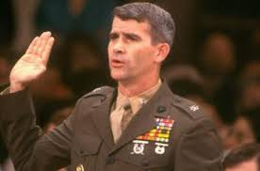
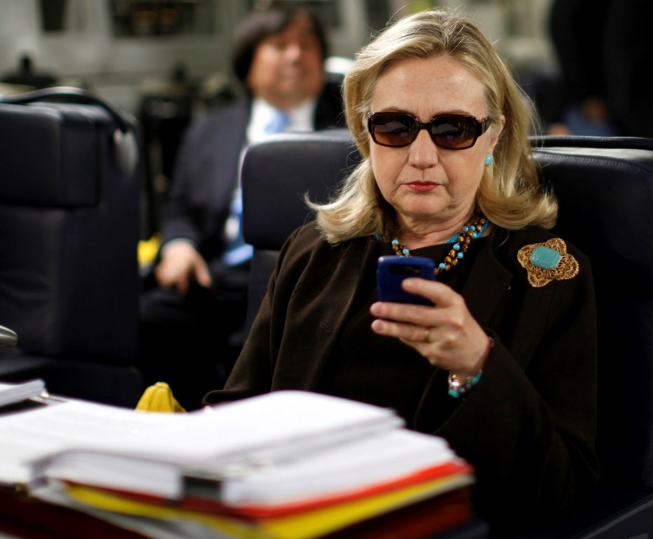
Two (In-)famous Incidents of Not Following the Rules for Information Management and Record-keeping
Oliver North – shredded documents but didn’t realize that his email was backed up
Hillary Clinton – sent messages about classified information on a personal email account

Slide 41
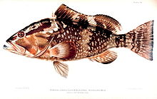
Is A Fish a Document?
John Yates, a commercial fisherman in Florida, was found with red groupers in his catch below the legal size limit. An inspector ordered him to return to port and hand the fish over to the authorities
When he dumped them overboard instead, he was charged with violating the Sarbanes-Oxley Act, which imposes harsh penalties for destroying “any record, document, or tangible object” to impede a federal investigation
The US Supreme Court ruled in favor of the fisherman (Yates v. United States 2015), finding that “tangible object” must be interpreted in the context of “record” and “document” and, as such, only applies to an object “used to record or preserve information”
41

Slide 42
Curation & Governance
CURATION a common term for maintenance activities in "memory institutions“
It includes work to improve access (through better organization or description) or to restore / transform the resource
Curation decisions are often on an item-by-item basis, or for a set of closely related ones
GOVERNANCE and Curation overlap, but the former term is more associated with corporate or enterprise data management and focuses more on policy than on process
Governance often has an economic basis or metaphor at its foundation
42

Slide 43
Crowdsourcing Digitization / Citizen Science
Many museums or scientific repositories are asking for help in digitizing their collections
Typically this involves the transcription of “pictures of documents” or preliminary classification so that scarce experts can focus on resources likely to be more important
Calbug: newscenter.berkeley.edu/2013/05/22/citizen-scientists-help-calbug/
Smithsonian Transcription Center:
WSJ Article 9/13/14
43

Slide 44
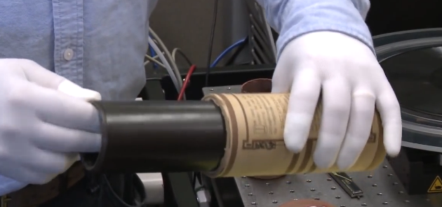
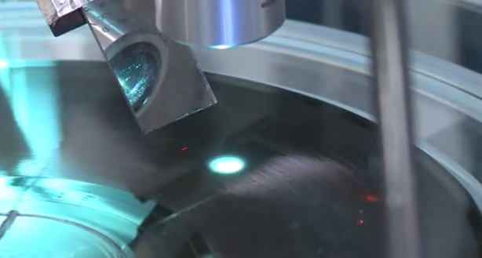
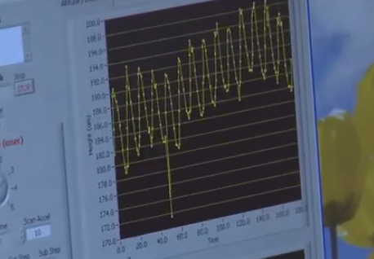
Restoration of Audio Resources
44

Slide 45
Carl Haber
http://www.macfound.org/fellows/892/

Slide 47
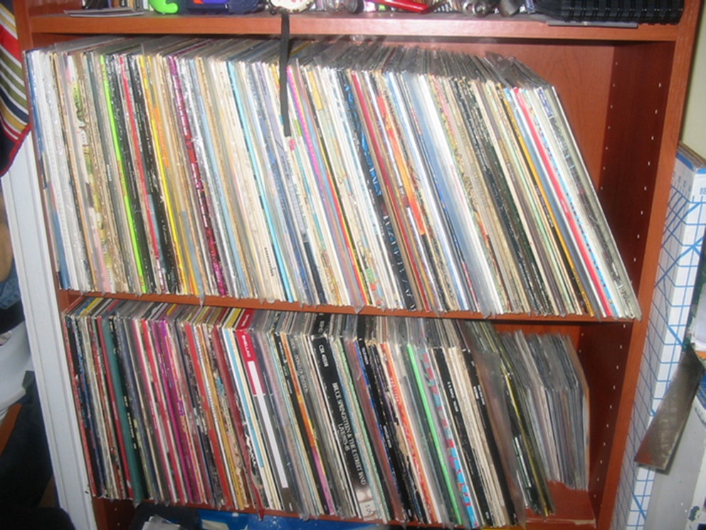
Assignment 1 due noon Feb 5
Design an organizing system for a collection of record albums
Compare it to the organizing system you use for digital music
YOU SHOULD BE ABLE TO COMPLETE THIS ASSIGNMENT IN 400-500 WORDS - NO LONGER THAN ONE SINGLE-SPACED PAGE OF TEXT IN A 10 OR 12 PT SIZE FONT

