Slide 1
CogSci 190 “Sensemaking and Organizing” Spring 2019
Robert J. Glushko glushko@berkeley.edu
5 February 2019 5) Resources

Slide 2
Plan for Today’s Lecture(s)
Resource granularity and abstraction
Documents as resources
Four distinctions about resources
2

Slide 3
What is a Resource?
When you look at, refer to, or pick up a natural physical object, it usually seems that it is "one thing"
But many things have highly visible parts or internal structures, and we must consider whether to treat them as assemblies or aggregations of these separate things
For digital and computational resources, it is much harder to know how many parts we can or should identify
3

Slide 4
Two Aspects of “Thingness”
Two separate aspects cut across the "thingness" distinctions:
Granularity – do we think of the resource as unitary, or as consisting of parts?
Abstraction – “thing” or “type of thing” – are we thinking of the resource as a single instance or as a member of a bigger category?
4

Slide 5
When “Thingness” Is Easy
Some of the “thingness” of physical objects directly follows from how our sensory systems perceive them
The boundaries between physical things are enhanced by human perceptual and interaction mechanisms; edge enhancement, object permanence, etc.
Many physical resources like paintings, sculptures, and manufactured goods:
have a material integrity that makes us usually consider them as indivisible
or are composed of indivisible parts
5

Slide 6
Pre-attentive/Automatic Organizing

Slide 7
“Carving Nature at its Joints”
FLASHBACK
Over 2000 years ago Plato argues that species are distinguished by "carving nature at its joints" - where the natural differences between things are the largest or most salient or where there are few connections
I.e., there are “natural kinds” – categories are discovered, not invented
"Joints" and the boundaries they create between things exist to some extent with physical resources and are manifested in their surface or perceptible properties
7

Slide 8
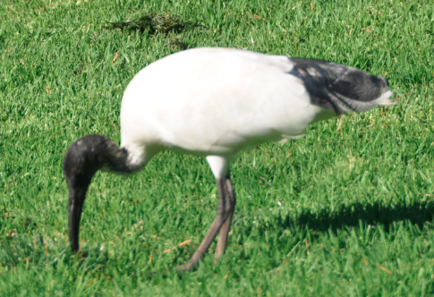
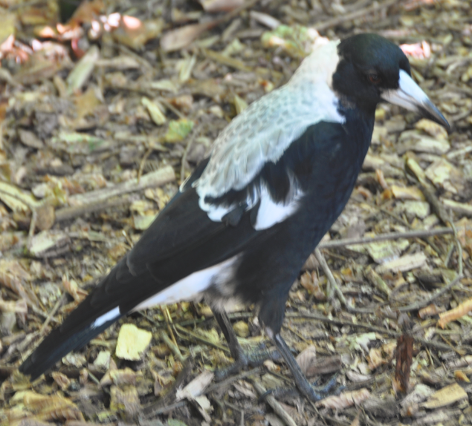
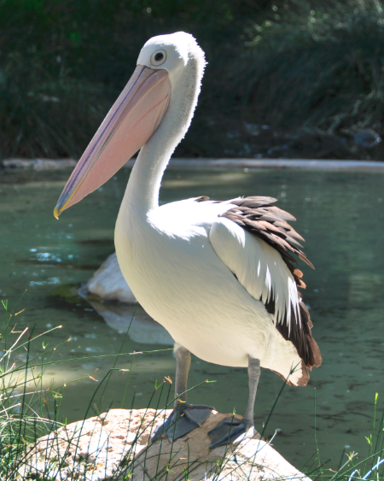
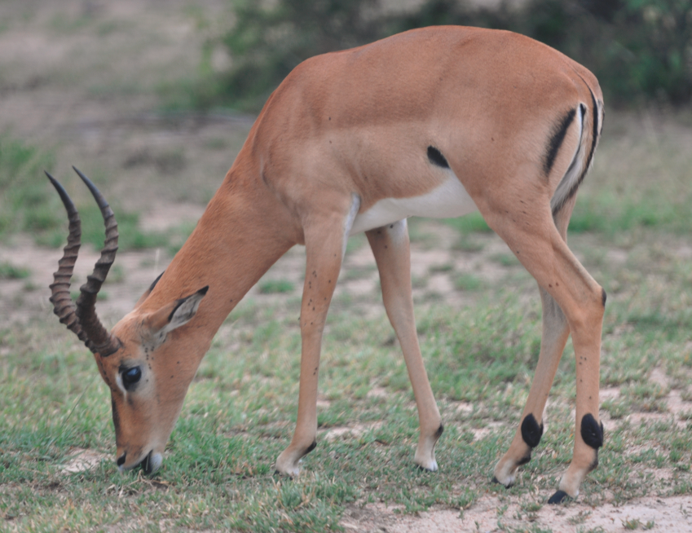
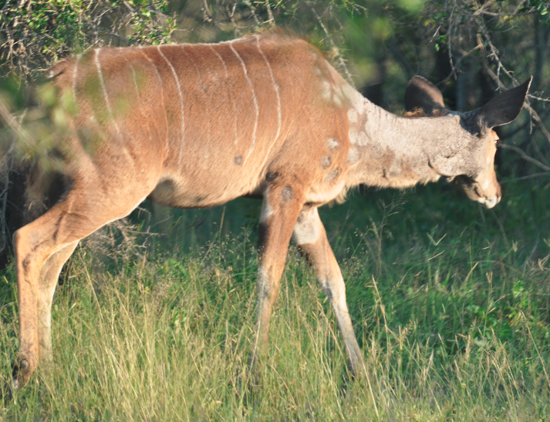
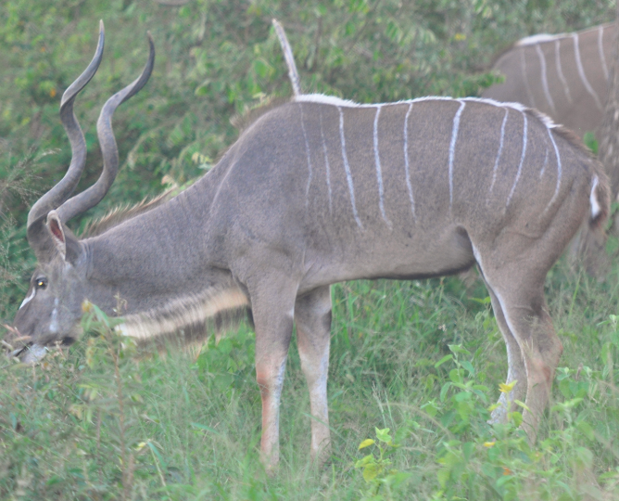
FLASHBACK
Shared Visible Features Carve These Animals into Two Categories

Slide 9
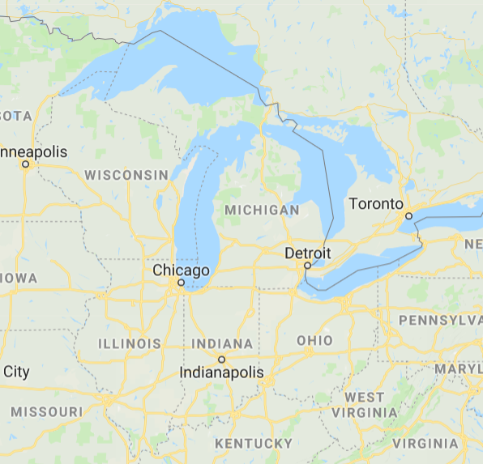
Geopolitical “Carving at the Joints”
Lakes, Rivers, and Mountains Create Natural Borders

Slide 10
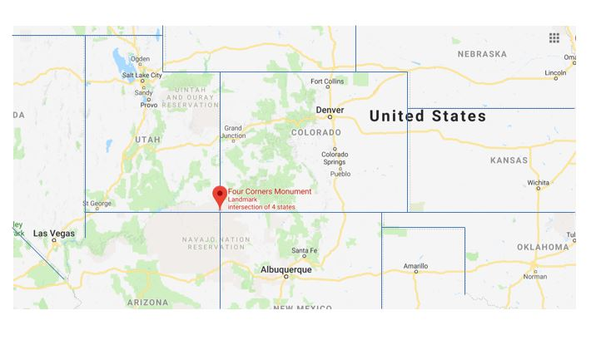
Not Carving at the Joints Here Is this a Problem?

Slide 11
Gerrymandering: Not Respecting the Joints formed by Cities

Slide 12
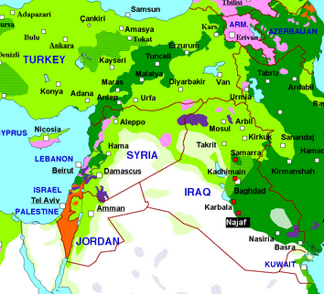
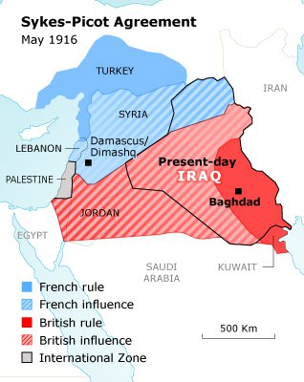
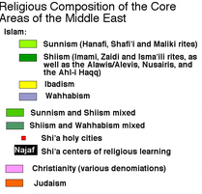
Not Carving at the Joints in 1916: Bad Outcomes
https://chronicle.fanack.com/iraq/history-past-to-present/from-ancient-civilizations-to-mandate/
http://www.mappery.com/map-of/middle-east-religious-composition-map

Slide 13
Granularity: Whole vs. Parts
Resources that are aggregates or composites of other resources, or that have internal structure, pose questions about the granularity of their "thingness"
We might need to organize and manage the granular resources, the composite resources, and the relationships between them - all at the same time
The "part things" can be identified at various levels of contexts/containers/collections in which they occur
The granularity of physical resources is more easily determined that for information resources
13

Slide 14
Carving Information at its Joints?
When we deal with resources that are made of information, any "joints" are man-made and arbitrary
There might be indications "on the surface" that suggest the "joints" between information resources, but these represent design decisions, might be more structure or presentation oriented than content oriented distinctions, and are subject to cognitive interpretation
14

Slide 15
The Document Type Spectrum
Different domains or types of documents can be distinguished according to the extent to which their content is semantically prescribed, by the amount of internal structure, and by the correlations of their presentation and for­matting to their content and structure

Slide 16
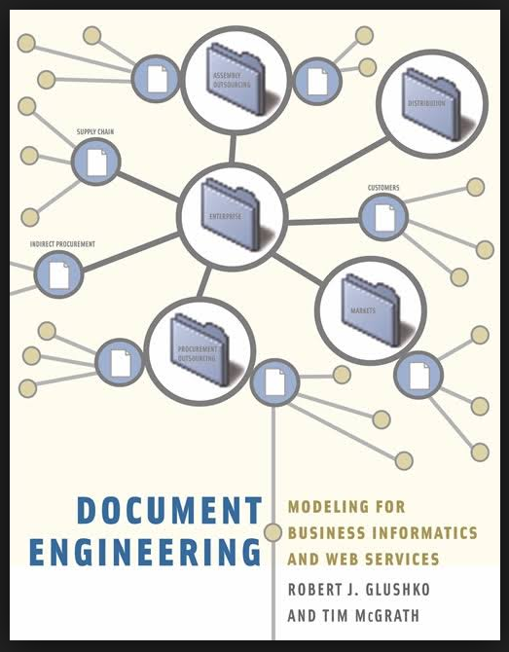
Analyzing Documents – 3 Types of Information
Content – "what does it mean" information
Structure – "where is it" or "how it is organized or assembled" information
Presentation – "how does it look" or "how is it displayed" information

Slide 17
Presentation Information
Human-oriented attributes for visual (or other sensory) differentiation (type font, type size, color, background, indentation, pitch, ...)
Implementation specific (e.g. Web vs print vs auditory)
Good user interface design correlates this with structural or content information for documents used by people

Slide 18
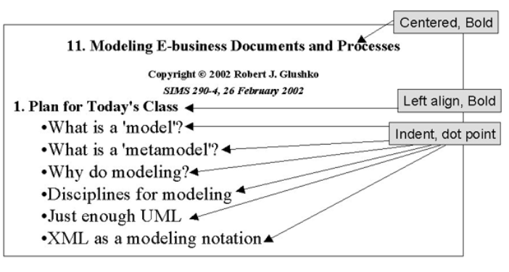
Presentation Information

Slide 19
Structure Information
The "where is it ..." information
Physical piece of a document (e.g. table, section, title, header, footer)
Structure provides the hierarchical "skeleton" or "scaffold" into which content is arranged
The structure also provides a framework for presentation
Structures are often hierarchical - one structure can contain others

Slide 20
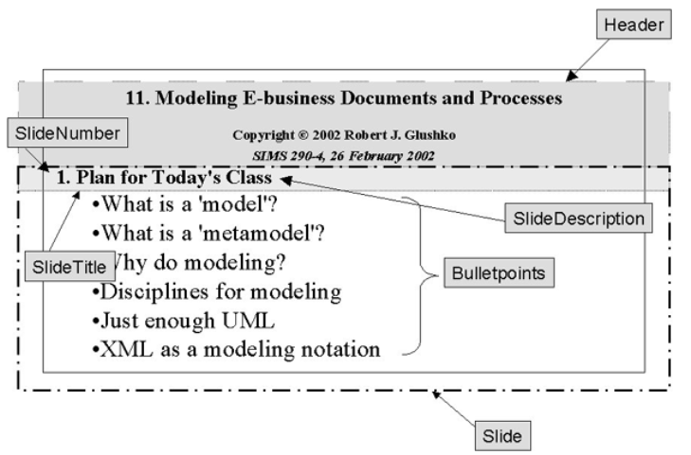
Structure Information

Slide 21
Content Information
Content information is the "nouns" in our documents or sets of data – things like "topic," "summary," "name," "address," "price"
This is the "what is it..." information

Slide 22
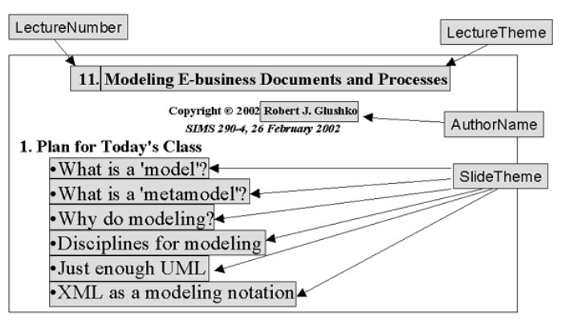
Content Information

Slide 23
The Spectrum of Structure
NARRATIVE documents typically have relatively little internal structure, and that usually varies across instances of the same document type
HYBRID document types are often called "semi-structured“ because they have more structure than narrative ones but less than fully-structured transactional ones
TRANSACTIONAL documents are completely and regularly structured because they contain many specific information components that are distinguished by their content type
23

Slide 24
Moby Dick
CHAPTER 1. Loomings.
Call me Ishmael. Some years ago—never mind how long precisely—having little or no money in my purse, and nothing particular to interest me on shore, I thought I would sail about a little and see the watery part of the world. It is a way I have of driving off the spleen and regulating the circulation. Whenever I find myself growing grim about the mouth; whenever it is a damp, drizzly November in my soul; whenever I find myself involuntarily pausing before coffin warehouses, and bringing up the rear of every funeral I meet; and especially whenever my hypos get such an upper hand of me, that it requires a strong moral principle to prevent me from deliberately stepping into the street, and methodically knocking people’s hats off—then, I account it high time to get to sea as soon as I can. This is my substitute for pistol and ball. With a philosophical flourish Cato throws himself upon his sword; I quietly take to the ship. There is nothing surprising in this. If they but knew it, almost all men in their degree, some time or other, cherish very nearly the same feelings towards the ocean with me.
There now is your insular city of the Manhattoes, …

Slide 25
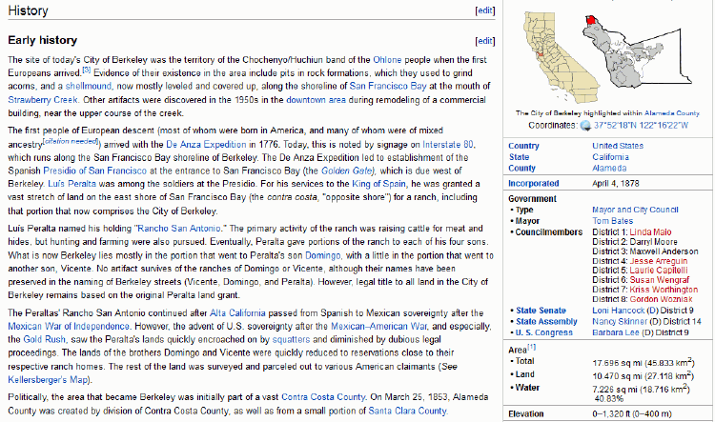
Encyclopedia: Hybrid or Semi-Structured Document Type

Slide 26
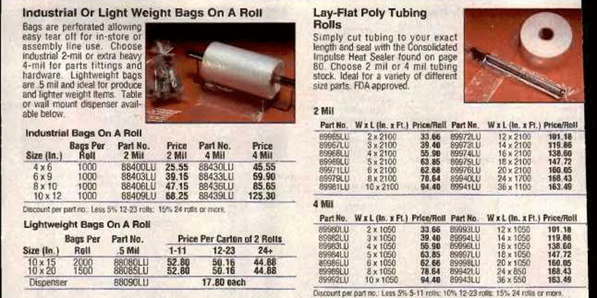
Catalogs Often Combine Narrative and Transactional Content

Slide 27
Prescription: Transactional Document

Slide 28
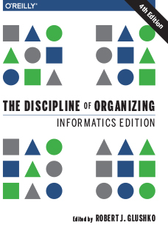
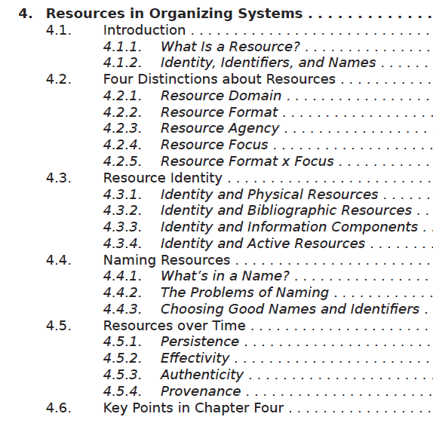
How Many Things is a Document? (the answer depends on its location on the Document Type Spectrum)

Slide 29
Abstraction
We can identify a resource as a unique instance or as a member of a class of resources
The size of this class - the number of resources that are treated as equivalent - is determined by the properties or characteristics we consider when we examine any instance
The choice of these properties depends on context and intent, so the same resource can be identified abstractly in some situations and very concretely in others
29

Slide 30
FLASHBACK
How Big is the Category?
This is an orca (N > 100K)
This is an orca trained to perform at a marine park (N about 100)
This is an orca that used the stage name “Shamu” at Sea World ( N = 28)
https://www.flickr.com/photos/saechang/4496400672/in/photostream/
This is the orca that performed at San Diego Sea World on April 5, 2010 (N = 1)
30

Slide 31
Design Choices & Patterns for Resources
31

Slide 32
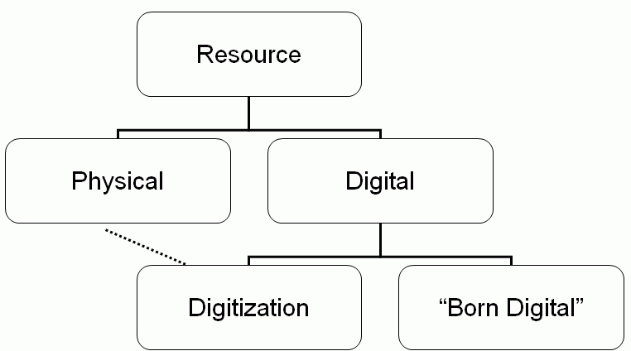
Resource Format in TDO
How are digitized and born digital likely to differ?
32

Slide 33
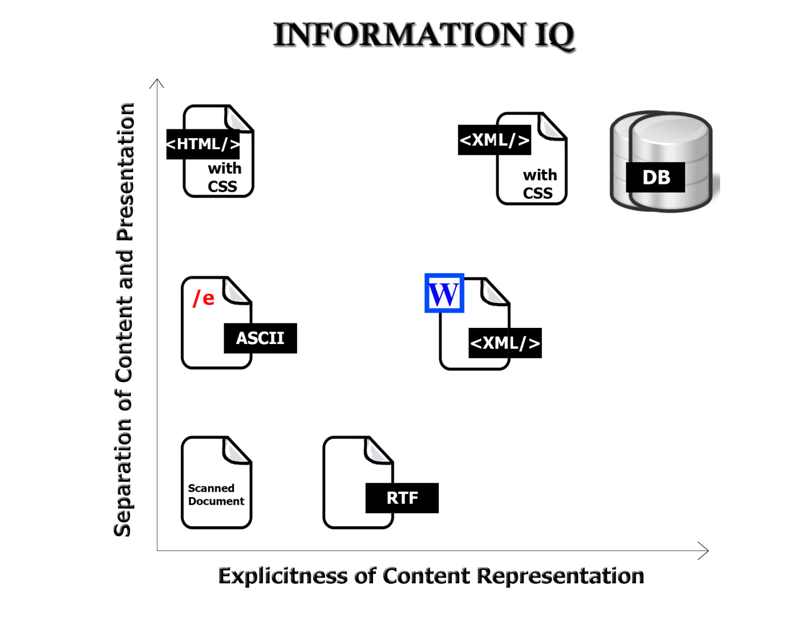
The Digital Format Matters!
FLASHBACK
33

Slide 34
Bits vs Atoms
A contrast between information as "bits" and information as "atoms" was first expressed by Nicholas Negroponte of the MIT Media Lab (see Being Digital (1995)
Moving Bits != Moving Atoms
What are the most important differences?
34

Slide 35
Resource Focus
Any resource can have other resources associated with it, usually to describe it in some way to facilitate finding it, interacting with it, or interpreting it
So we can designate a resource as a primary one or as a description resource associated with it
Description resources are often called METADATA
Metadata often defined as “data about data” but I do not like that definition ☹ (We’ll talk about “Resource Description” on February 19)
35

Slide 36
Resource Focus
In the bibliographic domain the resource vs. description distinction is deeply embedded
It other domains it can be quite arbitrary and "focus" is an important decision
36

Slide 37
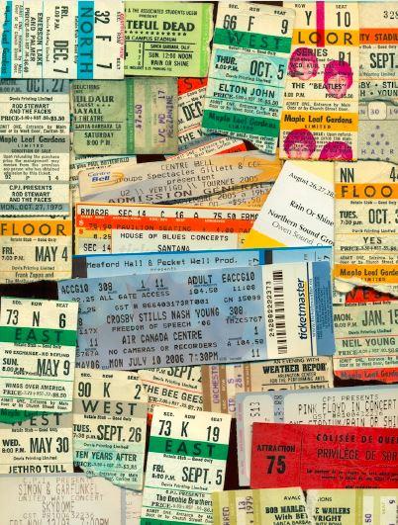
Concert Ticket: A Resource Composed of Resource Descriptions
The distinction between resource and resource description is sometimes subtle and arbitrary
37

Slide 38
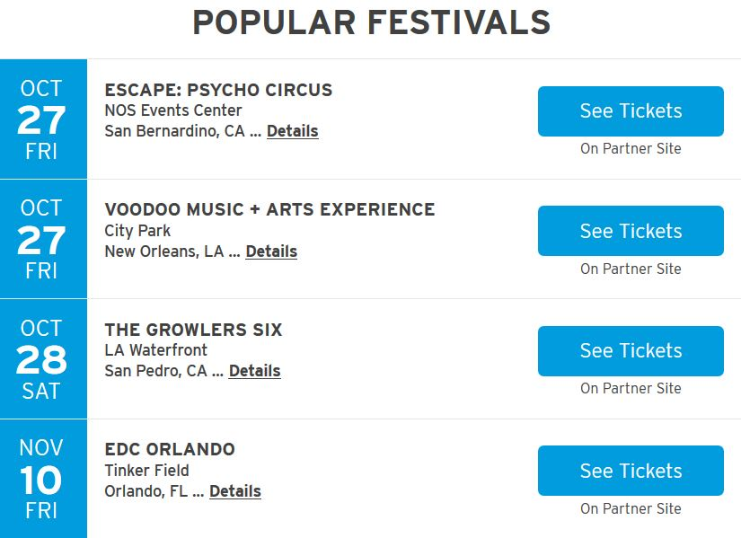
Concert Calendar: A Resource Composed of Resource Descriptions
A resource description is also a resource from the perspective of any other resource that uses it, ad infinitum (TDO 4.2.4, 4.2.5)
Ticketmaster Festival Guide 23 October 2017
38

Slide 39
Resource Agency
Traditional organizing systems contain tangible and static resources that must be acted upon or interacted with to produce an effect
Active resource create effects or value on their own, sometimes when then initiate interactions with static or passive resources.
Sensors, web-based services, information feeds are active resources that often are combined to implement business processes or business models
People are almost always active resources that initiate interactions, especially with each other
39

Slide 40
Active / Operant / Smart Resources
“Smart” is a commonly used description of resources that can exploit sensing, computing, and communication capabilities
Virtually any product that uses electricity - toys, coffeemakers, cars, medical diagnostic machines - possesses inherent data processing capabilities. Each has a wealth of information about its current status, usage history, and performance
A “smart” resource with an IP address is said to be part of the “Internet of Things”
40

Slide 41
What Makes A Resource Smart?
Sensing – the resource can sense, measure, track, or record some aspect of its environment or context, or its interactions with other resources
But sensing something in itself does not create any value in an organizing system. Something needs to be done!

Slide 42
The “Smartness” Continuum
Sensing or Awareness – measuring some aspect of the environment
Actuation – initiate some action or message
Connectivity – connected to other resources
Computation or Programmability – so they can analyze and adapt
Composability and Cooperation – can function as modules or services in more complex systems
42

Slide 43
Some Design Issues for Smart Sensing
HOW SMART IS THE RESOURCE?
HOW SMART DOES IT NEED TO BE?
Are the sensors in known locations, or is locating and arranging them a task in its own right?
How "smart" is the information communicated by the sensor? What format? Is there any local processing?
What initiates the sending of the sensed information?
43

Slide 44
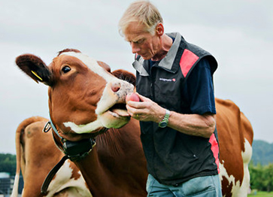
What Makes A Resource Smart?
Actuation – the resource can initiate an action based on what it senses
Turning on lights, motors, speakers, cameras
Displaying, broadcasting, or sending information about its state
A Smarter Cow can “Sext” when it is “in heat”

Slide 45
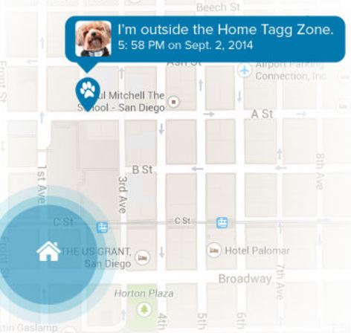
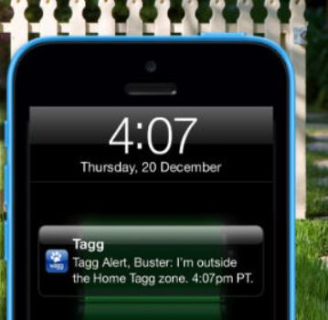
Your Dog Tells You When It is Bad
A location tracking collar on your dog can send you a text message if your dog runs away from some defined location

Slide 46
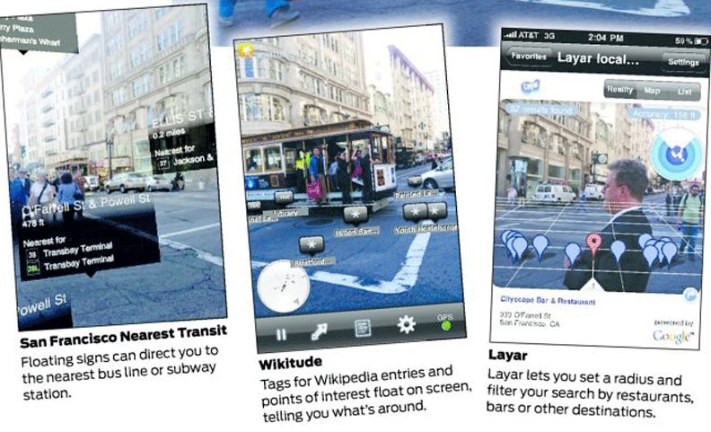
Augmented Reality
Location and resource-based information is sent to or layered on your smart phone
Resources with “beacons” can broadcast this kind of information

Slide 47
What Makes a Resource Smart?
Connectivity – physical and permanent connection, or digital (e.g., with IP)
Can enable the resource to send information to a more capable resource
Computation – analyze, refine, learn from the information it senses or obtains from connected resources
Programmable resources can have their capabilities upgraded by software updates

Slide 48
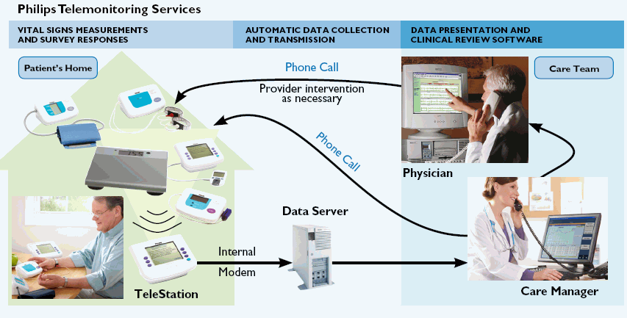
Remote Patient Monitoring
Wearable devices or home appliances can capture vital signs and activity data and inform medical personnel as needed
Enabling "aging in place" with "assistive technology" can vastly improve the quality of life for old folks
48

Slide 49
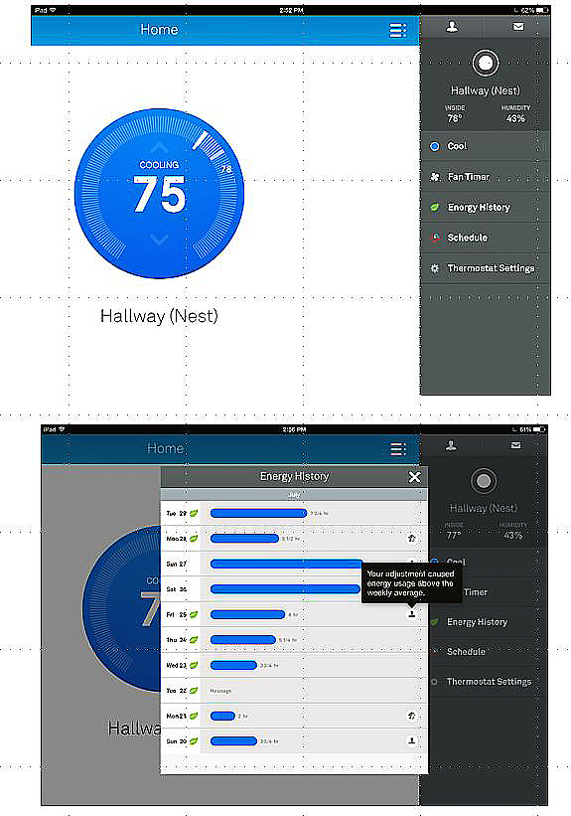
The Nest Learning Thermostat
The thermostat control panel and an energy history report
Can serve as a hub device, communicating with lights, appliances, alarms, your car, your fitness sensor, and other active resources

Slide 50
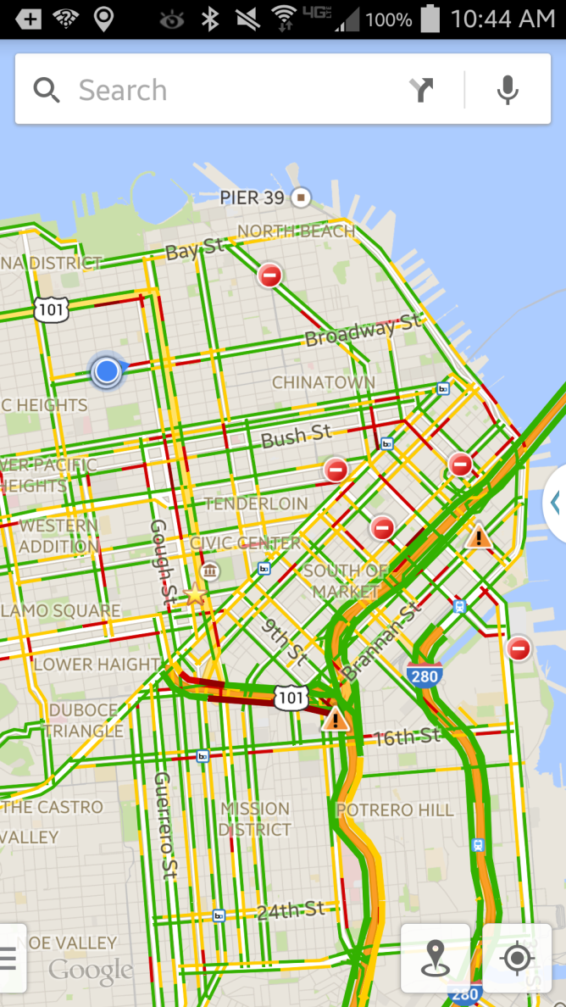
What Makes a Resource Smart?
Composability and Cooperating – independently designed and deployed resources can work together to enable services based on aggregated information

Slide 51
Smart Transportation Systems
Goal is to build a transportation system that will be more efficient, less polluting, and safer for better-informed drivers
Sensors count cars and identify their locations (from which traffic speed is calculated)
"Personal navigation devices" were once dedicated devices, often built into vehicles, but we now have them as smart phone applications
51

Slide 52
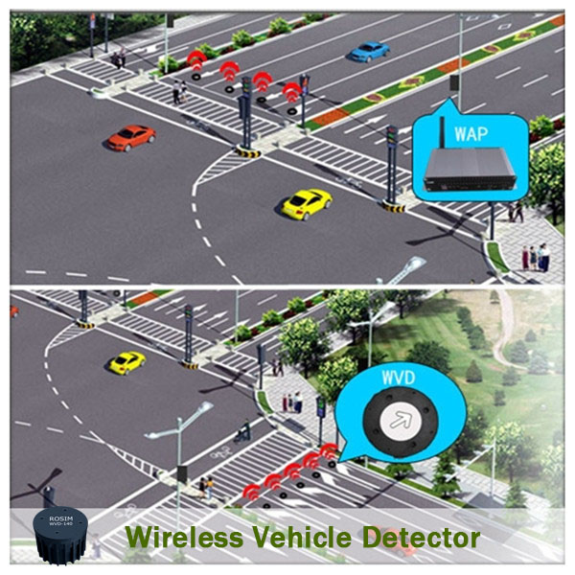
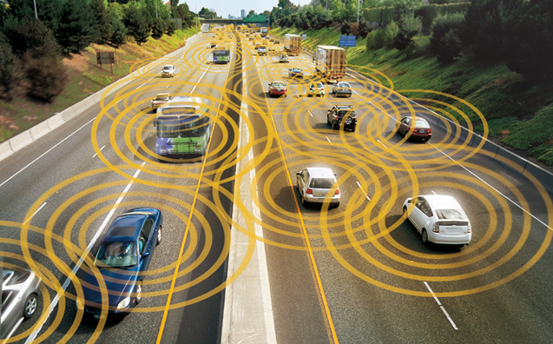
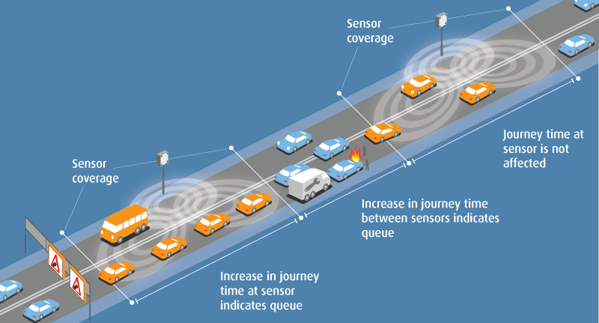
Smart Roads
V2V Networks
http://www.blipsystems.com/danish-german-partnership-disseminate-smart-city-solution-help-ease-traffic/

Slide 53
Stop And Think
There is a great deal of hype about the Internet of Things, and if you search for the phrase “Internet of Things” along with almost any physical resource, chances are you will find something
Try “baby,” “dog,” “fork,” “lettuce,” “pajamas,” “streetlamp,” …
53

Slide 55
CogSci 190 “Sensemaking and Organizing” Spring 2019
Robert J. Glushko glushko@berkeley.edu
5 February 2019 (#5) GROUP WORK Abstraction and Granularity

Slide 56
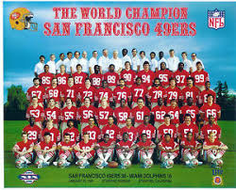
Granularity Analysis: Sports Team
A sports team is treated as a single resource for some purposes (which ones?)
Or as a collection of individuals, or as a number of sets of individuals for other purposes (which ones?)

Slide 57
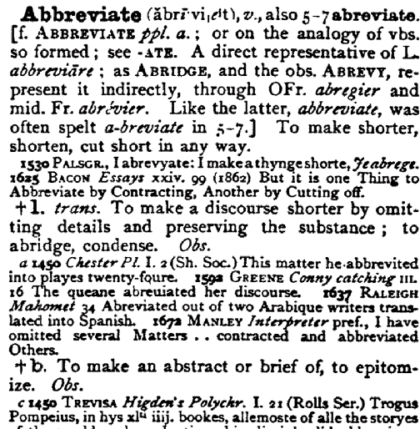
What are the Information Components in this OED entry?
What are the types of content?
How are they structured?
How is presentation used to reinforce content and structure?

Slide 58
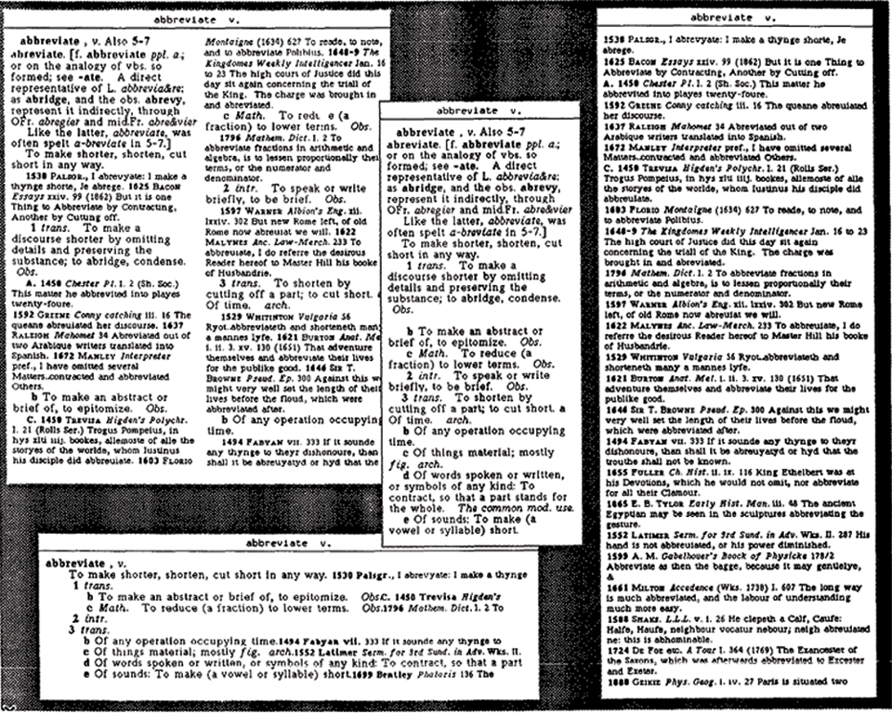
HINT: Different Views Enabled by the Detailed Model of an OED Entry

Slide 59
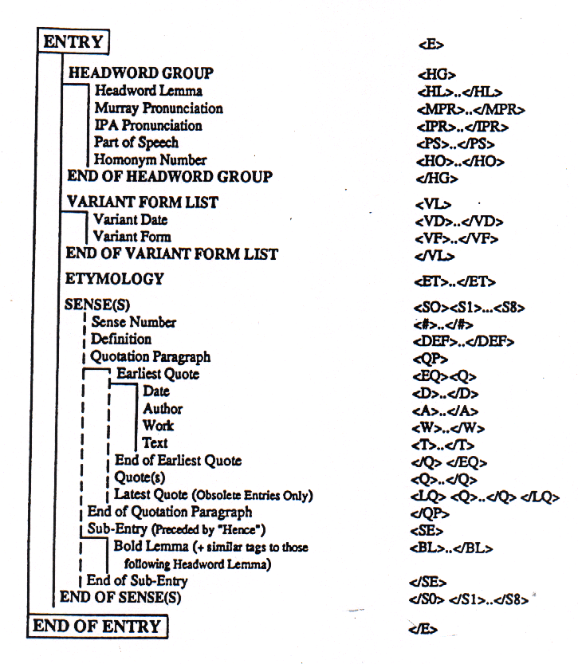
Model for OED “Entry”

Slide 60
Granularity Analysis: Web Page
How many things is a “web page” like
https://www.berkeley.edu/
https://www.amazon.com/

Slide 61
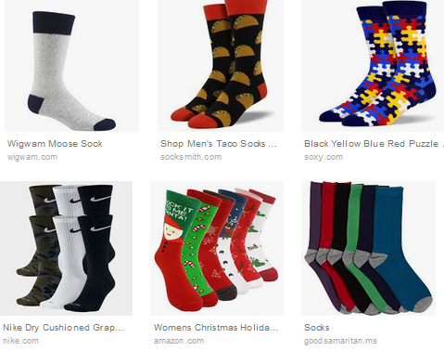
Granularity and Abstraction for Your Socks
Is it more natural to think of one sock at a time, or think that the basic “unit of analysis” is a pair of socks?
Is “sock” the most useful level of abstraction for this resource? Would you want to distinguish dress socks from athletic socks? Would further distinguish your socks by color or the material they are made of?

Slide 62
Tradeoffs
Poets and programmers both create resources, but if we put both into a “Creator” category we obscure important differences.
A system of job classification might have “software engineer” or might use less abstract categories and distinguish “build engineer”, “test engineer”, or distinguish programmers by their language (Python, Java, etc.).
Why wouldn’t we always use precise categories if we have them? Are there downsides?

Slide 63
Abstraction and Granularity Together
Imagine you want to visualize on a map a detailed data set of crimes reported in San Francisco over the last 10 years.
What are the important questions about category abstraction ?
What are the important questions about granularity?
If you want to show trends over time, what are the important questions to answer?

Slide 65
CogSci 190 Assignment 2 Comparing a Physical and Online Store
Assigned on 5 February 2019; SUBMIT YOUR WORK USING BCOURSES BY NOON ON TUESDAY, FEB 12 2019. please bring a printed copy of your analysis to class on the due date (February 12) and be prepared to discuss.
-----------------------------------------------------------------------------------------------------------------------------------------------------------------------------------------------We organize things and we organize information. This assignment explores the differences and similarities in how we do this. In this assignment you will compare and contrast the organizing principles and design patterns guiding the organization of resources in Andronico’s (using the store map on the next page) and at Amazon.com using the directory (https://www.amazon.com/gp/site-directory). We are aware that there are alternative ways of viewing Amazon’s resources via search, and that the resources may be organized very differently in Amazon’s warehouses. However, for the purposes of this assignment, use only the directory as your guide.
Limit your analysis to what you can see or directly infer from the Andronico’s store map and Amazon.com. You do not need to do any research about supermarket or e-commerce site design, and in fact if you try, it will probably distract you.
Please base your analysis on Amazon directory ONLY. DO NOT analyze the Amazon homepage.
Please frame your analysis in terms of the four questions below:
1. What principles are used by the Andronico’s organizing system? Define each principle and provide a specific example of resources whose organization follows it.
2. What principles are used in the Amazon.com organizing system? Define each principle (if you haven’t already done so in part 1) and provide a specific example of resources whose organization follows it.
3. Compare and contrast the principles behind the two organizing systems.
4. Review each of the principles in the Andronico’s organizing system and try to revise it to be more abstract so that it can apply to the Amazon organizing system. If a principle can’t be revised in this way, explain why.

Slide 66
