Slide 1
CogSci 190 “Sensemaking and Organizing” Spring 2019
Robert J. Glushko glushko@berkeley.edu
7 February 2019 6) Names and Identifiers

Slide 2
Give Me A Name

Slide 3
What is a Name?
A NAME is a label for some thing or some category that is used to distinguish one from another
Many English (sur)names are literally resource descriptions (other languages?)
But most resource names do not convey properties of the resource
If a name is used to refer to some thing and is unique in some context it is an IDENTIFIER
3

Slide 4
Issues with Names and Naming – 1
A specific resource or type or resource can often have multiple names; these are SYNONYMS or ALIASES
Different things can sometimes have the same names -- these are HOMOGRAPHS or POLYSEMES
Which is the more important problem?
4

Slide 5
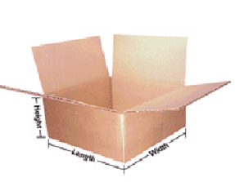
SYNONYMS: “Box,” “Carton,” or “Shipping Container” ?
5

Slide 6
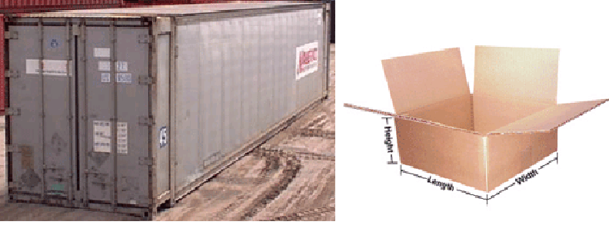
POLYSEMES: Both are “Shipping Containers”
How can you (or some computational process) determine which meaning is intended with polysemous words or phrases?
6

Slide 7
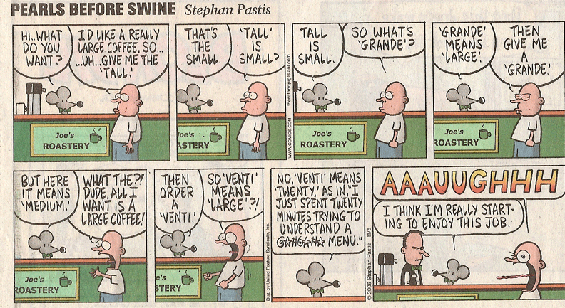
The Vocabulary Problem
7

Slide 8
The “Vocabulary Problem”
People use a large variety of words for the same thing or concept
Most people - especially system designers - are surprised by this because they think their own word choices are “intuitive” or "natural“
The extreme variability of word selection is an inescapable fact that has its roots in the nature of language and categorization
What are the implications for UI design? How do you choose names for resources and interactions?
8

Slide 9
Issues with Names and Naming – 2
False cognates (GIFT, PAIN)
A name can have undesirable associations
A name can have assume impermanent attributes or associations or be “faddish” (baby names over time)
Alphabetic ordering bias
Autogenerated names don’t convey any meaning (SCAN0098.JPG)
Problems caused by careless programmers
9

Slide 10
OSHA – In Thai, means “delicious”
OSHA, the Occupational Safety and Health Act of 1970, gives employees and their representatives the right to file a complaint and request an OSHA inspection of their workplace if they believe there is a serious hazard

Slide 11
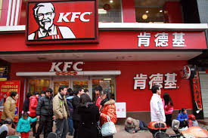
The Most Popular Fast Food Chain in China
A long way from Kentucky, so a name change made sense

Slide 12
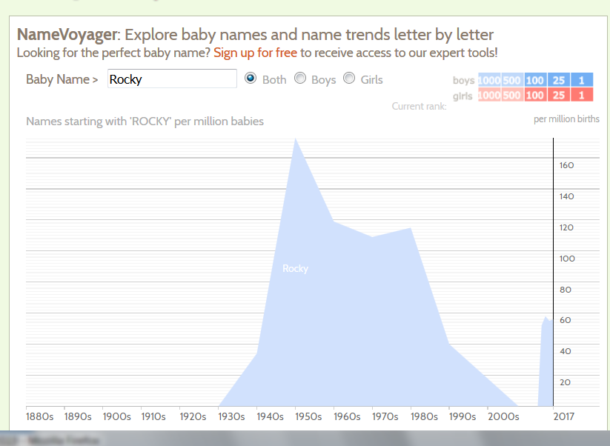
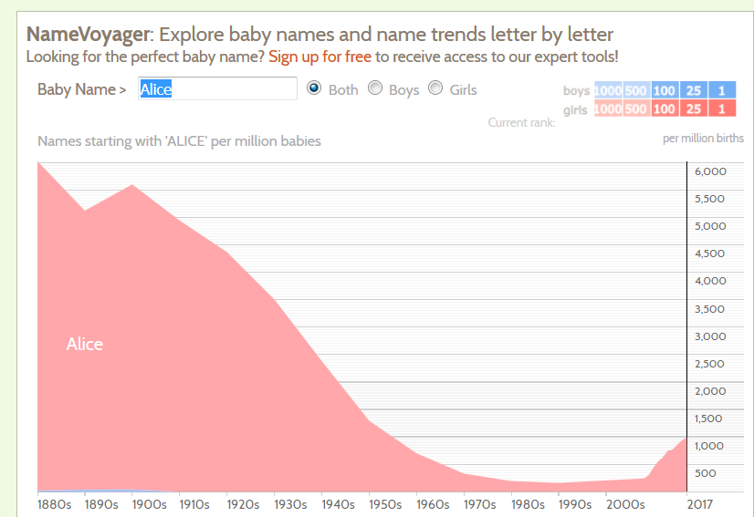
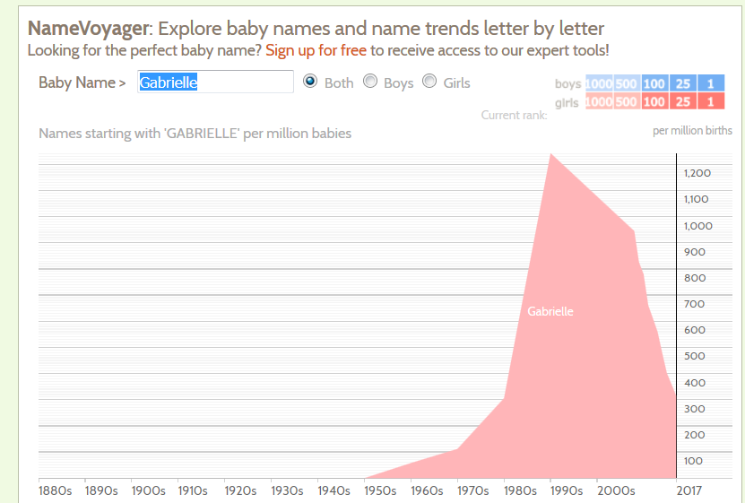
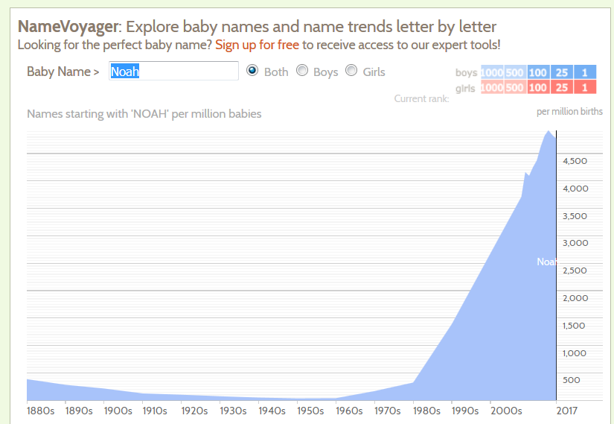
ROCKY
ALICE
NOAH
GABRIELLE

Slide 13
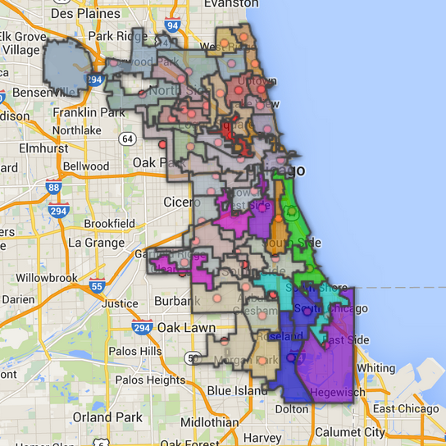
Political “Dirty Tricks” in Ward Listings in the Chicago Phone Book
1st
2nd
3rd
4th
5th
6th
7th
Fifth
First
Fourth
Second
Seventh
Sixth
Third
Democratic party offices (left) appeared contiguously; Because the numerals were spelled out, Republican party offices (right) were scattered in the phone book, making then hard to find

Slide 14
Naming Laws
Many countries have laws that restrict the names that can be given to children
Many countries require that names “indicate gender”
Many countries prohibit names that “might offend a reasonable person” or cause trouble for the child
See: Larson, C. F. (2011). Naming Baby: The Constitutional Dimensions of Parental Naming Rights. Geo. Wash. L. Rev., 80, 159.

Slide 15
Jordan (Taylor, Ryan…)

Slide 16
Sonoran List of Prohibited Names
Aceituno All Power Anivdelarev Aguinaldo Batman Benefecia Burger King Caraciola Caralampio Cheyenne Christmas Day Cacerolo Cesárea Circuncisión Culebro
Delgadina Diodoro Email Escroto Espinacia Facebook Fulanito Gordonia Gorgonio Harry Potter Hermione Hitler Hurraca Iluminada Indio
James Bond Lady Di Marciana Masiosare Micheline Patrocinio Panuncio Petronilo Piritipio Privado Pocahontas Procopio Pomponio Rambo Robocop
Rocky Rolling Stone Terminator Sonora querida Sobeida Telesforo Tránsito Tremebundo Twitter Usnavy Virgen Verulo Yahoo Zoila Rosa
The civil registry of Sonora state in Mexico establishes in Article 46 that it prohibits minors to be registered under names that are pejorative, discriminatory, shameful, degrading, lacking significance or constituting of signs or initials.

Slide 17
“China Lucky Numbers” for Air Travel (Wikipedia)
Air Canada route, Shanghai to Toronto: Flight AC88
KLM route, Hong Kong to Amsterdam: Flight KL888
Etihad Airways route, Abu Dhabi to Beijing then onwards to Nagoya: Flight EY888
United Airlines, Beijing to San Francisco: Flight UA888, and the route from Beijing to Newark is Flight UA88
Air Astana, Beijing to Almaty: Flight KC888
British Airways, Chengdu to London: Flight BA88
Cathay Pacific's from Hong Kong to Vancouver and New York is CX888
17

Slide 18
Variant Forms of Names
A generic problem in resource description is dealing with variant name forms
Same person (or resource) uses or is given different names
Different people (or resources) use the same name
18

Slide 19
Naming the Same Song?
Hemerly 2011
19

Slide 20
Different Forms of “Same” Author Name
From an old version of Bowker’s Books in Print
20

Slide 21
Same Name for Different Authors
21

Slide 22
Questions about Names
How many names should be associated with a information object or resource?
Should one be designated as the preferred or authoritative form? Who decides?
What references should be made from other possible forms of names that haven't been used? Should you autocorrect/coerce?
22

Slide 23
Normative Forms of Names
When names appear in multiple forms, one form needs to be chosen; criteria include:
Fullness (e.g., full names vs. initials only)
Language of the name
Spelling (choose predominant form)
Entry element
"Smith, John" not "John Smith"
"Mao Zedong" or "Zedong, Mao" or "Mao Tse Tung" or ?
23

Slide 24
Authority Control
Authority control is concerned with creation and maintenance of a set of terms that have been chosen as the standard representatives for some resource based on some set of rules
The Library of Congress maintains an "authority file" for the names of persons, corporate entities, geographic names of political entities, and titles of works
See http://www.loc.gov/marc/uma/ and http://authorities.loc.gov/
24

Slide 25
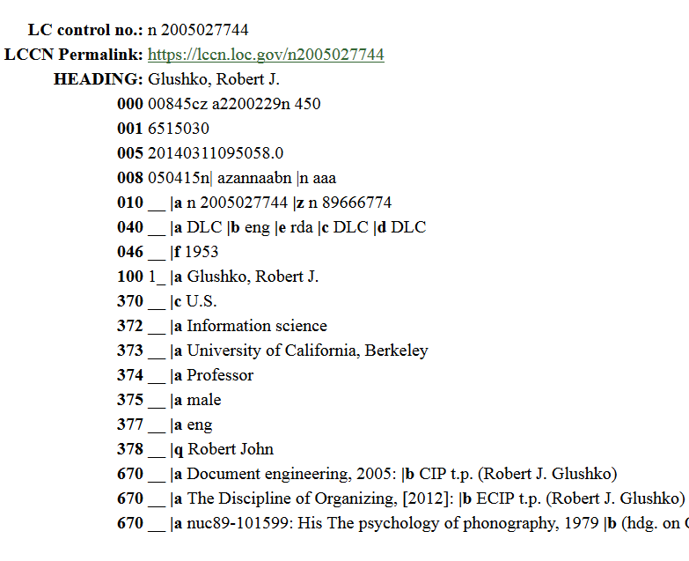
My Library of Congress Author Record

Slide 26
Naming Problems for Places
Variant forms: St. Petersburg, Санкт Пербургскйй, Saint-Pétersbourg
Multiple names: Cluj, in Romania / Roumania / Rumania, is also called Klausenburg and Kolozsvar
Name changes: Bombay -> Mumbai.
Homographs:Vienna, VA, and Vienna, Austria
Anachronisms: No Germany before 1870
Vague, e.g. Midwest, Silicon Valley
Unstable boundaries: 19th century Poland; Balkans; USSR,Ukraine
26

Slide 27
There are over 100 places called “Springfield” in the US, Canada, Australia, the UK, and elsewhere, but this one is more famous

Slide 28
Authoritative Place Names
Places have latitude and longitude coordinates, so we can link places and spaces with a GAZETTEER
A gazetteer is a place name authority file that:
Indicates what kind of place it is
Objectively specifies latitude and longitude
Disambiguates similar place names
Brings variant names together
Allows places to be displayed on maps
28

Slide 29
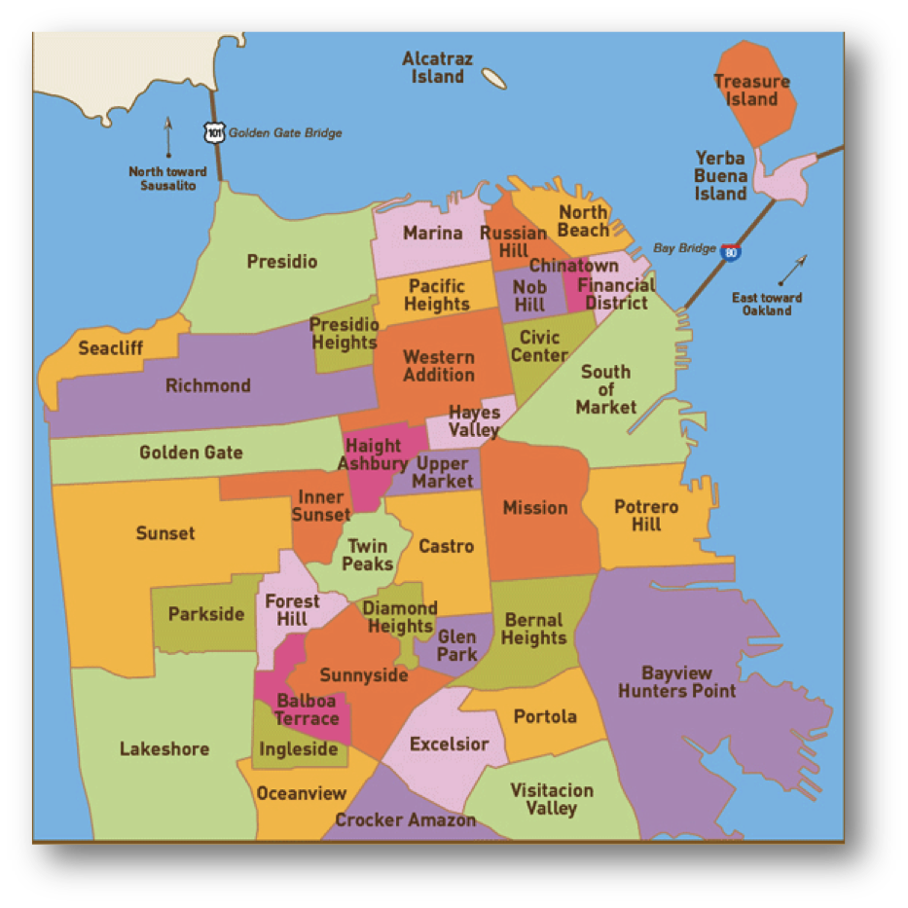
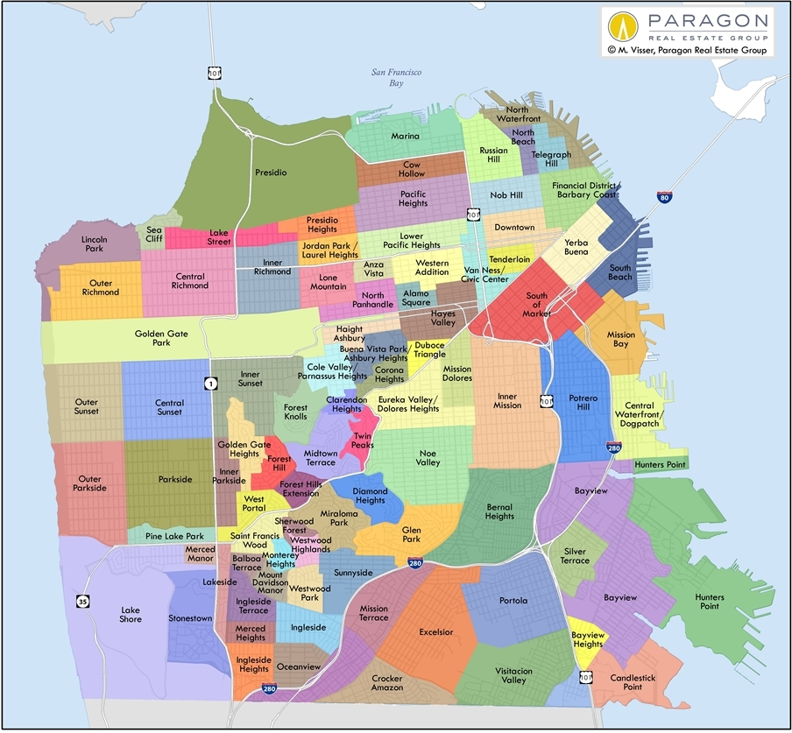
San Francisco Neighborhoods
A while ago…
Now
Why the change?

Slide 30
The Name Matching Problem
Name matching" is the task of determining when two different strings denote the same person, object, or other named entity
It is ironic that this problem has many other names:
Object consolidation
Merge-purge
Householding
Fuzzy/approximate matching
Co-reference resolution
Duplicate detection
Record linkage
30

Slide 31
Identifiers - 1
An identifier is a special type of name assigned in a controlled way and governed by rules that define possible values and naming conventions; "some person or organization asserts the relationship between the string and the thing” (Coyle, 2006, p. 428)
The same resource can have more than one identifier
How many different identifiers can a person have?
What if the answer is “none”?
31

Slide 32
Identifiers - 2
Identifiers are UNIQUE if they refer to one and only one resource within some defined context or scope
Identifiers are PERSISTENT if they resolve to the same referent indefinitely, or as long as needed; but persistence is a functions of organizations, not technology
32

Slide 33
Identifiers - 3
Identifiers are UNSTRUCTURED or DUMB (as opposed to STRUCTURED or INTELLIGENT ) if they have no inherent meaning based on their values
Identifier schemes are designed to be STRUCTURED or INTELLIGENT but over time they often become less so
33

Slide 34
ISBN on Bar Code
Publisher
Title
Check Digit
34

Slide 35
Location Identifiers
Identifiers that are well-known or highly-structured can be used to specify a location
South Hall, University of California, Berkeley
37.871432,-122.258499
But how this is done varies a lot
Addresses in Japan identify buildings by subdividing land into smaller units as needed based on population density
35

Slide 36
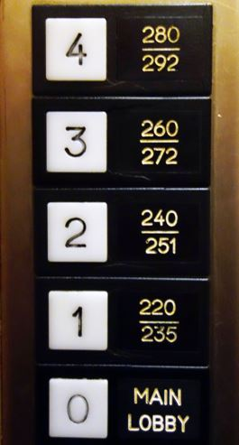
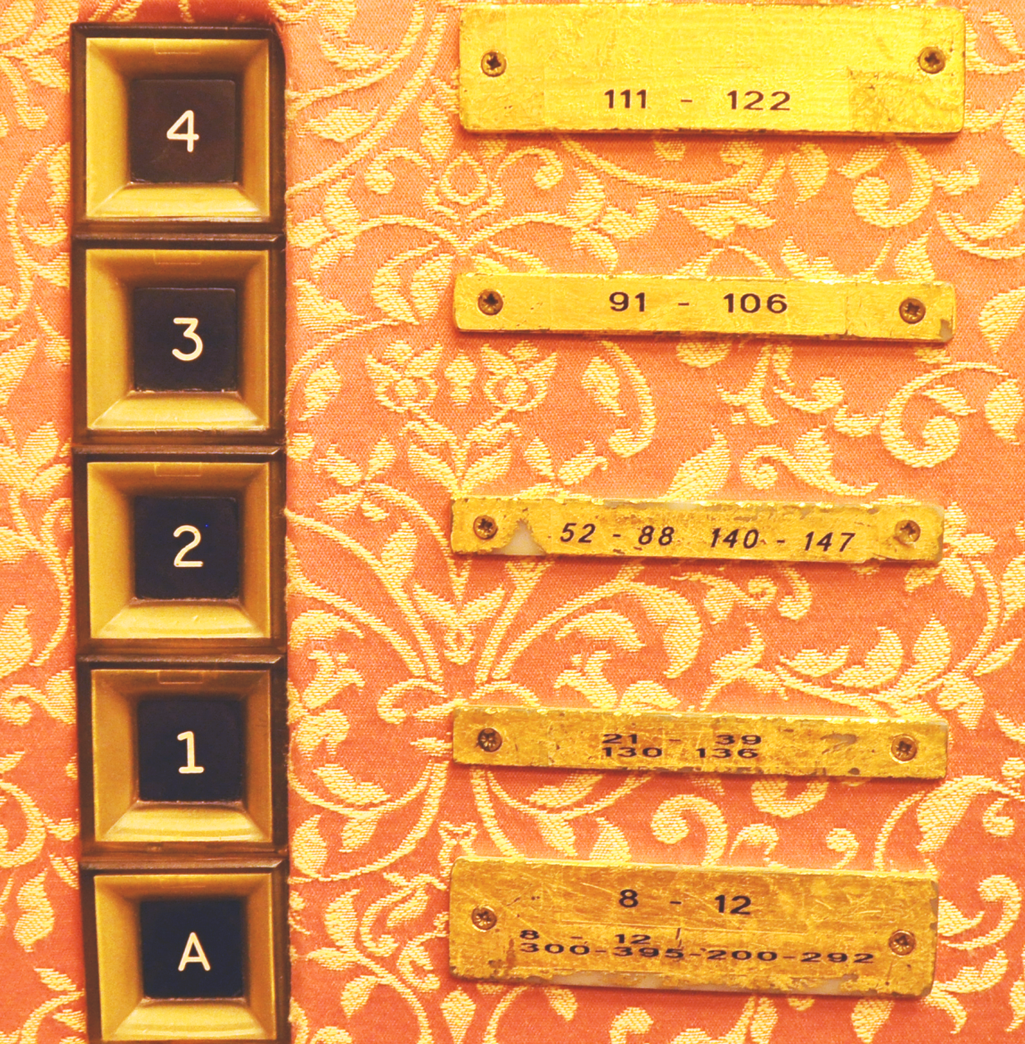
Bad Identifiers for Hotel Rooms

Slide 37
Resources over Time
Organizing systems continually need to adapt and evolve in response to changes in content and context
New resources are created or added, and other ones are destroyed or culled
Resources might change in controlled ways or in uncontrolled ways
The organizing system might need automated or formal mechanisms for ensuring persistence and authenticity
37

Slide 38
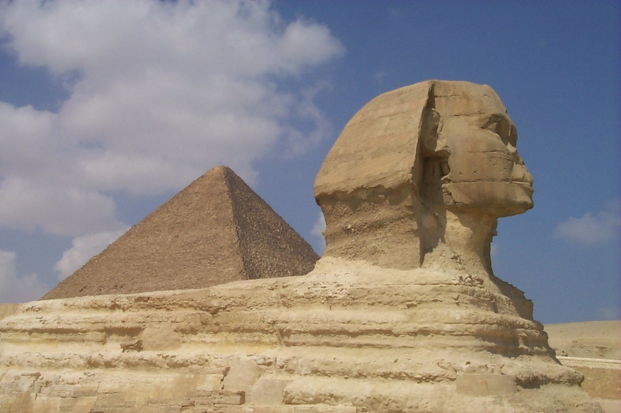
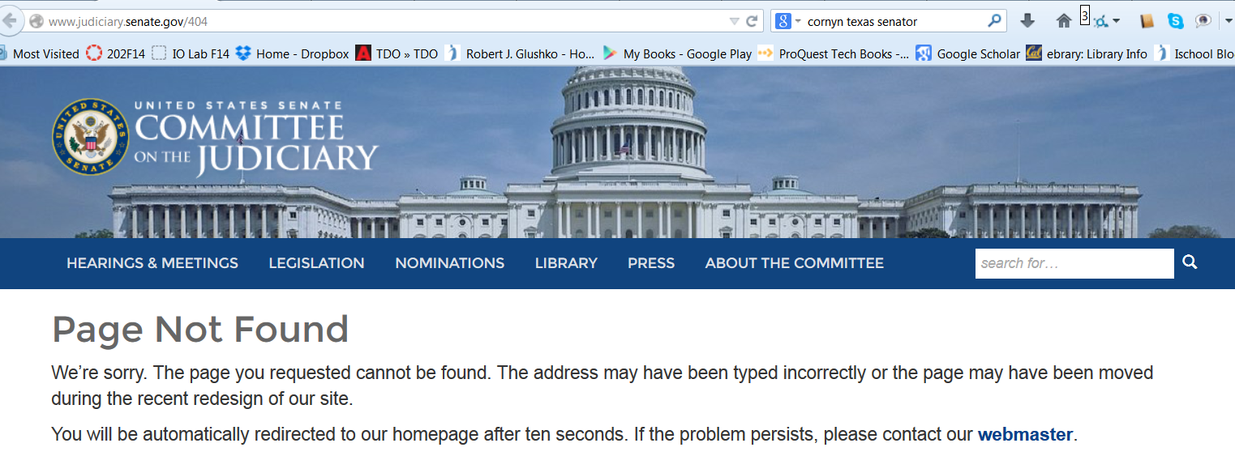
Persistence
38

Slide 39
Authenticity
Buy an autographed photo from Ustar.net and get a Certificate of Authenticity
Or make your own cert?
Famous Forged Documents
Famous Forged {paintings, sculptures, signatures,…}
39

Slide 40
Authenticity in a Digital Environment – 1
We often use judgments about the physical integrity of recorded information to stand in for a judgment about the integrity of the text
Digital resources have no independent physical manifestations or indications of usage that can provide evidence "about their fate in the world”
40

Slide 41
Authenticity in a Digital Environment – 2
The "permeability" of digital environments makes it harder to ensure that resources have not been altered
Scholars trust technological solutions like time stamps. encryption, watermarks, and digital signatures; technologists are skeptical of them
In the digital world selecting for preservation has become a process of constant re-selection
41

Slide 42
Provenance
42

Slide 43
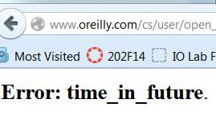
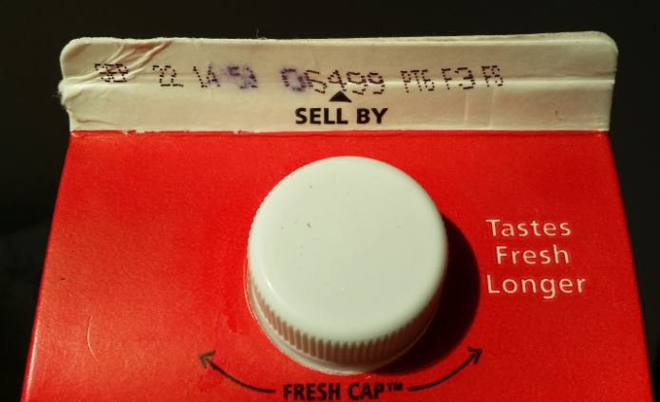
Effectivity
SEC. 108. This title shall take effect on the first day of the sixth month which begins after the date of the enactment of this title, except that the amendments regarding sections 19(b)(7) and 19(b)(8)(D) of the Federal Reserve Act shall take effect on the date of enactment of this title.
(From US Code of Federal Regulations)
43

Slide 44
Putting them all Together
TDO Figure 3.6
44

Slide 46
Assignment 1
Instructions contained hints at organizing principles but also suggested aspects that would require careful specifications
Alphabetizing rules
Conductors vs. composers as the “artist”
There are numerous classifications for music genres that vary greatly in abstraction and granularity; did you use an “other” category?
Physical albums make “thingness” easy to determine, but digital music can be organized in more complex ways

Slide 47
Organizing Record Albums by Genre, Artist, Album Title
Albums
Classical
Beethoven
Mozart
Rock
The Beatles
The Rolling Stones
5th Symphony
9th Symphony
Magic Flute Opera
Piano Concertos
Sgt. Pepper’s Lonely Hearts Club Band
Let It Bleed
Sticky Fingers
White Album

Slide 48
Albums
The Beatles
Beethoven
Sgt. Pepper’s Lonely Hearts Club Band
White Album
5th Symphony
9th Symphony
Mozart
The Rolling Stones
Magic Flute Opera
Let It Bleed
Sticky Fingers
Piano Concertos
Organizing Record Albums by Artist and then by Album Title

Slide 49
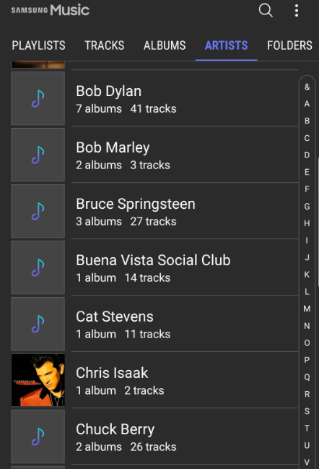
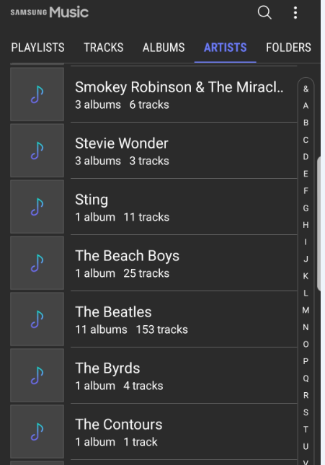
Poor Alphabetic Ordering of Artists

Slide 50
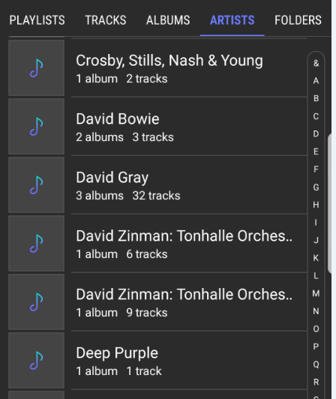
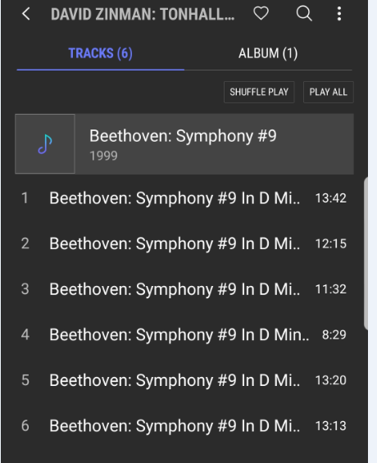
Wrong Resource Descriptions “David Zinman” is Conductor; “Beethoven” is Artist

Slide 51
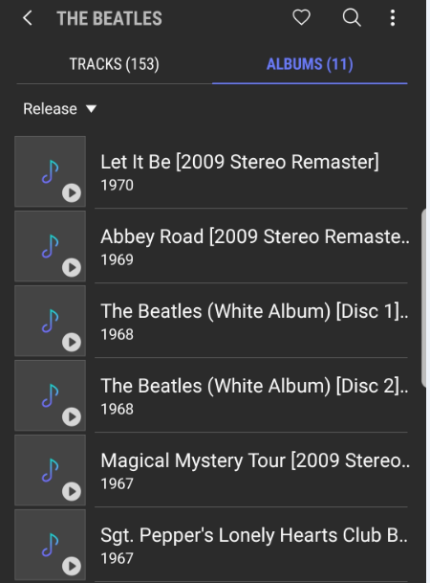
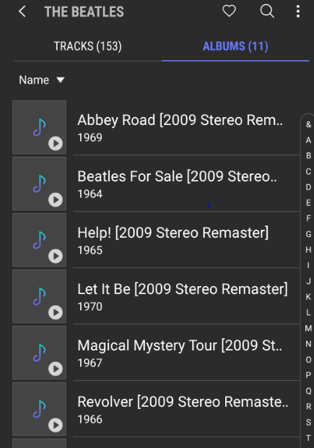
Sort By Release Date
Sort By Title

