Slide 1
CogSci 190 “Sensemaking and Organizing” Spring 2019
Robert J. Glushko glushko@berkeley.edu
12 February 2019 7) The Organizing System Lifecycle;
Architectural Thinking

Slide 2
Outline
The Organizing System Lifecycle
Architectural Thinking
Universal Vending Machine case study
Introduction to Assignment 3: Describing the BART system
Group work – review and self-grade Assignment 2

Slide 3
The Organizing System Lifecycle: 4 Phases
Defining and scoping the domain
Identifying requirements
Design and implementation
Operations and maintenance
There is always a lifecycle, but these phases are brief and mostly inseparable for some simple organizing systems, more sequential for others, and more systematic and iterative for complex organizing systems
3

Slide 4
Factors that Influence A Design Methodology
Your understanding of the problem and problem domain
How stable or predictable the domain is
Whether your design decisions are easily changed
Whether others must be involved in the design process

Slide 5
Organizing System: Home Kitchen
Photo by Emilie Hardman (http://www.flickr.com/photos/quintanaroo/2741672230//) Used by permission
5

Slide 6
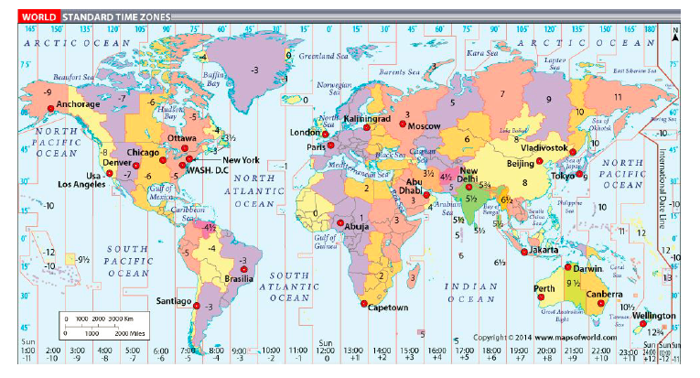
Organizing System: Time Zones

Slide 7
Case Studies
1/22
TDO 12.5 Organizing a kitchen (Hardman 2013)
Time Zones (Volkov 2015)
1/24
TDO 12.1 Multi-generational photo collection
TDO 12.3 Smarter farming in Japan
Medical Emergencies (Delzompo 2018)
1/29
TDO 12.4 Single-source textbook publishing
TDO 12.6 Earth orbiting satellites (Brenners 2014)
TDO 12.18 Neuroscience lab (Gerber 2013)
Cognitive Neuroscience (Griffith 2018)
Organized Crime (Sondhi 2015)
7

Slide 8
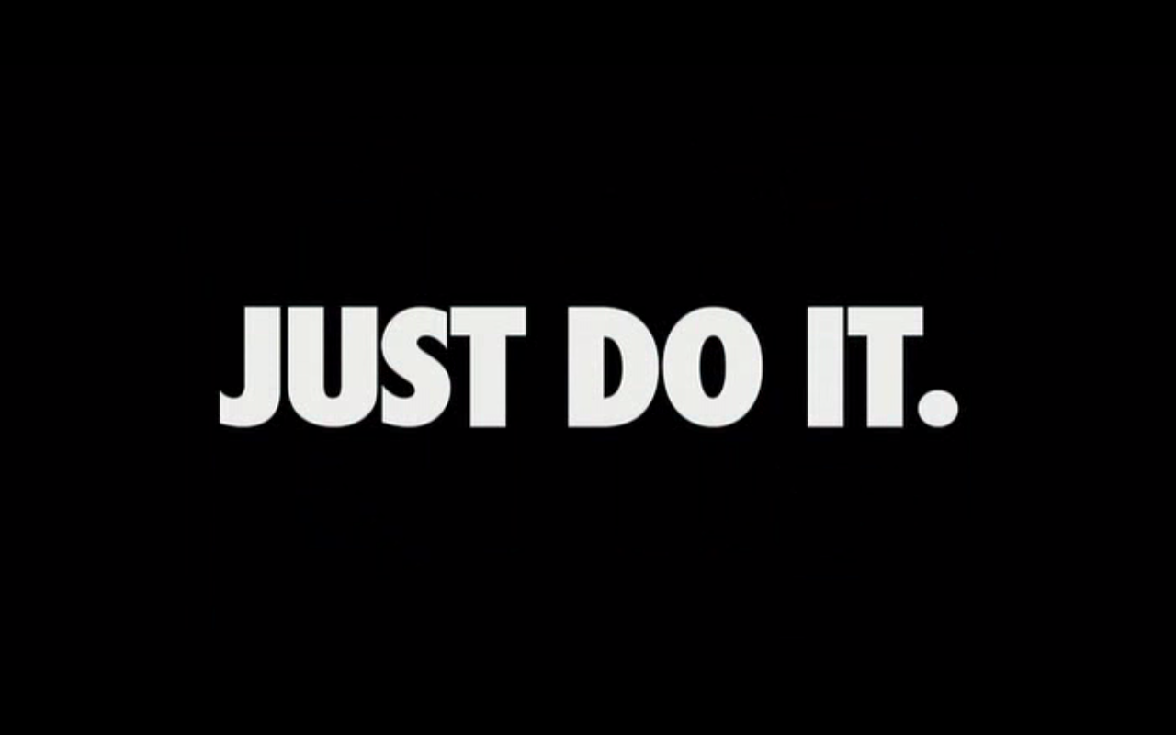
A Lifecycle with Inseparable Phases

Slide 9
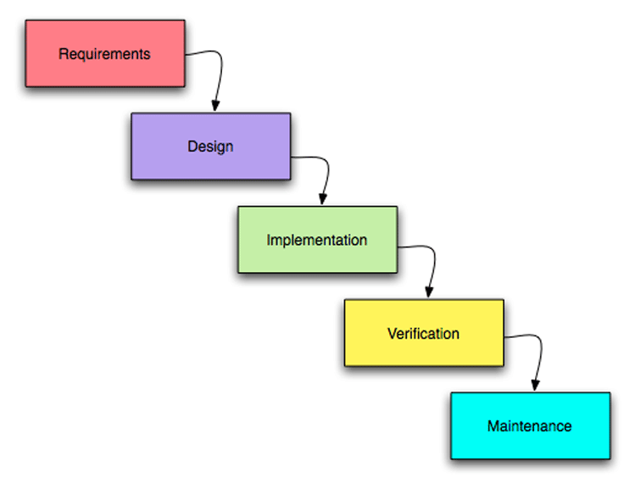
A “Waterfall” or Sequential Lifecycle
What kinds of systems can be built this way?
What kinds of systems can’t be built this way?

Slide 10
Waterfall Methodologies
Waterfall methodologies consist of a set of sequential activities in which the outputs of each step are the inputs to the next (the "waterfall“)
Its goal is to "get everything right before progressing to next step" to minimize rework, which assumes complete and clear requirements that can be validated at each step
What things can be built this way because you can more easily assess progress after each completed step?

Slide 11
Mise-en-place
FLASHBACK
11

Slide 12
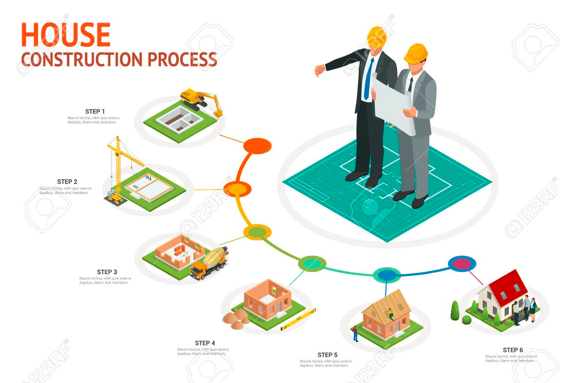

Slide 13
Case Studies
1/22
TDO 12.5 Organizing a kitchen (Hardman 2013)
Time Zones (Volkov 2015)
1/24
TDO 12.1 Multi-generational photo collection
TDO 12.3 Smarter farming in Japan
Medical Emergencies (Delzompo 2018)
1/29
TDO 12.4 Single-source textbook publishing
TDO 12.6 Earth orbiting satellites (Brenners 2014)
TDO 12.18 Neuroscience lab (Gerber 2013)
Cognitive Neuroscience (Griffith 2018)
Organized Crime (Sondhi 2015)
13

Slide 14
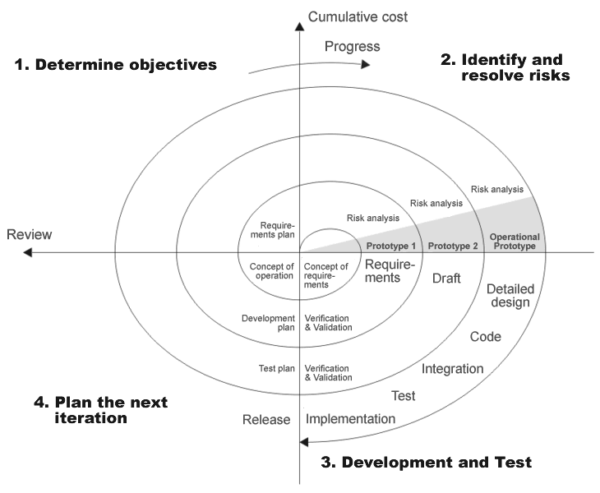
A “Spiral” or Iterative Lifecycle

Slide 15
Iterative Methods
Assume that rework is inevitable and desirable
The goal of iterative methods is "get enough right at each step to know which step to take next"
The idea is to invest to reduce risk, knowing you can never eliminate all of it
Where is this methodology most commonly used?

Slide 17
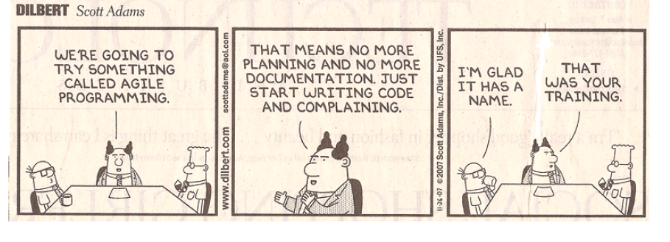

Slide 18
Phase 1: Defining and Scoping the Domain
Scope and scale
Nature and number of users
Time span
Physical / technological environment
Relationship to overlapping organizing systems

Slide 19
Scope and Scale
SCOPE: the breadth and variety of resource types
SCALE: the number of resource instances
Which of these is more important, and why?
19

Slide 20
Scope and Scale
Heterogeneity of resources is more important than absolute number
Broad and large collections are hardest to manage
Narrow and small collections are easiest
What is easier to manage?
A broad but small collection?
A narrow but large collection?
20

Slide 21
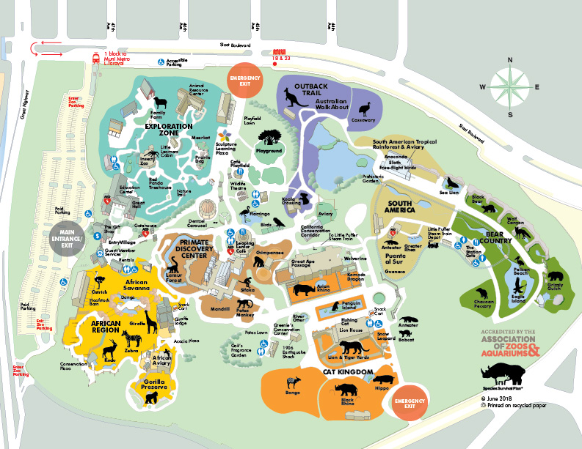
Scope and Scale: Cattle Ranch vs. Zoo
Harris Cattle Ranch Coalinga CA
100,000 cows
400 employees
San Francisco Zoo
100 animals
200 employees

Slide 22
Scope and Scale: Tall Data vs. Wide Data
A “tall” dataset might contain many millions or even billions of records, but each has a relatively small number of variables.
A “wide” dataset might have many records, but each record has a large number – hundreds or even thousands - of variables.

Slide 23
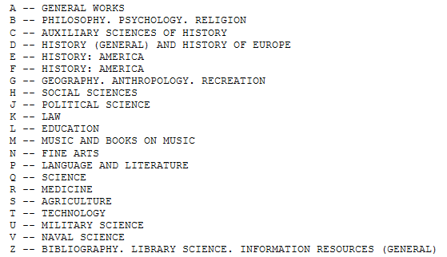
Library of Congress Classification
FLASHBACK
An Organizing System with Broad Scope and Scale
23

Slide 24
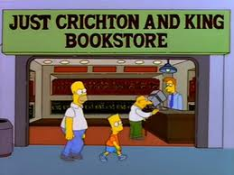
An Organizing System with Narrow Scope and Scale

Slide 25
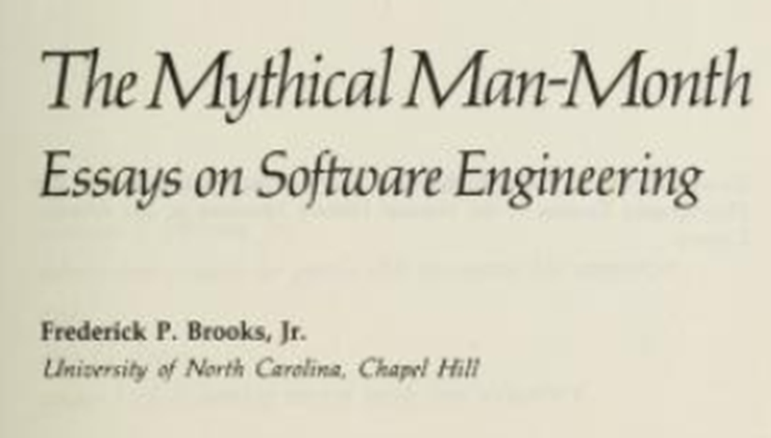
Why Is Scope More Important Than Scale?
Hint:

Slide 26
Nature and Number of Users
How precisely a collection of resources can be described and organized depends on well user types and requirements are known
In what contexts can user types and individual users be controlled and identified?
In what contexts is it difficult to know the number of types and users until the organizing system is in operation?
26

Slide 27
Who Are We Designing For?
User
Operator
Customer
Patient
Client
Buyer
…
How do these target users differ? Do they prioritize requirements in the same way?

Slide 28
The Choice of Organizing Properties Matters!
Organization using behavior or preferences can make interactions highly efficient for some users and the opposite for those who act differently
=> WINNERS AND LOSERS
When multiple properties are used to organize resources, their order determines the arrangement and the ease of interactions
This implies the need to prioritize user and interaction types
28

Slide 29
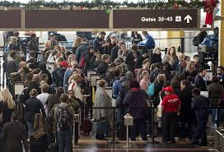
FLASHBACK
Winners and Losers in Airport Organizing Systems

Slide 30
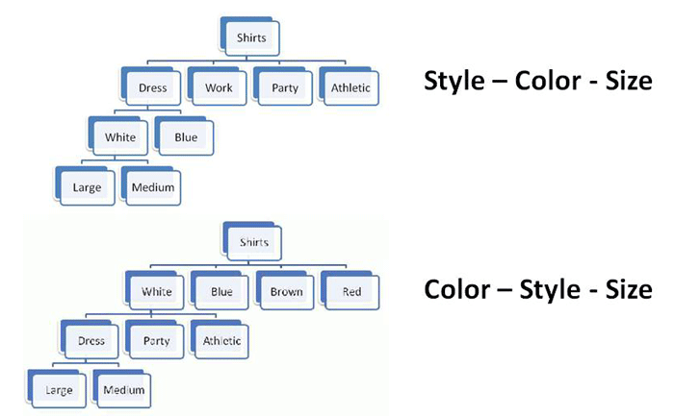
Multiple Properties in Different Order
Organizing the Shirts in a Department Store
30

Slide 31
Expected Lifetime
Usually correlated with number of users and resources; small collections with single users are often ad hoc and don’t outlive the specific tasks for which they were created
Think architecturally to enable more robustness and flexibility with respect to changes in technology or business contexts
31

Slide 32
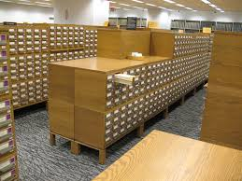
Technologically Obsolete Implementation of an Organizing System You Use A Lot

Slide 33
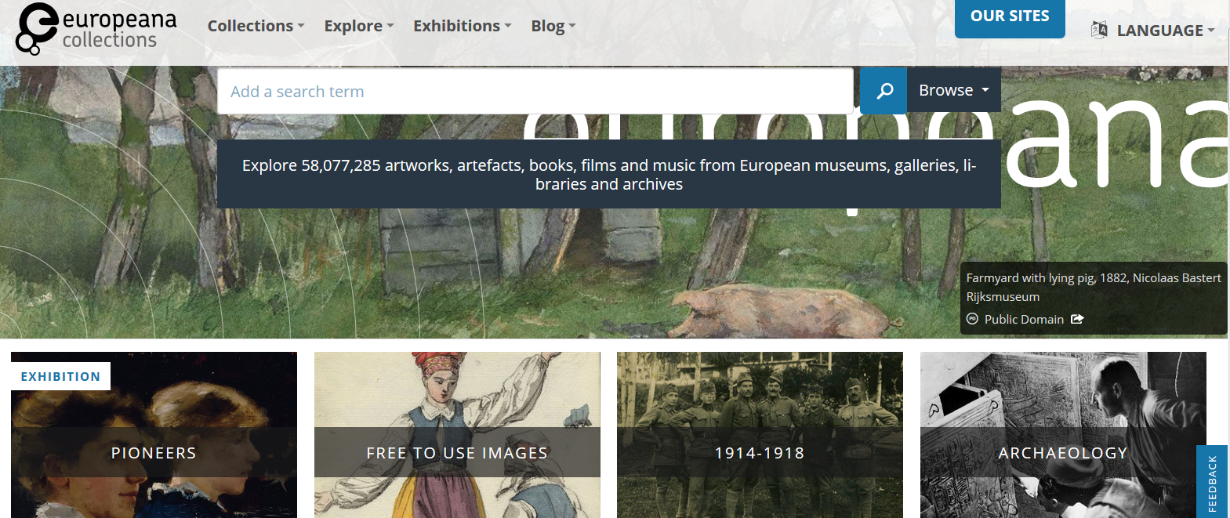
Technology Enables New Interactions… but the Primary Resources Were Not Changed

Slide 34
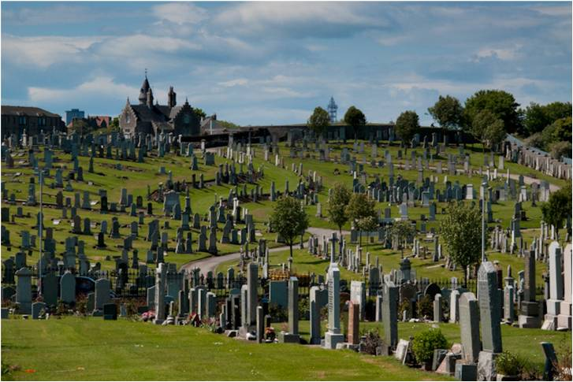
Don’t Confuse Lifetime of Resources with that of the Organizing System
34

Slide 35
Case Studies
1/22
TDO 12.5 Organizing a kitchen (Hardman 2013)
Time Zones (Volkov 2015)
1/24
TDO 12.1 Multi-generational photo collection
TDO 12.3 Smarter farming in Japan
Medical Emergencies (Delzompo 2018)
1/29
TDO 12.4 Single-source textbook publishing
TDO 12.6 Earth orbiting satellites (Brenners 2014)
TDO 12.18 Neuroscience lab (Gerber 2013)
Cognitive Neuroscience (Griffith 2018)
Organized Crime (Sondhi 2015)
35

Slide 36
Physical or Technological Environment
Physical environments create possibilities for organizing and interaction
But there might be constraints that limit them
“Installed base” or “legacy” concerns
Be careful if you are designing or selecting technology for an organizing system
Avoid resource-specific investments unless absolutely justified
36

Slide 37
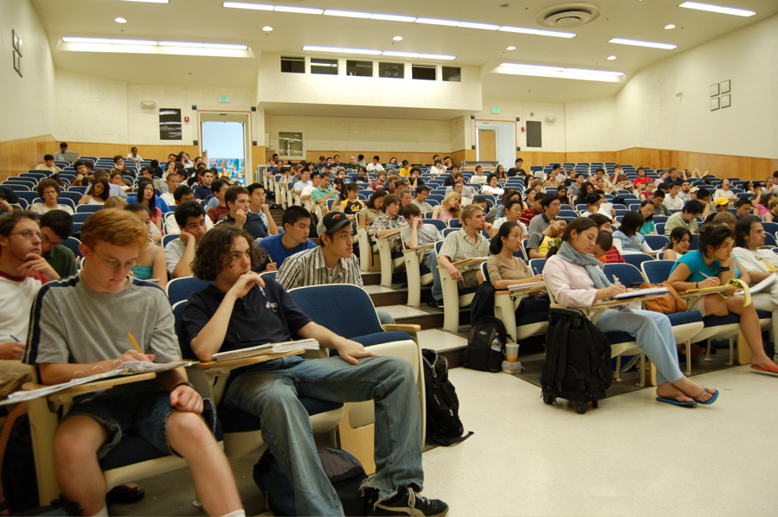
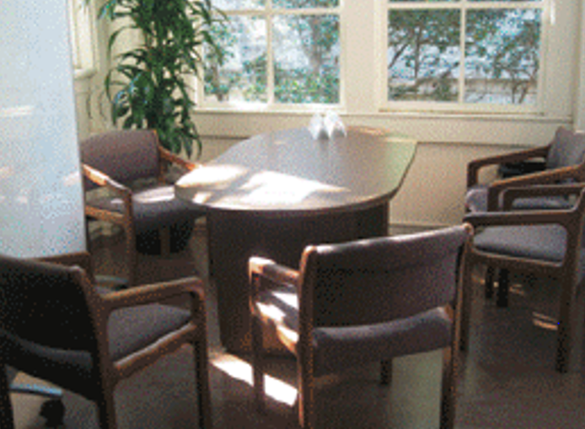
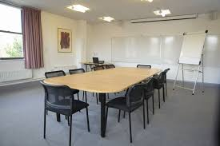
The environment influences that expectations, behavior, and experience of the people who interact with it
37

Slide 38
Physical or Technological Environment (2)
Estimating the ultimate size of a collection at the beginning of an organizing system’s lifecycle can reduce scaling issues related to storage or interaction space
Invest in flexibility and extensibility
38

Slide 39
Relationships with Other Organizing Systems
No organizing system exists in isolation
There are always overlapping and adjacent systems from the user’s perspective
BEST/WORST EXAMPLE: Healthcare ecosystem: the inter-enterprise interactions among the organizing systems of physicians, hospitals, medical labs, insurance companies, government agencies, and other parties involved in healthcare.
39

Slide 40
Relationships with Other Organizing Systems
Sometimes it is possible to design these to work together to achieve integration and interoperability
But sometimes “Standards Wars” emerge
At very least, try not to make this difficult
Architectural thinking helps a lot!
40

Slide 41
Architectural Thinking

Slide 42
Defining "Architecture"
An architecture describes a system's components (or "building blocks") and their relationships with each other
This gives an "architected" system an explicit model, in contrast with systems that are implemented incrementally without a master plan
Abstract patterns of information content or organization are sometimes called “information architecture”
42

Slide 43
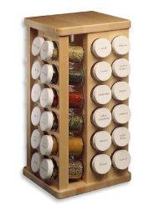
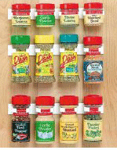
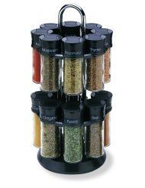
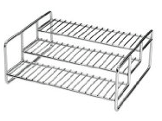
Principles don’t Specify Implementation: “Organize Spices Alphabetically”
FLASHBACK
THINK ARCHITECTURALLY!
43

Slide 44
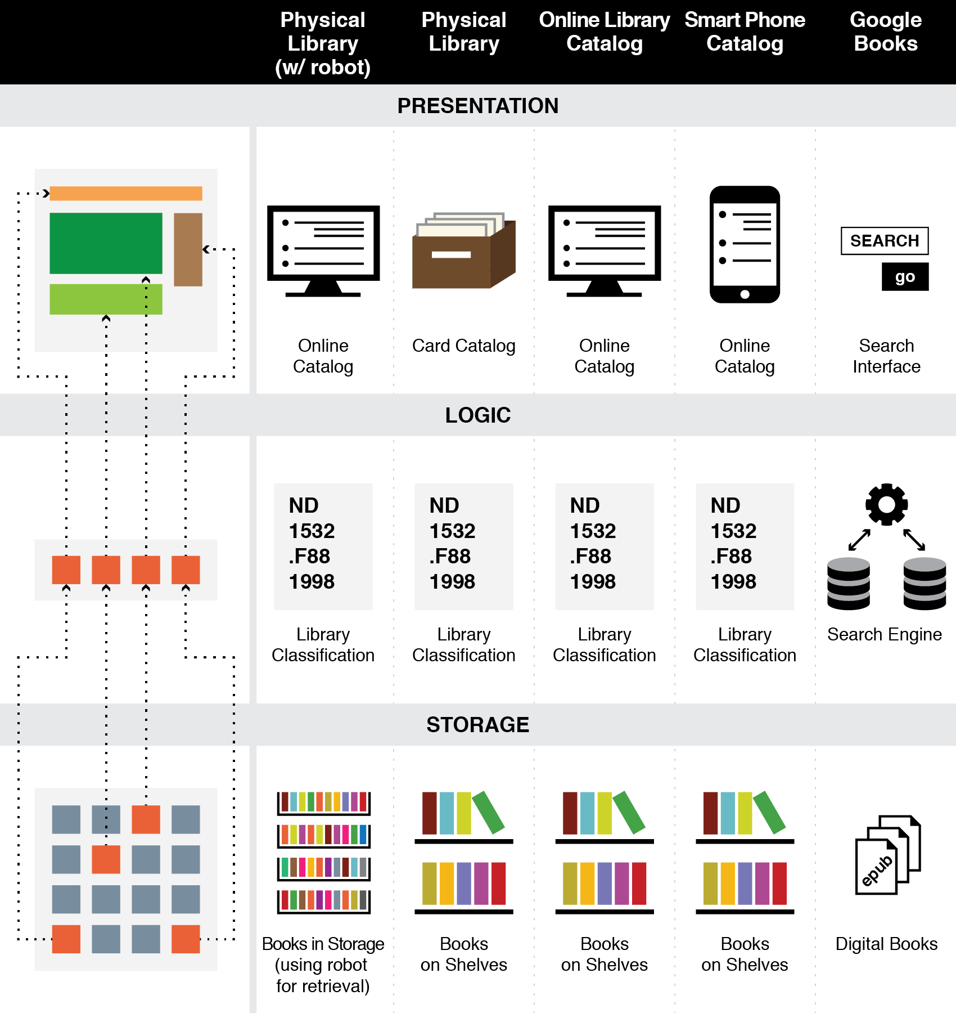
FLASHBACK
The Three-Tier Architecture
Organizing Principles are logically separated from Implementation and Presentation Tiers

Slide 45
Built Environments and City Plans
Built environments / city plans are places, but are usually organizing people and their interactions rather than “the land”
The easiest and most efficient way to organize space is using a coordinate grid, with streets intersecting at perpendicular angles
Hills, rivers, and other natural features make it more difficult to impose systematic organization
Most cities developed over long time periods and their “legacy organization” constrains their current organization
45

Slide 46
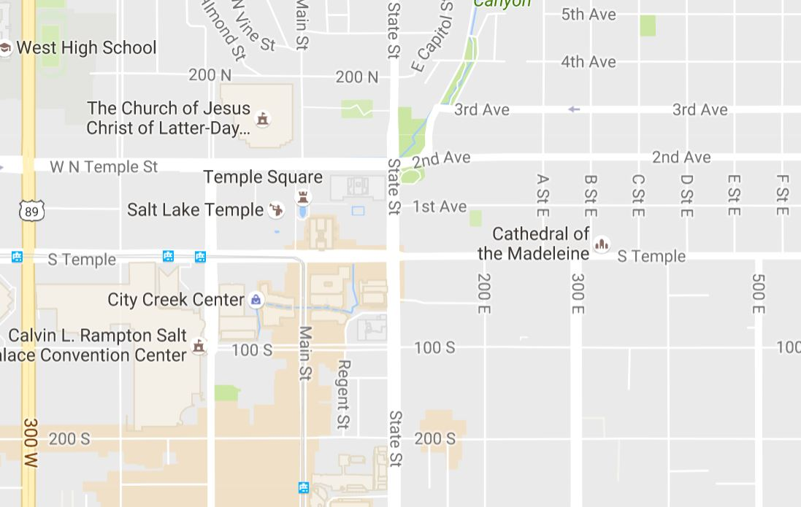
Salt Lake City

Slide 47
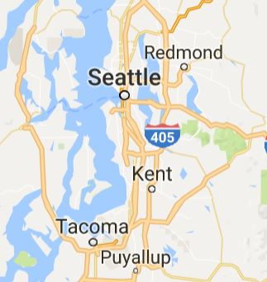
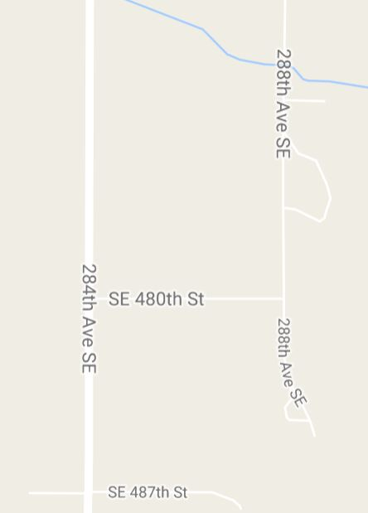
Seattle: Architectural Thinking
40 Miles from Downtown Seattle

Slide 48
Case Study: Universal Vending Machine
Traditional vending machines are designed for specific types of physical merchandise
Every vending machine can be different in terms of the merchandise sold, the organization of the merchandise in the machine, the currency accepted, the organization of the currency in the machine, the user interactions supported etc.
48

Slide 49
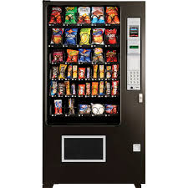
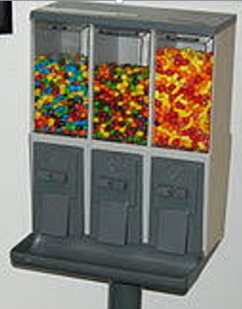

Slide 50
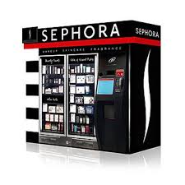
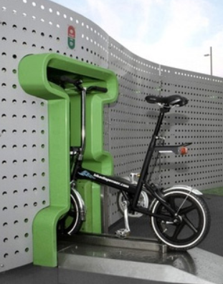

Slide 51
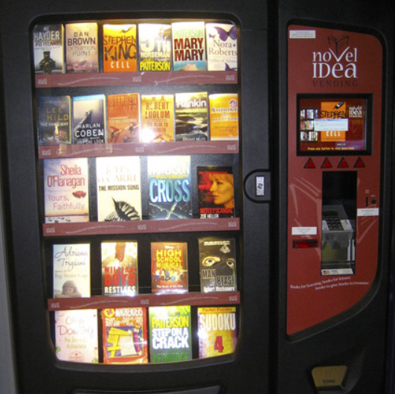
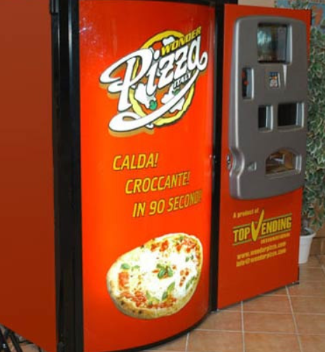

Slide 52
Potluri’s Universal Vending Machine
Separates the user facing component, storage component, catalog (and digital merchandise) component, payment component
Generalizes “storage” to include capability to deliver goods from other locations
Abstracts the concept of “payment” to include any resource or interaction the vendor is willing to accept
52

Slide 53
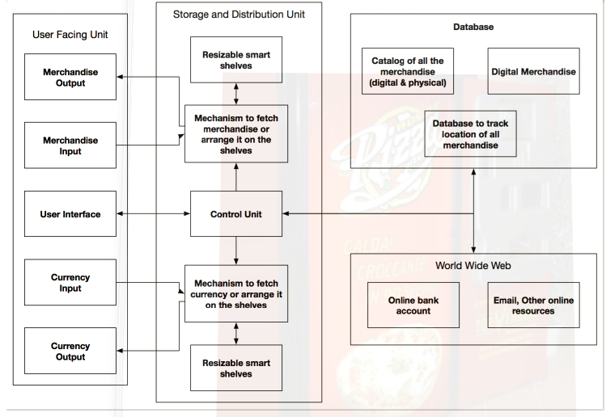

Slide 54
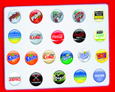
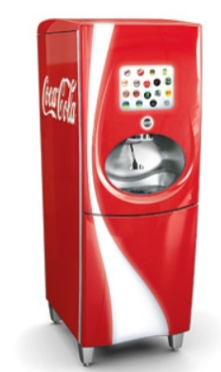
Partway There: Coke Freestyle Vending Machine
Instead of vending drinks in cans (which limits selection) drinks are mixed “on demand” using extremely concentrated “micro-doses” of ingredients
This enables the machine to offer more than 100 choices
54

Slide 55
Partway There: 3D Printing

Slide 57
Assignment 3 – The BART System
Describe the BART system by identifying the interactions used or experienced by people who ride BART.
Organize them into categories
Depict the organizing system using one or more diagrams that represent the relationships among the services or the categories of interactions that you came up in part 2.
Detailed instructions in bCourses. Due Tuesday Feb 19

