Slide 1
CogSci 190 “Sensemaking and Organizing” Spring 2019
Robert J. Glushko glushko@berkeley.edu
14 February 2019 8) Cultural categories; Natural categories; Linguistic relativity

Slide 2
Outline
Review of “Block 1”
Mini-tutorial on modeling for architectural thinking
Intro to “Block 2” – Sensemaking and Organizing in Language, Social and Cultural Groups
Natural categories
Linguistic relativity

Slide 3
Concepts You Should Know
Organizing system (not “organizational system”)
Resource
Intentional arrangement
Organizing principle
Generic
Domain-specific
Interactions
Generic
Domain-specific
“Organizing on the way in” vs. “Organizing on the way out”
“Thing” vs. “Type of thing” (Shamu question)
“Carving nature at the joints”
“Category thinking” vs. “Design thinking”

Slide 4
More Concepts You Should Know
Path dependence in selection
“Information IQ”
“Smart” resources
The paradox of Theseus
Identifiers vs. Names
The Vocabulary Problem
Polysemy vs. Synonymy
Curation vs. Governance
Persistence
Authenticity
Provenance
Effectivity

Slide 5
Mini-Tutorial on Modeling
What is a Model?
What are Models for?
Physical Models
Conceptual Models

Slide 6
An Introduction to Modeling - 1
Models are simplified descriptions of a domain or resource type that abstract from its complexity to emphasize some features or characteristics while intentionally de-emphasizing others
The primary purpose of modeling is to better understand some existing system or environment and its resources and to describe this understanding so it can be communicated and applied
6

Slide 7
The Modeling Gap
There is an essential difference or gap between the real world being modeled and any models of it, or else the models would serve no purpose
7

Slide 8
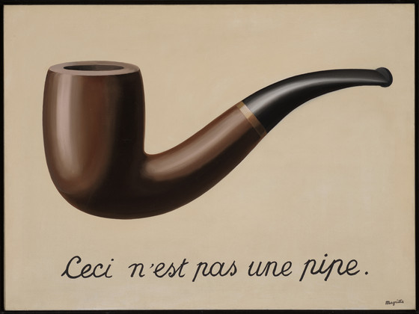
La trahison des images – Magritte (1929)

Slide 9
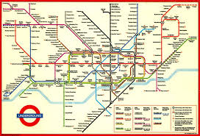
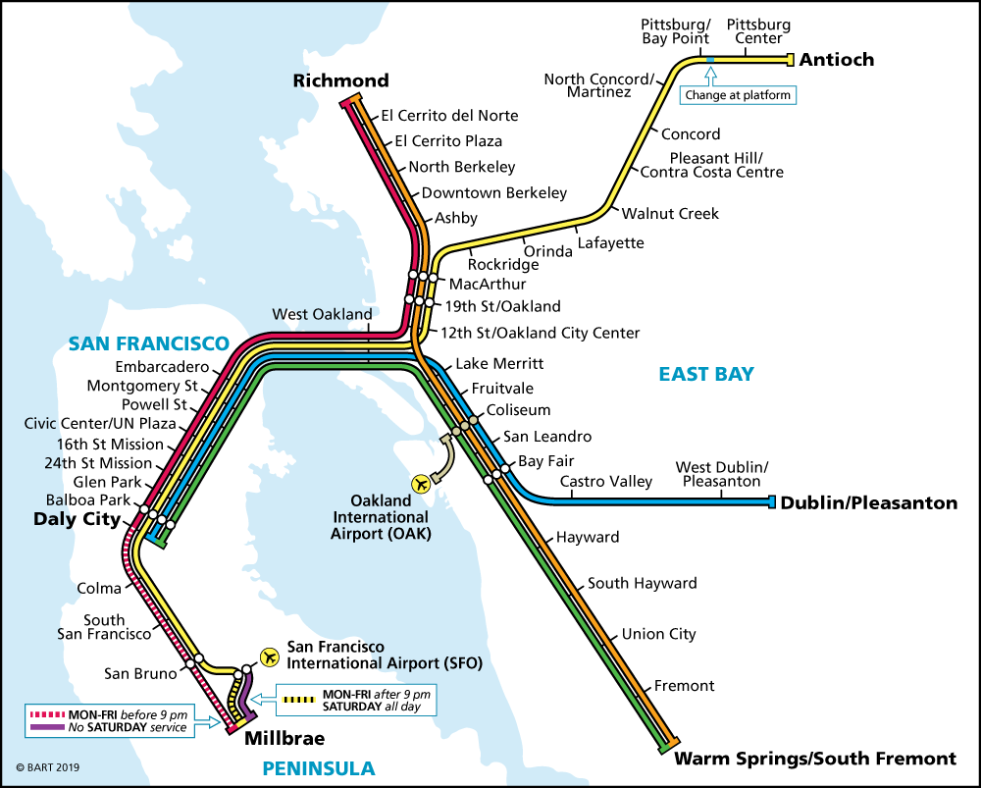
“The map is not the territory”
LONDON
BART

Slide 10
An Introduction to Modeling - 2
A model can represent a human activity, a natural system, or a designed system
We can model structures – objects, their characteristics, their static relationships with each other like hierarchy, and reference
We can model functions, processes, behaviors – dynamic activities that create and affect structures
10

Slide 11
Recipes as Everyday Models
A recipe describes both objects and structures (ingredients) and the processes (instructions) for creating a food dish
You can FOLLOW the recipe to make the dish
You can COMMUNICATE the recipe to someone else making the dish
You can use the recipe as a GUIDE FOR EXPERIMENTATION with the recipe to create alternative dishes
11

Slide 12
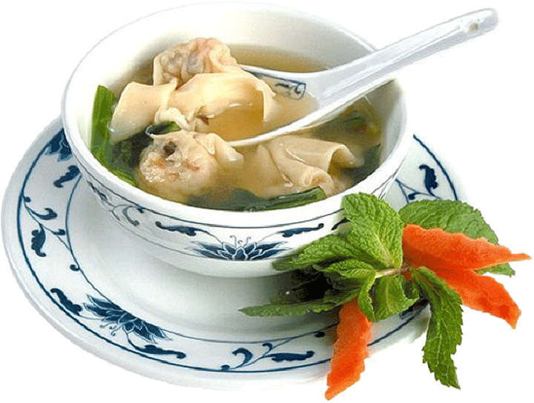
This is Not a Model of Wonton Soup
12

Slide 13
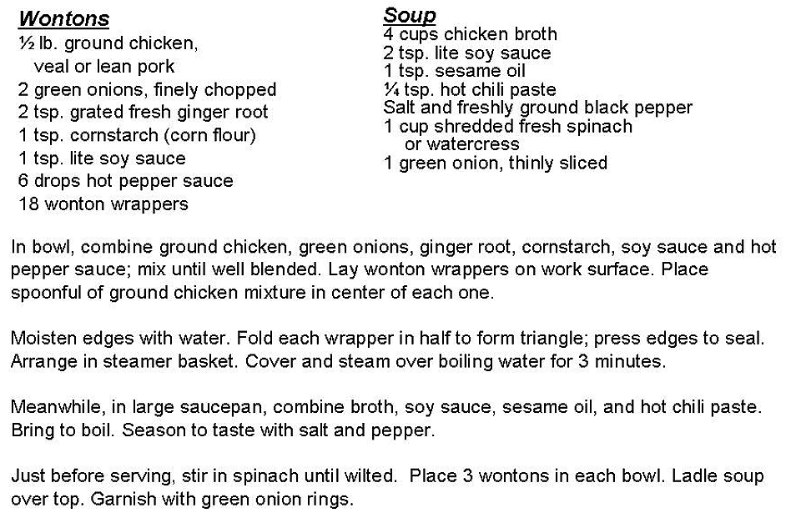
A Model of Wonton Soup
13

Slide 14
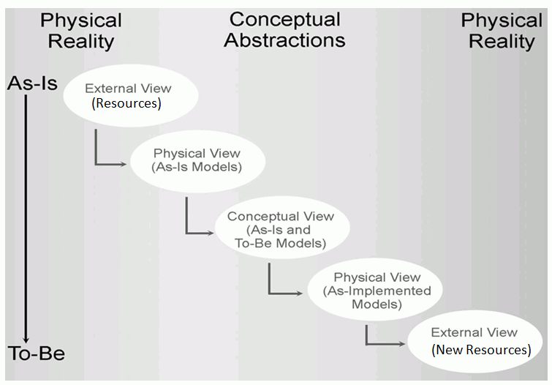
The Classical Modeling Approach
14

Slide 15
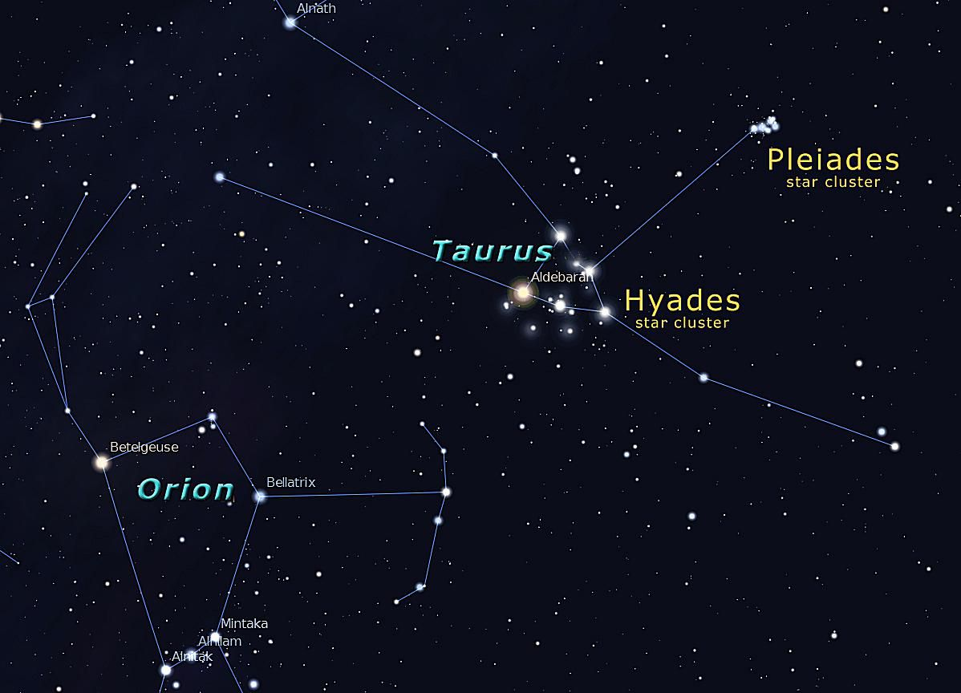
FLASHBACK
“People organize to make sense of equivocal inputs and enact this sense back into the world to make it more orderly” - (Weick 2005)
FOR EXAMPLE: ancient astronomers imposed “constellations” on star observations so they could represent and communicate about them
LASCAUX CAVE PAINTINGS
WINTER SKY, NORTHERN HEMISPHERE

Slide 16
The Classical Modeling Approach
enact this sense back into the world
16

Slide 17
Physical Modeling for Analysis - 1
Models of things as they currently exist are Physical or As-Is models
This modeling activity is usually called "systems analysis" or simply "analysis"
A basic task of modeling for analysis is capturing the languages and practices of the people who work with the resources in the "real world"
17

Slide 18
Physical Modeling for Analysis - 2
Any system (especially business and other institutional ones) has groups of stakeholders who do not fully understand the "big picture“
An analysis model can be used to prevent or repair their misunderstandings
A physical model synthesizes different views or observations into a more complete or generic perspective that accurately accounts for all of them
18

Slide 19
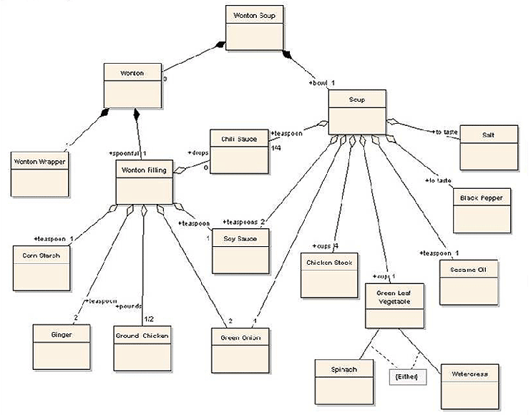
Physical View of Wonton Soup
19

Slide 20
Conceptual Modeling for (Re-)Design - 1
The next purpose of modeling is to assist in the design or re-design of a system or set of resources
This modeling activity is usually called "systems design" or simply "design"
Models of resources as they could be are Conceptual or To-Be models
A conceptual model abstracts away or generalizes from the technology and implementation details
20

Slide 21
Another Modeling Gap
There is always a gap between a physical model and a conceptual model, because a conceptual model is most useful when it isn't tied to specific or currently feasible implementations or technologies
21

Slide 22
Conceptual Modeling for (Re-)Design - 2
When technologies change, the implementation model may change but the conceptual model won't
When implementations in different technologies are based on the same conceptual models, they can more readily understood because of their common conceptual components
➔ ARCHITECTURAL THINKING
22

Slide 23
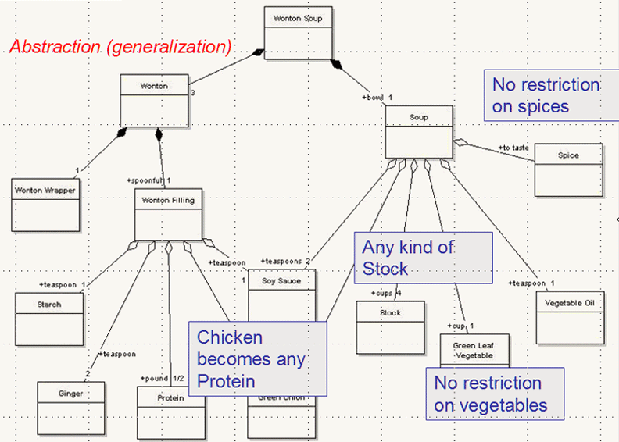
Conceptual View of Wonton Soup
23

Slide 24
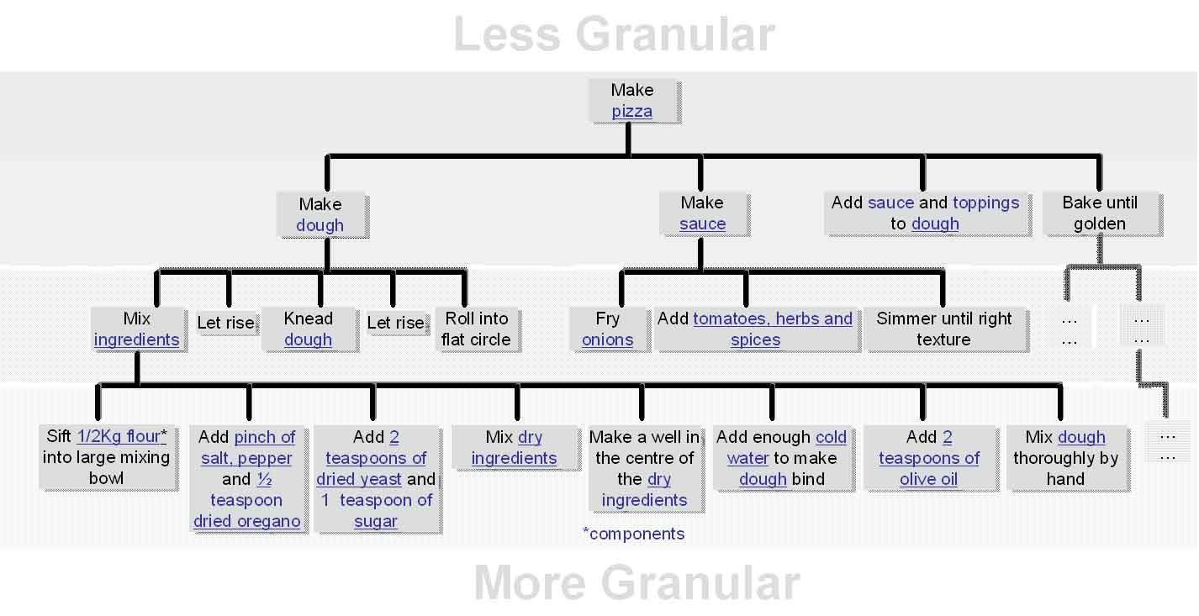

Slide 25
A Less Granular Model
Do the differences between the two models make them suitable for different purposes?

Slide 26
The Least Granular Model

Slide 27
Implementing a Conceptual Model as a Physical One
A model is purely theoretical until it is encoded in a technology that lets it operate in the real world again
When resources implemented in different technologies are generated or re-generated from models, they can more readily interoperate because of their common conceptual components
27

Slide 28
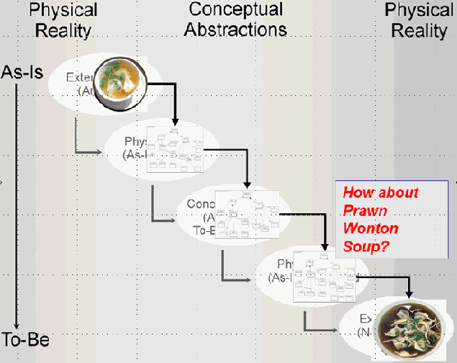
Applying the Conceptual Model
28

Slide 29
Adapting the Classical Modeling Approach to TDO – 1
In an Organizing System context we can analyze a domain and analyze its resources and their processes or behaviors as we normally would
But taking an architectural perspective that distinguishes organizing principles from implementation means that we emphasize the information or intangible content of the resources
29

Slide 30
Adapting the Classical Modeling Approach to TDO – 2
In some Organizing System contexts we start with a set of resources to organize
So we analyze the domain and the resources to determine appropriate properties to use in descriptions and organizing principles as we would in any other modeling activity
But sometimes we concurrently design the Organizing System and the resources it will contain
30

Slide 32
Plan for the Course
We can analyze sensemaking and organizing from four interrelated perspectives:
As a member of a social, cultural, or language community (linguistics, sociology, social network analysis)
As an individual (psychology and philosophy)
In institutional contexts (law and business)
In data-intensive or scientific contexts (statistics, computer science, info visualization).

Slide 33
Cultural Categories
We use tens of thousands of categories that are embodied in our culture and language
… oops, we haven’t defined “culture”
33

Slide 34
Some Definitions of “Culture”
the customary beliefs, social forms, and material traits shared by a group of people in a place or time (culture in the world?)
whatever someone has to know or believe in order to operate in a manner acceptable to other members of a group they belong to (culture in the mind?)
whatever knowledge or beliefs other groups have that prevents them from seeing the world objectively and “correctly” – the way we do (is culture defined relatively?)
34

Slide 35
Culture as a “System of Meaning”
Culture is not chaotic or random … it is a SYSTEM (of systems…)
This system determines what sorts of things or events need to be attended to and explained
It established complex interrelated beliefs and behaviors to create a “system of meaning” about those things and events
35

Slide 36
Culture as a “System of Meaning”
What are some examples of the systems of meaning that make up a culture?
How can we best identify and understand the organizing principles for these systems of meaning?
36

Slide 37
Cultural Categories
We use tens of thousands of categories that are embodied in our culture and language
They develop slowly and typically change slowly
Many have a perceptual or sensorimotor origin based on natural boundaries or discontinuities in perception and experience
Learned implicitly through development via parent-child interactions, language, and experience
Informal and contextual acquisition makes cultural categories flexible, creative, generative
37

Slide 38
Cultural Categories
When properties or behaviors co-occur in predictable ways, it is useful to have category words that name them => emergence of language
Formal education can teach cultural categories but the non-formal mechanisms often dominate or interfere
Cultures in which formal education is absent or uncommon are laboratories for the study of “intuitive” or “folk” cognition
38

Slide 39
Natural / Basic-Level Categories

Slide 40
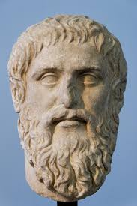
“One of the most basic functions of all organisms is the cutting up of the environment into classifications by which nonidentical stimuli can be treated as equivalent.”
Rosch, E., et al. (1976). Basic Objects in Natural Categories
I think you should have said
“carved up” and given me some credit
- Plato

Slide 41
Categories are “Equivalence Classes”
This almost never means that every instance of the category is identical
It only means that for some purpose we treat them in the same way
And it means that for different purposes we might change the size of the equivalence class (e.g., to trade Recall for Precision)
41

Slide 42
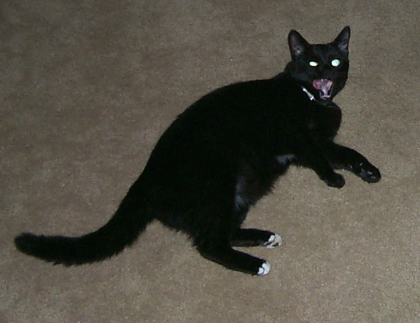
Category Hierarchies
Categories can be organized into a hierarchy from the most general to the most specific
My cat can be described as
An animal
A mammal
A cat
An American Shorthair
Boris
42

Slide 43
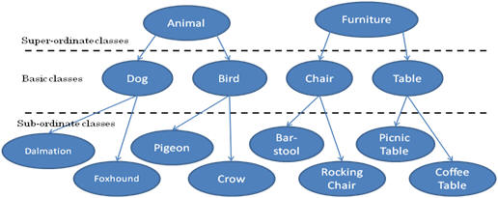
Three-Level Category Hierarchy

Slide 44
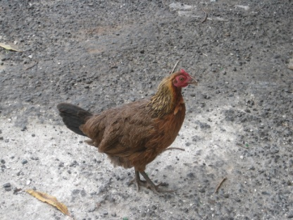
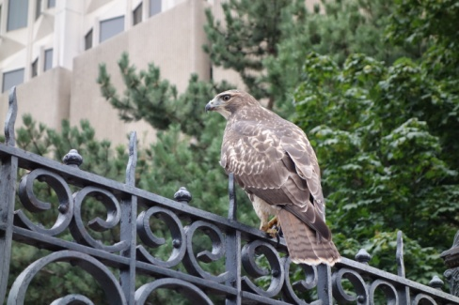
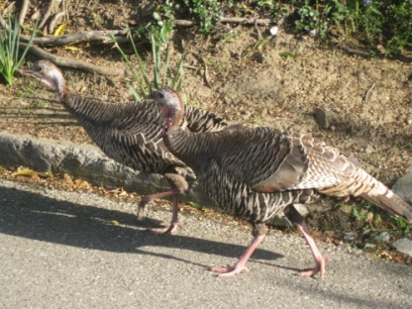
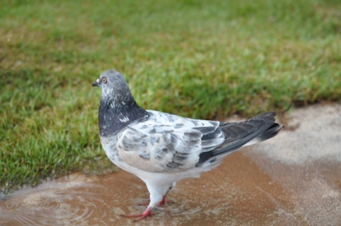
Basic-Level Categories: What
Members tend to have the same shape
They tend to "share parts"
The same motor movements are involved in interacting with them
44

Slide 45
Basic-Level Categories: Why
“The world is structured because real-world attributes do not occur independently of each other”
“Combinations of attributes of real objects do not occur uniformly. Some pairs, triples, or n-tuples are quite probable, appearing in combination sometimes with one, sometimes another attribute; others are rare; others logically cannot or empirically do not occur.”
Basic objects (e.g., bird, chair) are at the level at which there are attributes common to all or most members of the category

Slide 46
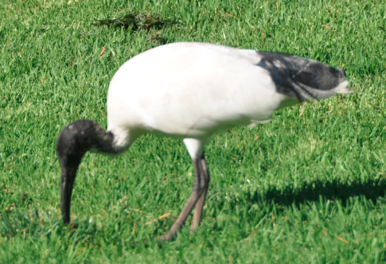
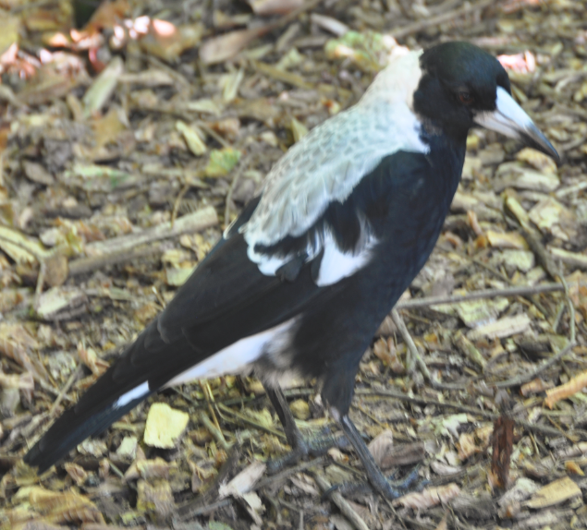
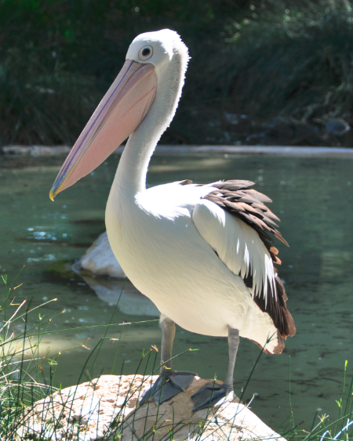
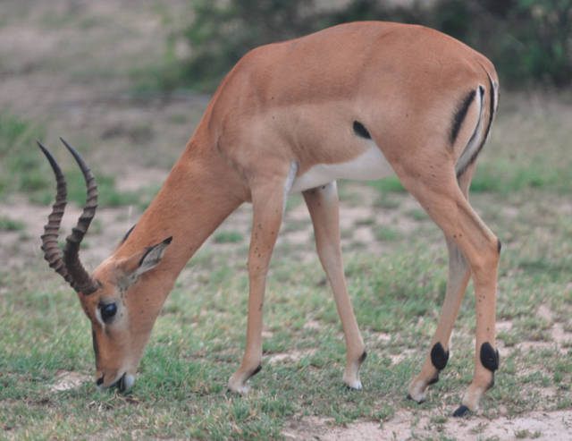
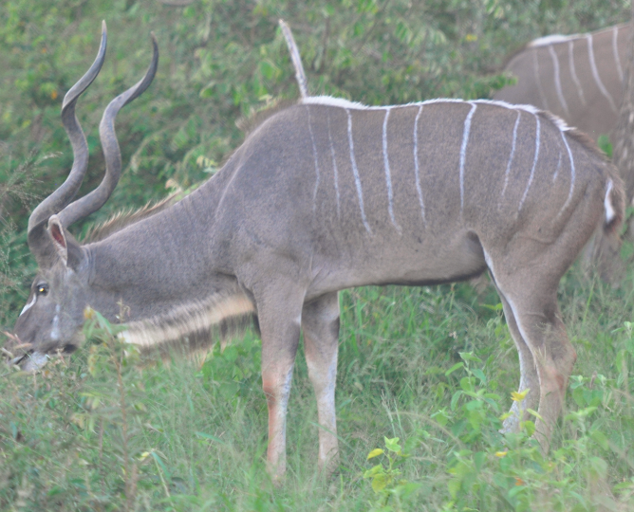
FLASHBACK
Shared Visible Features Carve These Animals into Two Categories

Slide 48
Tradeoffs in Abstraction and Granularity
The abstraction level we choose determines how precisely we identify resources. When we want to make a general claim, or communicate that the scope of our interest is broad, we use superordinate categories
As we go down in the category hierarchy, the categories have fewer members, so we can refer more precisely
48

Slide 49
The Precision-Simplicity Tradeoff
Precise (very granular) categories enable efficient communication – if every distinguishable color had its own name, “color talk” would be very concise
But this large set of color categories would not be as simple and easy to learn, remember, and use as one with a small set of color terms
The semantic systems in natural languages tend to achieve a near-optimal tradeoff between these two constraints
(Regier, Kemp, and Kay 2015)
49

Slide 50
Basic Categories and Language Use
Let the animal out
Let the mammal out
Let the cat out
Let the American Shorthair out
Let Boris out
50

Slide 51
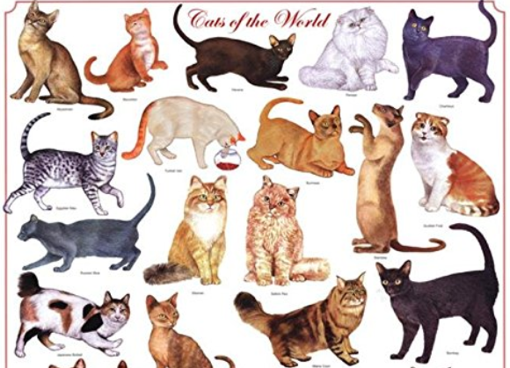
But Not in this Context

Slide 52
Language {and,or,vs.} Thought
What is the relationship between language and thought?
Universalist view: Languages are built on a universal cognitive and conceptual foundation that they use differently
Relativist view: Languages create categories that shape perception, causing speakers of different languages to conceptualize the world in fundamentally different ways
Reconciliation? Universal conceptual basis for the categorical distinctions that languages make, but that this conceptual foundation may be altered by language and culture
52

Slide 53
Linguistic Relativity
Languages differ a great deal in the words they contain (which concepts are lexicalized)
They also differ in more fundamental ways by requiring speakers or writers to attend to details about the world or aspects of experience that another language allows them to ignore
Does this mean that people can't understand concepts that are not lexicalized?

Slide 54
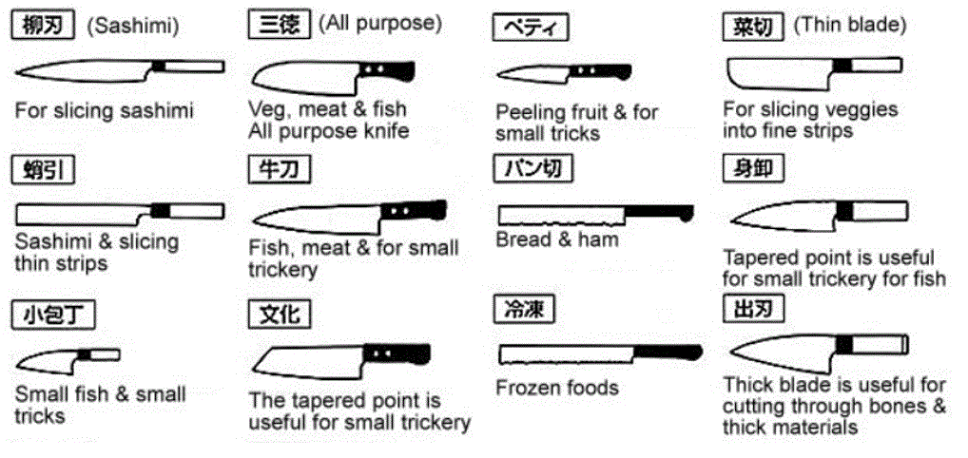
Japanese Kitchen Knives
Does your language have different words for each of these kinds of knives? If it doesn’t can you still distinguish them?

Slide 55
Alternative: Linguistic Relativity & the Whorfian Hypothesis
Benjamin Whorf (mid 20th century) is widely credited and miscredited with the strong form of the hypothesis that "language shapes thought" - that the categories embodied in languages shape or even constrain how people perceive and understand the world
Popular argument: Eskimos have lots of words for different kinds of snow, so they think about snow differently than native speakers of other languages
55

Slide 56
Hinting at Linguistic Relativity in Iceland Advertisement

Slide 57
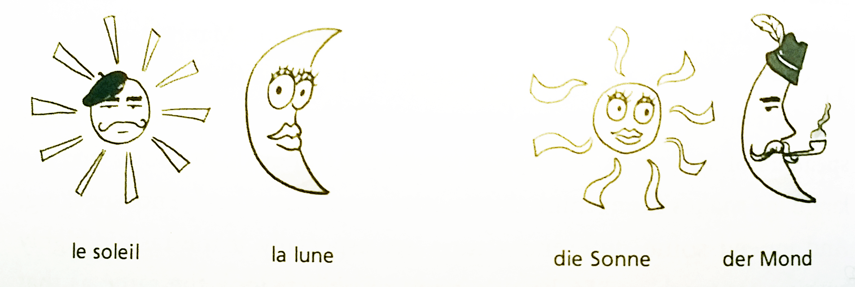
“Weak” Linguistic Relativity is Real
In languages in which nouns have gender, people associate gender-specific characteristics
English marks verb tense, Russian marks both tense and gender; Turkish marks verbs according to whether the speaker has first hand knowledge of the act
French: Sun is M, Moon is F
German: Sun is F, Moon is M

Slide 58
“Culture” is More Important than Language
English-speaking Americans “on the left” and “on the right” use the same words but with very different meanings
Marriage, freedom, liberty, responsibility
They use different words to frame the same issues
“Pro-life” vs. “Pro-choice”, “Spending” vs. Stimulus”, “Estate tax” vs. “Death tax”
58

Slide 59
Concluding Thoughts
Informal and contextual acquisition makes cultural categories flexible, creative, generative, and biased
Naming and vocabulary use is complicated and contentious
Most of our ordinary conceptual system is more metaphorical than literal
How can we ever understand each other?

Slide 61
Concepts You Should Know
Organizing system (not “organizational system”)
Resource
Intentional arrangement
Organizing principle
Generic
Domain-specific
Interactions
Generic
Domain-specific
“Organizing on the way in” vs. “Organizing on the way out”
“Thing” vs. “Type of thing” (Shamu question)
“Carving nature at the joints”
“Category thinking” vs. “Design thinking”

Slide 62
More Concepts You Should Know
Path dependence in selection
“Information IQ”
“Smart” resources
The paradox of Theseus
Identifiers vs. Names
The Vocabulary Problem
Polysemy vs. Synonymy
Curation vs. Governance
Persistence
Authenticity
Provenance
Effectivity

