Slide 1
CogSci 190
“Sensemaking and Organizing”
Spring 2019
Robert J. Glushko
glushko@berkeley.edu
19 February 2019
9) Resource Description

Slide 2
An Introduction to
Resource Description
What is a resource description?
Why do we describe resources?
What resource properties should be described?
How are resource descriptions created?
What makes a good resource description?
2

Slide 3

What is a Resource Description?
Information that is created intentionally and associated with a resource to enable it to be organized and interacted with
Structured descriptions of information resources are often called “metadata” (“data about data”) but… ☹
3

Slide 4
Let Me Say it Another Way
Resource description and organizing are intrinsically connected
You can’t organize what you haven’t described implicitly or explicitly.. because the principles embodied in any organizing system reflect decisions about what resource descriptions to use

Slide 5

A Resource

Slide 6
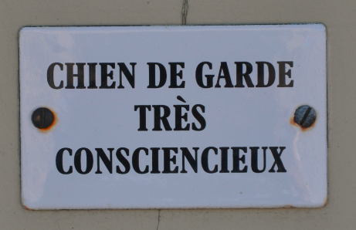
Metadog, not Metadata
dans Les Baux-de-Provence, 8 Août 2013

Slide 7
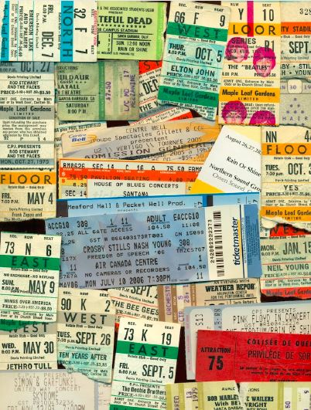
Concert Ticket:
A Resource Composed of Resource Descriptions
FLASHBACK
The distinction between resource and resource description is sometimes subtle and arbitrary
7

Slide 8
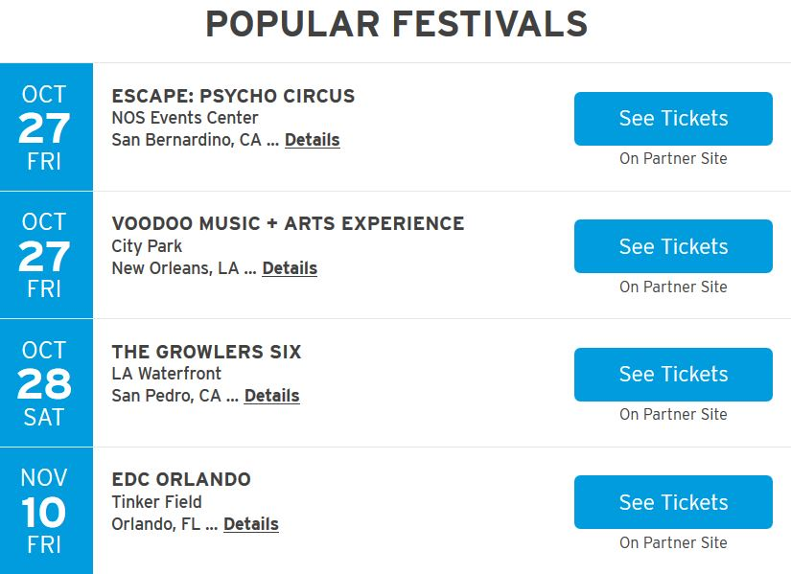
Concert Calendar: A Resource Composed of Resource Descriptions
FLASHBACK
A resource description is also a resource from the perspective of any other resource that uses it, ad infinitum (TDO 4.2.4, 4.2.5)
Ticketmaster Festival Guide 23 October 2017
8

Slide 9
Why We Describe Resources
We describe resources so we can refer to them, select them, organize them, interact with them (especially to compare them), and maintain them
Each purpose might require different descriptions and different methods of using them
Different resource domains can have characteristic or standard resource descriptions (or description categories)
9

Slide 10
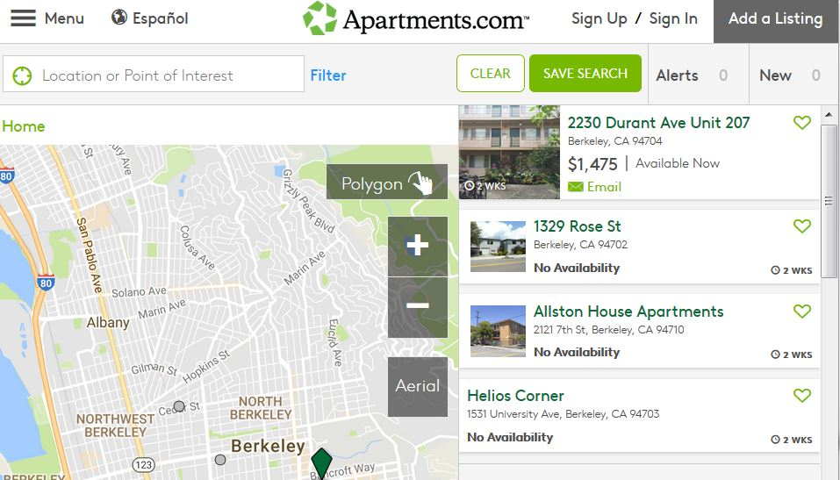
Resource Descriptions as Substitutes
A resource description is often a functional substitute for the resource it describes when the latter can’t be accessed or used easily
Digital descriptions of physical resources enable interactions that are otherwise impossible
10

Slide 11
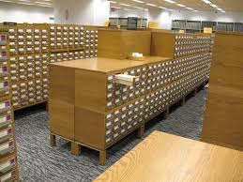
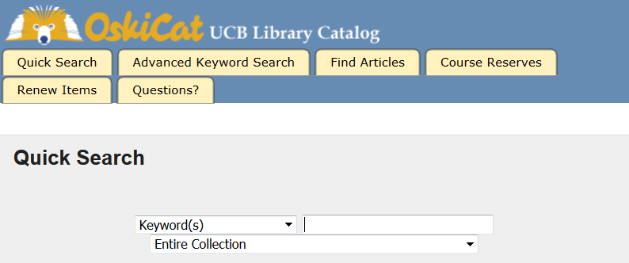
Two Collections of the Same Resource Descriptions

Slide 12

Selection Criteria
Utility for some specific purpose
Intrinsic value
Scarcity or uniqueness
Newest
To establish a brand or reputation
…
FITNESS FOR USE
12

Slide 13
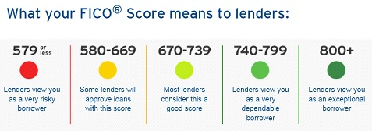
Computational Descriptions of People
A great deal of data is collected about people and is then used to make predictions about their future behavior
This data drives “predictive analytics” techniques that determine whether to give you credit, to hire / fire / promote you, to arrest / sentence you, to change your diet or exercise routine, or which resources to show you on Google, Facebook, Twitter, Amazon, etc.
13

Slide 14
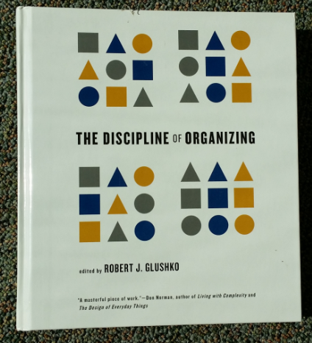
Describing the Information
<Book>
<Title>The Discipline of Organizing</Title>
<Editor>Robert J. Glushko</Editor>
<Publisher>MIT Press</Publisher>
<PublicationDate>2013</PublicationDate>
<ISBN>978-0-262-51850</ISBN>
<Keyword>Classification</Keyword>
<Keyword>Resource Description</Keyword>
</Book>
Describing the Thing
<Book>
<Weight unit=“pound”>2.58</Weight>
<Height unit=“inch”>9.25</Height>
<Width unit=“inch”>8.25</Width>
<Pages>540</Pages>
<SpineColor>White</SpineColor>
</Book>
14

Slide 15

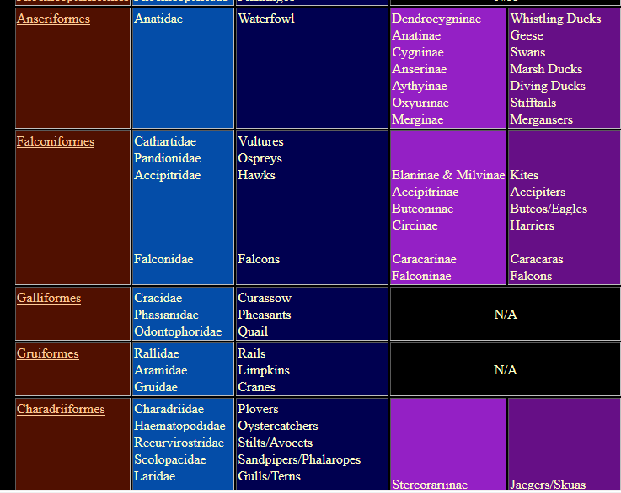
Organizing Birds for Scientists
15

Slide 16
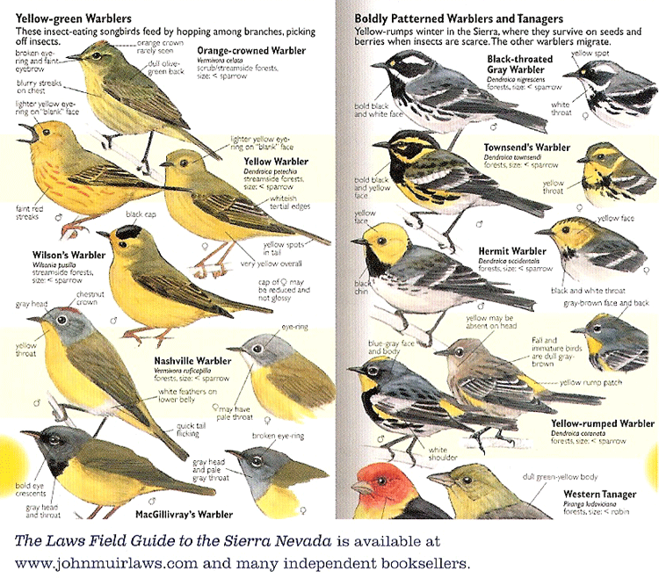
Organizing Birds for Birdwatchers
16

Slide 17
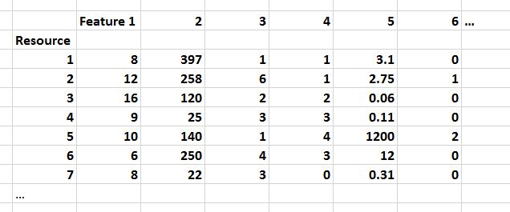
In data science, resource descriptions are typically called “properties” or “features” in a dataset like this…

Slide 18

Process of Describing Resources
(TDO 5.3)
Identify / scope the resources to be described
Determine the uses of the descriptions
Study the resource(s) to identify descriptive properties
Design the description vocabulary
Design the description form and implementation
Create the descriptions (either "by hand" or by some automated / computational process
Evaluate the descriptions
18

Slide 19
What is a Resource?
When you look at, refer to, or pick up a natural physical object, it usually seems that it is "one thing"
But many things have highly visible parts or internal structures, and we must consider whether to treat them as assemblies or aggregations of these separate things
For digital and computational resources, it is much harder to know how many parts we can or should identify
19

Slide 20
Scoping and Description
How explicit and thorough these 7 steps need to be depends on what we are calling "scope“
Do we know who the users are?
Are the describers the users?
Do we have all the resources, a representative set, or just the first set ... do we know what else is coming?
20

Slide 21

Description is Challenging!
People use different words for the same things, and the same words for different things (TDO 4.4)
Describing and organizing always (explicitly or implicitly) takes place in some context
The context shapes which resource properties are important and the organizing principles that use those properties
21

Slide 22

Describe This Resource

Slide 23


Slide 24


Slide 25


Slide 26
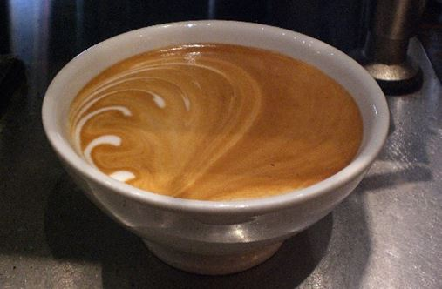

Slide 27


Slide 28


Slide 29
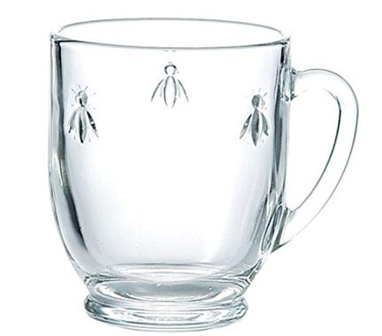

Slide 30
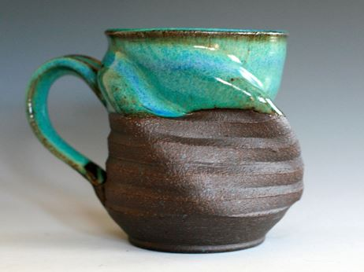

Slide 31
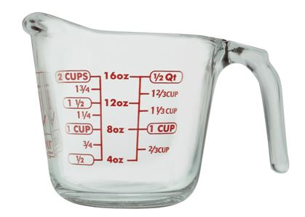

Slide 32


Slide 33
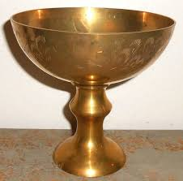

Slide 34


Slide 35


Slide 36


Slide 37
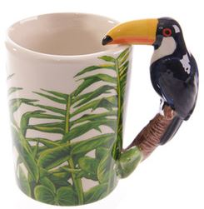

Slide 38
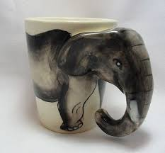

Slide 39


Slide 40
Possible Features
Exterior color
Interior color
Exterior finish
Interior finish
Category name
Capacity
Weight
Material of manufacture
Size
Shape

Slide 41
Possible Features
Primary use
Other use(s)
Current contents
Previous contents
Reusable?
Stackable?
Nestable?
Transparent?
Insulated?
Decorated?
Branded?
# of Spouts
Stem?
Lid?
Measurement marks?

Slide 42
Possible Features
Manufacturer name
Process of manufacture
Place of manufacture
Date of manufacture
Vendor name
Vendor location
Unit price
Bulk price
Previous unit price(s)
Previous bulk price(s)

Slide 43
Possible Features
Current location
Previous location(s)
Current user
Previous user(s)
Date of first use
Date of most recent use

Slide 44
Possible Features
Handle?
#of Handles
Handle material
Integrated handle?
Separate handle?
Decorative handle?
Animal handle?
Bird handle?
Toucan handle?
Fish handle?
Lizard handle?

Slide 45
If this is all you’re given, give up!

Slide 46
Resource Description Concerns for Data Scientists
Is the dataset relevant to the questions you’re asking?
  Do you understand the descriptions and their values?
  Are the values accurate? Stable? Current?
  Are they human-interpretable?
  Did the people who designed or created them understand them in the same way?
    Levels of measurement, granularity / precision, open vs. controlled vocabularies
    Did they have the same purposes/interactions in mind?
46

Slide 47
Designing the Description Vocabulary
  Good descriptions use terms that their intended users might use
  Good descriptions don't contain details that aren't necessary
  Good descriptions are created systematically and follow standards
What if these three design principles suggest incompatible vocabularies?
47

Slide 48

Creating Resource Descriptions
  By professionals: "Institutional" descriptions that follow standards
  By authors: Best knowledge of purpose and intended audience
  By users: Most variable, influenced by social purposes
  By automated processes: Most reliable, primarily technical / objective properties but semantic description capability is emerging
48

Slide 49

A Painting Described by the Painter

Slide 50
Descriptive Precision
Writers, poets, painters, composers, sculptors, technical writers, programmers, producers, architects, designers, and devices or machines can all create resources
The Dublin Core vocabulary for describing web pages has a single property for indicating a “creator” (TDO 5.3.1.3)
  “Shakespeare” and “Hubble Telescope” are both “creators”
Easy to use, but this tradeoff loses a great deal of precision compared to larger and more controlled vocabularies

Slide 51
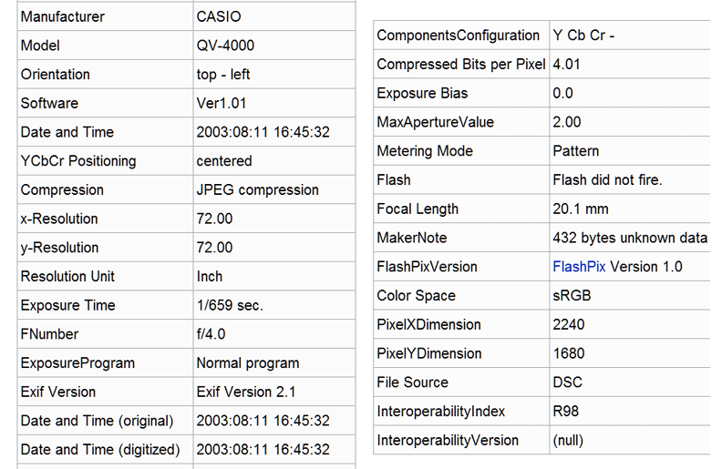
Human-Interpretable Automated Description by Digital Camera (EXIF)
51

Slide 52
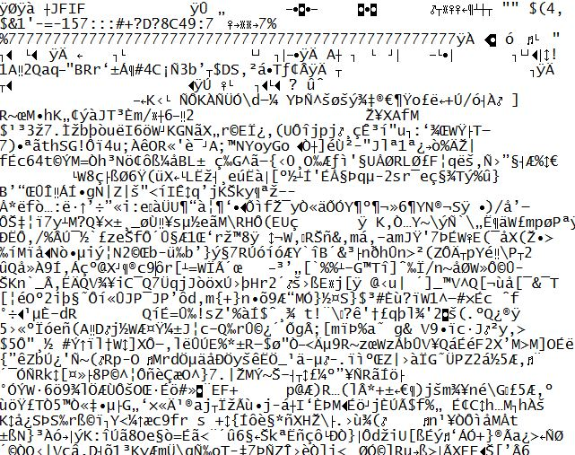
The Semantic Gap

Slide 53
Classifying Resource Properties

Slide 54
Intrinsic Properties
Intrinsic properties are inherent in a resource
Some are static, never changing their values
Others are dynamic, but they change “from the inside of the resource” not “from the outside” by actions or efforts of outside agents (like “developmental” properties – age, skill, experience)
Intrinsic properties can sometimes be used as an identifier - like a computed "signature" for a document or media object
54

Slide 55

Distinctive Physical Properties
55

Slide 56



Picture and Icon Signs as Resource Descriptions

Slide 57
Physical Properties
– Some Complications
For "manmade" things surface properties are less predictable ("innovation" enables the separation of form and function)
For "information" things in physical form the correlation between appearance and content varies across the Document Type Spectrum
For "born digital" resources the appearance is often extrinsic because it is assigned or associated (a style sheet, for example) instead of being an inherent part of the resource when it was created
57

Slide 58
Extrinsic Properties
Extrinsic properties are assigned to a resource rather than being inherent in it
Some extrinsic properties are static: assigned names or identifiers don’t usually change
Other extrinsic properties change often
Extrinsic properties differ in their "decay" functions, rate of change… a lot of data science is figuring out the function that relates the value of some resource property over time (examples?)
58

Slide 59
Cultural Properties
Cultural properties are those that derive from conventional language use or culture and often involve analogy
Because they derive from knowledge of culture or language, they might be unintelligible to people who don't have the same perspective and experience
.. and they might lose their cultural salience
Flapper, Greaser, Groovy, Bollywood, Grunge
One percenter
Light saber
59

Slide 60

“Holbein” Carpets
Anatolian Carpet,
16th Century
The Ambassadors, 1553
A
Anatolian Carpet,
16th Century

Slide 61
Contextual Properties
Contextual properties relate to the situation or context in which the thing being described exists
Location, time, activity, other people or things present are basic context descriptors, but there are many more
Since context changes, context-based descriptors might be appropriate when assigned but not later; see "persistence" and "effectivity“ (TDO 4.5.1, 4.5.2)
61

Slide 62
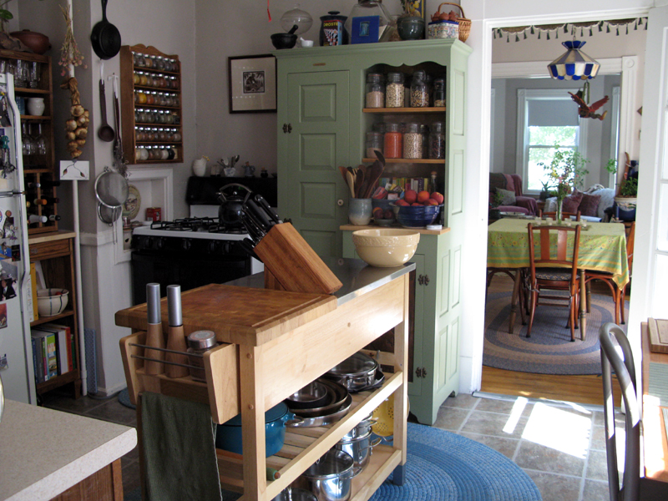
Organizing System: Home Kitchen
Photo by Emilie Hardman (http://www.flickr.com/photos/quintanaroo/2741672230//) Used by permission
62

Slide 63
Properties & Principles for
Organizing System of a Kitchen
  Intrinsic static properties: If you store your pots, frying pans, and baking pans and nest each set by size
  Extrinsic static properties: A spice rack with the spices arranged in alphabetical order
  Intrinsic dynamic properties if you arrange your milk and other perishable goods by expiration date, a “useful life remaining” property that decreases to zero as the expiration date approaches
  Extrinsic dynamic properties if you put the most frequently used condiments or spices in the front of a refrigerator or pantry shelf
63

Slide 64
Properties & Principles for a
Document Organizing System
  Intrinsic static properties: Author, date published, words in the text
  Extrinsic static properties: ISBN, LOC Classifications
  Intrinsic dynamic properties: Effectivity (e.g., laws and regulations)
  Extrinsic dynamic properties: Links/citations to and from other documents
64

Slide 65

Evaluating
Resource Descriptions
  Quality should be evaluated with respect to intended purposes... but what if different stakeholders have different purposes?
  Creating resource descriptions can be costly; is it worth it? How and when measure the costs?
  Computational description is vastly less expensive, but is it good enough? What is the cost of less or little transparency in the features?
  How can we incent "community" or "crowdsourced" description to be of better quality?
65

Slide 66

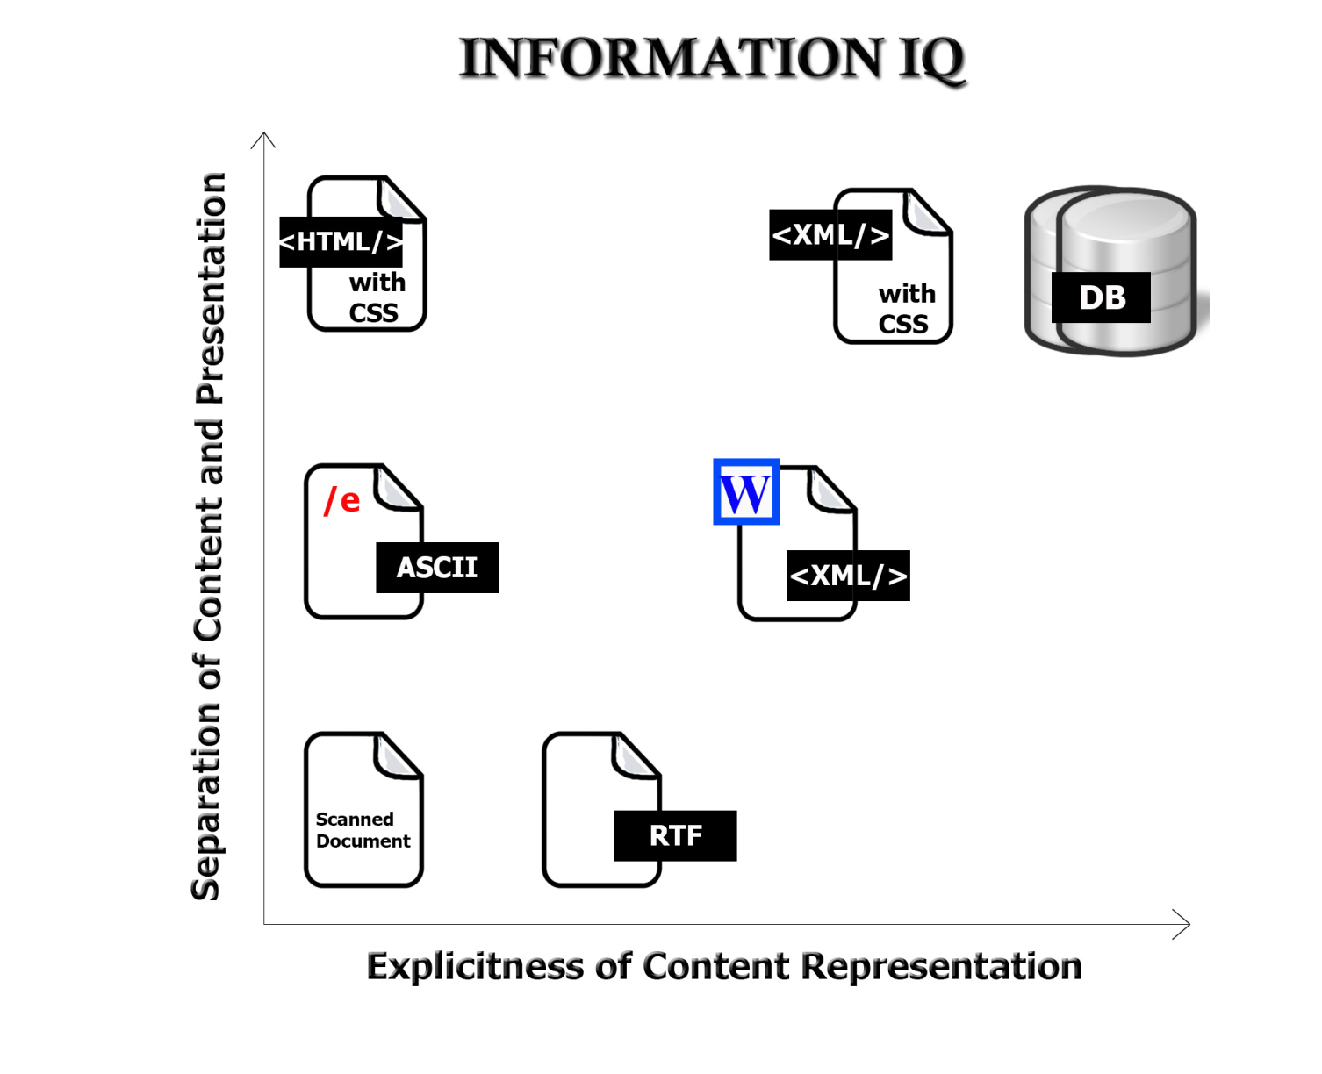
Description Form and Implementation: Format Matters!

Slide 67
Readings for Feb 21
Describing Non-Text Resources
Describing Non-Text Resources (TDO 5.4*)
Case studies
  Dabbawalas of Mumbai (12.16 in TDO book)
  What3Words
Music as an Organizing System: An Approach for Non-Musicians (Glushko & Freeman)
  (An improbable collaboration!)

Slide 68
Small Group Exercises

Slide 69
Name that App
…that tells you about interesting activities happening near you in the next few days
…for organizing and running a small online study group
…for creating and publicizing the inventory of items for an upcoming “garage sale”
…for managing information for planning and going on a long trip to Europe, South America, or someplace else for the first time
After every student has come up with a name, collect them to see if any two names are the same! Probably won’t be…

Slide 70
Describing Yourself
What are the 2 or 3 most important resource descriptions in each context?
  Applying to Berkeley
  Applying for a job
  Rushing a fraternity or sorority
  Looking for someone to date
  Looking for a roommate
  Applying for a loan or financial aid
  …
What other “contexts of description” have you been in?

Slide 71
Real Estate Advertisements
Real estate advertisements are notorious for their creatively optimistic descriptions; a house that is advertised as being “convenient to transportation” is most likely next to a busy highway or bus route, and a house in a “secluded location” is in a remote and desolate part of town
How would you describe the house or apartment or room where you live in a way that turns its negatives into positives?

Slide 72
Principles of Arrangement in
{a Clothing Store, …}
  Intrinsic static properties: …
  Extrinsic static properties: …
  Intrinsic dynamic properties: …
  Extrinsic dynamic properties: …
72

