Slide 1
CogSci 190 “Sensemaking and Organizing” Spring 2019
Robert J. Glushko glushko@berkeley.edu
21 February 2019 10) Describing Non-text Resources

Slide 2
Plan for Today’s Lecture
Introduction to Describing Non-text Resources
“Professional” Descriptions
“Contextual” Descriptions
Describing Music
2

Slide 3
Non-text Resources
Tangible Medium
Art, sculpture, physical designs
Audio (speech, music, sound)
Graphics and Images
“Moving” Images (video)
Multimedia -- Composed of more than one form of media
Time-based media -- Audio and video
3

Slide 4
The “Things” for Non-text Resources? (Granularity and Abstraction)
Songs and sound recordings
album, playlist, queue
cover, remake
mix, remix
sample, soundbite
Video
clip, snippet, still
broad-/narrow-/simul-/tele-/web-/pod- cast
4

Slide 5
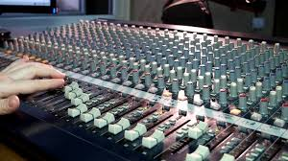
Audio Mixing

Slide 6
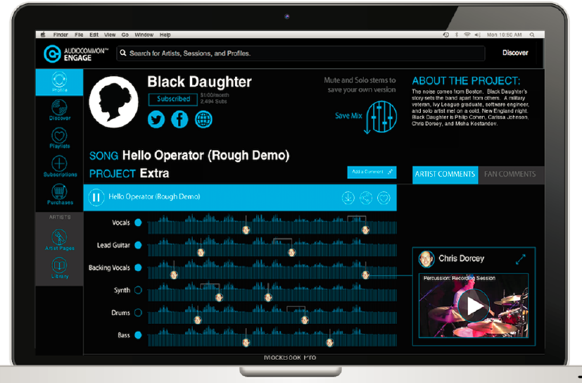
Combining Parts
Audiocommon’s user interface separates out various parts
of the song, from melody to bassline to vocals

Slide 7
Shazam, Midomi, and Shamu
Shazam – recognizes a specific piece of music using its unique “audio fingerprint”
Midomi (aka Soundhound) – identifies songs, but can do it from humming or whistling
Why is Shamu on this slide?
7

Slide 8
Shamu for Songs
If there are many different performances of “the same song” at what point does a variation become a different song?
Is one of these performances the exemplar or prototype of the song?
Or should we reject the idea that some specific performance is the exemplar and treat any “song” as a large category with many members

Slide 9
What's Different About Describing Multimedia?
Sensory Gap
Semantic Gap
Proliferation Problem
9

Slide 10
The Sensory Gap (1)

Slide 11
The Sensory Gap (2)
There is a gap between an object and a computer's ability to sense and describe the object
(it is getting a little easier with “deep learning” and convolutional neural networks)
An infinite number of different "signals“ can be produced by the same object
…And different objects can produce similar signals
How does our human perceptual machinery determine when different "signal patterns" are the same object or when similar patterns are different ones?
11

Slide 12
The Semantic Gap
Instruments, devices, and sensors encode data in formats that are optimized for efficient capture, storage, decoding, or other processing
What kind of information is typically encoded?
The representation of the object can't be (easily) processed to understand what the object "means"
So there is a semantic gap between the descriptions that people assign and those that can be assigned by automated mechanisms or that are otherwise built into the storage format
12

Slide 13
Luminosity Histogram

Slide 14
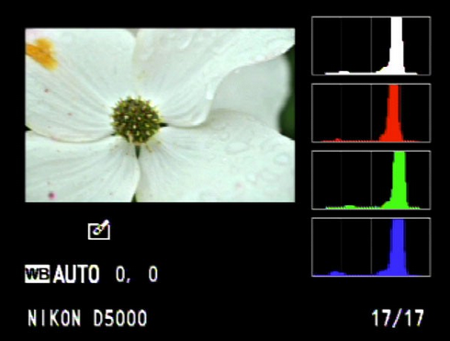
Color Histogram

Slide 15
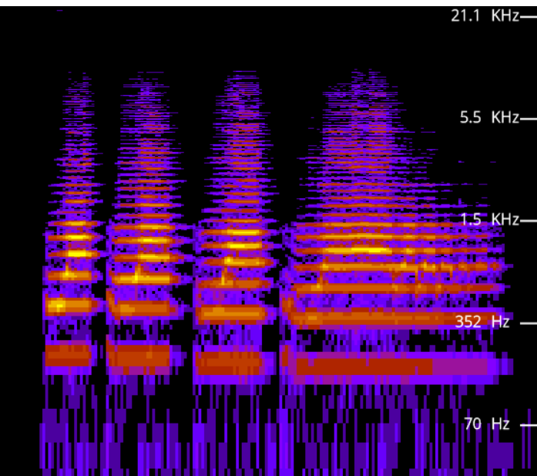
Spectogram
a visual representation of the spectrum of frequencies of a signal as it varies with time
https://academo.org/demos/spectrum-analyzer/

Slide 16
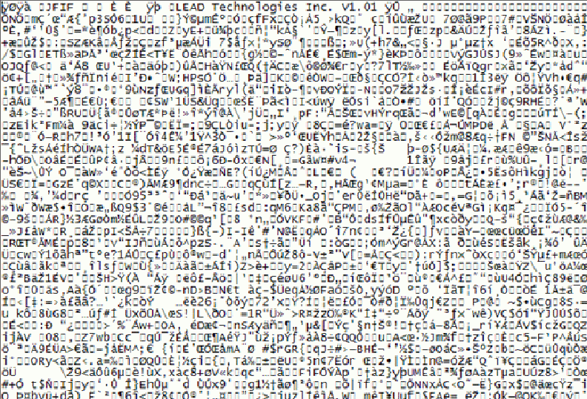
What’s this Picture About?

Slide 17
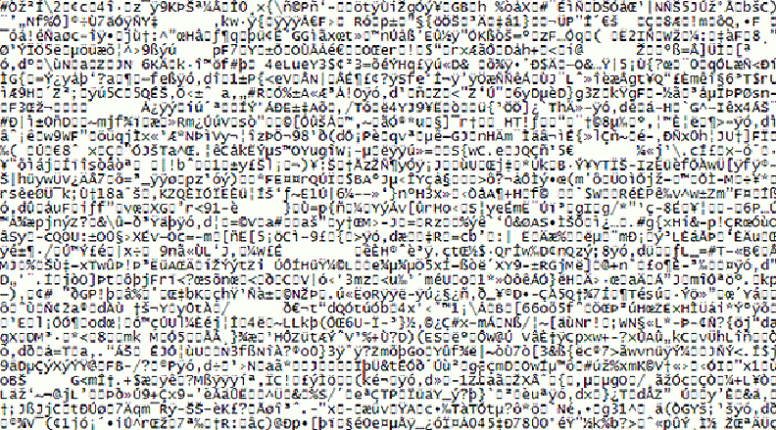
Name That Tune

Slide 18
Bridging the Semantic Gap, or Not?
Bridging the semantic gap means extracting features from non-text content and finding ways to infer semantic-level descriptions from them, even if those features are not interpretable
An image signature can be extracted from low-level features like color, shape, texture, and luminosity, and images are classified by computing the similarity between signatures
More recent deep learning approaches combine several layers of feature extractors to significantly improve object recognition
18

Slide 19
The Proliferation Problem
Digital cameras, video recorders, and smart phones have increased resolution and greater storage capacity every year
Non-professional consumers create very large collections of multimedia objects
The average object has less value and doesn't justify much effort to organize and describe it
These “objects” include audio or video “snippets” that can stand alone
19

Slide 20
Are these New Problems?
Museums face some of the same or similar problems in describing art works and artifacts:
There may be many artifacts that represent the same "work" - this is like the "sensory" gap
The materials or medium in which the artifact is embodied don't convey semantics "on their surface" - this is the semantic gap
There may be so many artifacts of a particular type that some get only limited descriptions - this is like the proliferation problem
20

Slide 21
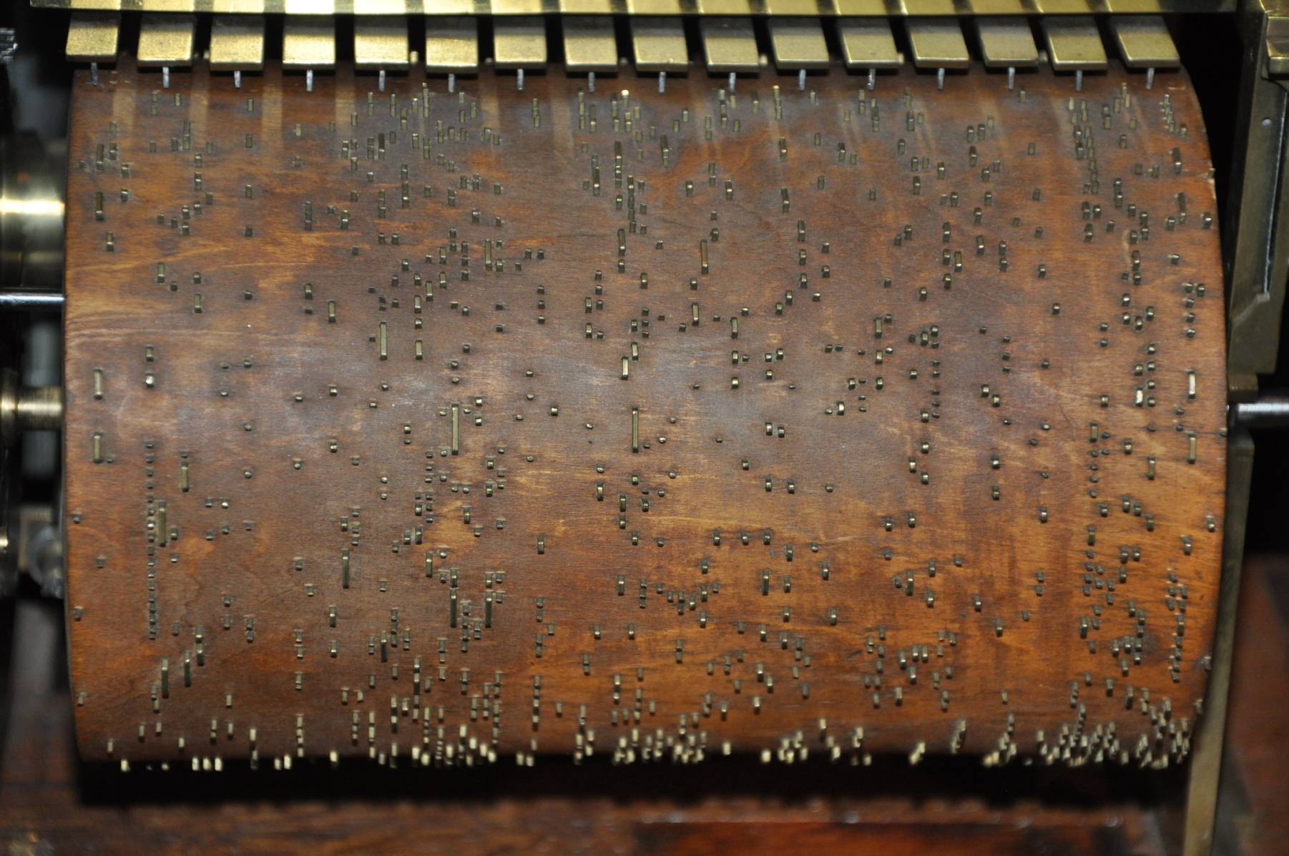
Name That Tune

Slide 22
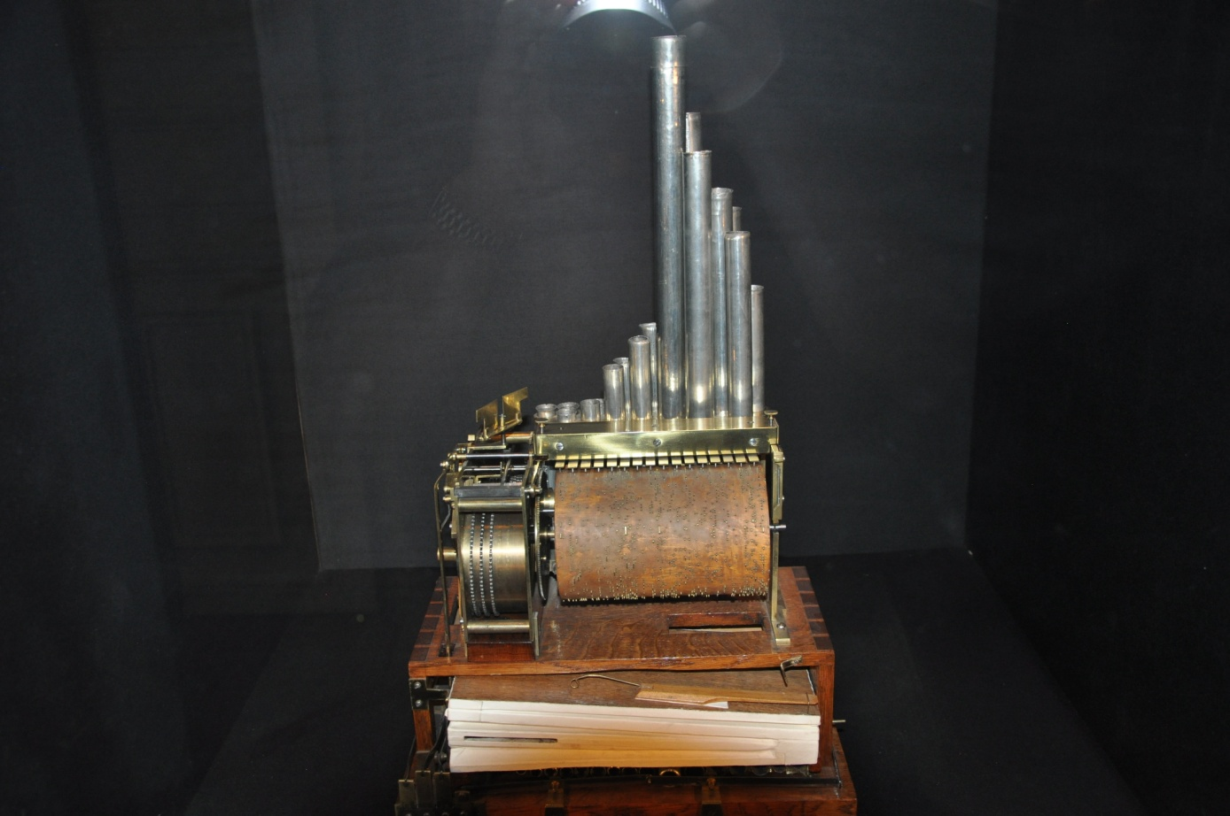
Music Box Controlled by Spoked Cylinder

Slide 23
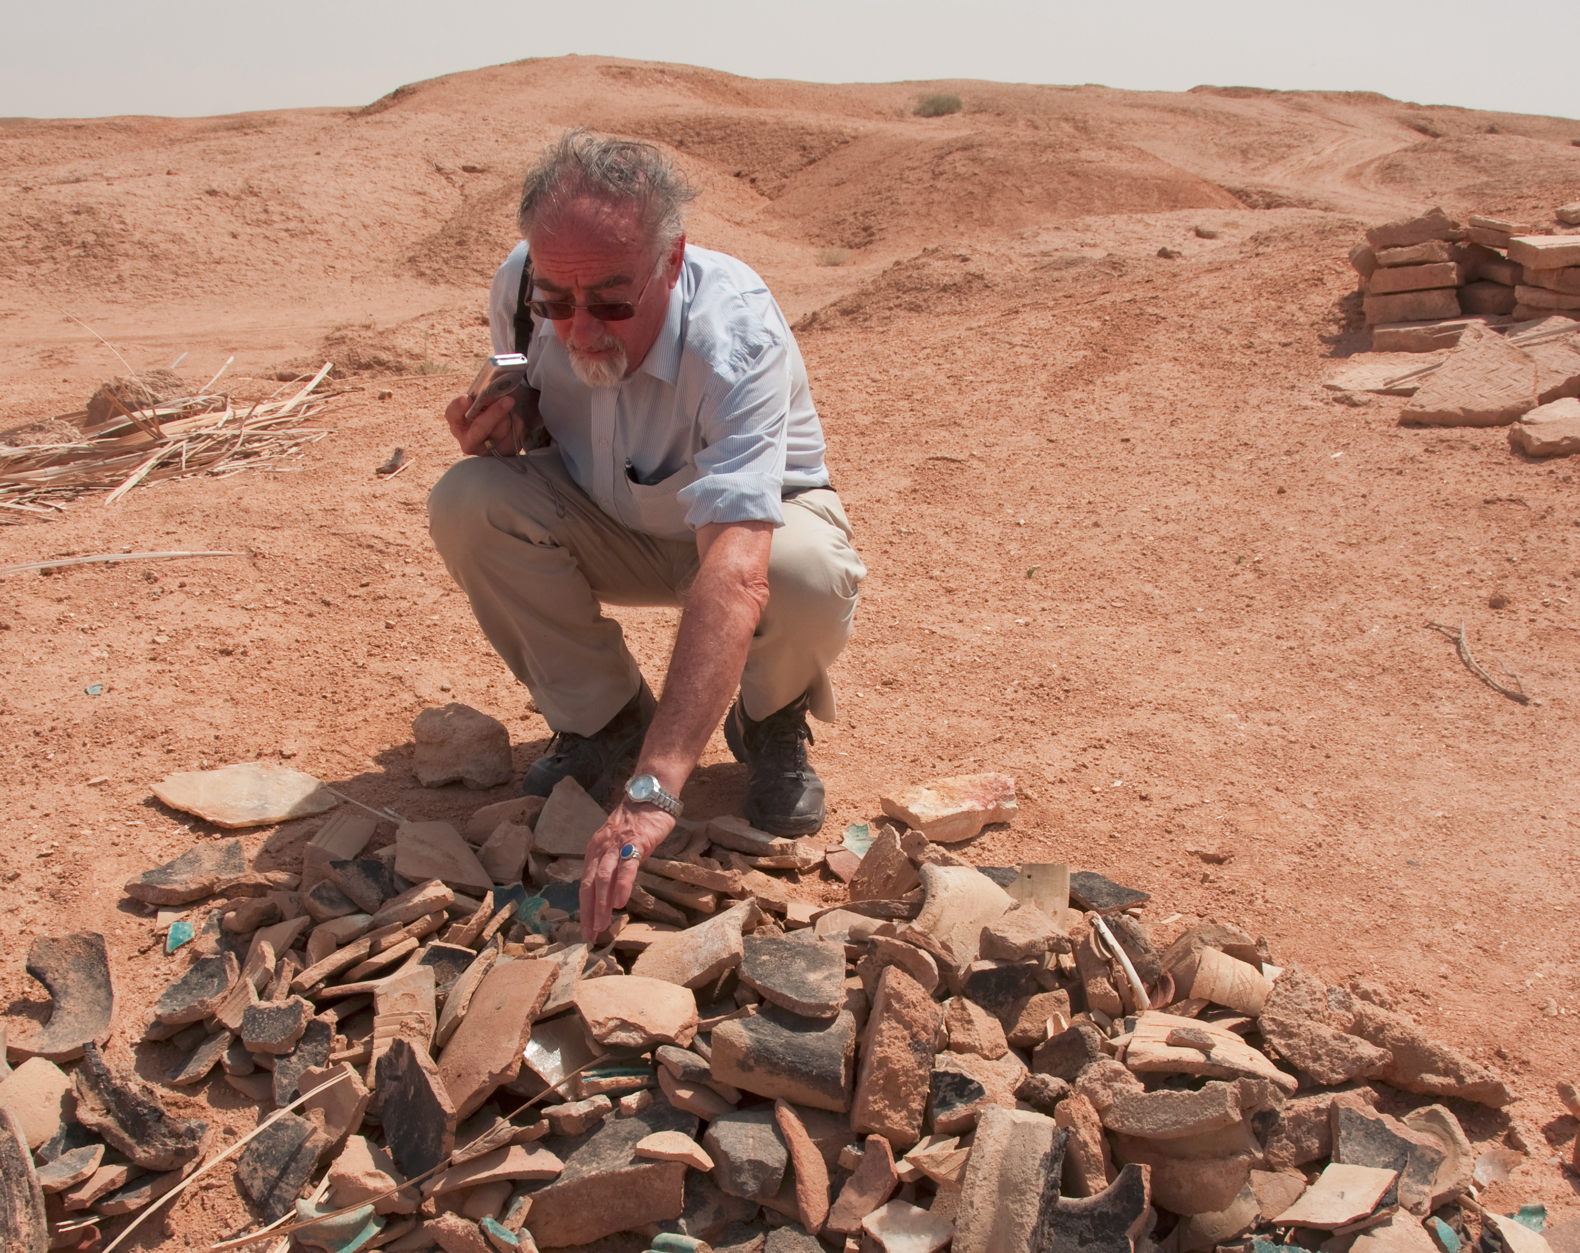
Too Many Pottery Shards

Slide 24
Some Problems May Be New
The temporal structure of music and video mandates new descriptive vocabulary and new ways to identify meaningful components
Music and video meet emotional/psychological needs that are more complex than those for “text documents" - so the descriptions of the latter have to be able to address these needs
People don't usually access or retrieve music or video "to satisfy information requirements”
24

Slide 25
Professional Descriptions for Non-text Resources

Slide 26
"Professional" Descriptions for Multimedia and Non-textual Works
Museum works and other non-text artifacts have long been described by professionals using structured resource descriptions according to classification rules
The descriptions are often "layered" beginning with accessible properties with more analytic descriptions added for those objects that warrant them
26

Slide 27
Layered Descriptions
Why do we need different levels of description?
Does every resource need them? For what kinds of works is it worth making this investment?
What kinds of people/skills are required to be work at each of these levels" -- and at what cost?

Slide 28
Panofsky's Three Levels of Meaning
Description ("Preiconographic“ or “Primary”)
Identification ("Iconographic“ or “Secondary”)
Interpretation ("Iconologic“)
28

Slide 29
Description / “Preiconographic” / Primary Level
The "primary" or "natural" subject matter of a work
“The kind of thing” - the generic elements or things depicted in, on, or by an object / image / art work
These would be recognizable by anyone, regardless of their expertise or training
29

Slide 30
Identification / “Iconographic” / Secondary Level
The (authoritative) name of the subject or thing depicted in the work
Can require research or fact assembly from sources of social and cultural knowledge
30

Slide 31
Interpretation / “Iconologic” Level
The meaning or theme represented by the subject matter or iconography of the work
This meaning is often symbolic, and deeply grounded in the culture in which the work was created
Done by domain and methodology experts
31

Slide 32
PRIMARY: Marble statue of nude woman standing on a seashell
SECONDARY: Statue made in 2005 by Lucio Carusi of Carrara, Italy, titled “Venus”, made of local marble
INTERPRETIVE: 3D transformation of 1486 painting by Italian painter Sandro Botticelli, titled “Birth of Venus.” Carusi’s Venus is substantially slimmer in proportions because of changing notions of female beauty
(TDO Figure 5.6)
Panovsky’s 3-Level Scheme
32

Slide 33
“Birth of Venus” Uffizi Gallery, Florence Italy

Slide 34
Getty Categories for the Description of Works of Art (CDWA)
The CDWA is a massive metadata schema with 532 elements and sub-elements
Each element typically has a controlled vocabulary or recommends one (e.g, Art and Architecture Thesaurus)
There is a core set of 36 elements
CDWA-Lite is the XML specification for another simple subset of CDWA
34

Slide 35
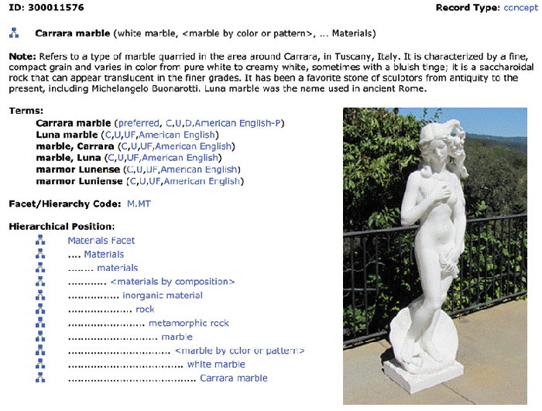
Art and Architecture Thesaurus
35

Slide 36
CDWA’s First Question
You should have been able to guess the first question raised in the CDWA documentation
Section 1.1 of the CDWA (the top level element) is “Object/Work”
Works of art or architecture may be considered a single item, or they may be made up of many physical parts or arranged in separate physical groupings. It is necessary to define the particular work of art, architecture, or group of objects in question, whether it be a single painted canvas or an altarpiece made up of many panels…
36

Slide 37
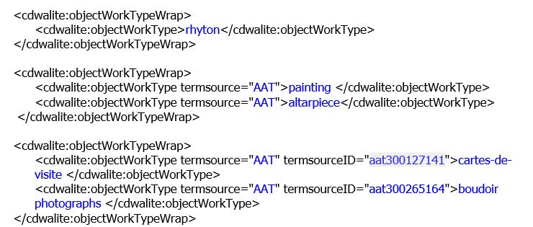
CDWA in XML – Examples of Progressively More Complete Descriptions
37

Slide 38
Can You Describe this Painting? At What Level(s)?
The painter
Not the only time this subject has been painted

Slide 39
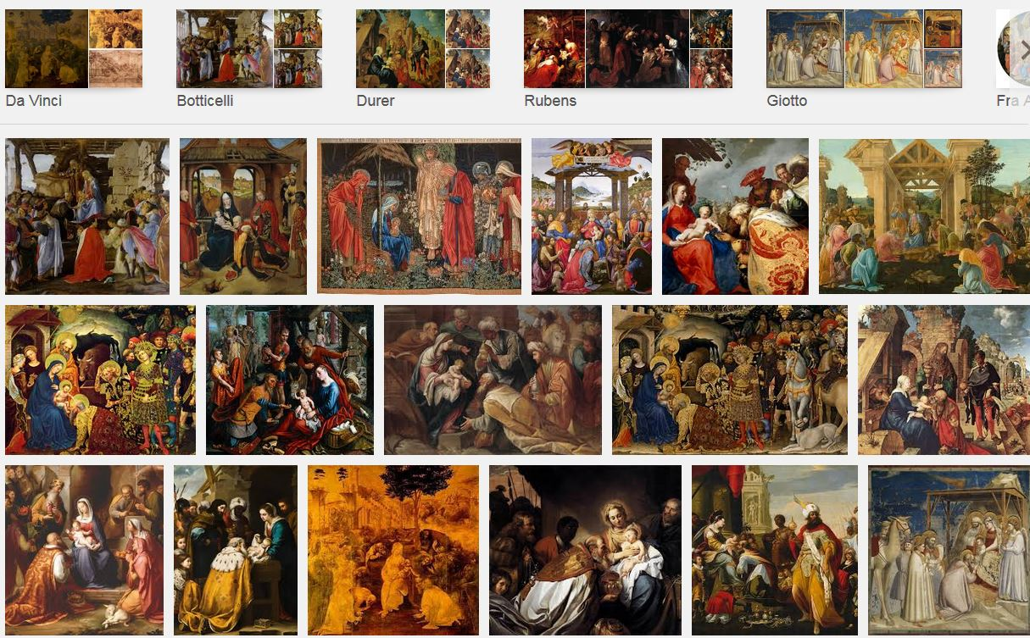
The Shamu Question for Paintings

Slide 40
“Contextual” Resource Description

Slide 41
Contextual Resource Description
Descriptions about the context in which some content was "captured"
Location, time, other people or things present are basic elements, but there are many more
This kind of information has often been collected, but not usually analyzed and applied to description until afterwards
41

Slide 42
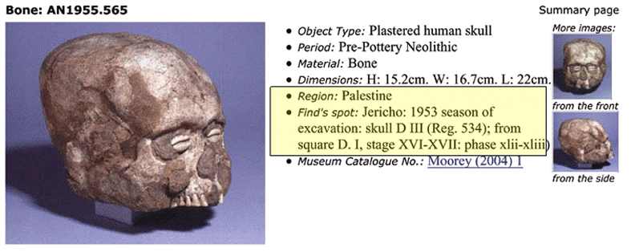
Non-Automated Contextual Description in Museum Catalog
42

Slide 43
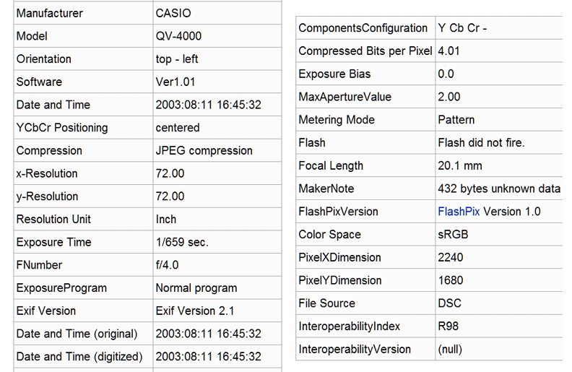
Automated Contextual Description in EXIF (Digital Camera)
43

Slide 44
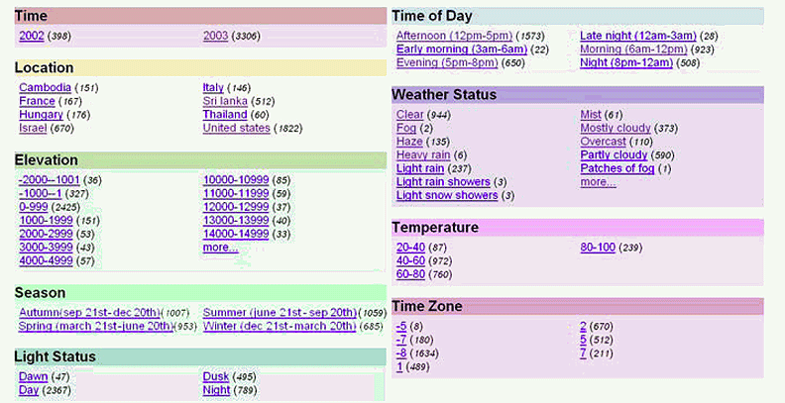
Augmenting EXIF (time) with Geo-Referenced Additional Resources
Naaman, Mor, et al. "Context data in geo-referenced digital photo collections.” 2004.
44

Slide 45
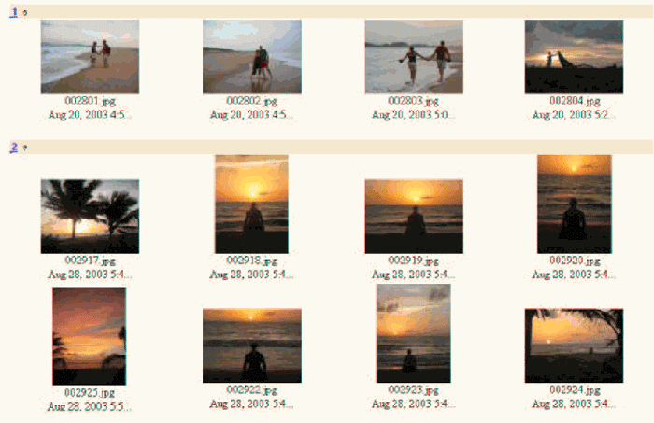
Using Contextual Metadata in Image Retrieval (Naaman et al)
45

Slide 46
Describing Music

Slide 47
Describing Music: Why
Flashback to FRBR – generic reasons for description: Finding, Identifying, Selecting, Obtaining, Exploring
Recommending tracks or artists we might like
Finding copyrighted music where it isn’t supposed to be…so music publishers and distributors can collect data that gets money to the people who deserve it
47

Slide 48
Types of Music Descriptions
The track – size, duration, bitrate, key, energy level, beats per minute
The medium– CD, cassette, vinyl
The format –
lossless: WAV, AIFF, FLAC, SNF...
lossy: MP3, WMA...
Who made it, and how it was made - who composed it, who performed on it, what instruments were used, who recorded it
How it relates to other music
What it sounds like, how it makes you feel
48

Slide 49
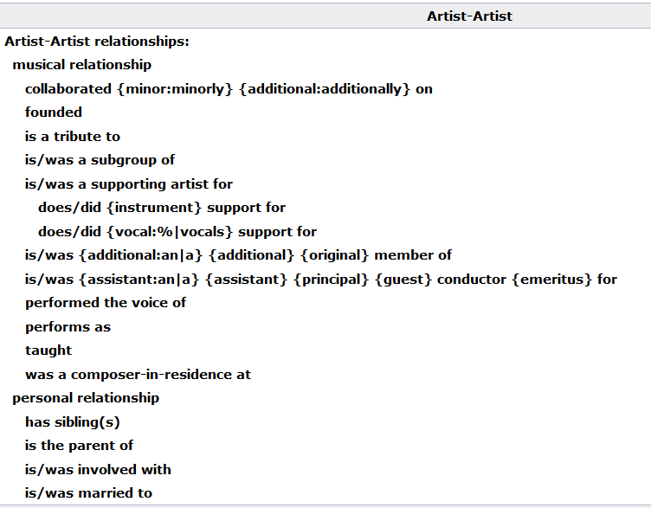
Relationships in Musicbrainz Database
49

Slide 50
Describing a Music Recording: Where & How Much
Oldest technique: encode descriptions in filenames
Example: gd83-10-31.horvath-nak.ladner.19894.sbeok.shnf
“Improvement” – encode description into the music files
ID3 format (1996) initially added as a hack to MP3 music files, which had no place for descriptions
Today – rich music descriptions that are managed by applications apart from the recordings
50

Slide 51
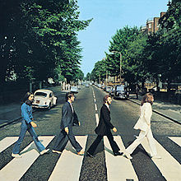
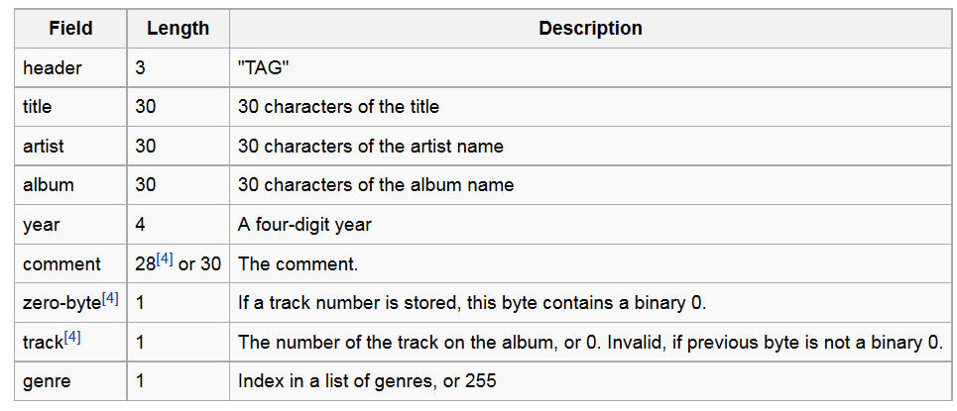
ID3
Barely adequate for ordinary “rock” or “pop” songs: Come Together / The Beatles / Abbey Road / 1969
It fails miserably for classical music; no way to encode part-whole relationships, composer, conductor, other stuff that matters to some people
51

Slide 52
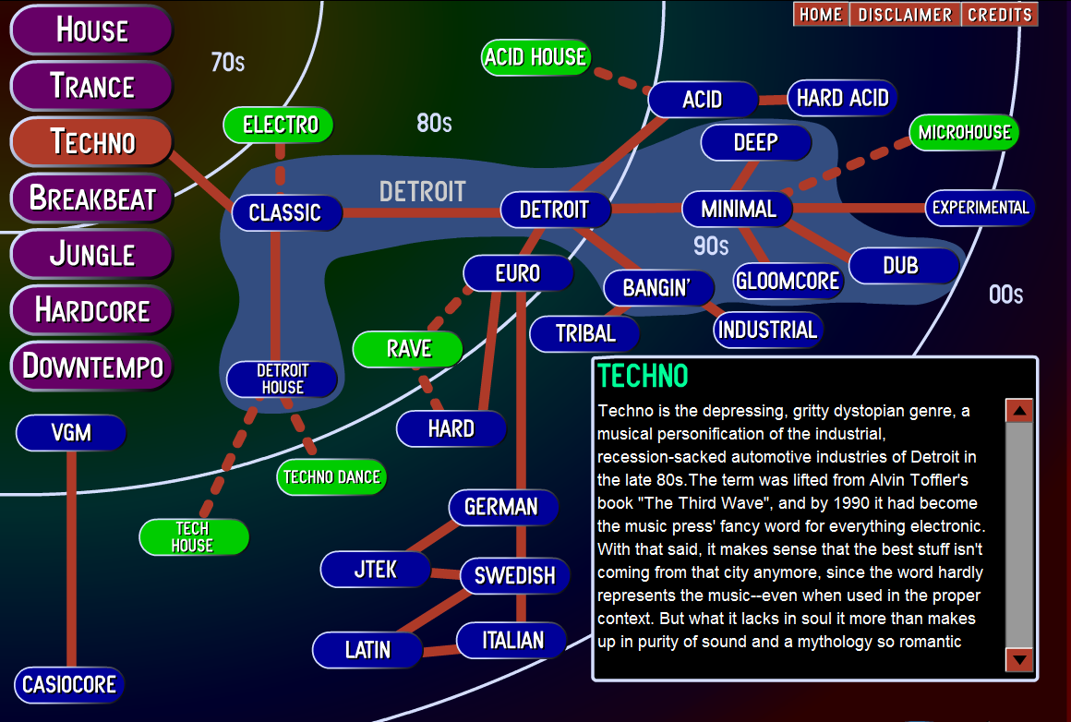
Music Genres (defined by human experts)

Slide 53
The Music Genome
Pandora founder Tim Westergren hired Stanford musicology grad students (led by Nolan Gasser) to implement his vision that there were “music species” that could be defined by sets of “music genes”
“Groups of genes” for musical analysis include melody, harmony, rhythm, form, instrumentation, lyrics
A specific gene might be “wah-wah and fuzz guitar distortion”, “gender of lead vocalist”, very granular features
Rock and pop songs have 150 genes, rap songs have 350, jazz songs have approximately 400, classical music often more
2 million songs analyzed manually (20-30 minutes each, 25 people doing it); this collection used to train computational classifier
53

Slide 54
Data-driven Organization of Music and Music Artists
Every interaction with music that CAN be captured is probably being captured; this includes music playing in any connected app, music streaming, likes, comments, tweets, facebook posts, attending concerts, whatever…
These rich data sets can be analyzed to organize music and to organize music artists
Example: “Music Map” organizes artists by their musical similarity and into five popularity categories: Undiscovered, promising, established, mainstream, epic
54

Slide 55
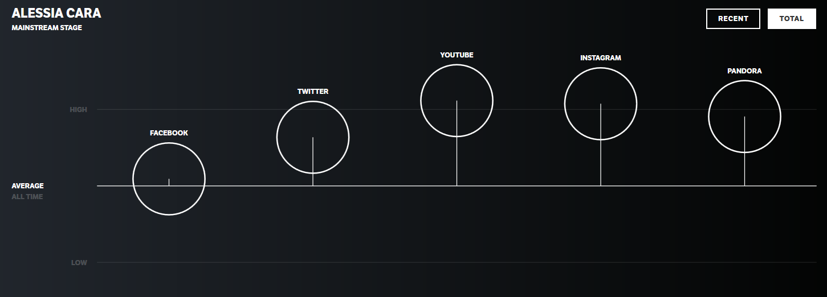
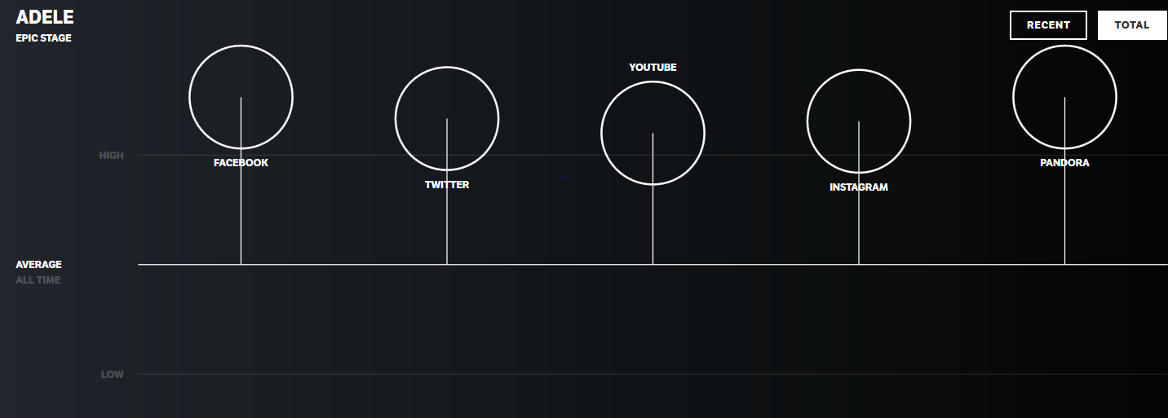
Music Maps for Alessia Cara and Adele

Slide 56
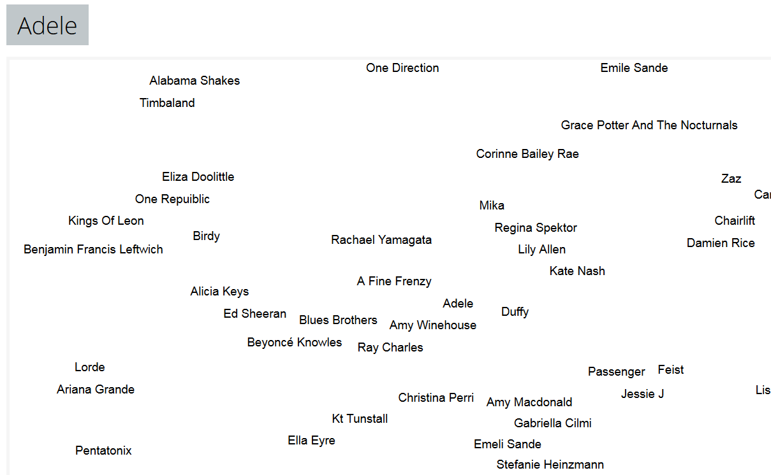
Musical Similarity to Adele http://www.music-map.com/adele.html

Slide 57
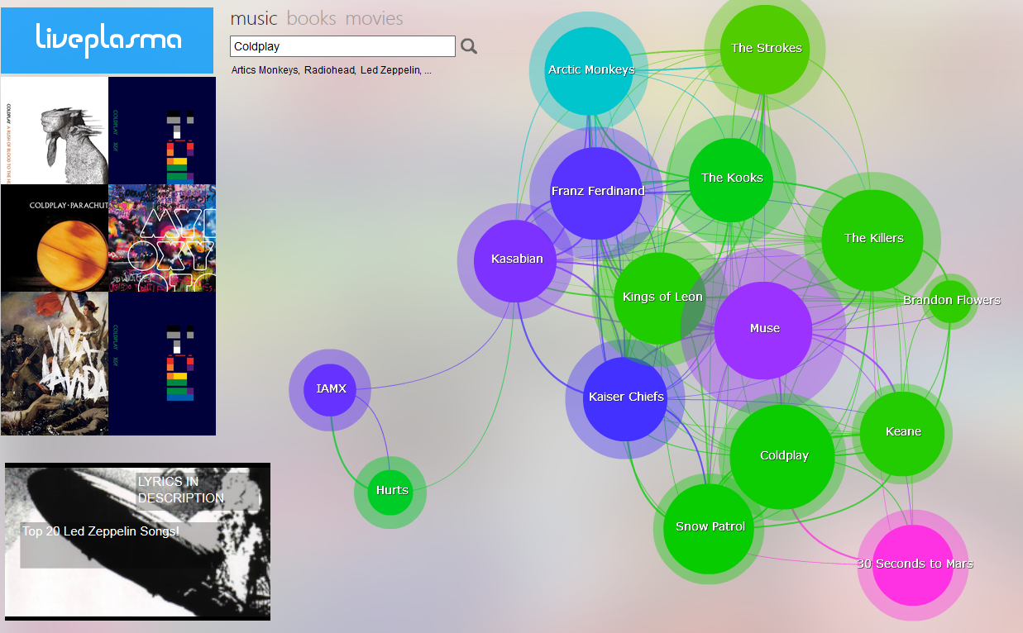
Music organized by machines – liveplasma.com

Slide 58
Music as an Organizing System
An improbable collaboration with Graham Freeman, musicologist in Toronto

Slide 59
The Problem – part 1
Most descriptions of music that are actually about the music are created by experts using specialized vocabulary that non-experts can’t understand
The opening motive is an anacrusis that implies the dominant with a repeating alternate pattern emphasizing the chromatic lower auxiliary to E…

Slide 60
The Problem – part 2
…or they are very subjective, and not tied to any musical structures or events
It sounds like a sad man walking around looking for the woman he loves.

Slide 61
Music is “Organized Sound”
An often-cited definition of music is that it is "organized sound", a term originally coined by modernist composer Edgard Varèse
But what this means is NEVER DEFINED
Graham Freeman and I have applied TDO’s concepts of the organizing system to give this definition some substance and applicability

Slide 62
Our Proposal
Music is sound intentionally organized according to a system of constraints that are arbitrary, dynamic and non-universal
In Western music, sounds become music when they are intentionally organized to create rhythms, melodies, harmonies and other musical structures
These structures can be arranged in complex ways using repetition, contrast, transformation and other compositional processes

Slide 63
Four Levels of Constraints
Level 1 (Definitional) – is this music?
Level 2 (Creative) – what musical style or genre is it?
Level 3 (Compositional) – identify a particular piece of music
Level 4 (Performance) – what is the range of different performances that are all identified as the same piece of music (Shamu’s question)

Slide 65
Feb 26: Cognitive Universals? Folk biology. Bilingualism
Medin, D. L., & Atran, S. (2004). The native mind: biological categorization and reasoning in development and across cultures. EXCERPT
Bailenson, J. N., Shum, M. S., Atran, S., Medin, D. L., & Coley, J. D. (2002). A bird's eye view: Biological categorization and reasoning within and across cultures. Cognition, 84(1), 1-53. EXCERPT
Ramírez-Esparza, N., & García-Sierra, A. (2014). The bilingual brain: language, culture and identity. Handbook of Multicultural Identity: Basic and Applied Perspectives, (pages 35-37 and all the "Conclusion" sections)

