Slide 1
CogSci 190 “Sensemaking and Organizing” Spring 2019
Robert J. Glushko glushko@berkeley.edu
26 February 2019 11) Cognitive Universals? Folk biology. Bilingualism

Slide 2
Outline
Knowledge about trees
Universal cognition?
Primitive/savage/native minds?
Folk biology vs “expert” biology
WEIRD science
Bilinguals and biculturalism
West vs East: Analytic vs holistic cognition

Slide 3
Have You Heard of These Trees?
Acacia
Bamboo
Birch
Buckeye
Cedar
Dogwood
Elm
Eucalyptus
Holly
London Plane
Loquat
Magnolia
Maple
Melaleuca
Oak
Pine
Pittosporum
Poplar
Redwood
Yew

Slide 4
Your Knowledge of Trees
How many of the 20 tree names did you know?
How many of the trees do you think you could identify?

Slide 5
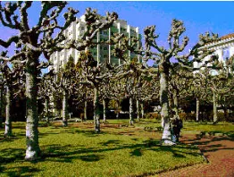
Name That Tree!

Slide 6
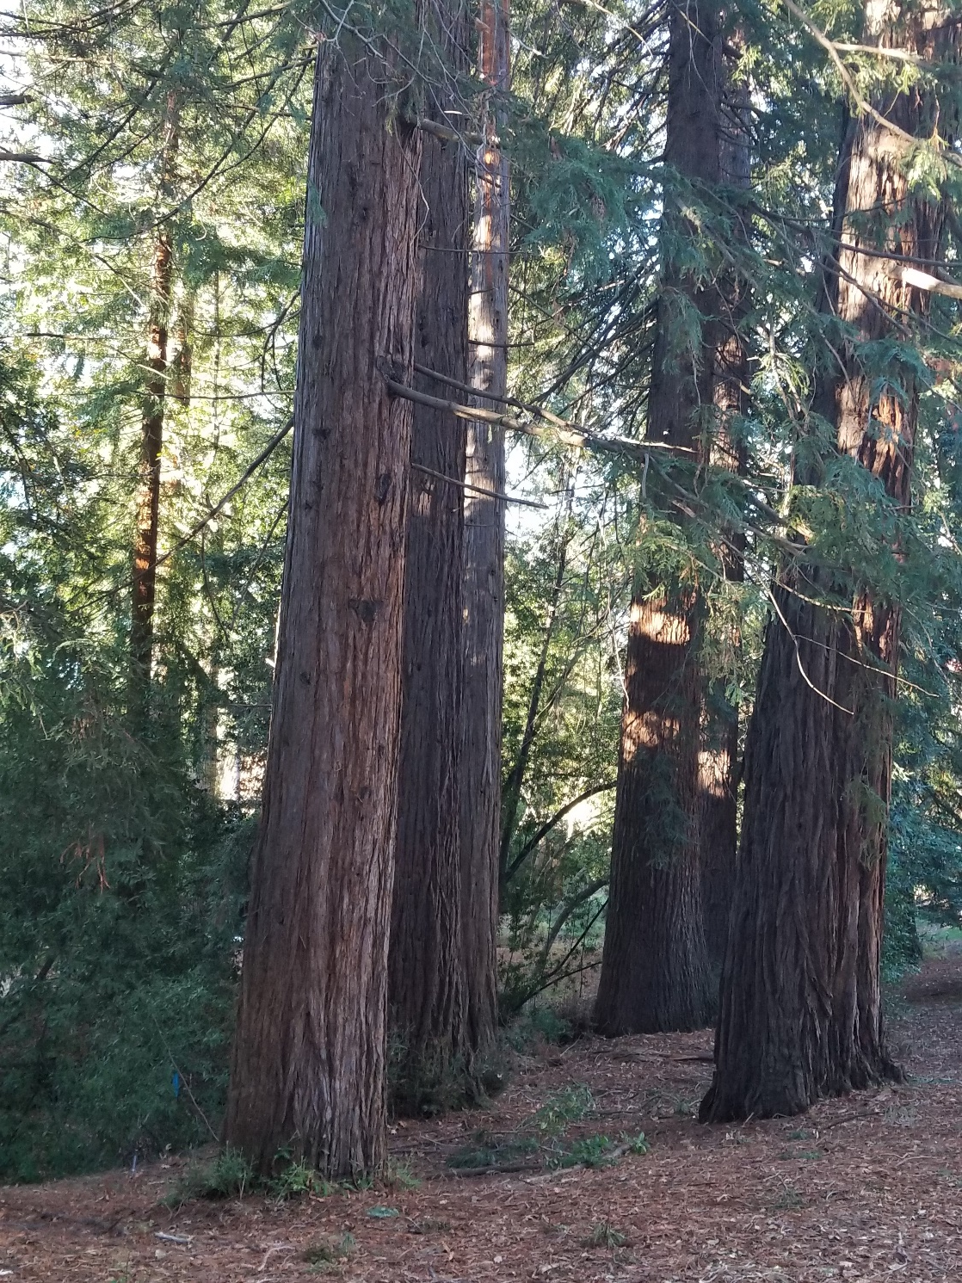

Slide 7
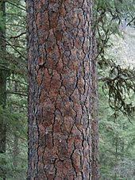
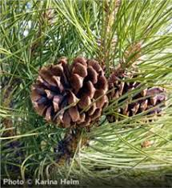

Slide 8
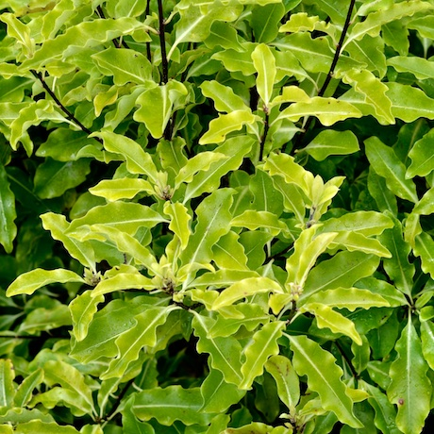
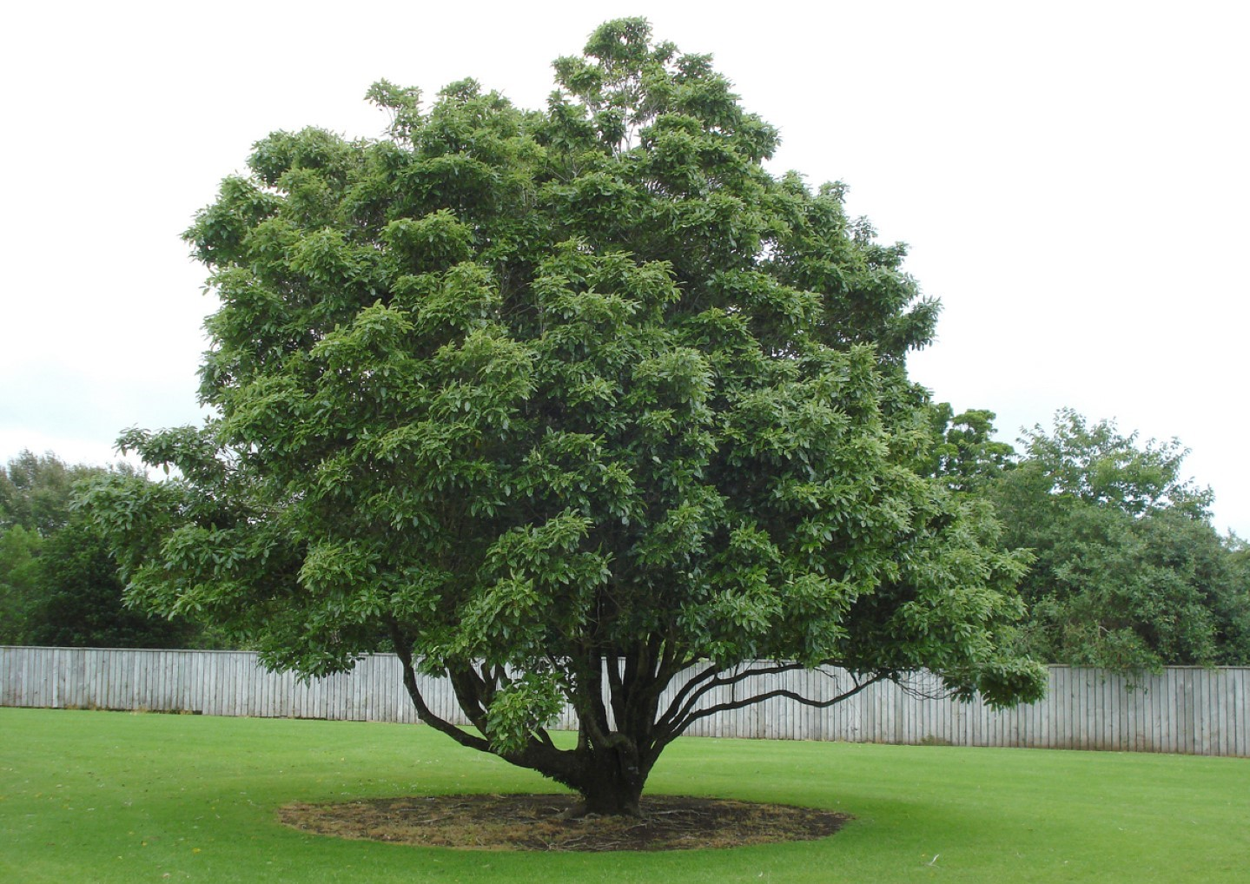

Slide 9
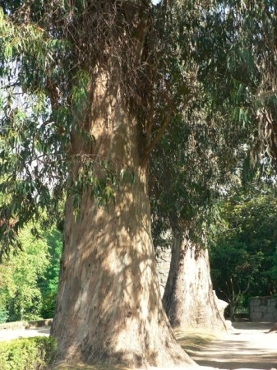

Slide 10
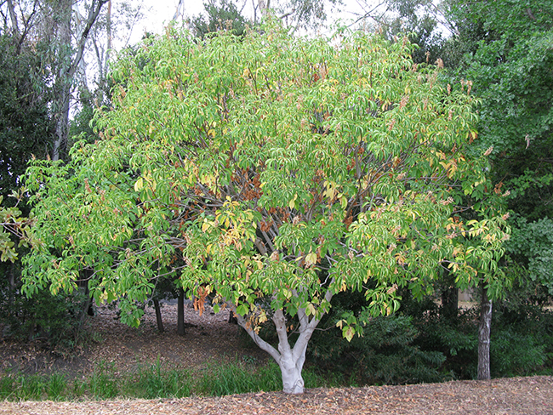

Slide 11
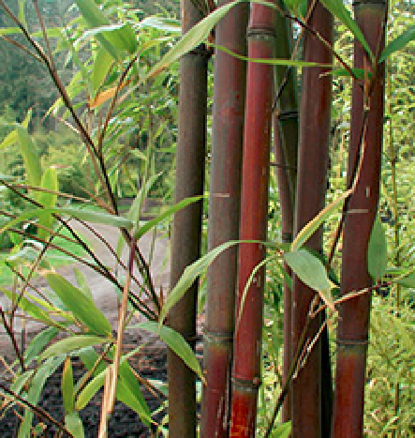

Slide 12
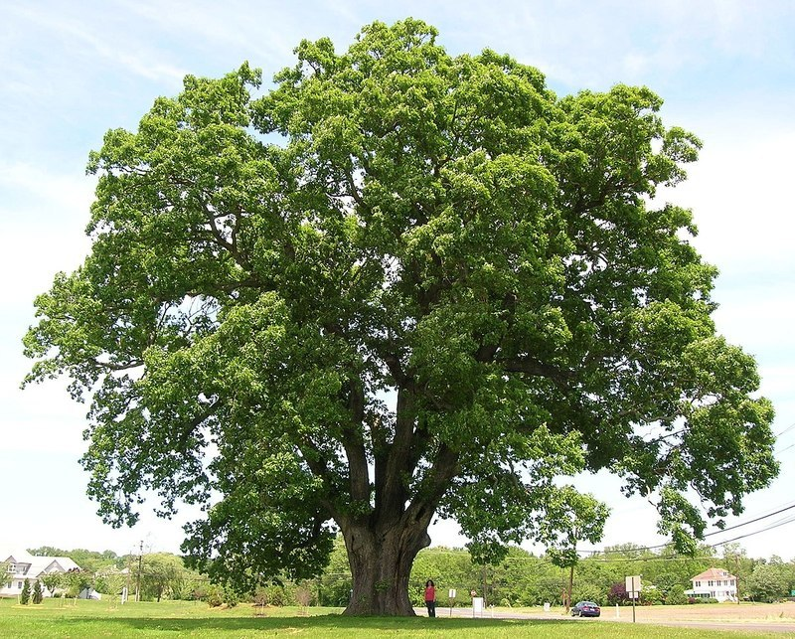

Slide 13
Your Knowledge of Trees
Of the 20 tree names… every one is on the Berkeley campus, and 7 of the listed trees are within a few hundred feet of our classroom location in Wheeler Hall
…Including 6 of the 8 trees you just saw pictures of
How many different tree species do you think there are on the Berkeley campus?

Slide 14
Shamu for Berkeley Campus Trees (Many of the tree names identify categories with many species)
Acacia (5)
Birch (5)
Cherry (6)
Dogwood (5)
Elm (5)
Eucalyptus (8)
Magnolia (5)
Maple (9)
Oak (22)
Pine (22)
As of 2016, there were 276 different species of trees on the campus

Slide 15
Your Knowledge of Trees
How would you rate your knowledge of trees?
Compared to a “typical” Berkeley student
Compared to someone who works with trees (landscape designer, arborist)
Compared to someone who lives in a forest near Lake Tahoe
Compared to someone who lives in the Amazon rain forest
What determines someone’s level of knowledge about trees?

Slide 16
Comparative Knowledge About Trees
Maintenance workers, landscaper designers, and botanists know a lot about trees, but
While they have some shared concepts, botanists have much more detailed classifications
Maintenance workers think about how they work with trees (tools, activities); Landscapers think about how trees are used (specimens, ornamental, weeds)
4 year-old children living in rain forests can identify more trees than US college students
Some adults can identify and reason about hundreds of different trees and plants plants

Slide 17
What An Adult Inhabitant of the Ecuador Rain Forest Knows
Berlin, Brent. Ethnobiological classification: Principles of categorization of plants and animals in traditional societies. 1992

Slide 19
Is There Universal Cognition? (1)
Two fundamental cognitive processes are categorization (how do we decide what objects are the same kind of thing) and inductive reasoning (given that one object or class exhibits a property, how do we decide whether other related objects or classes do).
Are these and other cognitive processes universal? Do all people have the same “cognitive toolkit” to use?
How should we try to answer these questions?

Slide 20
Is There Universal Cognition? (2)
We can compare different groups doing the same or equivalent cognitive tasks to look for differences
But which groups should we compare?
If people in one culture differ from those in another on cognitive tasks, why?

Slide 21
Sources of Cognitive Differences
If people in one culture differ from those in another on cognitive tasks, why?
because use different parts of the cognitive toolkit?
because they have had different life experiences and have been exposed to different aspects of the world?
because they have been explicitly taught different things or taught in different ways?

Slide 22
Some Definitions of “Culture”
FLASHBACK
the customary beliefs, social forms, and material traits shared by a group of people in a place or time (culture in the world?)
whatever someone has to know or believe in order to operate in a manner acceptable to other members of a group they belong to (culture in the mind?)
whatever knowledge or beliefs other groups have that prevents them from seeing the world objectively and “correctly” – the way we do (is culture defined relatively?)
22

Slide 23
Culture as a “System of Meaning”
FLASHBACK
Culture is not chaotic or random … it is a SYSTEM (of systems…)
This system determines what sorts of things or events need to be attended to and explained
It established complex interrelated beliefs and behaviors to create a “system of meaning” about those things and events
23

Slide 24
Systems of Meaning – What vs How (1)
Roy D’Andrade (1981) suggested a division of labor between psychology and anthropology:
Cognitive anthropology would study what people think about (ethnography)
Cognitive psychology would study how people think (experiments)
What assumptions does this research strategy make about how cognitive processing works?
24

Slide 25
Systems of Meaning – What vs How (2)
Andrade’s proposal came at a time when cognitive science was dominated by a “human information processing” view of cognition; “’the mind is a computer” metaphor
This implies that processing is largely independent of context
Content varies across cultures, but the processor itself, and hence the processing, are universal, that is, independent of people's cultural background.
25

Slide 26
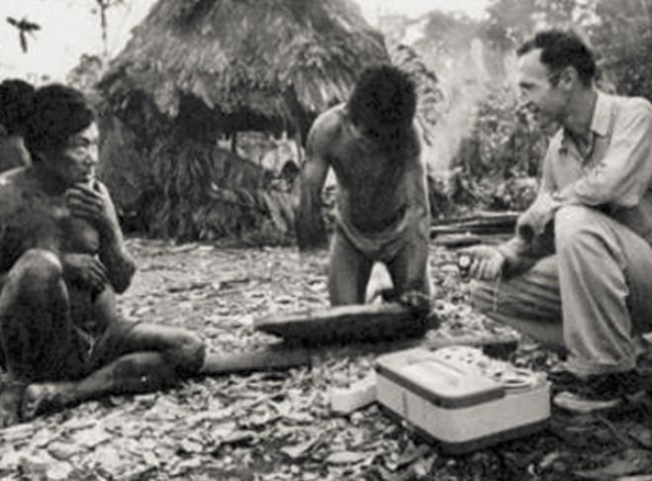
The Stereotype of an Ethnographic Study – 1930s?
Ethnography:
“writing about people”
Understanding
a community or culture through observation, interviews, and collection and analysis of artifacts

Slide 27
The Savage/Primitive Mind
Anthropology emerged in the 19th century as an extension of “natural history”
Just as Europeans studied the flora and fauna on remote locations (often European colonies) they also studied the language, culture, and artifacts of the people who lived there
Many of these peoples had no written language and limited technology, which led some anthropologists to describe them as savage or primitive compared with “modern Europeans”

Slide 28
Cognition of the “Savage Mind”
Language analysis suggested that cognition of pre-literate rural cultures was different – and less abstract – than European thinking
Such languages have many very specific words for a detailed inventory of plant and animal species and varieties
They lack words for abstract categories like “tree” or “animal”
Other languages that otherwise identify specific animals or plants often no not name those that are neither useful nor harmful
Do you agree that these language properties suggest a more primitive mind?

Slide 29
Ethnobiological (“Folk”) Classification
“Folk biology” (studying ordinary people’s relationships with plants and animals) reveals that people in all cultures classify plants and animals into species-like groups
These species-like groups are further organized in a non-arbitrary hierarchy that can be scientifically interpreted in terms of “speciation” from a common ancestor

Slide 30
Five Levels of Taxonomic Classification
Berlin, Brent, Dennis E. Breedlove, and Peter H. Raven. "General principles of classification and nomenclature in folk biology." American anthropologist 75, no. 1 (1973): 214-242.

Slide 31
The Five Levels
“Unique Beginner” (at the top of, or root of, the tree) - categories like “plant” or “animal”
“Life-form” – typically a single word like “tree”, “vine”, “grass”, or “mammal”
“Generic” - first learned, most commonly used, and most psychologically salient description descriptor – “oak”, “pine”, “perch”
“Specific” and “varietal” – more particular, qualified names like “black spruce”, “white pine”

Slide 32
Folk Biology
This hierarchical system is complemented by other classifications for particular uses (beneficial vs. harmful, edible vs. inedible, wild vs. domestic, etc.)
These classification systems enable systematic inferences about the distribution of physical and ecological properties
These regularities are best explained in terms of the similarities in how people perceive and appreciate (largely unconsciously) that natural groupings of plants and animals in their environment
32

Slide 33
Classifying and Reasoning About Birds and Fish
When people are asked to sort birds or fish into groups that “go together by nature” experts in diverse cultures rely on both visible features (“morphology”) and on less-visibly distinctive features that enable the same function
In contrast, people without expert knowledge sort primarily on visible features
Experts put greater emphasis on ecological relationships (which animals share habitats) and commercial/utilitarian factors
33

Slide 34
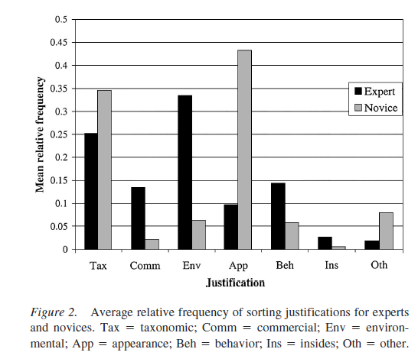
Rationales for “Fish Sorting” (Shafto & Coley, 2003)

Slide 35
“Approaches to Nature” Identified in Folk Biology Studies (Bang, Medin, Atran 2007)
HOLISTIC -A belief that everything in nature is interconnected; harmony and balance in nature.
SPIRIITUAL - A tendency to access or ﬁnd spiritual meanings, lessons, importance (“Mother Earth”)
TRADITIONAL - Referring to an activity in nature as something that has occurred throughout history and should continue for that reason.
SURVIVAL SKILLS - A belief that nature is something that can harm us if underestimated.
MORALISTIC - Strong feelings of moral and ethical responsibility.

Slide 36
“Approaches to Nature” (2)
ECOLOGISTIC - Nature can be understood from empirical study from a systems perspective. Relating species to other aspects of nature.
PERSONAL UTILITY – Providing human sustenance, protection, and security for the self or those in the immediate family or social network
ABSTRACT RESPECT - A positive but abstract attitude towards nature
ABSTRACT KNOWLEDGE - Expressing learning goals abstractly
DISTANT UTILITY – Utility for others

Slide 37
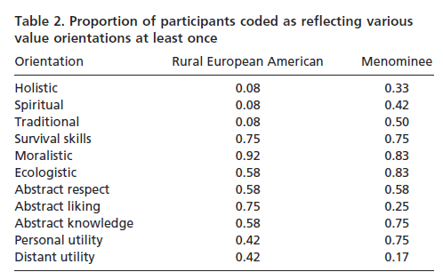
Comparing the Value Orientations of European Americans and Native Americans in Rural Wisconsin

Slide 39
Do WEIRD Subjects Make Bad Science?
Many psychological studies of categorization and reasoning use undergraduates to make claims about human cognition
These subjects come from: Western, educated, industrialized, rich, and democratic societies (WEIRD populations)
Similarly, many studies of children aimed to understand the development of cognition use children in schools affiliated with or near universities
39

Slide 40
Do WEIRD Subjects Make Bad Science? (2)
This means that researchers have neglected roughly 95% of the world population, about which – from a psychological and cognitive science perspective – we know practically nothing
There is increasing evidence and concern that WEIRD subjects are among the least representative populations one could find for generalizing about humans
They exhibit a much narrower range of rationales or attitudes toward nature
40

Slide 41
The “Devolved” Mind
Researchers have found it convenient to treat undergraduates as the reference population and to categorize groups that know more as “experts”
An alternative perspective would be to take the knowledge of the typical member of a non-industrialized society as the standard
With this reference point, undergraduate knowledge would be considered much below average or “devolved” – cognitively impoverished, with only generic reasoning strategies to rely on

Slide 42
An Alternative Explanation to “Savage” or “Primitive” Mind
The use of more or less abstract terms is a function not of greater or lesser intellectual capacity, but of differences in the interests – in their intensity and attention to detail – of particular social groups

Slide 43
“We are all born with native minds, though some develop in a manner better attuned to their natural surroundings than others. The full expression of the folk-biology module requires environmental triggering conditions and cultural support that may be lacking for certain groups in industrialized societies, including the usual participants in most cognitive and developmental psychology experiments.
- Medin & Atran, “The Native Mind: Biological Classification and Reasoning in Development and Across Cultures” (2004, p. 980)

Slide 44
From a theoretical perspective, the chief interest in studying these groups may not be to establish a baseline for generalizations about folk-biological knowledge but to explore the cognitive consequences of limited input”
- Medin & Atran, “The Native Mind: Biological Classification and Reasoning in Development and Across Cultures” (2004, p. 980)

Slide 45
Cultural Support for Knowledge (or the lack of it)
Does a society promote a particular area of knowledge?
How much do people focus on a domain of knowledge in their everyday interactions?
When you were a child, did your parents call your attention to plants and animals? If they did, did they refer to robins, trout, and maples or to birds, fish, and trees?
Do you consider yourself devolved with respect to the natural world?

Slide 46
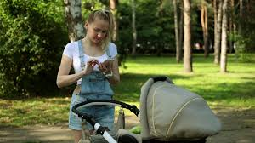
These phone-addicted parents are clearly not pointing out the natural world to their neglected kids
https://nypost.com/2018/05/19/our-digital-addictions-are-killing-our-kids/

Slide 47
Cultural Support, Continued
Should we blame your parents for your lack of knowledge about nature?
How might we measure the amount of cultural support?

Slide 48
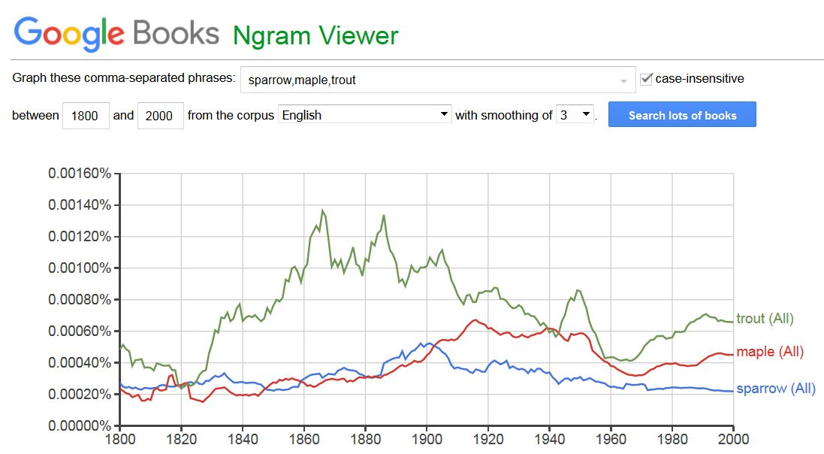

Slide 49
Get a Pet; Go Outside and Play
In technologically-oriented cultures contact with biological kinds may be so minimal that researchers can demonstrate significant differences in children's biological reasoning as a function of whether they do or do not have goldfish as pets
Optional Homework Assignment…. Walk around the campus (without your phone in your hand) and look for interesting trees (then, take out your phone and take a photo of what makes the tree interesting).

Slide 50
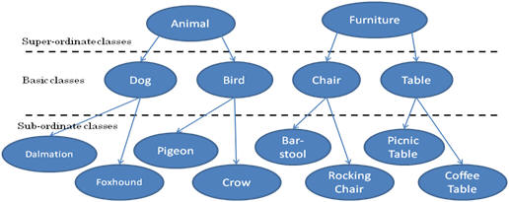
Three-Level Category Hierarchy (Rosch)
Is it possible that “basic level categories” are an artifact of studying how WEIRD people categorize?

Slide 51
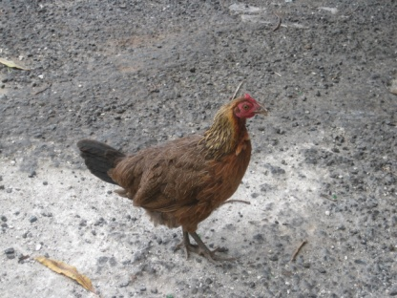
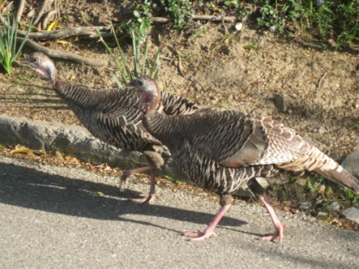
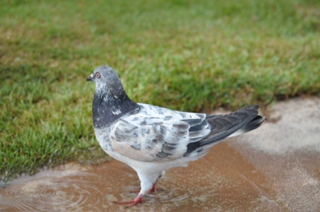
Basic-Level Categories: What
Members tend to have the same shape
They tend to "share parts"
The same motor movements are involved in interacting with them
51

Slide 52
Basic-Level Categories: Why
“The world is structured because real-world attributes do not occur independently of each other”
“Combinations of attributes of real objects do not occur uniformly. Some pairs, triples, or n-tuples are quite probable, appearing in combination sometimes with one, sometimes another attribute; others are rare; others logically cannot or empirically do not occur.”
Basic objects (e.g., bird, chair) are at the level at which there are attributes common to all or most members of the category

Slide 53
To Make You Feel Better… Recognize These Restaurant Names?
Arby’s
Burger King
Chick fil-A
Chipotle
Dairy Queen
Dominos
Dunkin’ Donuts
Jack in the Box
KFC
Little Caesars
McDonalds
Panda Express
Panera
Papa John
Pizza Hut
Sonic Drive In
Starbucks
Subway
Taco Bell
Wendy’s
How many of these names would an Anchuar recognize?

Slide 55
Bilinguals & Biculturals: Definitions
Simultaneous bilinguals - Both languages learned concurrently from birth
Second language learners – 2nd language learned after first language is established
Bicultural bilinguals – Speak two languages and identify as belonging to both cultures
Monocultural bilinguals – Speak two languages but identify with one culture
Do any of you identify yourselves as bilinguals or biculturals? Which category?

Slide 56
2nd Language Competence
Many bilinguals are fluent speakers of both languages but have only minimal writing competence in one of them
Degree of competence in 2nd language reflects perception of the degree to which one’s identity in 2nd language is “compatible and integrated”
Relative social status of the two languages influences the extent of “compatibility and integration”

Slide 57
Vocabulary Learning
Learning any language requires “tuning” of the mechanisms of speech perception, which in turn reduces the ability to discriminate speech features used in other languages
But vocabulary learning in a first language is faster as a result of this “tuning”
Infants raised in bilingual environments have slower “neural commitment” because they are learning vocabulary in two languages
57

Slide 58
Cognitive Performance
Many cognitive performances of bicultural bilinguals may vary with the language used in testing
Many multilinguals report different personalities, or even different worldviews, when they speak their different languages
These personality/culture shifts can be primed by speaking the language or by more subtle signals and symbols that “prime” one culture
58

Slide 59
Code Switching
Bilingual children are constantly alternating between different words that describe the same things
This “code switching” might underlie findings that bilingual adults demonstrate more cognitive flexibility and better “executive control”

Slide 60
Expanding scope – culture {and,or,vs} thought
Some places with many bilinguals (Montreal, Los Angeles) bring together people who differ in language but share much common culture
Are there cultural and languages that are so large that they result in qualitative cognitive contrasts?

Slide 61
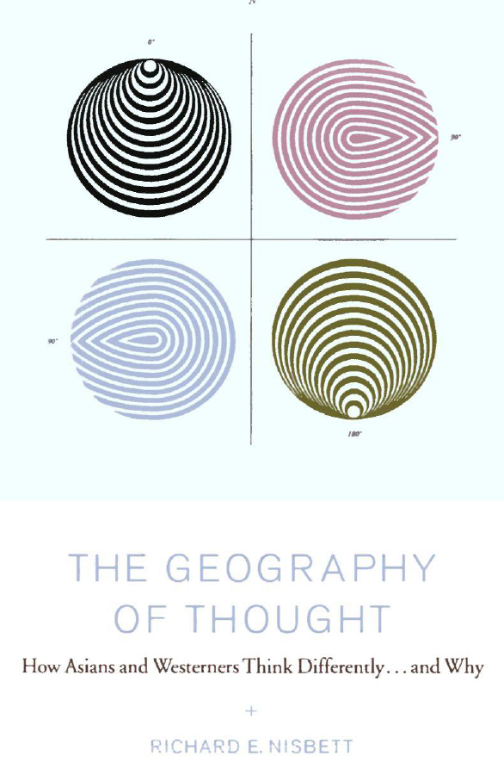
This book argues that Asian and Western societies differ greatly in their “systems of thought”
How general and persistent are these effects of culture?

Slide 62
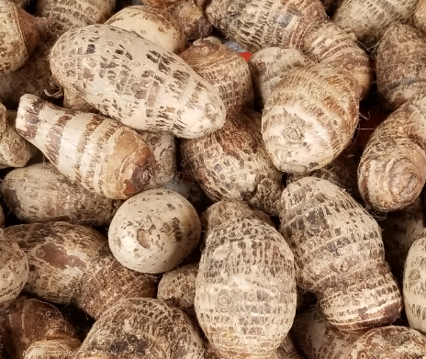
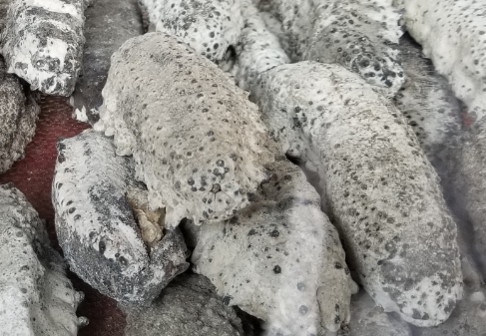
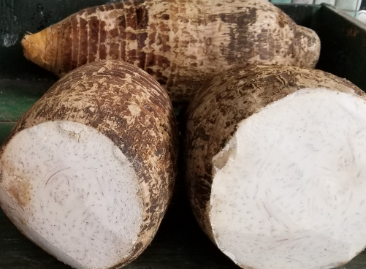
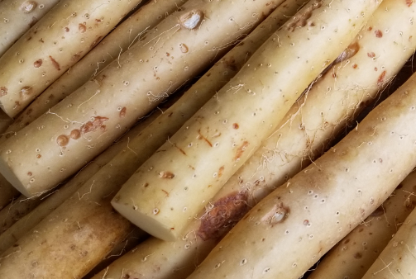
Everyday Food for Millions of People
… that most of you can’t even recognize

Slide 63
Philosophy and Science in Ancient Greece and China
Greece
Understand objects in isolation; the world is discrete
Explanations based on object properties
Objects and properties don’t change
China
Understand objects in terms of their relationships; the world is continuous
The world is in constant change (The “I Ching” or “Book of Changes” is the oldest Chinese book and is a guide to just about everything)

Slide 64
Philosophy and Science in Ancient Greece and China
Greeks invented science (=rules + categories) – despite technological superiority of Chinese
Law in Greece principle-based, universal
Law in China precedent-based, particularistic

Slide 65
“Westerners” – Analytic Perception and Cognition
Focus on object and its attributes
Use attributes to categorize
Use universal laws about categories to model and control events
Use formal logic in deriving laws and evaluating propositions

Slide 66
Social Structure and Culture (West)
Both ancient Greece and modern Western culture relatively individualistic or independent, high degree of personal agency
Resolving differences through logic and debate
People expect their environment to be sensitive to them, and will actively work to change it for their benefit

Slide 67
East Asians: Holistic Perception and Cognition
Focus on field in which the object is located
Relationship between object and field used to predict and explain behavior
Absence of universal laws means control is difficult
No tradition of formal logic
Dialectical approach: the middle way

Slide 68
Social Structure and Culture (East)
Both ancient China and modern Asian culture relatively collectivist or interdependent, high degree of collective agency
Harmony is the goal; confrontation and debate discouraged; seek compromise
The world is a network of relationships; it is essential to be situation or context-sensitive
People are obliged to be sensitive to their environment

Slide 69
yin yang 陰陽
Seemingly opposite or contrary forces may actually be complementary, interconnected, and interdependent in the natural world
They may give rise to each other as they interrelate to one another
Yin (the feminine and dark and passive) alternates with yang (the masculine and light and active

Slide 71
Your Case Study - Timeline
Meet with me or Lauren to discuss ideas (strongly recommended but not required) (between now and March 11)
Submit a one paragraph proposal by March 12
Get feedback from teaching team by March 15
Present your case study idea – 1 minute (March 19)
Present your case study in 5 minutes (May 7 or 9)
Submit your final case study report (May 12)

