Slide 1
CogSci 190 “Sensemaking and Organizing” Spring 2019
Robert J. Glushko glushko@berkeley.edu
28 February 2019 12) Describing Relationships & Structures, Part 1: Semantic & Lexical Relationships

Slide 2
Why This Stuff Matters!
An organizing system can use existing relationships among resources, or it can create relationships by applying organizing principles to arrange the resources
We need a vocabulary for talking about these relationships precisely and consistently so that we can analyze, design, reason about them, and implement them in organizing systems
In fact, we need 5 different vocabularies because there are 5 different perspectives on relationships
2

Slide 3
Five Perspectives on Relationships (1)
SEMANTIC: the meaning of the association
LEXICAL: how the conceptual description of a relationship is expressed using words in a specific language
STRUCTURAL: analyzes the patterns of association, arrangement, proximity, or connection between resources (and often ignores the reasons for them)
3

Slide 4
Five Perspectives on Relationships (1)
ARCHITECTURAL: emphasizes the number (binary, ternary, etc.) and abstraction level of the components of a relationship, which together characterize its complexity
IMPLEMENTATION: how the relationship is implemented in a particular notation and syntax and the manner in which relationships are arranged and stored in some technology environment
4

Slide 5
Defining "Relationship“ (Kent, “Data and Reality”)
“An association among several things, with that association having a particular significance”
"A relationship is sequence of categories, that includes one thing from each category”
The reason is an important part of the relationship
Multiple relationships can exist among the same objects, so the order of the objects matters
5

Slide 6
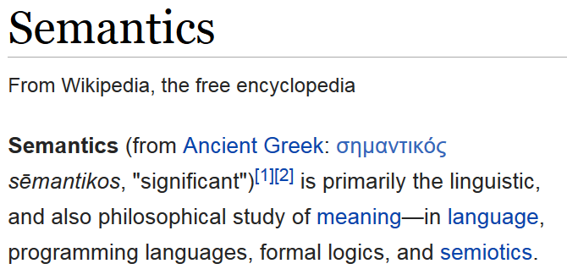
6

Slide 7
IF “semantics” means “meaning,” what does “meaning” mean?
7

Slide 8
Defining and Dictionaries
DICTIONARY: a resource that lists the words of a language (typically in alphabetical order) and gives their meaning
But this makes it difficult to define what a word means in a non-circular way that doesn't rely on lots of undefined meanings...
To understand a word you have to understand all the words in its definition, so you look up those words… and suppose that the first word appears in one of the definitions…
8

Slide 9
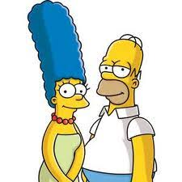
The Semantic Perspective on Relationships
The essence of relationships; why the resources are related
Relies on or expresses information that is not directly available from perception
“Homer is married to Marge" is a semantic relationship
"Homer is standing next to Marge" is a structural relationship that is perceivable
9

Slide 10
Making Meaning (1)

Slide 11
Making Meaning (2)
Draw a diagram that represents these assertions:
"Mary and Sue are sisters“
"Sally and Martha are mothers”
11

Slide 12
Mother
Mary
Sue
Mary and Sue are sisters…
…of each other

Slide 13
Mary’s Mother
Mary
Mary’s Sister(not Sue)
Mary and Sue are sisters…
…of other people
Sue’s Mother
Sue
Sue’s Sister (not Mary)

Slide 14
Sally
Sally’s Child
Sally and Martha are mothers
…of different children
Martha
Martha’s Child

Slide 15
Sally and Martha are mothers
…Sally is Martha’s mother
Sally
Martha (Sally’s Child)
Martha’s Child

Slide 16
Language and Meaning
Words and sentence structure only hint at meaning
Meaning is constructed not just from the literal language used, but from all the clues or cues in the CONTEXT OF USE
16

Slide 17
If “meaning is constructed from context”… then what does “context” mean?
17

Slide 18
Defining “Context”
The context in which language is understood includes:
the common knowledge of the “sender” and “receiver”
any assumptions they make
any previous discourse
the current discourse
the current situation (location, time, environment)
inferences from all of these
18

Slide 19
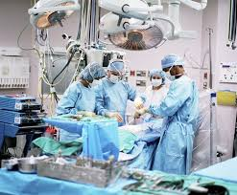
Context and Meaning
In the operating room,
the surgeon used a knife
to cut the …?
19

Slide 20
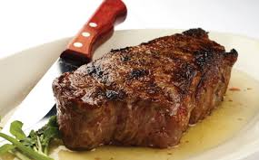
Context and Meaning
In the restaurant, the surgeon used a knife to cut the …?
SAME RESOURCES
DIFFERENT CONTEXTS => DIFFERENT MEANING
20

Slide 21
Specifying Semantic Relationships
"A relationship is sequence of categories, that includes one thing from each category“
Predicate/Argument Syntax:
is-married-to (Homer Simpson, Marge Simpson)
Subject / Predicate / Argument Syntax:
Homer Simpson => is-married-to => Marge Simpson
21

Slide 22
Types of Semantic Relationships
To fully understand a domain you need to know different types of relationships about and between the resources it contains
Class inclusion
Part-whole inclusion
Attribution
Class inclusion relationships form a kind of backbone or framework to which other kinds of semantic relationships attach, creating a network of them
22

Slide 23
The Semantics of "Inclusion"
One class or type of resources logically contains another; predicate is usually “is-a” or "is-a-type-of"
A set of interconnected class inclusion relationships defines a HIERARCHY or TAXONOMY
An inclusion relationship between an instance and a class -- assigning an instance to a class - is CLASSIFICATION
23

Slide 24
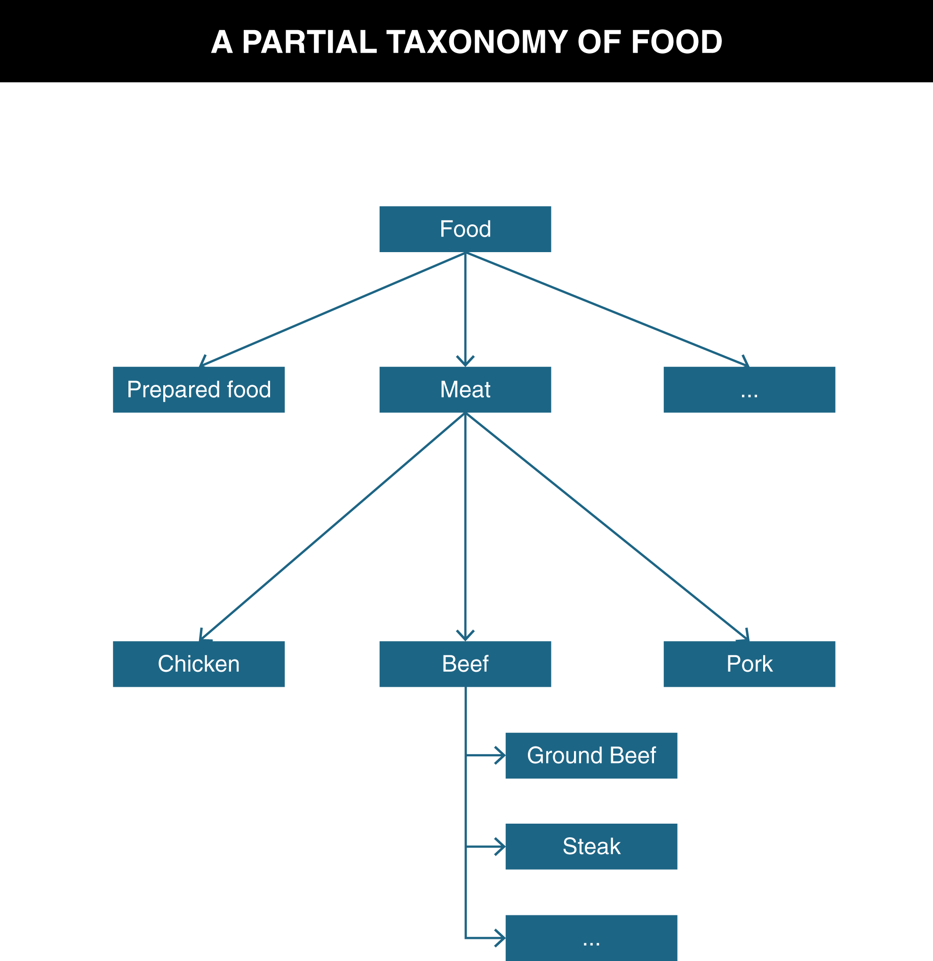
TDO Figure 6.1

Slide 25
Ontology
An ontology defines the concepts and terms used to describe and represent some domain or area of knowledge
To fully understand a domain you need to know different types of relationships about and between the resources it contains
Class inclusion relationships form a kind of backbone or framework to which other kinds of relationships attach, creating a network of relationships
25

Slide 26
Definitions of Ontology
“Ontology” can describe artifacts with different degrees of structure that differ:
... In how precisely the terms are defined
... In how precisely the relationships among them are expressed
The simplest ontology is a dictionary; a thesaurus is a somewhat more complex one
More complete ontologies are expressed using formal logic-based language
26

Slide 27
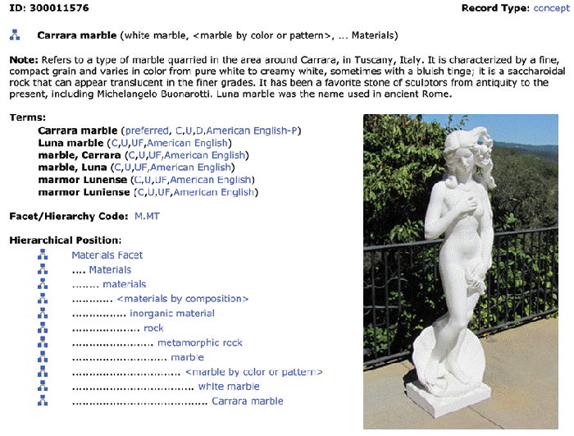
FLASHBACK: Art and Architecture Thesaurus
27

Slide 28
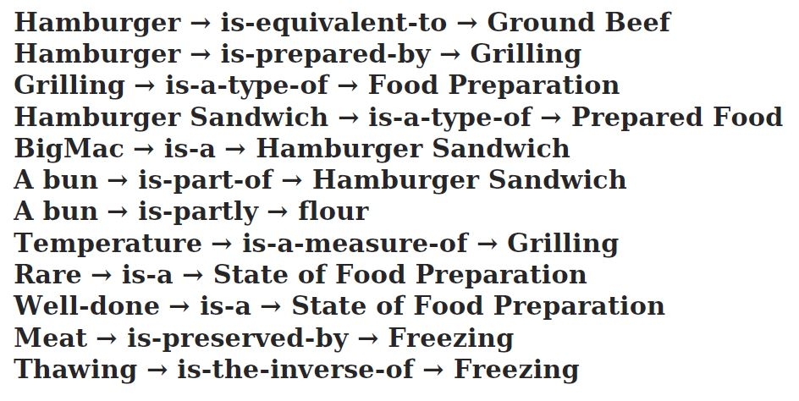
Ontological Assertions That Annotate the Food Taxonomy
???
The first assertion is also not quite right… It’s hard to be semantically precise

Slide 29
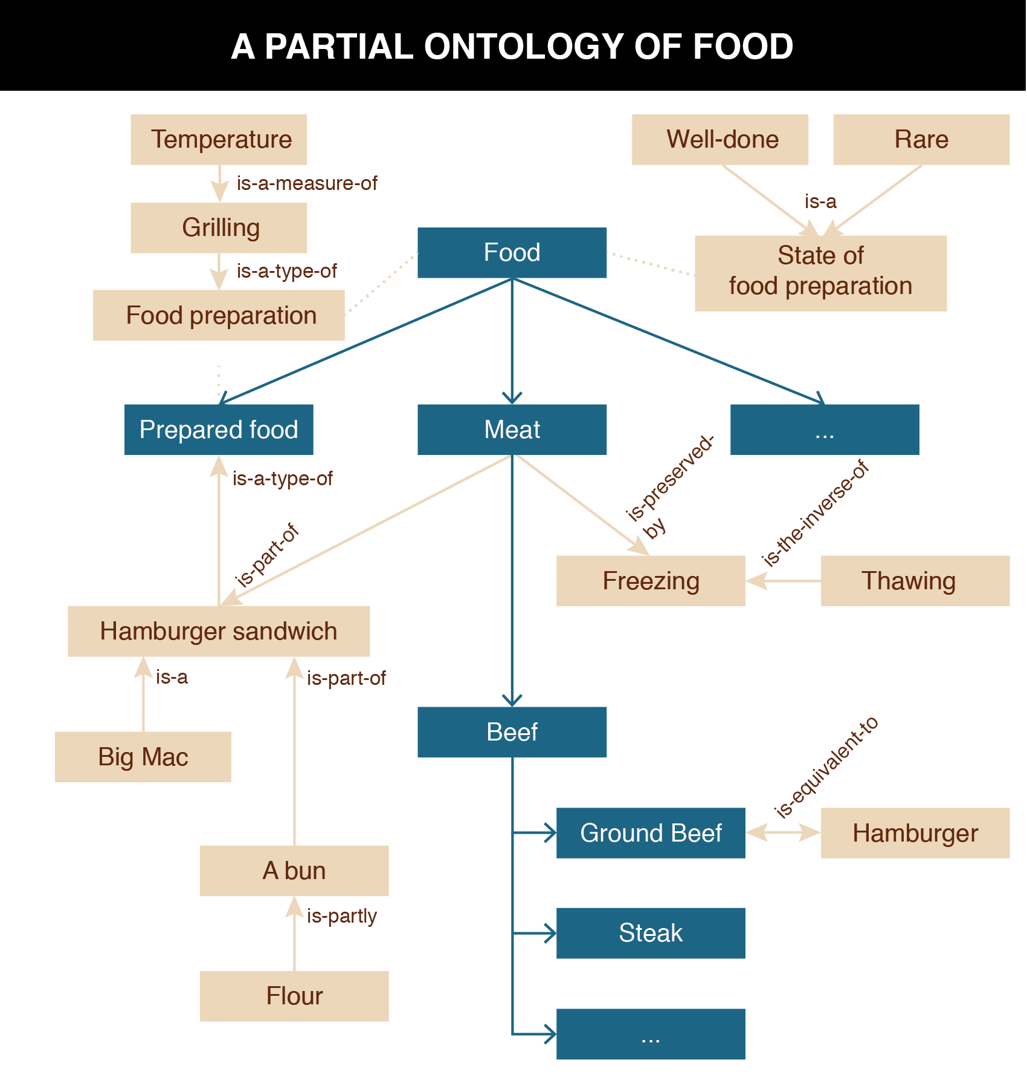
TDO Figure 6.2
Oops! This should say “has part”

Slide 30
Part-Whole (Meronymic) Inclusion
A resource class or instance can contain another as physical or logical parts
Expressed using “is-part-of,” “is-partly,” or with other similar predicate expressions
The engine is part of the car
The book is part of the library
Wine is partly alcohol
The Napa Valley is part of Northern California
Extra time is part of a football match
30

Slide 31
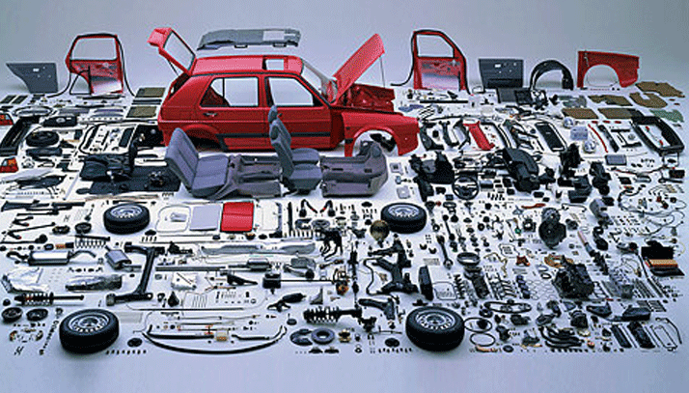
Part-Whole Relationship (Component-Object)

Slide 32
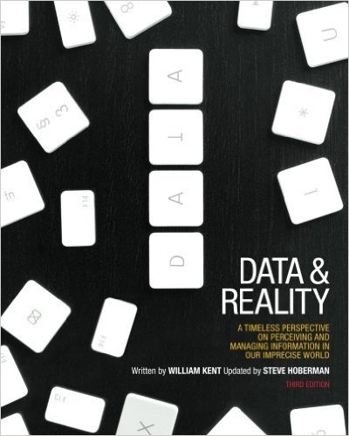
Chapters are Parts-of A Book
Entities
The Nature of an Information System
Naming
Relationships
Attributes
Types and Categories and Sets
Models
The Record Model
Philosophy

Slide 33
Topological, Locative, and Temporal Inclusion
A relationship between container, area, or time period and something it surrounds or contains (expressed using “is in”)
But unlike part-whole inclusion, the contained thing is not part of the container
The Vatican City is in Italy
The meeting is in the afternoon
“IS A”, “IS PART OF”, “IS IN” DO NOT MEAN THE SAME THING
33

Slide 34
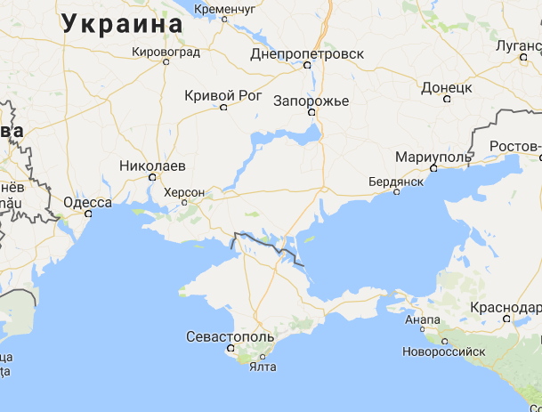
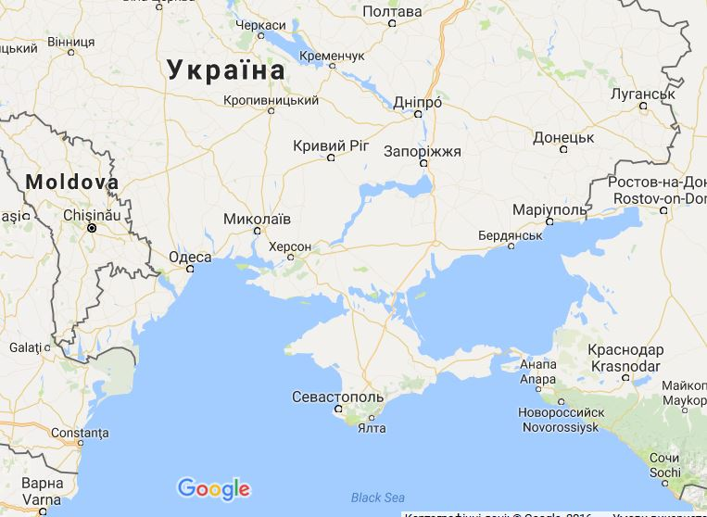
Crimea “In” Ukraine – Google Map in Russia
Crimea “Part of” Ukraine – Google Map in Ukraine

Slide 35
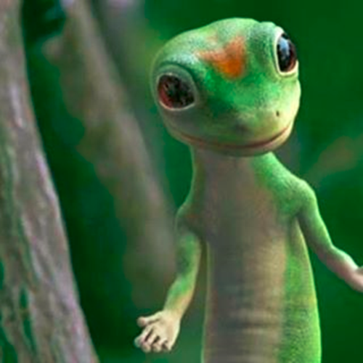
“Attribution” Relationships
In contrast to inclusion expressions that state relationships between resources, attribution relationships assert or assign values to properties for a particular resource
Attribution can be a binary relationship whose predicate has a single argument:
Martin the Gecko => is-small
"Title" : "Moby Dick“
Or with two arguments:
Martin => has-size => small
35

Slide 36
The Semantics of “Attribution”
There are often many different ways of expressing equivalent attribute values.
Martin → has-size → 6 inches
Martin → has size → 152 mm
Do these mean the same thing?
36

Slide 37
Properties of Semantic Relationships: Symmetry (1)
SYMMETRY: the order in which the arguments of a binary relationship doesn't matter
Homer Simpson => is-married-to => Marge Simpson
Marge Simpson => is-married-to => Homer Simpson
37

Slide 38
Properties of Semantic Relationships: Symmetry (2)
Relationships that are symmetric are also called BI-DIRECTIONAL
ASYMMETRIC relationships are those where the order of the arguments matters
Homer Simpson => is-parent-of => Bart Simpson
38

Slide 39
Properties of Semantic Relationships: Inverse
For asymmetric relationships, it is often useful to be explicit about the meaning of the relationship when the order of the arguments in the relationship is reversed
The resulting relationship is called the INVERSE or the converse of the first relationship
39

Slide 40
Properties of Semantic Relationships: Transitivity (1)
TRANSITIVITY: if X and Y have a relationship, and Y and Z have the same relationship, then X also has the relationship with Z
Homer Simpson => is-taller-than => Bart
Bart => is-taller-than => Maggie
IMPLIES THAT
Homer Simpson => is-taller-than => Maggie
40

Slide 41
Properties of Semantic Relationships: Transitivity (2)
Any relationship based on inclusion or ordering is transitive
Ordering includes numerical, alphabetic, and chronological relationships as well as those that imply qualitative or quantitative measurement
41

Slide 42
Properties of Semantic Relationships: Equivalence
Any relationship that is both symmetric and transitive is an EQUIVALENCE relationship
We often need to assert that a particular class or property has the same meaning as another class or property or that it is generally substitutable for it
42

Slide 43
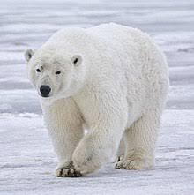
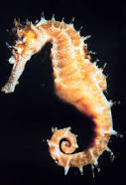
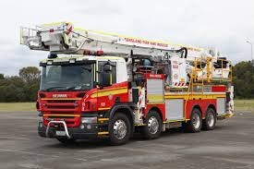
The Lexical Perspective on Relationships
A prototypical word is the minimal "meaning bearing" element of language
But this definition is oversimplified…some things are named using two words
…but are best treated as a single unit of meaning because what they mean isn't decomposable into the meaning of the two parts
43

Slide 44
The Lexical Perspective on Relationships
Words express concepts and relationships, but not all concepts and relationships have words for them (are "lexicalized")
We don't have a word for "all the stuff you'd take from your home if the fire was coming in 10 minutes" but we just created a concept for it
These "lexical gaps" differ from language to language
Whereas "conceptual gaps" -- the things we can't think of -- may be innate and universal
44

Slide 45
Lexicalization of Inverse Relationships
In some domains there are words for both relationships and their inverses – both relationships are “lexicalized”
Kinship is the best example, where many languages lexicalize both directions
Is parent of – is child of
uncles, aunts – nephews, nieces
But many more relationships are lexicalized in only one direction

Slide 46
Relationships Among Words / Relationships Among Concepts
Representing the relationships among words is a task for linguistics and cognitive science
In contrast, representing the relationships among concepts is a task for computer science
Understanding both kinds of relationships is essential for designers of organizing systems
46

Slide 47
Relationships Among Words
Hyponymy/Hyperonymy
Metonymy
Synonymy
Polysemy
Antonymy
47

Slide 48
Hyponymy/Hyperonymy
When words encode IS-A or inclusion relationships, the word for the more specific class is the HYPONYM and the other is the HYPERNYM
So there can be a "lexical hierarchy" that represents the "semantic hierarchy"
Often used to situate "basic categories" with respect to superordinate and subordinate categories
48

Slide 49
Hyponymy/ Hyperonymy
A is a hyponym of B if A is a type of B
A robin is a hyponym of bird
A is a hypernym of B if B is a type of A
An animal is a hypernym of bird
49

Slide 50
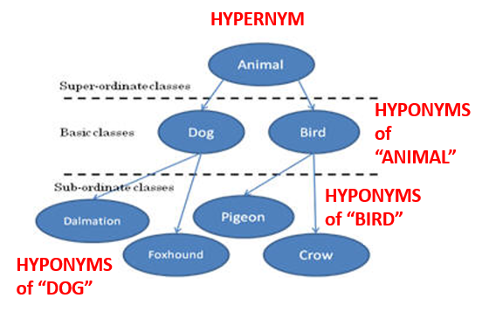

Slide 51
A Formula for Definitions
hyponym = {adjective+} hypernym {distinguishing clause+}
Robin = Migratory BIRD with clear melodious song, a reddish breast, gray or black upper plumage
Doesn't mention every characteristic of hyponym, only those needed to distinguish from other hyponyms
51

Slide 52
Metonymy
The lexical representation of or analogy to part-whole or meronymic relationships
Using one aspect of something to stand for the whole
"Bank" as building stands for the institution of the "bank"
"The White House released new budget figures today"
52

Slide 53
Synonymy
Synonyms are different word forms that can express the same concept
cat, feline, Siamese cat
Absolute synonyms that can always substitute for each other probably don't exist
Propositional synonyms are those where substituting one for another isn’t likely to change the truth value of the statement
Lisa Simpson plays the {violin, fiddle}
53

Slide 54
Polysemy
Many "word forms" (particular spelling patterns) are polysemous with multiple senses established in the language -- they are semantically ambiguous
- That dog has floppy ears - She has a good ear for jazz.
"bank" (financial) has related senses:
- a building (the bank on Shattuck) - specific financial firm (Wells Fargo) - where money is kept (abstract notion) - where anything of value is kept (more abstract)
54

Slide 55
Antonymy
Antonyms are lexical opposites
Some are inherently binary “true antonyms”
dead / alive, true / false, on / off
Others are "graded"
long / short, hot / cold
Markedness: one member of a pair is more restricted in its contexts
long is unmarked, short is marked
tall/short, old/young
55

Slide 56
Implications for Vocabulary Design
Choosing vocabulary terms for resource descriptions and precisely defining their semantics is essential but impossible to do perfectly
Your vocabulary must express what YOU intend, so you "look inward" -- analyze how you think about a domain
You want others to understand what you mean, so you also "look outward" -- analyze the terms used by users, competitors, or subject matter experts
You should reuse other vocabularies or thesauri if they exist to improve transformability and interoperability
56

