Slide 1
CogSci 190 “Sensemaking and Organizing” Spring 2019
Robert J. Glushko glushko@berkeley.edu
5 March 2019 13) Describing Relationships & Structures; Social Network Analysis

Slide 2
The Structural Perspective on Relationships
Analyzing the association, arrangement, proximity, or connection between resources without primary concern for their meaning or the origin of these relationships
Sometimes structure is all we know...and sometimes we ignore what we know about relationship semantics to focus on the generic aspect of structural connectivity
2

Slide 3
Internal and External Structure
Resources can have INTERNAL structure as well as EXTERNAL structure that connects them to other resources
We often make arbitrary decisions about the granularity with which we describe the internal structure of a resource
3

Slide 4
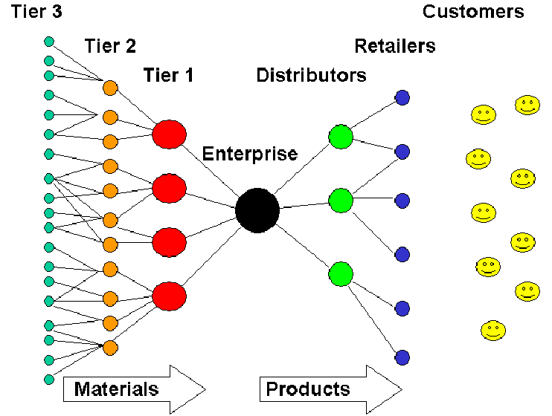
Example: Generic Supply Chain
4

Slide 5
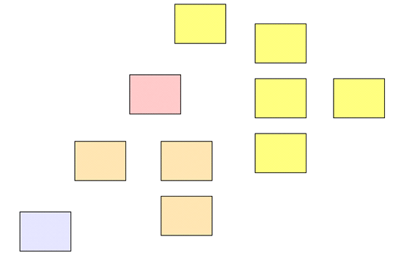
Separate Resources or Resource Components?
The boundaries we impose to identify resources determines whether some structure is internal or external with respect to them
5

Slide 6
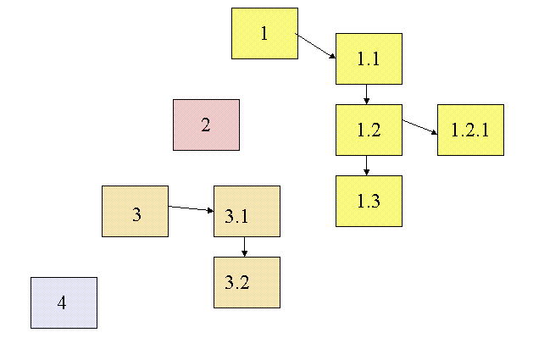
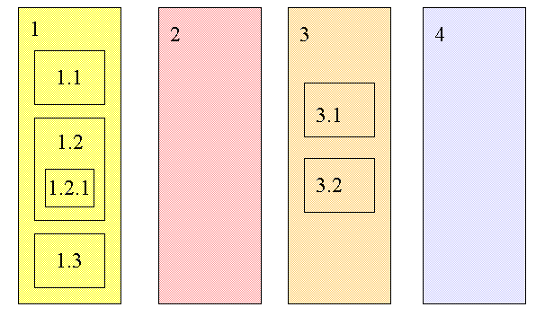
Changing Resource Boundaries Changes External to Internal Structure
Do these represent the same structural relationships among information resources?

Slide 7
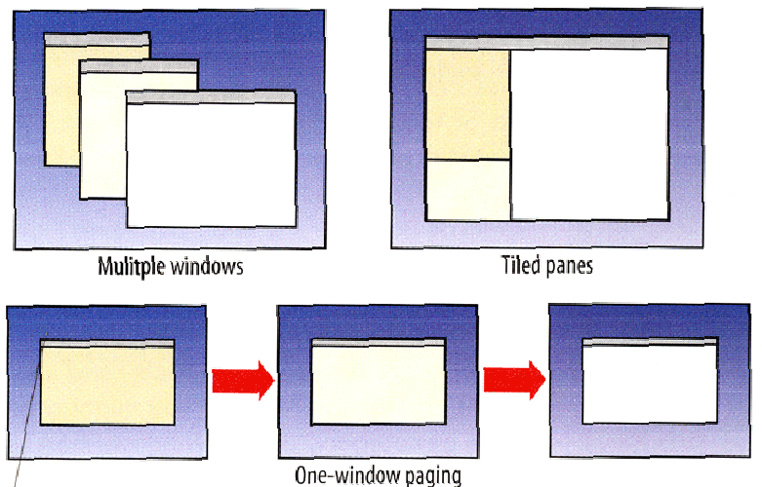
External or Internal Structures in a User Interface?

Slide 8
Internal Links in Documents
From one component to another
From document component to document component, pop-up (two-way, mandatory return link)
From document component to contained document component (call out)

Slide 9
Familiar Terms for Structures within Documents
Footnotes and Endnotes (often contain citations to external resources)
Cross references within the document
Pull quotes (structures for emphasizing some document content)
Sidebars (supplemental content)
Annotations (could be considered footnotes created by readers rather than by the author)
9

Slide 10
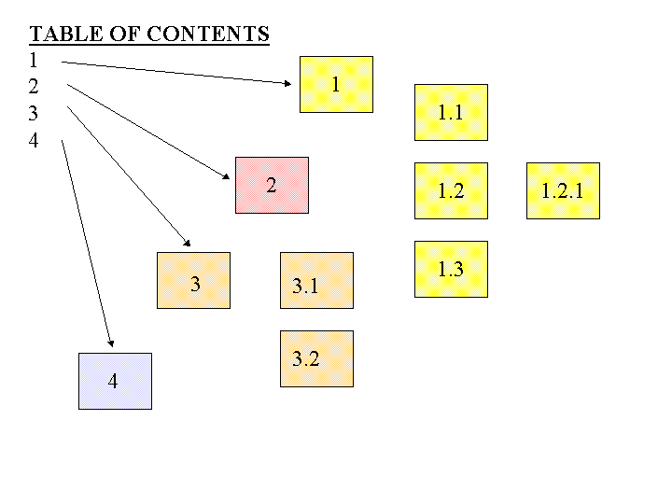
A Table of Contents is a Numeric Hierarchical Set of Structural Links to Document Components

Slide 11
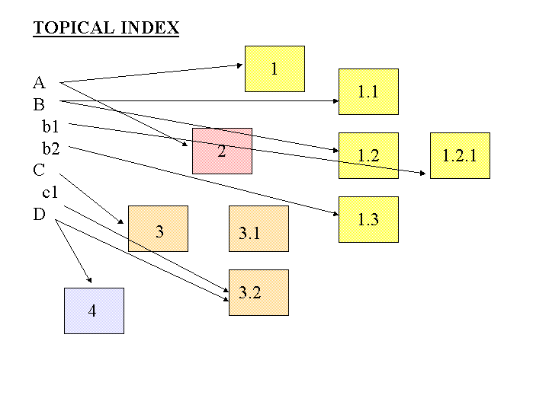
An Index is An Alphabetically Arranged Set of Semantic Links to Document Components

Slide 12
Annotation
An annotation is a link from some anchor to a newly-created destination, the contents of which are the BODY of the annotation
Highlighting can be conceived of as a link from an anchor back to itself where there is no new BODY created
12

Slide 13
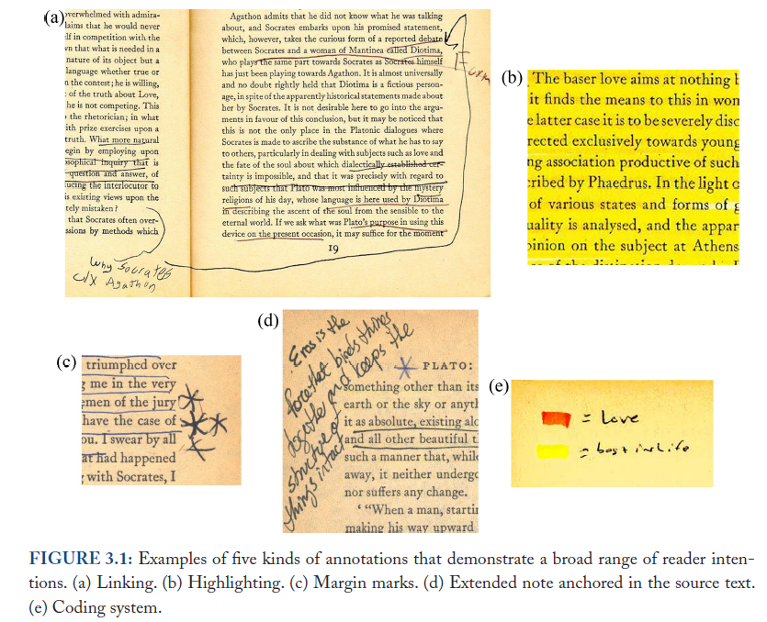
Annotation
Marshall, Reading and Writing the Electronic Book, 2010

Slide 14
“Hypertext” Vocabulary: Link Properties
Starting point of the link (the ANCHOR)
The end point of the link (the DESTINATION)
The reason for the link (the LINK TYPE)
The DIRECTIONALITY
The number of resource types (ARITY or DEGREE) or resource instances (CARDINALITY) linked to (1-1 or 1-many)
Example: Link from a word to its definition, a picture, and pronunciation
14

Slide 15
Separation of Link Concerns
These structural and semantic issues are distinct from presentation ones that UX designers deal with
Is the presence of the link indicated (the LINK MARKER)?
Does the link marker change to indicate that the link has been followed?
Is the LINK TYPE indicated by some presentation convention?
Is the DESTINATION TYPE indicated by some presentation convention?

Slide 16
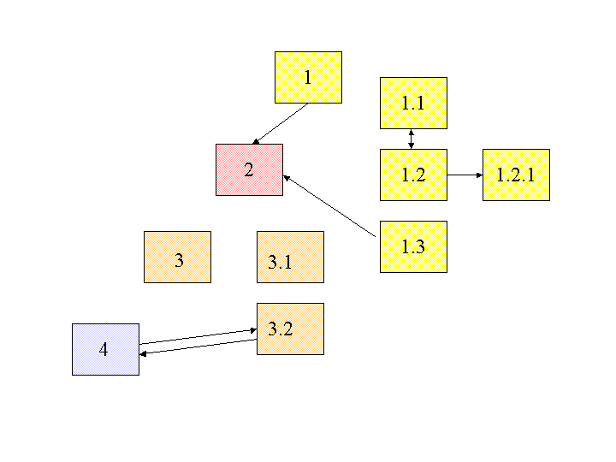
Embedded Links
Are the links embedded in the resources, or are they architecturally distinct in a “link base”?

Slide 17
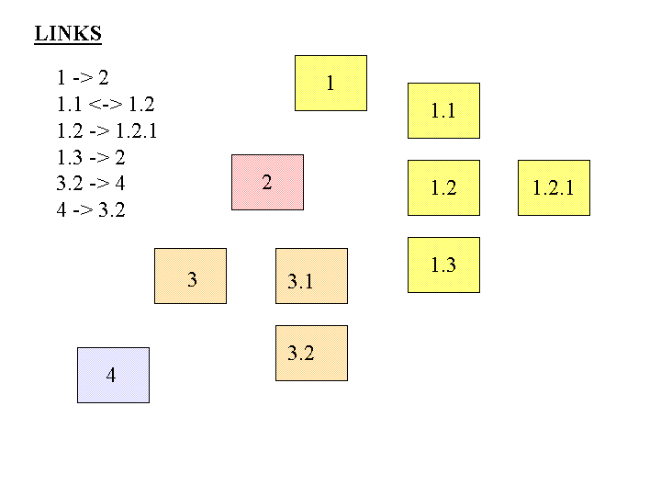
Separate Links
What would it mean to store links apart from the resources? What are the implications?

Slide 18
External or Between-Document Links
From document to document
From document to document component
From document component to document
From document component to document component

Slide 19
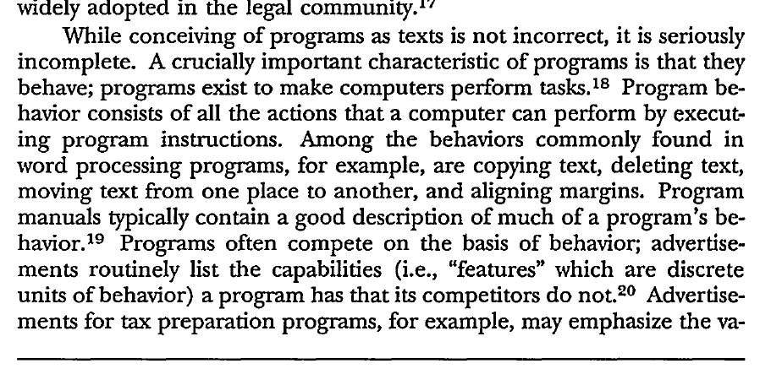
FOOTNOTE
COMPLEX STRUCTURES IN LAW ARTICLES
EXTERNAL CITATION
INTERNAL CITATION TO A PREVIOUS FOOTNOTE
“supra”
“infra”
INTERNAL CITATION USING A LATER FOOTNOTE AS INDIRECT POINTER

Slide 20
Thinking Abstractly About Linking
We can analyze all of these with some common concepts and abstractions
Links between printed or digital documents
Links between web pages
Links between databases
Links – communication and information flows - between people, organizations, any other kind of interacting “actors” or resources – social networks
20

Slide 21
Linking in Relational Databases
A relational database system consists of a set of data tables (often managed by a single firm)
The rows in a table describe resources; the columns are the values of the properties or attributes in the resource description
One of the properties is the “primary key” whose value uniquely identifies the resource in a given row of a particular table
Tables can be linked by using their “foreign key” – a resource description in one table that is the primary key in another

Slide 22
Linking Between Datasets
There are usually many collections of data about the same type of resources
But often the resources are not identified and described in the same way (because they are from different firms)
Different granularity
Different properties in the resource descriptions
Different perspectives or principles governing the values of the resource descriptions
If the same resources can be identified in different datasets, they can be linked

Slide 23
Alternative Vocabulary: Graph Theory
We can apply graph theory to understanding relationships from a structural perspective
A GRAPH treats resources as VERTICES or NODES
The pairwise relationships between resources are represented by the EDGES that connect them
If the edges have an associated direction, this is a DIRECTED graph
A WEIGHT can be assigned to each edge if the relationship is numerical (distance, cost, time, frequency of interaction, perceived strength, etc.)
23

Slide 24
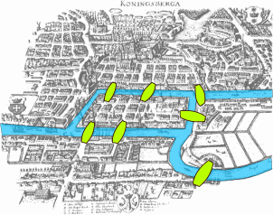
The Origins of Graph Theory (Euler 1735)
2 islands, 7 bridges – can you visit all 4 land masses without crossing any bridge more than once? Euler (1735) proved you couldn’t and invented much of graph theory to explain it
Euler’s Seven Bridges of Königsberg Problem
24

Slide 25
Three Network Representations
Edge List
Essentially the raw data, the list of relationships
Matrix
Necessary for computation
Graph
Easiest to grasp patterns

Slide 26
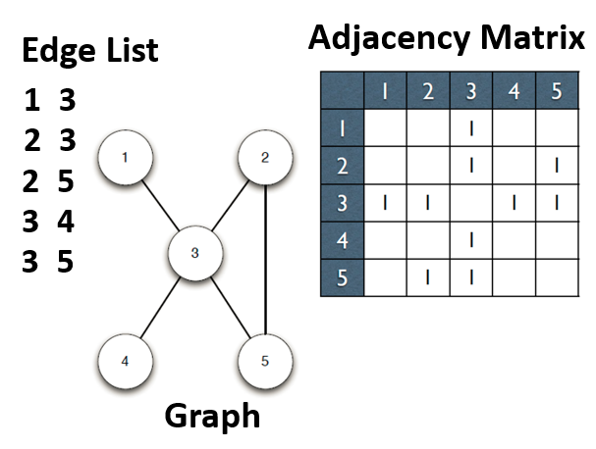

Slide 27
Relationship “Abstraction and Granularity”
A relationship between two people could be abstractly characterized as a “connection”
But it could also be analyzed with more granularity as a set of different relationships
Are they members of the same work organization?
Do they have face-to-face meetings
Do they regularly send email or text messages to each other?
Do they talk on the telephone?
Each of these more granular definitions of a relationship could define separate (but overlapping) networks

Slide 28
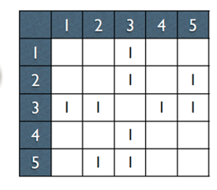
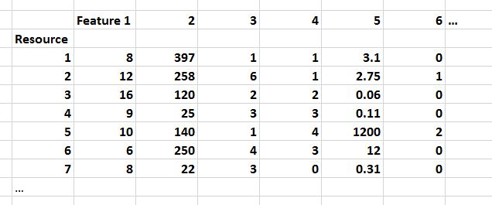
If this is all you’re given, give up!
FLASHBACK

Slide 29
Properties of Graphs
Reachability – is there a path between any two nodes in the graph?
Shortest path – if there are multiple paths between two nodes, which is the shortest?
Subgraph discovery – are there sub-graphs that are completely contained in a larger graph?
Centrality – which nodes are the most connected or have the average shortest paths to the other nodes?
29

Slide 30
Reachability and Transitive Closure
The REACHABILITY property of a graph is "can you get there from here”
We can determine whether a path exists between any two nodes in a graph by calculating the transitive closure of the graph
This is done by taking its adjacency matrix and raising it to the nth power, where n is the number of vertices in the graph
When we raise the graph to the kth power, we add exactly the edges which represent paths of length k in the original graph.
30

Slide 31
Degrees of Separation (“edge counting”)
If you have 44 Facebook friends, and each of those people has 44 friends who are not also your friends
And each of them has 44 friends, and each of those has 44 new friends…
In a chain of just 6 steps, you would be connected to 44 ^ 6 people…. Which is 7,256,313,856 (everyone in the world, but they’re not all on Facebook)
A 2011 Facebook analysis computed the average “degree of separation” of any two individuals in the “Facebook world” to be 4.74
The Oracle of Bacon
31

Slide 32
Shortest Path (weighted edges)
If edges are weighted (different costs in distance, time, etc.) the shortest path between two nodes in the graph might not be the one with the fewest edges
The shortest path problem is ubiquitous and its solution has obvious value – travel, transportation, grocery shopping, financial arbitrage…
32

Slide 33
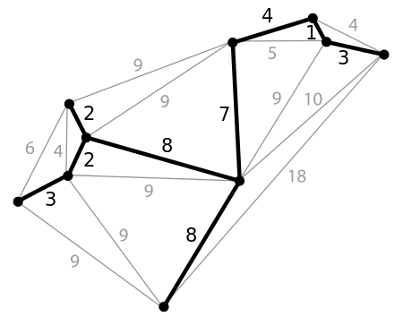
Minimum Spanning Tree
A spanning tree of a graph is a subgraph that is a tree that connects all the vertices
Why would we want to find the spanning tree with the shortest path?
33

Slide 34
Centrality Measures
Degree Centrality – number of direct connections
Closeness – low average path length
Betweenness – a location in the network that interconnects different clusters
34

Slide 35
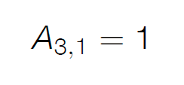
Are 3 and 1 connected?
In-degree is the number of incoming connections
Out-degree is the number of outgoing connections
In an undirected graph like this these numbers are the same!

Slide 36
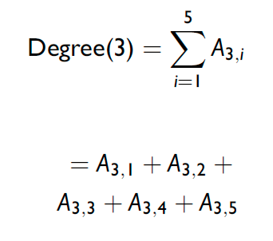
Computing “Degree Centrality”

Slide 37
“Degree Centrality” for Each Node

Slide 39
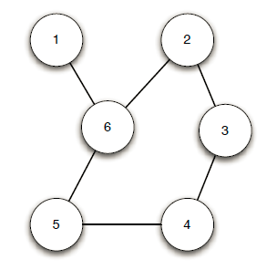
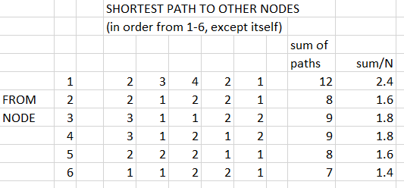
A More Complex Example
Does Node 6 Seem The Most Central?
Does Node 1 Seem The Least Central?

Slide 40
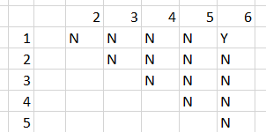
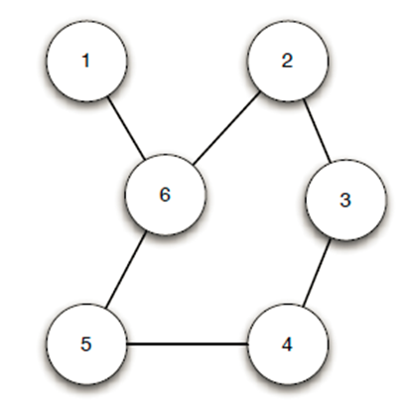
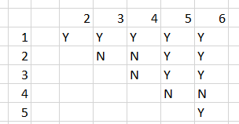
Betweenness Centrality
Node 1 - On 1 Shortest Path
How often does a node fall “between” any two nodes on their shortest path?
Node 6 – On Many Shortest Paths

Slide 41
Moving Beyond Graph Analysis to “Relational” & “Social Network” Analysis
We've been treating relationships in purely structural terms - is one thing connected to another - but we can refine that into two perspectives:
RELATIONAL analysis treats links as indicators of the amount of connectedness or the direction of flow between documents, people, groups, journals, disciplines, domains, organizations, or nations
EVALUATIVE analysis treats links as indicators of the level of quality, importance, influence or performance of documents, people, groups
41

Slide 42
Social Networks
When nodes represent people, groups, organizations, etc., thee structure of the graph and the weights assigned to edges can be interpreted in social terms like popularity power, and influence
Many social networks are directed graphs because of asymmetries in status, power, or values
Tightly connected communities can hinder rather than help the spread of information (or innovations)
Analogy to epidemics… if there is some probability of infecting someone you come into contact with, the more different people you encounter will determine how fast a disease spreads
42

Slide 43
Questions about Individuals
Who is the most popular person in the network?
Who has the most influence?
Who connects or serves as the bridge/gatekeeper between different groups
If you want to disrupt a network, which individual should you remove (or convince to defect, subvert, etc.)
Can we predict social behavior by analyzing patterns in the structure of the network?
43

Slide 44
NSA’s Social Network Analysis (as revealed by Edward Snowden)
The agency was authorized to conduct “large-scale graph analysis on very large sets of communications metadata without having to check foreignness” of every e-mail address, phone number or other identifier, the document said.
The agency can augment the communications data with material from public, commercial and other sources, including bank codes, insurance information, Facebook profiles, passenger manifests, voter registration rolls and GPS location information, as well as property records and unspecified tax data, according to the documents.
NSA Gathers Data on Social Connections of US Citizens.
NY Times 28 Sept 2013
44

Slide 45
Today’s Group Work
Calculate and interpret centrality measures for a social network

Slide 46
A Small Social Network
10 Nodes (people) and 18 Edges (representing their professional interactions).

Slide 47
Centrality Measures
Degree Centrality – number of direct connections
Closeness – low average path length
Betweenness – a location in the network that interconnects different clusters
47

Slide 48
Computing “Degree Centrality”

Slide 50
Betweenness Centrality
Node 1 - On 1 Shortest Path
How often does a node fall “between” any two nodes on their shortest path?
Node 6 – On Many Shortest Paths

Slide 51
Answer these Questions
Who is the most connected person?
Who is the least connected person?
Which person has the most influence?
Who connects or bridges different sub-groups?

Slide 52
DO THE CALCULATIONS BEFORE LOOKING AT THE NEXT SLIDES
(the answers!)

Slide 53
Questions About Individuals
Who is the most/least connected person?
Diane is the most connected, but she’s connected to people who are all connected to each other
The least connected person IN THIS NETWORK is Jane
Which person has the most influence?
Fernando and Garth have the highest “closeness” scores and so are well positioned to know what’s going on in the entire network (and can influence everyone more easily than anyone else)
Who connects or bridges different sub-groups?
Heather has the highest “betweenness” score; she keeps Ike and Jane connected to the “Diane” clique and so she is also very influential

Slide 54
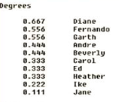
Calculations taken from http://www.orgnet.com/sna.html

Slide 55
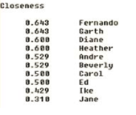
Calculations taken from http://www.orgnet.com/sna.html

Slide 56
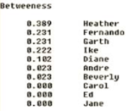
Calculations taken from http://www.orgnet.com/sna.html

Slide 57
Relationships with Other Organizing Systems
FLASHBACK
No organizing system exists in isolation
There are always overlapping and adjacent systems from the user’s perspective…
Don’t Feel Sorry for Ike & Jane
Ike and Jane have low centrality scores for THIS NETWORK… but Ike and Jane are not in the “small company” that everyone else works for, and they have their own networks that are not depicted when the network is scoped to emphasize the relationships in that company
57

Slide 58
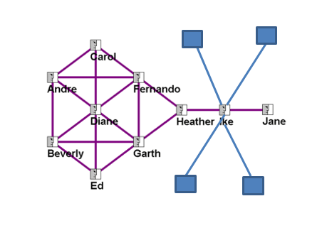

Slide 59
The PageRank of a page is defined recursively and depends on the number and PageRank metric of all pages that link to it ("incoming links"). A page that is linked to by many pages with high PageRank receives a high rank itself.
It weights the contribution of the incoming links by dividing it by the number of their outgoing links

