Slide 1
CogSci 190 “Sensemaking and Organizing” Spring 2019
Robert J. Glushko glushko@berkeley.edu
12 March 2019
15) Causality and Explanation

Slide 2
Where Does The Sun Go At Night?
Irwin: Where does the Sun go at night?
Broom-Hilda: It’s kept in a big barn in California.
Irwin: Then how does it get back East in the morning?
Broom-Hilda: By bus.
Irwin: Things are so easy to understand when you have a smart person to explain them!
Does Broom-Hilda’s response explain Irwin’s observations?
Why is it inferior to other explanations involving the Sun?

Slide 3
Why Does It Rain?
CHILD: It rains so we can have water to drink
EDUCATED ADULT: It rains because water vapor condenses in clouds and forms droplets
ADULT ALZHEIMER’S DISEASE PATIENT: It rains so we can have water to drink
Is it cognitively innate and natural to believe that things and events have a purpose?
What changes or constrains this preference or belief in purposeful design?
Does “purposeful design” require a designer?

Slide 4
Jane Gets Sick
Jane gets food poisoning after eating at a restaurant. Should she return to the restaurant?
What do you need to know to answer this question?

Slide 5
Diseases on Planet Zorg
Treda, who lives on planet Zorg, is ill with two symptoms: her minttels are sore and she has developed purple spots.
Trichet’s syndrome always causes sore minttels and purple spots
Morad’s disease always causes sore minttels, but never causes purple spots.
A Humel infection always results in purple spots, but the infection will never cause sore minttels.
WHAT IS CAUSING TREDA’S SYMPTOMS?
1. Treda has Trichet’s syndrome
2. Treda has Morad’s disease
3. Treda has a Humel infection
4. Treda has Trichet’s syndrome and also has Morad’s disease
5. Treda has Trichet’s syndrome and also a Humel infection
6. Treda has Morad’s disease and also has a Humel infection
7. Treda has Trichet’s syndrome, Morad’s disease, and a Humel infection

Slide 6
What Is Causing Treda’s Symptoms?
#1 – Trichet’s Syndrome – is sufficient to explain both sore minttels and purple spots
#2 – Morad’s disease – can’t be correct because it can’t explain why Treda has purple spots
#3 – Humel infection – can’t be correct
#4 – Trichet and Morad together - explains both
#5 – Trichet and Humel together – explains both
#6 - Morad and Humel together – explains both
#7 – All three together – explains both symptoms
#1, 4, 5, 6, and 7 are correct but 96% of people choose #1. Why?

Slide 7
Outline
Causality {and, or, vs.} Explanation
Causality in Philosophy
Issues and Implications in “the Search for Meaning”
Other Contexts for studying Causality and Explanation
Cognitive Development
Social Psychology
Religion
Philosophy of Science
Economics
Legal Reasoning
AI

Slide 8
“It is somewhat surprising, given how central the idea of causality is to our daily lives, but there is simply no unified philosophical theory of what causes are, and no single foolproof computational method for finding them with absolute certainty.”
Kleinberg, S. (2015). WHY: A Guide to Finding and Using Causes. Chapter 1

Slide 9
“The question often boils down to whether we should see causes as a fundamental building block or force of the world (that can’t be further reduced to any other laws), or if this structure is something we impose.”
Kleinberg, S. (2015). WHY: A Guide to Finding and Using Causes. Chapter 1
Can you see why “causality” is relevant to sensemaking and organizing?

Slide 10
What is a Cause?
(Kleinberg) “Cause” generally means something:
that makes an effect more likely
without which an effect would or could not occur
or that is capable of producing a certain effect under the right circumstances.
A cause can be a “story” that ties several events or observations together to make them coherent
It can be based on something you perceived
Or it can be based on INFERENCE, indirectly deducing causality using your understanding of some mechanism that could create the effect

Slide 11
Causality {and, or, vs.} Explanation
Explanations often mention causes, but not all explanations are causal, and not all causes are explanatory
Causal claims are often answers to why or how something occurred
The nature of the explanation can affect whether people can learn and reason about causes
We often infer that a causal hypothesis is true because it best explains the data

Slide 12
What Causes Causality?
What makes some sequences of events causal, so we make inferences about similar events, and other sequences non-causal?
Causes are not deducible, and are not always explicitly visible in sensory input
When you see a brick go through a window, a billiard ball strike another and make it move, or a match light a candle, you have an impression of causality based on the sensory input.
But what are the causes of good or poor health?
When we count, 6 is always followed by 7. Does 6 cause 7?

Slide 13
Causal Mechanisms
Our judgments of causality are influenced by knowledge of possible causes, so we can reason even when we don’t see the cause and effect together
These two complementary ways of inferring causes, one using covariations (how often things happen together) and the other using mechanistic knowledge (explanations of how the cause produces the effect) can work together

Slide 14
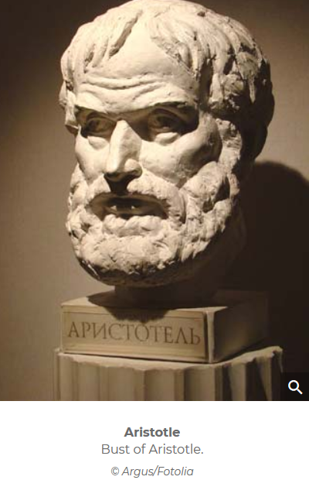
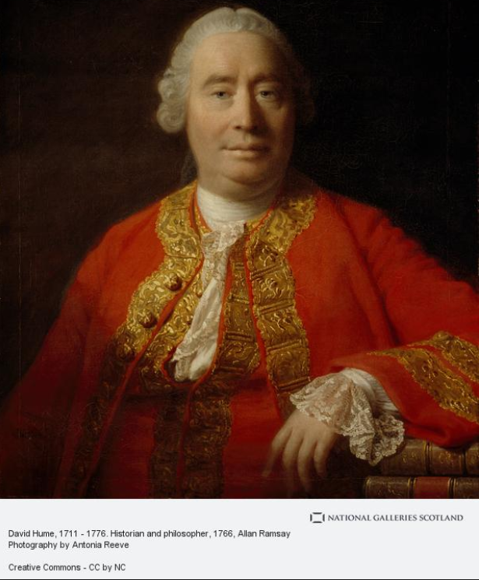
Causality in Philosophy
The concept of causality is central in philosophy and has a very long history
Aristotle (about 2400 years ago) defined four types of causes or “modes of explanation” that distinguish four types of answers to the question of why something happens
Hume (300 years ago) crisply analyzed the question of how we identify causal relationships

Slide 15
The Problem of Induction
Hume and other philosophers posed and struggled with “the problem of induction”
how can we justify making any generalization or inference about the properties of some class of things after observing some instances of the class?
No matter how many observations we’ve made, we haven’t seen all of them
Our sample could be too narrow; there could be other variables that influence the observations
How would your concept of “bird” differ if you grew up in the desert, in the mountains, or in the tropics near the ocean?
Why would a data scientist care about this problem?

Slide 16
Hume: How Do We Find Causes?
Causes are inferred from the spatial and temporal contiguity of the cause and effect
The cause comes first
Whenever the cause comes, the effect happens
By repeatedly seeing things happen together, we develop causal hypotheses
Causes are relationships that are distilled patterns of regular occurrence

Slide 17
Michotte’s Demonstrations
Inspired by David Hume and others, Albert Michotte in 1946 devised an elaborate mechanical apparatus that allowed him to manipulate the animation of two objects on a projection screen.
Both could move left and right at various speeds and with various delays. Small variations in their movement produced large variations in the way his subjects described what they saw.

Slide 18
Some Difficulties with “Temporal Contiguity”
Can we always tell what came first?
When a gun fires, a flash and then a loud noise follow.
So we can conclude that the gun causes the flash, and that the flash causes the noise
Two events might seem to be simultaneous only because of the granularity of measurements or limitations on our observation ability
Can we infer causes when there is a long delay between the cause and effect?
What causes climate change?

Slide 19
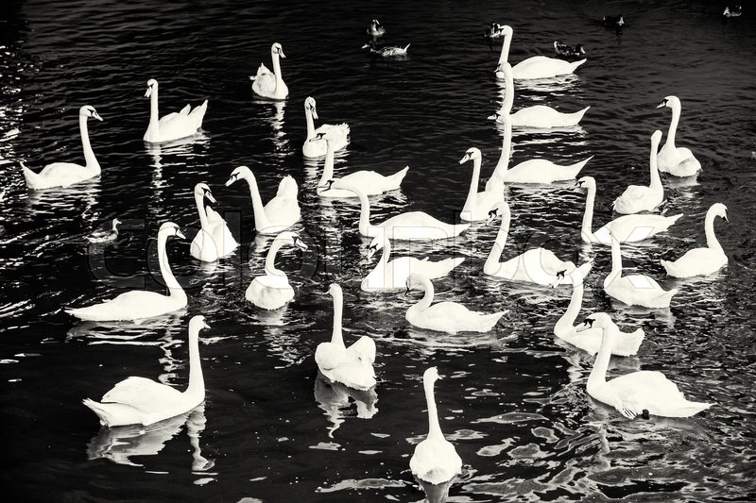
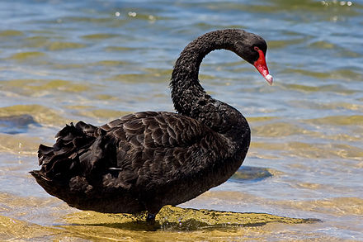
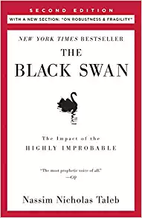
Black Swans
Example:
OBSERVATIONS: Every swan you’ve ever seen is white
INFERENCE: All swans are white
BUT in Australia there are black swans
Today a “black swan” is a metaphor for a rare unexpected event

Slide 20
The “Search for Meaning” (1)
People have a cognitive bias to see order and purpose in the world
It is essential for survival to understand and predict the properties and behaviors of:
Physical objects and substances (Physics)
Plants and animals (Biology)
Other people (Psychology)

Slide 21
The Search for Meaning (2)
People also have a bias to prefer simpler explanations to complex ones
The knowledge structures for simpler explanations are easier to remember and reason with
This idea is embodied in the principle called “Occam’s Razor” and in machine learning techniques that penalize models that use more parameters or more complex functions

Slide 22
The “Search for Meaning” (3)
The vast majority of our decisions are influenced—at least in part—by our beliefs about the causal structure of the world
Which include our beliefs about what other people will do and why they will do it (“theory of mind”)
But both kinds of beliefs are often wrong

Slide 23
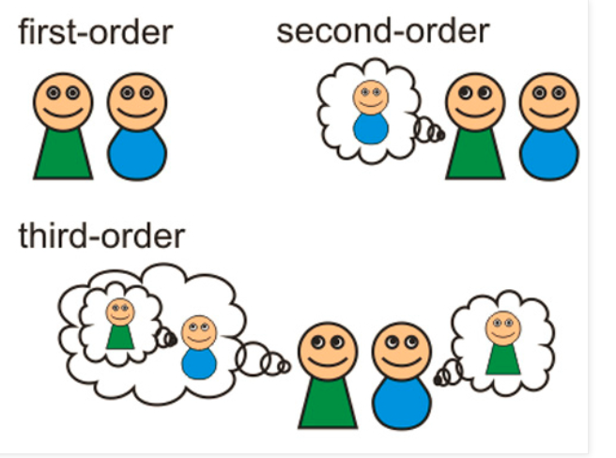
Theory of Mind
http://integral-options.blogspot.com/2013/08/theory-of-mind-mechanisms-methods-and.html

Slide 24
The “Search for Meaning” (4)
People also have a cognitive bias to see order and purpose in their lives
It is essential for psychological well-being to believe that your life has meaning
People (and literature) create “stories” to give some set of events or experiences some coherent explanation
(and both kind of stories are often fictions)
(We’ll talk about the “narrative fallacy” on March 21)

Slide 25
“ a belief in some sort of guiding intentional agency or cosmic order in life is pervasive even among the non-religious due to a deeply-rooted social-cognitive bias to imbue the world with agency, intention, and purpose”
Banerjee, K., & Bloom, P. (2014). Why did this happen to me? (p. 278)

Slide 26
The “Search for Meaning” (5)
People don’t like randomness or not being able to predict the future
So people like to use the probability of an event occurring to support a causal conclusion, even when it is inappropriate
“That’s too much of a coincidence for this to be happening by chance… something must have caused it”
(We’ll also talk about “judgment under uncertainty” on March 21)

Slide 27
The “Search for Meaning” (6)
This human need for order and purpose is especially important when dealing with emotional or traumatic life events
It often motivates a person to identify with and support the values and goals of a larger group – a family, profession, nation, religion

Slide 28
“a belief in a benevolent, purposeful God satisfies humans’ fundamental psychological need for control—particularly in circumstances where people lack personal control”
Banerjee, K., & Bloom, P. (2014). Why did this happen to me? (p. 301)

Slide 29
Have You Ever Said?
“things happen for a reason”
“he got what was coming to him”
“the world was teaching him a lesson”
“my destiny was to be …”
“it was fate”
“it was God’s will”

Slide 30
“Even when an event’s material cause is obvious, people often explain the same event simultaneously as due to both natural non-teleological processes and supernatural goal-based influences”
Banerjee, K., & Bloom, P. (2014). Why did this happen to me? (p. 278)
What is the benefit of invoking both kinds of explanations?

Slide 31
Teleology (1)
Teleology, (from Greek telos, “end,” and logos, “reason”), explanation by reference to some purpose, end, goal, or function
People generally explain their actions and those of others in terms of ends or goals pursued or alleged to be pursued
Theories of our mind and our theories of other minds

Slide 32
Teleology (2)
People often use teleological reasoning (appropriately) when analyzing the design of “human-made” artifacts, which are most often designed and built for particular purposes
The saw is sharp so it can cut things
X helps there to be more Y; It is better for X to have Y property; X exists so that/for Y

Slide 33
Promiscuous Teleology
“Promiscuous teleology” is the inappropriate application of teleological reasoning to living species and natural objects; “backwards causality” when a functional consequence is its own cause
Birds have wings so they can fly
Clouds are for raining, mountains are for climbing

Slide 34
Natural Theology
The strongest form of PT is in creationist views of the universe – starting with “Natural Theology” arguments of William Paley at beginning of 19th century
The great complexity and adaptation seen in nature must have been designed, and the perfection and diversity of these designs shows the designer to be omnipotent, the Christian God
When he was a student, Charles Darwin wrote to Paley and praised his arguments... 20 years later he refuted them when he proposed “natural selection” as the evolutionary mechanism that made a purposeful designer unnecessary

Slide 35
Some of the 79 Species of “Butterflyfish”

Slide 36
“Christians and Hindus generally conceive of fate in different ways; Christians primarily hold an agentic deity-centered worldview while Hindus believe in both a deity-centered worldview and also a non-agentic, destiny-centered conception of fate”
Banerjee, K., & Bloom, P. (2014). Why did this happen to me? (p. 278)

Slide 37
Karma
Karma in several Eastern religions is the spiritual principle of cause and effect where intent and actions of an individual (cause) influence the future of that individual (effect)
Good intent and good actions contribute to good karma and future happiness, while bad intent and bad actions contribute to bad karma and future suffering
Hindu theories of salvation posit that future births and life situations will be conditioned by actions performed during one’s present life—which itself has been conditioned by the accumulated effects of actions performed in previous lives.

Slide 38
Dharma
A key moral and religious concept with multiple meanings in Hinduism, Buddhism, and Jainism
In Hinduism, dharma governs individual conduct; some dharma applies to everyone (sadharana dharma)—consisting of truthfulness, non-injury, and generosity, among other virtues
there is also a specific dharma (svadharma) to be followed according to one’s class, status, and station in life
this second type of dharma is sometimes translated as “destiny”

Slide 39
Why We Need Causes (1)
Prediction
Causes provide more robust ways of forecasting events than do correlations
If we don’t know why a prediction works (why does winning a particular state lead to winning the presidential election?), we can never anticipate its failure
Understanding why factors are predictive can improve both the accuracy and cost of decision-making (you won’t collect unnecessary data)

Slide 40
Why We Need Causes (2)
Explanation
Knowing the cause of an event is essential if you want to repeat it or prevent it
Jane gets food poisoning after eating at a restaurant. Should she return to the restaurant?

Slide 41
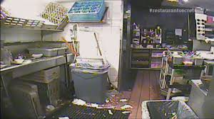
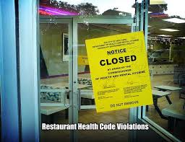
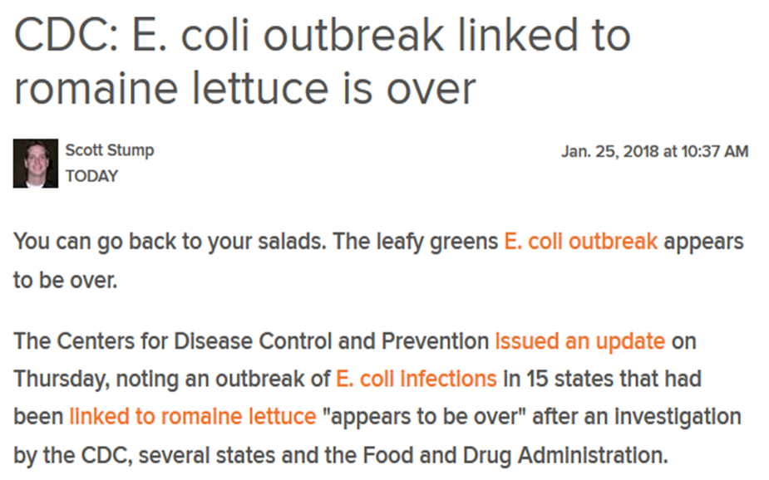
What Caused Jane’s Food Poisoning?
Poor restaurant hygiene? Don’t go back!
One-time contamination of a food ingredient? OK to return (try something else)

Slide 42
Why We Need Causes (3)
Intervention
We don’t just want to learn why things happen; we want to use this information to prevent or produce outcomes
If we have a correlation but don’t distinguish the cause from the effect our understanding will be “backwards”
We must be sure that interventions target causes that can actually affect outcomes. If we intervene only on something correlated with the effect then the interventions will be ineffective

Slide 43
Why We Need Causes (4)
Intervention
Explanations that explain why time passes between cause and effect, or how long it takes for the effect to be produced, are essential for intervention
If you have smoked cigarettes for 40 years, giving up smoking probably won’t significantly reduce your chances of getting lung cancer

Slide 44
Ineffective Interventions
If smoking cigarettes causes lung cancer
banning matches and lighters to reduce to reduce smoking is likely to be ineffective

Slide 45
Unobservable Causality
Some things are caused by the absence of a factor, which can’t be observed
A lack of vitamin C causes scurvy
Psychological states like beliefs or intentions can be causes, and they can’t be observed either (at least not easily)

Slide 46
Counterfactuals
How can we discover a cause when the absence of a factor causes an effect?
Hume proposed the counterfactual approach, which defines causes in terms of how things would have been different had the cause not occurred
If you hadn’t run the red light, the car crash wouldn’t have happened …. So you caused the car crash!
Counterfactuals are the building blocks of scientific thinking and legal/moral reasoning

Slide 47
Causal Attribution (Shamu Question)
We often talk about causes “in general” – “Type-level” causality
Distracted or drunk drivers cause car accidents
We also take about causes of specific events – “causal attribution” or “token causality”
What caused the accident last week when Bob crashed his car into Ed’s bike?

Slide 48
Some Refinements About Attribution
We often need to distinguish between:
The cause closest to, or immediately responsible for causing, some observed result
This is the actual cause.
Bob’s car hit Ed’s bike because Bob was distracted
the "real" reason something occurred in some larger or longer context (often called the Ultimate (or Distal) cause
Bob hasn’t slept well lately because he’s worried about the stock market; Bob is worried about the stock market because he wants to retire soon

Slide 49
Causes and the Law
The cause-in-fact or actual cause is the action that is immediately responsible for some result; it typically is something that takes place right before some negative event occurs
More important, however, is the legal or proximate cause that a court deems as the primary cause for the negative event. It is an action that produced foreseeable consequences without intervention from anyone else

Slide 50
Intentionality and the Law
Culpability for bad outcomes is based on the intentionality behind the proximate cause
Why we distinguish “caused deaths” on the spectrum from “involuntary manslaughter” to “first degree murder
If I deliberately drove onto the sidewalk so I could crash into Ed’s bike, it is a worse offense than if I lost control of my car because the brakes failed
Counterfactual reasoning is essential – we compare the actual outcome with what would have happened if the defendant’s action had not taken place

Slide 51
Causality {and,or,vs.} Probability
For Hume, a causal relationship implies law-like necessity
But many causal relationships are probabilistic, where the antecedents make the consequences more likely but not certain:
Reckless driving causes accidents
Lazy students fail my courses
Probabilistic causal relationships can be represented with directed graphs (an arc between X and Y in the graph means that X is a direct cause of Y)
These “Bayesian networks” are causal models that show how many factors are probabilistically connected

Slide 52
Scientific Explanation
Humankind has searched for scientific knowledge for several thousand years
Philosophers of science have long distinguished between “knowing that” (description) and “knowing how” (explanation)
But what counts as “reasonable explanation” has changed qualitatively over time

Slide 53
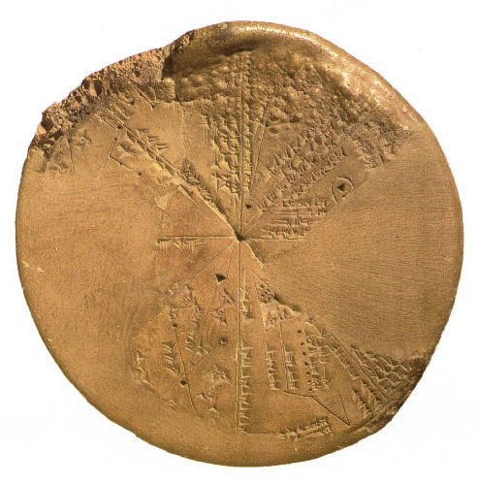
FLASHBACK
We Have Always Organized/
Tried to Make Sense
For thousands of years, even before the invention of written language, people have systematically collected things, information about those things, and observations of all kinds to understand how their world works
Babylonian Astronomy
Ancient Egyptian Hydrology – Nile Flood Records
53

Slide 54
Thagard: Types of Scientific Explanation
Theological
Qualitative
Mechanistic
This can be considered as “intellectual development of the human species” (vs. cognitive development of a single person)

Slide 55
Theological Explanation
the primary explanatory entities are supernatural ones beyond the reach of science, such as gods, devils, angels, spirits, and souls;
No need to tie the explanation to observations about natural details
many cultures worldwide have different accounts of how one or more deities brought the Earth and the living things on it into existence.

Slide 56
Fire: Theological Explanation
The god Zeus gave the task of creating man from water and earth to Prometheus
Prometheus empathized with his human creations and stole fire from the gods to give to mankind
Zeus punished Prometheus by chaining him to a rock so eagles could chew on his liver

Slide 57
Qualitative Explanation
Explanations that reject supernatural entities, but which postulate natural entities not far removed from what they are supposed to explain
It might seem as though observations are relevant, but they are often interpreted tautologically
Living things have a “vital force” in them that creates life and which leaves the body upon death (aka “soul”)

Slide 58
Fire: Qualitative Explanation
In Greek philosophy, fire is one of four fundamental elements or substances
Aristotle: the most important property of “fire atoms” was that they were hot and dry
Fire is also a fundamental substance in traditional Indian religions with the same qualitative arguments

Slide 59
Mechanistic Explanation
Explanations consist of identifying systems of discrete interacting parts that produce observable changes
Mechanistic explanation evolved with the understanding of the human biology (dissection, body parts and systems) and especially with the invention of more complex machines
Mechanical machines were especially important in enabling more complex explanations of natural phenomena

Slide 60
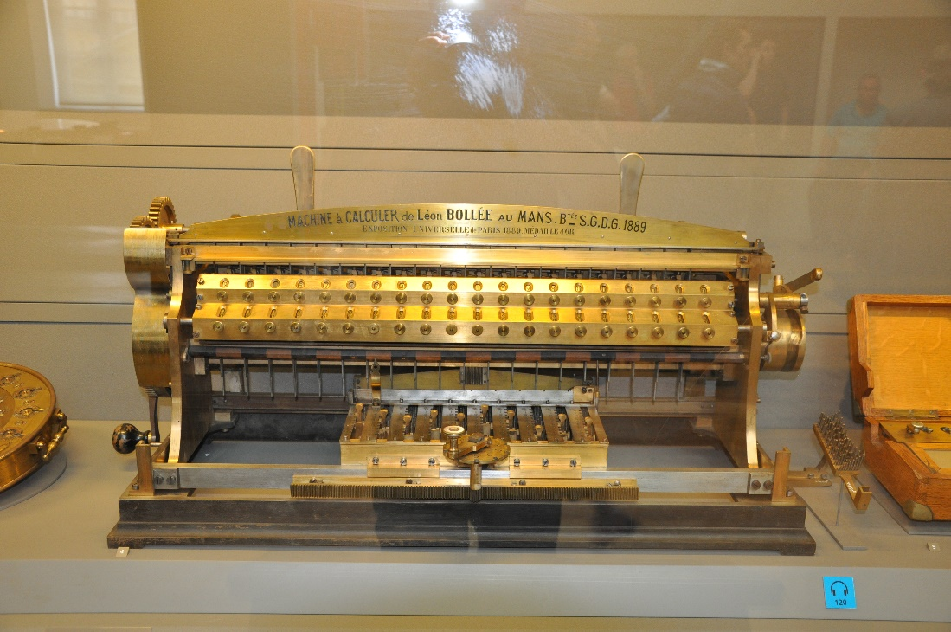
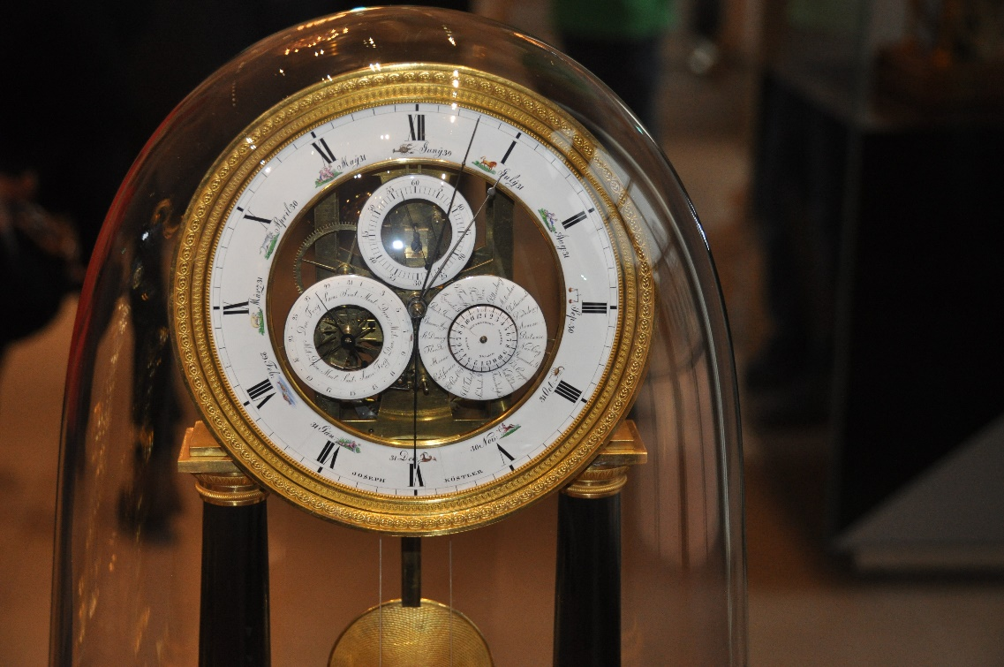
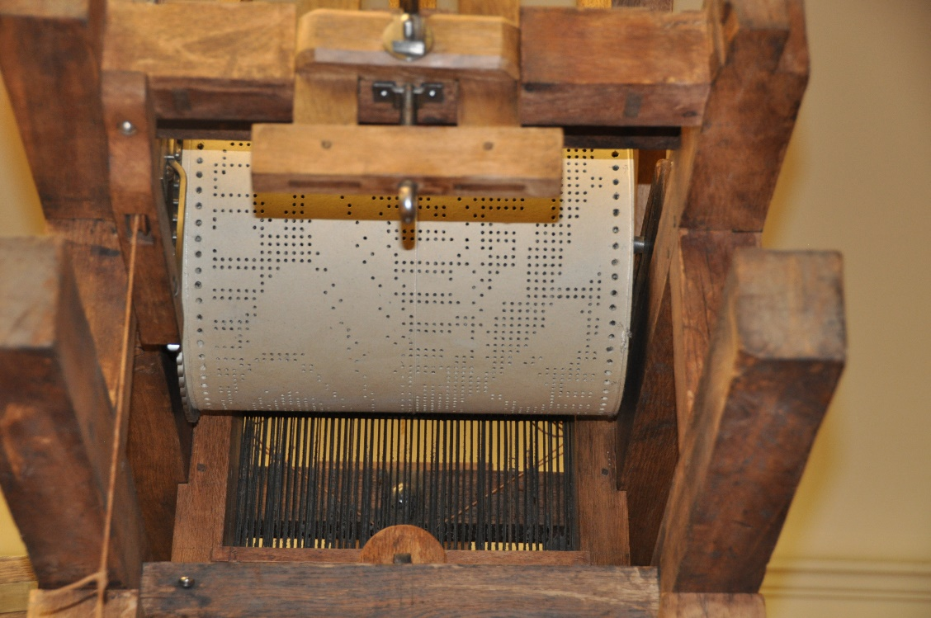
Calculating Machine (right)
Clock (below)
Programmable loom (lower right)

Slide 61
Fire: Mechanistic Explanation
Fire is rapid oxidation, a chemical reaction between oxygen and some kind of fuel
The reaction begins when the fuel reaches its ignition temperature
The heat released by oxidation sustains and grows the fire and can be controlled by careful fuel management

Slide 62
Mechanistic Explanation: Advantages and Disadvantages
+ Mechanistic explanations can be based on or complementary to scientific laws that are grounded in physics, chemistry, or other “hard” sciences
+ If you understand the mechanism, you can perform causal reasoning about the system without ever observing it in operation
- Mechanistic explanations often conflict with theological ones that are emotionally more satisfying

Slide 63
Conceptual Change in Science in terms of Knowledge Representation
Scientific explanation proceeds at different rates… some is relatively simple, incrementally addition of facts and concepts
Other changes are discontinuous and highly disruptive
These different degrees of change can be distinguished in terms of changes to the semantic structure or ontology of a scientific domain

Slide 64
Degrees of Conceptual Change
Learning about a new instance of a concept
Learning a new weak rule about some fact
Learning a new strong rule useful in problem solving and explanation
Learning new part-whole relation (adding a hyponym)
Learning a new kind-relation (splitting a hypernym)
Adding a new concept
Merging two hypernyms
Branch jumping – moving a concept to another part of the semantic taxonomy
Tree switching – changing the organizing principle embodied in a semantic taxonomy

Slide 65
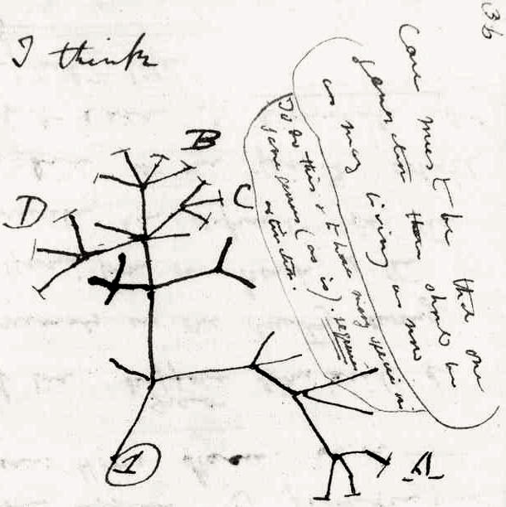
Darwin’s Radical Conceptual Changes
“Branch Jumping”- reclassifying people as animals
“Tree Switching” – changing the organizational principle of the tree of life to be evolutionary rather than morphological

