Slide 1
CogSci 190 “Sensemaking and Organizing” Spring 2019
Robert J. Glushko glushko@berkeley.edu
14 March 2019
16) Categories made by individuals, individual differences in organizing and sensemaking; cognitive overload and offloading; distributed cognition and taskonomy

Slide 2
Individual Categories
FLASHBACK
Created to satisfy ad hoc requirements that emerge from an individual’s unique experiences, preferences, and resource collections
Created intentionally in response to specific organizing requirements, often short-term ones
Can have an imaginative or metaphorical basis that distorts or misinterpret cultural categories
Collection hobbies often embody peculiar individual categories
2

Slide 3
Outline
Information Overload and Dealing with It
The Memex
Personal Information Management
Distributed Cognition
The Intelligent Use of Space
Cognitive Offloading
Activity-based or “Taskonomic” Organizing

Slide 4
You Don’t Need This Fake Graphic To Know That TMI Is A Thing
Eppler, M. J., & Mengis, J. (2004). The concept of information overload
“The quality of decisions or reasoning in general of an individual correlates positively with the amount of information he or she receives—up to a certain point. If further information is provided beyond this point, the performance of the individual will rapidly decline”
Why is this a “fake” graphic?

Slide 5
Definitions of Information Overload
Too much information supply
Too little processing capacity
Too little time to process the information
Too little time to interact with relevant people
When a backlog of “reading matter” builds up
Feelings of stress, confusion, pressure, anxiety, and low motivation for information-intensive tasks
Why does it matter how we define information overload? Can any of these definitions be the basis of quantitative measurement?

Slide 6
Factors Influencing Information Overload
Information quantity, frequency, intensity, and quality
The capabilities of the person receiving, processing, or communicating the information
The processes and tasks for the information
The information technology used
Formal and informal organizational / communication structures (“Social Thinking”)

Slide 7
Countermeasures to Overcome Information Overload
Better personal information management
Better selection of information sources
Exploit technology for automatic and assisted information organization and use
…. How well does this work in our Facebook or Twitter feeds?

Slide 8
Vannevar Bush
MIT Scientist (Claude Shannon was one of his grad students)
Ran the Office of Scientific Research and Development during WW2, which coordinated all the work of scientists (including the Manhattan project)
His efforts after the war to continue federal funding for scientific research led to creation of NSF
8

Slide 9
“There is a growing mountain of research. But there is increased evidence that we are being bogged down today as specialization extends. The investigator is staggered by the findings and conclusions of thousands of other workers—conclusions which he cannot find time to grasp, much less to remember, as they appear.”
“The difficulty seems to be…that publication has been extended far beyond our present ability to make real use of the record.”

Slide 10
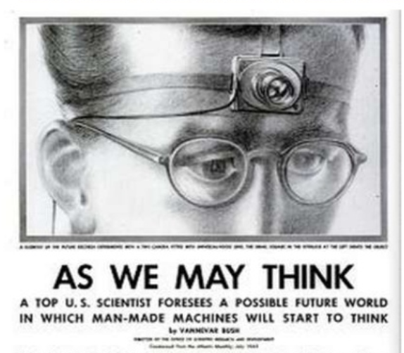
A memex is a device in which an individual stores all his books, records, and communications, and which is mechanized so that it may be consulted with exceeding speed and flexibility. It is an enlarged intimate supplement to his memory.
Consider a future device for individual use, which is a sort of mechanized private file and library

Slide 11
The Memex
11

Slide 12
Memex Big Ideas
“The human mind works by association” -> hypertext linking in “trails”
Because trails are separate packages of links, they can be shared and combined
Text or voice annotation of documents
Speech synthesis

Slide 13
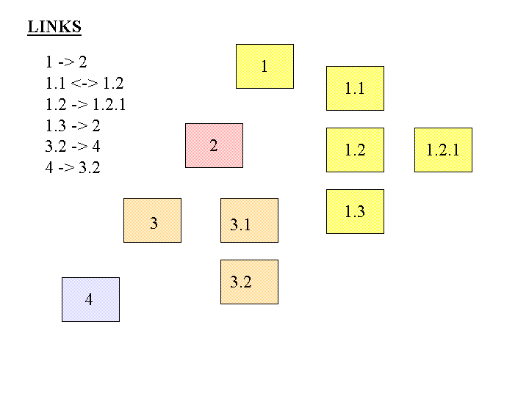
FLASHBACK
Separate Links
What would it mean to store links apart from the resources? What are the implications?

Slide 14
Memex Limitations
Linear extrapolation of prevailing technology, “technical difficulties of all sorts have been ignored”
No mechanism for searching documents or trails
Memexes are stand-alone, not networked

Slide 15
Memex as an Organizing System
What?
Why?
How much?
When?
Who (and by what means)?)
A good way to test your understanding of Memex
15

Slide 16
Personal Information Management
"The practice and the study of the activities that people perform to acquire, organize, maintain, and retrieve information for everyday use"
So PIM covers personal actions (or inactions) that are the result of individual choices
Having this discretion about information organization and "making sense of it" to make decisions is a defining characteristic of professional, as opposed to clerical, information work

Slide 17
PIM and Technology
Because PIM is embedded in user tasks and work context it reflects the prevailing technology support for information work
The personal computer has had the greatest impact (so far ) on PIM technology
But as processors and connectivity is increasingly embedded in objects of all kinds, information "from and about stuff" has to be managed and the PC is losing lose its central role
PIM on smart phones and storage "in the cloud" is taking over

Slide 18
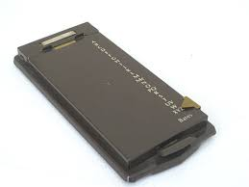
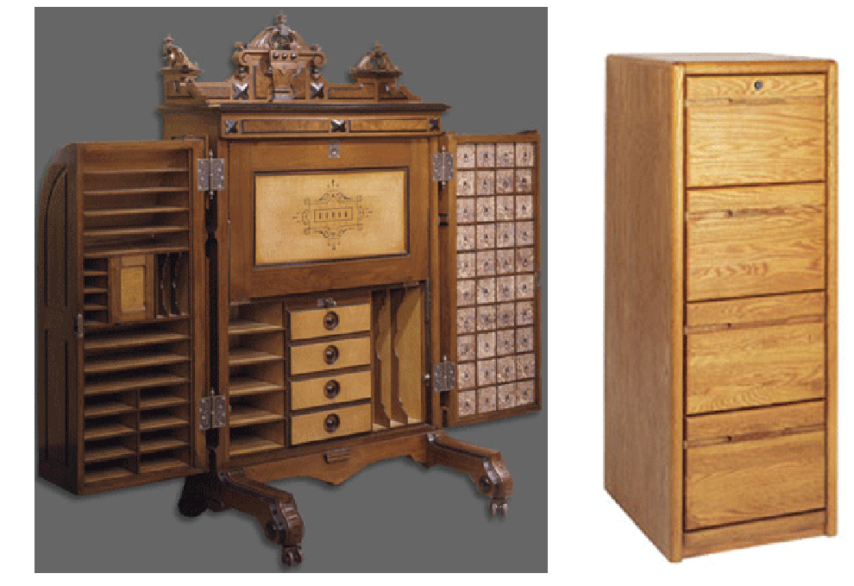
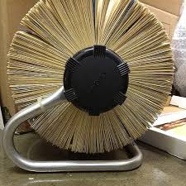
Historically Disruptive Technologies for PIM
3
1
2
4

Slide 19
The Contemporary PIM Challenge
Vastly more personal information of all kinds
Much of this information is in incompatible digital formats produced and consumed by a variety of devices and applications
These devices and applications separately provide support for PIM that is collectively incompatible
But our work often requires that information be created, managed, and retrieved in ways that cut across these format and device boundaries
What can be done to ensure that PIM can span devices and applications?

Slide 20
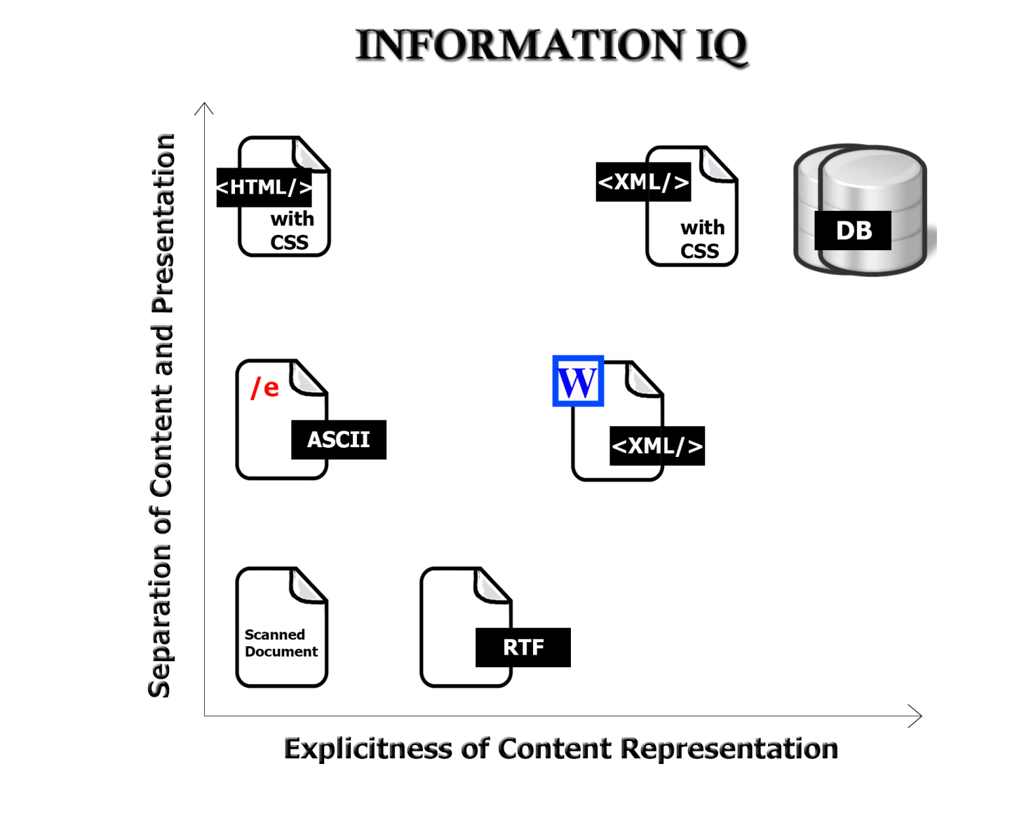
The Digital Format Matters!
FLASHBACK
20

Slide 21
A Taxonomy of PIM Apps/Systems
Graphical knowledge capture tools (“mind” or “concept” mapping)
Note-taking applications
Autonomous or wearable PIM applications

Slide 22
Mind-Mapping Software

Slide 23
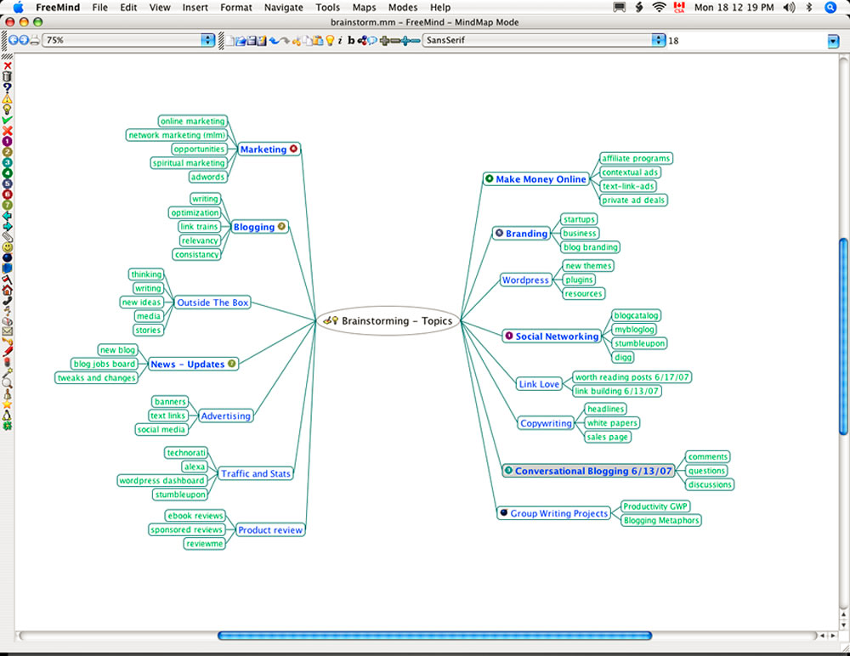

Slide 24
Note-Taking Software
BEST ONE
BEST FREE ONE

Slide 25
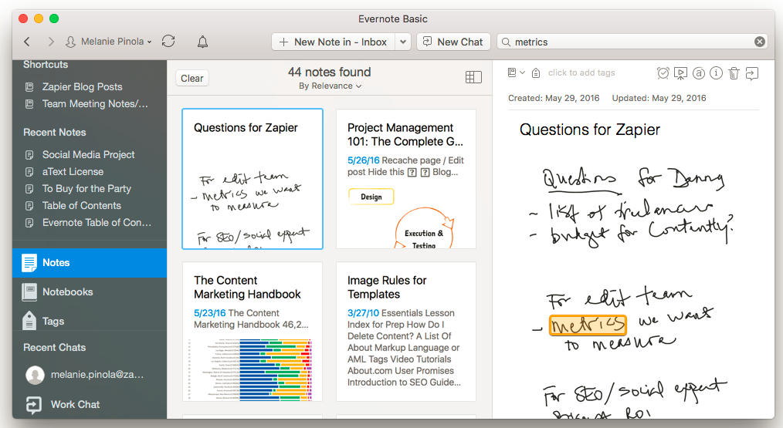

Slide 26
Autonomous / Wearable PIM

Slide 27
Your “Personal Information Space”
Your PSI is an abstract organizing system that contains all of the various physical and digital information resources that are nominally under your control
Some of these are located "in the cloud" and are thus only indirectly controllable, but people tend to think of all the distributed digital storage as being "in one place"
A fundamental challenge is maintaining an integrated view of the PSI
A corollary challenge is reconciling the tension between one's PSI and the need to contribute and use information from common information spaces

Slide 28
What’s In YOUR PSI?
The slide is about 10 years old. What has changed? What new things are missing?

Slide 29
PIM Activities
Selection (Keeping) activities are carried out when you encounter information - they determine the input of information into the PSI
Organizing
Interactions: Finding or re-finding activities within the PSI determine the output of info from the PSI or its use in work
Maintenance activities are those taken to organize, re-organize, or integrate the PSI

Slide 30
Selection Decisions
Pushed information comes to our PSI (not as the result of any immediate action on our part); could be previously-selected subscriptions
Pulled or Retrievable information is what we intentionally seek
What is YOUR mixture of pushed and pulled information?

Slide 31
Decisions to Make on Information Exposure / Receipt
Consume immediately
Ignore
Keep
What are reasons for keeping information?

Slide 32
Decisions About Keeping and Organizing
Does the "to be kept" information item fit into our existing classification scheme within our PSI?
If we use an existing category or location or naming scheme, is the degree of "fit" acceptable or does it distort the existing organizational or naming scheme?
Is it necessary to create new categories, locations, or names?
Do we abstract / summarize / data mine / secure or otherwise process the "to be kept" information?
How much of this "keeping and organization" work could be done automatically?

Slide 33
“Distributed Cognition” (Hollan, Hutchins, & Kirsh, 2000)
"Distributed cognition" is a "dialect" of cognitive science that views cognitive activity as not just something that takes place within the mind of a single person a some moment in time; it is:
Distributed and organized across the members of a social or goal-oriented group
Distributed and organized between people and the technology and artifacts they create and use
Distributed through time; results of earlier events and interactions that transform future ones
33

Slide 34
Application Areas for DCog
DCog concepts are mostly used in systems design and implementation in specific work environments
Its main method is field research, going into the workplace and making rigorous observations (often video), studying and coding the recorded activities using qualitative research methods (“ethnography”)
Goal is to understand and codify the various ways in which cognitive structures and processes are distributed between internal and external representations, across a group of individuals, and across space and time

Slide 35
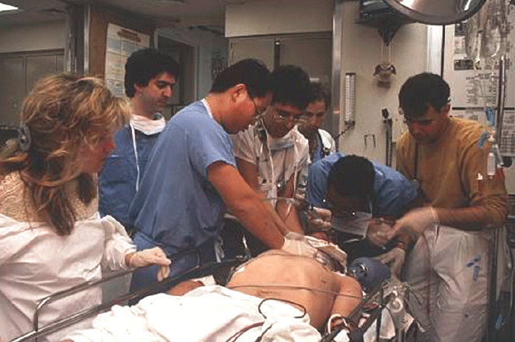
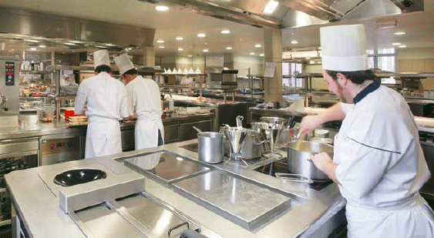
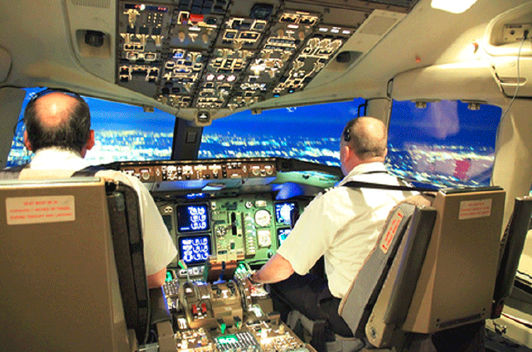
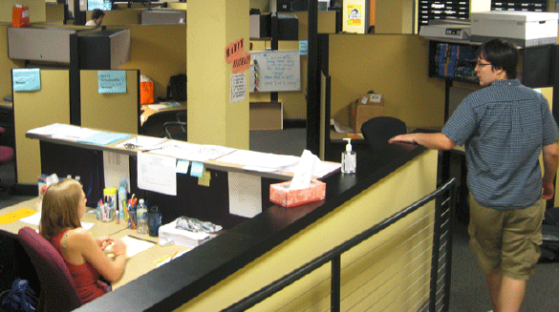
Intensive Care Units, Offices, Kitchens, & Cockpits

Slide 36
Putting Cognition into the World
Offloading cognition into-the-world is a ubiquitous part of our everyday cognitive lives
A key way in which we offload cognitive processes into-the-world is by using it as a repository of representational information, thus eliminating the need for an internal representation
For example, individuals might write down, type into a computer, sketch, or in some other manner alter the environment so as to record information that needs to be remembered
We can also offload memory demands into the world using external tools to supply perceptual cues that can trigger intended actions

Slide 37
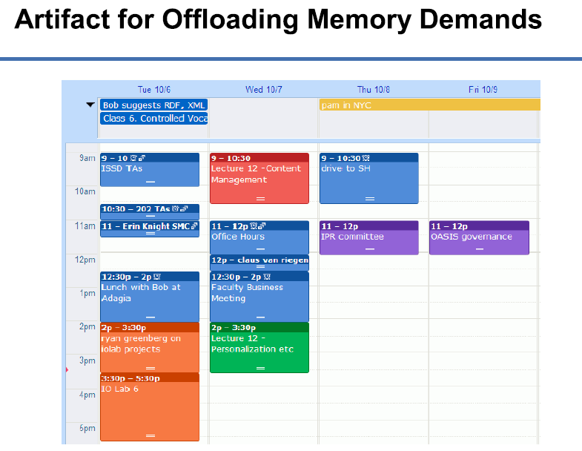

Slide 38
What role does the “cup as document” perform at Starbucks?

Slide 39
It’s Not Just A Cup
The cup improves quality at “specification time” by recording drink orders in a consistent and robust way
The order of the cups is an external representation of the “production queue”
It improves quality at “production time” because the barista's memory load is minimized

Slide 40
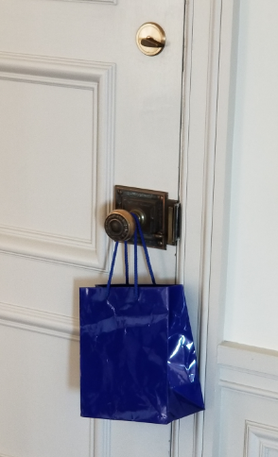
Offloading “Prospective Memory”
We rely on memory not only to recall information from the past but also to execute intended behaviors in the future. Our ability to remember delayed intentions is called “prospective memory”
Delayed intentions can be triggered by perceptual cues in our environment

Slide 41
“The Intelligent Use of Space”
Kirsh, David. "The intelligent use of space." Artificial intelligence 73, no. 1 (1995): 31-68.
“Work materials” and “artifacts” are more than just the inputs and outputs of cognitive activity; they can become part of the cognitive system”
"Whether we are aware of it or not, we are constantly organizing and reorganizing our workplace to enhance performance"
“At times the histories of use are perceptually available to us in ways that support the tasks we are doing"
"When space is used well, it reduces the time and memory demands of our tasks... to simplify choice, to simplify perception, and simplify internal computation”
41

Slide 42
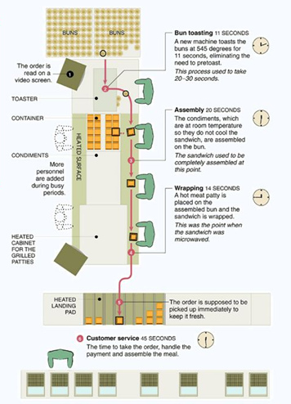
Using Space to Simplify Choice
A production line serially decomposes a complex task by dividing the space in which it is performed into functional stations where sub-tasks are performed
Each spatial region creates a task context in which only certain skills, tools, and rules are appropriate
Once a context has been selected, the local affordance make clear what can and must be done
The New McDonalds Layout

Slide 43
Mise-en-place
43

Slide 44
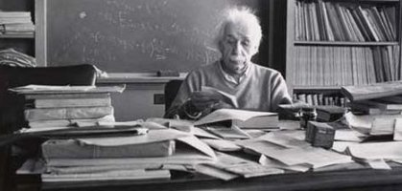
Space naturally encodes linear orders. If items are arranged in their sequence of use, it is unnecessary to remember that order
BUT linear order is not expressive enough to handle “sub-assemblies” and many tasks can’t be decomposed into predictable steps
The tradeoff: More complex spatial arrangements impose the requirement of remembering how things were laid out
If a cluttered desk is a sign of a cluttered mind, of what, then, is an empty desk a sign?
- Einstein
44

Slide 45
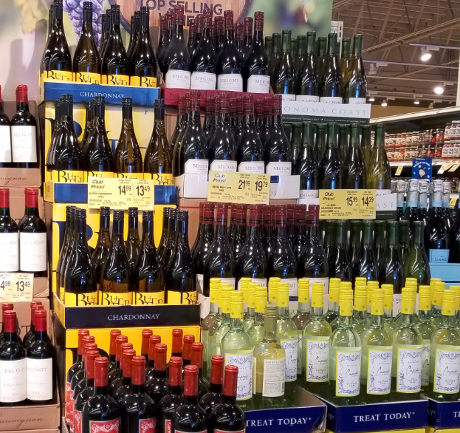
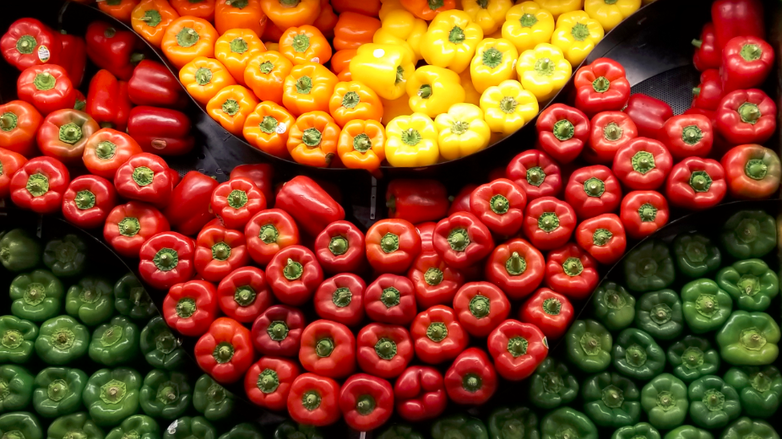
Using Space to Simplify Perception
Arrange objects in space so they form categories that reflect relevant preconditions, or properties that are useful to notice or exploit

Slide 46
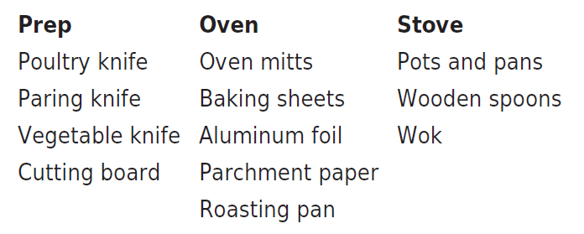
Taskonomy
In contrast to "taxonomy" - an approach to organization based on similarity of content or characteristics - a "taskonomy" organizes on the basis of purpose or "activity structure“
A COOK’S TASKONOMY (Figure 8.1 in TDO)
46

Slide 47
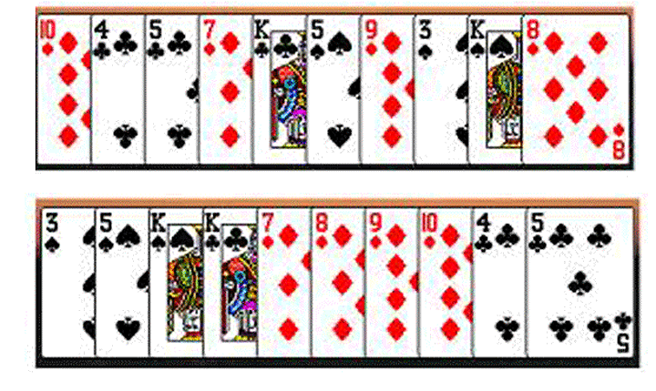
Task-Based Card Sorting
47

Slide 48
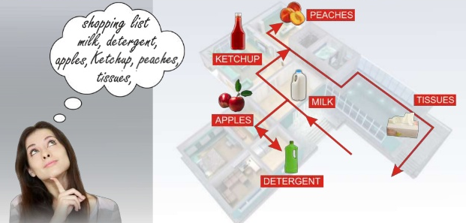
The Intelligent Use of “Mental Space” – The Method of Loci
The hippocampus, the brain component dedicated to memory, is highly developed for storing and recalling memories of physical locations
The ancient Greeks relied on this capability and devised a mnemonic system—the method of loci—which involved attaching things to remember, the key ideas in a speech perhaps, to well-known physical locations
While giving the speech one imagines walking through that physical location from idea to idea
Today, champion memorizers use this technique to associate items with places in vividly imagined “memory palaces.”

Slide 49
Some Questions
Do you remember addresses and phone numbers or do you just store them on your smartphone?
We can search the web for almost anything. How does this change how we read, study, learn?

