Slide 1
CogSci 190
“Sensemaking and Organizing”
Spring 2019
Robert J. Glushko
glushko@berkeley.edu
19 March 2019
17) “Automatic” Organizing

Slide 2
Outline
Perception is “Inference and Interpretation” and not “Recording”
Sensemaking == Simplification?
Automatic / Pre-attentive Organizing & Gestalt Perception
Ambiguity and Illusion
Affordances

Slide 3
The Problem of Induction
FLASHBACK
Hume and other philosophers posed and struggled with “the problem of induction”
  how can we justify making any generalization or inference about the properties of some class of things after observing some instances of the class?
  The same question arises with perception – there are always a great many interpretations that are compatible with some set of sensory inputs
  But somehow, we make sense of it!

Slide 4
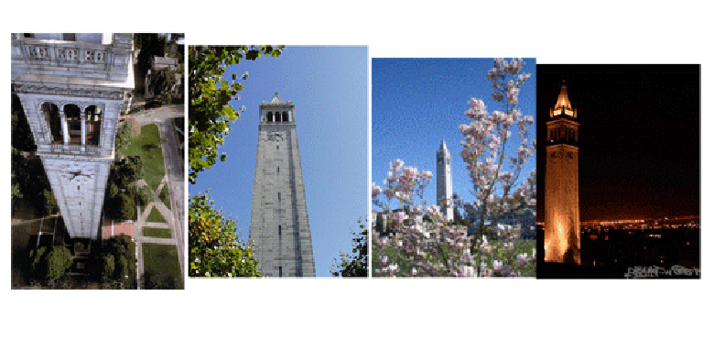
An infinite number of different “sensory signals“ can be produced by the same object
…And different objects can produce similar signals
Human perceptual machinery excels at recognizing when different "signal patterns" are the same object or when similar patterns are different ones
And we do it automatically or sub-consciously

Slide 5

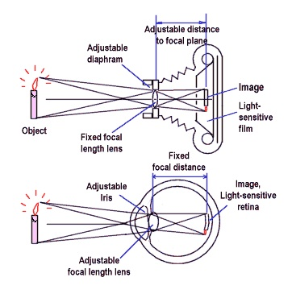
A Very Misleading Analogy
The “eye as camera” depiction trivializes the complex processes by which the visual system interprets visual input
Light enters each eye and forms an almost-flat 2-dimensional image on the retina
This image is upside-down and is high-resolution and in color only in a small area (the fovea)
But we don’t perceive the world as 2-dimensional; we perceive a 3-dimensional world, and we experience a full field of view in color

Slide 6
The Process of Visual Perception – Inference and Interpretation
The human visual system interprets its 2-D inputs using built-in constraints that relate to brightness, contrast, color, edges, motion, depth, light direction, object size, and many other characteristics of the visual input
Together these constraints enable the rapid creation of a 3-D mental representation of the external world
This process is automatic and sub-conscious; you can’t turn off visual perception
But if some of the necessary visual input is missing or in conflict, the visual system can’t create a stable interpretation, resulting in ambiguity or illusion

Slide 7
Sensemaking == Simplification?

Slide 8
Sensemaking & Simplification (1)
Evolution has produced elaborate neural mechanisms for the simpliﬁcation and distillation of information because of limitations on how much information the brain can process and store
Interpreting data by imposing some sense or structure helps the brain encode data efficiently; so we can invert this logic, and use the brevity of the encoding as a measure of the amount of sense that it makes of the data.
      Nick Chater

Slide 9
Which Description is Simpler?
A red square in front of a blue square
A red square bordered on all four sides by blue triangles

Slide 10

What are simple and complex descriptions for this?

Slide 11
Sensemaking as Simplification (2)
One solution to the problem of induction is that the cognitive system should prefer the inference or interpretation that gives the simplest description
This principle is consistent with the heuristic used by scientists called Occam’s Razor to prefer theories that require the fewest assumptions or variables to make a prediction

Slide 12
Measuring “Description Complexity”
The length of a natural language description is a poor measure of its complexity
An “artificial language” expresses ideas concisely by introducing new terms or symbols that represent complex ideas along with syn­tactic mechanisms for combining and operating on them
  Mathematical nota­tion, programming languages, schema languages that define valid document in­stances, regular expressions that define search and selection patterns
Chater likes the Kolmogorov complexity of an object (such as a piece of text), a measure as the length of the shortest computer program (in a predetermined programming language) that produces the object as output
Why “Description Complexity” rather than “Description Simplicity”

Slide 13
Rosch’s Principle of
“Cognitive Economy”
“what one wishes to gain from one’s categories is a great deal of information about the environment while conserving finite resources as much as possible”
“It is to the organism’s advantage not to differentiate one stimulus from another when that differentiation is irrelevant to the purposes at hand.”

Slide 14
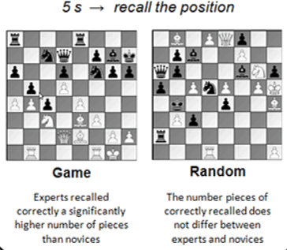
Perceptual Learning Reduces Information Overload
Perceptual learning: “an increase in the ability to extract information from the environment, as a result of experience and practice with stimulation coming from it”
Chase, W. G., & Simon, H. A. (1973). Perception in chess. Cognitive psychology, 4(1), 55-81.

Slide 15
Automatic / Pre-attentive Organizing & Gestalt Perception

Slide 16
Automatic / Pre-attentive Organizing
Physical resources are often organized according to intrinsic physical properties like their size, color, or shape, because the human visual system quickly and automatically pays a lot of attention to them
Likewise, because people have limited attentional capacity, we ignore a lot of the ongoing complexity of visual (and auditory) stimulation, making us perceive our sensory world as simpler than it really is.
Together these two ideas explain why we automatically or “pre-attentively” organize separate things we see as groups or patterns based on their proximity and similarity (the Gestalt principles)
16

Slide 17

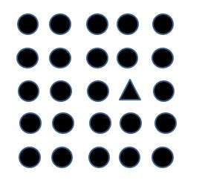
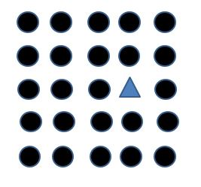
Pre-attentive Processing
of Shape and Color
Do any of these visual arrays contain a triangle?
Because shape and color are pre-attentive attributes, It takes about the same time to decide over a large range of array sizes
It is easier still if the shape is of a different color

Slide 18
Pre-attentive Processing
of Shape and Color
Do these visual arrays contain any red triangles or blue circles?
When the shape and color properties are uncorrelated, pre-attentive parallel processing isn’t possible

Slide 19
Figure and Ground
About 100 years ago Edgar Rubin studied the fundamental phenomenon of visual perception to organize some part(s) of the visual field as in the foreground and other parts as the background
When the visual information is ambiguous, this can result in two alternating interpretations
The contrast between the figure and ground determines how easily they are separated

Slide 20

Rubin’s Face-Vase Illusion
Flipping between the face and vase interpretations involves changing which part of the image is ‘figure’ and which is ‘ground’
The brain can only make sense of the world in one way at any point in time –
we see the face or the vase, but not both

Slide 21
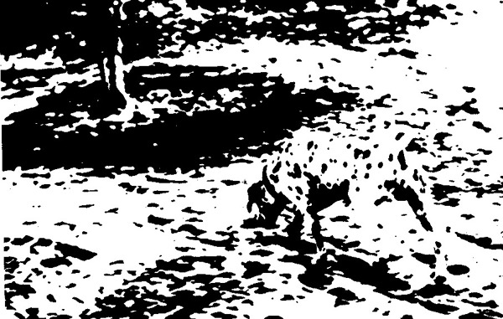
A Classic Figure-Ground Ambiguity

Slide 22
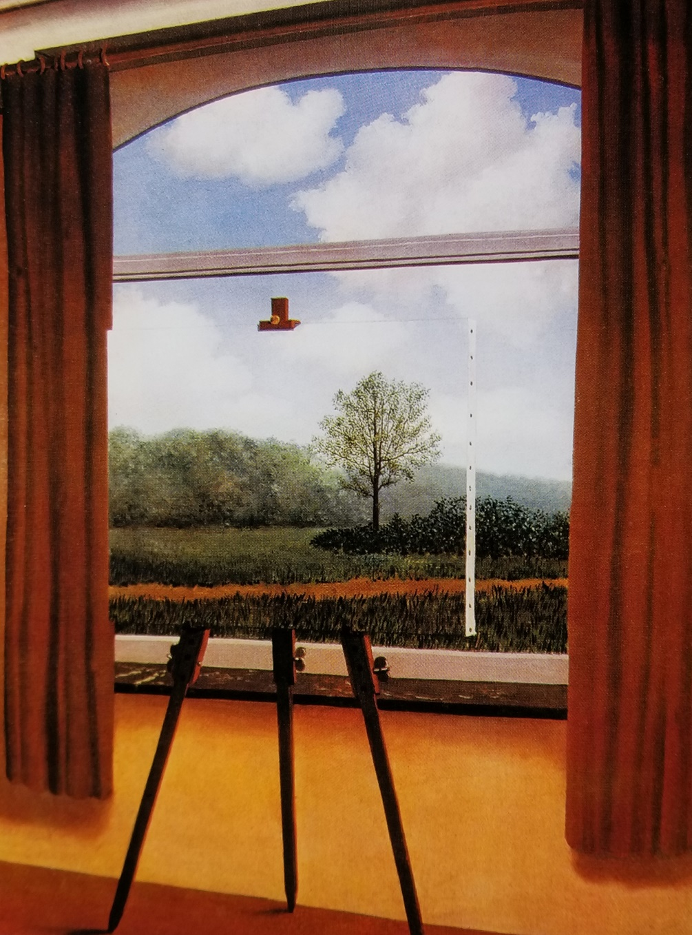
La condition humaine
“In front of a window seen from inside a room, I placed a painting representing exactly that portion of the landscape covered by the painting. Thus, the tree in the picture hid the tree behind it, outside the room. For the spectator, it was both inside the room within the painting and outside in the real landscape.”
René Magritte, 1933

Slide 23
Gestalt Perception
In the 1930s, Psychologists Max Wertheimer, Wolfgang Kohler, and Kurt Koffka extended Rubin’s work and proposed six principles that explain how our visual system imposes order on what it sees to perceive as organized and structured wholes rather than the sum of their constituent parts
Proximity
Similarity
Continuity
Connection
Enclosure
Closure

Slide 24

Proximity
Objects close to each other, especially when they are aligned, are perceived as belonging together
What groupings do you perceive here?

Slide 25
Similarity
Elements that look similar are seen as being in the same group
The shape and visual design for the icons distinguishes files from folders, and file types from each other
You don’t need to be able to read the labels to perceive the groups, although the visual similarity of the names suggests some similarity of content
TDO 3.3..1.1 Organizing with Properties of Physical Resources

Slide 26

Proximity & Similarity Together
If we change the color here, how does it change the perceived groupings?

Slide 27



Slide 28
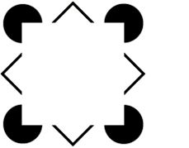
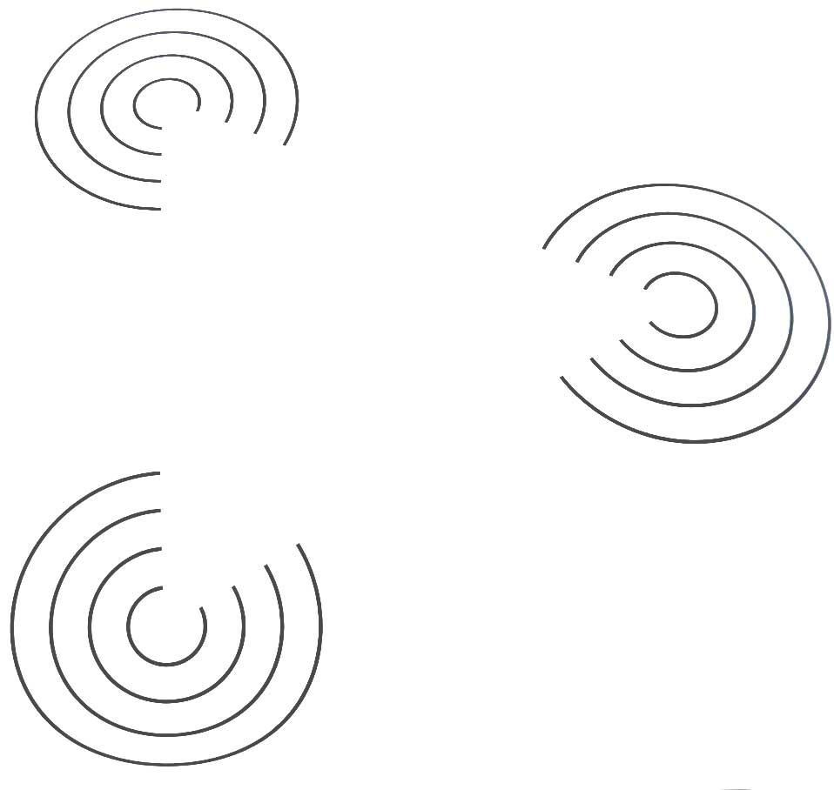

Continuity
Aligned objects are perceived as belonging together, and are perceived as a continuous whole when that perception is a simpler interpretation

Slide 29


Visual stimuli that could be perceived either as open, incomplete, or unusual forms are more naturally perceived as closed, complete, regular => simpler

Slide 30


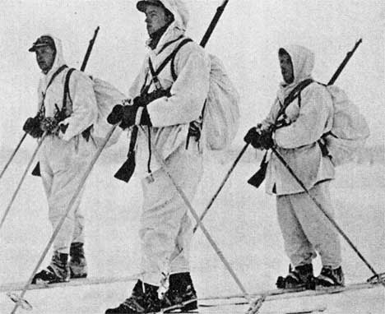
Camouflage
Disruptive coloration, colors and patterns that resemble backgrounds, countershading, shadow elimination, and techniques that disrupt edge detection prove the power of Gestalt processing

Slide 31


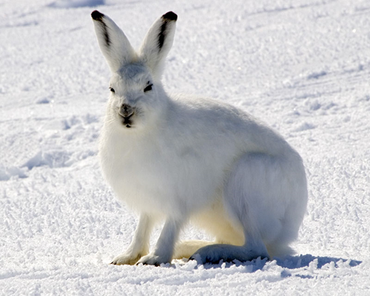
Animal Camouflage

Slide 32




Underwater Camouflage

Slide 33





Slide 34
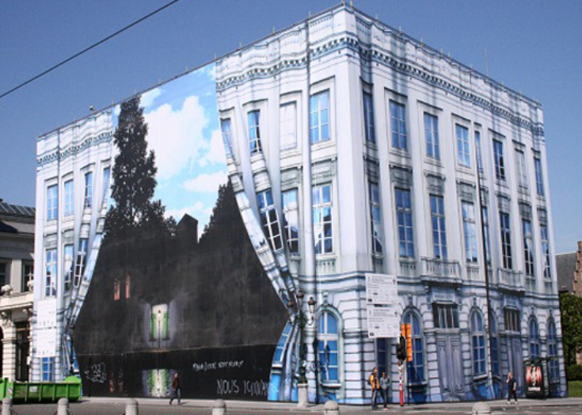
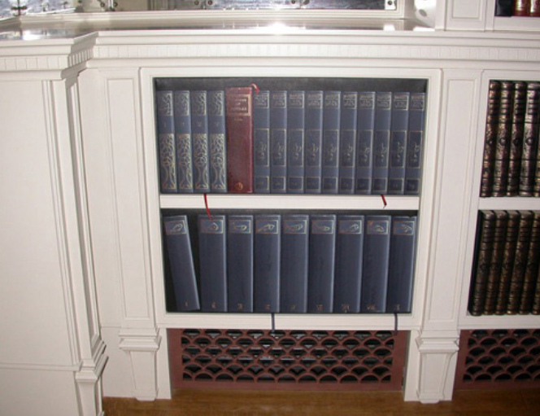
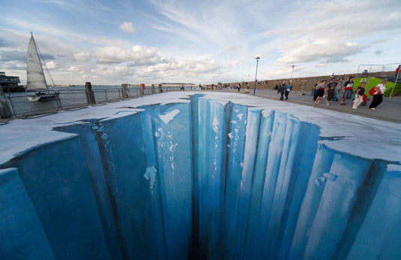
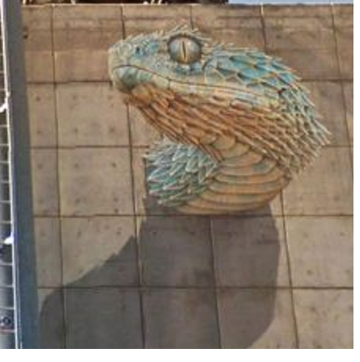
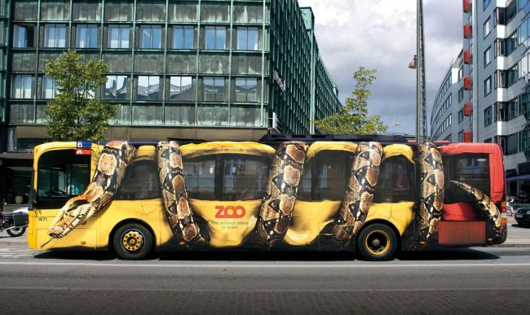
Trompe l'oeil (“trick of the eye”)
https://www.musee-magritte-museum.be/en/about-the-museum/origin
http://www.metanamorph.com/

Slide 35

L’empire des lumières
Daytime or
Nighttime?
Because the tree and other objects in the lower half of the painting are black or nearly black colors, with bright colors next to them, we perceive the bottom of the scene as nighttime and the top as daytime
René Magritte, 1954

Slide 36
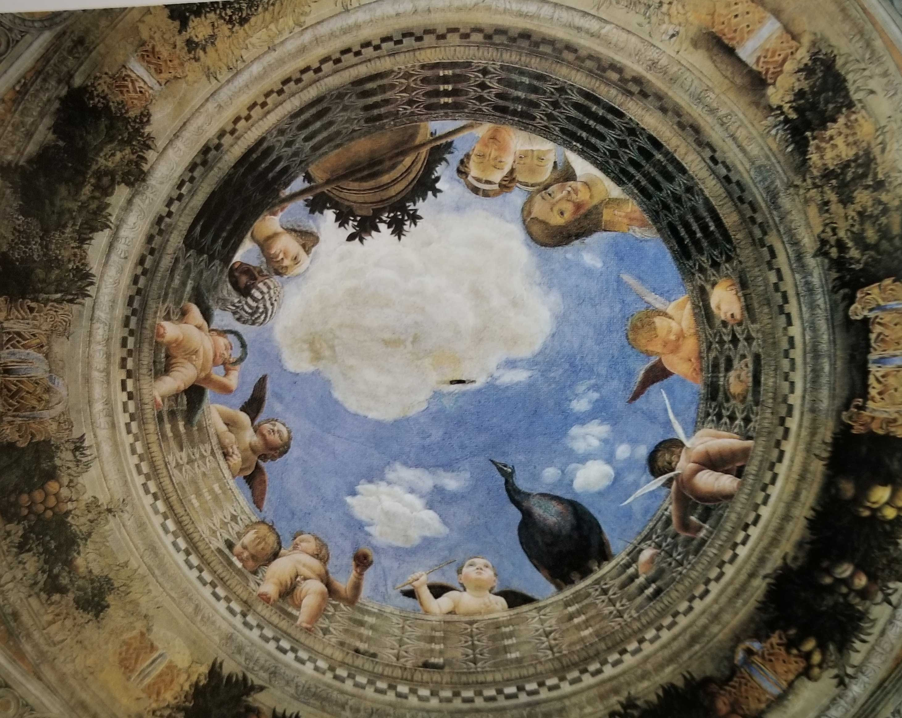
Mantegna, Painted Ceiling in Mantua Palace (1465-74)

Slide 37
Visual Perspective and Illusions
Some related constraints used by the visual system in constructing a 3D world are:
  Objects are smaller when they are further away
  An object's dimensions along the line of sight appear shorter than its dimensions across the line of sight
  Interpretations of separate parts of the visual input are preserved even if they are inconsistent when combined

Slide 38
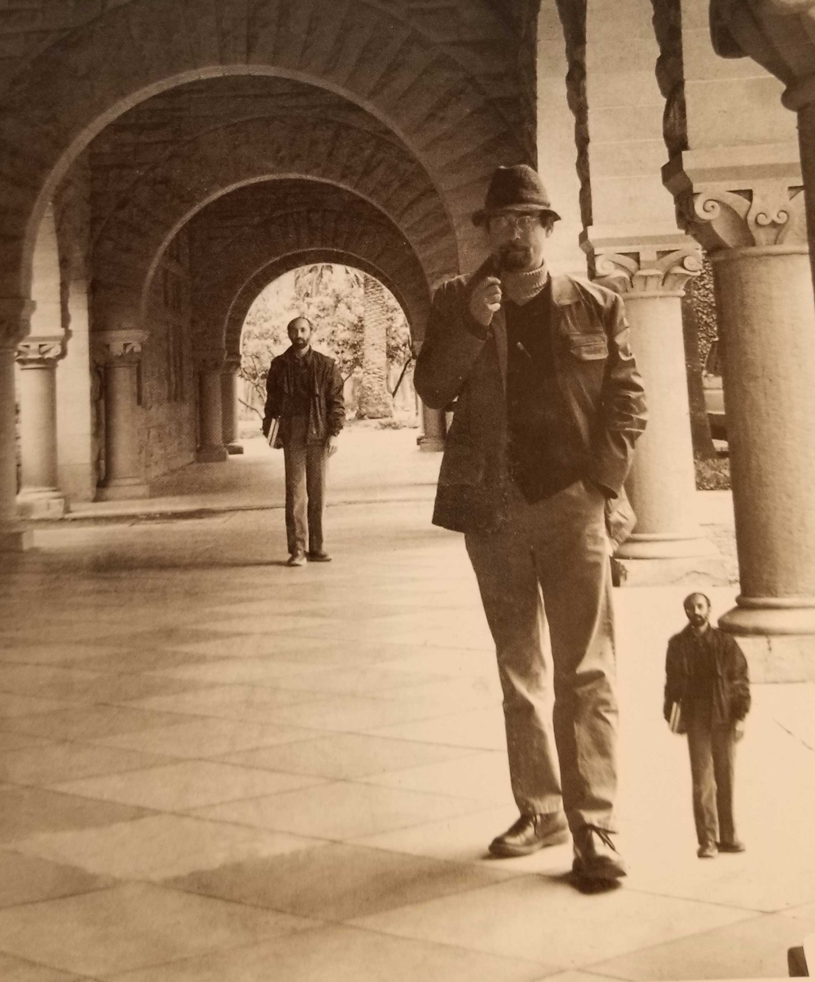

Slide 39
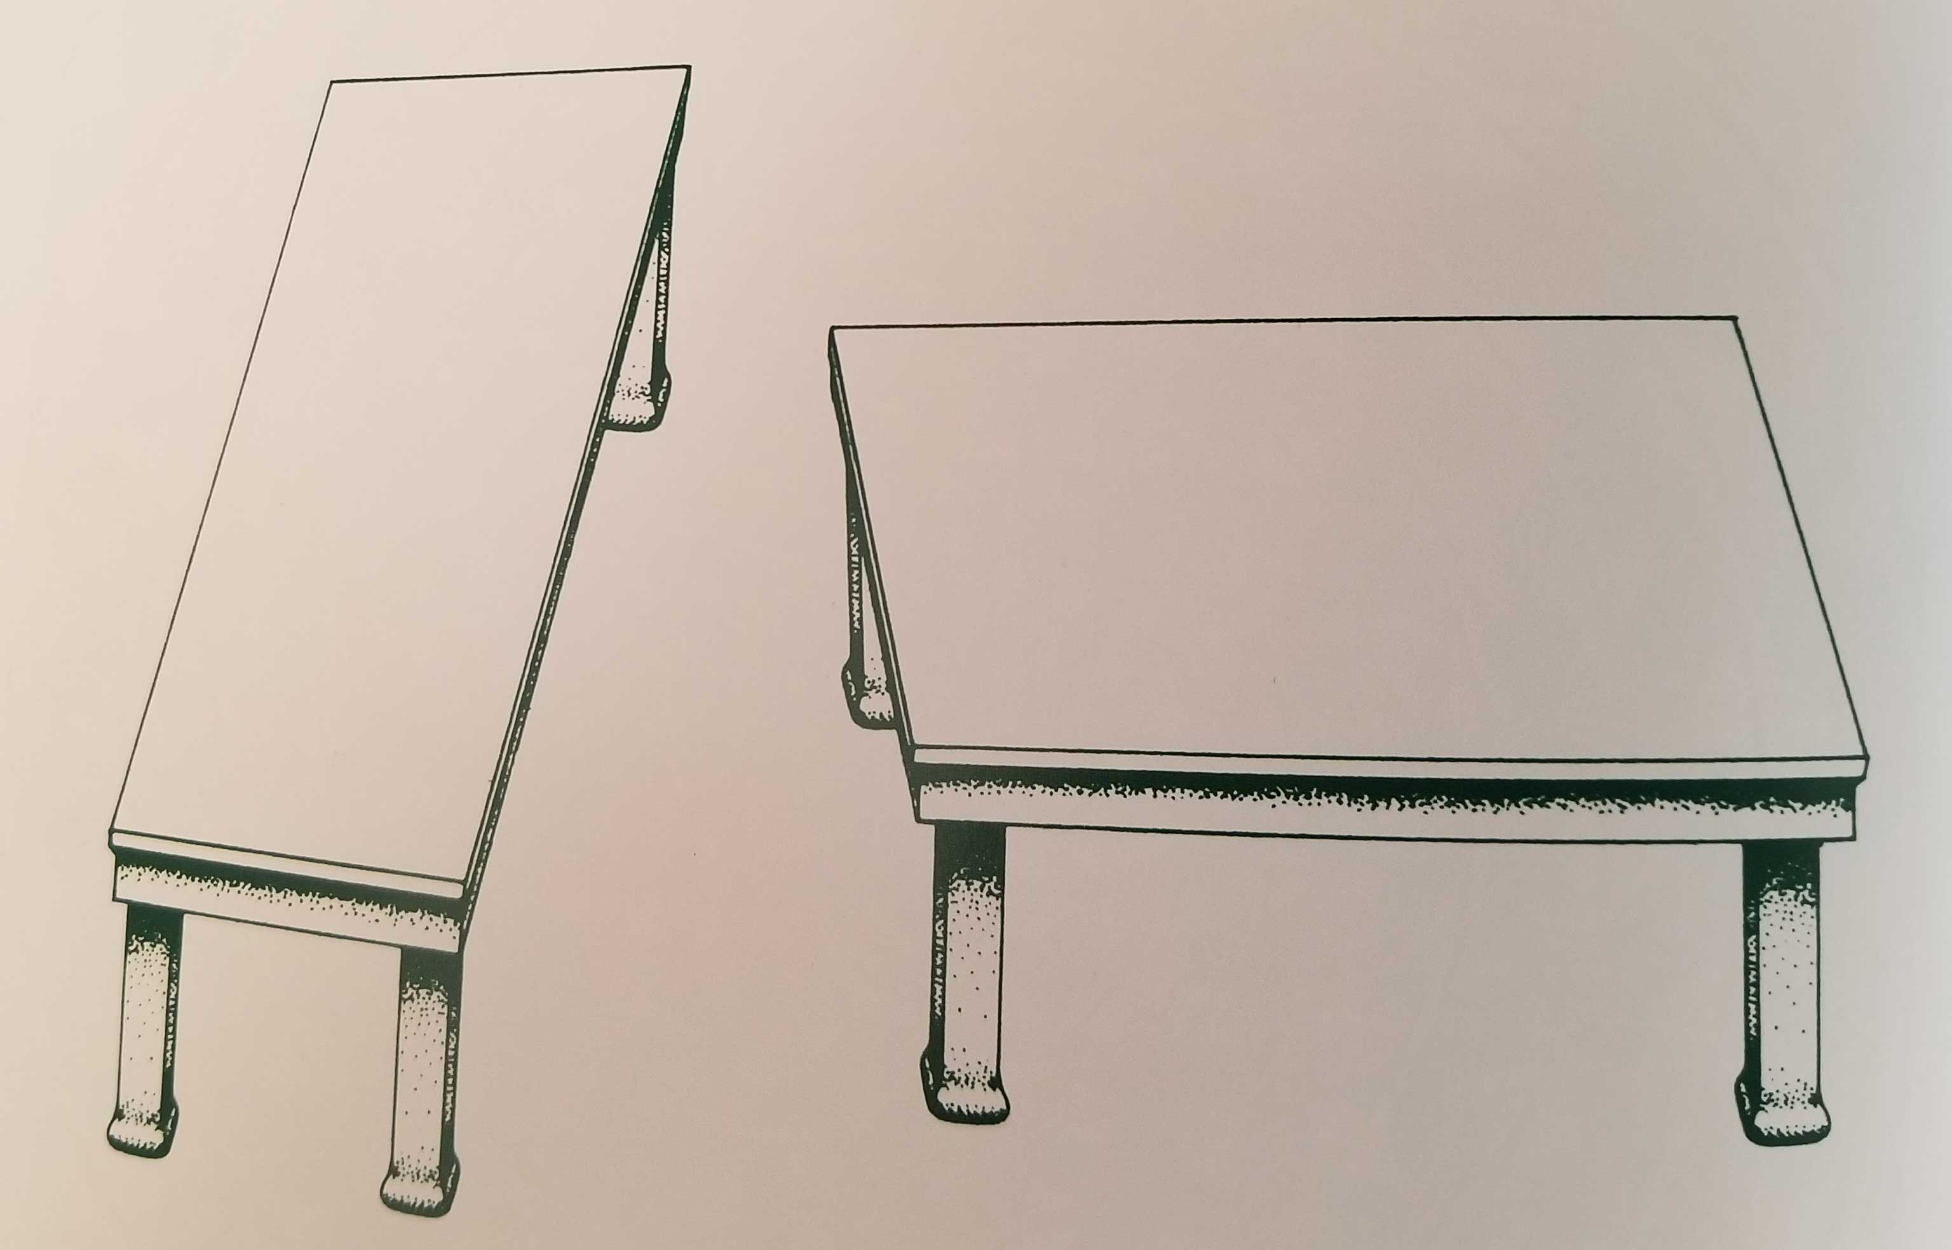

Slide 40
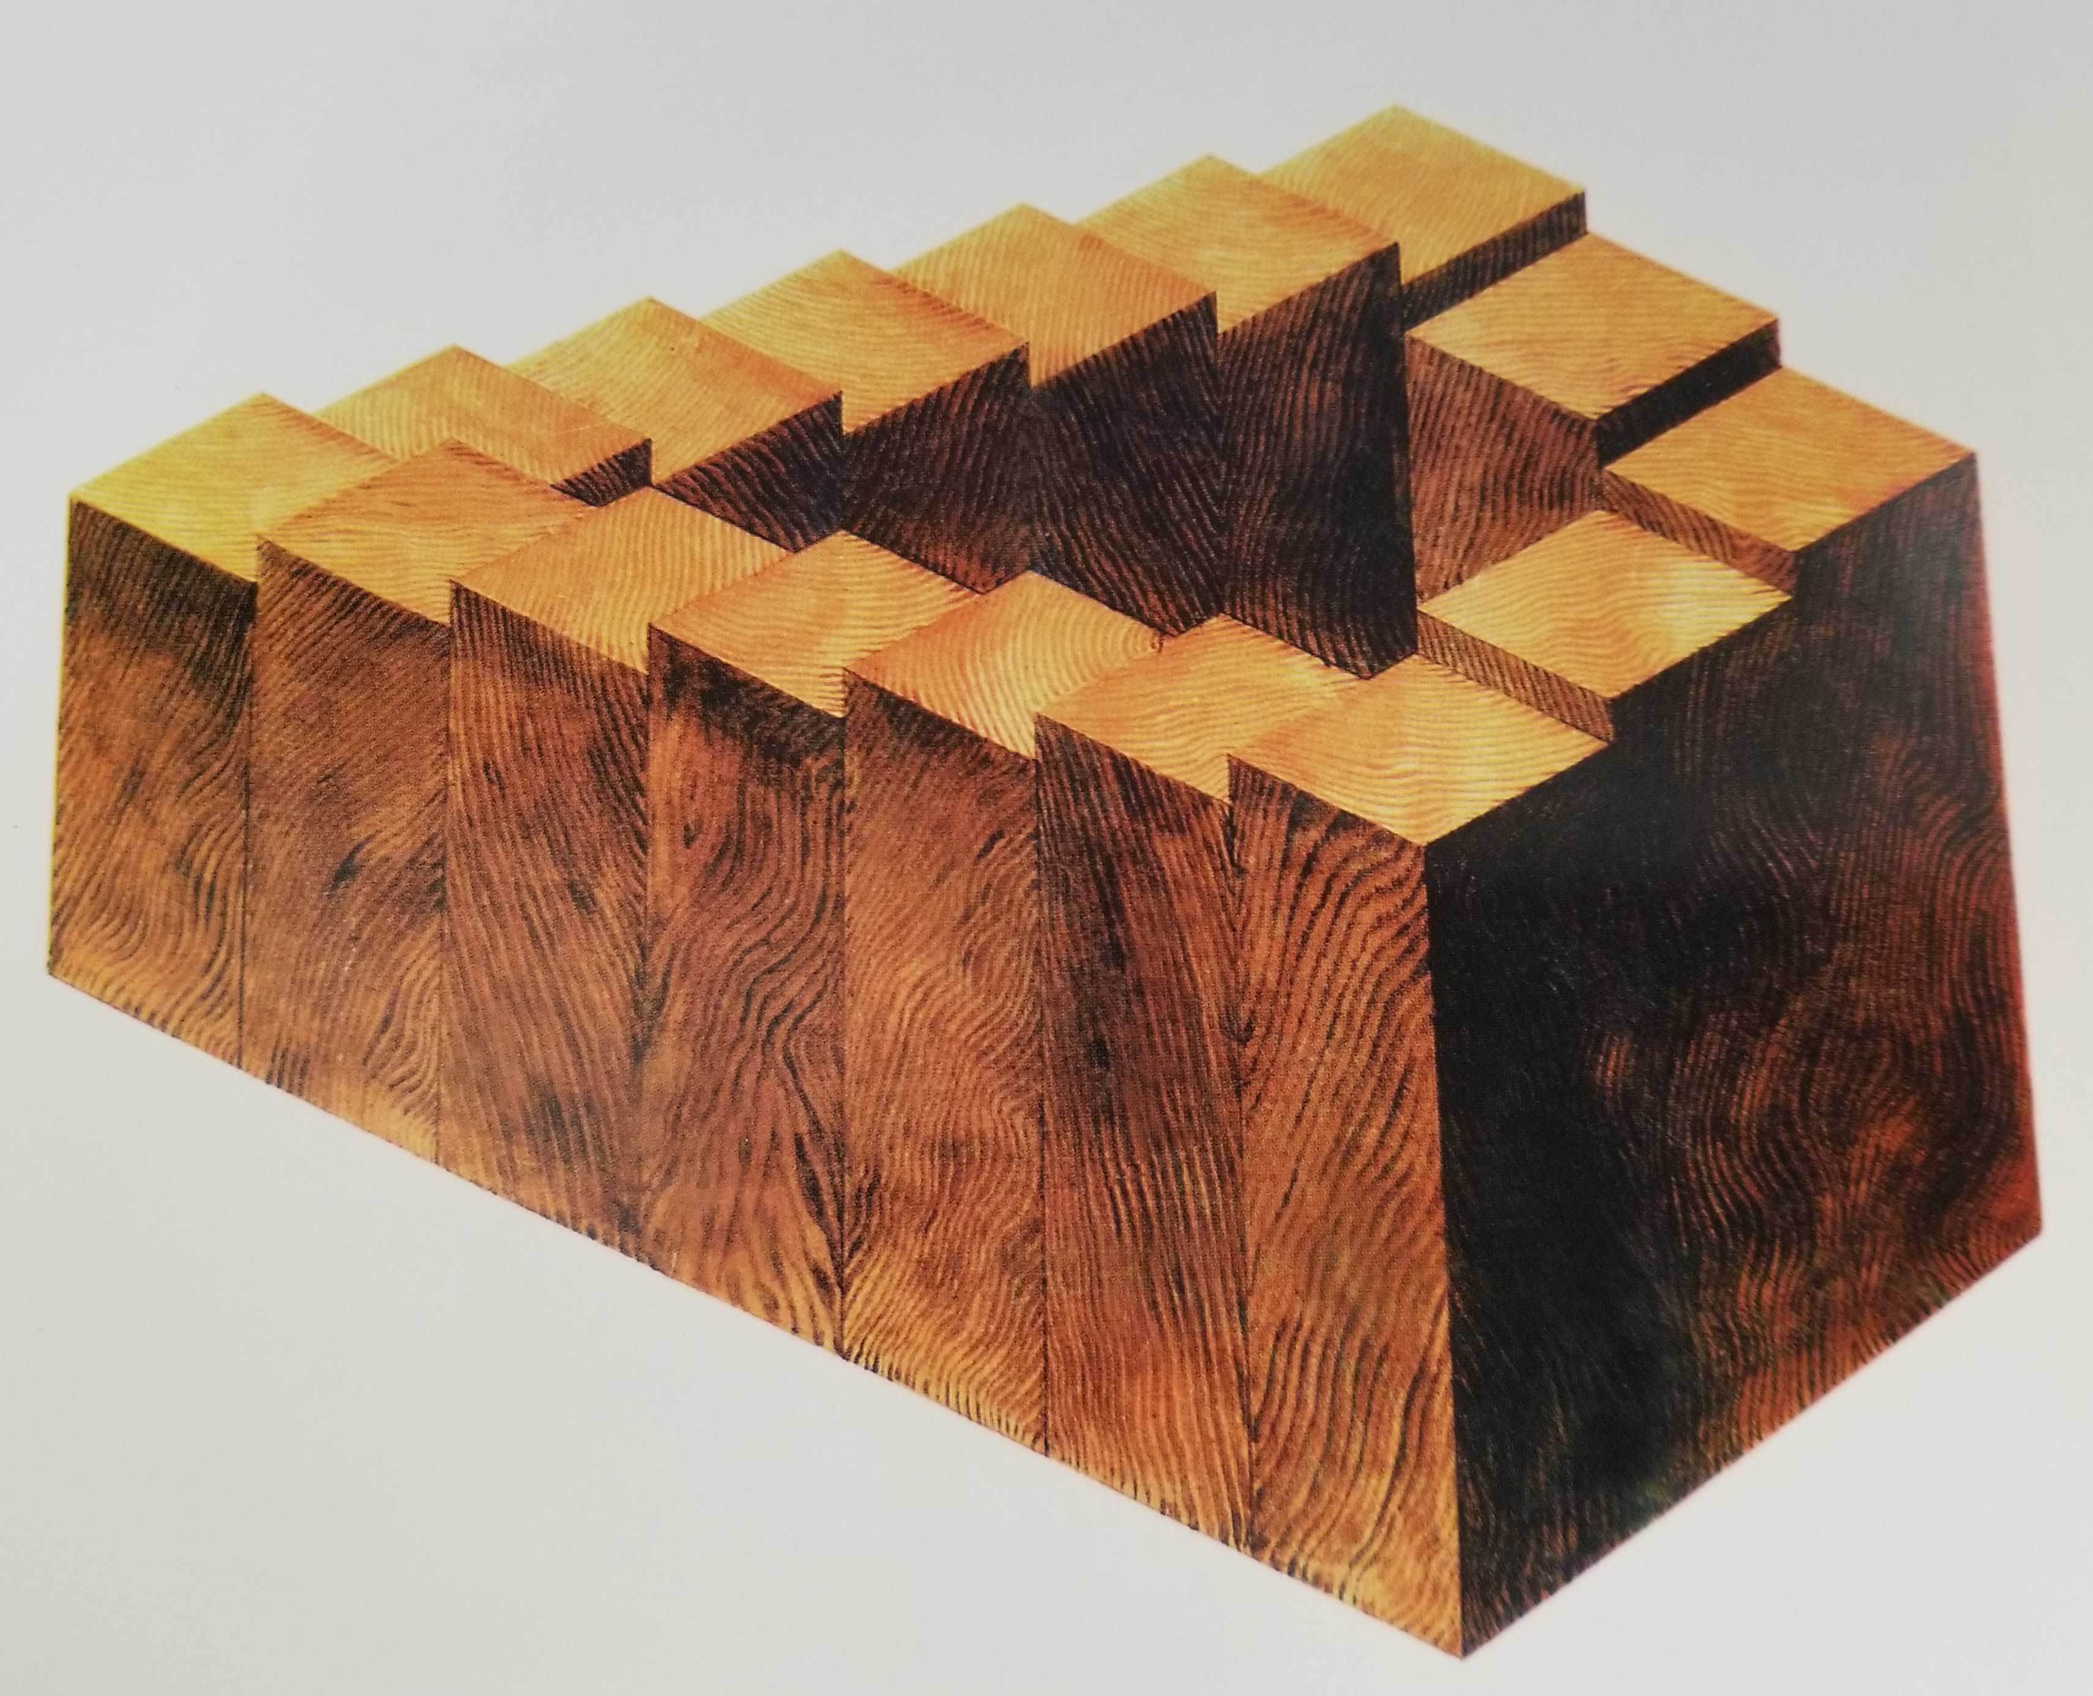

Slide 41
Affordances

Slide 42
Value Creation: Affordances vs. Designed Interactions
For physical resources, many potential interactions are inherent in their affordances – perceptible and actionable properties that determine what can be done with them
Digital resources require “designed interactions” made possible by intentional acts of description, arrangement, or technological mediation

Slide 43
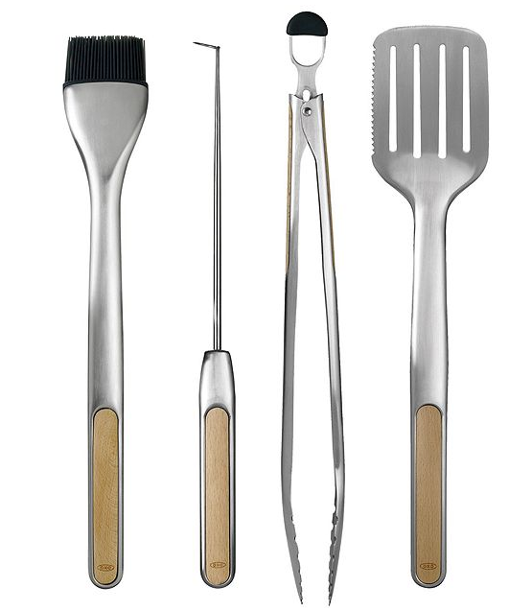
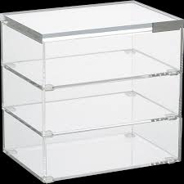
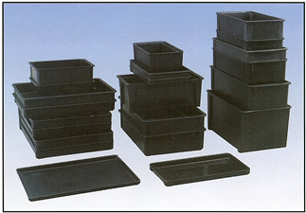
Easily Perceivable Affordances
43

Slide 44
Affordances
The interactions that are “afforded” are distinct from the “designed interactions” that are made possible by intentional acts of description, arrangement, or technological mediation
For physical resources, many potential interactions are inherent in their affordances – perceptible and actionable properties that determine what can be done with them
Many organizing systems use these affordances as the basis for resource selection, arrangement, and interaction design
Creating affordances is often the purpose of design
44

Slide 45
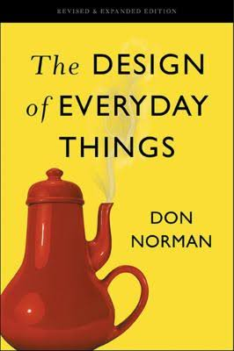
Design and Organizing
“intentional arrangement of resources and the interactions they support? – that’s what design does” (Don Norman)
45

Slide 46
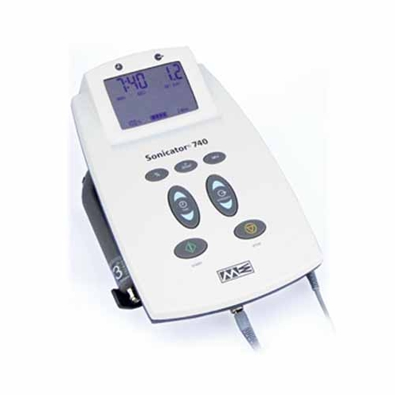
Design Supports Interactions
With physical resources, good design makes it easy to distinguish between parts and properties that are functional and those that are decorative or otherwise non-functional
But with digital and computational resources, it is often impossible to discern capability because it is internally implemented rather than inherent in perceptible surface properties
What can I do? How do you interact with me?
46

Slide 47


Interactions with Digital and Computerized Resources
Even when we see some indications of potential interactions we can't directly understand or compare their capability
47

Slide 48
[18 – March 21] The narrative fallacy, applied behavioral economics
The Narrative Fallacy and What You Can Do About It
Thaler, R. (2015) “Unless You Are Spock, Irrelevant Things Matter in Economic Behavior” New York Times.
Tversky, A., & Kahneman, D. (1974). Judgment under uncertainty: Heuristics and biases. Science, 185(4157), 1124-1131.
Lewis, Paul. Our minds can be hacked. https://www.theguardian.com/technology/2017/oct/05/smartphone-addiction-silicon-valley- dystopia

