Slide 1
CogSci 190 “Sensemaking and Organizing” Spring 2019
Robert J. Glushko glushko@berkeley.edu
21 March 2019
18) The narrative fallacy, applied behavioral economics
How does information and organization affect human decision-making?

Slide 2
Exercise 1
“Steve is very shy and withdrawn, invariably helpful, but with little interest in people, or in the world of reality. A meek and tidy soul, he has a need for order and structure, and a passion for detail.”
Is Steve more likely to be:
a farm worker
a college librarian
a pilot
a school teacher
a salesperson
a physician

Slide 3
Exercise 2
“Linda is thirty-one years old, single, outspoken, and very bright. She majored in philosophy. As a student, she was deeply concerned with issues of discrimination and social justice, and also participated in antinuclear demonstrations.”
Is Linda more likely to:
Be active in the feminist movement?
Be a bank teller?
Be a bank teller and active in the feminist movement?

Slide 4
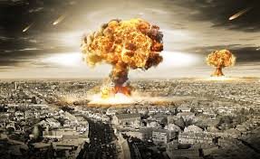
Exercise 3
Which scenario is more
likely?
1. An all-out nuclear war between the US and North Korea
2. A situation on which neither country intends to attack the other side with nuclear weapons, but an all out-nuclear war between the US and North Korea is triggered by the actions of a third country such as South Korea, Russia, or Japan

Slide 5
Exercise 4
Which of these “Heads” and “Tails” sequences of 6 flips of a “fair” coin is most likely? Least likely?
1) H H H T T T
2) H H H H T H
3) H T H T T H

Slide 6
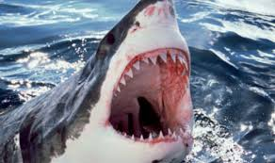
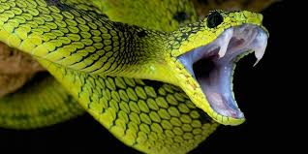
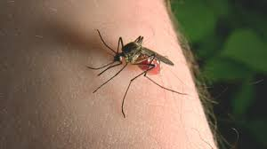
Exercise 5
Which of these is the most frequent cause of human deaths?
1. Shark attacks while swimming, surfing, or scuba diving
2. Bites from a poisonous snake
3. Bites from a mosquito
What information are you using to answer this question?

Slide 7
Today’s Outline
How do people use probability and frequency information when they organize or decide?
Exercises
Theories of human decision making
The Tversky & Kahneman biases and heuristics
The narrative fallacy

Slide 8
Decision Making and Assessing Probabilities
Many of the decisions we make in our personal and professional lives are in situations where outcomes are uncertain
Is there a “rational” way to assess probabilities and make decisions?
HINT:
Probability of an event = ? divided by ?

Slide 9
Decision Making and Assessing Probabilities
Is there a “rational” way to assess probabilities and make decisions?
How does this “rational” way compare to what people actually do?
Do people want to act rationally?
If they don’t or can’t, why not?

Slide 10
Economic Theories of Human Decision Making (1)
Economic theories of human decision making assume that people can be reasonably approximated or described as “rational” agents
Individuals have precise information about the consequences of their actions
Individuals have sufficient time and capability to weigh alternatives

Slide 11
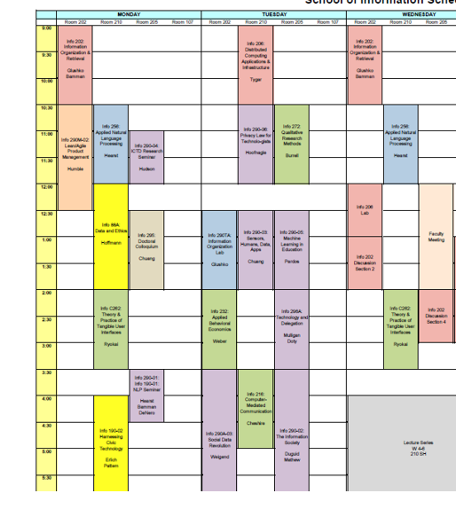
Deciding What Courses to Take
Did you have precise information about the content of a course, or how taking it would advance your career goals?
(…but first, do you know all of your career goals?)
Did you have sufficient time and capability to study the syllabus and course evaluations for every course you might take?

Slide 12
Economic Theories of Human Decision Making (2)
Different outcomes can be compared in terms of their “utility” (which is revealed by the choices people make)
The “value” or “utility” of a choice is the expected value of its probabilistic outcomes
Rational agents seek to maximize their utility

Slide 13
Deciding What Courses to Take
Can you rate each individual course in terms of how likely it is to advance your career goals?
Course A would be easy and interesting, and somewhat relevant to career goals
Course B would be pretty hard, but would probably help me get an internship
Course C would be very hard, but I’m sure that if I did well, the company that I worked for as an internship would offer me a full-time job
…
Can you compare different sets of courses in terms of how likely they are to advance your career goals?
Courses A, B, and G would be a pretty good schedule, not overwhelmingly hard, and would probably enhance my chances of getting a good job
Courses A, B, and C would be really hard, but I’d be sure of getting the job I want … but I’d have no free time
…

Slide 14
Deciding What Courses to Take
What future events comprise the “total number of outcomes” when it comes to choosing sets of courses to take?
Which combinations of courses will result in successful outcomes?
How far into the future do you look when you predict whether some set of courses will lead to a successful outcomes?

Slide 15
Economic Theories of Human Decision Making (3)
The “rational choice theory” enables calculations and predictions in situations with uncertainty (for example, in “game theory”)
Decisions that deviate from this theory can occur if people have incomplete information or insufficient time
But these deviations should be unsystematic because the factors that cause them are random and “average out”

Slide 16
Econs vs. Humans
“Economists study mythical creatures often known as Homo economicus. I prefer to call them “Econs”— highly intelligent beings that are capable of making the most complex of calculations but are totally lacking in emotions”
Richard Thaler (“Unless You Are Spock, Irrelevant Things Matter in Economic Behavior”)
Thaler uses a cultural reference that is pretty old here when he refers to “Spock” = do you all know who Spock is?

Slide 17
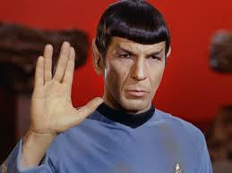
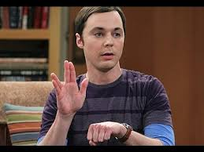
Mr. Spock (from Star Trek)
Sheldon Cooper (from Big Bang Theory)

Slide 18
“Economists discount any factors that would not influence the thinking of a rational person. These things are supposedly irrelevant. But unfortunately for the theory, many supposedly irrelevant factors do matter...”
Richard Thaler

Slide 19
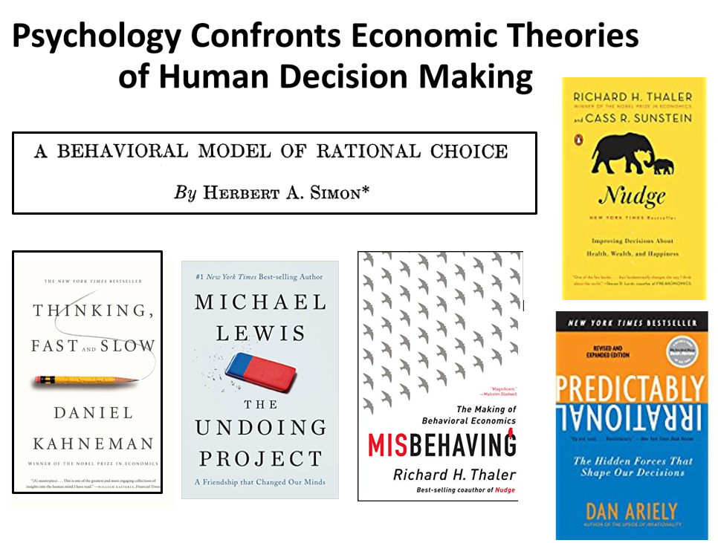

Slide 20
Bounded Rationality (Simon)
“Because of the psychological limits of the organism (particularly with respect to computational and predictive ability), actual human rationality-striving can at best be an extremely crude and simplified approximation to the kind of global rationality that is implied, for example, by game-theoretical models”
- Herbert Simon (1955). A behavioral model of rational choice. The quarterly journal of economics, 69(1), 99-118.
Simon was more famous for other research (how big firms work, which won econ Nobel prize in 1978), and for a book called “Sciences of the Artificial” (AI), so his critique of rational decision making didn’t have that great of an impact as it otherwise might have

Slide 21
Bounded Rationality
People often lack perfect information of outcomes and probabilities, and don’t have the time and cognitive capabilities to make the calculations implied by rational choice theory
Decision-makers act as satisficers, seeking a satisfactory solution rather than an optimal one
Can you think of situations where you settled for a satisficing solution rather than the optimal one?
When would you want to hold out for the optimal solution?

Slide 22
Beyond Bounded Rationality
Bounded rationality can explain why people sometimes make suboptimal decisions
But rational choice theory expects that suboptimal decisions should be unsystematic
WHY?
Tversky & Kahneman identified numerous systematic errors in judgment and proposed psychological mechanisms for them, mostly in terms of decision-making heuristics

Slide 23
“People rely on a limited number of heuristic principles which reduce the complex tasks of assessing probabilities and making predictions to simple judgmental operations. In general, these heuristics are quite useful, but sometimes they lead to severe and systematic errors”
Amos Tversky & Daniel Kahneman

Slide 24
Heuristics
A heuristic is any approach to problem solving, learning, or discovery that employs a practical method not guaranteed to be optimal or perfect, but sufficient for the immediate goals
When finding an optimal solution is impossible or impractical, heuristics can be used to speed up the process of finding a satisfactory solution
Heuristics can be mental shortcuts that ease the cognitive load of making a decision

Slide 25
Tversky & Kahneman’s Human Probability-Assessment Heuristics
Representativeness
The more object X is similar to class Y, the more likely we think X belongs to Y
Availability
The easier it is to consider instances of class Y, the more frequent we think it is
Anchoring
Initial estimated values affect the final estimates, even after considerable adjustments

Slide 26
Representativeness Bias (1): Ignoring Prior Probabilities
It is easier to assess similarity than to compute probabilities
If people judge the probability that X belongs in class Y by how representative it is (its similarity to a stereotype) they will ignore the prior probabilities

Slide 27
Steve
Steve is very unlikely to be a college librarian because they are only ½ of 1 percent of the total people in these occupations
a farm worker (over 3,000,000)
a college librarian (about 100,000)
a pilot (about 600,000)
a school teacher (over 3,000,000)
a sales person (over 15,000,000)
a physician (over 1,000,000)

Slide 28
Representativeness Bias (2): Misconception of Chance
People expect random sequences to be “representatively random” even when the sequence is short
E.g., they consider a coin-toss run of HTHTTH to be more likely than HHHTTT or HHHHTH (they expect too many alternations and too few runs)
The Gambler’s Fallacy
After a run of reds in a roulette, black will make the overall run more representative

Slide 29
“Chance is commonly viewed as a self-correcting process in which a deviation in one direction induces a deviation in the opposite direction to restore the equilibrium. ”
Amos Tversky & Daniel Kahneman
Does this remind you of some concept from the lecture on causality and explanation?

Slide 30
Karma
FLASHBACK
Karma in several Eastern religions is the spiritual principle of cause and effect where intent and actions of an individual (cause) influence the future of that individual (effect)
Good intent and good actions contribute to good karma and future happiness, while bad intent and bad actions contribute to bad karma and future suffering
Hindu theories of salvation posit that future births and life situations will be conditioned by actions performed during one’s present life—which itself has been conditioned by the accumulated effects of actions performed in previous lives.

Slide 31
“Rational” Calculation of Probability
Example: 6 flips of a fair coin produces 64 different sequences, each of which is equally likely (½ * ½ * ½ * ½* ½ * ½ = 1/64)
H H H T T T, H H H H T H, H T H T T H, …
But in these 64 sequences there are
1 that have 0 or 6 heads (6 or 0 tails)
6 that have 1 or 5 heads (5 or 1 tails)
15 that have 2 or 4 heads (4 or 2 tails)
20 ways to get 3 heads and 3 tails

Slide 32
Representativeness Bias (3): Conjunctive Fallacy
The joint probability of two independent events cannot be more probable than either of them occurring separately
But if the conjunction seems like a representative outcome it can be judged more likely

Slide 33
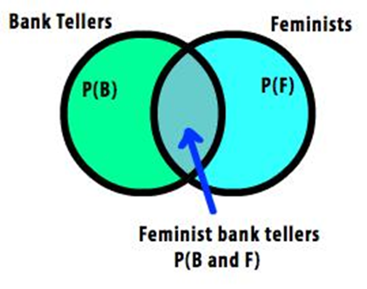
Conjunctive Fallacy with Linda
Be active in the feminist movement?
Be a bank teller?
Be a bank teller and active in the feminist movement?

Slide 34
The Availability Heuristic
“Availability is a useful clue for assessing frequency or probability, because instances of large classes are usually recalled better and faster than instances of less frequent classes. ”
Amos Tversky & Daniel Kahneman

Slide 35
Availability Biases : Ease of Retrievability
Classes whose instances are more easily retrievable will seem larger
For example, judging if a list of names had more men or women depends on the relative frequency of famous names
Salience affects retrievability
E.g., watching a car accident increases subjective assessment of traffic accidents
Recency affects retrievability

Slide 36
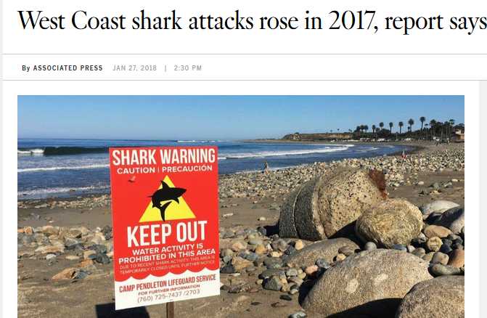
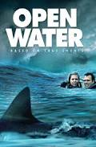
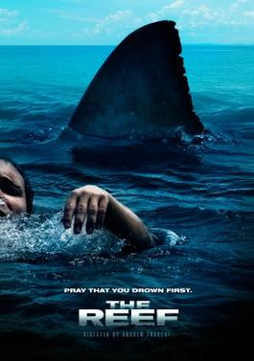

Slide 37
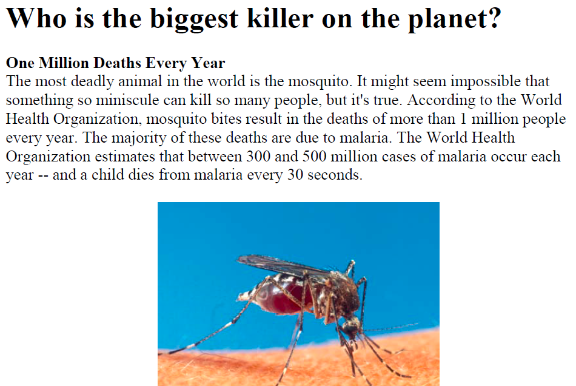

Slide 38
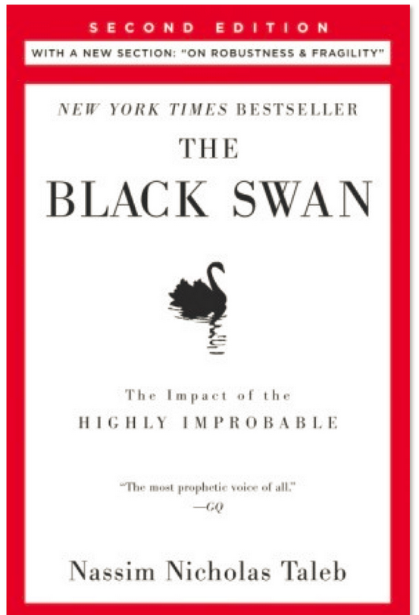
The Narrative Fallacy (the phrase comes from this book)

Slide 39
What is a Cause?
FLASHBACK
(Kleinberg) “Cause” generally means something:
that makes an effect more likely
without which an effect would or could not occur
or that is capable of producing a certain effect under the right circumstances.
A cause can be a “story” that ties several events or observations together to make them coherent
It can be based on something you perceived
Or it can be based on your understanding of some mechanism that could create the effect

Slide 40
The Narrative Fallacy
“the backward-looking mental tripwire that causes us to attribute a linear and discernable cause-and-effect chain to our knowledge of the past”

Slide 41
Stories
Stories serve many wonderful functions: teaching, motivating, inspiring. The problem though is that we too often believe our stories are predictive
Put simply: stories replace probability judgments
We often decide that some outcome is impossible or very unlikely because we can’t imagine any chain of events that would cause it
And if something did happen, a good story about it can make it seem inevitable

Slide 42
“We are so willing to take a description and mentally categorize the person it describes — in this case, feminist bank teller is much more salient than simply bank teller — that we will violate probabilities and logic in order to uphold our first conclusion. The extra description makes our mental picture much more vivid, and we conclude that the vivid picture must be the correct one
The Narrative Fallacy

Slide 43
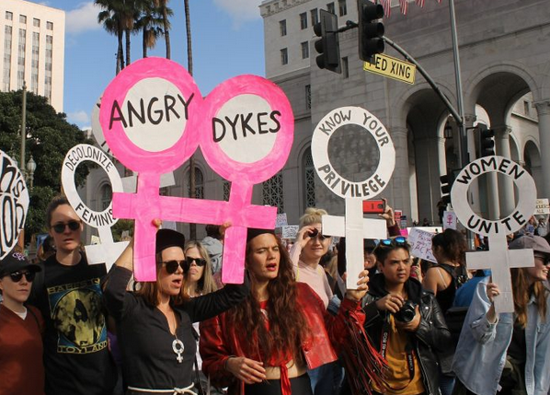

Slide 44
The Problem with Stories
Availability bias – Stories can make evidence or events extra-vivid, making it more available and memorable, making us more likely to attribute them as causes
Representativeness bias - Stories highlight a particular outcome but ignores base rates
Confirmation bias – Stories lure us into believing that we can explain the past through cause-and-effect when we hear a story that supports our prior beliefs

Slide 45
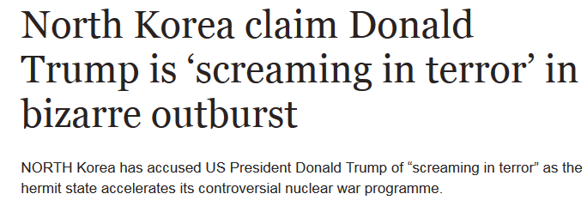
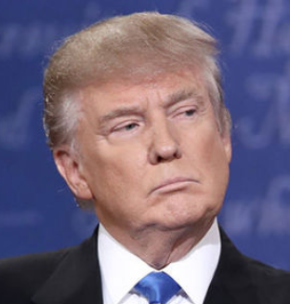
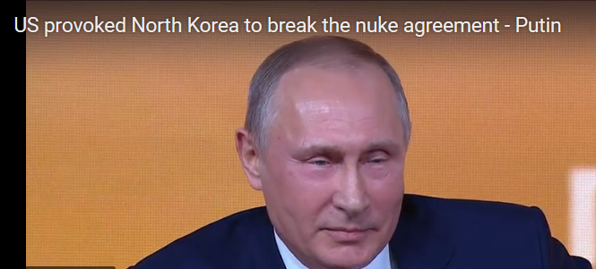
Can You Tell A Story About This War?

Slide 46
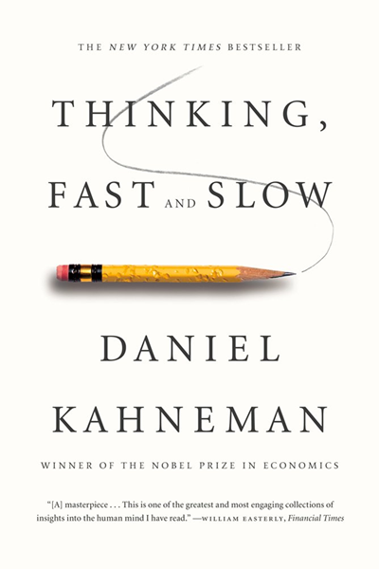
Some Questions
Are rational and heuristic approaches fundamentally different modes or mechanisms, or are they just different patterns of behavior that people can follow?
Would rational thinking be better for us?
When AI makes all of our decisions, do we want them all to be rational?

Slide 47
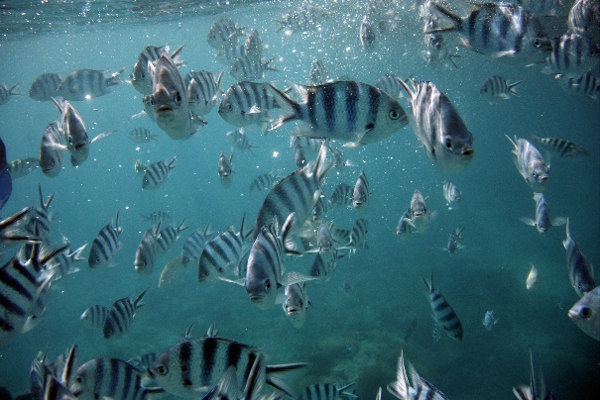
Enjoy Your Spring Break
I plan to enjoy mine!

